Slide 1
RhicEbis Design and Performance*
E. Beebe, J. Alessi, A. Pikin
Brookhaven National Laboratory
*Project funded by US Department of Energy
and the National Aeronautics and Space Administration

Slide 2
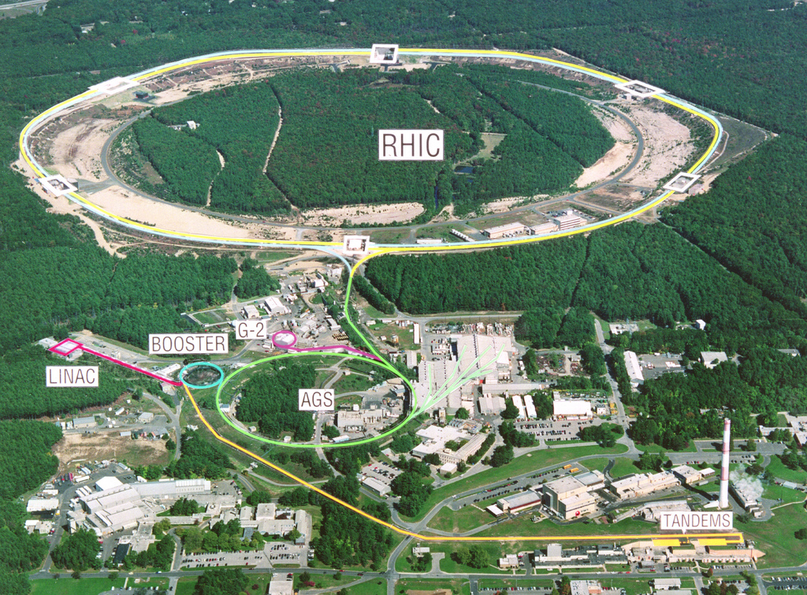
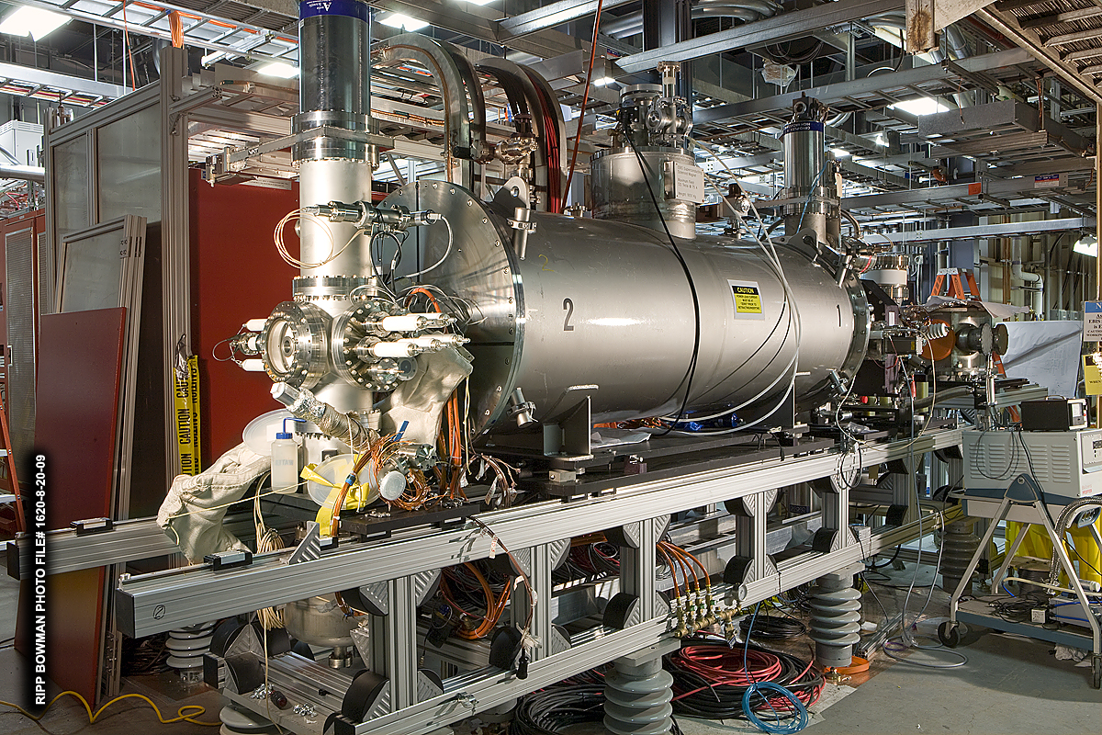
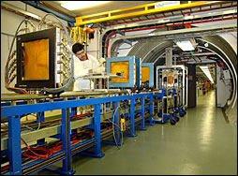
Two simultaneous users of RhicEbis ions
EBIS & RFQ & Heavy Ion Linac
Relativistic Heavy Ion Collider
Au, Fe, He, U, etc.
In addition the EBIS must be able to diagnose operating performance and prepare for new beams, parasitically.
These considerations lead to a choice of electrostatic beam transport and switching in LEBT and a pulsed HV EBIS platform
NASA Space Radiation Lab

Slide 3
EBIS based preinjector vs Tandem
Increased flexibility to handle the simultaneous needs of RHIC and NASA (fast switching between species)
Capability to provide ions not presently available, such as noble gas ions (for NASA), uranium (RHIC).
Simpler technology, robust, more modern
Elimination of two stripping stages and an 860 m long transport line, leading to improved performance (stability, easier tuning).
Notes:
Add – motivation was NOT for higher intensity than Tandem.
Emphasize flexibility.

Slide 4
RhicEBIS OverView
High current electron beam (~10A), current density ~600A/cm2
The goal is to produce high particle currents in intense charge pulses, which are well matched to the acceleration scheme.
For an EBIS, the charge state is moderate (e.g. Au32+), but the ion currents are high (~10mA) for total extracted charge >100nC and short pulses ~10 to 40 microseconds.
In order to maintain high vacuum in the face of electron beam losses and potential high voltage discharges, a warm, baked vacuum system design was used.
Pumping includes Cryopumps, turbo pumps, sublimation pumps as well as passive and electrically heated NEG pumps. The pressure achieved currently is 2E-10 at the gun and 7e-11 in the trap.

Slide 5
Some key features of Rhic EBIS
A novel electron gun based on a design from Novosibirsk, which uses a convex cathode
  produces a low rotational electron beam well suited for the accelerations and decelerations common in the EBIS transport system
A warm bore, unshielded superconducting solenoid for the main trap region
Vacuum separation of the trap region from the electron gun and electron collector regions
Large bore (32mm) drift tubes have been used (pumping, reduced alignment precision, fast extraction, reduced RF coupling)
The use of auxiliary (warm) solenoids & many transverse magnet coils for steering corrections on the electron beam
The electron beam is pulsed to reduce the average power on the electron collector
Versatile controls and hardware allow one easily manipulate the time dependent potential distribution to accommodate various injection and extraction techniques.

Slide 6
Magnetic geometry and electron beam envelope
RHIC EBIS operates with the electron gun cathode immersed in the magnetic field of a launching coil. The electron beam is then compressed by the main magnetic field.

Slide 7
External ion injection modes:
Fast Injection: Ions are injected into the electron beam in an ion beam pulse typically ranging from a few uS to a few hundred uS. Raising a potential barrier traps the ions axially while terminating further injection. Retarding the incoming beam can greatly increase the linear charge density, lowering the required injector current. The efficiencies can be very high, typically above 50%, and there is a well defined beginning of confinement period.
Slow injection: (accumulation mode) allows trap filling with much lower current beams. The injected ion energy is adjusted so that ions pass over a potential barrier on the way into the trap, but if they are further ionized during a round trip transit and if ionized during a round trip, they will be trapped. In general, this type of injection is much less efficient with trapping rates typically a few percent or less.
This mode can be useful when efficiency is not important or when the incoming beam is very low intensity and accumulation is essential. High electron beam current densities help improve the efficiency.
RhicEbis usually operates in the accumulation mode which places less demand on the external injection sources and beam transport.

Slide 8
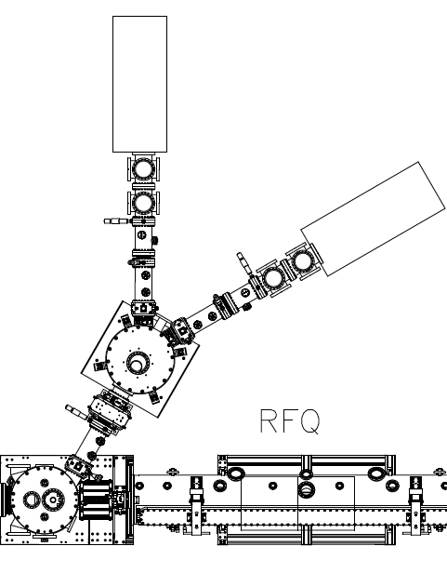
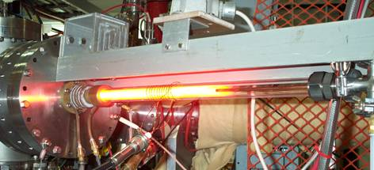
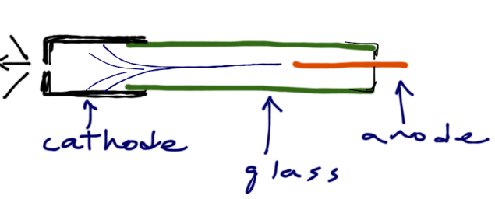
External 1+ ion production to feed the EBIS trap
Cu source
Hollow cathode ion source
U source, then Au
EBIS is a “charge breeder” of the injected 1+ ions
1+ Ions
into EBIS

Slide 9
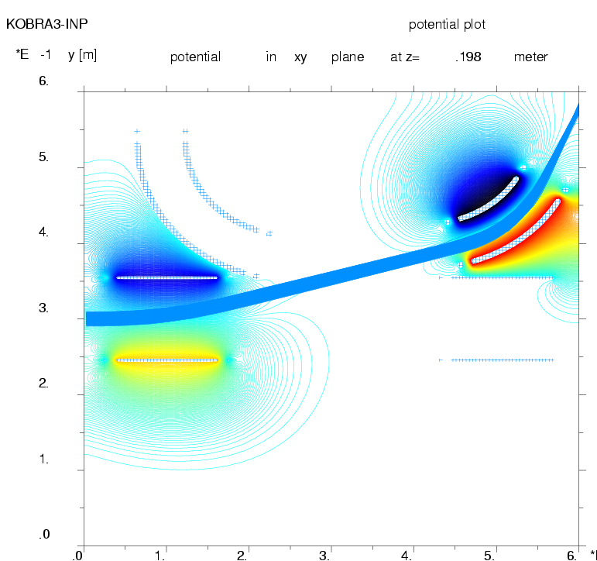
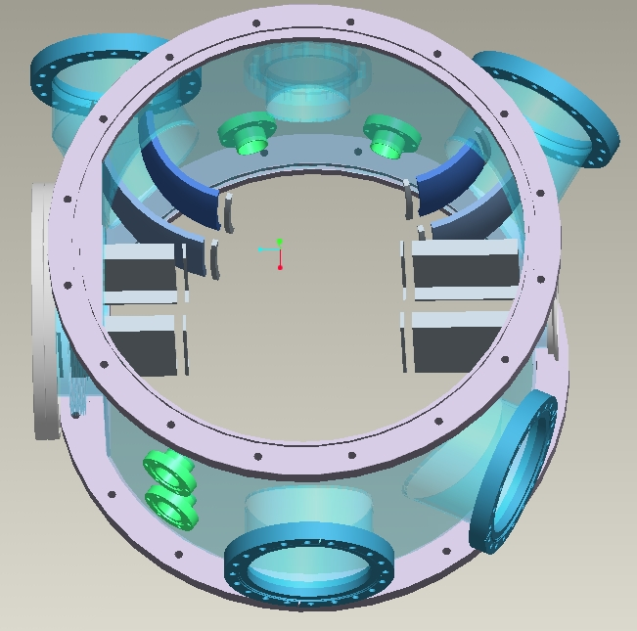
LEBT Switchyard and Diagnostic Chamber
Left: Multi-port LEBT chamber with spherical & flat bending elements for ion injection into EBIS
Right: Simulated 15keV beam trajectory for injection into the EBIS

Slide 10
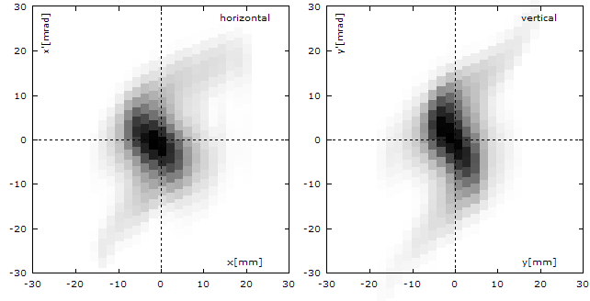
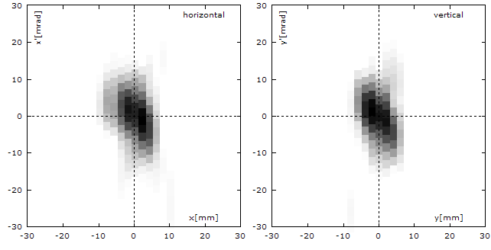
Pepperpot emittance measurements of injected 1+ ions
Emittance at the exit of the LEBT chamber, Cu¹⁺, 11 keV, 10 μA.
Aberrations observed when the beam fills the quadrupole aperture.
Emittance at the exit of the LEBT chamber when the beam is collimated between the ion source and the first quadrupole.
Output emittances with collimation are ≤0.02 π mm mrad, norm., rms.

Slide 11
Ion Elevators: Pulsed High Voltage Platforms
During injection and confinement the RHIC EBIS operates at ground potential.
Just before ion extraction the EBIS Platform Voltage is applied such that the ions are extracted through 100kV (nominal) to attain the ~17keV/amu needed for acceleration by the RFQ
(Platform pulsing is also useful for injection and TOF energy adjustments)

Slide 12
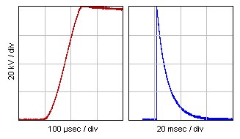
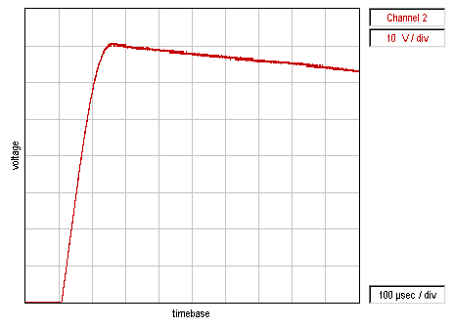
HV Platform Pulsing for EBIS ion beam injection into RFQ
80kV pulsing of Test EBIS Platform:
  100μs/div shows rise time and Flat Top (Far Left)
  20ms/div shows recovery to ground between EBIS cycles. (maximum EBIS Repetition frequency is 5Hz)
RHIC EBIS Platform pulsed to 100kV
(baseline is offset 30V below screen lower limit)
Red Trace: Platform potential (1V=1kV)
Horizontal scale is 100μs/div
20100104-04

Slide 13
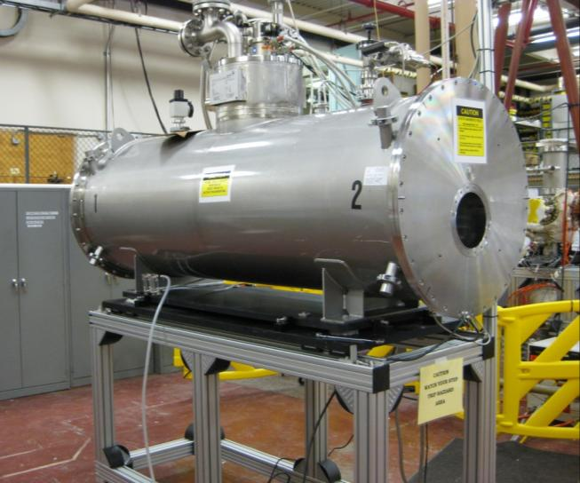
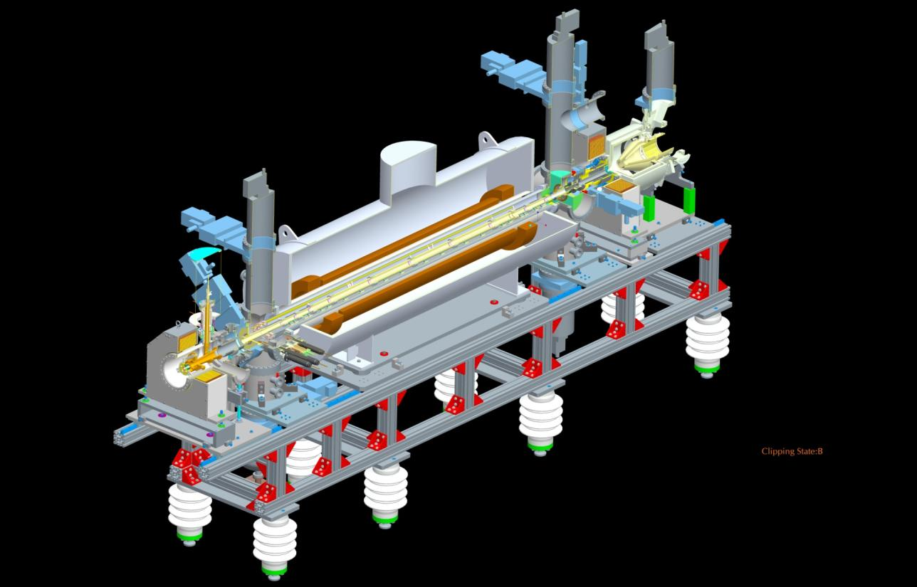
EBIS Superconducting Solenoid
Length of the SCS coil: 190 cm
Magnet field: 5 T
Warm bore inner diameter: 204 mm (8”)
Solenoid is twice the length of that used for R&D prototype EBIS

Slide 14
RHIC EBIS design parameters
Parameter | RHIC EBIS
Max. electron current I_{el}= | 10 A
Electron energy E_{el}= | 20 keV
Electron density in trap j_{el}= | 575 A/cm²
Length of ion trap l_{trap}= | 1.5 m
Ion trap capacity Q_{el}= | 1.1x10¹²
Ion yield (charges) Q_{ion}= | 5.5x10¹¹ (10 A)
Yield of ions Au³²⁺ N_{Au}³²⁺= | 3.4x10⁹
RHIC EBIS unshielded superconducting solenoid manufactured by ACCEL:
Maximum magnet field | 5.0 T
“Warm” ID | 204 mm
Length of solenoid | 1900 mm
He refilling period | 30 days

Slide 15
Rhic EBIS Upgraded pumping capabilities compared with Test EBIS :
Larger inner diameter of drift tubes (42 mm instead of 31 mm) to reduce ion losses and further reduce electron beam – wall coupling (which may be important for higher electron current)
Added actively heated NEG strips in the central chamber and passive NEGs on inner surface of drift tubes to improve vacuum conditions in the ionization region

Slide 16
- Improved ion optics for extraction and injection with larger apertures to accomodate larger angles

Slide 17
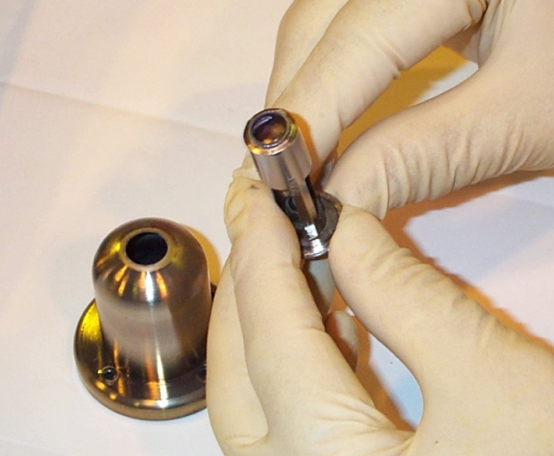
The EBIS 10A electron gun
This was a key development. Previous EBIS operation was typically at 0.5A or less
Electron beams up to 10A, 100kW have been propagated with very low loss, using IrCe cathodes from BINP, Novosibirsk.
Electron gun cathode

Slide 18
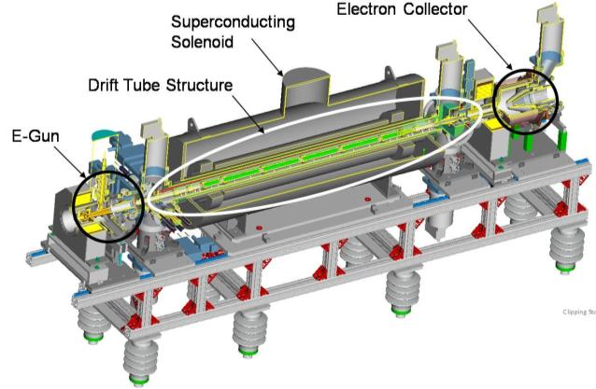
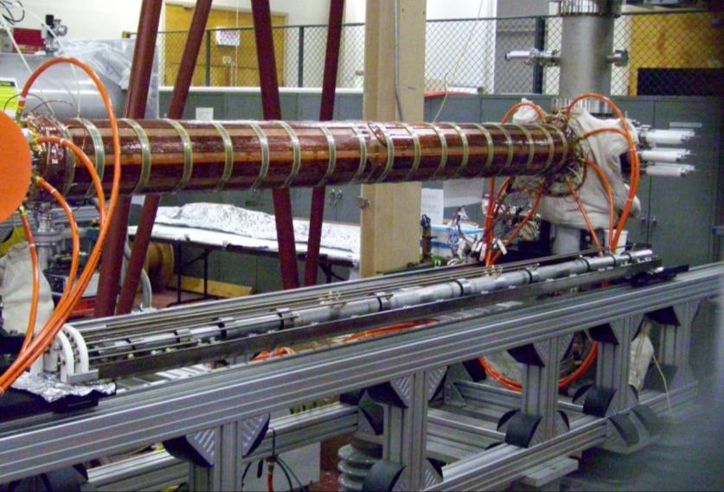
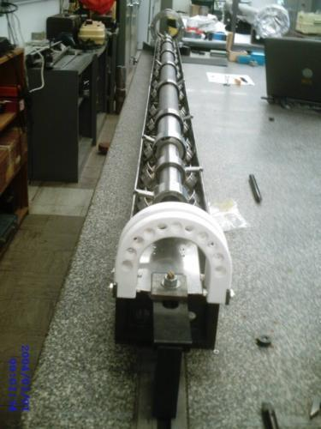
Drift tube structure
Large-bore drift tubes sit inside the central vacuum tube.
Heaters on the outside of the vacuum pipe allow baking to 450 C.
Outside the water cooled jacket, there are transverse steering coils.
EBIS Drift tubes

Slide 19
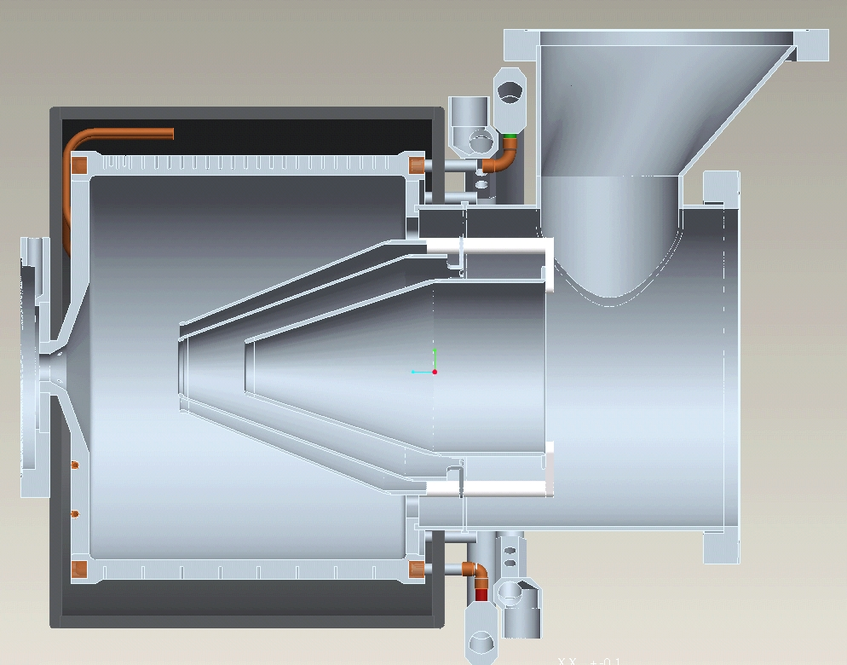
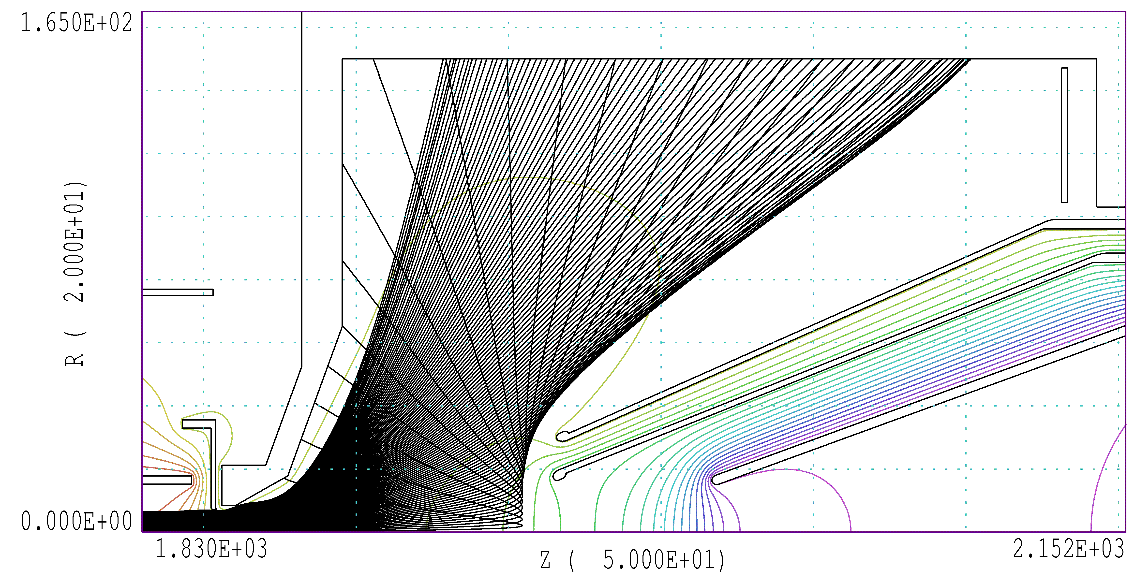
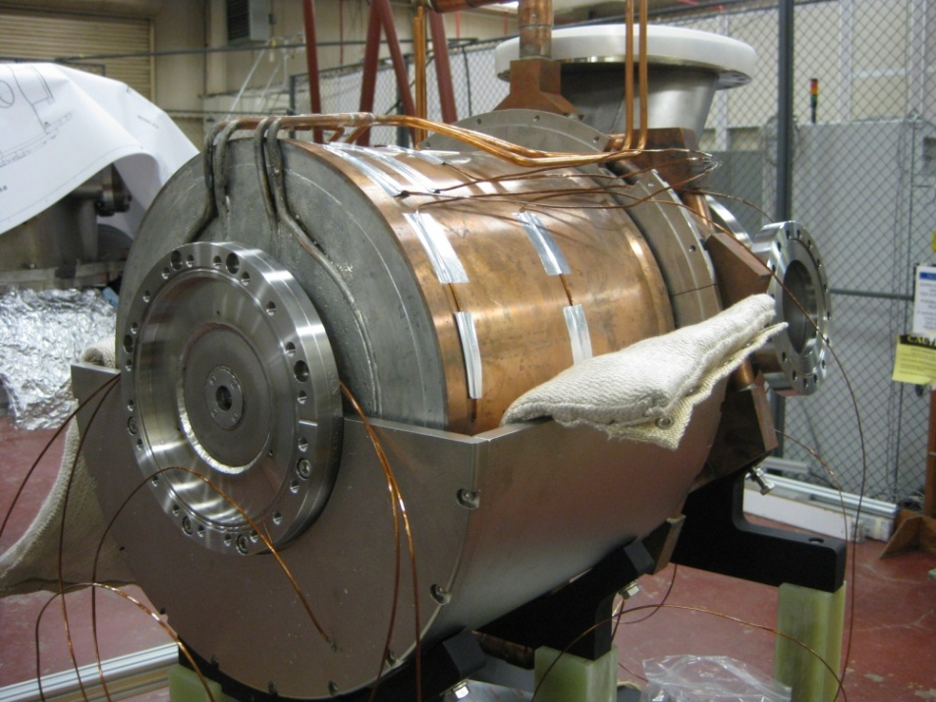
EBIS electron collector
Another key development.
Electron collector capable of dissipating electron beam up to 20 A (300 kW peak power) with length 50 ms and frequency 5 Hz
Trajectory simulations in RHIC EBIS electron collector. I_{el}=20.6 A, E_{el}=15 keV
BeCu collector is installed on the RHIC EBIS

Slide 20
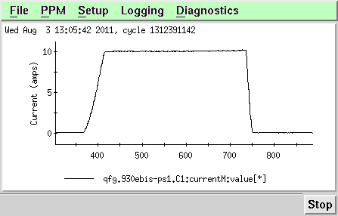
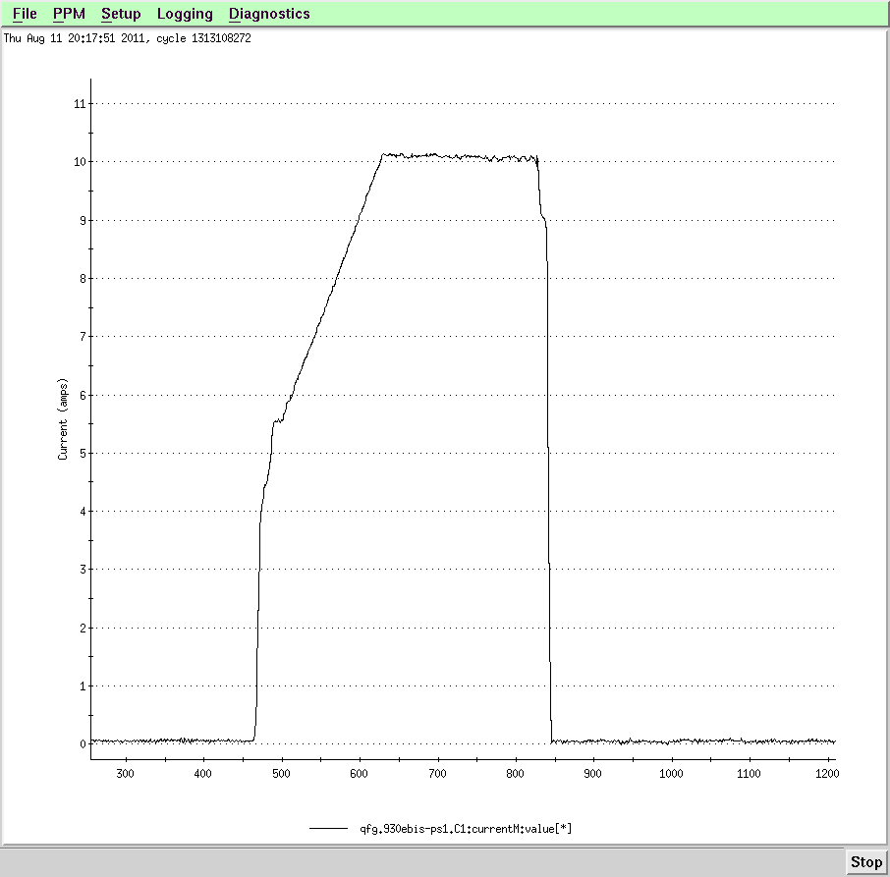
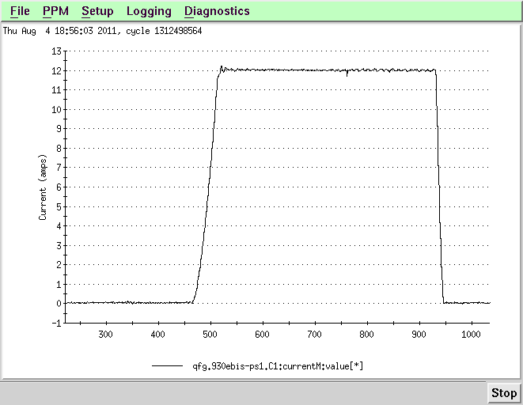
EBIS high electron beam current traces
First 10.1A 32ms e-beam in RhicEBIS
10A, 35ms used for Au ion production (82nC)
Initially, propagation of high electron beam current is obtained using rather simple drift tube electrode voltage and electron current distributions.
Later, when ion trapping is added, more complex distributions are used to accommodate ion injection, ion trapping, and ion extraction, while maintaining a very low loss electron beam propagation.
12A 40ms ebeam

Slide 21
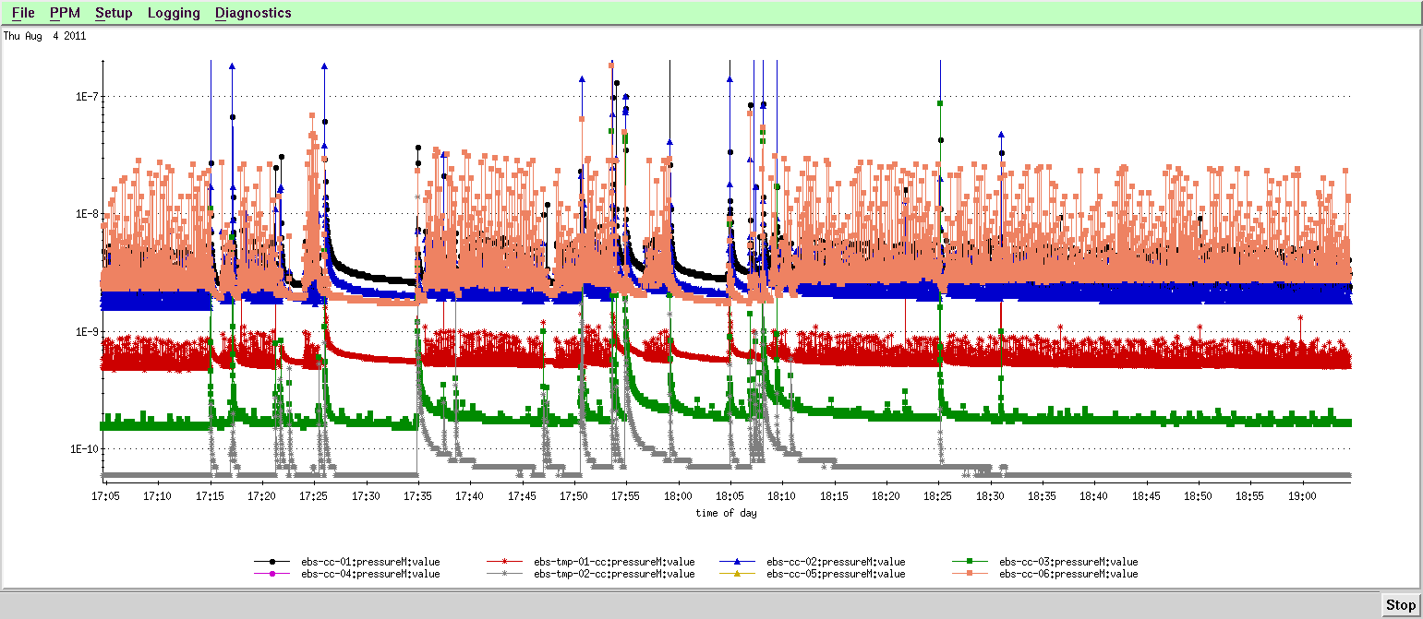
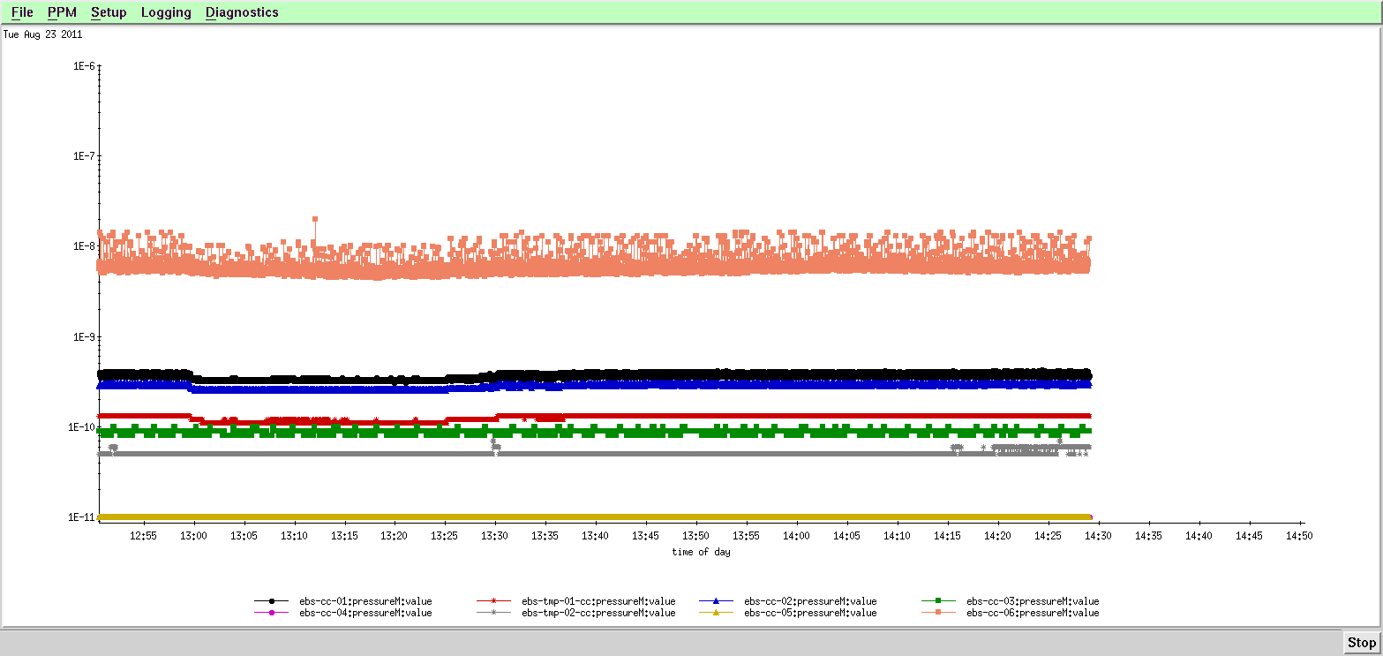
EBIS Pressures with high electron beam current
Pressures log for a 12A, 40ms beam
Pgun = 5 E-10
Ptrap =2 E-9
Pcol = 3 E-9
20110804
Pressure log for 7.6A e-beam with a 65ms ion confinement
Extracted ions:
70nC Au with inj, 1nC no inj
Pgun = 1.5 E-10
Ptrap =9 E-11
Pcol = 5 E-9
20110823

Slide 22
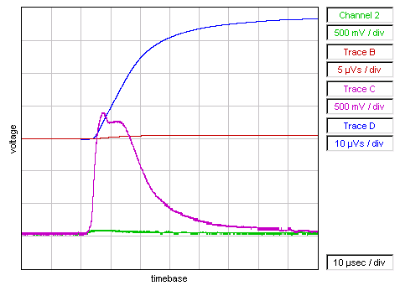
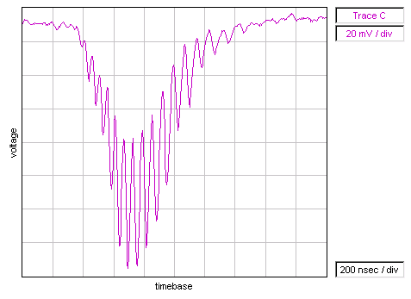
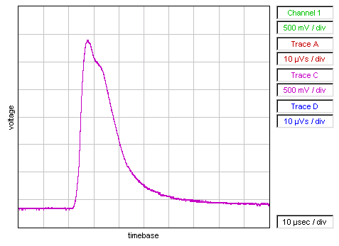
Highly charged Au extraction from RhicEBIS after fast injection from the HCIS
Au pulse (all charge states), slightly slowed extraction
ChC Magenta: (Current with Au+ inj) 3.5mA, 1 mA/div, 10 µs/div
ChD Blue: (Total extracted charge) 70nC , 20uVs/div
Ch2 Green: (Current without Au+ inj) 0.2mA, 1 mA/div, 10 µs/div
ChB Red: (Total extracted charge) 1nC , 10uVs/div
File name: 110823-08_Au__70nC_7.5Ae_65ms_on_neg_8kV
_platform_fast_Inj_HCIS1_16kV_pulser_at_63__1nC_wo_inj.wfm
Left: Au Time-of-Flight Spectrum
(Reflex mode – channeltron EM)
Max peak is Au32+
File name: 110823-09_Au__high_res_65ms_conf
_8kV_retardation_7.6A__Au32.wfm
Right: Au pulse (all charge states), faster extraction
~6 mA peak, at EBIS output
1 mA/div, 10 µs/div
I(e)=7.6A, 65 ms confinement

Slide 23
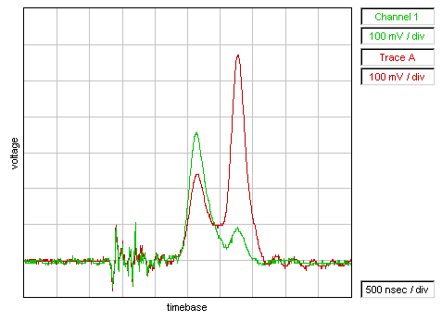
Rhic EBIS Low resolution TOF after 15 degree bend
Red Trace: With Au+ injection from HCIS
Green Trace: reduced Au+ injection
(Au injection not completely “off”)
High background; unbaked system
Low resolution TOF spectrum measured on a Faraday Cup shows a gold fraction of extracted charge is approximately 60%.
Electron current I_{el}=5.6 A, confinement time τ_{conf}=36 ms, dominant Gold ion charge state is ~30+.

Slide 24
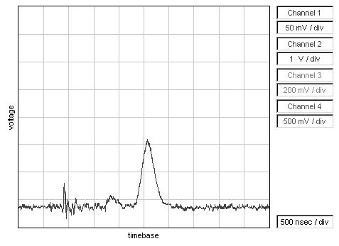
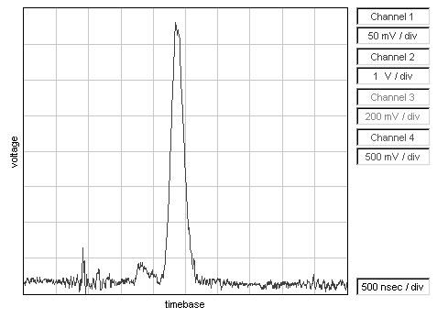
Low Resolution TOF on a Faraday Cup (15 deg off axis)
Au Time-of-Flight (25ms confinement)
(peaked at Au25+)
Au Time-of-Flight (65ms confinement)
(peaked at Au32+)
Well baked system and excellent electron beam propagation result in very pure Au spectrum.

Slide 25
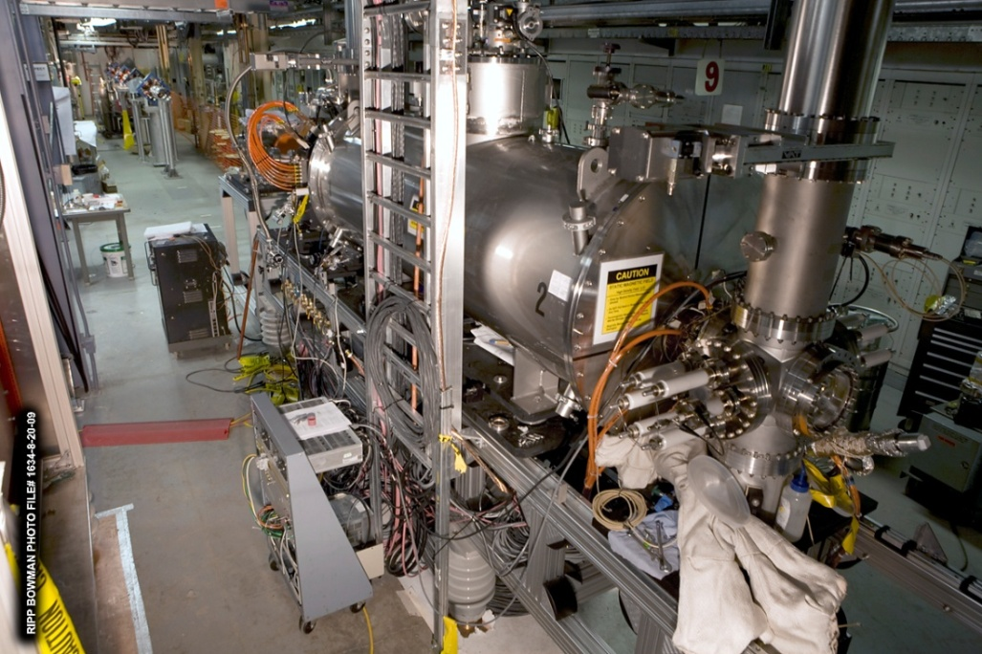
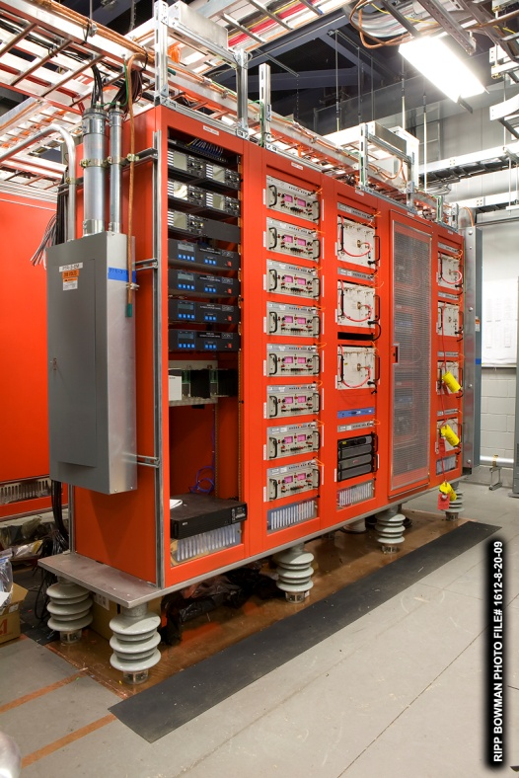
EBIS during installation
11 Racks of power supplies for EBIS, all pulsing to 100 kV along with the EBIS, during ion extraction.

Slide 26
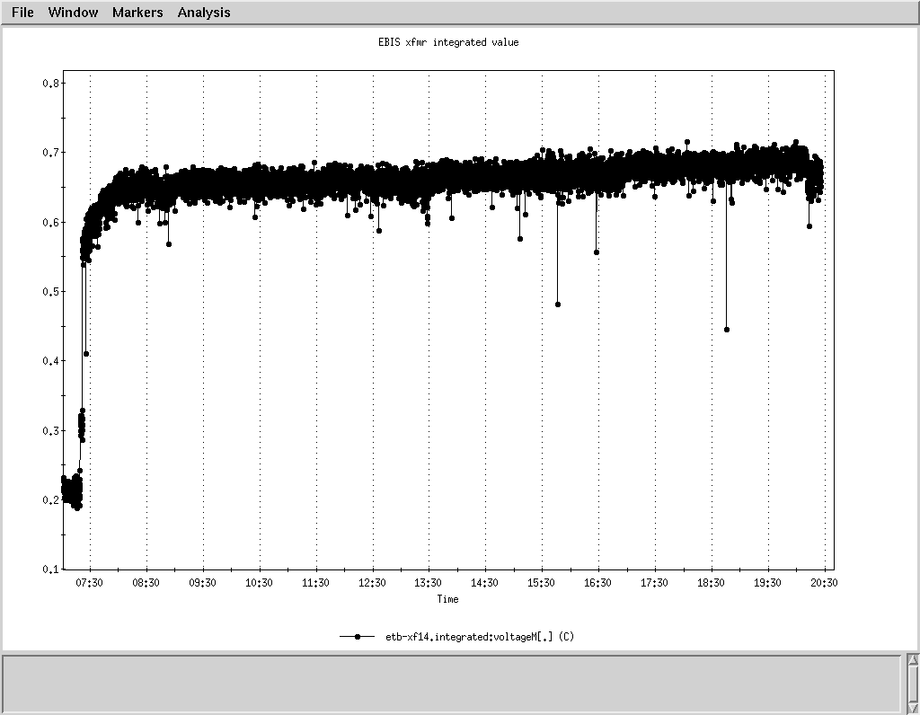
Summary of First Run to NSRL (Mar-Jun 2011)
EBIS operated ~ 6 days/ week, 12-16 hours/day, from ~ March through June
  Delivering beam to NSRL, and working on adding species and increasing intensities
Ran 38 days for NSRL biology experiments
  Delivered Fe 20+, He 2+, Ne5+, Ar10+, and Ti18+ beams
  (He, Ne, Ar were new beams for NSRL)
  No downtime
  Excellent stability (eventually got to where it ran for days without any adjustments)
All RF systems and transport magnets ran 24/7 for ~ 4 months
All EBIS source, rf system, and transport magnet settings are very reproducible
Fe20+ to NSRL:
Each point on the plot is the
integrated current in one EBIS pulse
13 hours without a missed pulse

Slide 27
Rapid switching between ion species
Ion injection into the EBIS trap was tested first with Fe¹⁺ and Au¹⁺ (two sources)
EBIS confinement time was switching between 65 ms for Au³²⁺ and 130 ms for Fe²⁰⁺
Also switching pulse-to-pulse: platform high voltage, power to all RF systems,
current to the large dipoles, and all transport line elements.
  This rapid switching of species has been a frequent mode of operation during the RHIC run when both Au32+ and Cu11+ were delivered by EBIS. Switching will also be necessary when beams are delivered to both RHIC and NSRL.

Slide 28
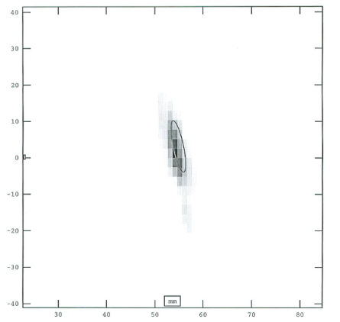
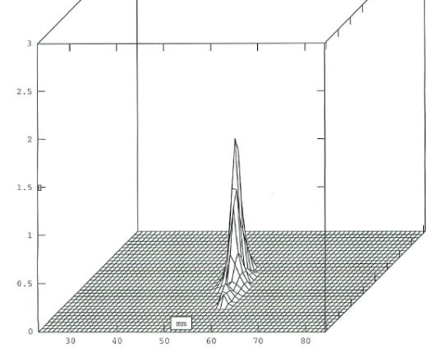
Ion Yields from RhicEBIS (and TestEBIS)
Dotted line is 100% neutralization of the electron beam space charge. Red line is 50% neutralization (design value)
Au emittance at RFQ output
Ions produced with e- beams up to 10A
Ion yield scales properly with Ie-
Cu, Au, U beams using electron beams > 8A benefit from an increased source capacity of ~19% due to a longer axial trap configuration
ε(n, rms) = 0.19 π mm mrad
(2-3 mm beam width)

Slide 29
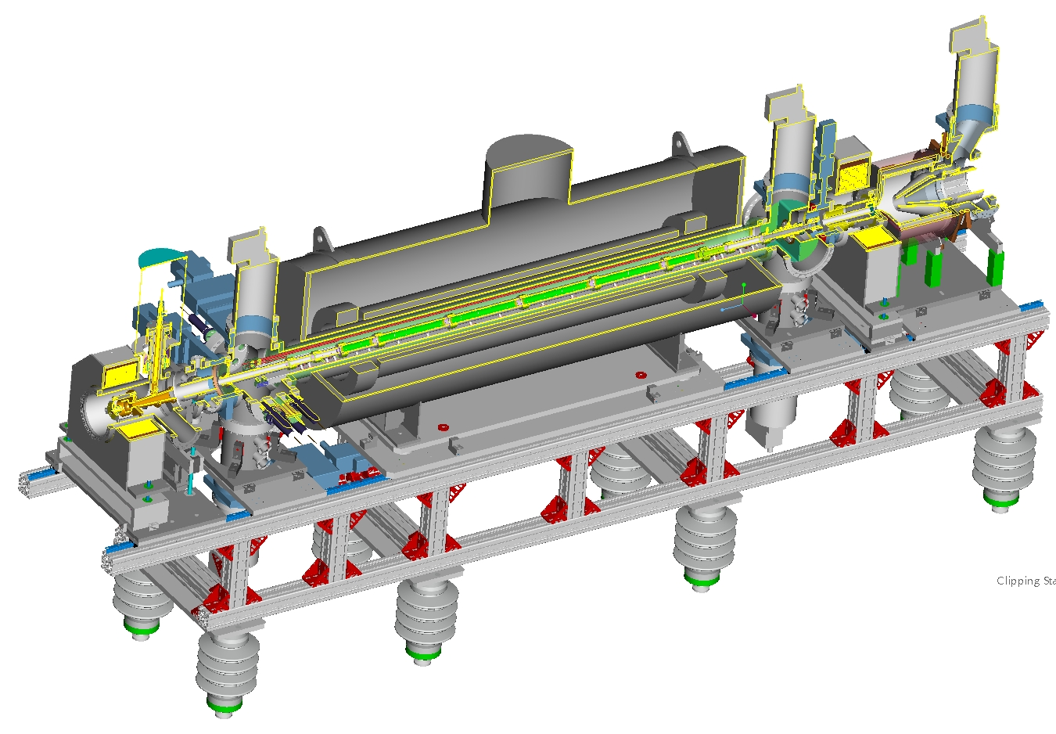
Lengthened trap region from 1.5m to ~1.8m. Ion output increased proportionally.
Electron Collector
Superconducting Solenoid (6 T)
Drift Tube Structure
Acceleration Tube
E-Gun
(10 A)
Original trap
Trap extended by one tube on each end to increase ion output

Slide 30
EBIS Ions in Booster (per EBIS extraction)
Charge for a single species charge state is measured close to the Booster ring input after the RFQ and Linac and Two dipole bends plus collimation. Measurement is made for best transmission through the rest of the complex rather than for maximizing the charge delivered by EBIS at that location.
EBIS electron Current [A] | Ion | Booster Input (ions) | Booster Input One Ch State (Charges) | EBIS All Ch States (Charges) | Charge Fraction EBIS to Booster
8.3 | 63Cu11+ | 6.1e9 | 6.7e10 | 6.9e11 | 9.7%
9.5 | Au32+ | 1.5e9 | 4.7e10 | 9.4e11 | 5.0%
9.6 | 238U39+ | 1.1e9 | 4.2e10 | 8.1e11 | 5.2%
Transport to Booster/AGS/Rhic rings with nominal 10A EBIS electron beam operation:
Transmission to Booster input is ~56% of what is expected, and there are additional shortfalls in the the Booster/AGS rings. We believe that the early losses are due to a broadening of the EBIS charge state distribution with high neutralization coupled with a 30% decrease in the RFQ/Linac transmission efficiency due to mismatch and/or emittance growth due to misalignment.
The RHIC injection goals have been met by extending the EBIS trap, doubling the number of EBIS pulses per injection cycle, and performing an extra bunch merge in the AGS ring.

Slide 31
Measured charge state distributions (orange), vs. calculated (blue, R. Becker code), which assumes 100% overlap of ions with electron beam
Normal running at >50% of capacity gives
~13% in desired charge state vs. 18.5%
calculated.
Test at reduced charge - measured distribution matched calculated
13% in 32+ * 75% of capacity =9.75%
vs. design values of
18.5% in 32+* 50% capacity=9.25%
→ Should still be ok

Slide 32
First RHIC Run with EBIS
EBIS operated 7 days/ week, 24 hours/day, from ~ April through June
First RHIC run with Uranium collisions
First RHIC run with Au-Cu collisions
Goals were achieved for RHIC luminosity and bunch intensity - with the addition of bunch merging and higher duty factor EBIS operation.
No major downtime from the new preinjector
Excellent stability, eventually getting to where it would run for days without needing any adjustments

Slide 33
Uranium from EBIS
Uranium time-of-flight charge state distribution; Peak at U 39+
(~13% in the desired charge state)
Uranium (all charge states) at EBIS output and RFQ input (both 2 mA/div)

Slide 34
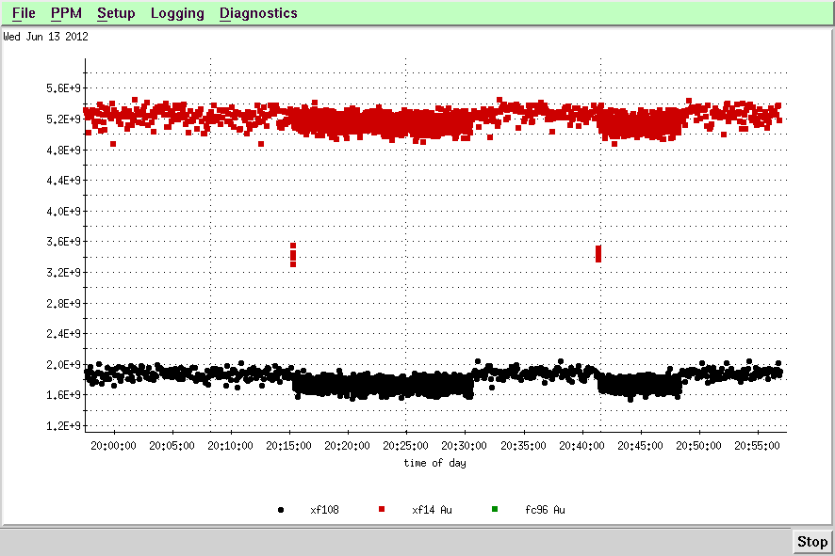
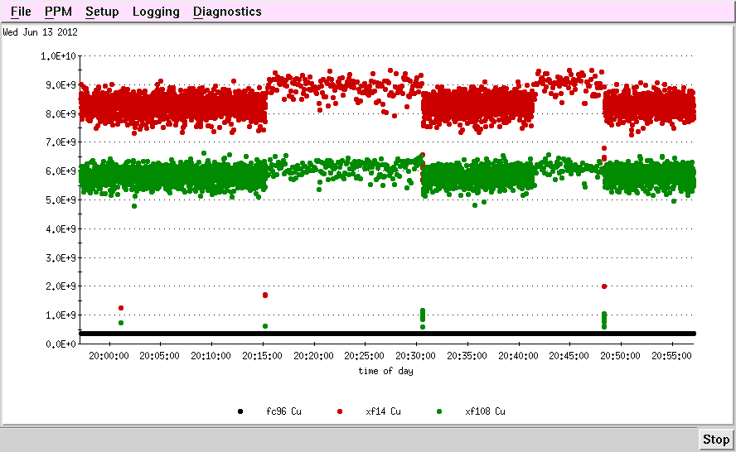
Always had both Au and Cu running
Linac output
Each 5 second “supercycle”
8 Au & 1 Cu or
8 Cu & 1 Au or
1 Au & 1 Cu
(during stores)
Au
EBIS confinement time was switching between 55 ms for Au³²⁺ and 5 ms for Cu¹¹⁺
Also switching pulse-to-pulse: platform high voltage, power to all RF systems, current to the large dipoles, and all transport line elements.
Linac output
Cu
Note – single pulse intensity is higher than the 8-pulse (difference is even larger when tuned for single pulse)

Slide 35
Fourteen EBIS beams delivered to date
He-3 2+ AGS
He-4 1+, 2+ NSRL
C 5+ NSRL
O 6+ NSRL
Ne 5+ NSRL
Ar 11+ NRSL
Ti 18+ NSRL
Fe 20+ NSRL
Cu 11+ RHIC
Kr 18+ NSRL
Xe 27+ NSRL
Ta 38+ NSRL
Au 32+ RHIC & NSRL
U 39+ RHIC
Carbon (and silicon ?) are new beams this fall

Slide 36
Future developments the BNL EBIS program
Polarized He-3 source
Brillouin gun tests on Test EBIS
Brillouin gun / Fe²⁶⁺ for NSRL
Laser Ion Source for 1+ injection into EBIS

Slide 37
Summary
RhicEBIS and all systems making up the new EBIS preinjector are operating as expected.
EBIS has delivered a variety of ion beams to both NSRL and RHIC
EBIS has operated above its design value of 10A electron beam (12A).
Extracted ion charge with He gas injection reached 85.6% of the electron charge in the trap
EBIS source charge out exceeds the design value, but the % in desired charge state is lower than design. The result is that the current in the desired charge state is ~ the design value.
Several improvements are being implemented to increase the intensity at Booster extraction. (MEBT steering, additional matching quad at Booster, and increased gap of the inflector).
Ion intensity at electron beams ~10A has been developed meeting the design goal for acceleration of ions such as U39+, Au32+ and Cu11+ for RHIC. Intensity and luminosity goals have been met with the help of bunch merging and increased EBIS duty factor.

