Slide 1

Production of High Charge States with the LLNL Super EBIT
Ross Marrs
Lawrence Livermore National Laboratory
HIE-EBIS Workshop
CERN
16-17 October 2012
LLNL-PRES-590672

Slide 2


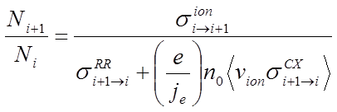

Production of high charge states
The LLNL EBIT and Super EBIT were designed for high x-ray emission from highly charged trapped ions (over ~1 cm of beam length)
X-Ray emission rate: • large current density j_{e}
• good ion-beam overlap
(low ion temperature)
Number of ions in trap: • large beam current I_{e}
Equilibrium abundance of desired charge state:
                • low neutral density n₀
                • high beam energy
Requirements for fast charge breeding are similar

Slide 3
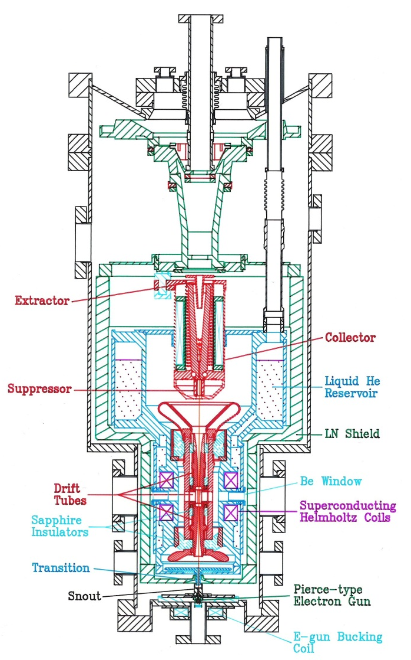
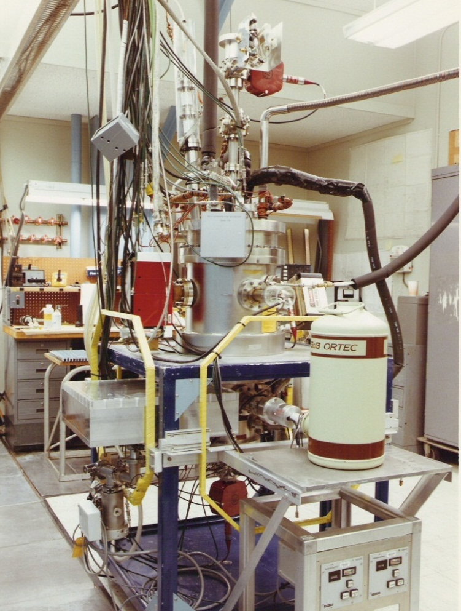
The first EBIT
Cathode grounded
Vacuum chamber grounded
Drift tubes float at beam voltage (<20 kV)
Trap at 4 K
Helmholtz coil geometry
Multiple radial x-ray ports
Magnetic field nulled at cathode for maximum beam compression
Liquid nitrogen cooled collector
Beam steering coils
The first EBIT at the time of initial operation at LLNL (1986) shown with Bragg crystal and Si(Li) x-ray spectrometers
M. A. Levine et al., Phys. Scr. T22, 157 (1988); R. E. Marrs et al, Phys. Rev. Lett. 60, 1715 (1988).

Slide 4
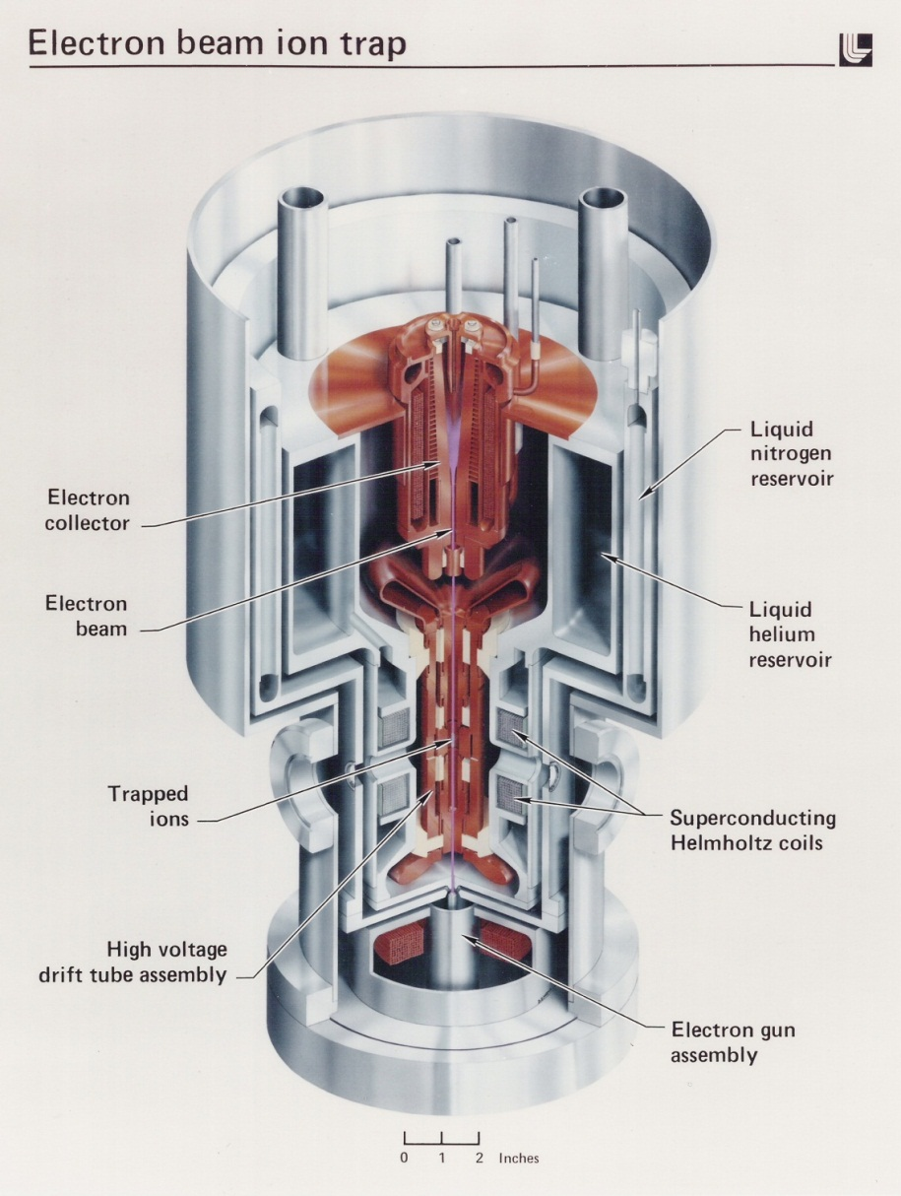
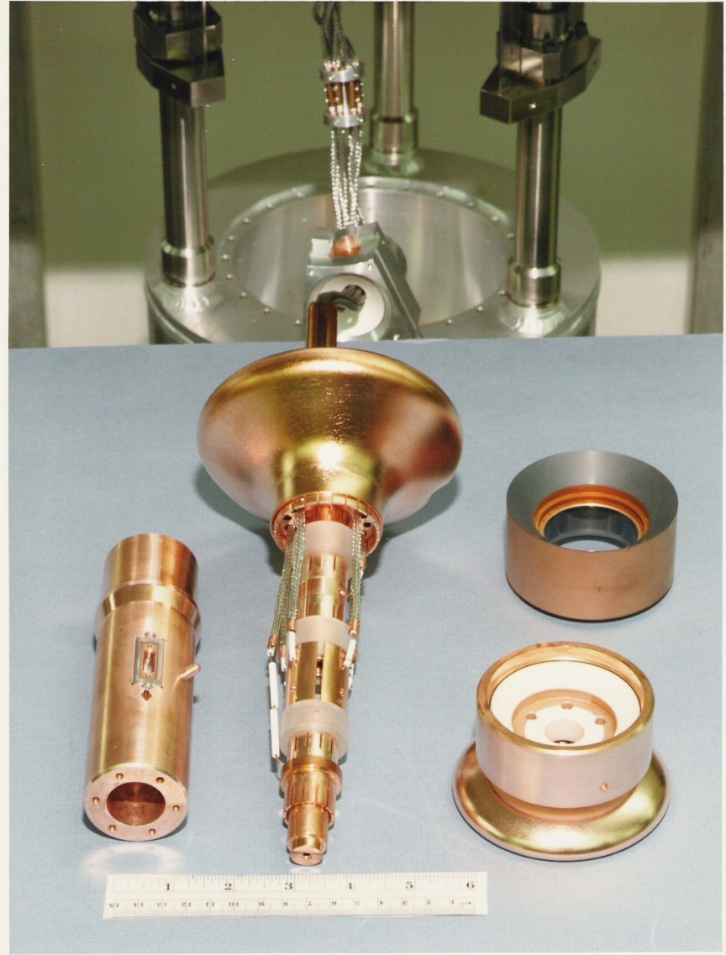
LLNL EBIT and drift tube assembly

Slide 5
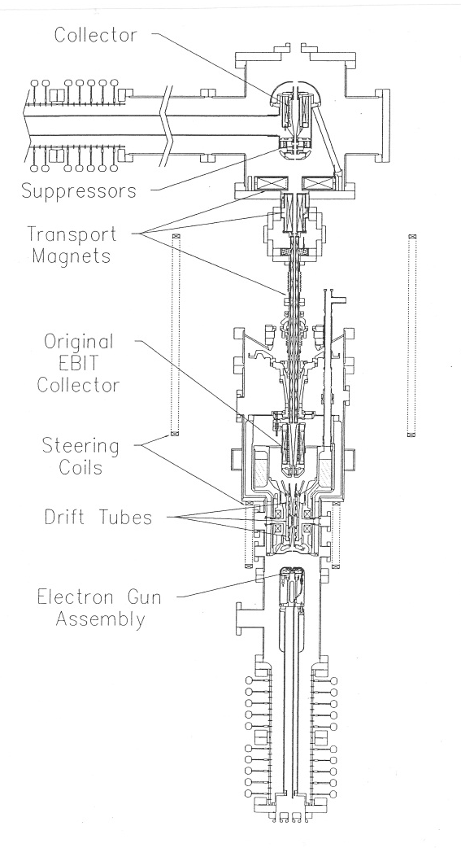
The 200-keV LLNL Super EBIT
Super EBIT is the original EBIT with replacement of the electron gun and collector – both float together at <170 kV
Vacuum chamber grounded
Electron gun and collector power supplies in floating high voltage (low current) rack
EBIT electron gun (same current, <200 mA) in redesigned high voltage assembly
New collector is at room temperature
Drift tubes float at <40 kV
Use of original EBIT vacuum chamber requires transport magnets
High voltage upgrade of the LLNL EBIT (1992) showing the high voltage column for the electron gun assembly (bottom)
D. A. Knapp et al., NIM A 334, 305 (1993)

Slide 6
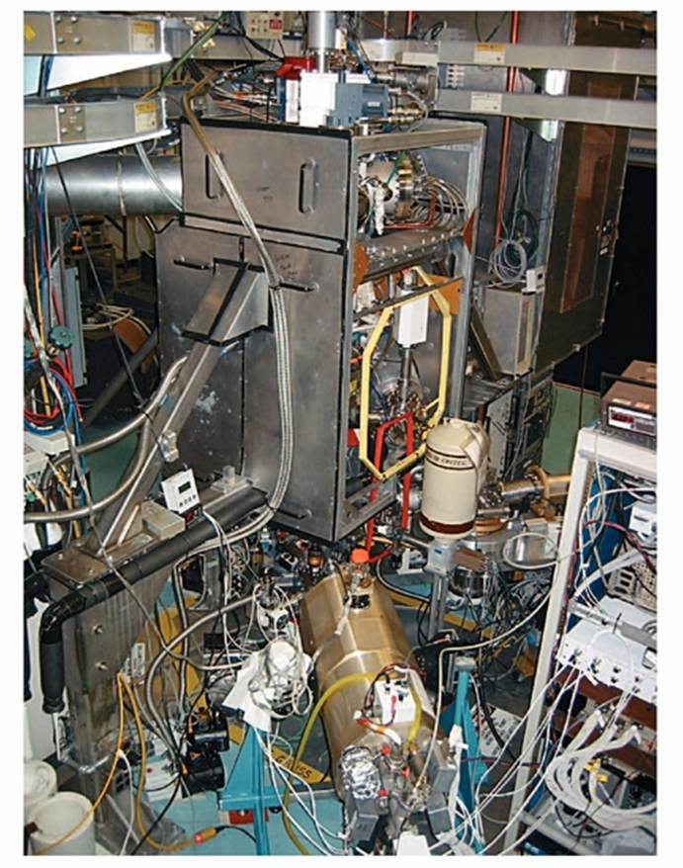
The LLNL Super EBIT with x-ray spectrometers
Photo shows present location in a different building
Lead panels surround collector area (top) and electron gun (below floor) to reduce x-ray background
Floating high voltage rack for electron gun and collector is to left of photo
Trap (fast switching) ~300 V power supplies are in the floating drift tube rack at upper right

Slide 7
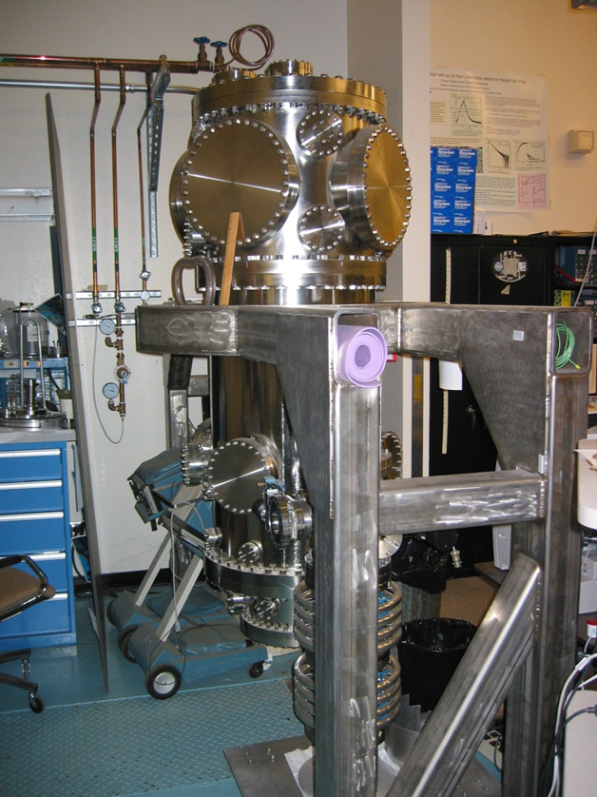
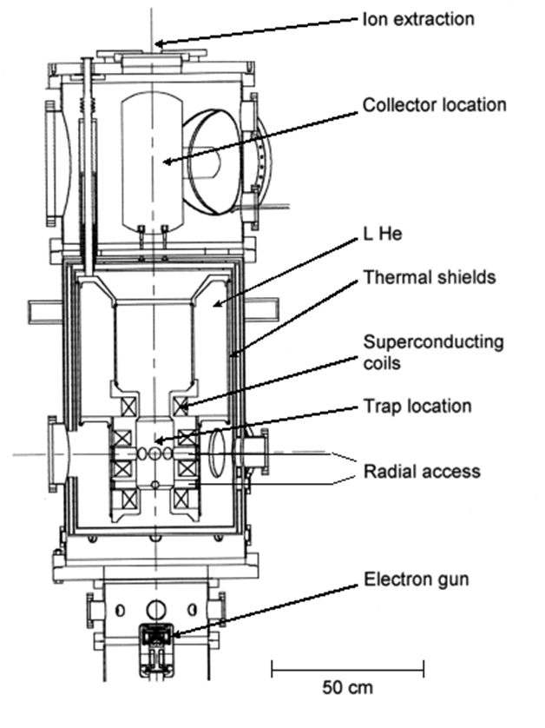
A high-intensity high-energy EBIT designed at LLNL was also a prototype fast charge breeder
Designed for 100-fold higher x-ray intensity and 1000-fold more extracted ions
Never completed – parts still in storage
R. E. Marrs and D. R. Slaughter, AIP Conf. Proceedings 475, 322 (1999).

Slide 8
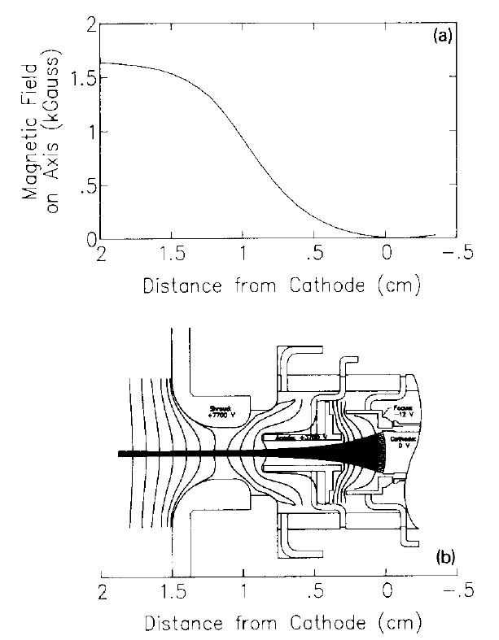
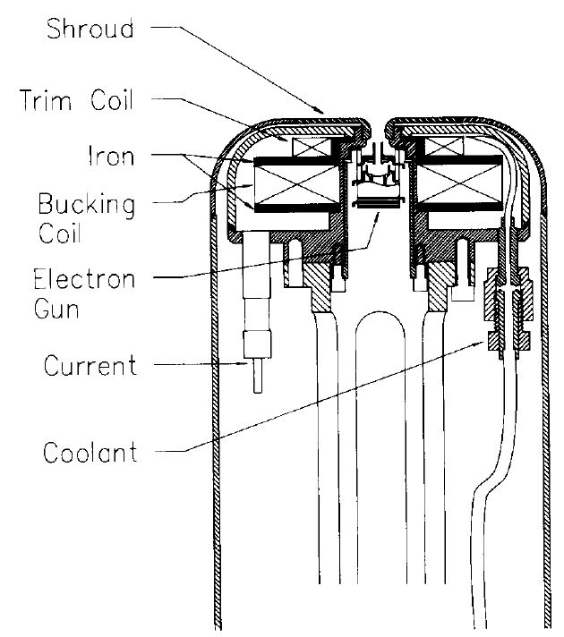
The EBIT electron gun assemblies were designed for maximum compressed current density in the trap
LLNL Super EBIT electron gun
A bucking coil, iron shims, and location in the fringe field of the main magnet are used to obtain zero magnetic field on the cathode and the correct gradient for beam injection into the main-magnet field with minimal beam ripple
Barium dispenser cathode, r_{c} = 1.5 mm, I_{e} ≤ 200 mA, j_{c} ≤ 2.8 A/cm²

Slide 9
Electron beam current density is given by the Herrmann formula
The electron beam current density j_{e} depends on the trap magnetic field and properties of the electron gun
  Beam radius (for ∼ 80% of current) is given by the Herrmann formula
We use an “average” current density defined by
Compressed beam profile is roughly Gaussian and beam radius is limited only by cathode temperature for EBIT conditions (B_{c} = 0, good beam optics, and high compression)
  Beam radius Note: beam radius is independent of beam current and energy (r_{beam} ≈ 35 µm for LLNL EBIT and Super EBIT)
  Current density j_{c} = cathode current density
B_{c} = cathode field
B = trap field
T_{c} = cathode temperature
r_{c} = cathode radius
r_{B} = Brillouin radius

Slide 10
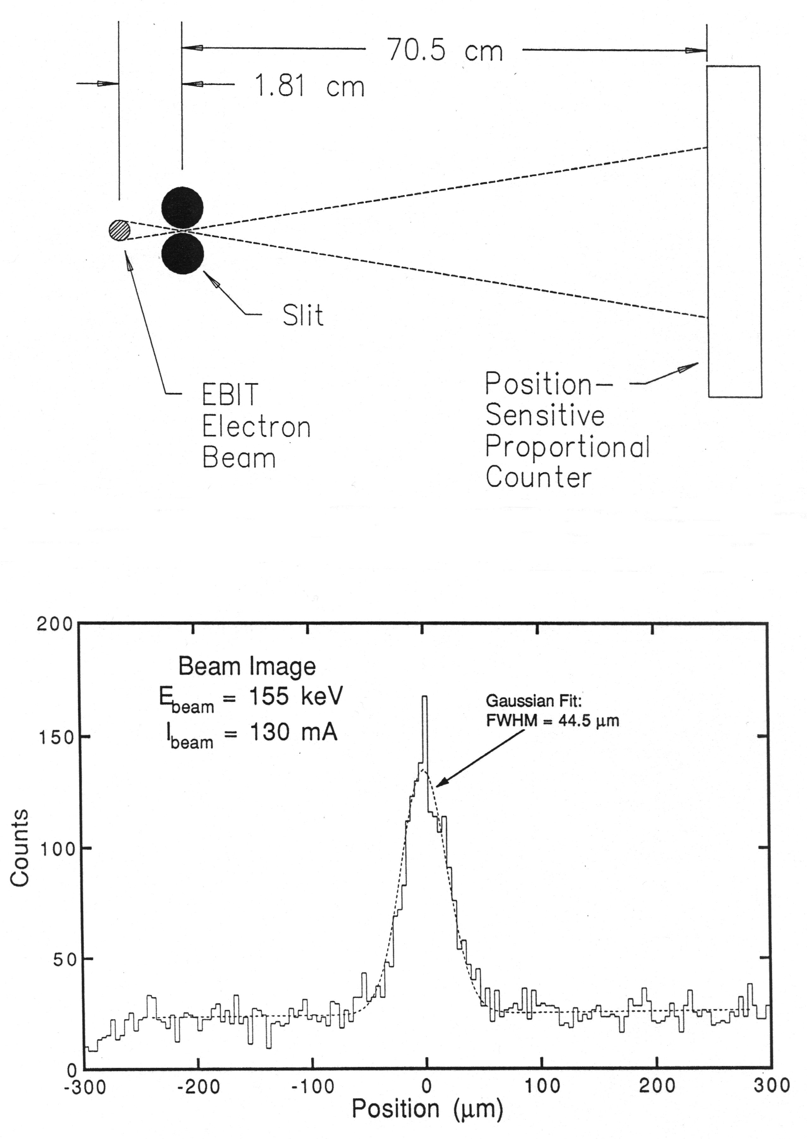
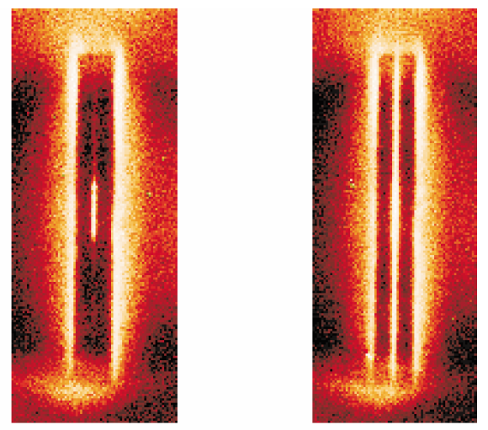
Predicted electron beam current density for the LLNL Super EBIT is confirmed by imaging of both x rays and visible light
Imaging of x-ray emission shows beam profile with predicted radius
Imaging of optical emission also shows expected beam size and ion distribution
2 cm
Neutral gas emission
Trapped ion emission
J. R. Crespo et al., Can. J. Phys. 80, 1687 (2002)
D. A. Knapp et al., NIM A 334, 305 (1993)

Slide 11
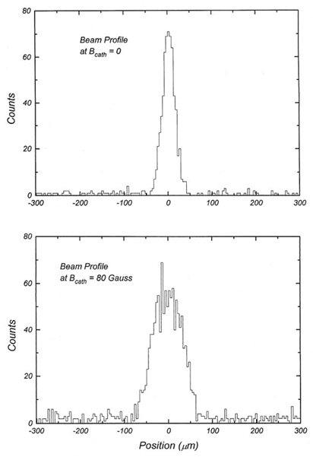
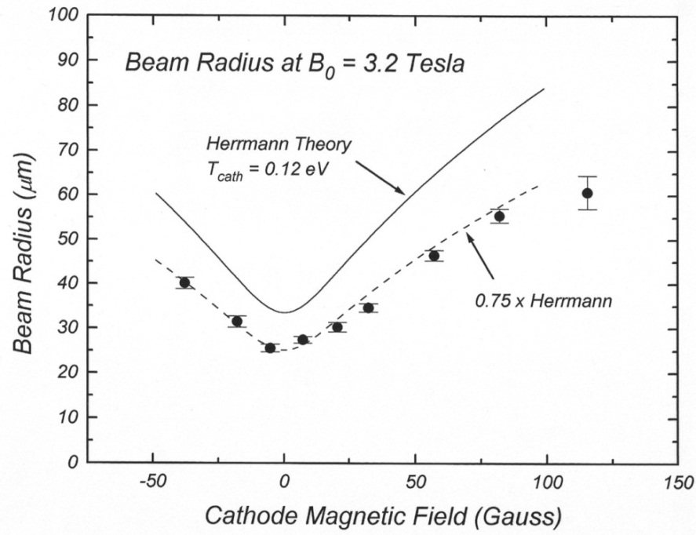
Effect of cathode magnetic field on compressed current density also follows Herrmann theory predictions
Beam radius is measured from imaging of x-ray emission from electron-ion collisions
  X-ray emission radius is determined by the overlap of the electron beam with the ion radial distribution and is smaller for cooler ions
Transverse electron temperature of compressed beam is T┴ = T_{c} (j_{e} / j_{c}) ≈ 200 eV (beam is “hot”)

Slide 12
Breeding high charge states by successive ionization
Ionization cross sections depend on beam energy (E_{e}), ionization potential (I_{j}), and number of bound electrons (r_{j}) in each atomic shell j
[cm², eV]
Ionization cross section ∼ 1/q²
→ rapid decrease as
charge state increases
Electron energy (keV) | Ionization potential (keV) | Cross section (cm²) | Rate per ion (s⁻¹) at 5000 A/cm²
10 | 0.02 | ~ 10⁻¹⁷ | ~ 10⁵
200 | 130 | ~ 10⁻²⁴ | ~ 10⁻²
Time for sequential ionization to charge state n
Example: Sn(Z=50) in a 2000 A/cm² beam
∼ 150 ms to reach Ne-like Sn⁴⁰⁺

Slide 13
Ion heating
Energy transfer from beam electrons to trapped ions by single particle collisions
  Heating rate per ion is
  High ion charge and low electron energy are bad
Heating rate ∼ q² Ionization cross section ∼ 1/q²
Ion temperature exceeds beam space charge potential for high charge states
Evaporative ion cooling is used (either by design or by accident) to achieve the production and retention of very high charge states
Production of charge states of roughly 50+ or greater is impossible without ion cooling!

Slide 14
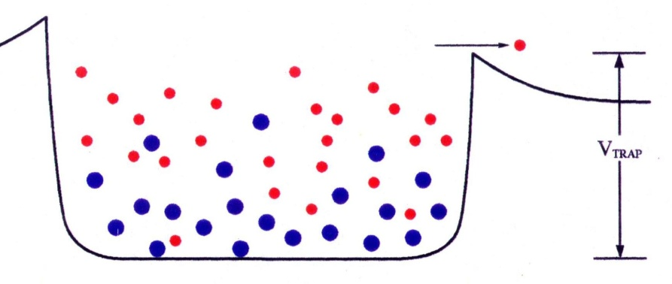
Evaporative ion cooling enables the production of very high charge states and almost unlimited confinement times
evaporation rate ∼
⇒ low-q ions are lost
⇒ high-q ions are trapped
Loss rate depends exponentially on ion charge
Evaporation of low-Z ions compensates for electron beam heating of high-q ions
Thermal equilibrium
⇒ T_{i} ≈ 0.1qeV_{trap}
The axial trap potential controls the ion temperature and radial distribution of ions within the electron beam
A low-Z coolant (typically neon gas) is injected into the EBIT trap for production and retention of very-highly-charged ions

Slide 15
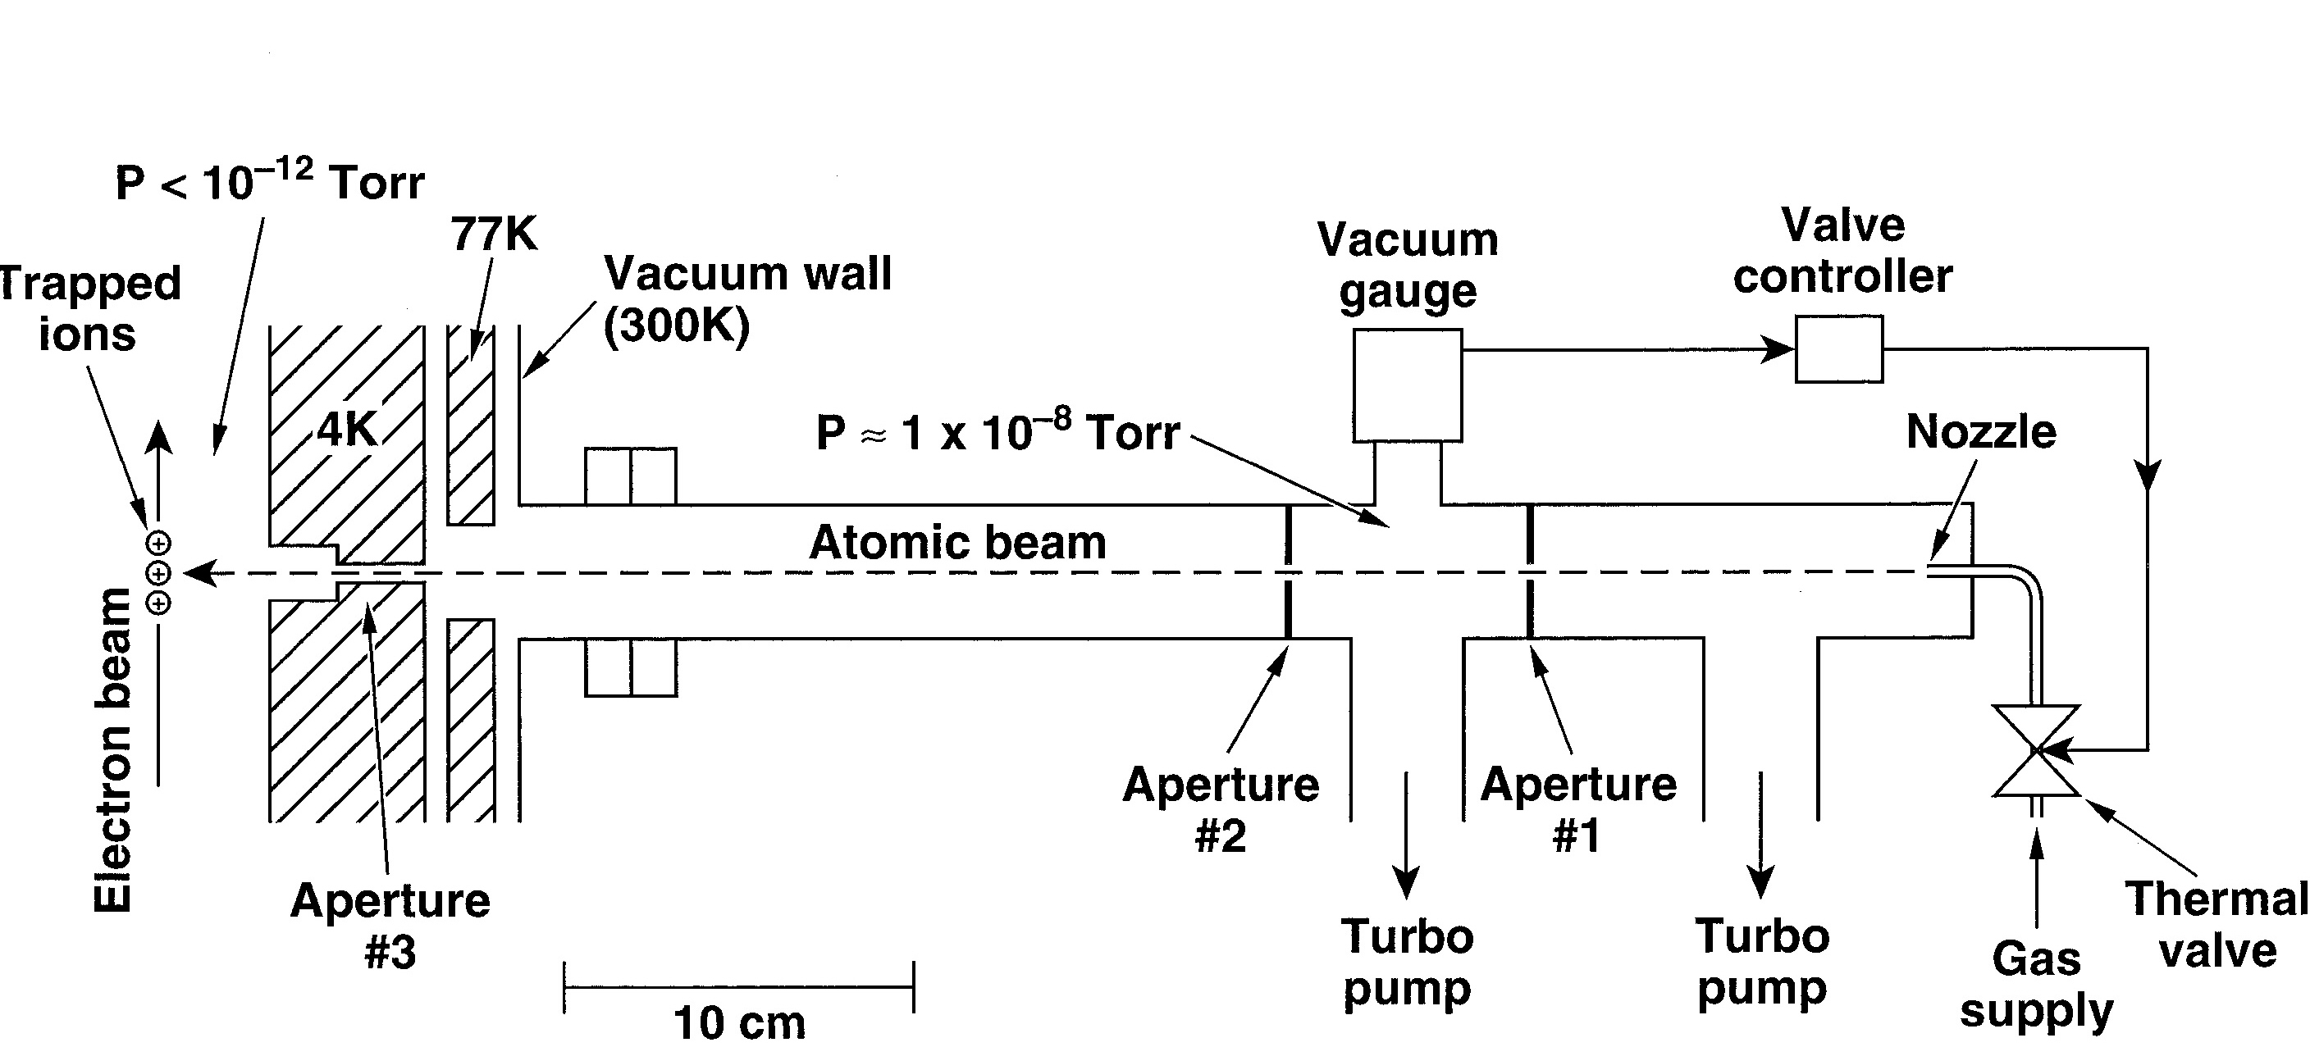

LLNL Super EBIT cooling-gas injector
A beam of neutral atoms (usually neon) is produced by differential pumping and collimation
Neutral atomic beam crosses electron beam in trap center
Best performance is achieved when all x-ray ports are covered by beryllium windows at 4 K to minimize background gas density in the trap
Neon is a good choice for cooling: atomic number is about right, chemically inert, small charge exchange recombination cross section

Slide 16
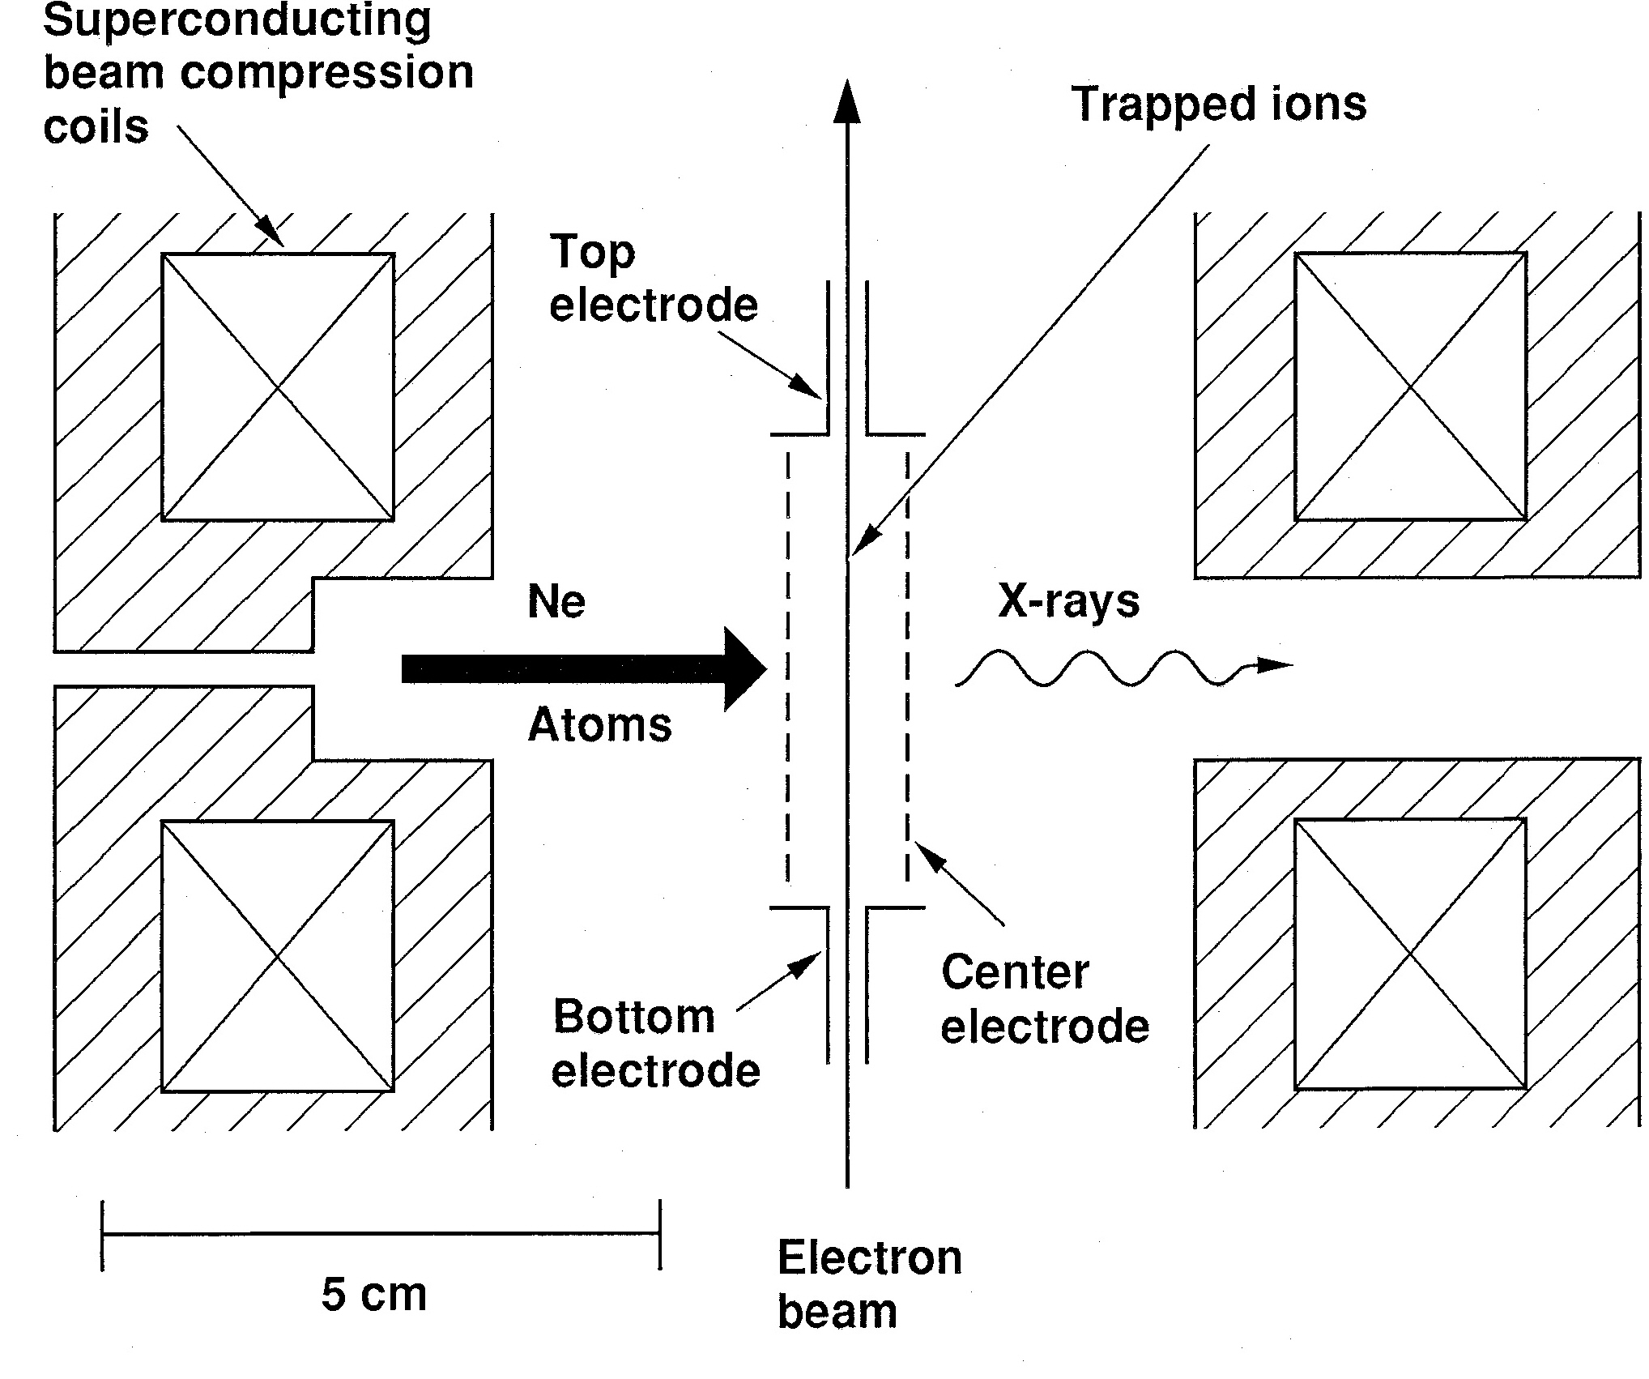
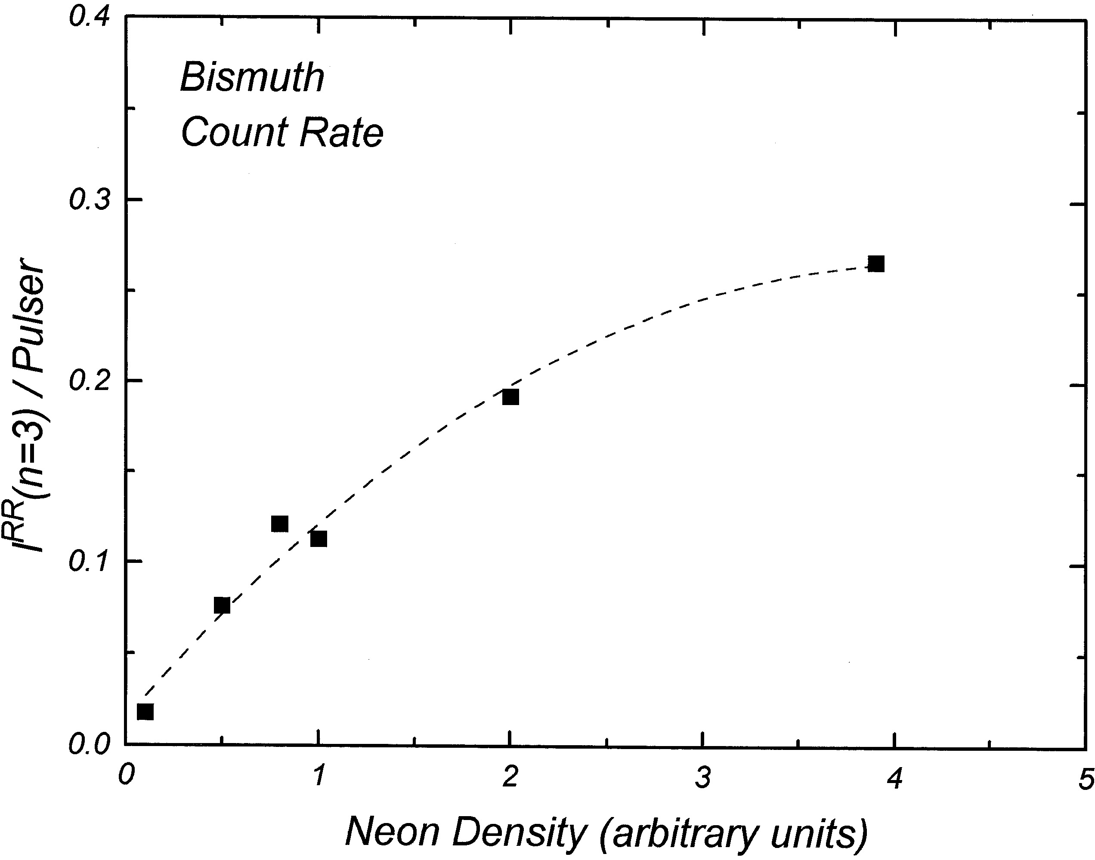
Injection of low-Z cooling gas controls high-Z ion inventories
Neutral neon atoms are injected radially through an aperture in the 4 K magnet bobbin
Some neon atoms are ionized and captured in the electron beam
The trap is filled with a single injection of low-charge bismuth
The amount of highly charged bismuth retained in the trap is controlled by the amount of neon cooling
Data with a clean trap confirms that the number of high-charge ions retained in the EBIT electron beam is roughly proportional to the injection rate of low-Z cooling ions

Slide 17
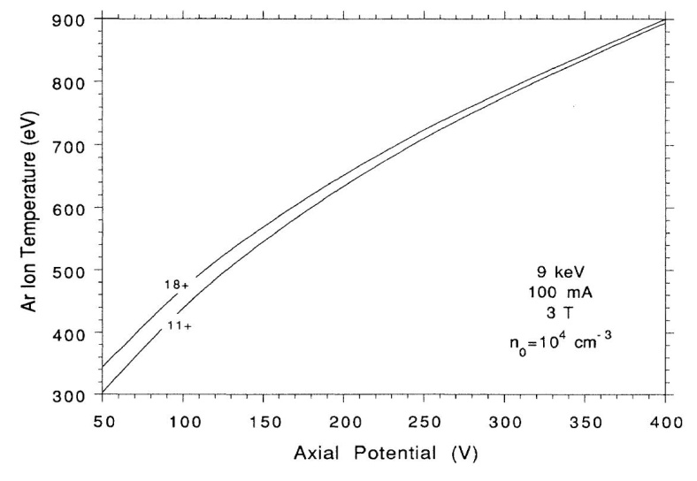
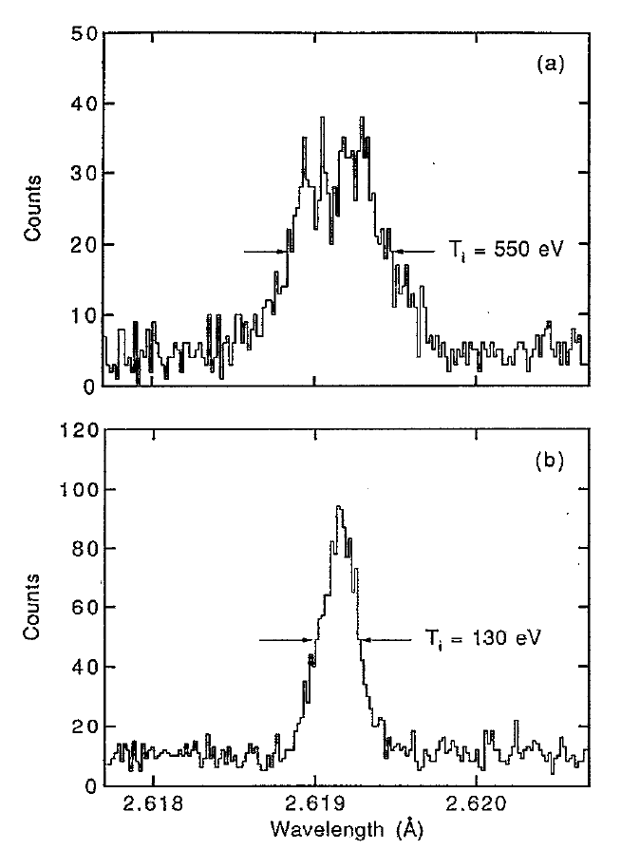
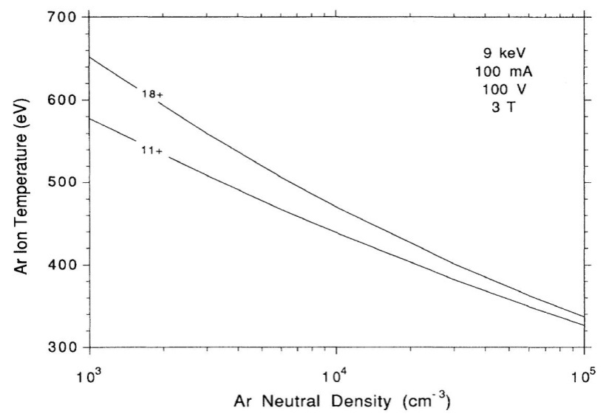
Measurements and detailed computer models support our understanding of ion thermal processes
Computer model of steady-state argon ion temperature
Measured He-like Ti²⁰⁺ Doppler-broadened x-ray line width
Deep axial trap
High ion temperature
Shallow axial trap
Low ion temperature
B. Penetrante et al., PRA 43, 4861 (1991)
P. Beiersdorfer et al., RSI 66, 303 (1995)

Slide 18

Charge-exchange recombination with neutral gas destroys high charge states
Destruction rate is
  The cross section is enormous: σ^{cx} ∼ 2 × 10⁻¹⁴ cm² for q = 50+ and neutral neon
Neutral gas density must be very low ( ∼ 10⁻¹² Torr equivalent pressure or less) to avoid destruction of high charge states
Several features of the EBIT design were
chosen to minimize neutral gas in the trap
  Trap electrodes at 4 K with small
  beam entrance and exit holes
  Beryllium x-ray windows at 4 K
  Collector cooled by liquid nitrogen

Slide 19
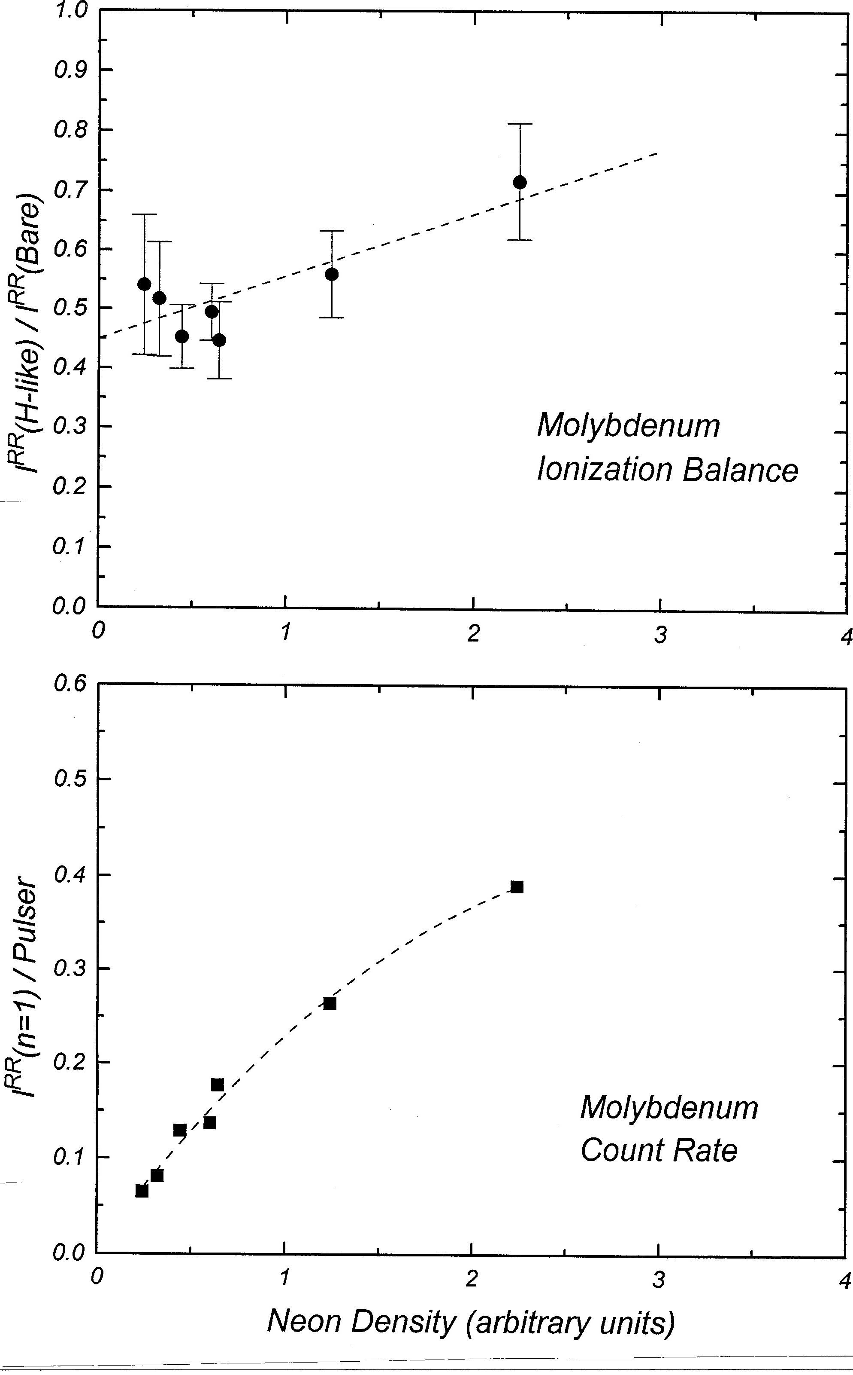
It is possible to have good cooling (i.e., high count rate) and good ionization balance at the same time
Several operating parameters can be adjusted to optimize conditions for specific measurements
  Cooling gas density
  Axial trap potential
  Electron beam current and density
We are lucky that the ratio of cross sections for electron impact ionization and charge exchange recombination is sufficient for production of high-charge-state ions

Slide 20
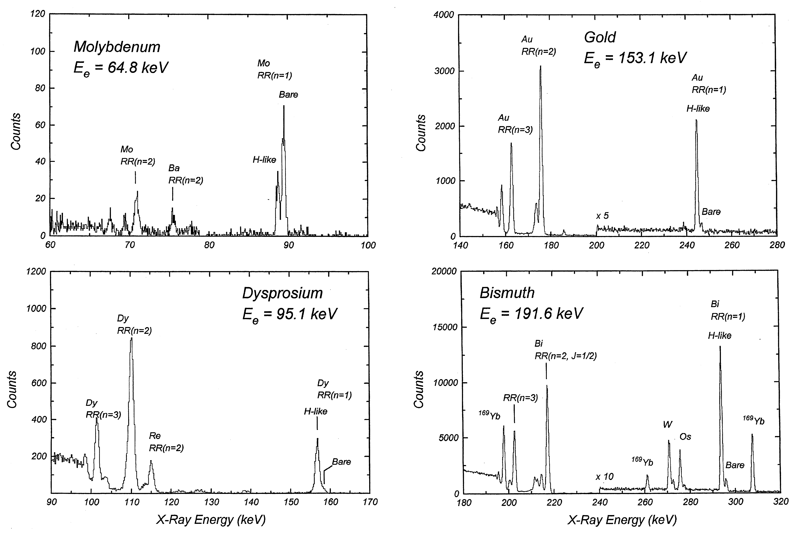
X-Ray spectroscopy is an important diagnostic for trap operation
Radiative recombination x-ray spectra from the LLNL Super EBIT
Time-dependent x-ray emission spectra obtained in a solid state detector (silicon, germanium, CdTe) provide
  Ionization balance and its evolution
  Number of ions in the electron beam (ion-beam overlap)
  Abundance of contaminants
Combining x-ray measurements of trapped ions with measurements of injected and extracted ions contributes to understanding machine operation

Slide 21
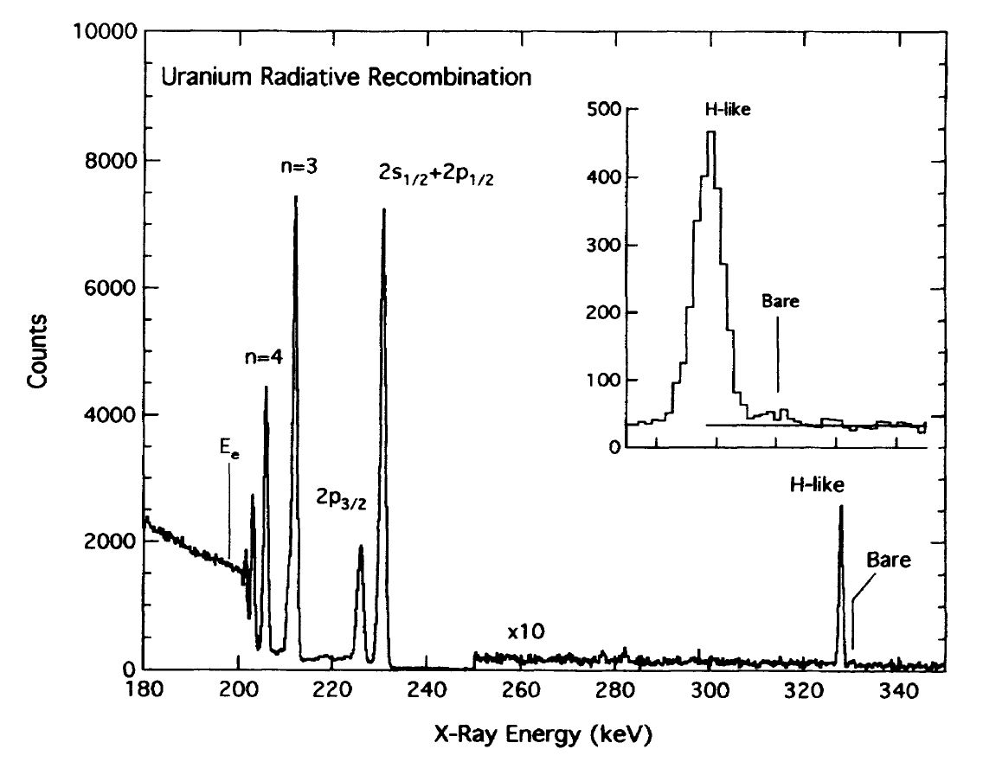
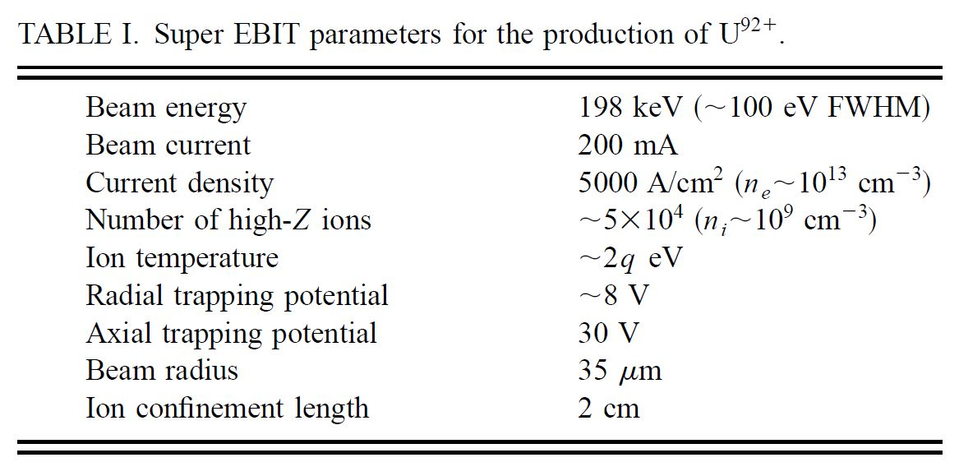
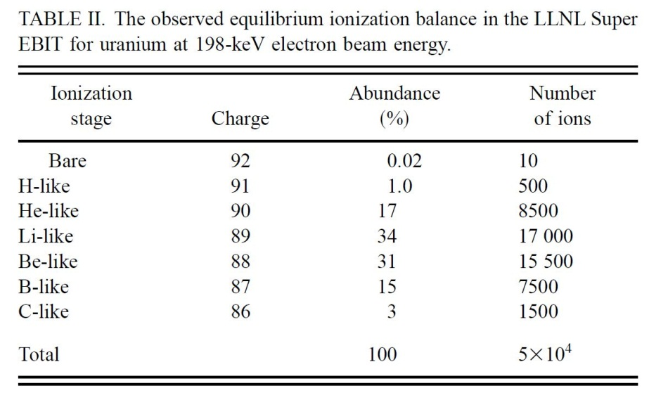
Production of bare U⁹²⁺ stretched the LLNL Super EBIT to its limits
Maximum Super EBIT beam energy and current
Cooling optimized for inventory of highest charge state
Radiative recombination x rays from roughly 10 trapped U⁹²⁺ ions were observed and used to measure the ionization cross section for H-like U⁹¹⁺
R. E. Marrs, RSI 67, 941 (1996); R. E. Marrs, S. R. Elliott, and D. A. Knapp, Phys. Rev. Lett. 72, 4082 (1994)

Slide 22
Moving form Super EBIT to high-performance charge breeding
LLNL developed a high performance EBIT (5 A, 10⁵ A/cm²) for trapped ion spectroscopy and charge breeding of radioactive ions
Trap current density is limited only by cathode temperature for EBIT conditions (B_{c} = 0 and good beam optics)
  Current density becomes (note dependence on r_{c})
Average electron beam current density at an electron energy of 30 keV for different magnetic fields and cathode radii
We can increase j_{c} , B, r_{c} , and total current to get high performance

Slide 23
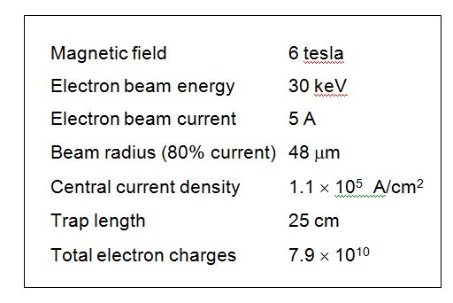
Experience with Super EBIT influenced the design of the LLNL high-intensity EBIT
100-fold greater x-ray emission
10-fold longer trap for use as ion source
Maximum electron beam energy >200 keV
Radial access at two axial locations to permit cooling gas injection into a two level trap
Proposed as charge state booster for radioactive ion beams (1998)
Example parameters for charge state boosting

Slide 24
Summary
The EBIT and Super EBIT at LLNL were built to produce and retain highly charged ions for x-ray spectroscopy
  Short (2 cm) trap with Helmholtz-coil geometry and multiple access ports between the coils for spectrometers, x-ray imaging, and cooling gas injection
  Zero magnetic field at cathode for maximum electron beam current density in trap
  Drift tubes and beryllium x-ray windows at 4 K to minimize background gas
  Active ion-ion evaporative cooling by low-Z gas injection
X-ray observations were extremely important for understanding and improving EBIT operation, and for the successful production and retention of very high charge states
Experience with Super EBIT shaped the design of a high intensity EBIT with parameters appropriate for an advanced charge breeder

Slide 25
Backup slides

Slide 26
Electron beam parameters for the LLNL EBIT
Beam parameters
Cathode magnetic field | B_{c} = 0
Trap magnetic field | B = 3.0 T
Cathode temperature | T_{c} = 0.12 eV
Cathode radius | r_{c} = 1.5 mm
Beam radius in trap | r_{beam} = 35 µm
Beam current | I_{e} < 200 mA
Example
I_{e} = 100 mA
Current density j_{e} = 2600 A/cm²
Electron flux Φ_{e} = 1.6 × 10²² cm⁻² s⁻¹
Electron beam current density is known for all operating conditions

Slide 27
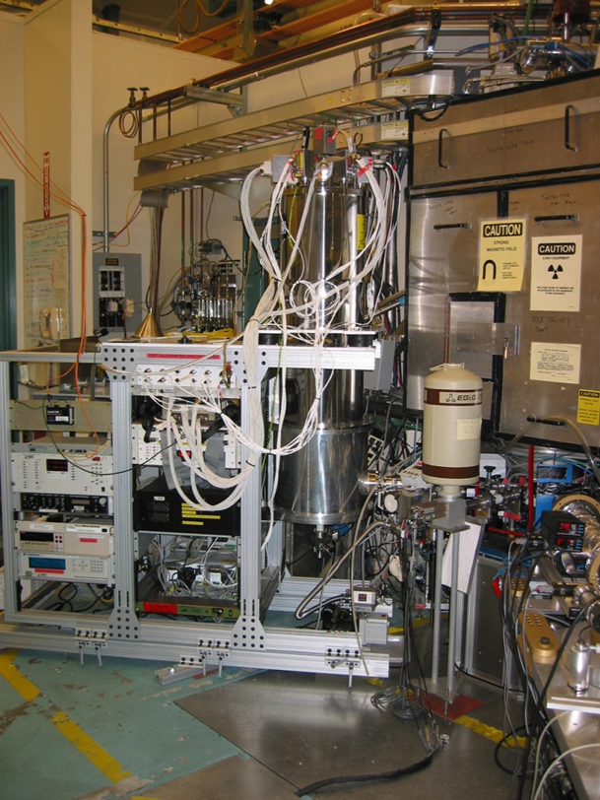
View of the cryogenic spectrometer at the LLNL Super EBIT

Slide 28
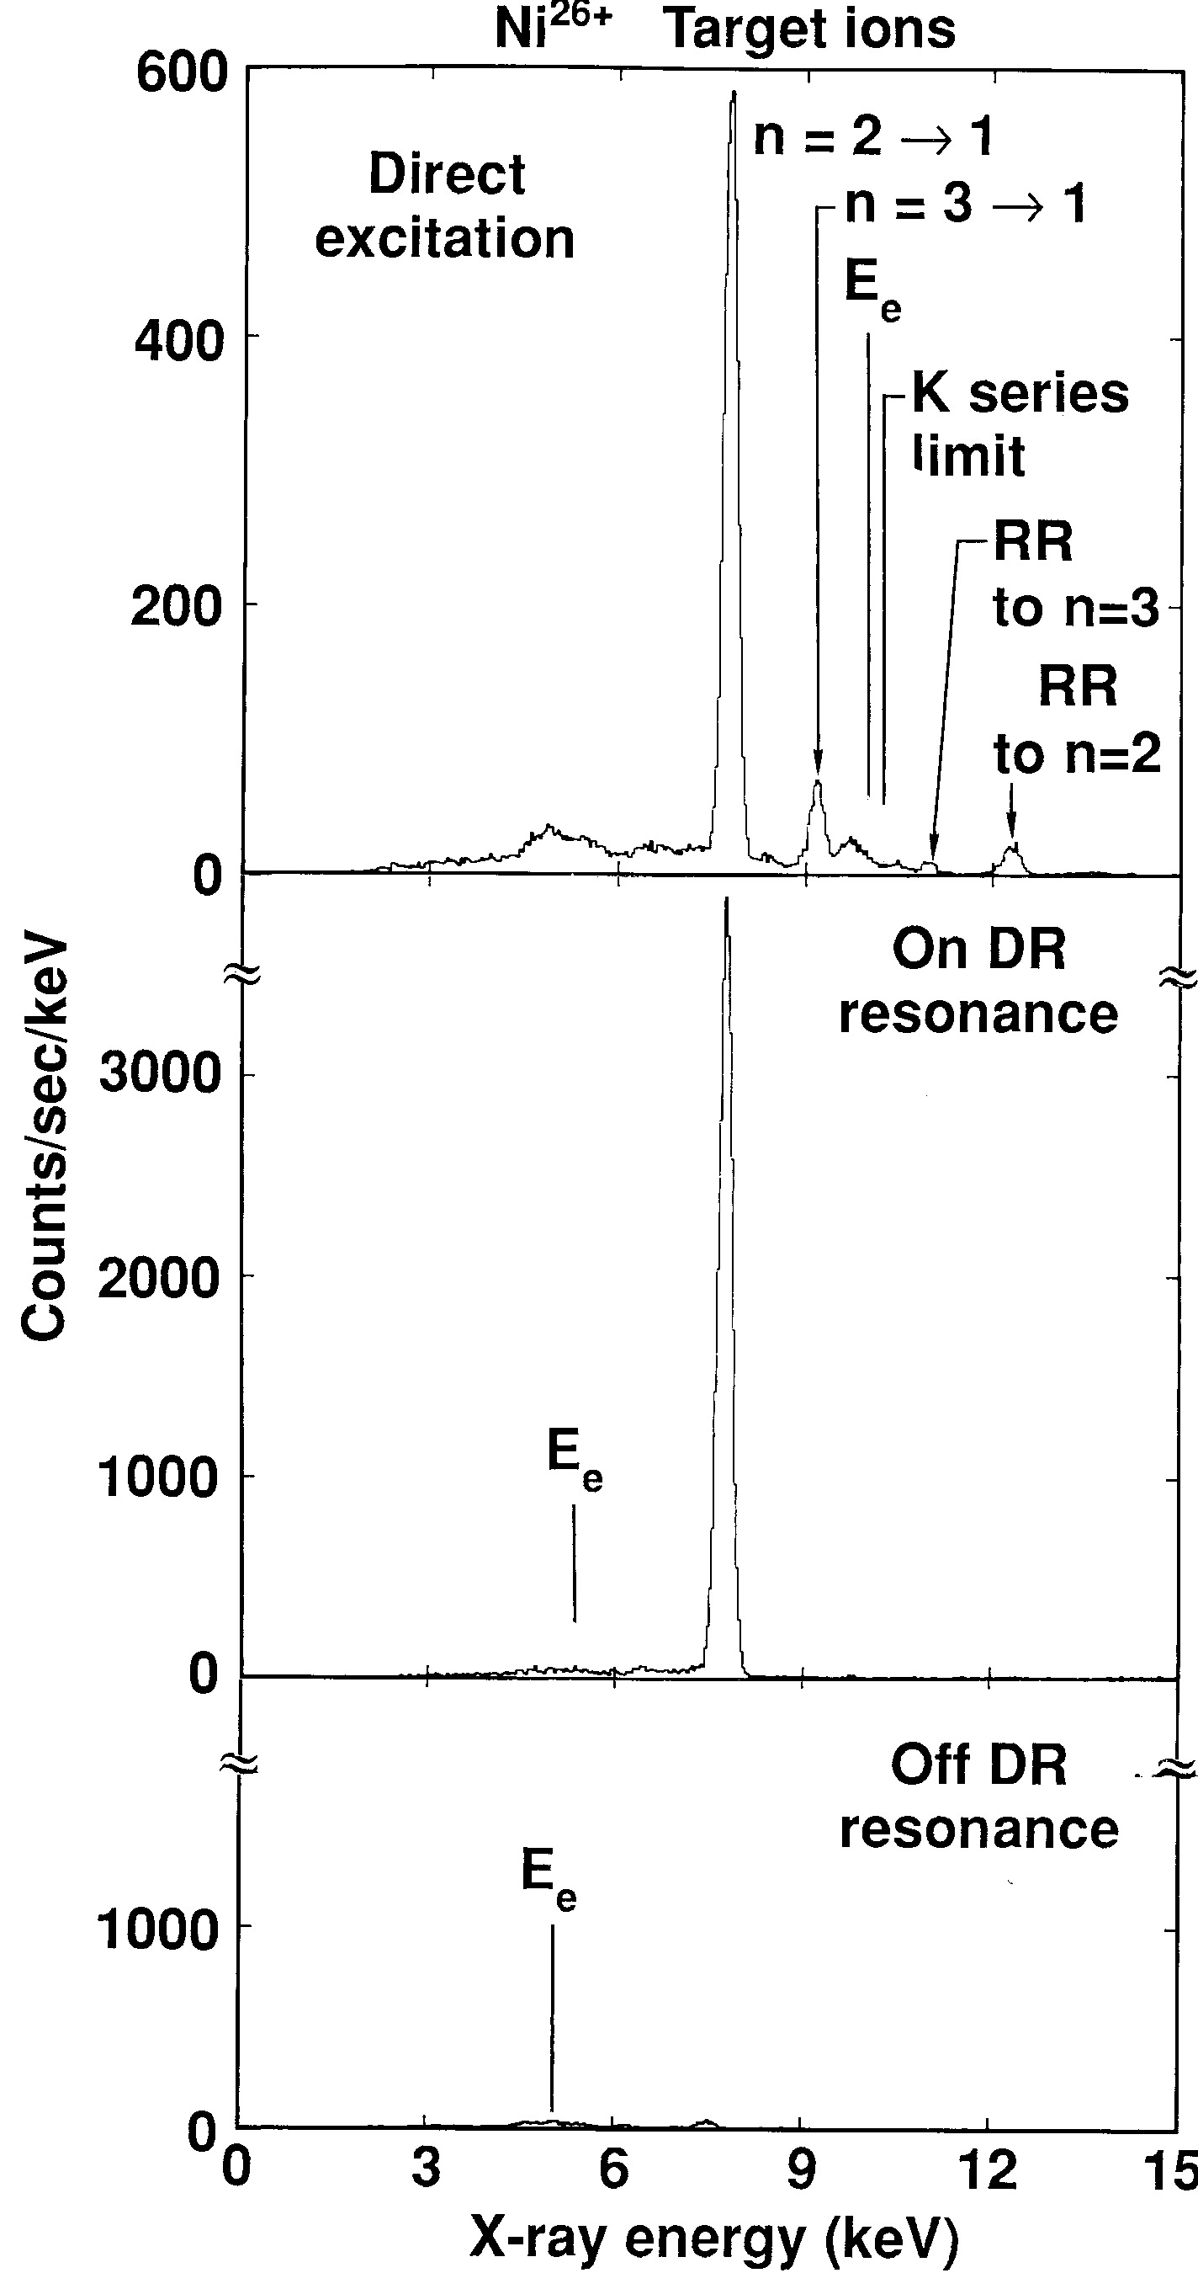
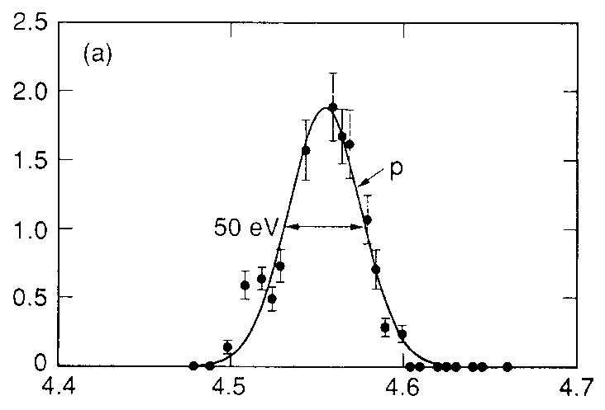
Control and resolution of the electron beam energy
Programming of the electron beam energy allows injection of low-charge ions, production of high charge states, and measurement of x-ray spectra at different electron energies
Maximum electron energy was increased to 200 keV (Super EBIT) with little loss of resolution
The EBIT electron beam energy resolution is surprisingly good
  No evidence of a low energy tail from secondary electrons
DR satellite intensity
Electron energy (keV)
The good quality of the EBIT electron beam enabled the study of resonant reactions and excitation functions

