Slide 1
HIE-EBIS Workshop
Vacuum Aspects and Recommendations
Paolo Chiggiato
CERN
Technology department
Vacuum, Surfaces and Coatings group
Injectors & Vacuum Measurements

Slide 2
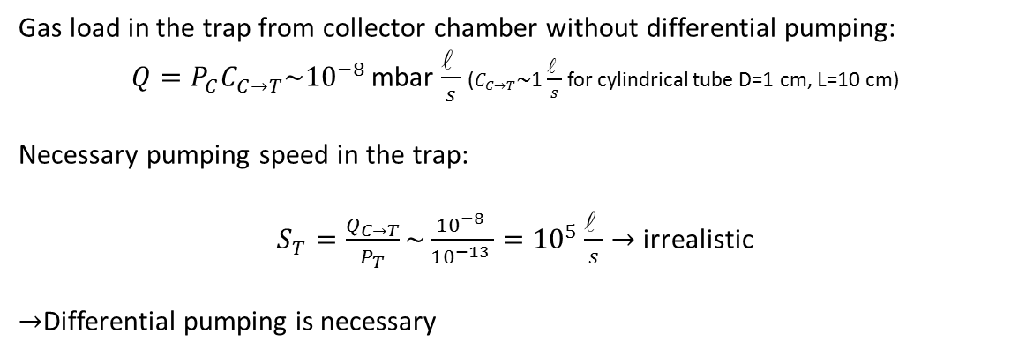
Request to vacuum system
Gun
Differential pumping
Trap
Differential pumping
Collector
Hot cathode
Gas load from extremities
ESD from collected e-
(2-5 A, 1-10 KeV)
ESD of lost e- (≈1mA -1KeV)
ESD by lost e- and ions
Material outgassing
Material outgassing
Material outgassing
Pressure requirements
Protection of cathode Reduced gas transmission | Lowest possible gas density | Reduced gas transmission
10⁻⁹ mbar | 10⁻¹³ mbar | 10⁻⁸ mbar
Is this value mandatory also for H₂?
Gas load in the trap from collector chamber without differential pumping:
$Q=P_{C}C_{C→T}\sim {10}^{−8 }$mbar $\frac{\text{l} }{s}$ ($C_{C→T}\sim$1 $\frac{\text{l} }{s}$ for cylindrical tube D=1 cm, L=10 cm)
Necessary pumping speed in the trap:
$S_{T}=\frac{Q_{C→T}}{P_{T}}\sim \frac{{10}^{−8 }}{{10}^{−13 }}={10}^{5}\frac{\text{l} }{s}→$ irrealistic
$→$Differential pumping is necessary

Slide 3

Gas sources: outgassing
$$P=\frac{Q}{S}+P_{0}$$
Thermal outgassing for traditional vacuum materials after bakeout:
Mainly H₂, except for porous solids (ceramics and graphite)
Low T (<200°C) bakeout: 10⁻¹² mbarls⁻¹cm⁻² for stainless steel and copper, lower for Al alloys
Chemical and electrochemical treatments have minor effects on H₂ outgassing rate.
Thermal desorption measurement: 1 mm thick ribbons, heating rate 5 K min⁻¹,
bakeout temperature 150°C (15h)

Slide 4
Gas sources: outgassing
Stainless steel vacuum fired at 950°C (2h): 2 10⁻¹³-7 10⁻¹⁵ mbarls⁻¹cm⁻²
semi-infinite model
Outgassing rate of vacuum fired austenitic st. steels
q [Torr l s⁻¹ cm⁻²]
10⁻⁵ Torr pressure in the furnace
For zero pressure in the furnace
L [cm]

Slide 5
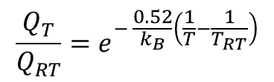



Gas sources: outgassing
Effect of temperature on outgassing rate
$$Q∝e^{− \frac{E_{D}}{k_{B}T}}$$
Example: outgassing rate of stainless steel
$$\frac{Q_{T}}{Q_{RT}}=e^{− \frac{0.52}{k_{B}}\left(\frac{1}{T}−\frac{1}{T_{RT}}\right)}$$
T = 100 K $→\frac{Q_{T}}{Q_{RT}}=4 {10}^{−18}$
T = 300°C $→\frac{Q_{T}}{Q_{RT}}=21000$

Slide 6
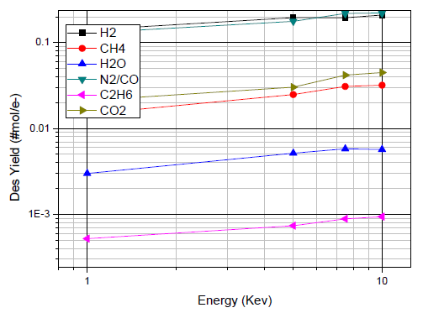
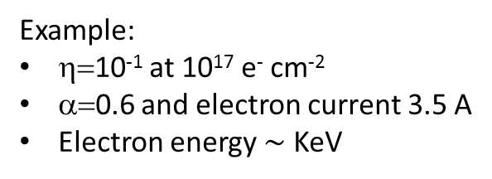
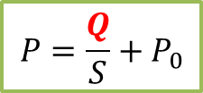

Gas sources: ESD
Chiara Pasquino, Master degree thesis, Politecnico di Milano
$$P=\frac{Q}{S}+P_{0}$$
In general: the electron energy has a minor effect on η for electron energies higher than 2 KeV.
Desorption yields as a function of
electron energy at dose 1.6 10¹⁵ e⁻ cm⁻²
η= η₀ $D^{−α}$
0.6 < α < 1
Example:
η=10⁻¹ at 10¹⁷ e⁻ cm⁻²
α=0.6 and electron current 3.5 A
Electron energy $\sim$ KeV
Conditioning time | 1 day | 10 days
Desorption yields | 1.6 10⁻⁵ | 4 10⁻⁶

Slide 7
Gas sources: ESD
The desorption yield is only slightly affected by chemical and thermal treatments.
Only TiZrV thin film coating may provide low effective desorption yields without conditioning

Slide 8
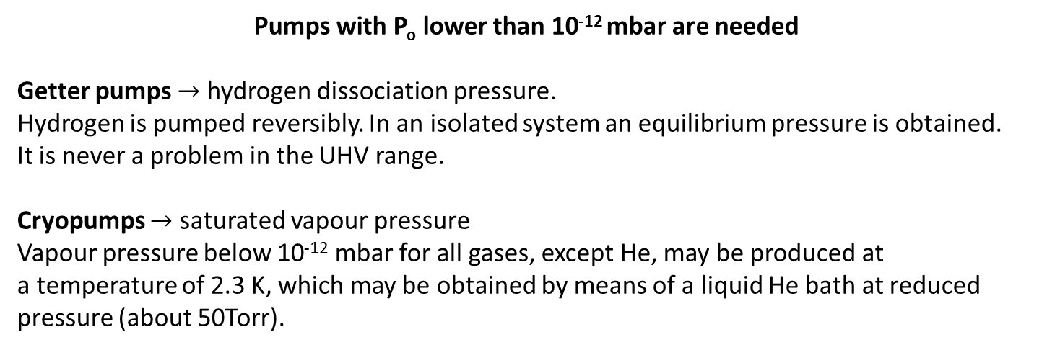
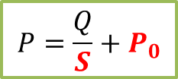
Gas pumping
$$P=\frac{Q}{S}+P_{0}$$
Pumps with P_{o} lower than 10⁻¹² mbar are needed
Getter pumps $→$ hydrogen dissociation pressure.
Hydrogen is pumped reversibly. In an isolated system an equilibrium pressure is obtained.
It is never a problem in the UHV range.
Cryopumps $→$ saturated vapour pressure
Vapour pressure below 10⁻¹² mbar for all gases, except He, may be produced at
a temperature of 2.3 K, which may be obtained by means of a liquid He bath at reduced pressure (about 50Torr).

Slide 9
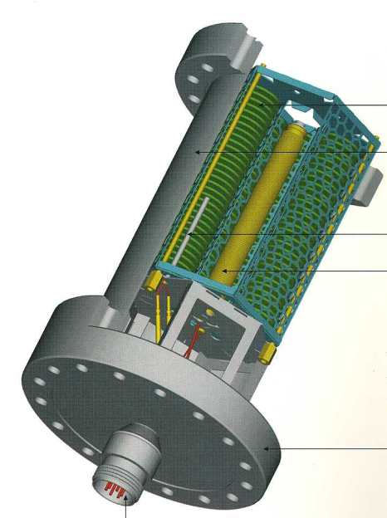
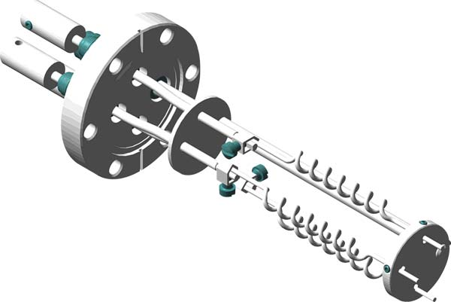
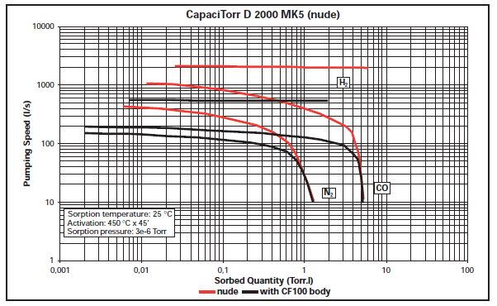
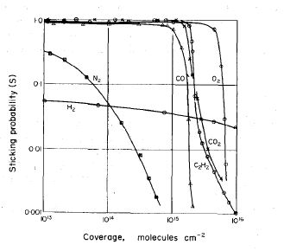
Lump getter pumps
Courtesy of SAES Getters
A K Gupta, J H Leck, Vacuum, 1975
Saturated after the adsorption of one monolayer (3.3x10⁻⁵ Torr l cm⁻²) of CO.
Already tested at 10⁻¹³ mbar
Q_{sat}= 5 Torr l equivalent to 15 m² of smooth getter surface.
Already tested at 10⁻¹² mbar
Getters do not pump rare gases and CH₄: they always need auxiliary pumps

Slide 10
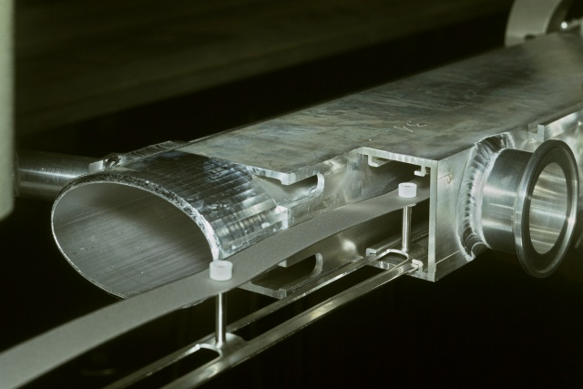
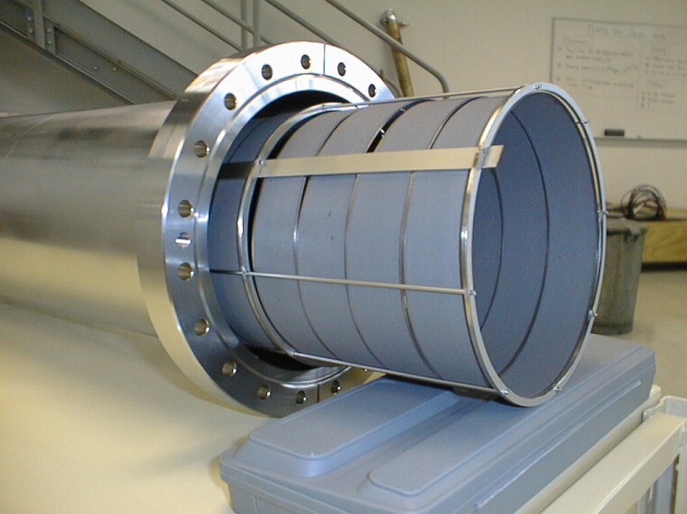
Getter pumps: NEG ribbon
St 101
St 707
In LEP, it was activated by ohmic effect
This alloy may be activated at temperatures as low as 300°C (24h): passive activation may be applied
Both solutions may be used when distributed pumping is needed, however:
High temperature needed for activation (T>300°C)
Space needed for supports
Gas sources not reduced
Potential risk of dust production
Equivalent to 50-100 cm² of smooth getter surface

Slide 11
Getter pumps: NEG thin films
TiZrV is deposited by sputtering onto the inner wall of vacuum chambers.
It may be activated at 180°C (24h). It is the main pump of the warm LHC’s LSS.
Typical S at zero coverage: 0.3-0.5 ls⁻¹ for H₂.
The pumping capacity may be increased by coating rough coatings on rough substrates
Very large surfaces may be coated
The outgassing rate of the substrate surfaces is suppressed
No experience in pumping at cryogenic temperature, but we are eager to start…

Slide 12
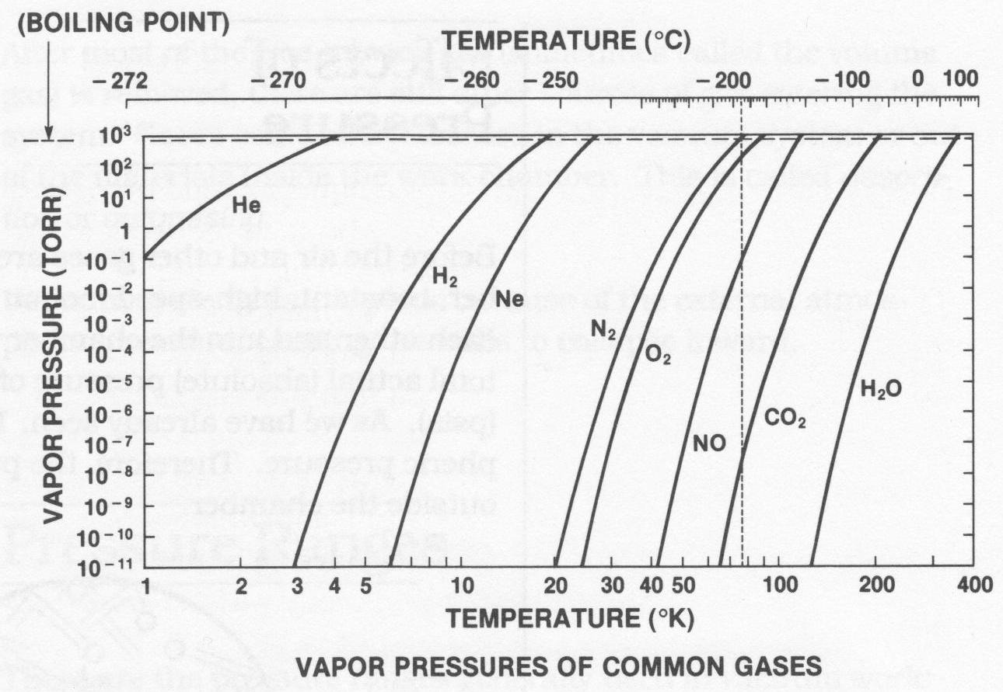
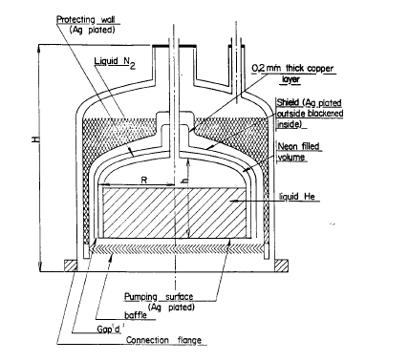
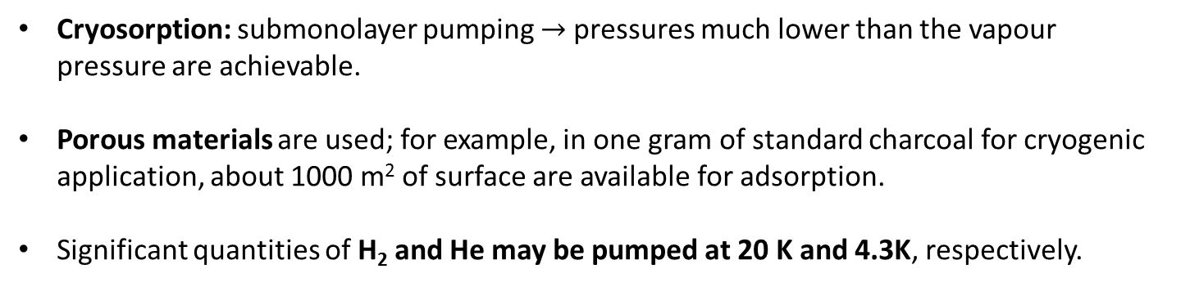
Cryo pumps
Cryocondensation: surfaces cooled at temperature lower than 3 K are needed to achieve vapour pressures lower than 10⁻¹¹ Torr for H₂.
C. Benvenuti, Vacuum 1979
Cryosorption: submonolayer pumping $→$pressures much lower than the vapour pressure are achievable.
Porous materials are used; for example, in one gram of standard charcoal for cryogenic application, about 1000 m² of surface are available for adsorption.
Significant quantities of H₂ and He may be pumped at 20 K and 4.3K, respectively.

Slide 13
Cryo vs NEG pumps
 | NEG pumps | Cryosorption pumps
Pumping selectivity | No pumping for rare gas and CH₄; need of auxiliary pumps | No selectivity
Regeneration/Condi-tioning | Full bakeout for passive activation of NEG films or St707 ribbon | Auxiliary pumps to remove desorbed gas.
Maintenance | No maintenance | Regular and expensive for refrigerators
Power cut | Continue pumping, no need of power supply | Desorption; need of an auxiliary pump.
Bakeout issue | Temperature of NEG surfaces > 180°C | Need for bakeable cryosorbers
Cost | Lower | Higher
Dust production | Not excluded a-priori for ribbons | No problem
Safety issues | Pyrophoricity, except for NEG films | No problem for refrigerators
Space needed | Negligible | Integration of refrigerator
Inlet valve for lump pumps | No need | Necessary for regeneration -> €
Operational incidents | Strongly affected by contamination (F, Cl, hydrocarbon) | Unduly gas charge on porous surface

Slide 14
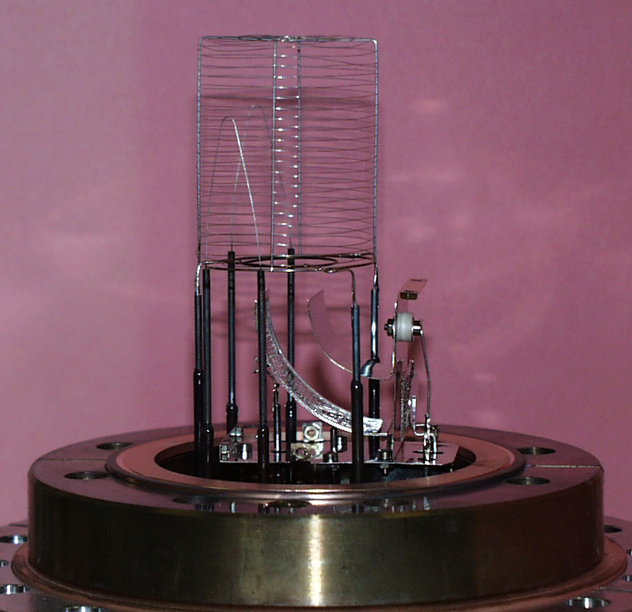
Pressure measurement
Nowadays, no commercial vacuum gauges can measure 10⁻¹³ mbar at room temperature
At CERN, a Bayard-Alpert gauge developed in the ‘70th is currently used.
It has a x-ray residual pressure of about 2 10⁻¹² Torr; pressure measurement in the 10⁻¹³ Torr range is possible by modulation.
The modified Helmer gauge gave reliable results in the low 10⁻¹⁴ Torr: but it is not anymore available at CERN. A development programme is going to be launched in 2013 in collaboration with an industrial partner.

Slide 15
Conclusions
The pressure requirement in the HIE-EBIS’s trap is so challenging that every single material must be selected, treated and checked with the highest precaution.
If a getter based solution is selected, be sure that:
  the coated surface is the largest possible;
  the design allow a uniform temperature bakeout;
  during the activation, the coated surface is not unduly charged by gas desorbed by uncoated areas ;
  no F contamination is present (for example Teflon in primary pumps)
  the NEG is activated after the full conditioning of the collector and cathode.
If a cryosorption solution is selected, be sure that:
  all parts are bakeable;
  the cryosorber is strongly fixed and can withstand several bakeout cycles;
  consider a scenario that include power cut;
  cool the cryosorber surface as late as possible after the beginning of the pumpdown.
As devil is in the details, work closely with your vacuum experts in any step of the project, especially design, and ask for vacuum validation tests as soon as possible.

Slide 16
Additional slides

Slide 17
Gas sources: outgassing
Electropolishing reintroduces about
1/50 of the quantity of H initially present in the sample.
Thermal desorption measurement: 1 mm thick ribbons,
heating rate 5 K min⁻¹, bakeout temperature 150°C (15h)

Slide 18
Gas sources: ESD
Effect of bakeout temperature and cleaning product

Slide 19
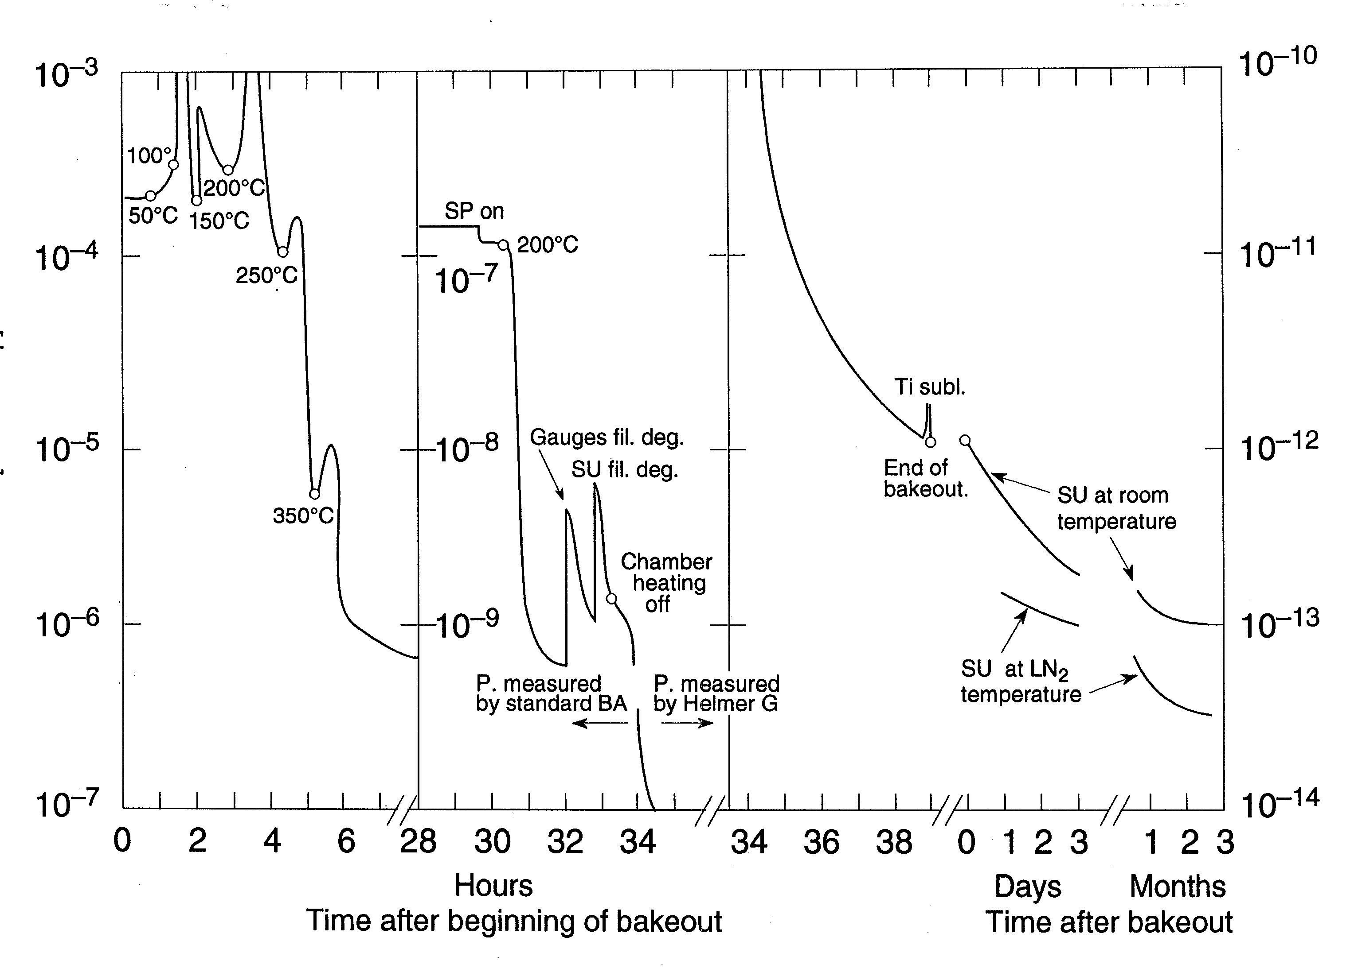
Operational issues

Slide 20
Gas sources: ESD
500 eV electrons, no conditioning

Slide 21
NEG coating performance deterioration

Slide 22
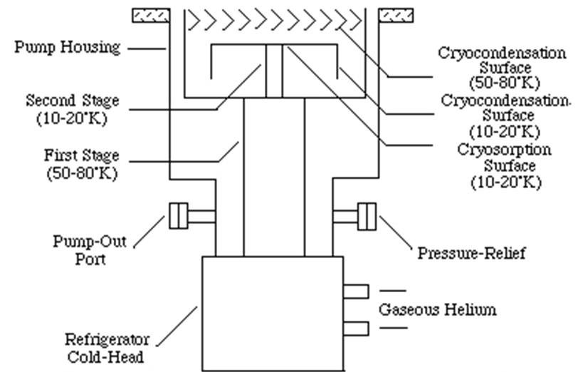
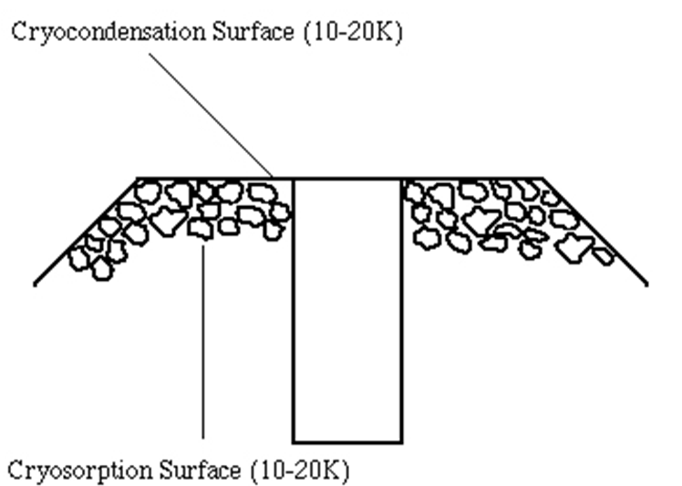
Cryopumps
Very high pumping speeds
Cryosorption and cryocondensation are used for distributed pumping, in particular in vacuum chambers installed in superconducting magnets.

