Slide 1
Low-contamination Rare and Exotic Beams
(at CARIBU)
Sergey Kondrashev
October 16, 2012

Slide 2
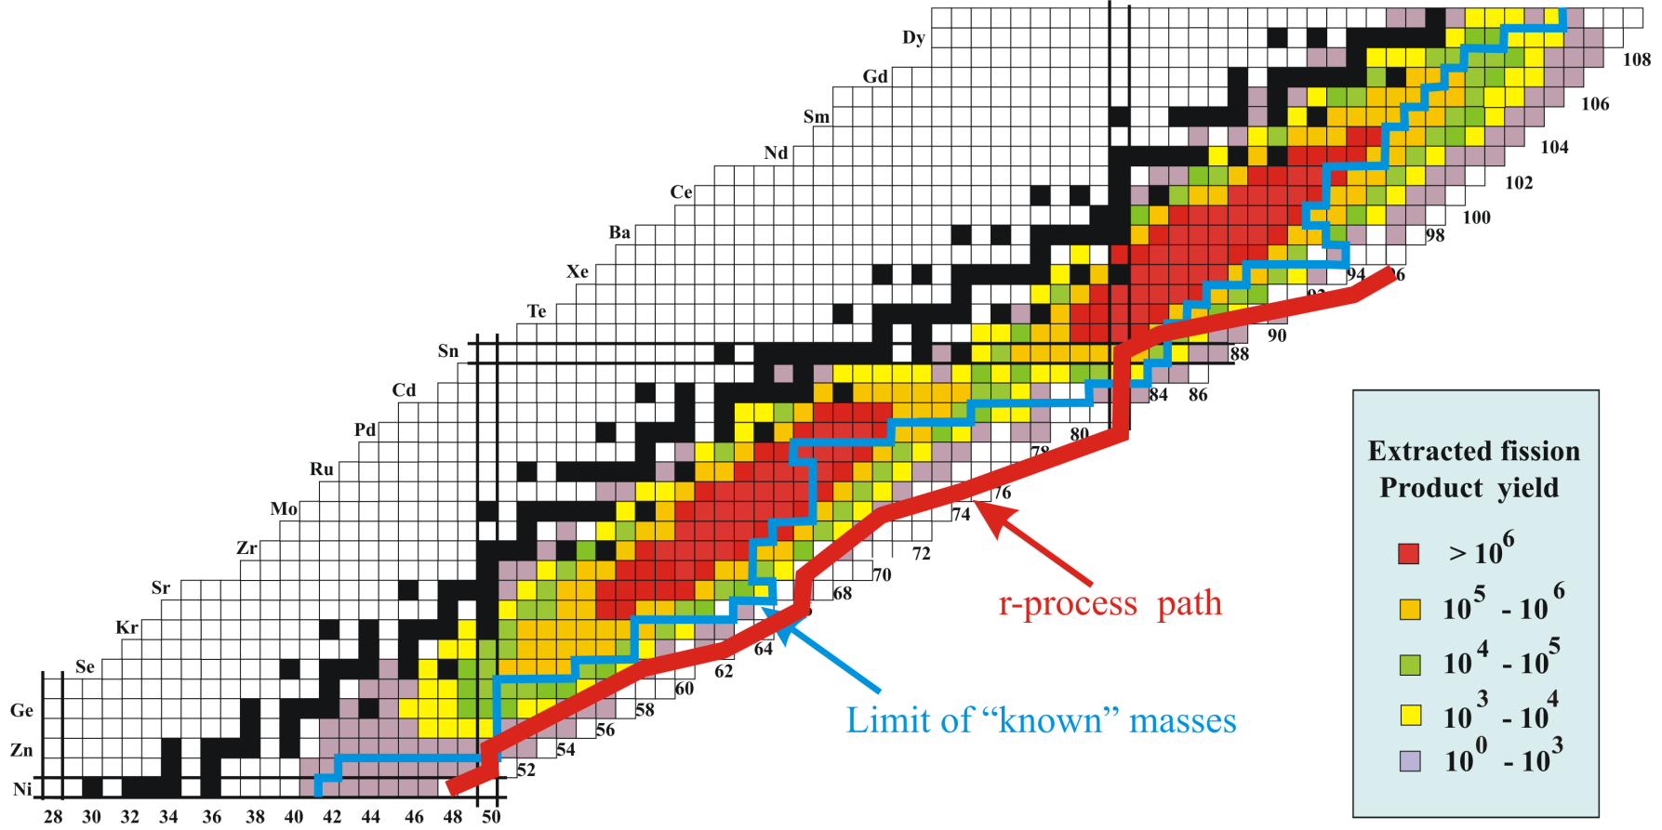
CARIBU – Californium Rare Ion Breeder Upgrade
²⁵²Cf source, gas catcher, isobar separator
²⁵²Cf fission source provides radioactive species (80 – 160 a.m.u)
  500 mCi source installed September 5, 2012
High quality beam out of gas catcher
  Energy spread of 1 eV
  Emittance of 3 π mm mrad
Stopped beams and reaccelerated beams up to 15 MeV/u
Highest yields are in the mid-mass species
  Above Germanium, below Dysprosium
To low energy area
Stable beam platform
ECRCB ion source

Slide 3
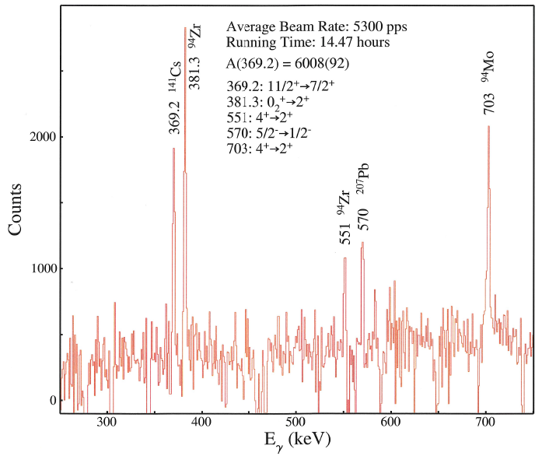
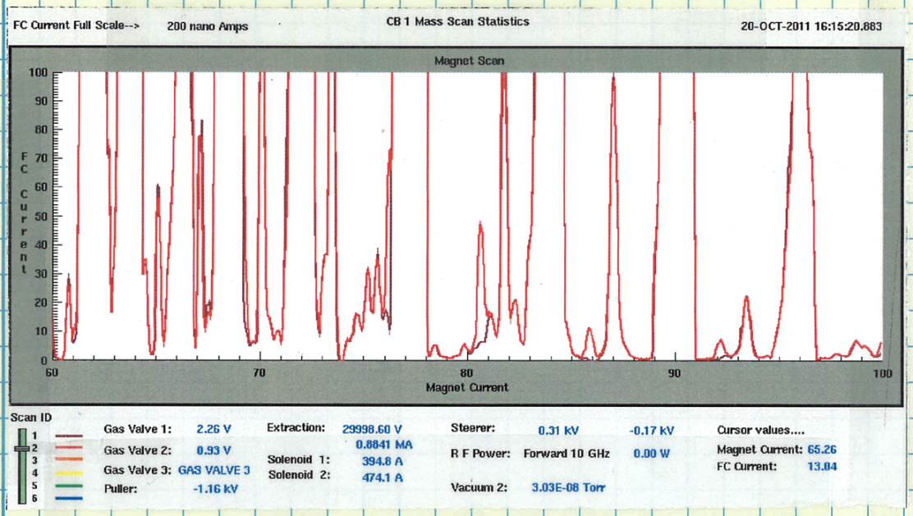
From “Messy” Beam at CB Output to “Clean” Post-accelerated Beam
Post-accelerated ¹⁴¹Cs RI beam
At output of ANL ECR CB
16/4+
14/3+
16/3+
12/2+
10+
40/9+
40/8+
9+
8+
7+
40/7+
Mass scan of background plasma constituents and charge bred ³⁹K beam showing peaks for 7+, 8+, 9+, and 10+ (courtesy of Rick Vondrasek).
(courtesy of Rick Vondrasek)

Slide 4
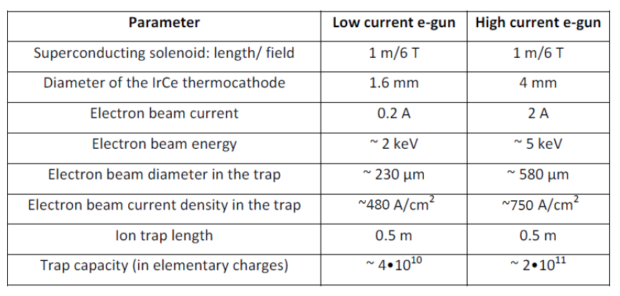
Main Parameters of CARIBU EBIS Charge Breeder
(q/A) ≥ 1/7 at CB output
Warm bore superconducting solenoid
Low-current e-gun to study efficiency gain at shell closures
BNL Test and RHIC EBIS were used as prototypes

Slide 5
Sources of Beam Contamination in EBIS/T CB
Residual gas atoms and molecules
Evaporated atoms of e-gun cathode, cathode heater and surrounding elements
Electron beam induced desorption from collector walls
Highly-charged ion induced desorption from drift tube walls
Only the first source of contamination is relatively easy to control.

Slide 6
How to Purify Charge-bred Ion Beam?
Separation of different species in LEBT (ATLAS LEBT - two 90° bending magnets, mass separation is about 500)
Separation in linear accelerator? No, typical mass separation less than 100 (ATLAS linac doesn’t provide further purification)
Choose q/A of charge-bred rare isotope with the lowest intensity of surrounding background within LEBT resolution – easy to implement for EBIS CB by changing breeding time
Residual pressure in the trap should be as low as possible to minimize background, although in many cases it can be not the main source of local contamination

Slide 7
Vacuum System of CARIBU EBIS CB
Similar to BNL RHIC EBIS:
TMP and cryopump on each side of the trap
Differential pumping between trap and heavily outgassing e-gun and collector chambers
Additional features:
Drift tubes with longitudinal slots to enhance trap vacuum conductance
NEG coating of trap supporting tube

Slide 8
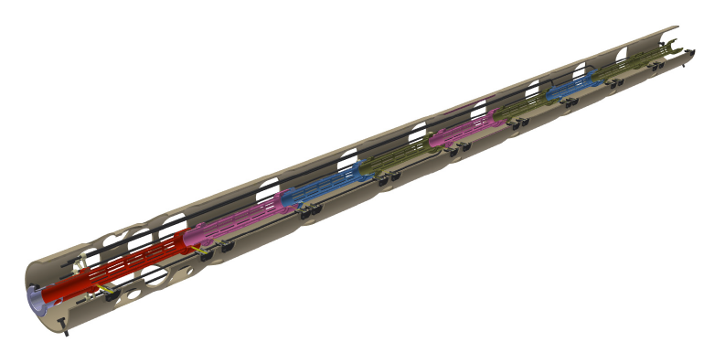
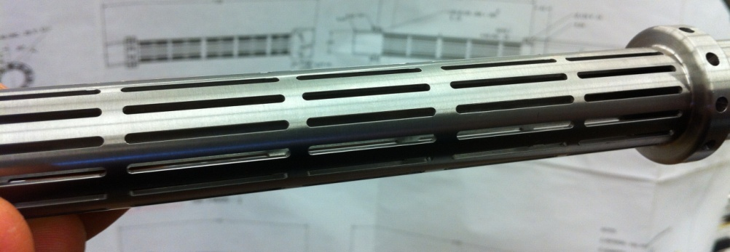
CARIBU EBIS CB Drift Tube Structure
Openings for pumping
Potential leads (SS roads, Ø 3 mm)
Openings for potential leads
NEG coating
Drift tubes with longitudinal slots
Supporting tube (scaffold)

Slide 9
Number of Residual Gas Ions Inside CARIBU EBIS CB Trap
Number of atoms/molecules ionized within 30 ms breeding cycle ~ 2·10⁸ for residual gas pressure in the trap ~ 10⁻¹⁰ mbar
Trap capacity (for 2 A electron beam) ~ 10¹¹ elementary charges
Ratio of total charge of residual gas ions to trap capacity is independent on electron beam current, if electron beam current density in the trap is the same
Degree of trap neutralization by residual gas ions is less than few percent already at trap pressure ~ 10⁻¹⁰ mbar
Residual gas ions are a major part of charge-bred beam at trap pressure ~ 10⁻¹⁰ mbar
Trap pressure ~ 10⁻¹² mbar is required for the most intense rare isotopes to become a major part of the beam

