Slide 1

Ion Heating and Cooling in an EBIT or EBIS
Ross Marrs
Lawrence Livermore National Laboratory
HIE-EBIS Workshop
CERN
16-17 October 2012
LLNL-PRES-590713

Slide 2

Three mechanisms for ion heating
Electron beam heating by single-particle Coulomb collisions
  (eV/s) j_{e} [A/cm²], E_{e} [eV],
  A = mass number, λ_{ie} ~ 15
Heating by radial contraction of the ion distribution
        Example: 10% decrease in radius increases ion temperature by 20%
        (Same equation as for compression of an ideal gas or conservation of emittance)
  Important for high-emittance ions injected at large radius
  Ion radius contracts with increasing charge state
  Not important for steady state (EBIT) operation
Heating by plasma instabilities
  Dominant heating rate if it occurs

Slide 3
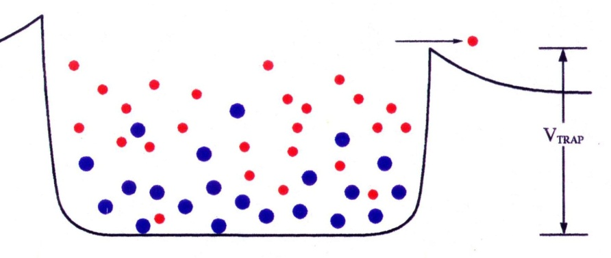
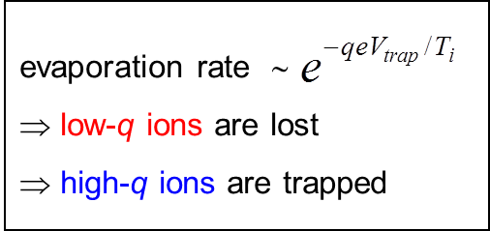
Ion heating requires ion cooling for high charge state production
Electron beam heating rate ∼ q² Ionization cross section ∼ 1/q²
Ion temperature exceeds electron beam space-charge potential for high charge states
Production of charge states of roughly 50+ or greater (depending on machine parameters) is impossible without ion cooling
Evaporative ion cooling is used (either by design or by accident) to achieve the production and retention of very high charge states
Loss rate depends exponentially on ion charge
Thermal equilibrium ⇒ T_{i} ≈ 0.1qeV_{trap}
The axial trap potential controls the ion temperature and radial distribution of ions within the electron beam

Slide 4
Ion-ion energy exchange
Energy exchange among ions is determined by the ion-ion collision rate
  (s⁻¹) n_{i} [cm⁻³], T_{i} [eV],
  A = mass number, λ_{i} ~ 9
Ion-ion energy exchange is usually the fastest rate in the trap – faster than ion heating, ion evaporation, and high charge state production
  Highly charged ions are all at the same temperature
  Low charge ions gain energy quickly from highly charge ions and are not far behind in temperature
Rapid ion-ion energy exchange enables light-ion evaporative cooling of highly charged ions

Slide 5
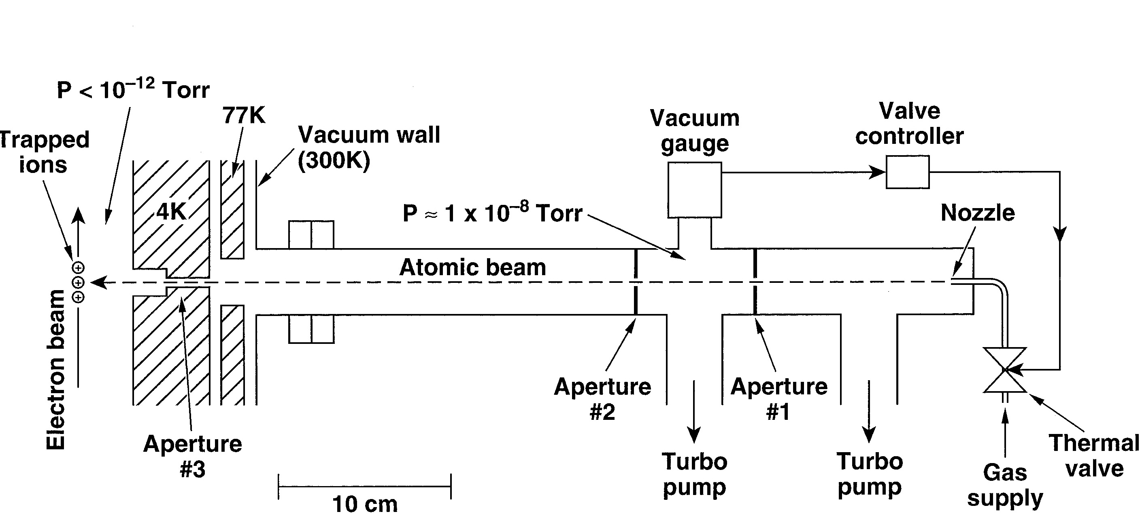
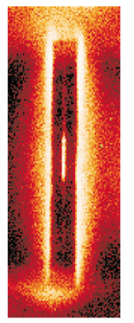
LLNL Super EBIT cooling-gas injector
A beam of neutral atoms (usually neon) is produced by differential pumping and collimation
Neutral atomic beam crosses electron beam in trap center
Best performance is achieved when all x-ray ports are covered by beryllium windows at 4 K to minimize background gas density in the trap
Neon is a good choice for cooling: atomic number is about right, chemically inert, small charge exchange recombination cross section

Slide 6
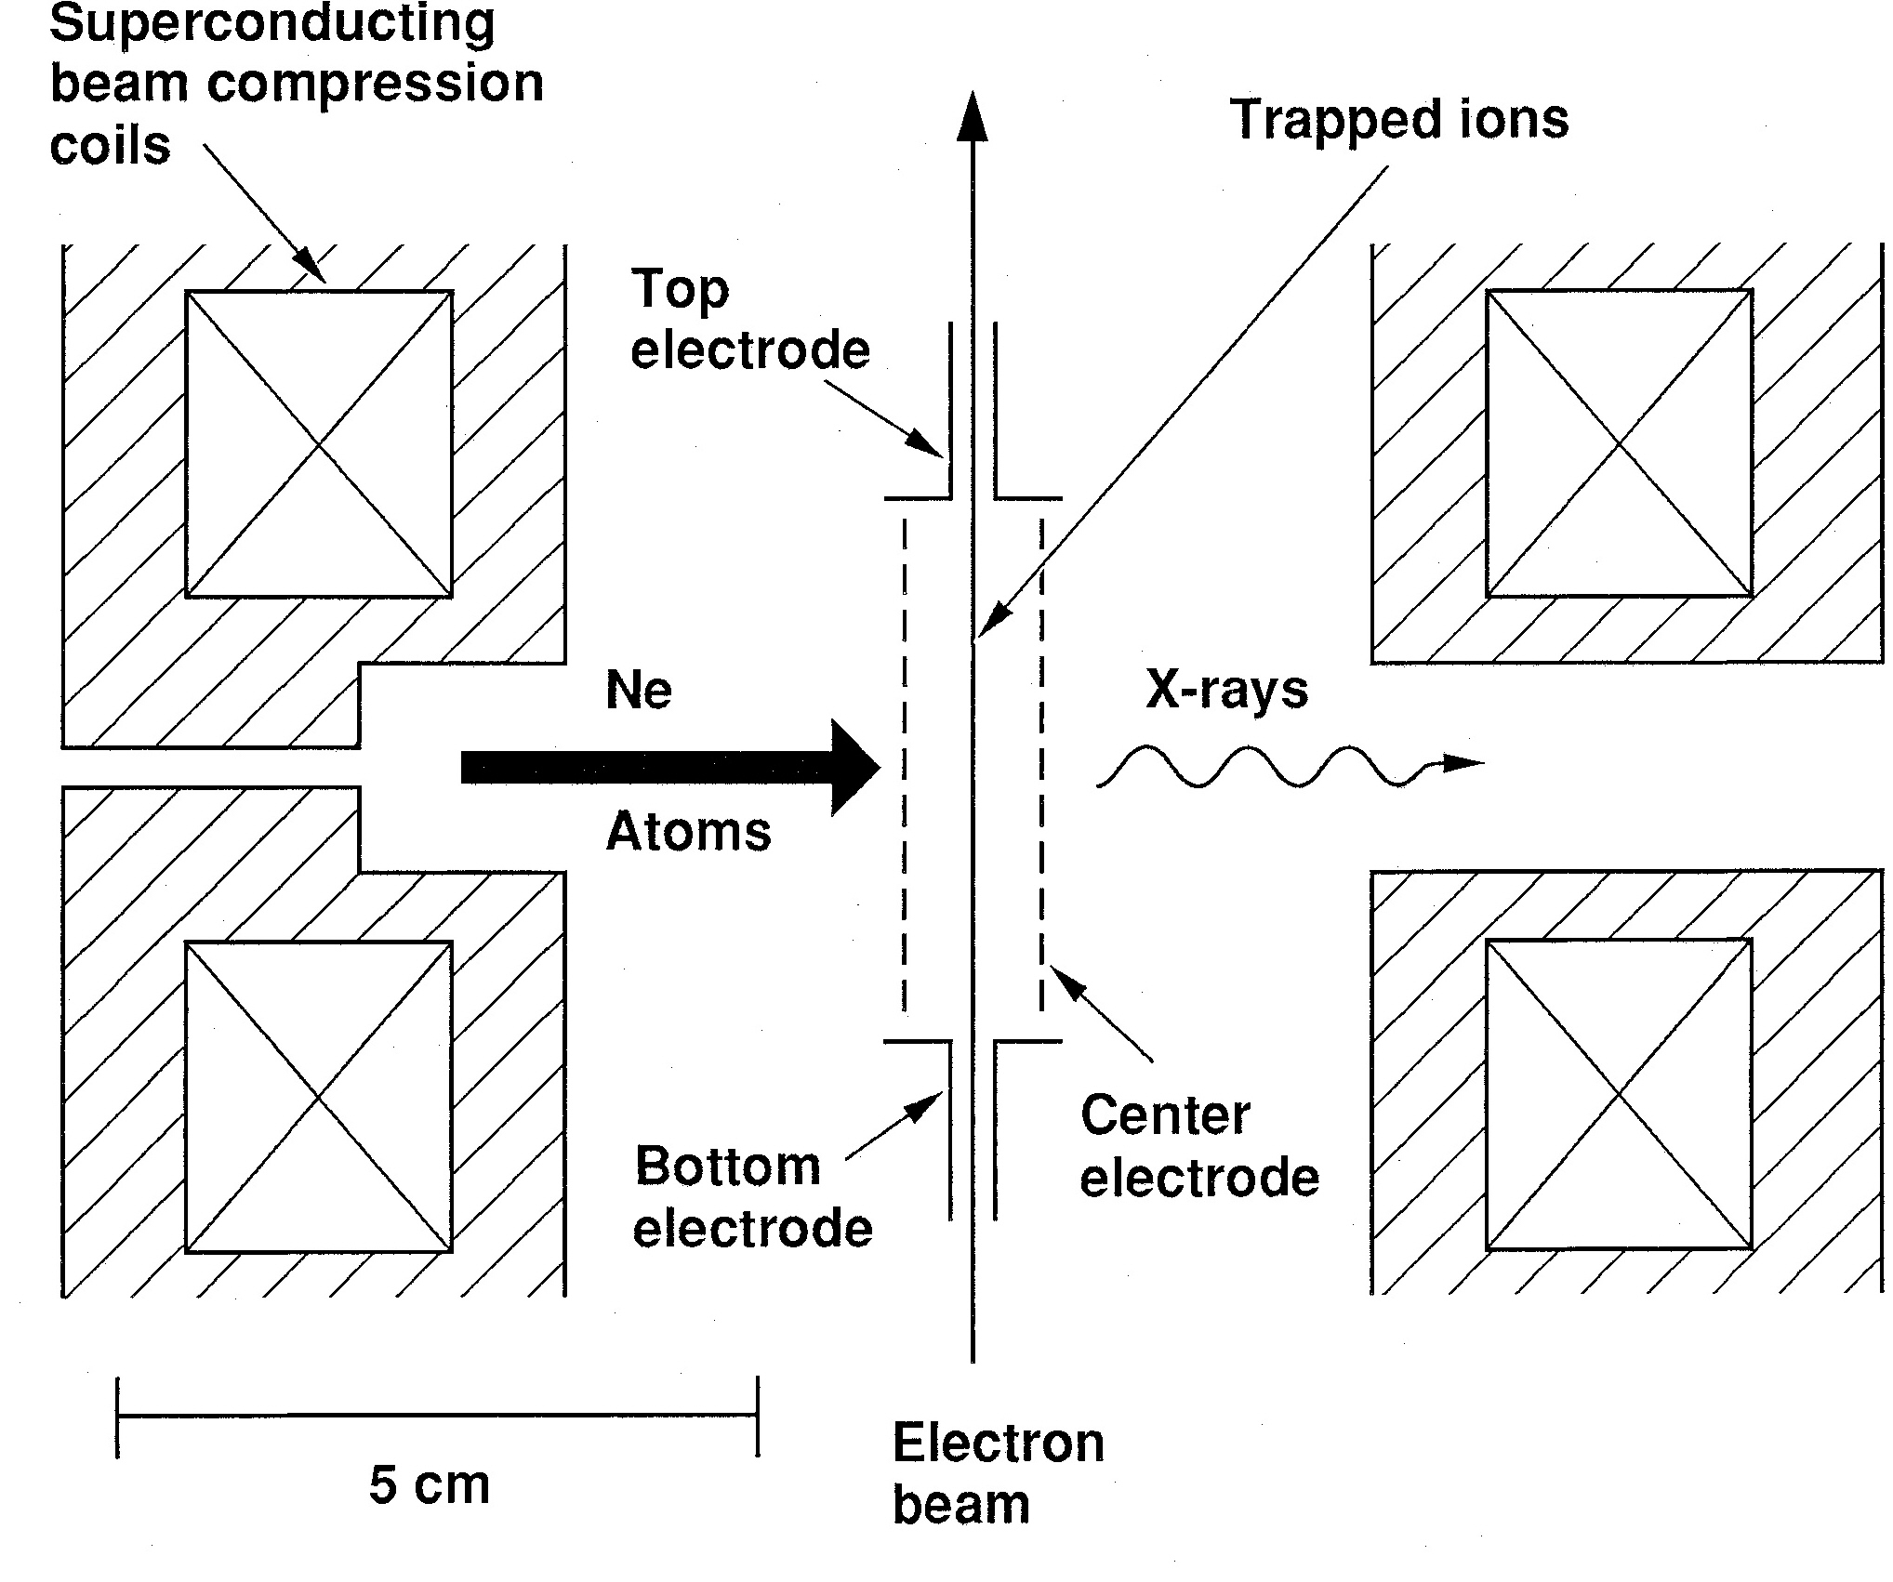
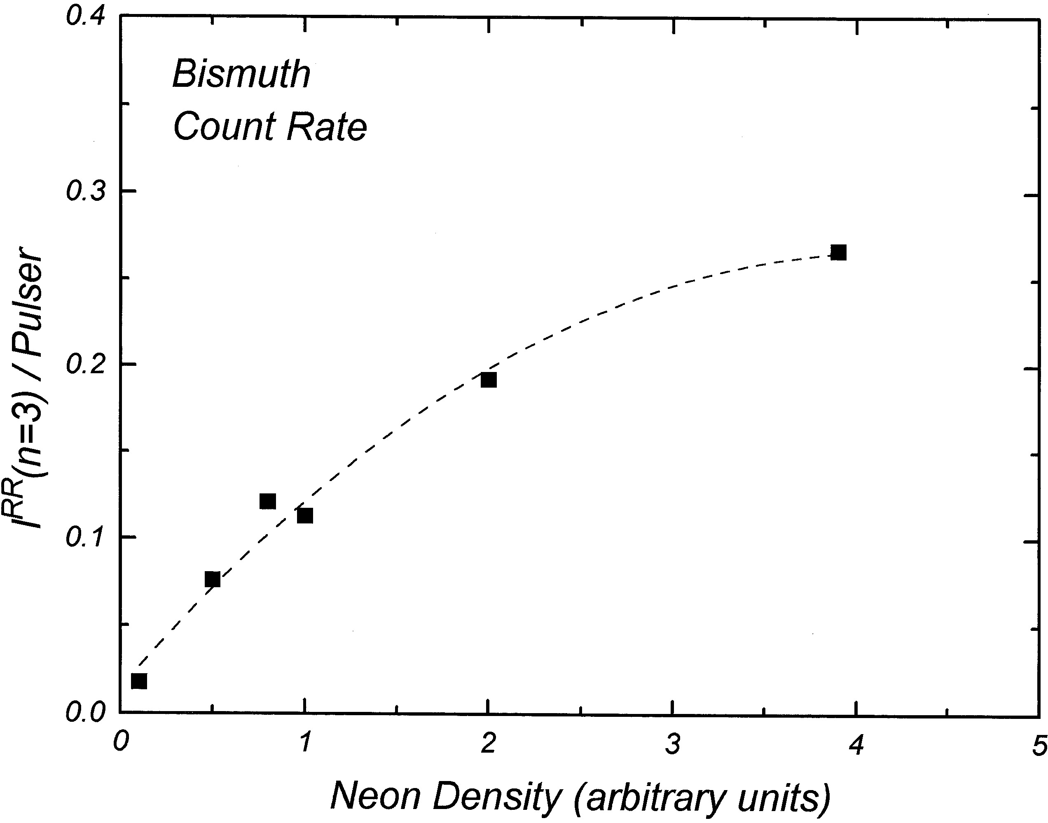
Injection of low-Z cooling gas controls high-Z ion inventories
Neutral neon atoms are injected radially through an aperture in the 4 K magnet bobbin
Some neon atoms are ionized and captured in the electron beam
The trap is filled with a single injection of low-charge bismuth
The amount of highly charged bismuth retained in the trap is controlled by the amount of neon cooling
Data with a clean trap confirms that the number of high-charge ions retained in the EBIT electron beam is roughly proportional to the injection rate of low-Z cooling ions

Slide 7
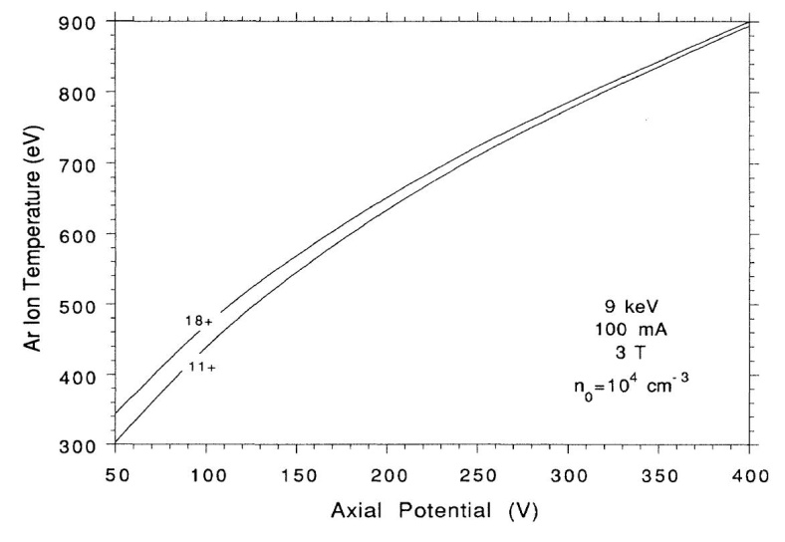
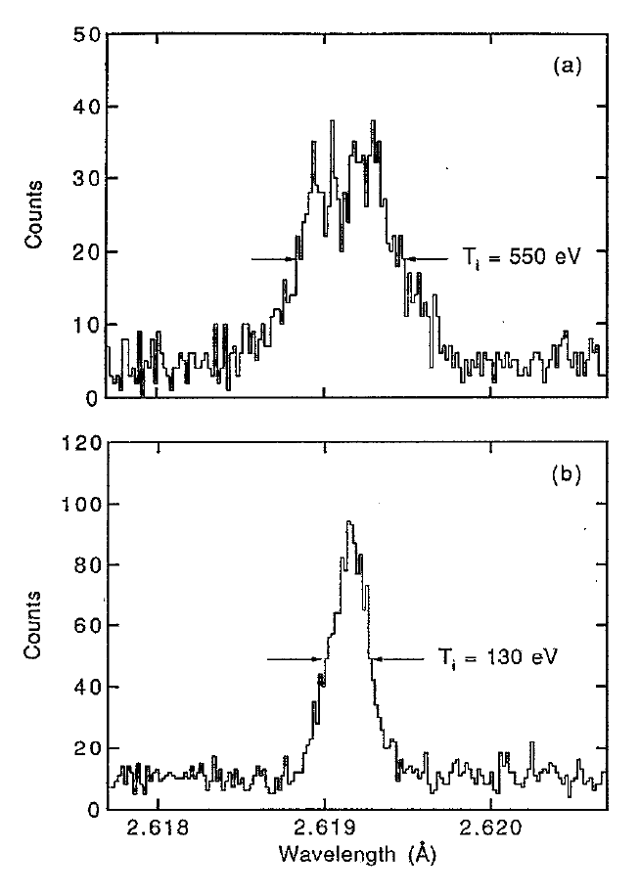
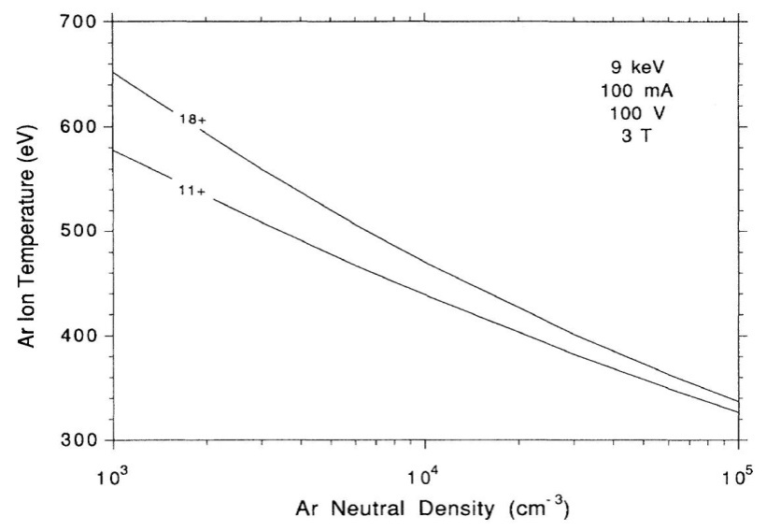
Measurements and detailed computer models support our understanding of ion thermal processes
Computer model of steady-state argon ion temperature
Measured He-like Ti²⁰⁺ Doppler-broadened x-ray line width
Deep axial trap
High ion temperature
Shallow axial trap
Low ion temperature
B. Penetrante et al., PRA 43, 4861 (1991)
P. Beiersdorfer et al., RSI 66, 303 (1995)

Slide 8
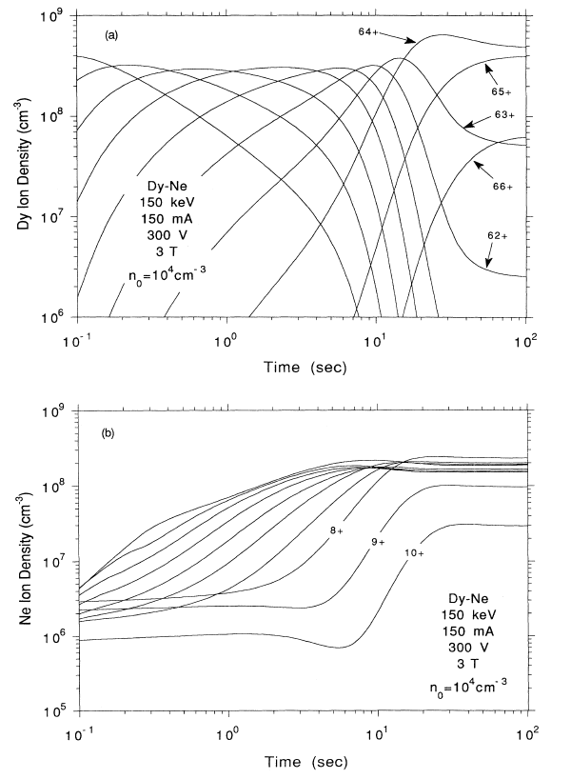
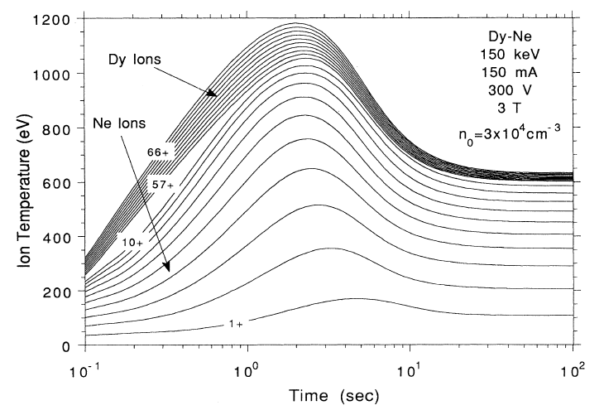
Computer model of charge-state evolution for neon-cooled dysprosium
Predicted evolution of charge states of Dy (Z=66) and Ne (Z=10) in the LLNL Super EBIT following injection of low-charge dysprosium ions
  Calculation uses a 300-V axial trap potential that produces a hot ion distribution
Calculation includes electron ionization and recombination, charge exchange recombination, ion heating, energy exchange, and escape
B. Penetrante et al., PRA 43, 4873 (1991)

Slide 9
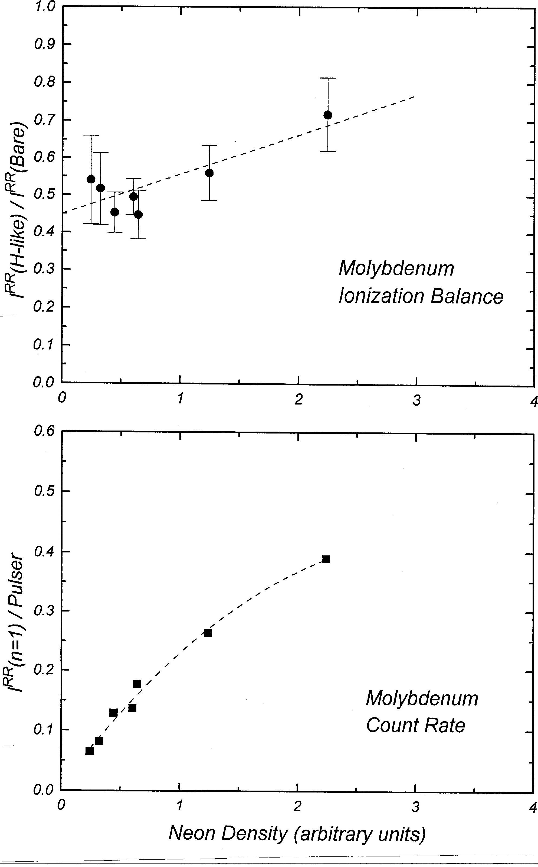
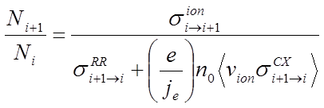
It is possible to have good cooling (i.e., high count rate) and good ionization balance at the same time
Several operating parameters can be adjusted to optimize conditions for specific measurements
  Cooling gas density
  Axial trap potential
  Electron beam current and density
We are lucky that the ratio of cross sections for electron impact ionization and charge exchange recombination is sufficient for production of high-charge-state ions

Slide 10
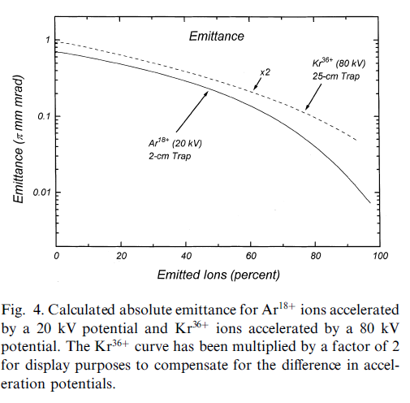
Strong self cooling during ion extraction
Strong self cooling is enabled by a favorable ordering of the time scales for ion-ion energy exchange, ion evaporation, and ion extraction
  Does not occur in all devices, but could be achieved in advanced charge breeders
  Produces extremely low emittance and high brightness
Example: Kr³⁶⁺ ions in an advanced breeder, extracted by lowering the axial barrier at a rate of 25 volts/ms
Time (ms) | Trap potential (V) | Remaining ions (10⁸) | Emittance (π mm mrad) | Brightness (10⁹ ions per mm² mrad² s)
-12 | 300 | 2.0 | 0.46 | 0.96
-1.2 | 30 | 0.87 | 0.12 | 6.0
-0.4 | 10 | 0.53 | 0.065 | 13
-0.12 | 3 | 0.28 | 0.036 | 22
-0.04 | 1 | 0.15 | 0.025 | 24
0 | 0 | 0 | -- | --
From R. E. Marrs, NIM B 149, 182 (1999)

Slide 11
Electron-ion two stream instability: a possible big heating mechanism
Effect of electron-ion two stream instability is to convert free energy of the electron beam into ion thermal energy
Heating power is much greater than for single particle electron-ion collisions
  Two-stream instability could prevent successful charge breeding if it occurs
Growth rate calculated by: C. Litwin, M. C. Vella, and A. Sessler, NIM 198, 189 (1982)
                where
                (f = space charge neutralization fraction, φ = electron-ion overlap factor)
                Instability is avoided if either condition (1) or (2) holds
                (1) [A, keV, cm]
                (trap length is less than
                ~3 growth lengths)
                (2) where [A, keV]
                (Debye length is larger than electron beam radius)

Slide 12
Electron-ion two stream stability for a few devices
 | Parameters |  |  |  |  |  |  | Stability criteria
Device | I_{e} (A) | j_{c} (A/cm²) | j_{e} (A/cm²) | T_{e} (eV) | E_{e} (keV) | L (cm) |  | j_{e} j_{e}(max) | r_{b} / λ_{D} | stable
LLNL EBIT | 0.15 | 2.2 | 4 x 10³ | 190 | 10 | 2 |  | 0.6 | 0.7 | yes
LLNL Super EBIT | 0.15 | 2.2 | 4 x 10³ | 190 | 150 | 2 |  | 0.01 | 0.4 | yes
REX-ISOLDE EBIS | 0.2 | 10 | 200 | 2 | 5 | 80 |  | 140 | 9.3 | no
RHIC EBIS | 10 | 15 | 500 | 3.3 | 25 | 150 |  | 110 | 34 | no
MSU EBIS | 1.5 | 4 | 1 x 10⁴ | 250 | 30 | 80 |  | 460 | 1.5 | ?
LLNL Intense EBIT | 5 | 4 | 1 x 10⁵ | 2500 | 30 | 25 |  | 450 | 0.8 | ?
T_{e} = 0.1 eV x j_{e} / j_{c} j_{e} (max) calculated for f = 0.3, φ = 0.5, q/A = 0.3
Short length, high electron energy, and high beam compression (i.e., electron temperature) are good for avoiding the electron-ion two stream instability

Slide 13
Summary
Heating of trapped ions by single particle Coulomb collisions with beam electrons is proportional to q² and produces ion temperatures that exceed the space charge potential of the electron beam before the highest charge states can be produced
Evaporative ion cooling (by design or accident) is required for the production, retention, and emittance reduction of very highly charged ions
Successful ion cooling was achieved in the LLNL Super EBIT with:
Low background gas density -- Drift tubes are at 4 K and have minimal openings that view room temperature surfaces
Controlled crossed-beam injection of neutral neon atoms for evaporative cooling
Use of the axial trap potential to adjust ion temperature and electron-ion overlap

Slide 14
Backup slides

Slide 15
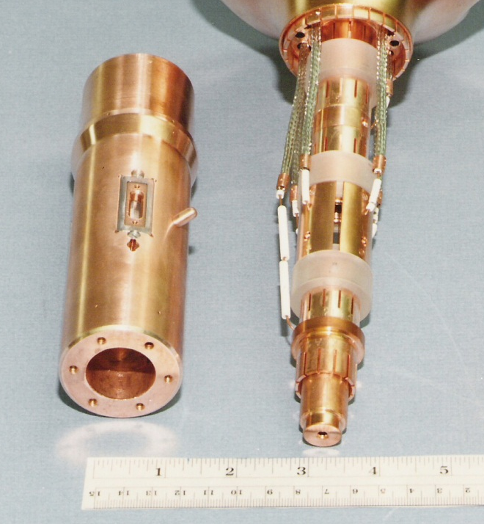
Charge-exchange recombination with neutral gas destroys high charge states
Destruction rate is
  The cross section is enormous: σ^{cx} ∼ 2 × 10⁻¹⁴ cm² for q = 50+ and neutral neon
Neutral gas density must be very low ( ∼ 10⁻¹² Torr equivalent pressure or less) to avoid destruction of high charge states
Several features of the EBIT design were
chosen to minimize neutral gas in the trap
  Trap electrodes at 4 K with small
  beam entrance and exit holes
  Beryllium x-ray windows at 4 K
  Collector cooled by liquid nitrogen

Slide 16
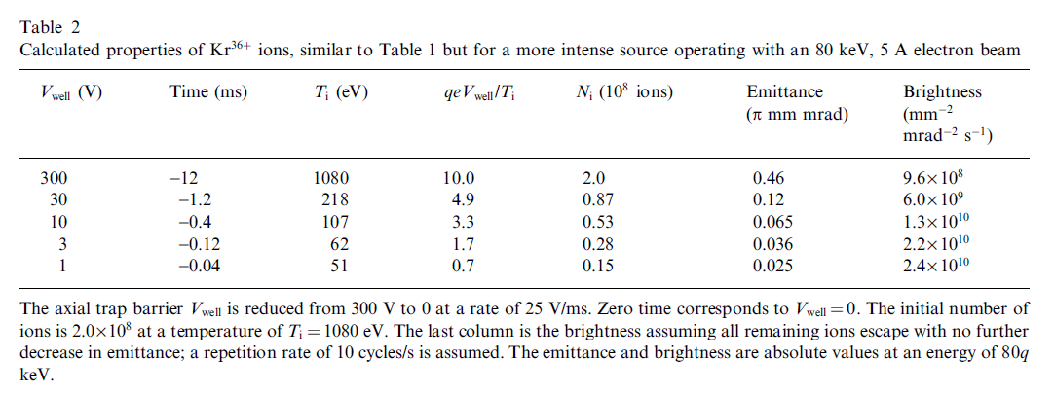
Strong self cooling during ion extraction

Slide 17
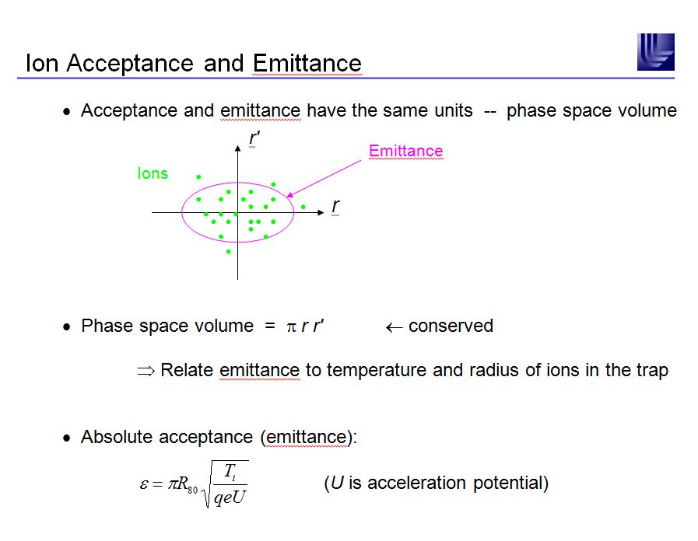

Slide 18
