Slide 1
WATCHMAN: A Field Demonstration of Remote Reactor Monitoring
Adam Bernstein for the WATCHMAN Collaboration
This work was performed under the auspices of the U.S. Department
of Energy by Lawrence Livermore National Laboratory under contract
DE-AC52-07NA27344. Lawrence Livermore National Security, LLC
Global reactor antineutrino fluxes
Simulation courtesy G. Jocher/J Learned, U Hawaii

Slide 2
Outline
A one-page nonproliferation tutorial
Antineutrinos and nonproliferation
The WATCHMAN project
The apparently unique advantages of the Boulby Mine
Nonproliferation, Technology and Fundamental Science

Slide 3
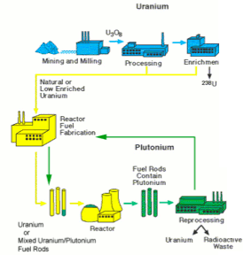
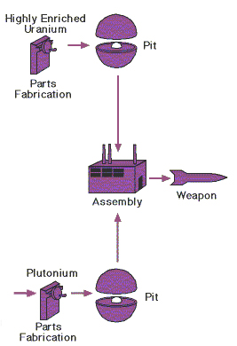

The IAEA Safeguards regime monitors the flow of fissile material through the nuclear fuel cycle in 170 countries
Generic fuel cycle
Weapons production
t
IAEA goal – detect diversion
of fissile material from peaceful
to military programs
Goal for antineutrino measurements -
track fissile inventories in operating reactors

Slide 4
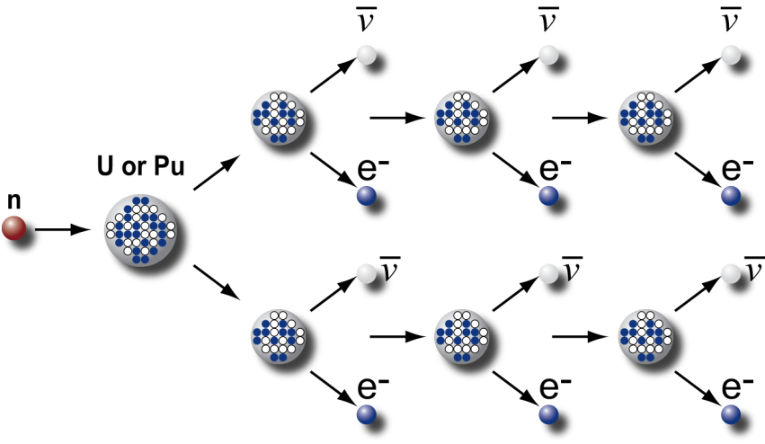
Monitoring nuclear reactors with antineutrinos
Reactors emit huge numbers
of antineutrinos
Detected rates are quite reasonable
6 antineutrinos per fission from beta decay of daughters
10²¹ fissions per second in
a 3,000-MWt reactor
10¹⁷ antineutrinos per square meter per second at 25-m standoff
6,000 events per ton per day with a perfect detector
600 events per ton per day with a simple detector
(e.g., SONGS1)
About 10²² antineutrinos are emitted per
second from a typical PWR
unattenuated and in all directions
Example: detector total footprint with
shielding is 2.5 meter on a side at 25-m
standoff from a 3-GWt reactor

Slide 5
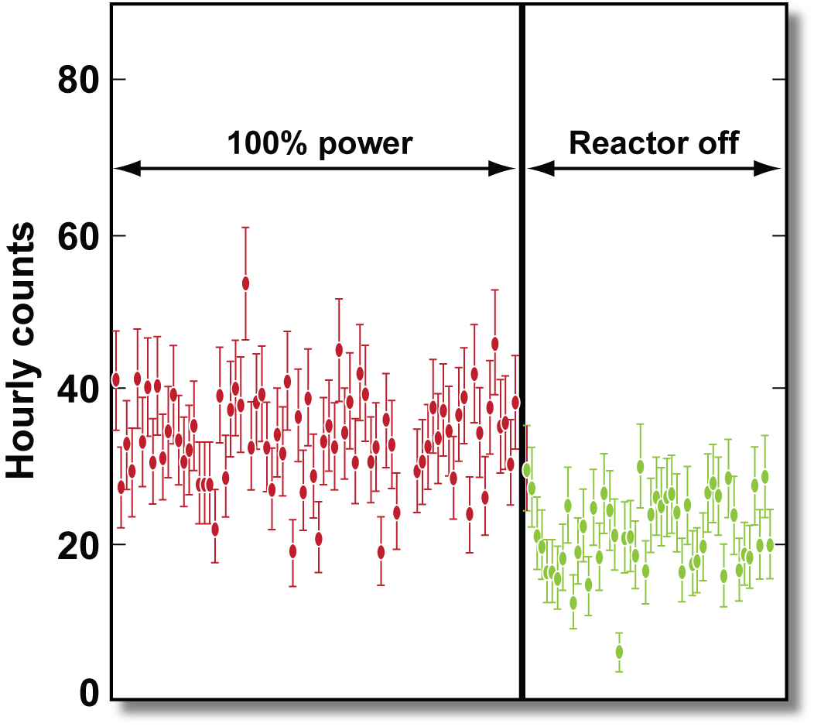
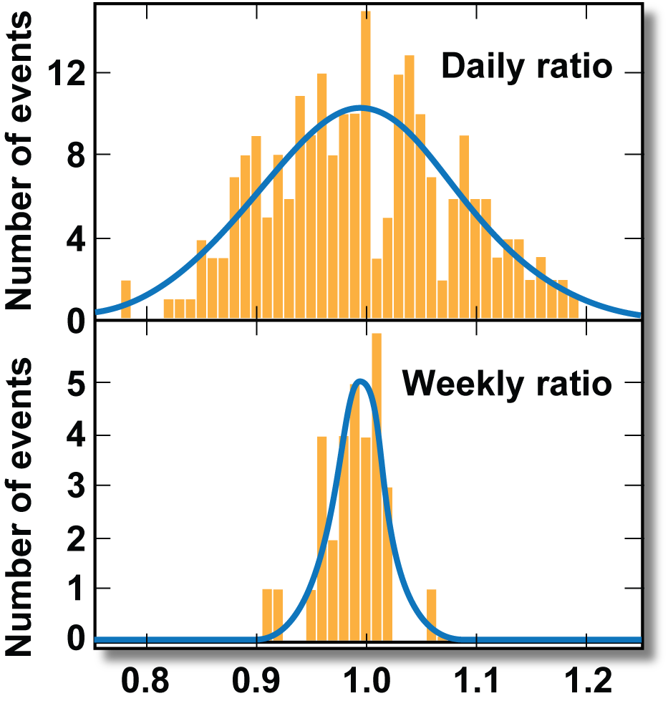
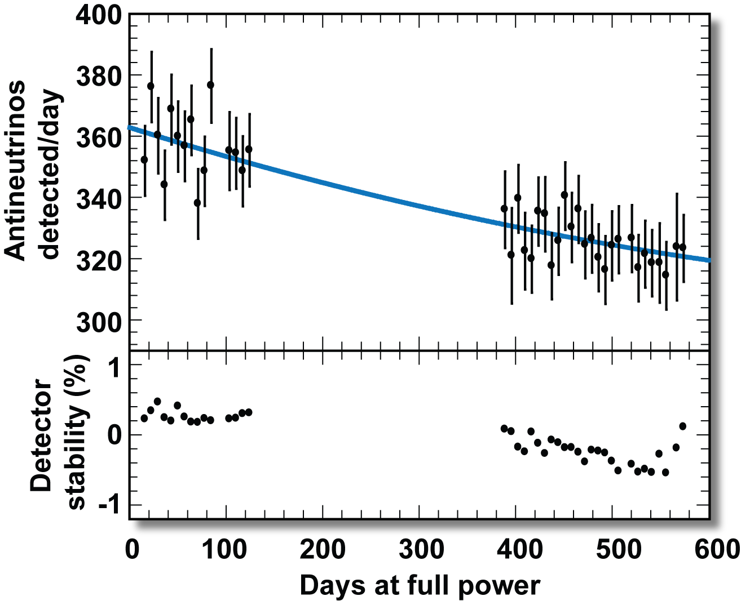
Our LLNL/SNL collaboration has helped create the field of applied antineutrino physics for nonproliferation
Determine reactor on/off status
within 5 hours with 99.9% C.L.
Measure thermal
power to 3% in one week
Sensitivity to 70 kg switch in U/PU:
known power and initial fuel content
In 2012, IAEA released an official report endorsing continued research into
several reactor monitoring applications – including long range reactor monitoring

Slide 6
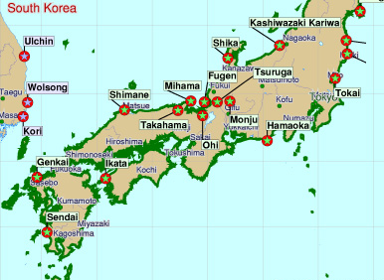
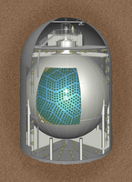
Cross-border reactor monitoring is going on right now – but only for GWt reactors and with a technology that is difficult to scale
~3% of signal from South Korean reactors
@ 400 km standoff
The KamLAND detector
Per month:
16 reactor antineutrinos
1 background event
From 130 GWt of reactors
1000 tonnes scintillator
1000 m depth

Slide 7
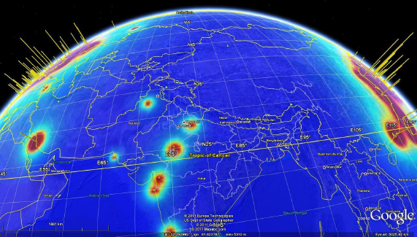
10 MWt reactors at a distance are a very hard problem
Goal | Detector mass | standoff | Required reduction in bg rate relative to KamLAND
16 events in 1 year from a 10 MWt reactor, ( 25% accurate thermal power) | 10 kiloton | ~40 km | 10x
 | 1 Megaton | ~400 km | 100x
http://arxiv.org/abs/0908.4338
Science & Global Security, 18:127–192, 2010
Gadolinium-doped (light) water
appears to be the most viable
option for scaling to the largest
sizes
Global reactor antineutrino fluxes

Slide 8
Advantages of antineutrino detection for remote discovery and monitoring of reactors
  Cross border detection – ultimate limit is perhaps ~800 km
  Continuous surveillance
  Constraints on power and plutonium production rate
  With long range capability, no cueing information required
  Eventually: Reactor localization with improved directionality or spectral measurement
My own guess at the most likely use: cooperative deployment to
confirm absence of reactors in a prescribed wide area
8

Slide 9








The WATCHMAN (Water Cherenkov Monitor for Antineutrinos) Collaboration
UC Davis
UC Berkeley
UC Irvine
Virginia Tech.
U of Hawaii
Hawaii Pacific
University
Current Phase: Two U.S. National Laboratories, 6 Universities, 4 M$, 2.25 years

Slide 10
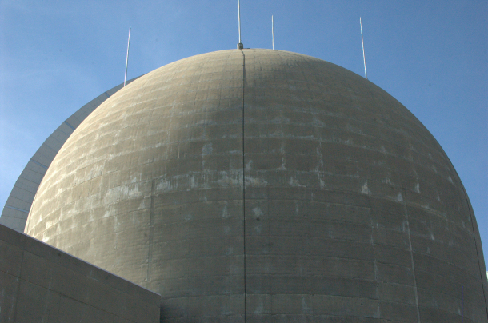
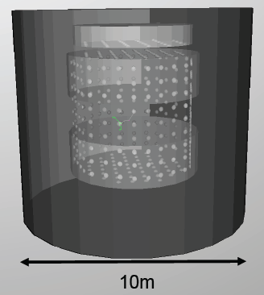
WATCHMAN is now in its first phase in the United States
Overall Project Goal: demonstrate sensitivity to reactor antineutrinos using a gadolinium-doped (light) water detector at 0.1-1 kilometer standoff from a 10-150 MWt US research reactor, or 10-20 kilometers from a 3000 MWt scale US commercial power reactor.
//
0.1 - 25 km standoff
Research or power reactor
//
100-1000 meters overburden
First Phase, 2012-2014:
identify site
measure backgrounds
develop a design envelope for the detector
Kiloton scale detector

Slide 11
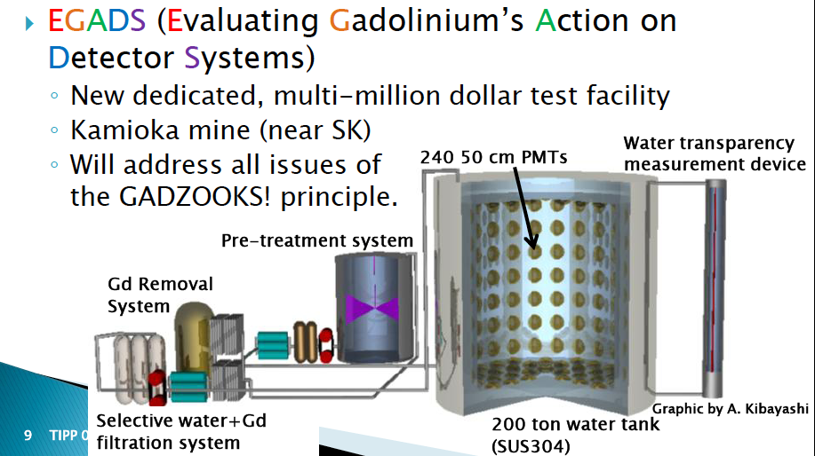
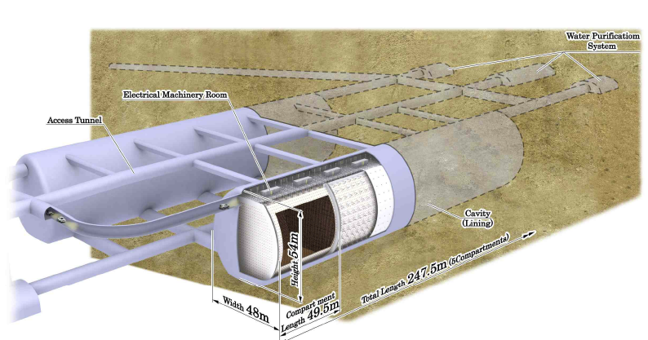
Complementary activities worldwide (OK mostly in Japan)
EGADS- 200 ton deeply buried detector
to evaluate Gd-doped antineutrino detection
  backgrounds
  materials
  energy thresholds
This detector volume is too
small for direct demonstration of sensitivity
- HyperKamiokande
560,000 ton multipurpose water detector being planned by Japan
Time scale: ~12 years
Interest in U.S. science community in participation will lead to further R&D in this area
Gd an option but not guaranteed
Our demonstration would give strong confidence for exercising the Gd option

Slide 12
Antineutrino signal and background
Backgrounds:
Real antineutrinos
Random event pair coincidences
Muon induced high energy neutrons
Long-lived (~ 1 sec) radionuclide decays
Signal in 1 kiloton of water
511 keV
511 keV
e⁺
ν_{e}
p
μ
n
Gd
Σγ ~ 8 MeV
τ ~ 30 μs
prompt e⁺ signal + n capture on Gd
n
(100-200 MeV)
n
n
β
⁹Li
μ
Exactly two Cerenkov flashes
within ~100 microseconds
Within a cubic meter voxel
‘The antineutrino heartbeat’

Slide 13
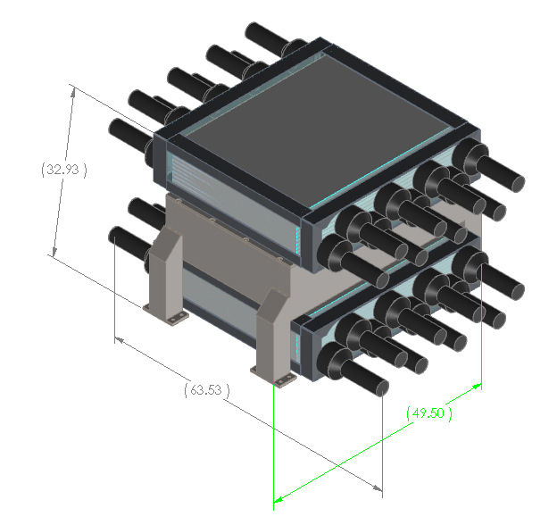
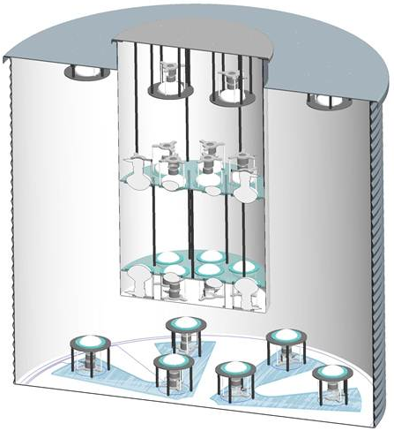
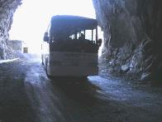
Step 1: What are the backgrounds ?
Shallow Depths (100-600 meters): not well known, measure as a function of overburden at a US facility (Kimballton)
Boulby: (1 km) reasonable extrapolations from past and ongoing experiments (KamLAND, Soudan mine water detector)
high energy neutron
spectrometer
radionuclide detector
(Water doped with gadolinium)

Slide 14
Step 2: Choose a location
Detect as few as ~1 but no greater than 10 signal events per day.
Three sigma detection of the presence of the reactor in <~1 month.
  For 1 signal event per day → tolerable background is 2 events per day.
  Greater standoff can be compensated by greater overburden
Overburden:
  Existing overburden preferred (cost savings)
Reactor Power:
  A small reactor is preferred, (greater similarity with the ultimate intended use)

Slide 15
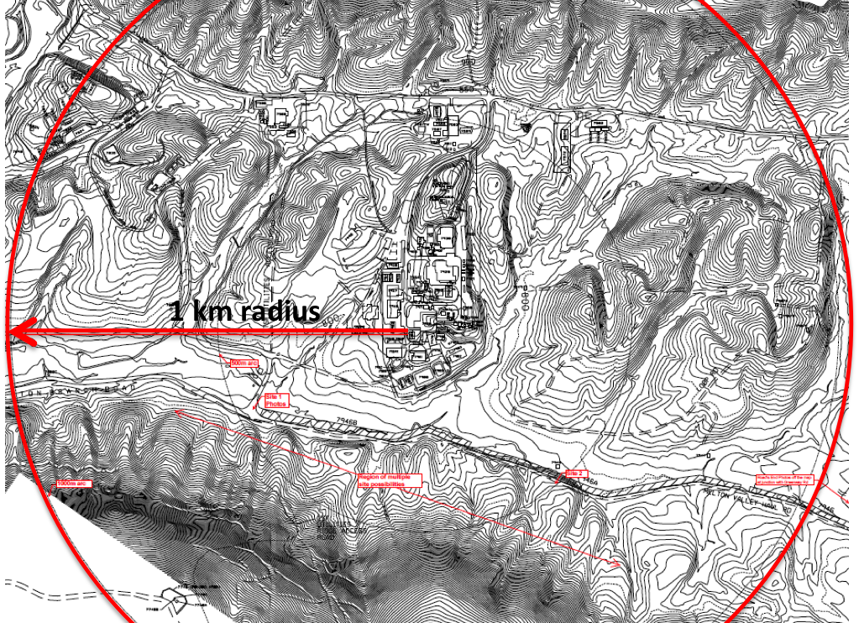
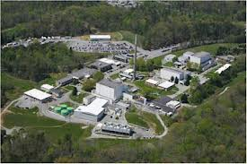
A shallow site: Oak Ridge High Flux Isotope Reactor, 100 m depth
1000 ton det. target mass
Power = 85 MWth
S = 13 events per day
B = 164 events per day
10 days ON and OFF to detect
@ 3 sigma
Main problem: excavation costs are high

Slide 16
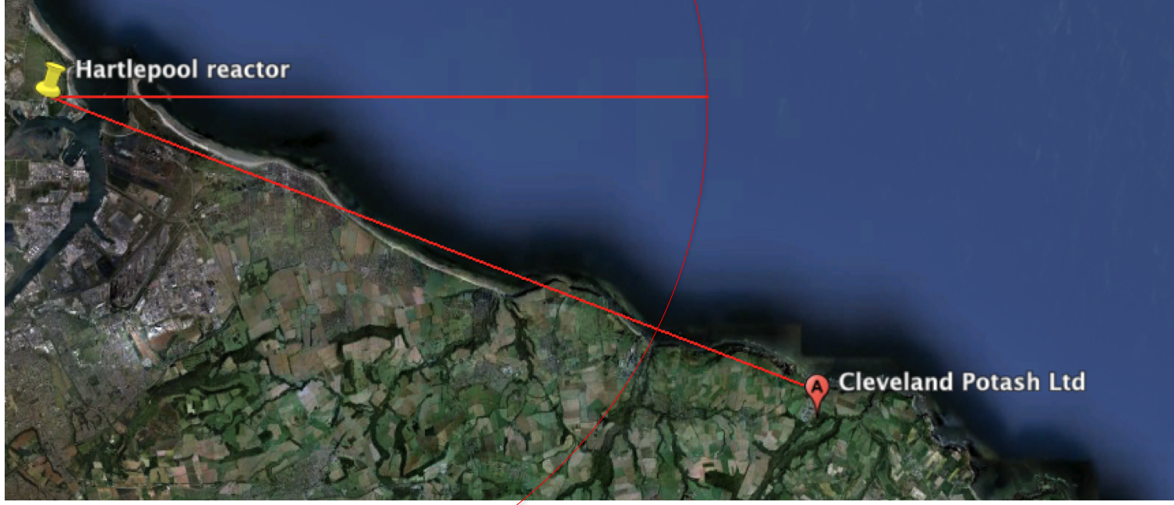
A deep site: the Boulby mine, 1000 meter depth
1000 ton detector target mass
Power = 1570 MWth (2 cores)
S~B = 0.9 events per day
20 days (ON and OFF) to detect @ 3 sigma
20 kilometer radius
25 kilometer radius
(S = 0.7 events per day)
30 days
16

Slide 17
Why is Boulby an interesting site ?
Event rate meets our detection goal
Depth suppresses most backgrounds
Relatively large standoff provides a convincing demonstration
Mature, well-run, well supported underground science infrastructure
Excavation costs lower than ‘greenfield’ options
Recent mine activity allows for larger cavern (15x15x15 m)
International cooperative deployment underscores and reinforces nonproliferation commitments of all participants
World-class science and a path towards very large detectors
17

Slide 18
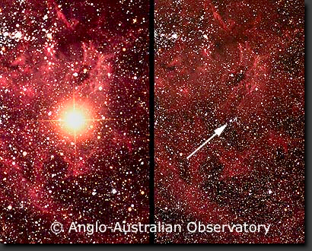
A shot of the scientific bow: WATCHMAN will also be one of the world’s largest supernova watch detectors
A 1000 ton detector even with moderate overburden (few 100 m.w.e.) could detect ~700 events from a supernova at the galactic center. Any detector capable of detecting reactor antineutrinos can do this by default (SN antineutrinos are higher energy and easier to detect).
Pre-1987
1987
WATCHMAN would see antineutrinos from a supernova like 1987a, shown here in the visible

Slide 19
Nonproliferation, Technical and Scientific objectives are all met with this proposal
Nonproliferation
Technology
Fundamental Physics
First ever demonstration of sensitivity to reactor antineutrinos at appreciable standoff from a reactor using a gadolinium-doped water detector – probably the only scalable technology choice
A concrete example to policy makers of a reliable low event rate antineutrino-based measurement system, with unambiguous detection of only a few events per day
Detection efficiencies and backgrounds for large Gd-WCD detectors
Well-benchmarked detector and background simulation tools
Experience with gadolinium-doped water handling, purification monitoring in order to scale to next generation experiment
Now:
Core-collapse supernovae in this galaxy
Eventually ?
Megaparsec supernovae detection
Diffuse supernova neutrino detection
proton decay
long baseline neutrino CP phase and mass-hierarchy experiments
60 km standoff mass hierarchy measurements at reactors

Slide 20
Conclusions
Antineutrino detectors deployed a few hundred meters from reactors detect operational status, thermal power and Pu production
Attempts at the far more ambitious long-range capability are underway in both the nonproliferation and scientific communities
WATCHMAN aims to meet a nonproliferation need and become a source of interesting science and detector technology for the neutrino community

Slide 21
Backup slides

Slide 22

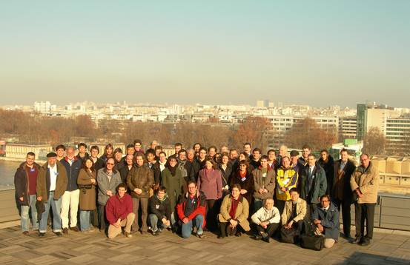



Applied Antineutrino Physics – a growing global community with strong ties to Dark Matter and Neutrino Science

Slide 23
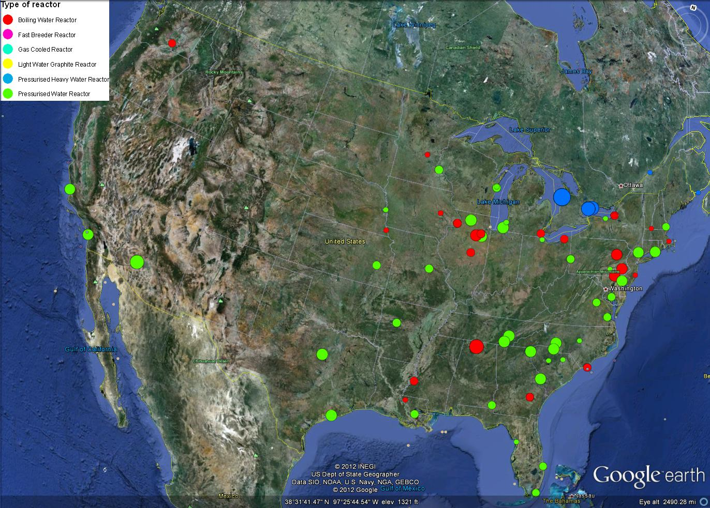
Map of US Power Reactors

Slide 24
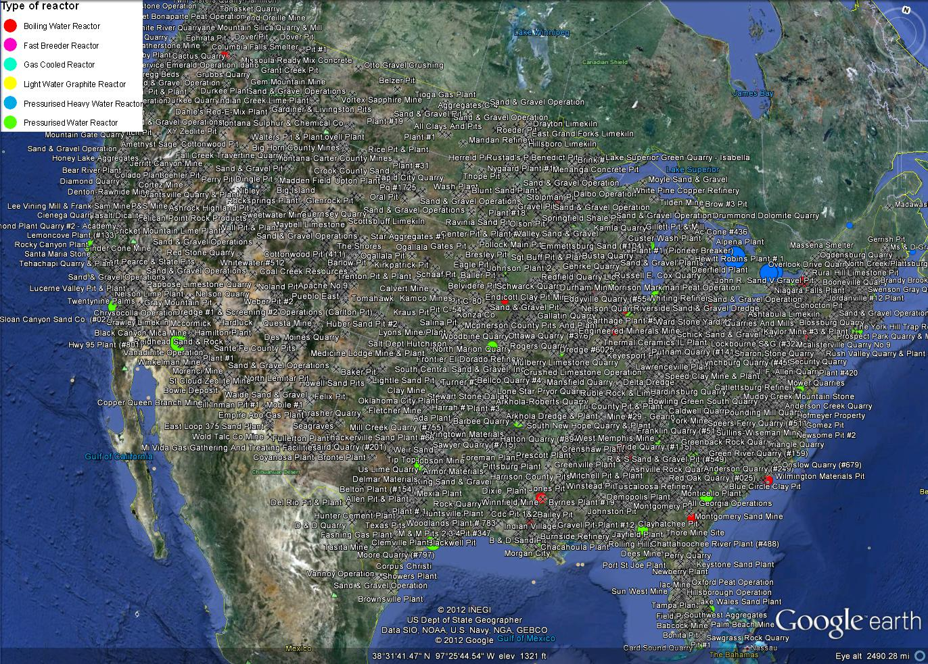
Map of US Reactors + Active Mines

Slide 25
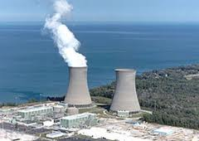
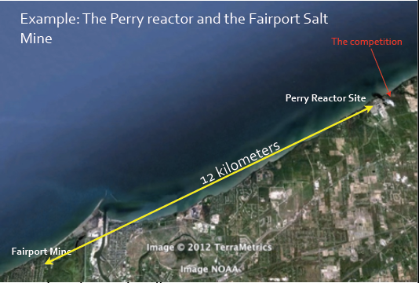
Perry Nuclear Generating Station
Perry Reactor Nuclear Generating Station to IMB cavern in the Fairport Salt Mine (Ohio)
1570 m.w.e.
cavity was 18m x 17m x 22.5m
~13 km standoff
3875 MWth
Pros
Existing cavern in active mine.
Large depth for low background.
Cons
Large stand-off will give low signal rate (0.5-1.0 per day).
Old cavern likely to require renovation.

Slide 26
What will we actually measure at shallow depths
The energy spectrum of muogenic fast neutrons as a function of depth below the Earth’s surface
  Allows us to model double-neutron antineutrino-like backgrounds in a kiloton scale detector
The rate of muogenic radionuclides such as 9Li
  Allows us to set an upper limit on the contamination of our signal by these antineutrino-like backgrounds

Slide 27
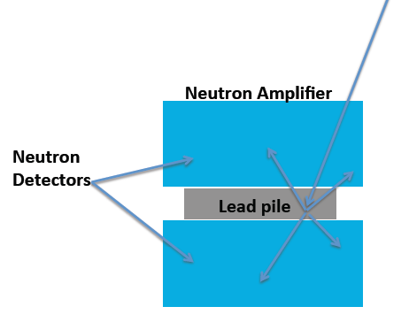
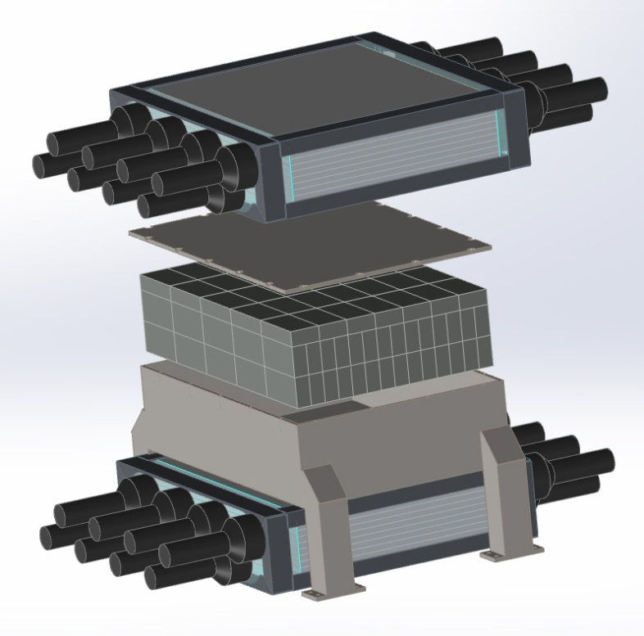
Fast Neutron Spectrometer
Plastic scintillator/Gd doped paint detectors sandwich ~4 tons of lead.
Direct interaction with scintillator for E < ~100 MeV.
Neutron multiplication off of the lead for E > ~50 MeV.
Expect 3000-5000 events per month at 100 m.w.e.

Slide 28
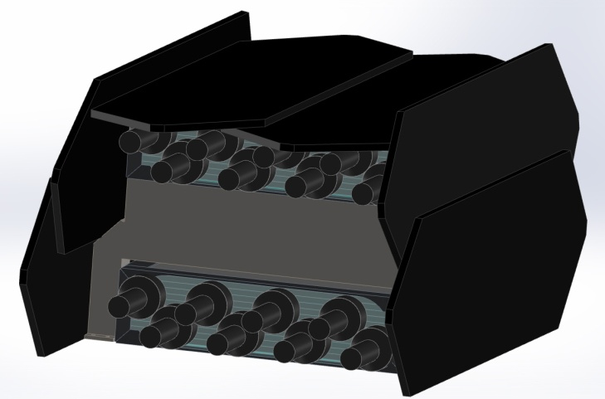
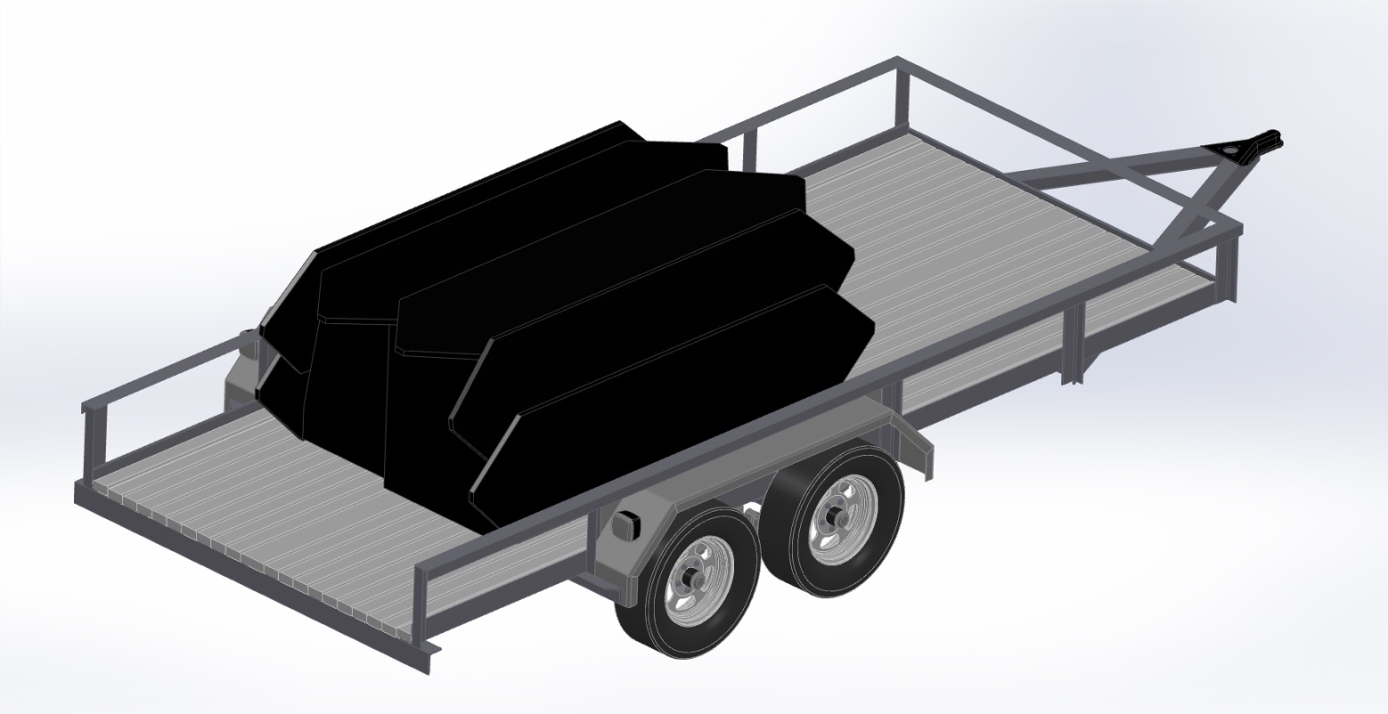
Fast Neutron Spectrometer – muon veto on platform
Detector + muon veto + data acquisition and peripherals are less than 9 tons.
Platform will be standard trailer outfitted with power and AC.

Slide 29
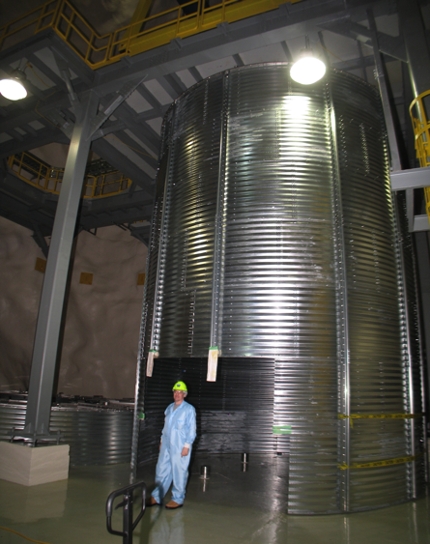
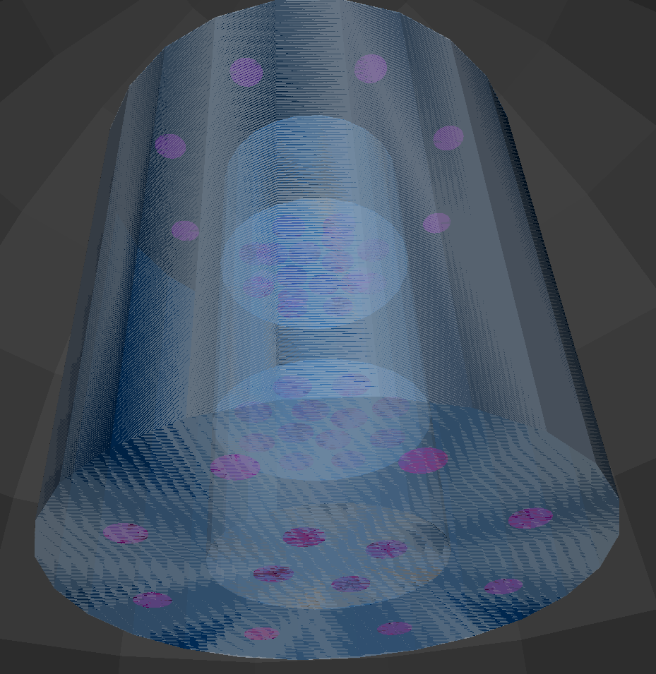
Radionuclide Background Detector
3.5x3.5 meter detector with 1.5x1.5 meter active inner volume.
Four optically segmented volumes with 0.1% GdCl3 doping.
Three inner volumes define a muon ‘telescope’
The central volume is the search region.
The outer volume is the muon/neutron veto.

Slide 30
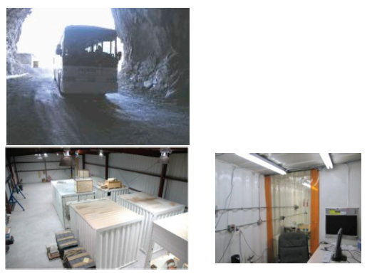
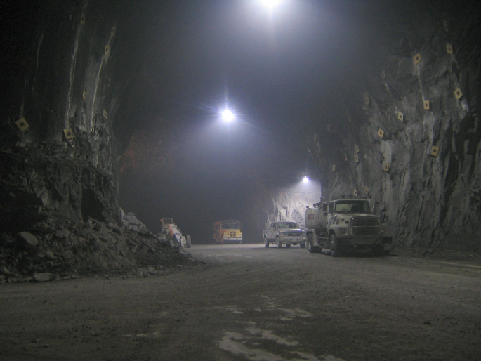
Background Measurements at the Kimbleton Underground Research Facility
Drive in access
Can deploy from
100 feet to 1400 feet
of overburden
Use of the same
detector at multiple
depths ensures
reliable comparison
of results
First-ever continuous
measurement as a
function of depth

Slide 31
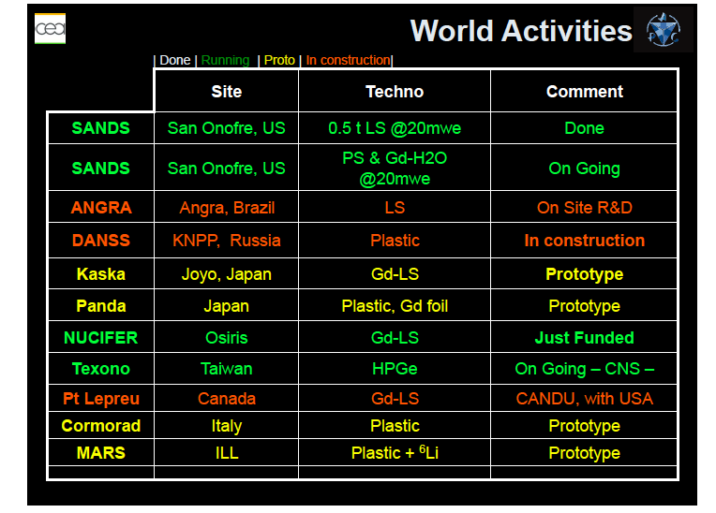
A groundswell of experimental activity worldwide

Slide 32
WATCHMAN has five phases –
Phase I (two years) currently funded
Phase | Activity
I | Siting and Scoping, including site identification and detailed estimates of signal, background, required overburden and total project cost, and experimental measurement of backgrounds
 | → Sponsor approval of large detector
II | Design and site licensing
III | Construction
IV | Deployment
V | Data-taking and demonstration to end users

