Slide 1
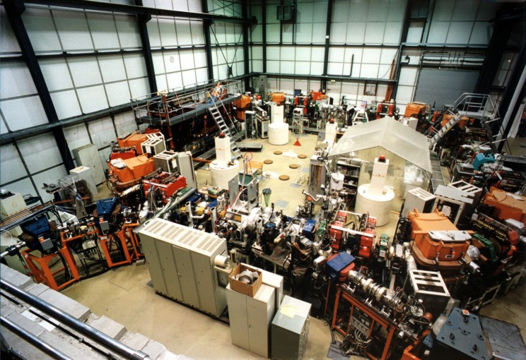
Atomic Physics Experiments at TSR@ISOLDE
Stefan Schippers
Institut für Atom- und Molekülphysik
www.uni-giessen.de/cms/iamp

Slide 2
Outline
TSR seen with the eyes of an atomic physicist
Atomic Physics at TSR@ISOLDE
  Atomic data for astrophyics
  Atomic data for fusion energy research
  Hyperfine induced atomic transitions

Slide 3
The Heidelberg TSR storage ring at MPIK

Slide 4
Decay of excited states
Be-like ⁴⁷Ti¹⁸⁺
2s2p ³P₀
decay
Simply wait until
metastable ions
have relaxed to
their ground state.
S. Schippers et al.
PRL 98 (2007) 033001

Slide 5
Reactions
charge-changing collisions
e⁻ beam
Reaction products
  beams of high directionality
  high particle energies in lab frame
100% detection efficiency
collision experiments with dilute ensembles of particles
tunable relative energy: sub meV to sub MeV
cross sections on an absolute scale
electron-ion recombination
electron-impact ionization of ions

Slide 6
The electron beam
acceleration and transverse expansion
high magnetic field B_{cath}
low magnetic field B
cathode
temperature
T_{cath} ≈ 1400 K
k_{B}T_{cath} ≈ 0.12 eV
longitudinal
temperature
(k_{B}T_{cath})²
2eU_{acc}
<<
transverse
temperature
B
B_{cath}
T || = + relaxation
T⊥ = T_{cath}

Slide 7
Experimental energy spread in history (DR of Li-like C³⁺)
1983: Dittner et al., PRL 51, 31
electron beam compression
no cooling of ion beam
kT⊥ = 5000 meV, kT|| = 1 meV
1990: Andersen et al., PRA 41, 1293
constant electron-beam diameter
no cooling of ion beam
kT⊥ = 135 meV, kT|| = 1 meV
2001: Schippers et al., ApJ 555, 1027
electron-beam expansion
electron cooling of ion beam
kT⊥ = 10 meV, kT|| = 0.15 meV

Slide 8
Photocathode vs. thermal cathode
dielectronic recombination of Li-like Sc¹⁸⁺
hot cathode, thermionic emission
TSR electron cooler
S. Kieslich et al.,
PRA 70 (2004) 042714
2p_{3/2}10l_{j}
resonances
photocathode, cooled with LN2
TSR electron target
M. Lestinsky et al.,
PRL 100 (2008) 033001
accuracy of resonance
energies on ppm level
HF-splitting

Slide 9
Outline
TSR seen with the eyes of an atomic physicist
Atomic Physics at TSR@ISOLDE
  Atomic data for astrophyics
  Atomic data for fusion energy research
  Hyperfine induced atomic transitions

Slide 10
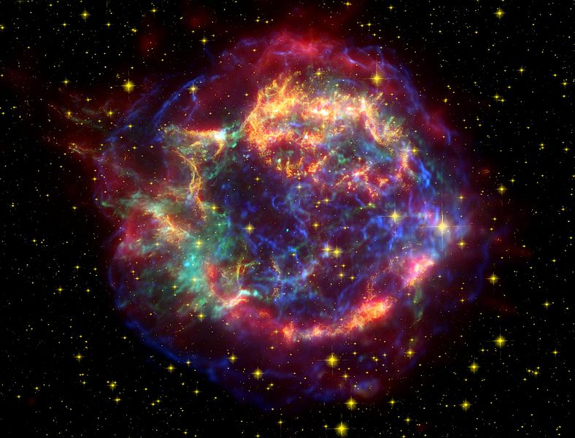
Supernova explosions

Slide 11
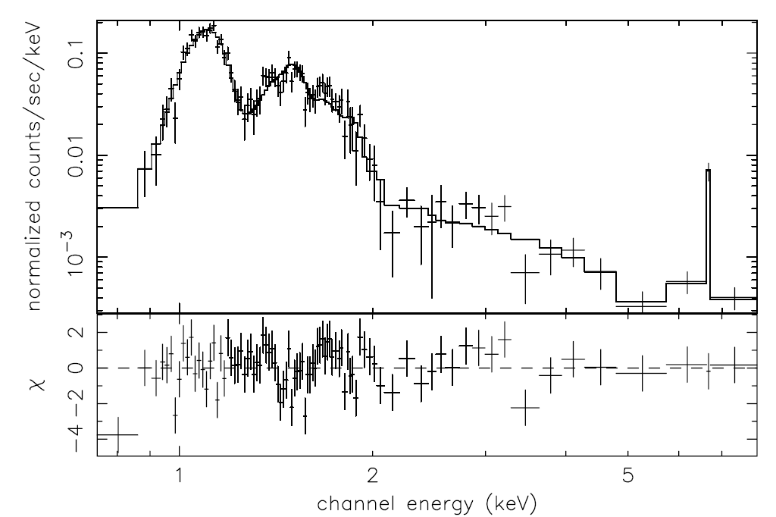
X-ray spectrum of CAS A
emission from Si & Fe cospatial?
Hwang and Laming,
ApJ 597 (2004) 362

Slide 12
Ionization balance in a plasma
ionisation
A^{(q-1)+}
A^{q+}
A^{(q+1)+}
recombination
Need to know rate coeffcients
for
electron-impact ionization
and
electron-ion recombination.
Stefan Schippers, TSR@ISOLDE, CERN, October 29-30, 2012
12

Slide 13
Electron-impact ionization of Fe¹¹⁺(3s² 3p³)
Experiment:
Gregory et al. (1987)
Recommendation:
Arnaud & Raymond (1992)
Theory:
Pindzola et al. (1986)
Experiment: TSR
Longest-lived
metastable level:
2s² 2p³ ²D_{5/2} 0.5 s
beam stored for 3 s
before start of measurement
metastable fraction
< 0.5%
M. Hahn et al., ApJ 729 (2011) 76
Stefan Schippers, TSR@ISOLDE, CERN, October 29-30, 2012
13

Slide 14
Outline
TSR seen with the eyes of an atomic physicist
Atomic Physics at TSR@ISOLDE
  Atomic data for astrophyics
  Atomic data for fusion energy research
  Hyperfine induced atomic transitions

Slide 15

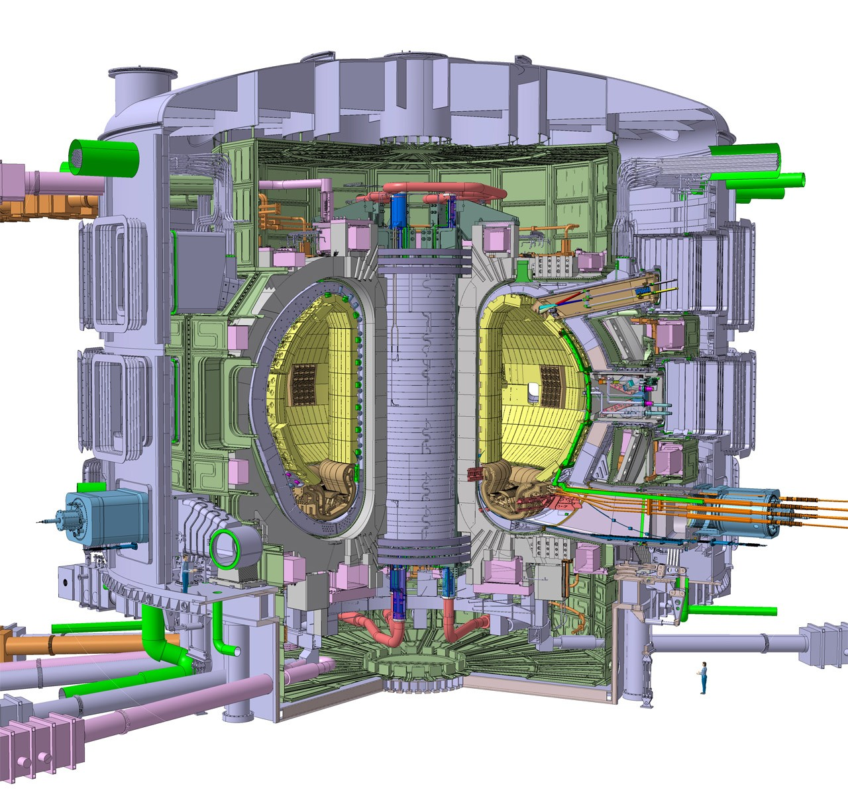
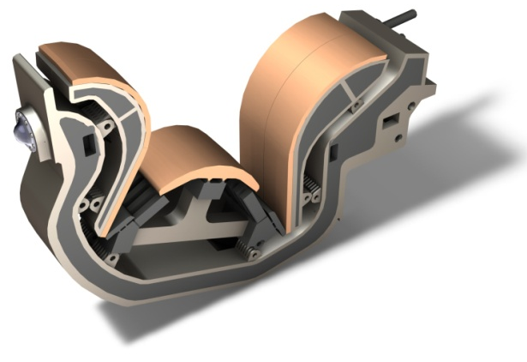
International Thermonuclear
Experimental Reactor
site: Cadarache/France
plasma volume: 840 m³
plasma mass: 0.5 g
energy gain: 10
output power: 0.5 GW
price: 13 G€
first plasma: 2019
divertor
W
Stefan Schippers, TSR@ISOLDE, CERN, October 29-30, 2012
15

Slide 16
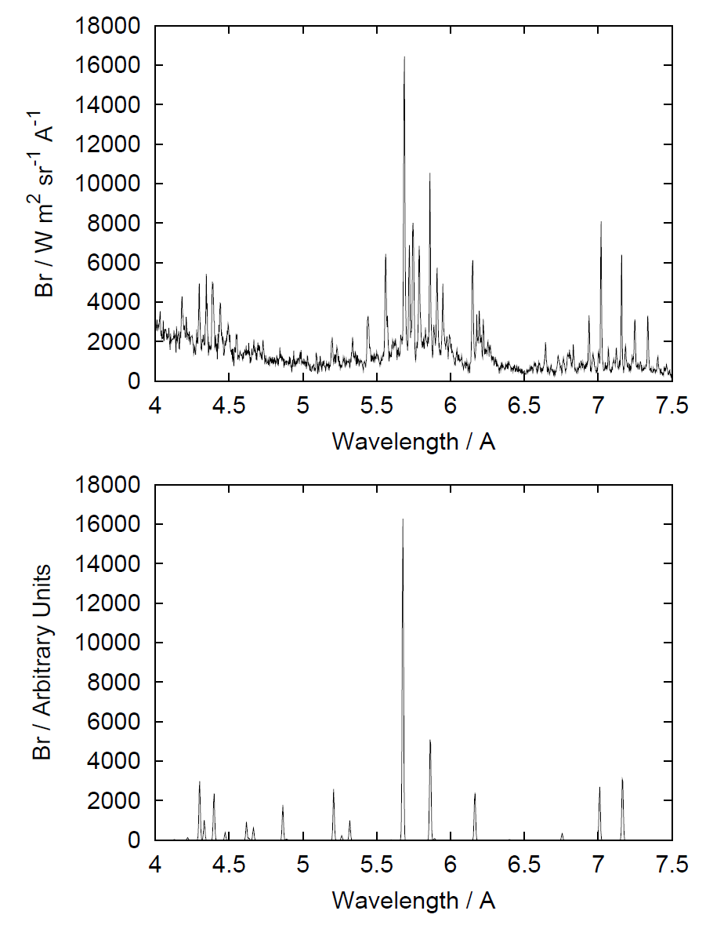
Plasma spectroscopy
emission from W⁴⁶⁺ in ASDEX-U
model prediction for W⁴⁶⁺ emission
A. Whiteford, PhD Thesis,
University of Strathclyde, UK (2004)
Stefan Schippers, TSR@ISOLDE, CERN, October 29-30, 2012
16

Slide 17
DR of Xe-like W²⁰⁺(4f⁸)
factor of 3000
difference
energy
range
of 4f⁸ fine-
structure
excitations
S. Schippers et al.,
PRA 83 (2011) 012711
Stefan Schippers, TSR@ISOLDE, CERN, October 29-30, 2012
17

Slide 18
W²⁰⁺ DR rate coefficient in a plasma
factor of 3000
difference
factor of 4
difference
S. Schippers et al.,
PRA 83 (2011) 012711
Stefan Schippers, TSR@ISOLDE, CERN, October 29-30, 2012
18

Slide 19
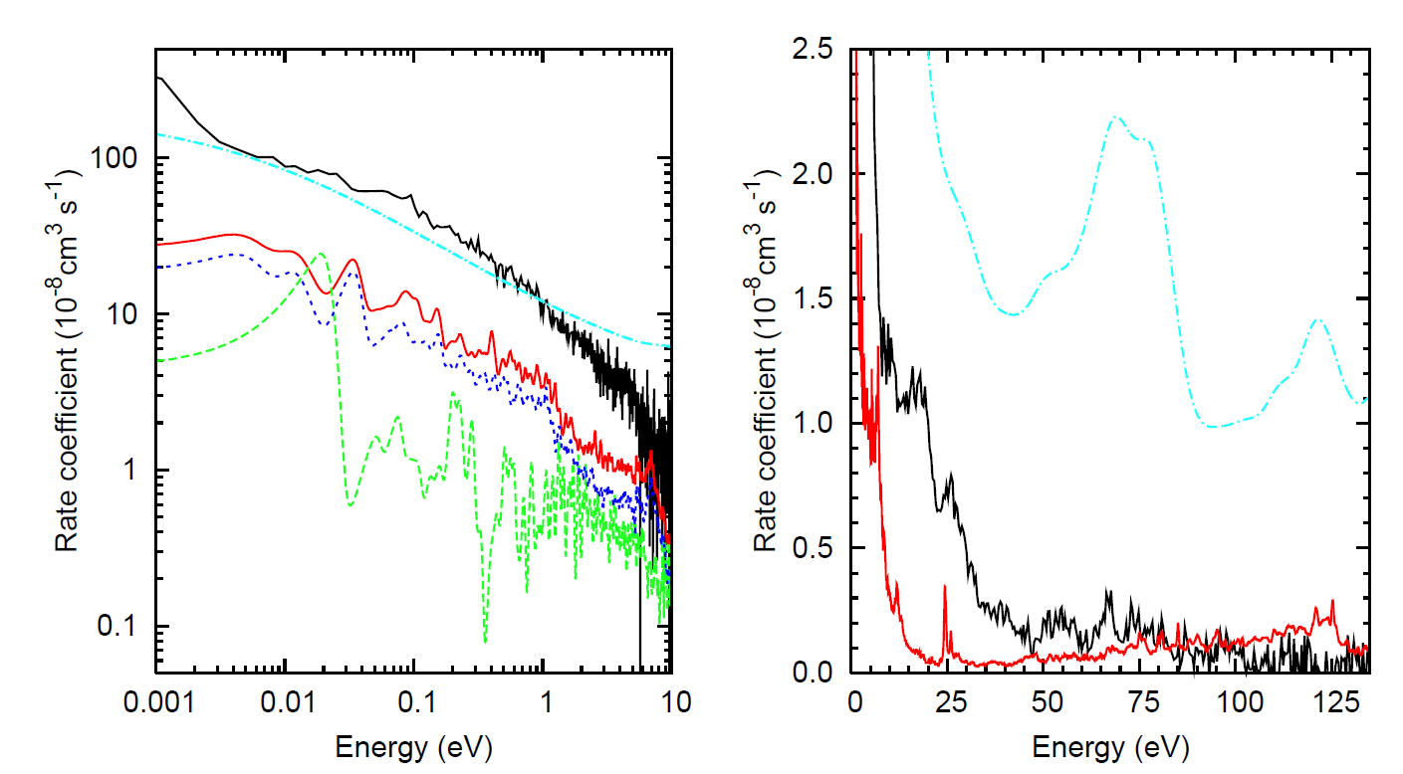
New theoretical W²⁰⁺ DR calculations
statistical approach (full mixing, see also Dzuba et al. PRA 86 (2012) 022714 )
4d→4f contribution (IC)
fine structure included (IC)
TSR
TSR
no fine structure
(LS-coupling)
N. R. Badnell, C. P. Ballance, D. C. Griffin, M. O’Mullane, PRA 85 (2012) 052716
Stefan Schippers, TSR@ISOLDE, CERN, October 29-30, 2012
19

Slide 20
Outline
TSR seen with the eyes of an atomic physicist
Atomic Physics at TSR@ISOLDE
  Atomic data for astrophyics
  Atomic data for fusion energy research
  Hyperfine induced atomic transitions

Slide 21
2s2p ³P – 2s² ¹S transitions in Be-like ions
J=2
2s 2p ³P
J=1
metastable
hyperfine-interaction
J=0
M2 (medium)
requires
nucleus
with I>0
IC (fast)
HFI (slow)
E1M1 (very slow)
2s² ¹S
J=0
ground state

Slide 22

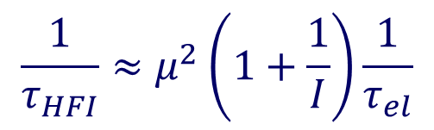
Theoretical predictions of 2s2p ³P₀ lifetimes
$$\frac{1}{τ_{HFI}}≈μ^{2}\left(1+\frac{1}{I}\right)\frac{1}{τ_{el}}$$
$$τ_{el}^{}$$
Cheng et al., PRA 58 (2007) 137

Slide 23
Detection of photons from excited state
Injection of ions in metastable states
Fe¹²⁺(3s² 3p² ¹D₂)
hν
τ = 8.0 ± 0.1 ms
PM
TSR: Träbert et al.,
JPB 35, 671 (2002)
Most photons
miss
the detector!

Slide 24
Ti¹⁸⁺ DR spectrum at low energies
A=48
95% ¹S₀: (2s 2p ³P) 11p
AUTOSTRUCTURE
5% ³P₀: (2s 2p ¹P₁) 11d
(2s 2p ³P₂) 26l
11f
A=47
Next step: measure
recombination
signal vs. time
RR
S. Schippers et al., JPCS 58 (2007) 137

Slide 25
Recombination signal at 0.75 eV vs. time
A=48
A=48
A=47
A=47
S. Schippers et al.,
PRL 98 (2007) 033001

Slide 26
Data analysis
A=48
essential feature of the method
usage of two isotopes
m = ³P₀
g = ¹S₀
Fit:
A=47
largest contribution to the experimental uncertainty
2
2s2p ³P
1
J=0
HFI
J=0
⁴⁷Ti¹⁸⁺: A_{HFI} = 0.56(3) s⁻¹
2s² ¹S

Slide 27
New measurements with Be-like ^{A}S¹²⁺ ions
A=32
A=33
B = 0.44 T
τ_{HFI} = 10.5(7) s
S¹²⁺ values
theory: 27.69 s Marques et al. (1993)
theory: 10.73 s Cheng et al. (2008)
theory: 10.69 s Andersson et al. (2009)
experiment: 10.4(5) s TSR (2011)
B = 0.44 T
τ_{HFI} = 10.5(1.4) s
B = 0.88 T
τ_{HFI} = 10.2(7) s
S. Schippers et al., PRA 85 (2012) 012513

Slide 28
Some uncertain nuclear moments
 | Z | A | t_{1/2} | μ / μ_{n} | Δμ / μ
S | 16 | 35 | 87.4 d | 1.00 | 4%
Ni | 28 | 65 | 2.52 d | 0.69 | 9%
Cu | 29 | 70 | 44.5 s | 1.60 | 44%
As | 33 | 69 | 15.2 min | 1.58 | 10%
Br | 35 | 72 | 79 s | 0.60 | 17%
Br | 35 | 74 | 46 min | 1.68 | 11%
Br | 35 | 75 | 97 min | 0.76 | 24%
values from N. J. Stone, ADNDT 80 (2005) 17

Slide 29
Summary
Atomic data for astrophysics
  - uncertainties of electron-impact ionization (EII) data limit
  understanding of supernova explosions
  - TSR@ISOLDE: cross sections for EII of Si & Fe & … ions
Atomic data for fusion energy research
  - Recombination of tungsten ions with complex electronic structure
  - TSR@ISOLDE: Recombination rate coefficients for more
  highly-charged tungsten ions from (upgraded) charge breeder
Hyperfine induced (HFI) transitions
  - First laboratory measurements of HFI transitions in Be-like ions
  - TSR@ISOLDE: Determination of nuclear magnetic moments

Slide 30



Current TSR collaborators & Funding
D. Bernhardt, A. Müller, K. Spruck
IAMP, Justus-Liebig-Universität Giessen
M. Lestinsky
GSI Helmholtzzentrum für Schwerionenforschung
M. Hahn, O. Novotný, D. W. Savin
Columbia Astrophysics Laboratory, Columbia University, New York
A. Becker, M. Grieser, C. Krantz, R. Repnow, A. Wolf
MPI für Kernphysik, Heidelberg, Germany

