Slide 1
RD50
Collaboration board meeting
CERN, 14.11.2012

Slide 2
Agenda
Report of the spokespersons (G. Casse, M. Moll)
Approval of the minutes of the CB meeting
Definition of observer status
Application for membership
  University of Seville (Francisco Rogelio) – observer
  LPNHE Paris (Giovanni Calderini) – membership
  DESY (Doris Eckstein) – membership
Financial report (M. Glaser, M. Moll)
  Budget status
  Financial status of RD50 projects
  Plans for funding new projects in 2013
Status review of the RD50 projects
Preparation of status report for 2011/2012
Issues regarding next RD50 meetings
Conferences with RD50 participation
AOB

Slide 3
Proposal of observer status definition
Definition:
RD50 observers are institutions that are invited to participate in RD50 Workshops and share their research results with RD50 collaboration members. The name of the institute together with a contact person will be listed on the RD50 website indicating the observer status of the institute. Members of the institute will be placed on the RD50 observers mailing list upon request.
Observers do not participate in the RD50 Collaboration Board, they do not have the right to vote on any RD50 decision, they do not pay the collaboration fee and they are not listed as co-authors on common RD50 publications. They might participate in RD50 common projects, but they will not be taken into account for the calculation of the RD50 financial support to the project (which depends on the number of the participating RD50 institutes).
Appointment of observers:
Any member of the CB has the right to propose an institution for the observer status, which then has to be approved by a vote in the CB.

Slide 4
RD50 projects in 2012
PROPOSED: Fabrication of new p-type pixel detectors with enhanced multiplication effect in the n-type electrodes (G. Pellegrini):
APPROVED: Production at CiS of planar pixel sensors and diodes with n-in-p technology and characterization of main radiation-induced defects (M. Bruzzi).

Slide 5
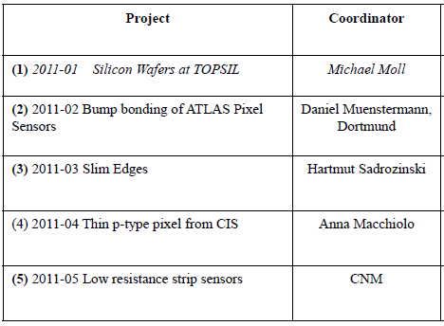
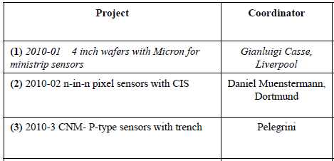
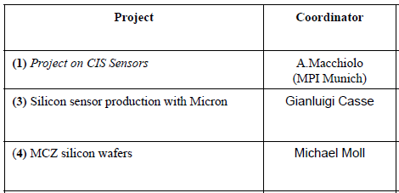
Review of the RD50 projects
2011
2010
2009

