Slide 1

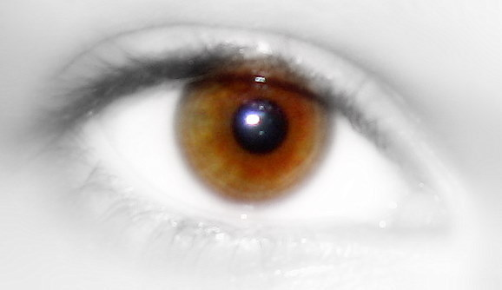
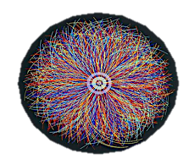
Introduction to heavy-ion physics
Seen through ALICE’s eye

Slide 2


ALICE
It’s scientific program
It’s detectors layout

Slide 3



Back to Basics
ALICE
From the Standard Model of particle physics to Big Bang cosmology

Slide 4
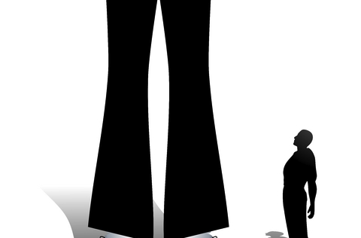
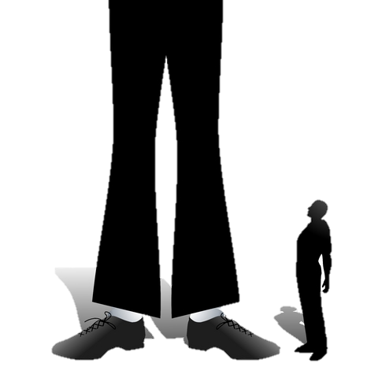
Modern-day physics describes the Universe at all scale

Slide 5


Modern-day physics describes the Universe at all scale
The_Cosmic_Web
From 10 ²⁸ cm …

Slide 6
Modern-day physics describes the Universe at all scale
… down to 10 ⁻¹⁸ cm

Slide 7




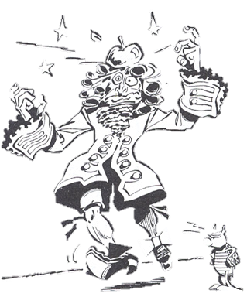
Modern-day physics describes the Universe at all scale
1
10⁻³
10⁻⁵
10⁻³⁸
Using 4 fundamental forces

Slide 8

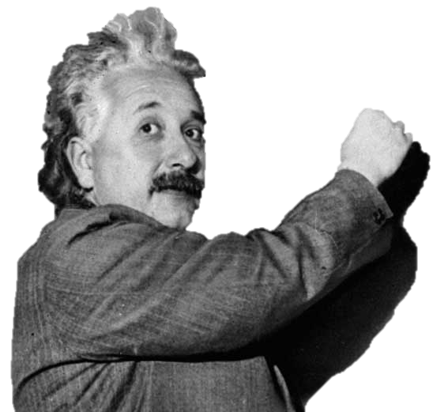

Gravity
R_{μν} – ½Rg_{μν} = 8πGT_{μν}
General relativity

Slide 9

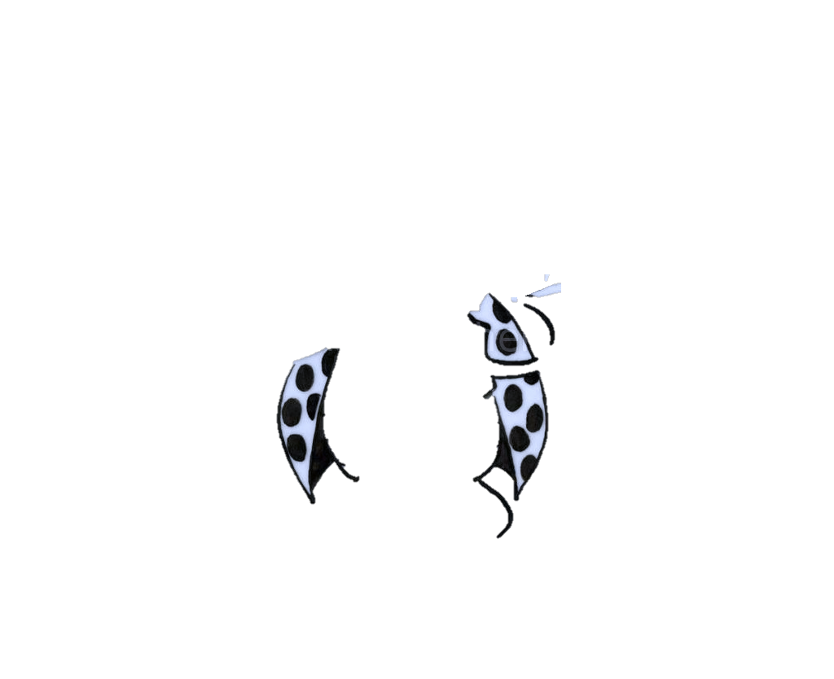
Strong, Electromagnetic, Weak
Relativistic Quantum field theory: the Standard Model of Particle Physics

Slide 10



The SM
ALICE
A cartoon

Slide 11
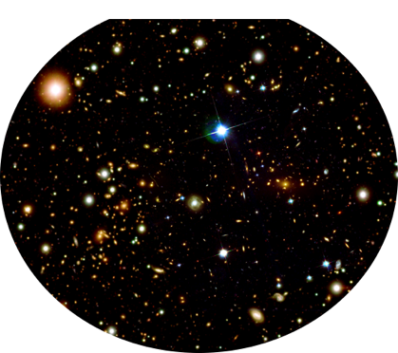
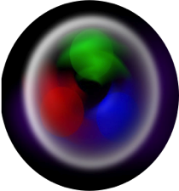

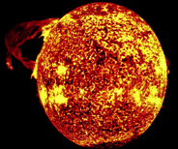




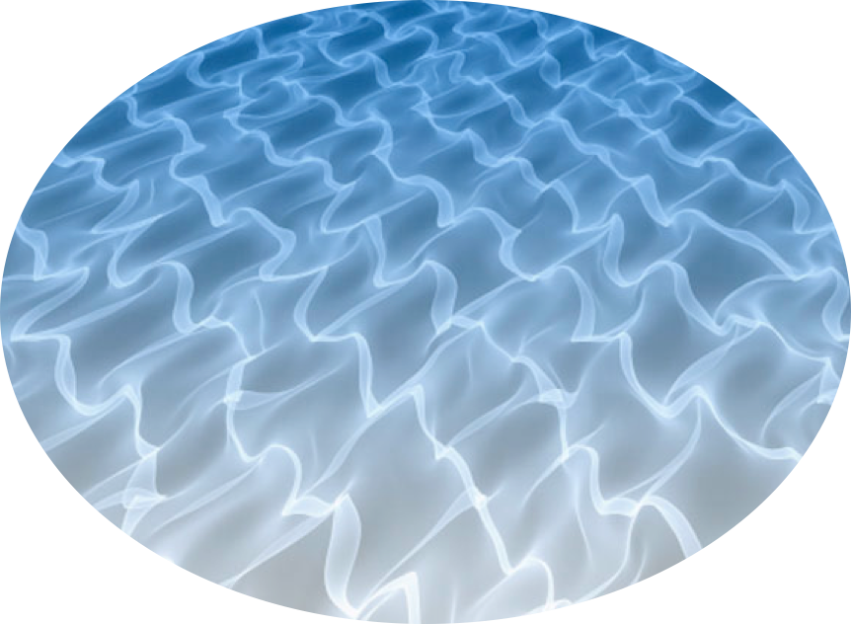







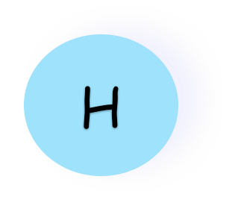










0,5
¯
H+H⇨D+e⁺+ν
n⇨p+e⁻+ν
Quarks
Masse 0-10⁵ ?
3
100
10⁵
Forces
6
10³
10³
0
10⁴
0
10⁴
0,5
100
10³
10⁻⁶
10⁻⁶
10⁻⁶
Leptons
Notes:
a parfaitement résisté à tous les tests expérimentaux réalisés à ce jour. Mieux, ce modèle rend compte des mesures les plus précises faites grâce à des microscopes géants, les collectionneurs de particules

Slide 12






Slide 13


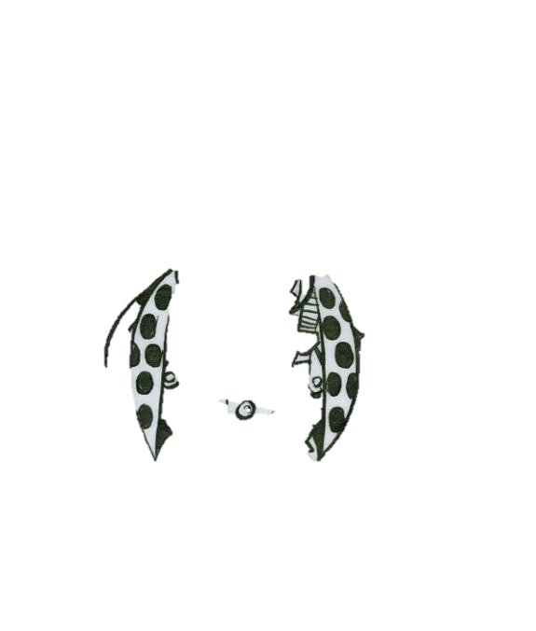
The ALICE scientific program is about the Strong Interaction
  Quantum Chromodynamics (QCD) is the relevant theory
  Quarks and gluons are the characters in our story
ALICE

Slide 14
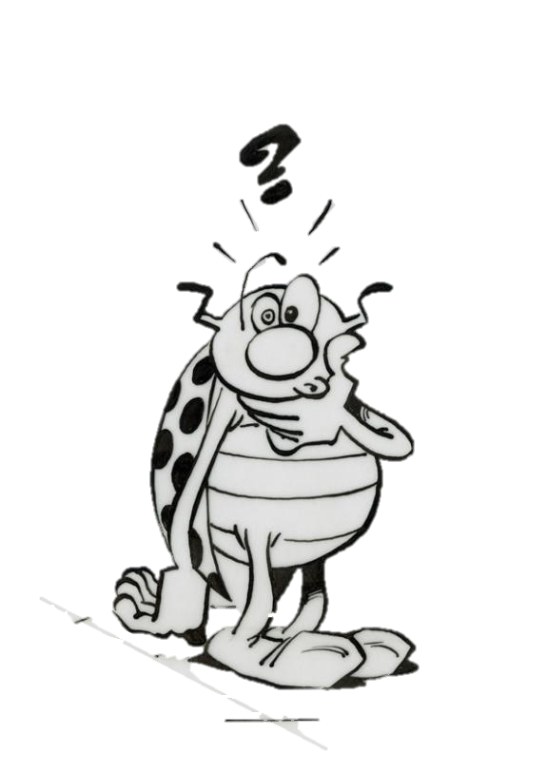
The outstanding puzzles
  How is the mass of hadrons generated

Slide 15
The outstanding puzzles
  How is the mass of hadrons generated
  What confines quarks permanently inside hadrons
F=kr₁
F=kR₂
F=kR₁
F=kr₂
q
q
q
q
q
q
q
q

Slide 16
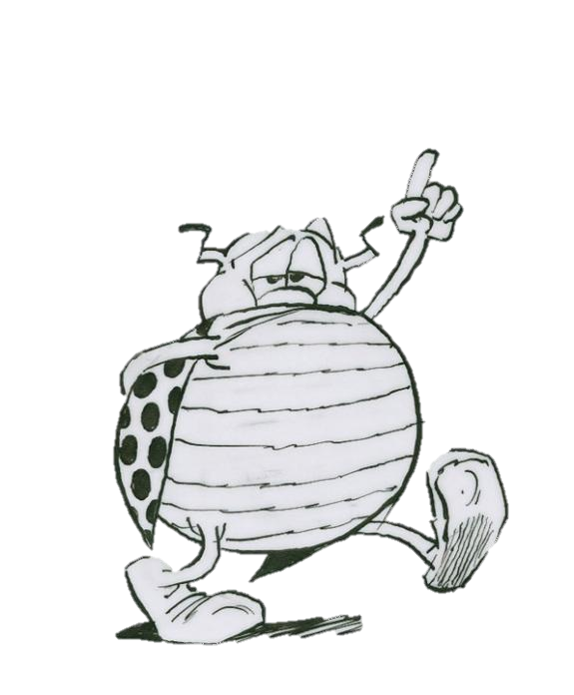

Quark Mass
Mass is generated through symmetry breaking phase transition
  Bare mass: electroweak phase transition, existence of Higgs field ?
  Composite mass: chiral symmetry spontaneously broken, existence of chiral condensate ?

Slide 17

Quark color
Color (R, G, B) is the relevant charge for the strong interaction
  Only color singlet (color neutral) states appear in nature
  This is called confinement: there exists no ab initio rigorous mathematical proof
Quarks (fermions) degrees of freedom
  6 flavors
  3 colors
  2 charge states
  2 spin states

Slide 18
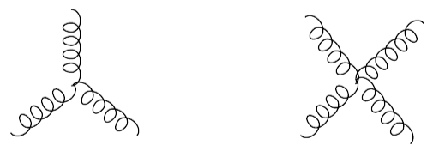

Gluon
The mediator of the strong interaction
  Gluon interact among themselves: asymptotic freedom, color confinement, chiral symmetry breaking
Gluon (boson) degrees of freedom
  8 choice of colors
  2 helicity states
Notes:
Self-interactions of gluons which are responsible for many important features of QCD,
such as asymptotic freedom, color confinement and chiral symmetry breaking.

Slide 19


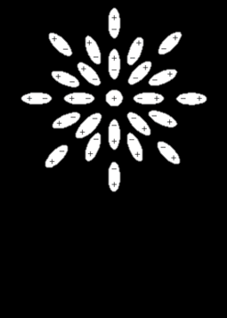
Remember QED
Vacuum polarization
α
R
Test charge
1/137
R
High energy probe
Low energy probe

Slide 20
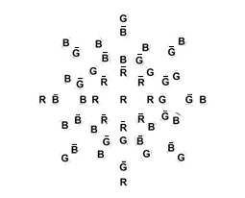

QCD is different
vacuum polarization
α_{s}
R
Confinement barrier
Test charge
R
1 fm
High energy probe: asmptotic freedom

Slide 21

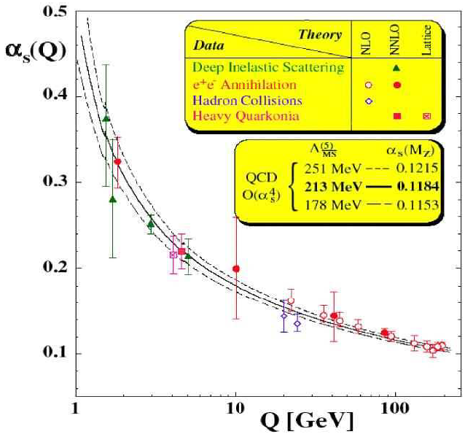
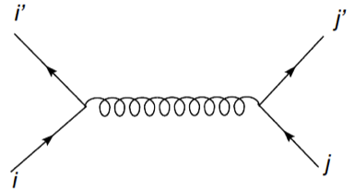
Asymptotic freedom
Interaction strength between quarks becomes smaller as the distance (transferred momentum) between them gets shorter (larger)

Slide 22

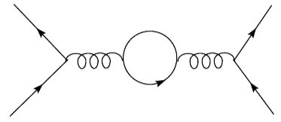
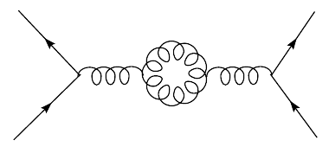
Asymptotic freedom
At short distance
  Vacuum polarization makes the interaction stronger (qq screening)
  Non linear gluon interaction makes the interaction weaker (gg anti screening)

Slide 23



Asymptotic freedom
Momentum scale
  μ>> Λ_{QCD} hard, perturbative
  μ<< Λ_{QCD} soft, non perurbarive

Slide 25
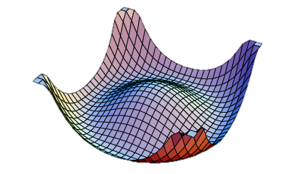



Chiral Symmetry
QCD vacuum
  An intrinsic symmetry of QCD for massless quarks: the strong interaction does not couple the left- and right-handed quarks
True QCD vacuum
  Quarks acquire a (small) mass through the spontaneous breaking of the symmetry

Slide 26

QCD conjecture
Any strongly interacting system at zero temperature and density must be a color singlet at distance scale larger than 1/Λ_{QCD} (≈ 1 fm)

Slide 27


QCD conjecture
Any strongly interacting system at zero temperature and density must be a color singlet at distance scale larger than 1/Λ_{QCD} (≈ 1 fm)
What about a system at high temperature or density, i.e high energy density ?

Slide 28
Intuitively
If color charge density is sufficiently high, Debye screening (electric charge in a plasma) weakens the interaction also at large distances
-
-
-
-
+
+
-
-
-
+

Slide 29

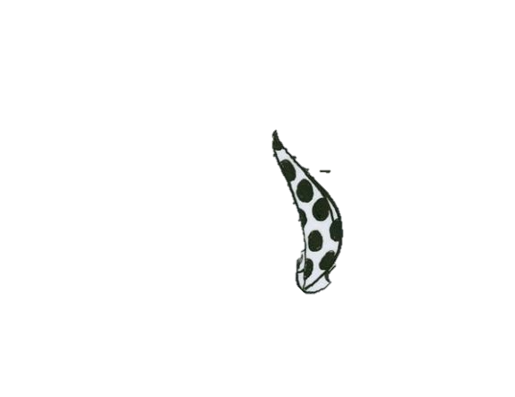
Intuitively
If color charge density is sufficiently high, Debye screening (electric charge in a plasma) weakens the interaction also at large distances
The system becomes a color conductor with free color charges
We call it a Quark Gluon Plasma
-
-
-
-
+
+
-
-
-
+

Slide 30



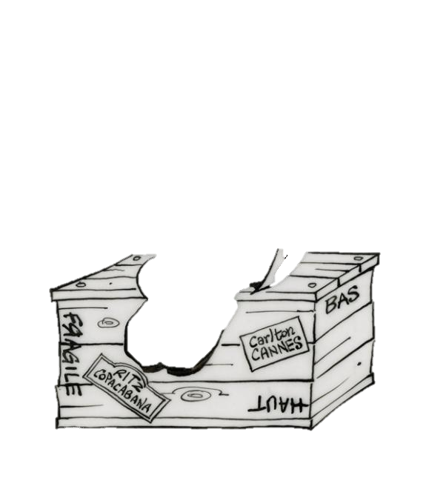
Does such a system exist ?
At very early times in the history of the Universe, temperature was high enough T ≈ 100 GeV (electroweak phase transition):
  All particles of the SM are relativistic
  N_{particle} = N_{particle} (chemical potential μ= 0)
  Quarks interaction is weak

Slide 31

Does such a system exist ?
At very early times in the history of the Universe, temperature was high enough T ≈ 100 GeV (electroweak phase transition):
  All particles of the SM are relativistic
  N_{particle} = N_{particle} (chemical potential μ= 0)
  Quarks interaction is weak
QGP is a free relativistic gas of partons (= quarks and gluons)
  Statistical mechanics applies

Slide 32




Equation of state
Energy density for a free gas

Slide 33

Equation of state
Energy density for a free gas
At temperatures below k_{B}T ～1 GeV (u,d,s)

Slide 34

Equation of state
At temperatures below k_{B}T ～1 GeV (u,d,s)
Equation of state

Slide 35






Phase transition
From a pion gas
To the QGP (u,d)
Transition temperature
Notes:
Pions are collective excitations of the non-perturbative QCD
vacuum. This true ground state of the QCD vacuum has a lower-energy −B than the perturbative
QCD vacuum B = 200 MeV

Slide 36
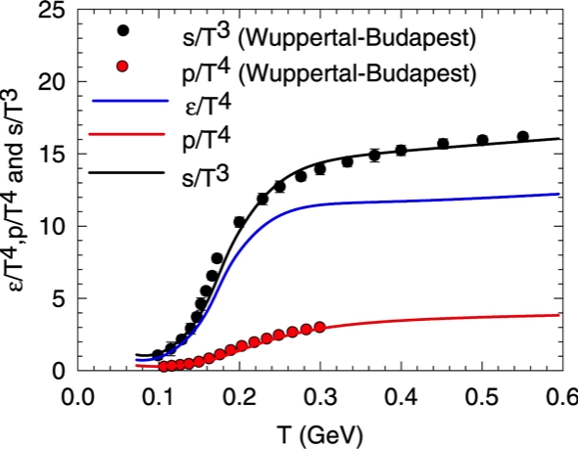
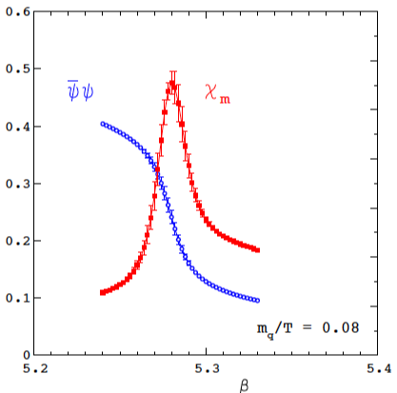

Ab initio QCD
Lattice QCD: to solve QCD in the strong coupling regime by simulating the theory on a finite space-time lattice
Notes:
The lattice QCD calculations can provide a measurement of the relevant “order
parameter”, the scalar quark density h ¯ ψψi, as a function of temperature. This order parameter
provides a measure of the effective mass of a quark in the medium.

Slide 37
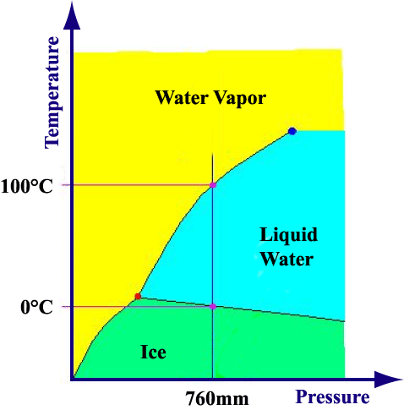
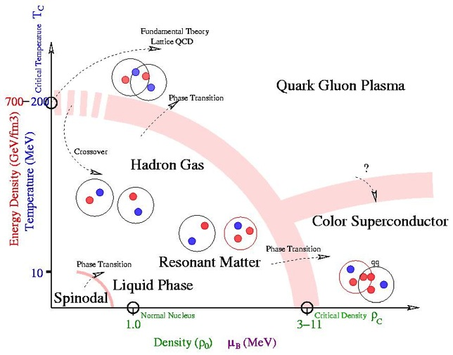

Phase transitions in nature

Slide 38

ALICE studies the QCD phase transition, the only SM phase transition that can be studied in the laboratory
ALICE
Tc ～ 170 GeV

Slide 39
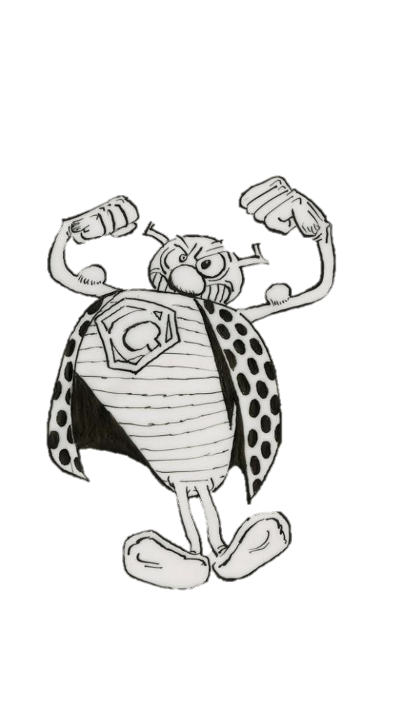

How ?
Colliding heavy-ion ions at close to the speed of light

Slide 40


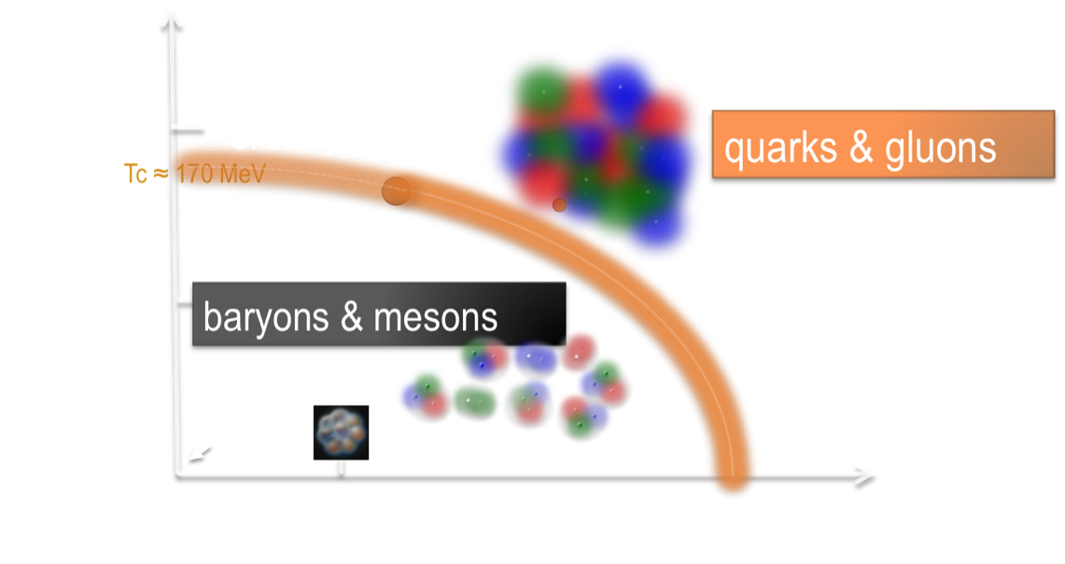
How ?
Colliding heavy-ion ions at close to the speed of light

Slide 41


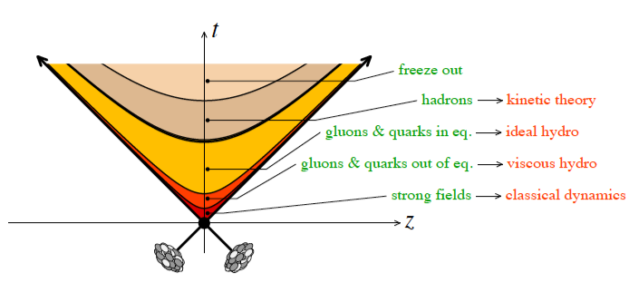
How ?
Colliding heavy-ion ions at close to the speed of light

Slide 42


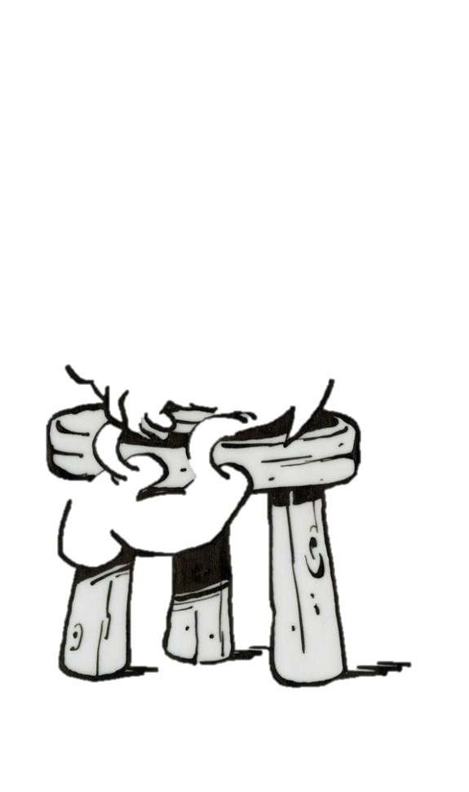

How ?
Detecting the residues of the collisions

Slide 43
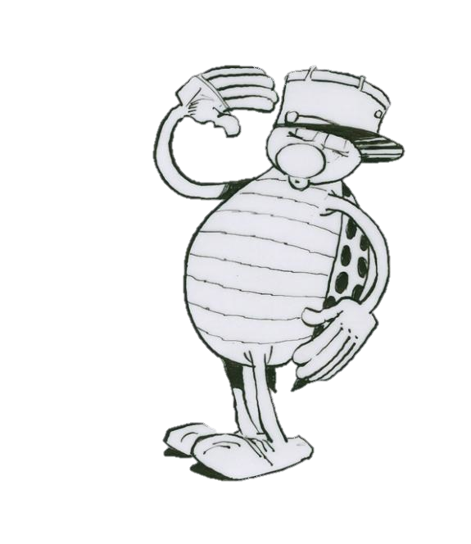



Slide 44

The todo program
About 10,000 particles cross the detectors in each collision ; the particle density reaches 90 particles per cm², near the interaction point !
Measure every particle individually: count them, localize their trajectory, identify their nature, establish their 4-momentum ;
Localize the origin within a few μm ;
Identify the interesting rare events in less than 100 μs ;
Store data 1,2 Go/s (2 CD/s) and 1 Po/year (a 4 Km high CD pile) ;
Give access of data to 1,000 physicists spread in 80 institutes in 28 countries.

Slide 45


Observing the phenomenon
Imagine…
  You lived in a frozen world where water existed only as ice
  and ice comes in only quantized sizes ~ ice cubes
  and theoretical friends tell you there should be a liquid phase
  and your only way to heat the ice is by colliding two ice cubes
  So you form a “bunch” containing a billion ice cubes
  which you collide with another such bunch
  10 million times per second
  which produces about 1000 IceCube-IceCube collisions per second
  which you observe from the vicinity of Mars
Change the length scale by a factor of ~10¹³
  You’re doing physics at LHC !

Slide 46



Slide 47
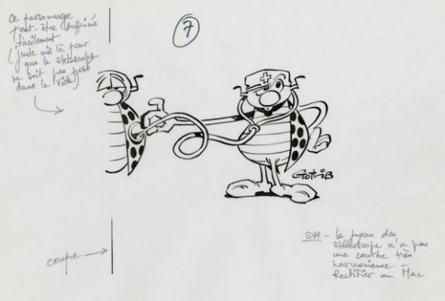

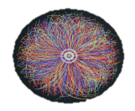
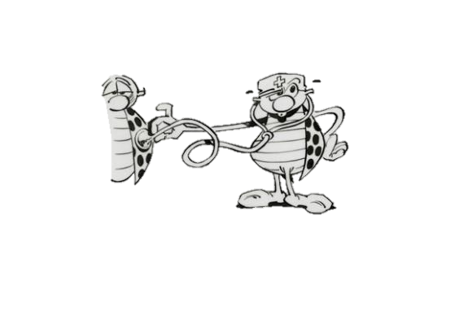
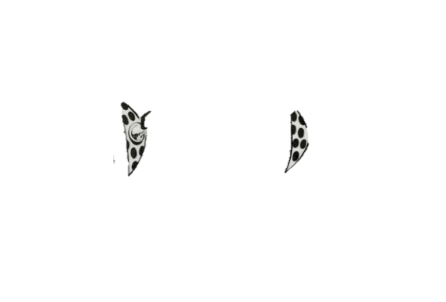
How to decipher

Slide 48
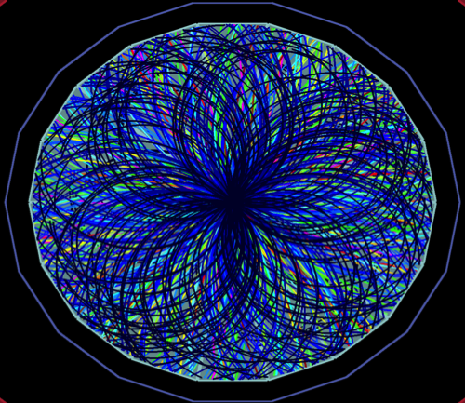
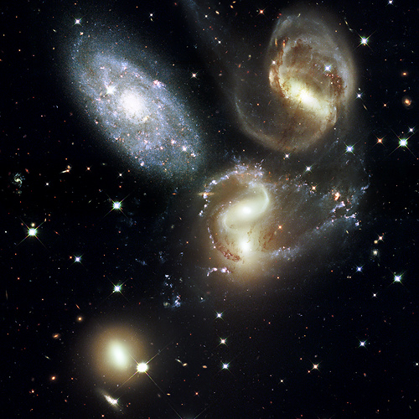
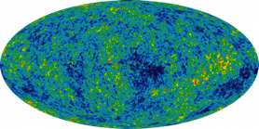
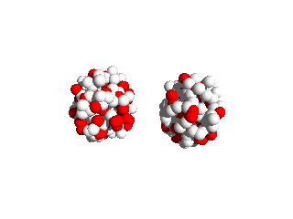

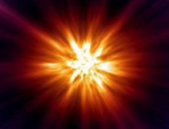
Big Bang
Little Bang
Present t₀+13.7×10⁹ years
Present t₀+3×10⁻²³ seconds
CMB
Hadron gas
time
QGP
QGP
t₀
Notes:
This analogy with the Big Bang is appropriate not only because we investigate a tiny piece of the early universe but also becase many of the tools and methods we are using are quite similar

Slide 49
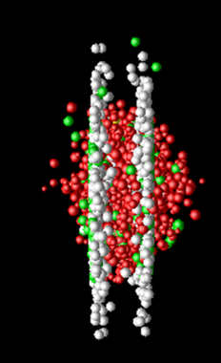
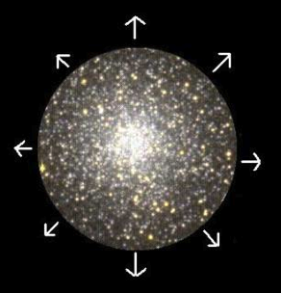
Big Bang
Little Bang
Global characteristics
  mass density Ω, age
Global characteristics
  Energy density, size, lifetime
Notes:
If you want to study the universe you want first to measure its mass density, you want to know its age likewise

Slide 50
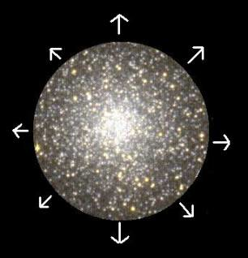
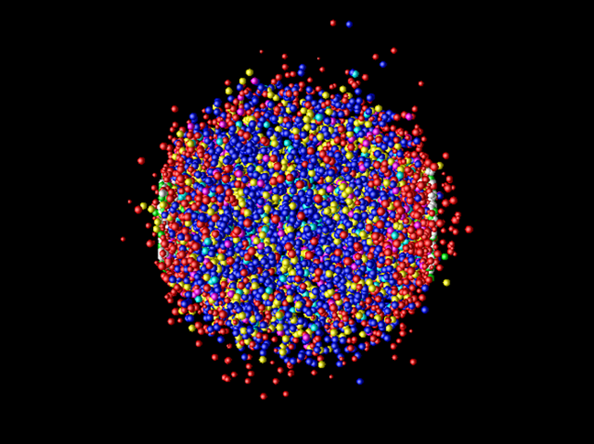
Big Bang
Little Bang
Global characteristics
  mass density Ω, age
Expansion (galaxies)
  Huble flow
Global characteristics
  Energy density, size, lifetime
Expansion (hadrons)
  Particles flow, π interferometry
Notes:
We know that the Universe expands, we can measure that by the Hubble flow of galaxies and also the little bang expands at the speed of light and we can measure its expansion by the flow of particles

Slide 51
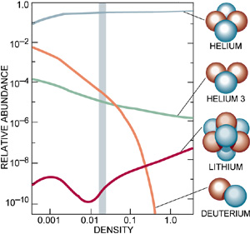
Big Bang
Little Bang
Expansion (galaxies)
  Huble flow
Primordial nucleosynthesis (H, He, Li)
  Thermodynamics at τ ∼ 100 s
Expansion (hadrons)
  Particles flow, π interferometry
Hadrochemistry (π, K, p ratios)
  Thermodynamics at τ ∼ 10⁻²¹ s
http://astro.berkeley.edu/~mwhite/darkmatter/bbn.html
http://arxiv.org/format/nucl-th/0511071v3
Notes:
Nucleo synthesis is one of the pillar of the BB model, by looking at the ration of light elements you can learn about the thermodynamical properties at the time these particles were created a few minutes after the BB. We do something similar by looking at particle ratiosto learn about temperature, pressure and thermodynamical evolution at the time these particles were created

Slide 52
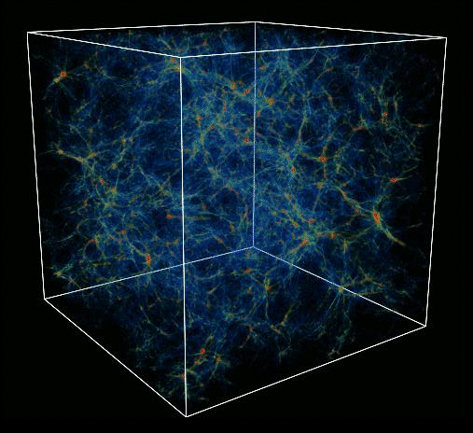
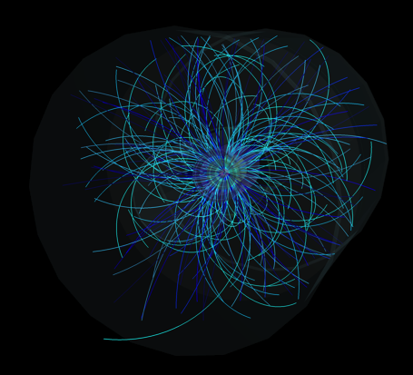

Big Bang
Little Bang
Primordial nucleosynthesis (H, He, Li)
  Thermodynamics at τ ∼ 100 s
Large scale structures
  Density fluctuations
Hadrochemistry (π, K, p ratios)
  Thermodynamics at τ ∼ 10⁻²¹ s
Event structures
  Fluctuations at phase transition
Notes:
In the Universe we look for large scale structures because they come from density fluctuations very early in the lifetime of the universe and likewise we look for event structures which can come from fluctuations which arise from the phase transition from QGP to normal matter

Slide 53

Big Bang
Little Bang
Large scale structures
  Density fluctuations
Cosmic microwave background
  Temperature at decoupling
Event structures
  Fluctuations at phase transition
Thermal radiation (γ, l⁺l⁻)
  Time evolution of temperature
COBE (Cosmic Background Explorer)
Black body radiation
Notes:
The microwave background tells us about the temperature at decoupling, we also want to measure the temperature of this hot phase by looking at thermal radiation

Slide 54


Big Bang
Little Bang
Cosmic microwave background
  Temperature at decoupling
Temperatures fluctuations
  Origin of big structures
Thermal radiation
  Time evolution of temperature
Tomography of QGP
  Density fluctuations,…
WMAP (Wilkinson Microwave Anisotropy Probe)
Notes:
By looking at fluctuations in the temperature we can get signals from the early parts which are beyond this horizon when the universe was opaque likewise we do have signals which are created at the very early moment of the collision like jet quenching .. A few examples

Slide 55







Let me tell you what I have learned so far

Slide 56










Notes:
ε = E/V = 1/(τA)dN/dy <m_{t}>
Contrib France: conception méthode vertex déplacé et détecteur (selectionné pour QM)
Présentation QM par Maxime Guillebaud

Slide 57

Isn’t it fun to work with me !

Slide 58
Soft sector
ALICE

Slide 59

Thermalized partonic phase
dN_{ch}/dη|_{η=0} = 1600 ± 76
EMCAL
ITS
MUON
V0-C
V0-A
ε > 15 GeV/fm³
T > 3 T_{c}
Multiplicité
η
Notes:
ε = E/V = 1/(τA)dN/dy <m_{t}>
Contrib France: conception méthode vertex déplacé et détecteur (selectionné pour QM)
Présentation QM par Maxime Guillebaud

Slide 60

Hydrodynamics
v₂
}
Collective flow v₂
partons -> hadrons

Slide 61
Hydrodynamics
v₂
}
Collective flow v₂
partons -> hadrons
v₃
v₄
v_{n}
Fluctuations état initial
η/S (?)
Notes:
Le rapport eta/S est le paramètre qui décrit dans les équations de l'hydrodynamique l'atténuation d'une perturbation dans un milieu en fait le paramètre est η/(ε+p) = η/(ST+μN) = η/ST dans notre cas où μ est petit. Ce facteur est aussi appelé la longueur d'atténuation du son. Si η/S est petit la perturbation n'est pas atténuée et se propage à l'infini. L'origine microscopique est liée au libre parcourt moyen des constituants du milieu: si le libre parcourt moyen est petit c'est à dire une forte interaction la viscosité est faible (la perturbation se propage facilement):
La viscosité est proportionnelle à énergie densité (ε) x temps de libre parcours moyen (τ)
entropie proportionnelle densité particules (k_{B}n)
η/S prop τε/k_{B}n
ε/n est l'énergie par particules, d'après Heisenberg: τε/n > h/2π
donc η/s > hbar/k_{B} (il manque un coefficient numérique 1/4π)

Slide 62

Hadronization
baryon/meson anomaly
Radial flow
Parton fragmentation
Coalescence (?)
Notes:
AOC Strasbourg
pT < 1.5 - 2 GeV/c composante “thermale” particules rayonnées par le milieu, flow radial responsable de la remontée flow = vitesse constante donc particules plus lourdes déplacées vers pt plus grand
pT > 6 GeV/c sondes dures, particules autogénérées dont la production est décrite par QCD perturbatif
pT intermédiaire: un effet typiquement dû au milieu hadronisation par coalescence de quarks pour former des objets incolores

Slide 63

Hadronic phase
Chemical freezeout:
T = 160 MeV ≈ T_{c}
μ_{b} = 1 MeV
proton ?

Slide 64

Hadronic phase
Chemical freezeout:
T = 160 MeV ≈ T_{c}
μ_{b} = 1 MeV
proton ?
Strangness excess PbPb/pp
 √s (trivial ?)
 Strangeness (QGP ?)
 Centrality (QGP ?)
Notes:
AOC Strasbourg

Slide 65
Hard sector
ALICE

Slide 66

Dynamics of partons inside QGP

Slide 67

Dynamics of partons inside QGP

Slide 68
Dynamics of partons inside QGP
Partons energy loss
méchanism (radiatif, collision)?
thermalization ?
q
q

Slide 69

Dynamics of partons inside QGP
Partons energy loss
méchanism (radiatif, collision)?
thermalization ?
q
q
R_{AA}^{g} < R_{AA}^{q} < R_{AA}^{Q} ?
Notes:
Présentation plénière à QM par Zaida Conesa

Slide 70

Color screening
0.2 T_{C}
0.74 T_{C}
1.2 T_{C}
2 T_{C}
Υ(3S)
Υ(2S)
Υ(1S)
Multiplicité
r_{debye}
-
+
-
ψ’
χ_{c}
J/ψ
-
-
+
+
-
-
-
+
Notes:
Interaction avec faible transfert d’impulsion (grande distance) es écrantée par plasma; interaction avec transfert d’impulsion élevé est faible (liberté asymptotique)
Plasma couplage fort: peu de charges dans la sphère Debye
Pour tester le degré d’écrantage des charges dans le QGP, on peut exploiter les états des quarkonia de la famille cc et bb. Plus le rayon de la résonance est grand plus facilement l’état est dissocié dans le plasma possibilité de réaliser un thermomètre-c

Slide 71

J/ψ dynamics inside QGP
Dissociation at high p_{T}
Regeneration at high c density
  y = 0
  b = 0
Notes:
Présentation plénière par Christophe Suire à Hard Probes
Régénaration lorsque la densité de c est élevée : centralité élevée (60 cc dans collisiobs centrales), rapidité centrale, bas pT

Slide 72
J/ψ dynamics inside QGP
Dissociation at high p_{T}
Regeneration at high c density
  y = 0
  b = 0
  p_{T} < 4 GeV/c
Notes:
Présentation plénière par Christophe Suire à Hard Probes
Régénaration lorsque la densité de c est élevée : centralité élevée (60 cc dans collisiobs centrales), rapidité centrale, bas pT

Slide 73
J/ψ dynamics inside QGP
Charme en équilibre avec QGP ?
Multiplicité
Notes:
Présentation plénière par Christophe Suire à Hard Probes
Régénaration lorsque la densité de c est élevée : centralité élevée (60 cc dans collisiobs centrales), rapidité centrale, bas pT

Slide 74
But there remains a lot to learn …

Slide 75


A magnetic field
Identify the charge
Smaller momentum
Larger
momentum
Measure the momentum

Slide 76


Particles cross sensitive materials
t=0
t=t₁
t=t₂
t=t₃
t=t₄

Slide 77


Slide 78



ALICE : Many cells everywhere …
To localise, segmenting the system in hundreds of millions of sensitive cells ;
Surround the interaction point with detector enveloppes
Internal trajectography (ITS): p, id
Time projection chambre (TPC) : p, pid
Transition radiation detector (TRD): électrons

Slide 79

… and a few specialized detectors
Muons spectrometre :
Passif absorber
B dipole
Trajectographe
Filter
Trigger
Photons

Slide 80
How does it work
Internal trajectographe : 6 layers of Si diodes with 2D localisation
-HV
Si-p
Si-n
300 mm
-
+
-
+
-
+

Slide 81





3 Si technologies
256 anodes, 294 mm pitch

Slide 82

How does it work
The main trajectographe : 1 time projection chamber
E
-HV
E
-
-
-
-
-
-
q,f
-
-
-
-
-
-
-
-
-
Arrival time

Slide 83

TPC ALICE
GAS VOLUME
88 m³
DRIFT GAS
90% Ne - 10%CO₂
E
E
Co₂ insulation
E
E
Drift volume
88ms
E
400 V / cm
1.6
P
b
P
5.6 m
NE / CO₂
88ms
510 cm
E
Central electrode
Readout plane segmentation
18 trapezoidal sectors
each covering 20 degrees in azimuth
End plate
5 m

Slide 84

Particles identification
p p
p p
Measure energy loss
Measure time of flight
K K⁻
p p⁻
Trajectography: charge and momentum

Slide 85

Even smarter
Distinguish relativistic electrons and pions
When a relativistic particle crosses an inhomogenuous medium an X ray is emitted
Select the medium such as only electrons create the transition radiation
Detect both the charged particle and the X ray
Multi-wire chamber filled with a heavy gas (Xe)

Slide 86

And to be complete
Dense like lead and transparent like crystal to stop photons
Photons materialise as a cascade of electrons and positons
Electrons excite atomes of the crystal
Atomes deexcitent by emetting an UV radiation
UV radiations are detected at one end of the crystal by a photodiode

Slide 87



From volts to bytes
The signal of each cell (～16 millions) is procesed by highly miniaturised electronic systems ;
The electric signal is digitalised to be processed by computers ;
The information is transported by optical fibers.

Slide 88
Design the detector
Simulations :
  Generate physics events at the best of our theoretical knowledge
  Construct a virtual detector and simulate its response based of our knowledge on the interactions of particles with matter
Tools :
  Programming techniques : object oriented
  Huge computing and storage capacities : distributed computing

Slide 89
Process the data
Reconstruction
  Hits to clusters to tracklets to tracks
  Compute for each track: 4-momentum and PID
Analyze data
  Generate physics information
Tools :
  Distributed computing: T1, T2, AF,…

