Slide 1
CTF3 highlights since last Project Meeting - Operation
Further consolidated factor 4 combination & transport to TBTS.
Carried out Break-down kicks and BD statistic studies in TBTS. Lots of data collected, being analyzed.
Established higher rep rate operation (2.5 Hz for now).
Re-commissioned TBL with 13 PETS, full transmission with factor 4, first tests with factor 8.
Re-commissioned and improved factor 8 combination
(new DL alignment and flexibility for closed RF bump in CR helped a lot).
Worked on beam performance (stability, emittance and bunch length). Established new chicane optics
(R₅₆ = 0.2 m and R₅₆ = 0 m).
Improvements in instrumentation, optics modeling, operational software & procedures…

Slide 2
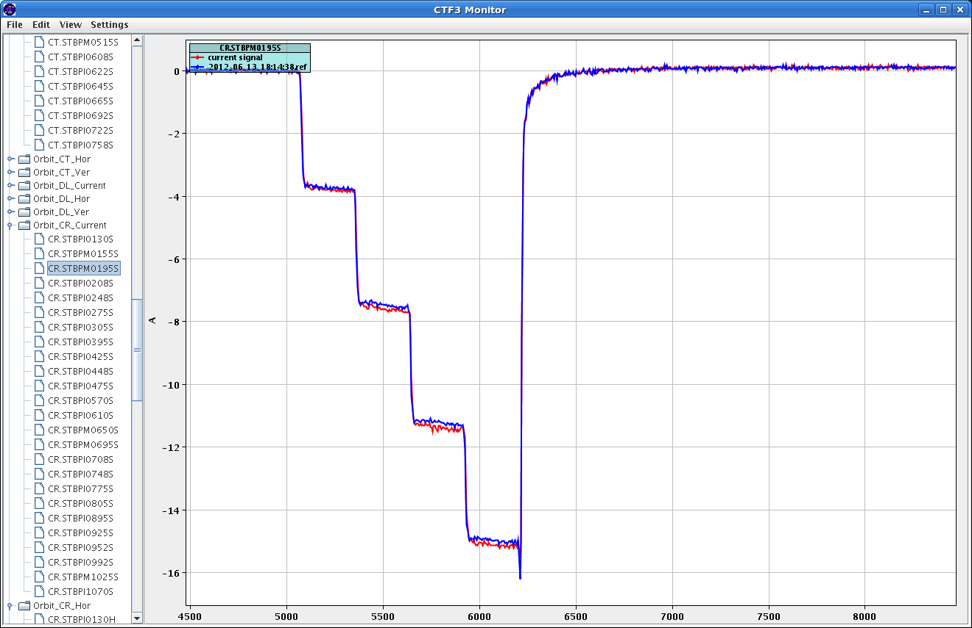
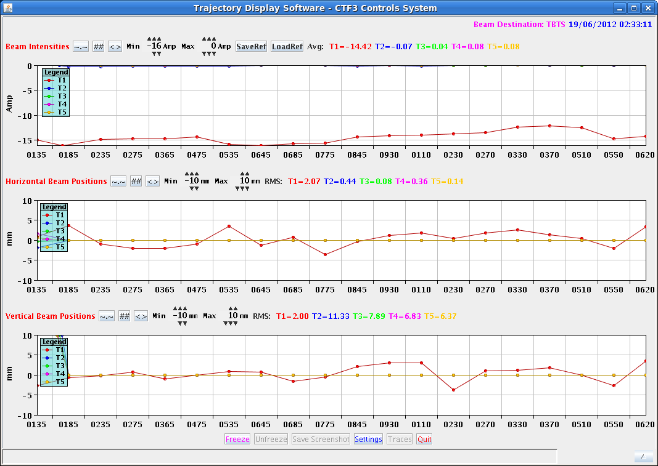
Further consolidated factor 4 combination & transport to TBTS
Current before night switch-off
Current at start-up in the morning (~ 10 min set-up)
Factor 4 beam to TBTS

Slide 3
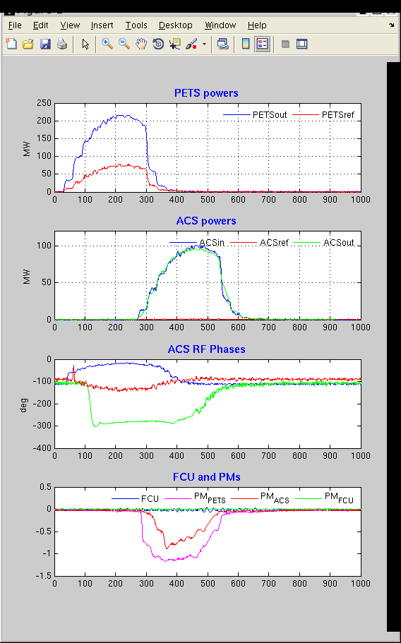
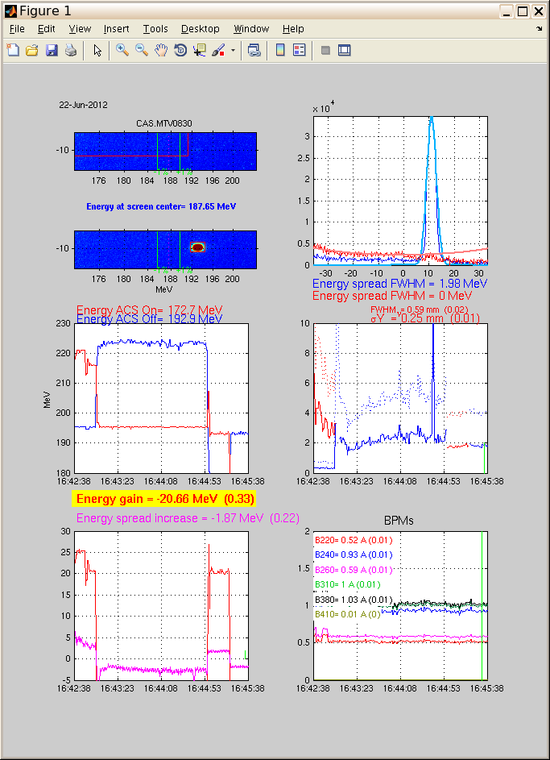
Power & Acceleration in TBTS
Typical (high) power levels, factor 4, recirculation
Two Beam acceleration – 145 MV/m
(31 MeV gain - about 105 MW input)
A. Dobrowski
W. Farabolini, J. Barranco

Slide 4
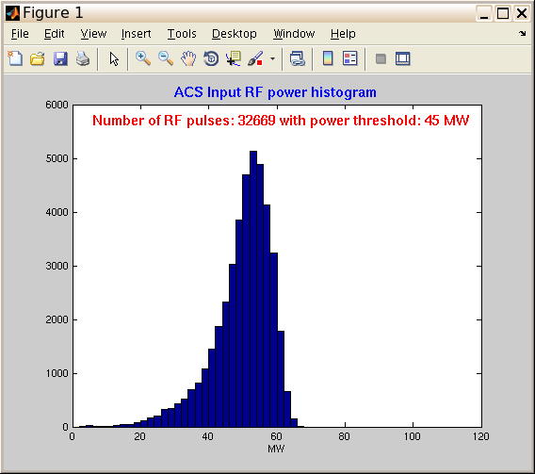
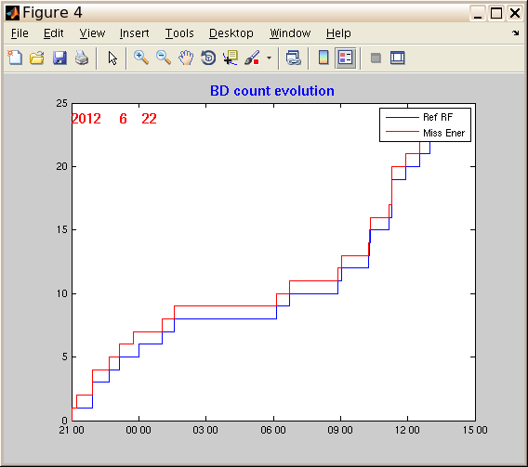
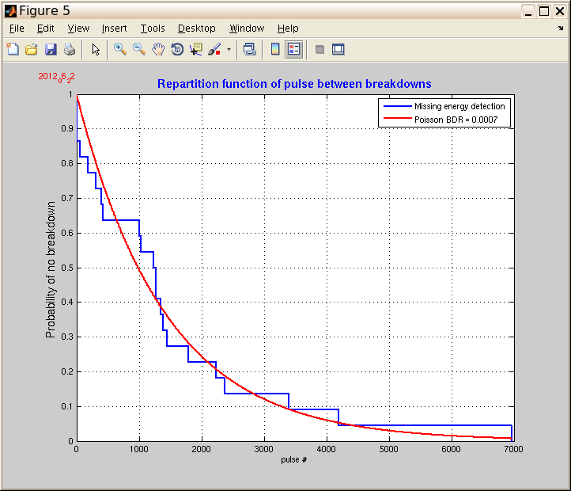
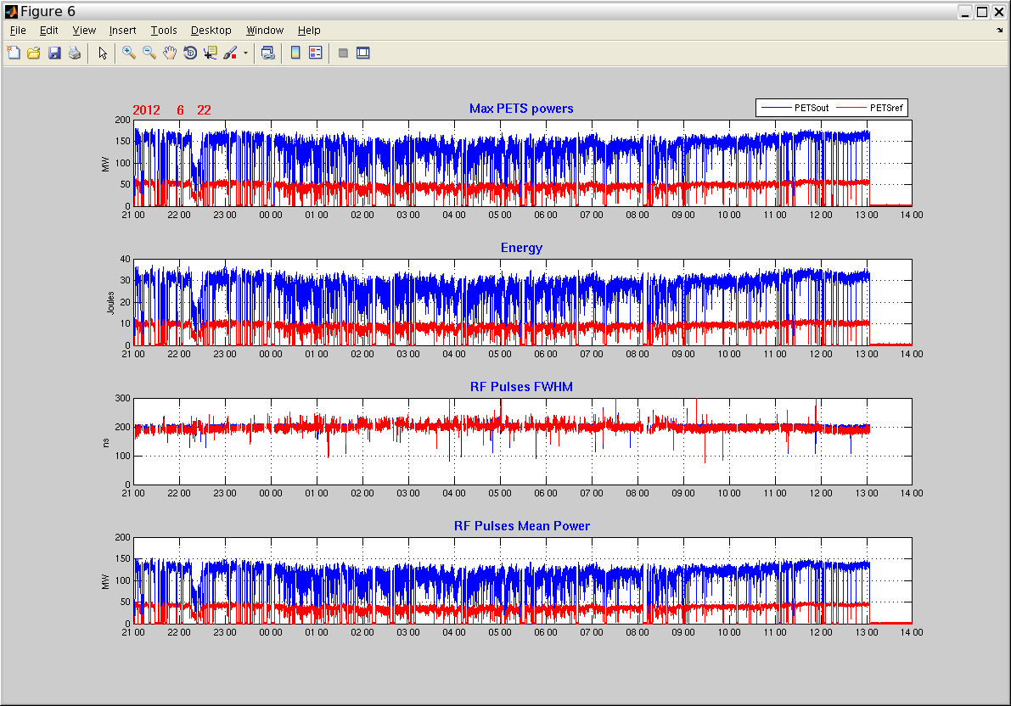
BD studies in TBTS
One of the first nights of TBTS operation
BDR ≈7 10⁻⁴
W. Farabolini

Slide 5
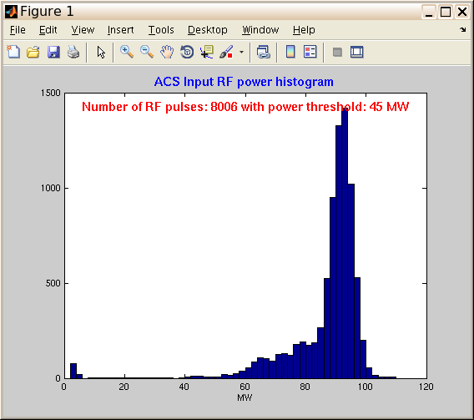
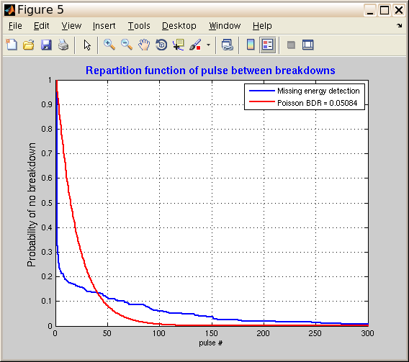
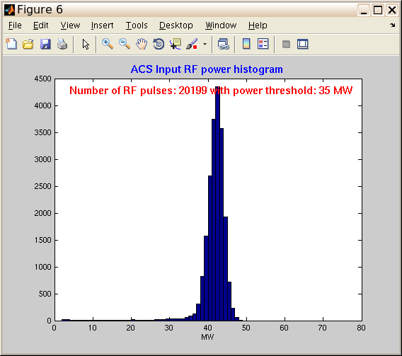
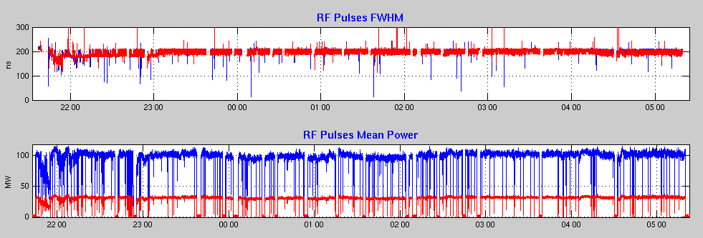
BD studies in TBTS
High-Power TBTS operation
BDR ≈5 10⁻²
Later TBTS operation
Higher rep rate, much more stable beam
W. Farabolini

Slide 6
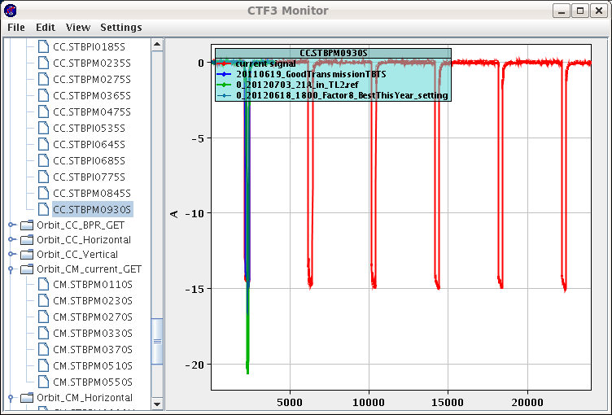
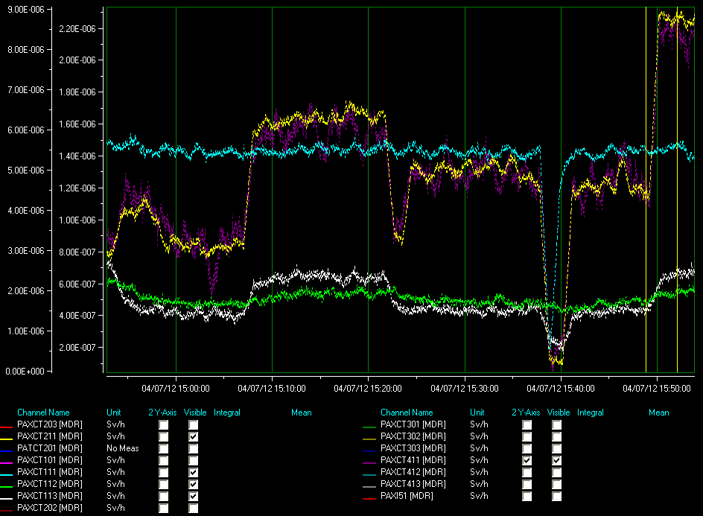
Higher rep rate operation
Radiation monitors
5 Hz, factor 4
BPM, TL2
F. Tecker, G. Dumont

Slide 7
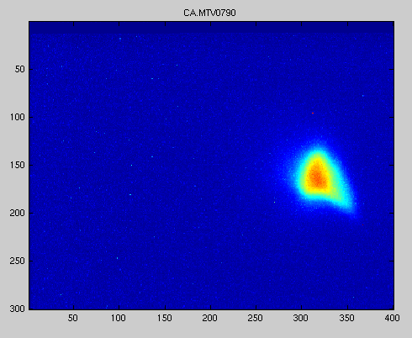
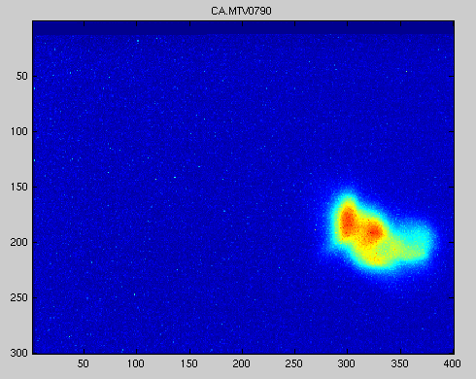
Break-down kicks measurements
First BD kick in 2012
A. Palaia, R. Ruber, W. Farabolini

Slide 8
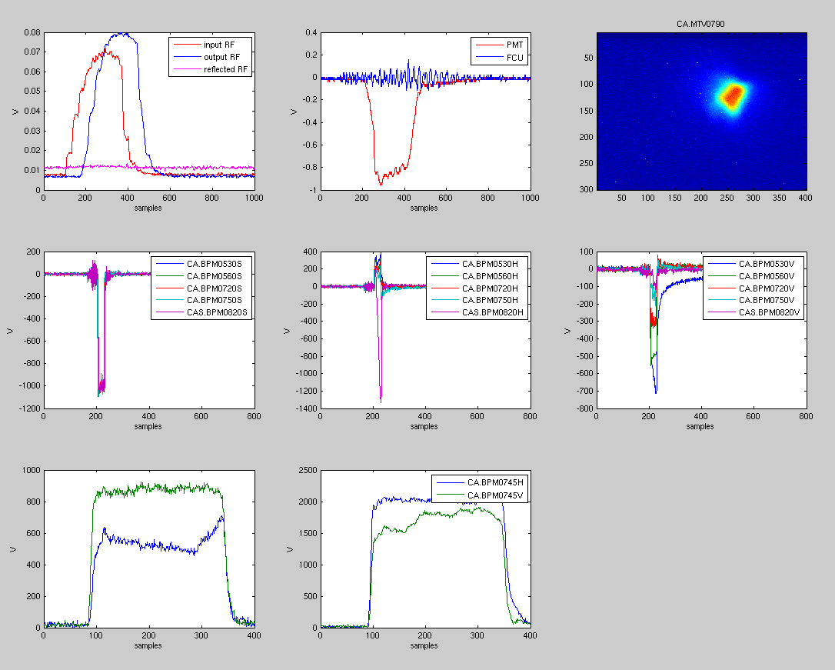
A. Palaia, W. Farabolini

Slide 9
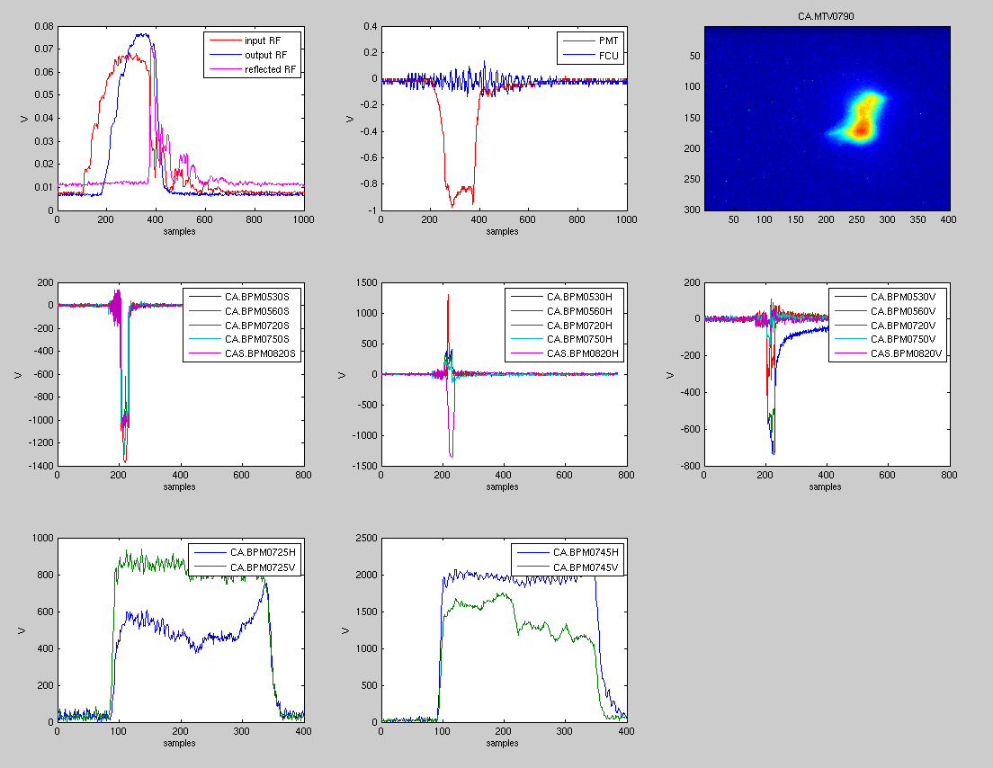
A. Palaia, W. Farabolini

Slide 10
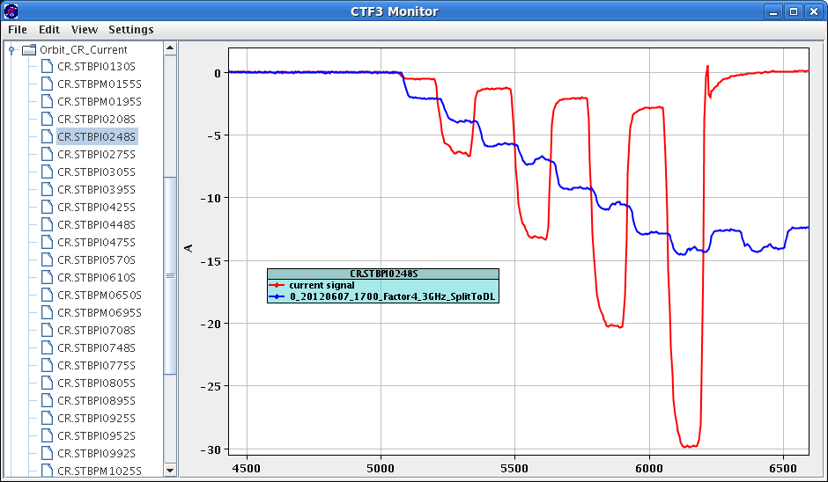
Re-commissioned and improved factor 8 combination

Slide 11
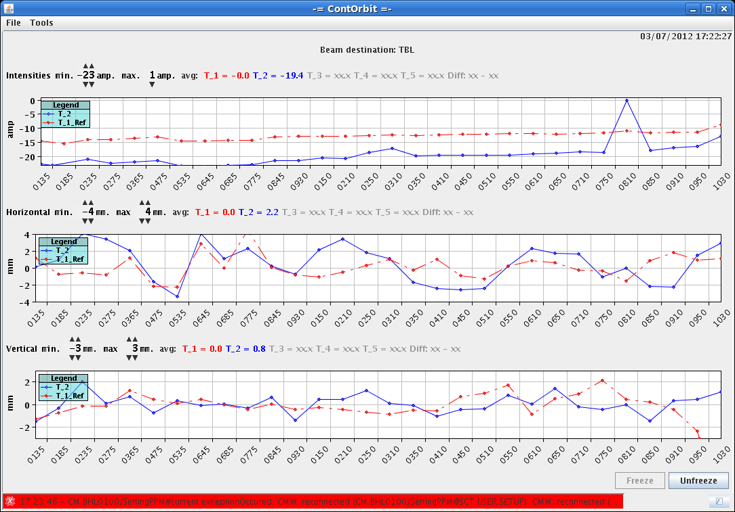
TBL with 13 PETS, transmission with factor 4 & 8
S. Doebert, R. Lillenstol

Slide 12
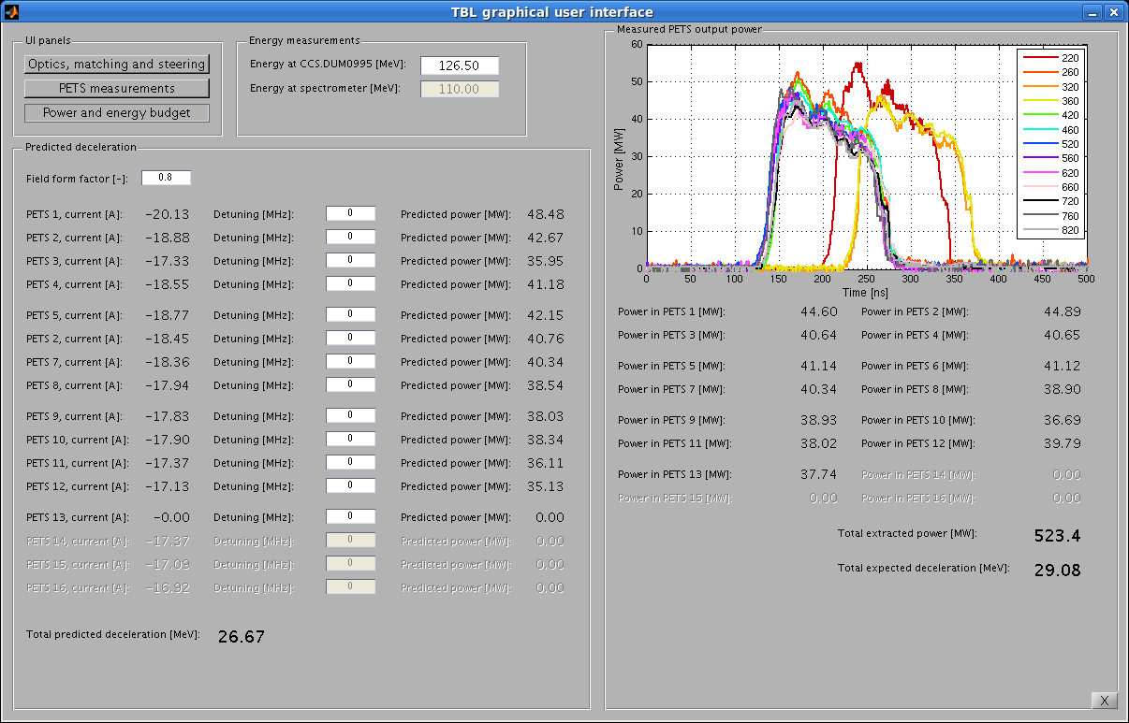
TBL with 13 PETS, first tests with factor 8.
W. Farabolini
R. Lillenstol

Slide 13
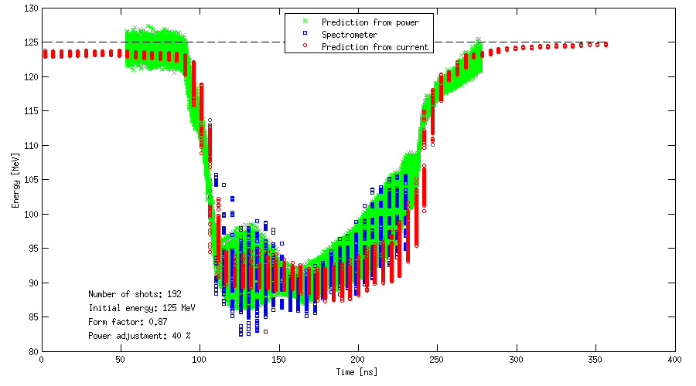
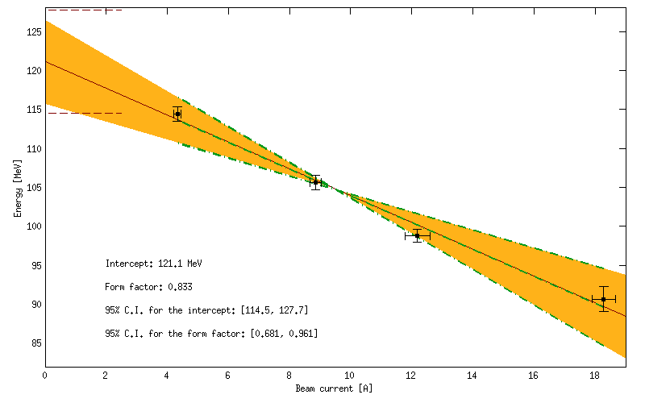
TBL with 13 PETS,
first tests with factor 8.
R. Lillenstol

Slide 14
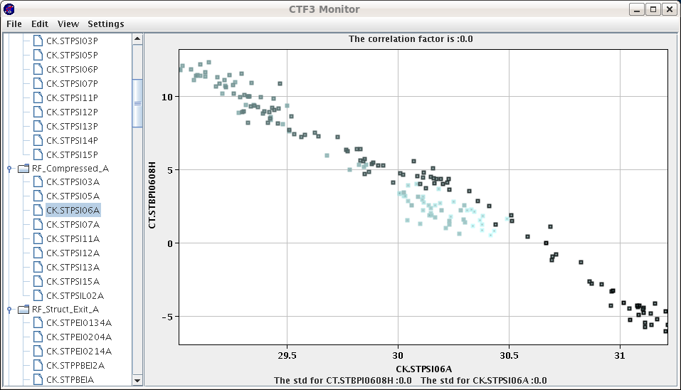
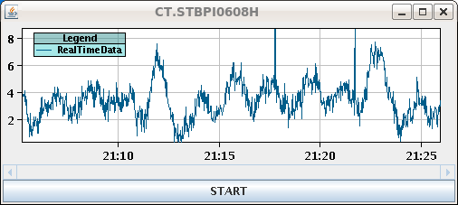
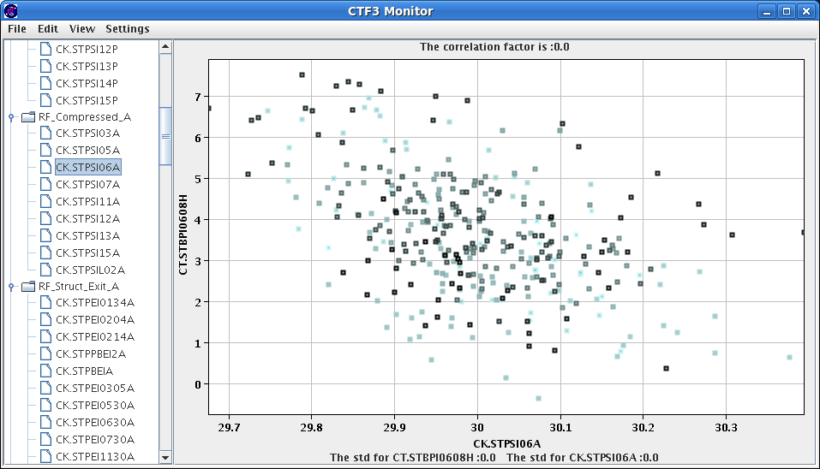
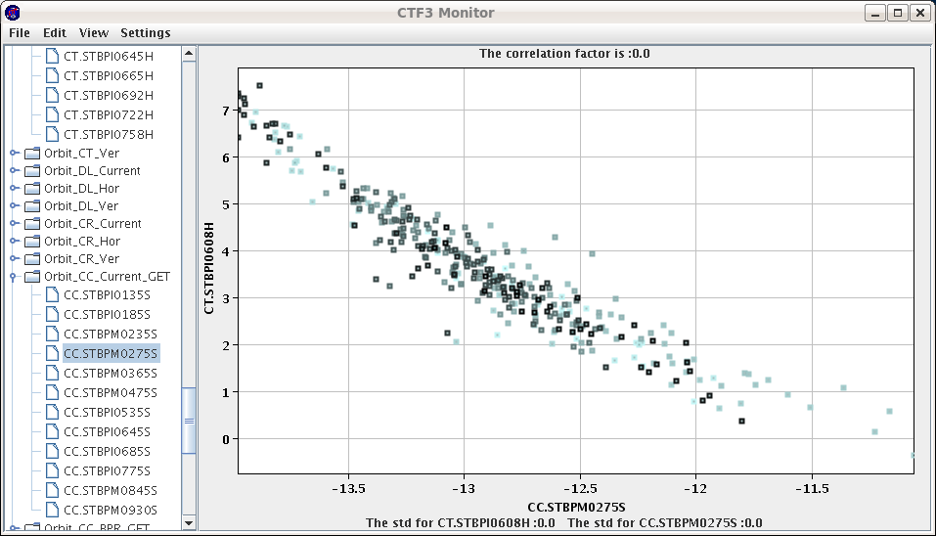
No feedback – Power MKS 06 vs. Hor. Position (momentum)
Energy/Charge stability
RF pulse power flattening feedback
Energy oscillation (temperature)
With feedback – Power MKS 06 vs. Hor. Position (momentum)
With feedback Charge vs. Hor. Position (momentum)
T. Persson, P. Skowronski

Slide 15
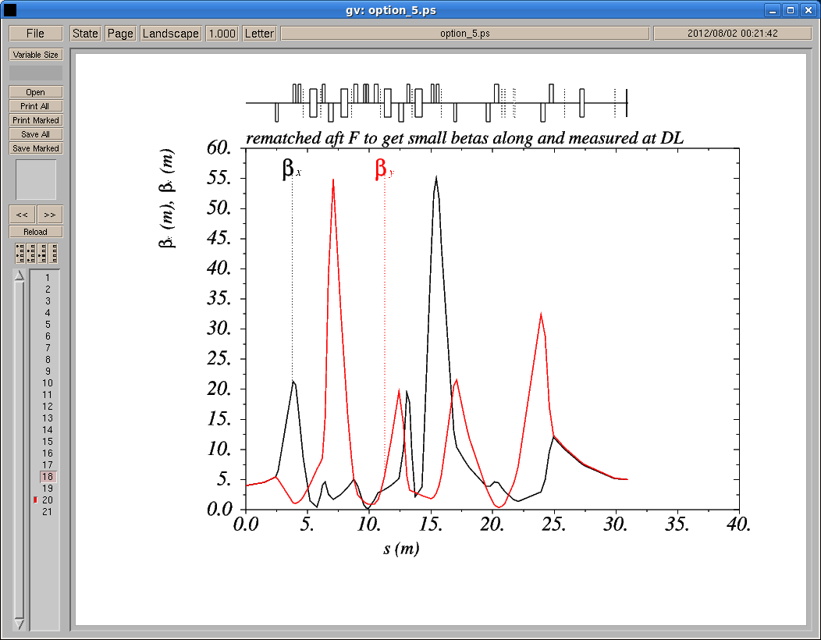
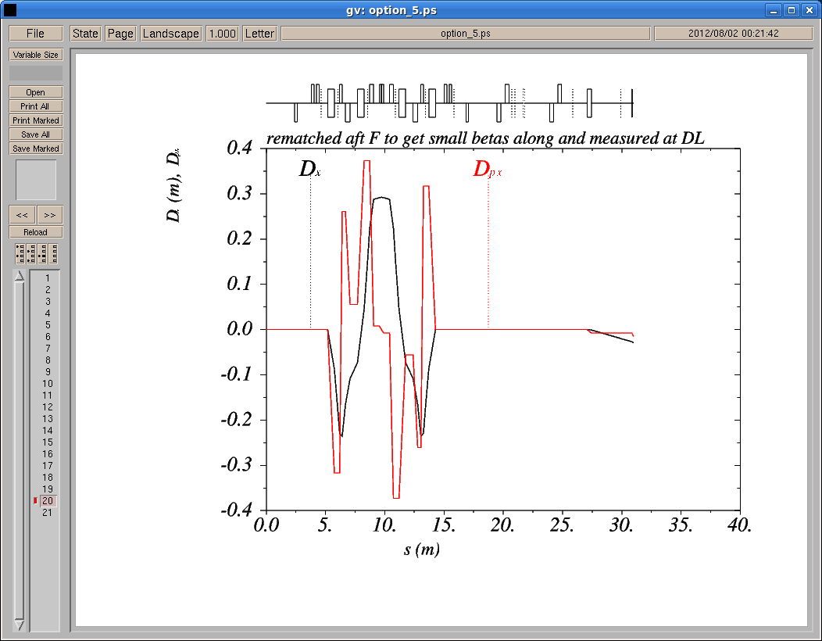
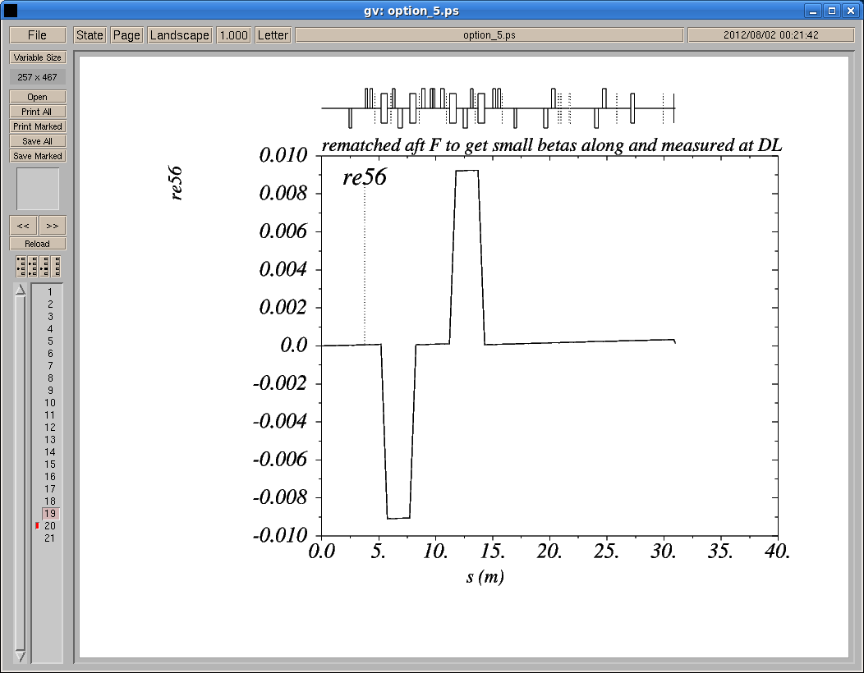
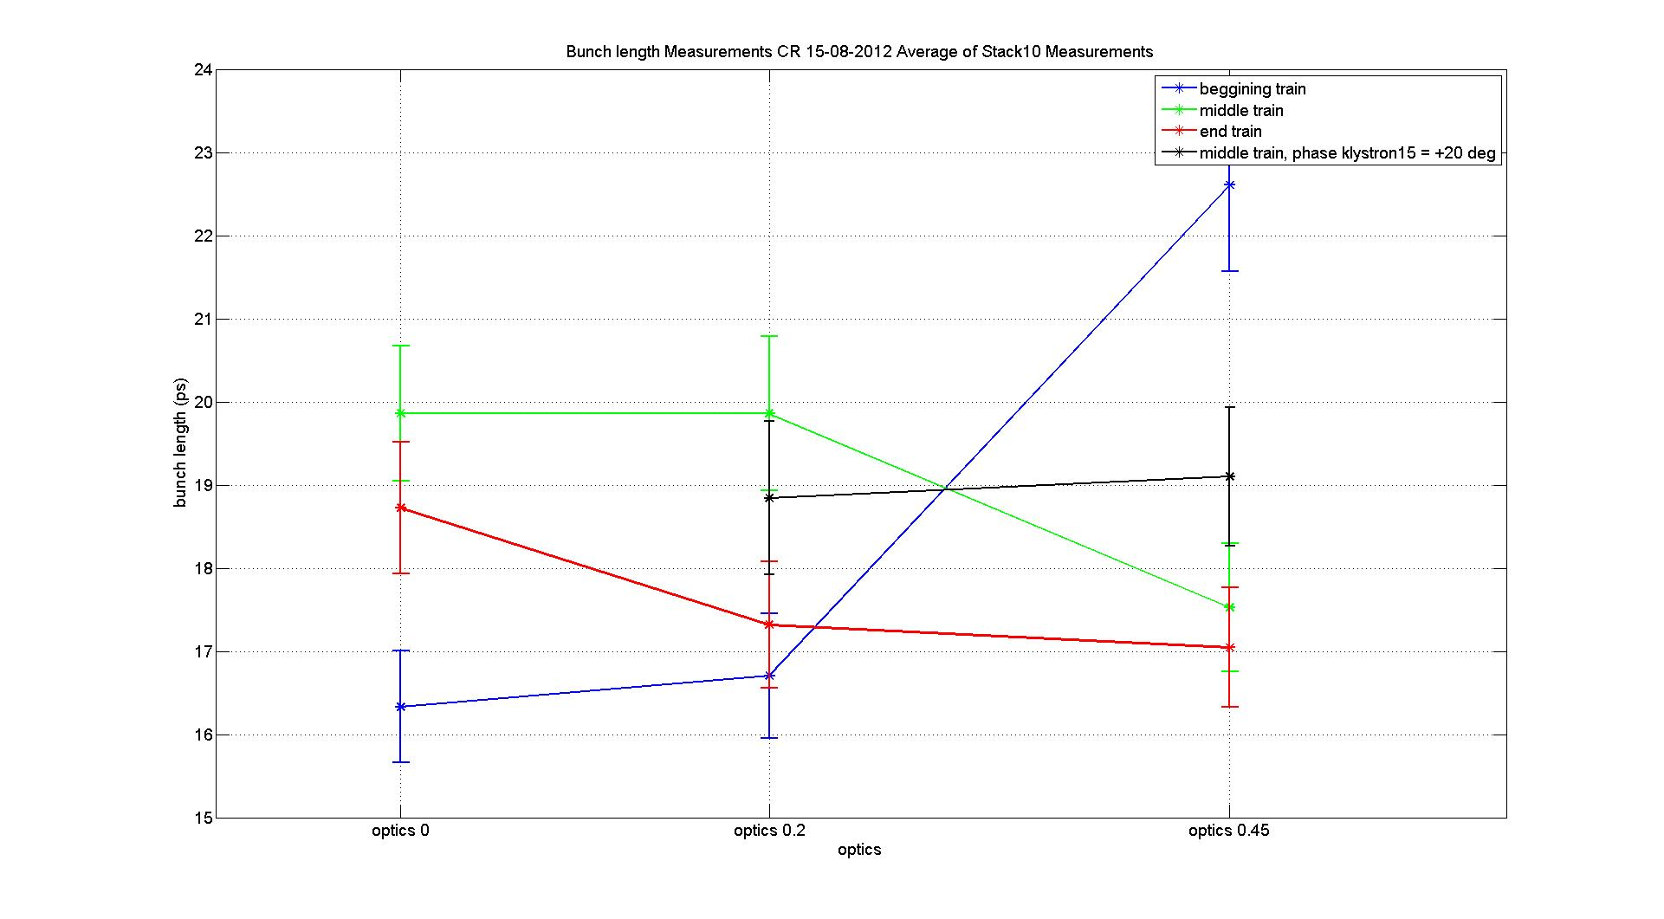
Chicane settings for low R56
P. Skowronski, J. Barranco
A. Goldblatt
Bunch length
measurements

Slide 16
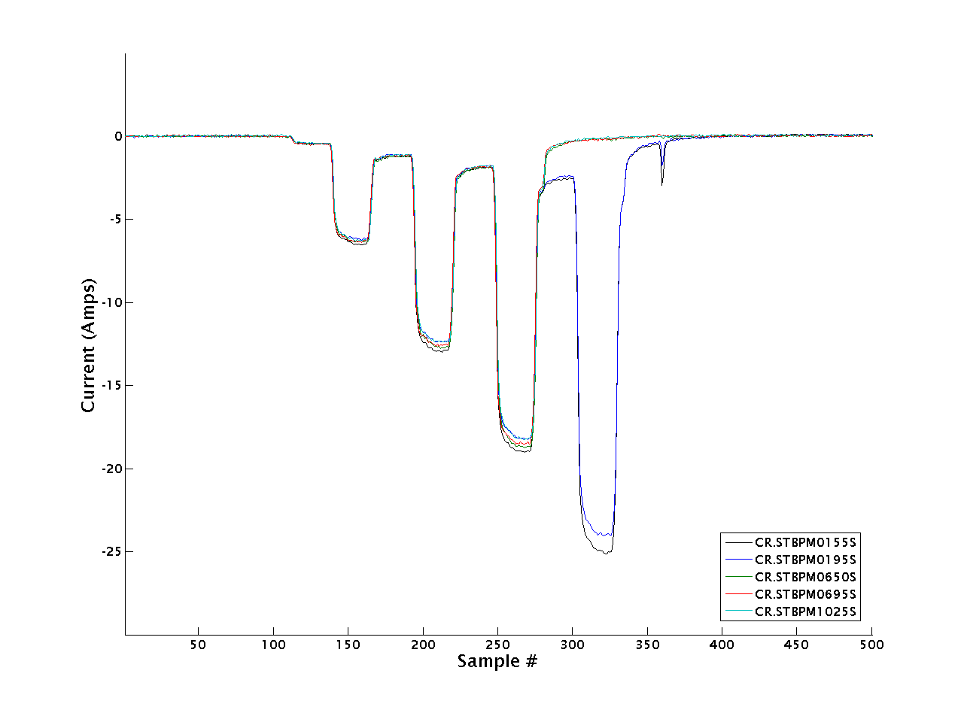
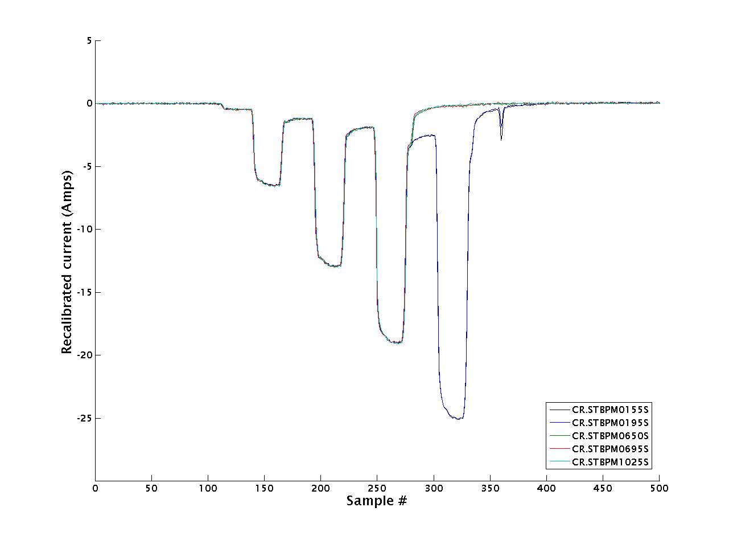
Current Measurement Calibration
CR BPMs
B. Constance

Slide 17
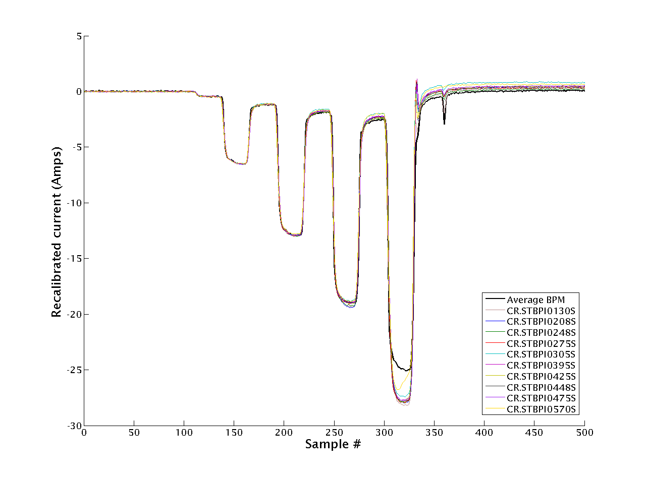
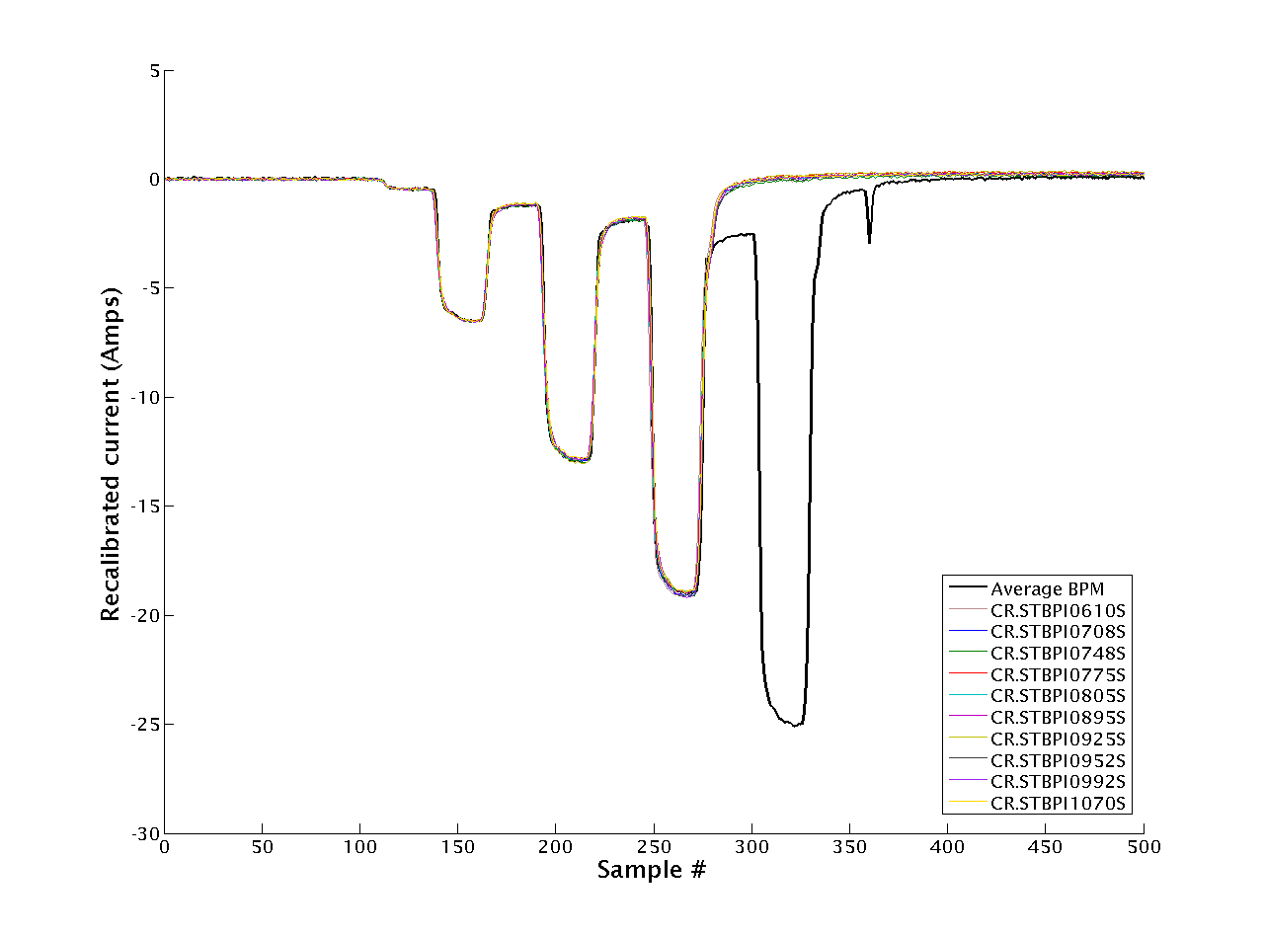
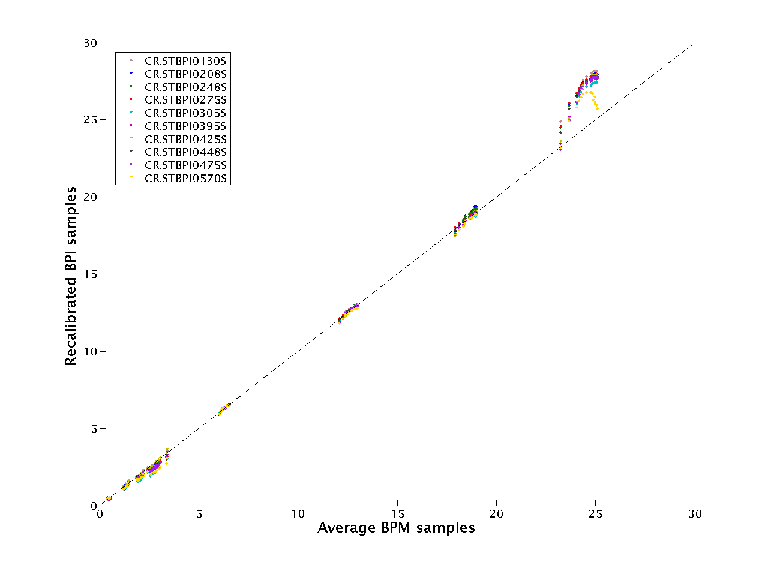
Current Measurement Calibration
CR BPMs & BPIs
B. Constance

Slide 18
CTF3 highlights since last Project Meeting - Installation
New TBTS tank with two accelerating structures installed ready to run from next week.
Drive Beam phase monitor being installed at the end of the linac for test.
Modified temperature stabilization system for RF pulse compression.
Sent dying TWT to repair. Should have it back in time for end of the run. 1st one shows some sign of aging…
Defining scenario for shutdown and running during LS1

Slide 19
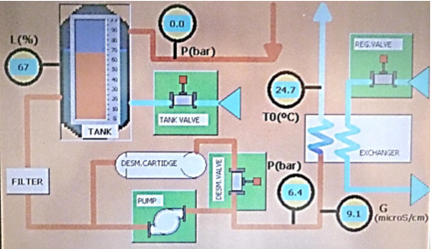
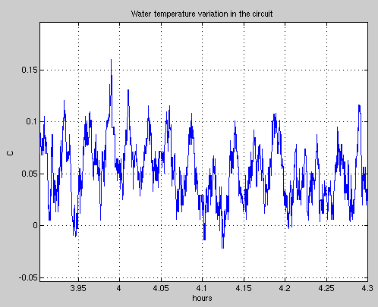
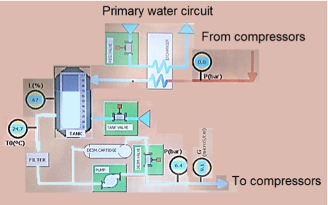
Modifications of the cooling station
A. Dubrowskyi, F. Tecker

Slide 20
Sketch Program
Factor 8 combination – TBL deceleration high current
Commissioning TBTS new tank
Commissioning DB phase monitors
Beam quality improvements (emittance – bunch length)
Run as planned until last week in December
Short Christmas stop (First 2 working weeks in January)
Run until May (June)
Summer shut down – Modulator/Klystrons maintenance

Slide 22
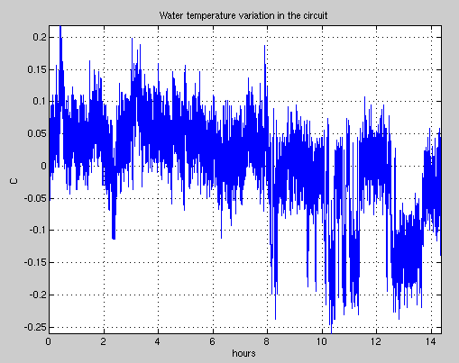
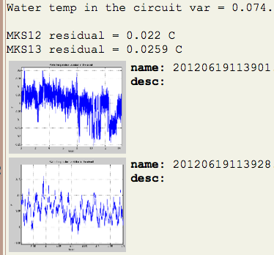

Slide 23
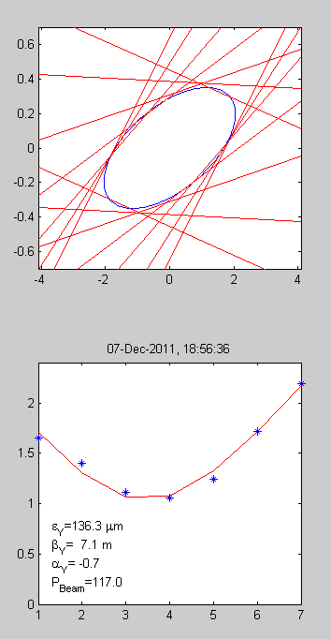
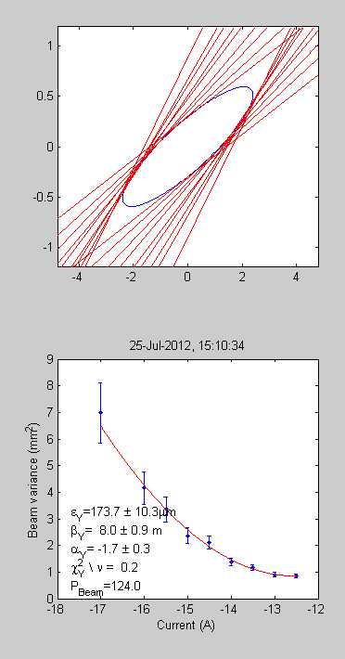
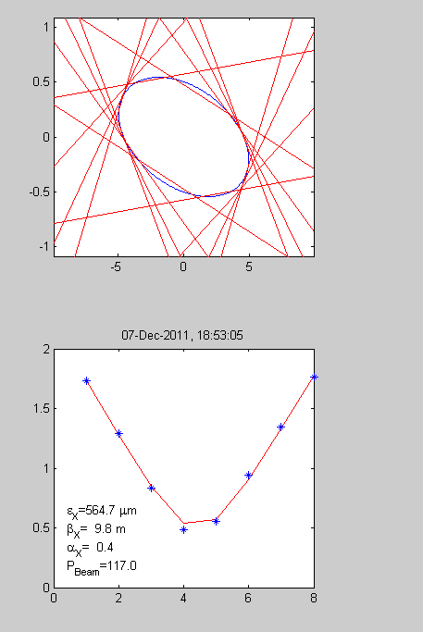
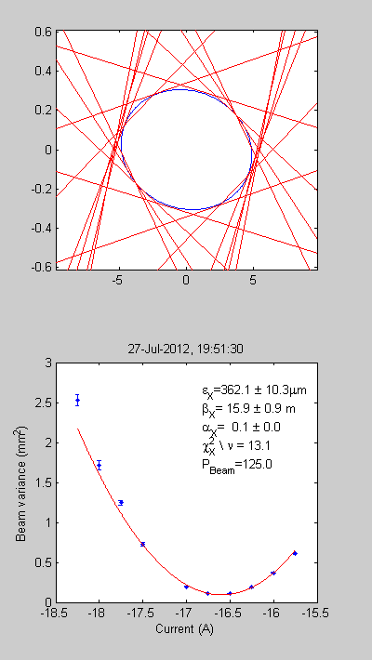
Emittance
Vertical
Factor 4
Horizontal
Factor 4
Factor 8
2012
2012
2011
2011

