Slide 1
CERN RF test-stands progress
I. Syratchev for X-band Testing Activity group
CLIC Project Meeting #8, 30.08.2012

Slide 2
List of high gradient X-band testing stands and testing areas.
KEK
2x50 MW klystrons test station (up to 100 MW peak power). The TD24_R05 structure is being installed. Tests will start soon.
SLAC
ASTA. 2x50 MW klystrons + SLED II (up to 300 MW peak power). Currently negotiating to fund 2000 hours of operation. The TD24_R05 is planned to be the first structure to test.
CERN
- SLAC 50 MW klystron + SLED (up to 130 MW peak power) station #1. The T24/CERN structure is now under the test.
- CPI 50 MW klystron + SLED (up to 130 MW peak power) station #2. Ready mid 2013.
- 4x6 MW + SLED (up to 80 MW x 400 Hz) cluster station #1. Ready late 2014.
- Dog-leg test area. Will be fed by RF power from klystron test station #1. Ready early 2013
- Two-beam Test stand, CTF3. TBTS PETS delivers up to 100 MW peak power. In operation.
CEA
- CPI 50 MW klystron + SLED (up to 130 MW peak power) station #3. Project.
Uppsala University
- CPI 50 MW klystron + SLED (up to 130 MW peak power) station #4. Project.
Dubna
- 4x6 MW + SLED (up to 80 MW x 400 Hz) cluster station #2. Project.
Valencia
- 6 MW x 9.3 GHz klystron station. Project.

Slide 3
50 MW klystron + SLED (up to 130 MW peak power) station #2.
50 MW CPI klystron. The klystron will be first tested in October at SLAC.
“ScandiNova” HV modulator has been ordered from the company. Following the schedule, both should be delivered to CERN in March 2013.
The purchasing order for the electronic cards and equipment is in preparation.
New SLED type RF pulse compressor (CERN/XTA-CEA collaboration). All the pieces are fabricated at CERN. Going trough the final brazing steps. Ready for the low RF power tests in October 2012.
The various RF components under responsibility of BE/RF/PM (pumping ports, gate valves, directional couplers) are ordered from the industry.
First prototypes will arrive to CERN in November 2012 for the acceptance RF check. The rest will be delivered to CERN before March 2012.
The detailed 3D layout and integration of the test stand is underway (XTA together BE/RF/PM).
The test stand location at CERN is not defined yet.

Slide 4
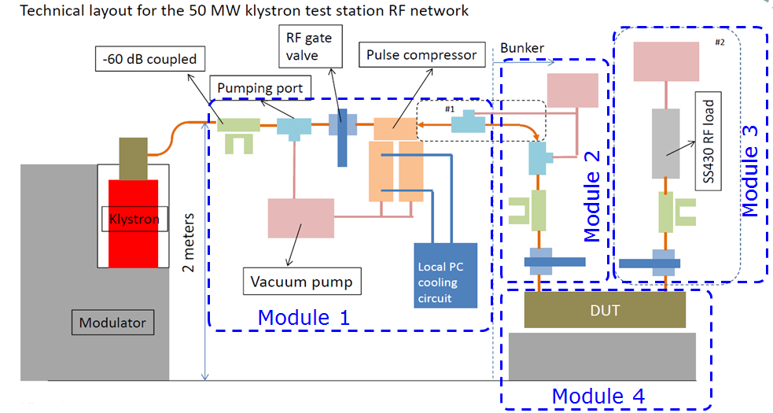
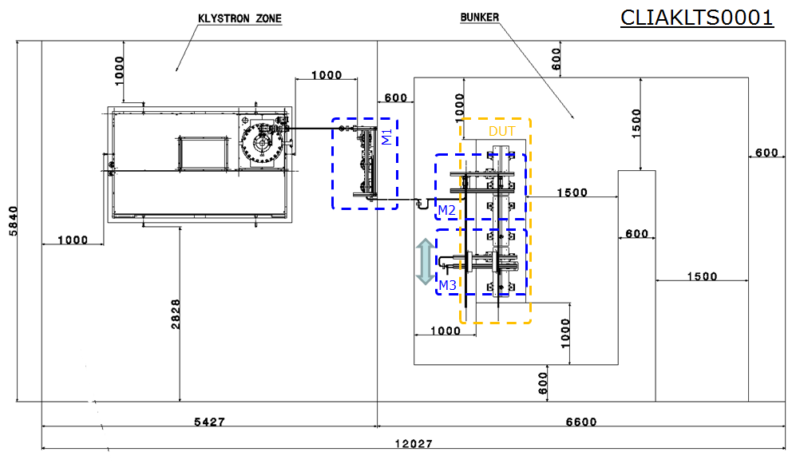
50 MW station #2 technical layout and space reservation.

Slide 5
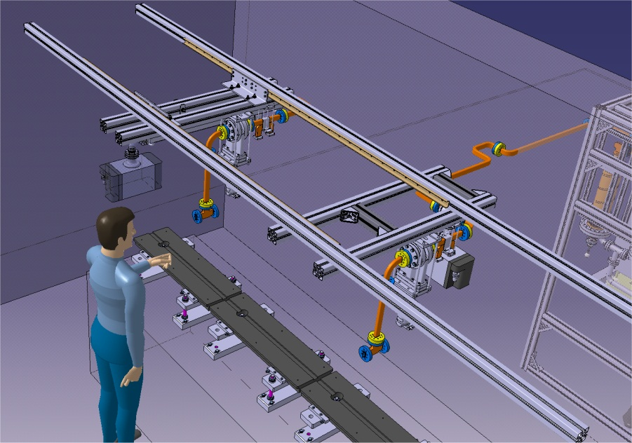
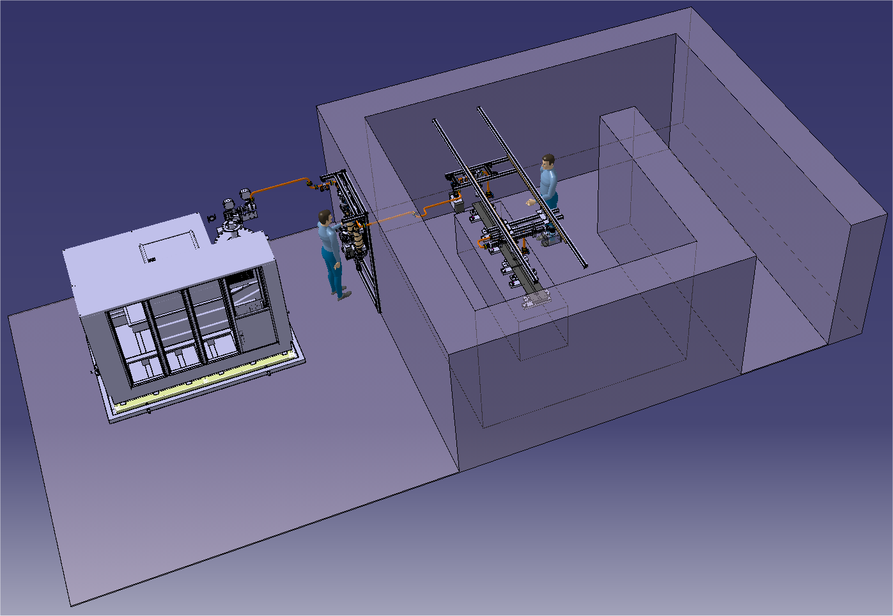
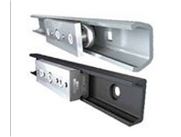
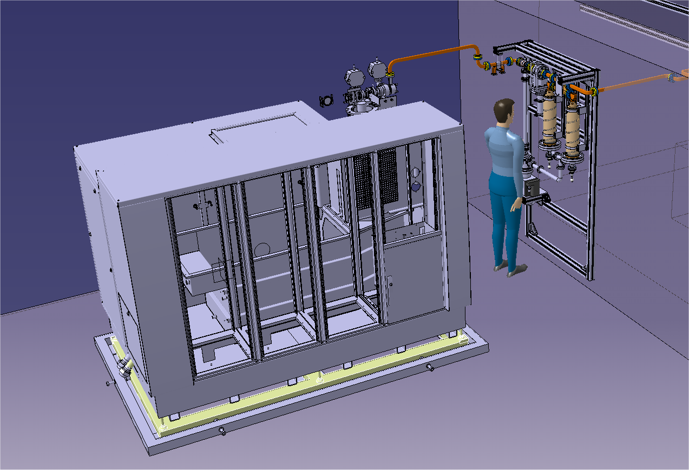
Engineering Design and Integration
Full 3D Layout
Module 1
Module 2
Module 3

Slide 6
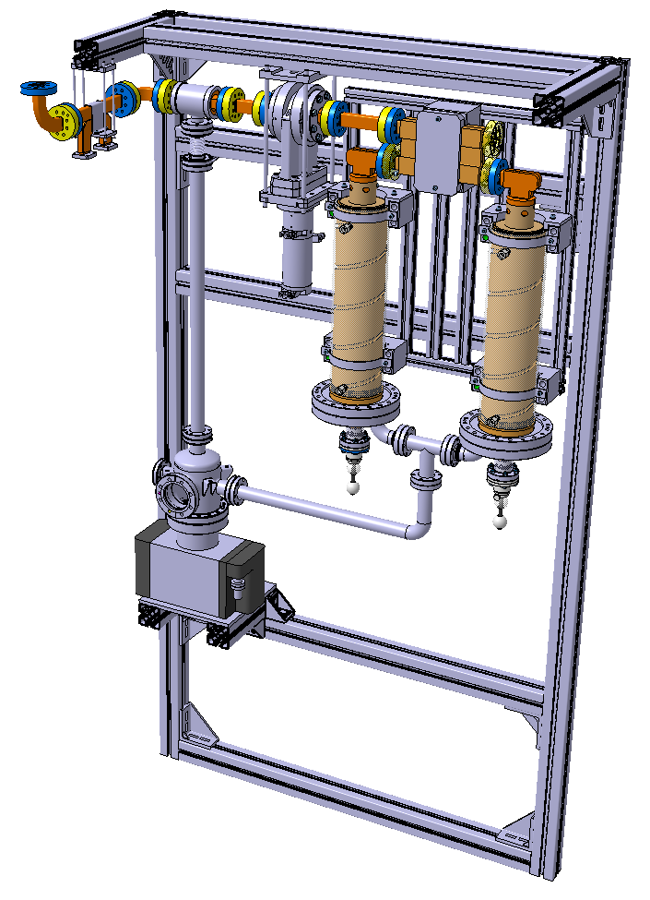
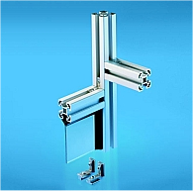
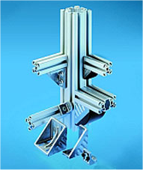
Module 1
RF-interface (connection to klystron)
Supporting frame
The frame can me fixed on the wall; on the floor or ceiling
Bosch Rexroth mechanic elements are used to assemble the frame
Vacuum Network
RF-interface (connection to module 2)
Vacuum Pump
VARIAN VACION PLUS 75
Cooling system interface

Slide 7
4x (6 MW + SLED) cluster station #1. Up to 80 MW x 400 Hz.
The Market Survey for the turnkey solution (klystron + modulator) was sent out of CERN. 6 companies are on the mailing list.
The RF components are similar to the ones used in 50 MW klystrons test stand #2, some of them are already in the production pipeline.
The detailed 3D layout and integration of the cluster test stand (needed also for the space reservation) will be done in September - October 2012.
The cluster test stand location at CERN is not defined yet.

Slide 8
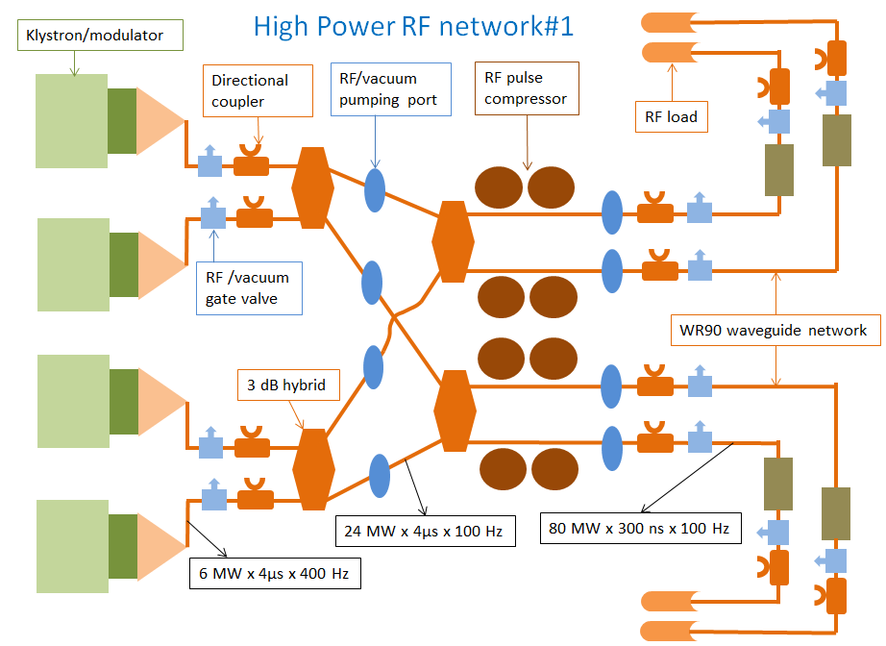
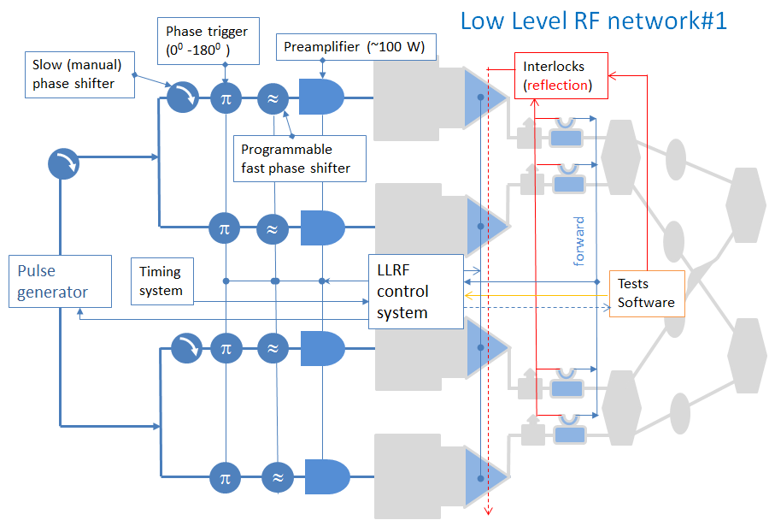
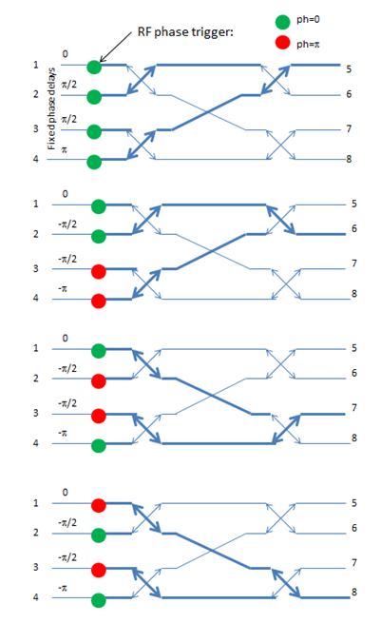
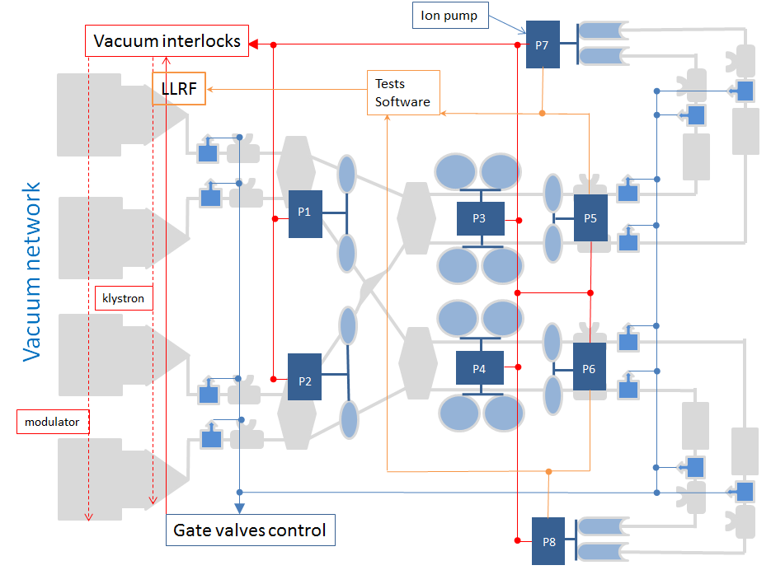
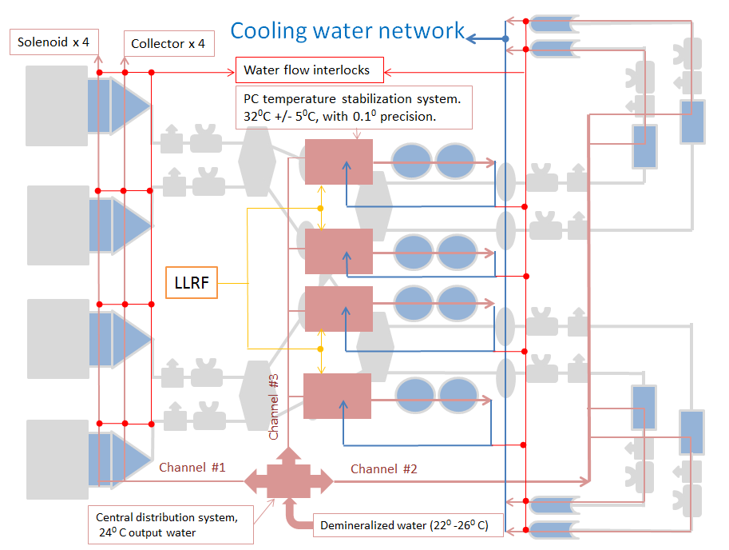
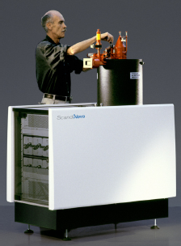
4x (6 MW + SLED) cluster station technical systems diagrams

Slide 9
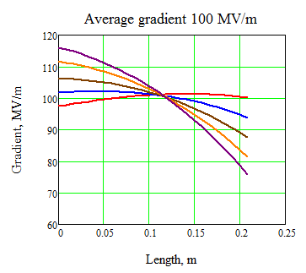
Dog-leg test area for the experiments with beam loading
Unloaded
Testing of accelerating structure with nominal beam loading is a missing block in our testing program.
Such a test will be done using CTF3 drive beam and RF power delivered from 50 MW klystron station #1 via modified 30 GHz low loss transfer line.
Inserting more loads racks
Fully loaded
All overmoded RF components (designed and fabricated in CEA) are in stock.
The accelerating structure (T24) is prepared and placed on its final girder.
The missing RF components (pumping ports, gate valves) are ordered from the industry and will arrive to CERN in November 2012
The installation will be done during 2013 winter shutdown.

Slide 10
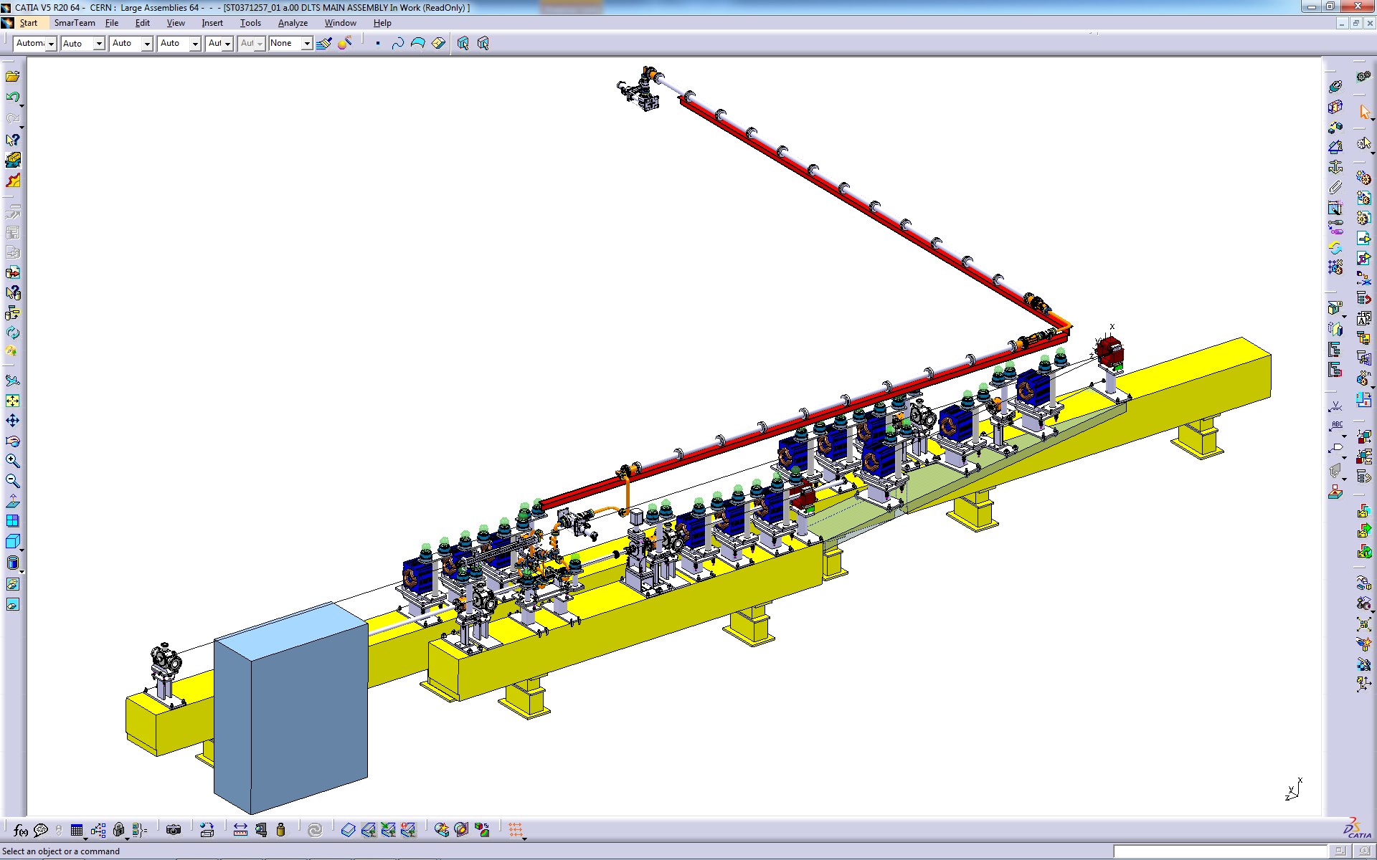
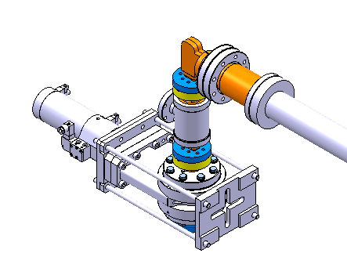
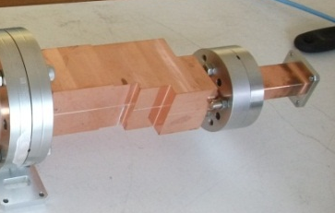
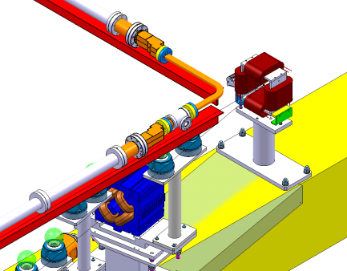
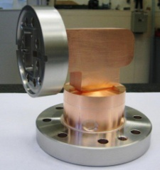
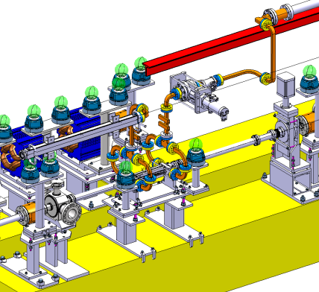
Dog-leg layout
RF
Beam
Anastasiya Solodko, BE-RF-PM

Slide 11
SLAC 50 MW klystron + SLED. Station #1, a.k.a. Xbox1
The test station is up and running.

Slide 12
Xbox 1 status end of august 2012 (1)
Klystron, modulator and subsystems are fully operational
Conditioning and data acquisition software under development/commissioning
Rf DAQ system nearly is nearly completed, last parts will arrive next week
Within ~100h, T24 was conditioned up to 88MV/m x 170ns: ~10⁻⁶ BDR (no compression)
Pulse compressor commissioning:
Proofed to have a fault in design - it needs active mechanical and frequency tuning if the RF conditions are changing. To overcome, the special control software is now under development and testing.
First results are promising.
Stable operation at 30MW, 170ns, 50Hz achieved for several hours.
Not yet ready for non- surveyed operation.
Jan Kovermann

Slide 13
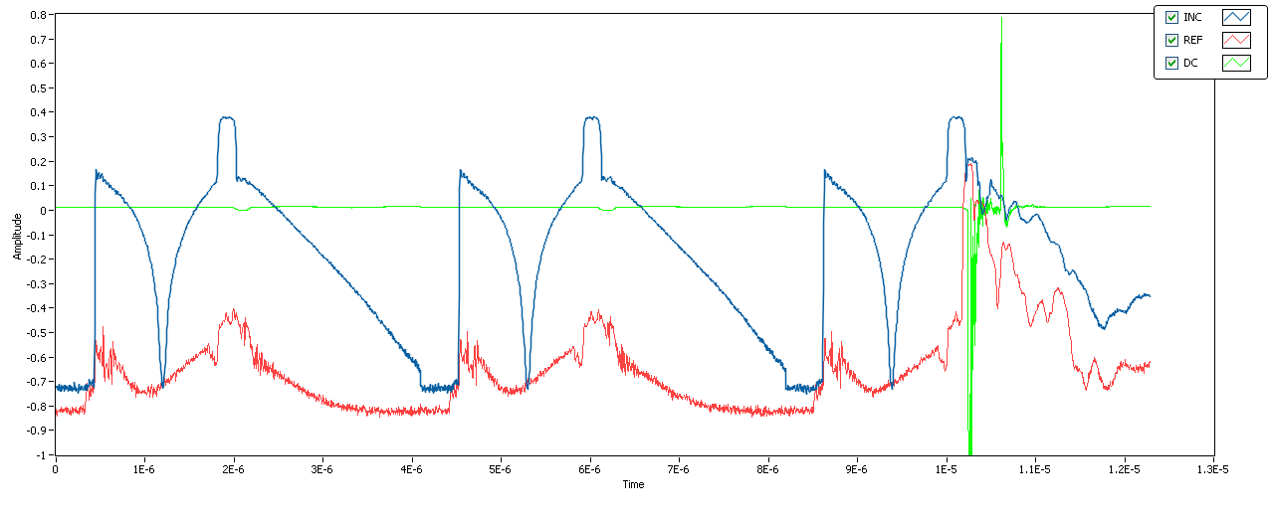
Xbox 1 status end of august 2012 (2)
NI LabView based software for test stand control and rf DAQ is under development
New rf-log detectors implemented for high dynamic range acquisition
The last Rf cannel (transmitted power) will be in a system next week
Example: Log power and dark current display of breakdown event :
Routine operation foreseen in October (this year!)
Jan Kovermann

