Slide 1
CLIC Project Meeting
Sept 2012
Various news:
CDR documents
Strategy Documents
LCWS2012

Slide 2
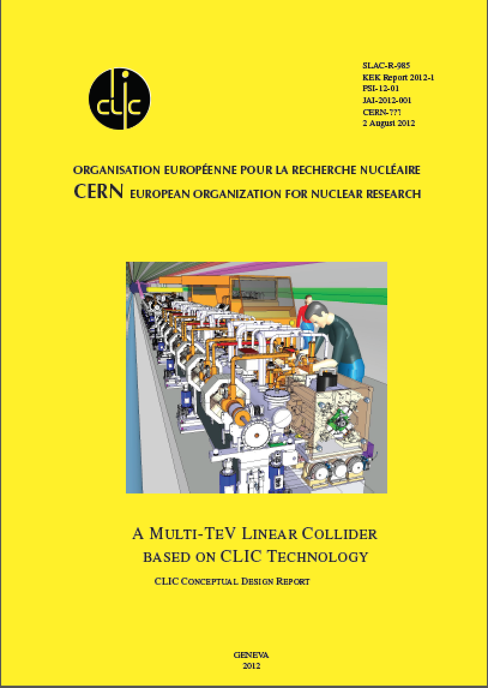
Volume 1:
Submitted to Yellow Report team, answer received (mainly related to figures), placement of logo, etc - etc … iterations in progress
CERN ref number not there yet
Link: http://project-clic-cdr.web.cern.ch/project-CLIC-CDR/CDR_Volume1.pdf

Slide 3
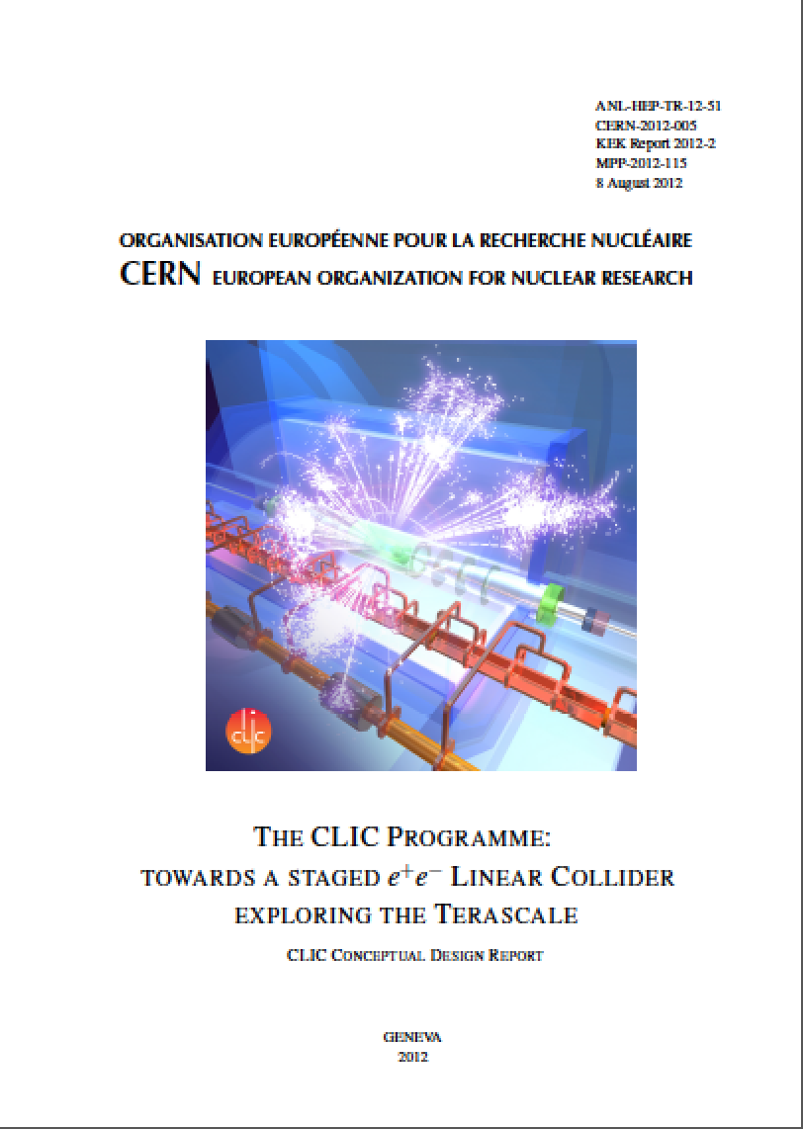
Volume 3:
Submitted to Yellow Report team and accepted, (being) launched for test-print.
CERN ref number given.
Links: https://edms.cern.ch/document/1235960/
To get printed document: https://indico.cern.ch/conferenceDisplay.py?confId=203399

Slide 4
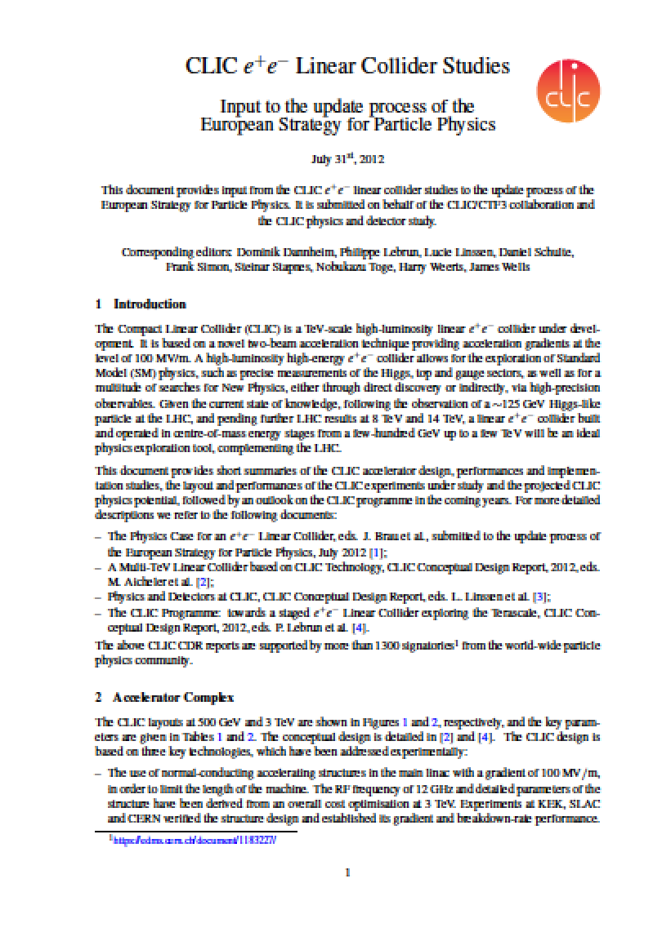
Input to the European Strategy, 15 pages with summary of summaries
Links to all submissions: http://indico.cern.ch/internalPage.py?pageId=3&confId=175067
Our input: https://indico.cern.ch/abstractDisplay.py/getAttachedFile?abstractId=99&resId=0&confId=175067

Slide 5
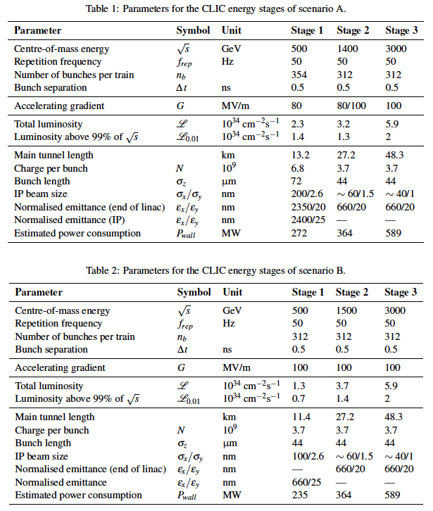
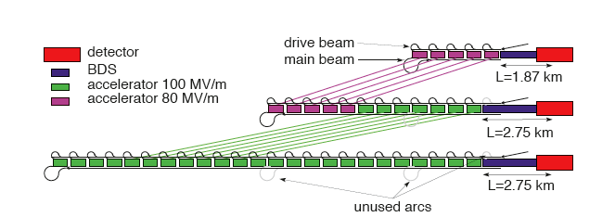
Possible CLIC stages studied

Slide 6
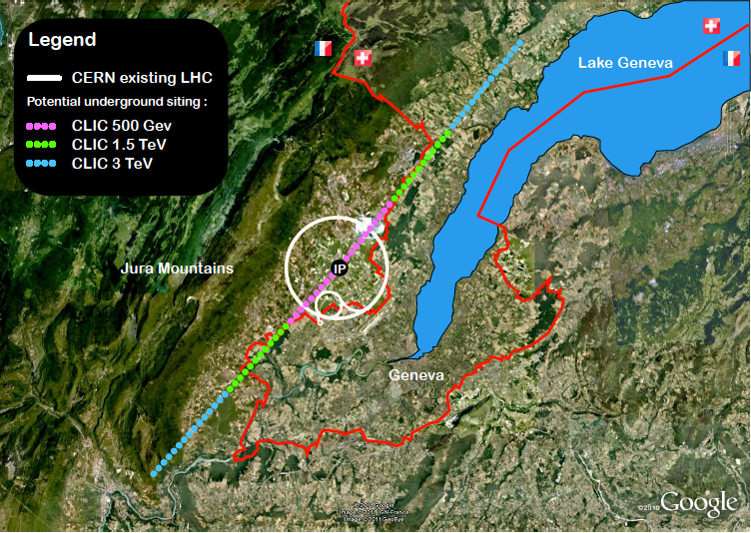
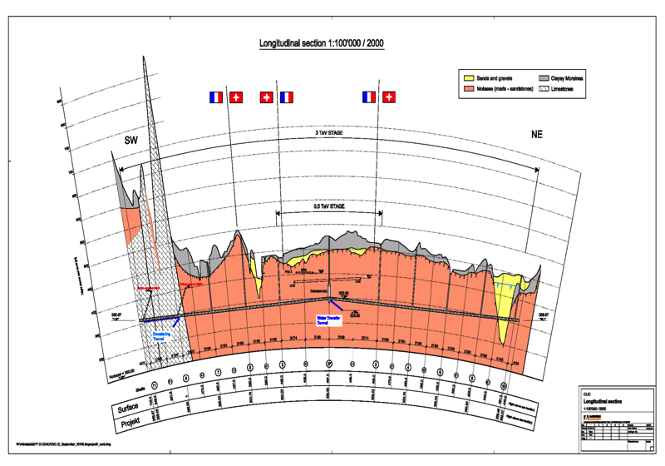
Tunnel implementations (laser straight)
Central MDI & Interaction Region

Slide 7
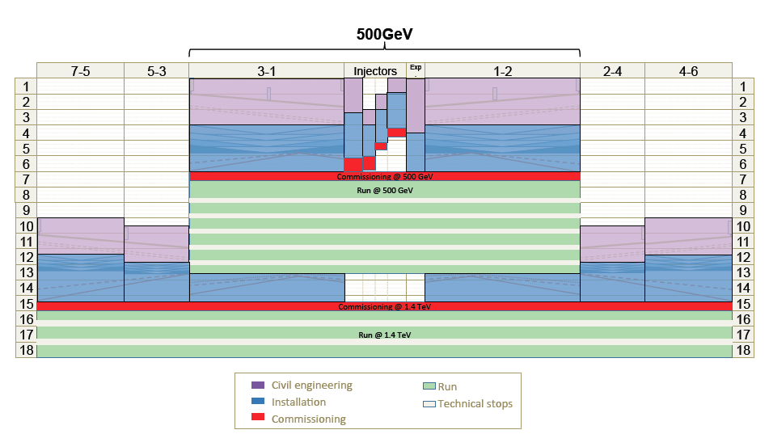
Schedule first two stages

Slide 8
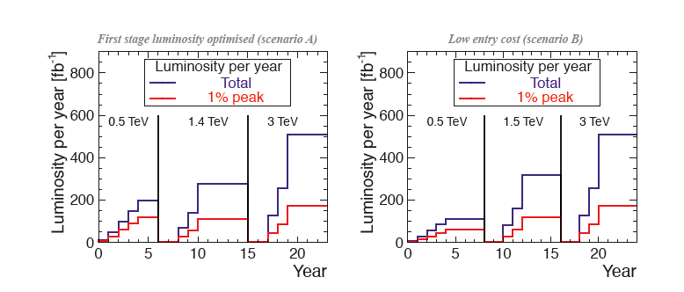
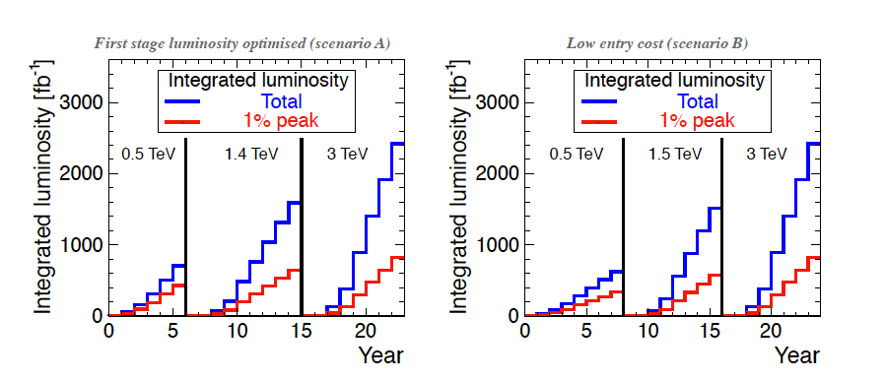
Possible luminosity examples
Notes:
For each value of CM energy:
177 days/year of beam time
188 days/year of scheduled and fault stops
First year
59 days of injector and one-by-one sector commissioning
59 days of main linac commissioning, one linac at a time
59 days of luminosity operation
Quoted power : average over the three periods
All along : 50% of downtime
Second year
88 days with one linac at a time and 30 % of downtime
88 days without downtime
Quoted power : average over the two periods
Third year
Still only one e+ target at 0.5 TeV, like for years 1 & 2
Nominal at 1.5 and 3 TeV
Power during stops (scheduled, fault, downtime) :
(40 MW, 45 MW, 60 MW) at (0.5, 1.5, 3) TeV, respectively
The possible « economy » (see blue curves):
Sobriety
Reduced current density in normal-conducting magnets
Reduction of heat loads to HVAC
Re-optimization of accelerating gradient with different objective function
Efficiency
Grid-to-RF power conversion
Permanent or super-ferric superconducting magnets
Energy management
Low-power configurations in case of beam interruption
Modulation of scheduled operation to match electricity demand: Seasonal and Daily
Power quality specifications
Waste heat recovery
Possibilities of heat rejection at higher temperature
Waste heat valorization by concomitant needs, e.g. residential heating, absorption cooling

Slide 9
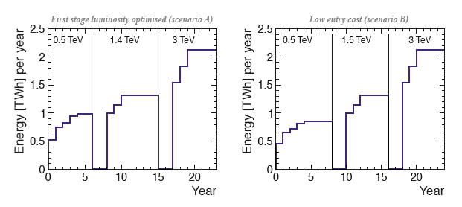
A possible energy/luminosity example
With a model for energies and luminosities, and assumptions about running scenarios, one can extract power and energy estimates as function of time (details in CDR text)

Slide 10
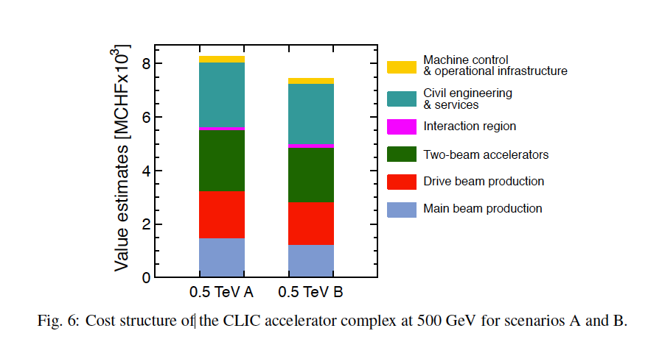
Costs
First to second stage: 4 MCHF/GeV (i.e. initial costs are very significant)
Caveats:
  Uncertainties 20-25%
  Possible savings around 10%
  However – first stage not optimised (work for next phase), parameters largely defined for 3 TeV final stage

Slide 11
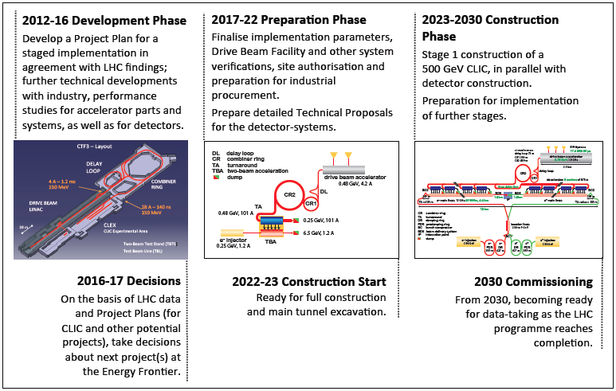
CLIC project time-line

Slide 12
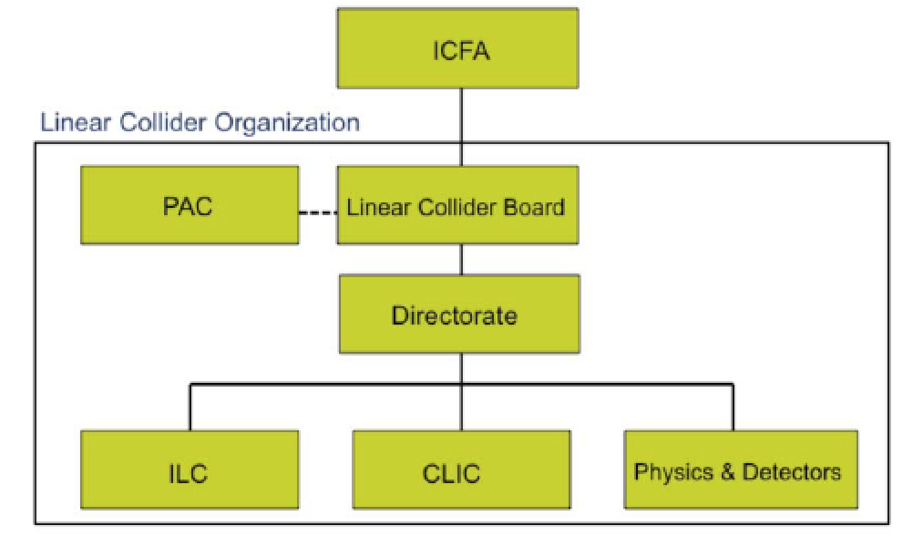
LC organisation
Lyn Evans appointed director for the LC efforts (starting in 2013) – ICFA announced in June
  He will participate in the CSC Tuesday
Also recent discussions of the European Members of the LCB and advisory group

Slide 13
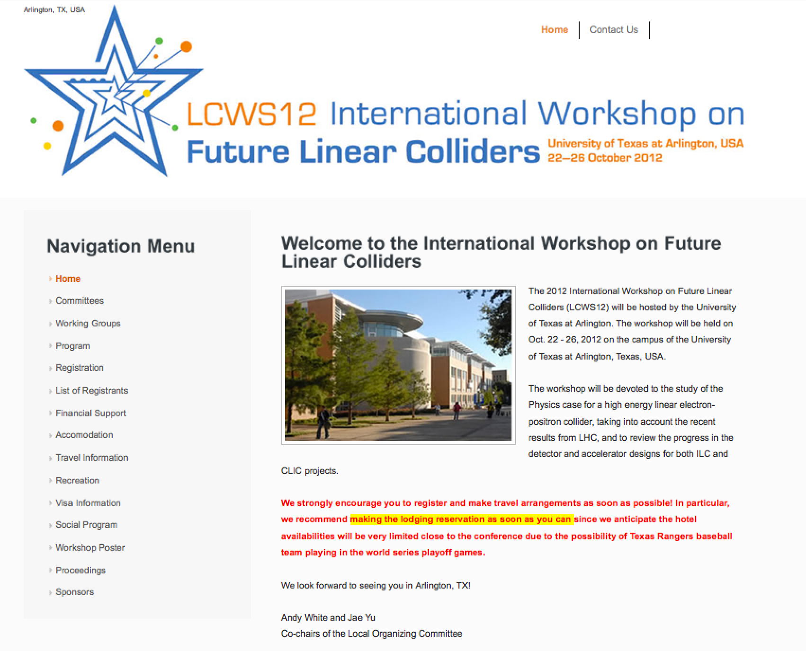
LCWS 2012
Today is the deadline for “cheap” registration
Draft agenda at: http://ilcagenda.linearcollider.org/conferenceOtherViews.py?view=standard&confId=5468

Slide 14
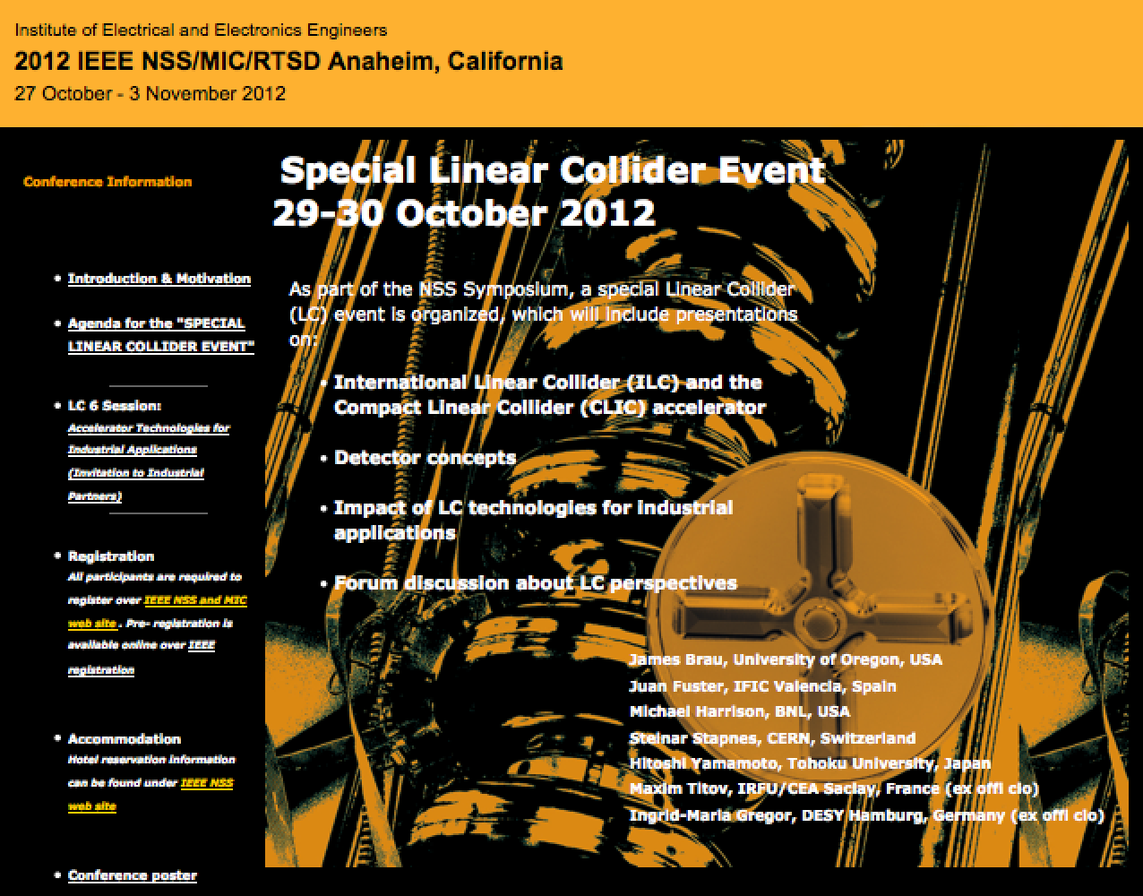
Special IEEE event
Programme: https://indico.cern.ch/getFile.py/access?contribId=0&resId=0&materialId=1&confId=200468

