Slide 1
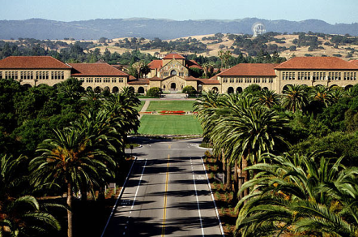
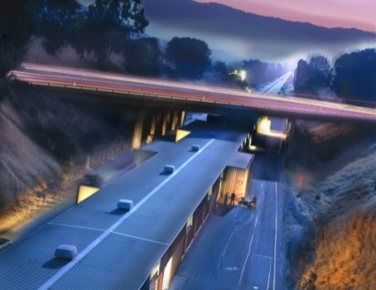

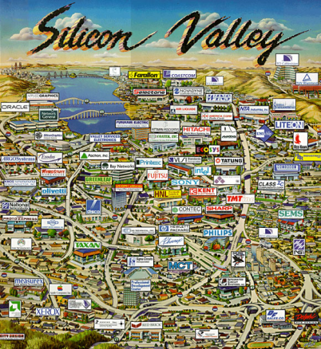
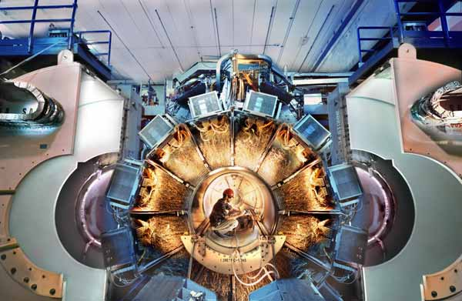
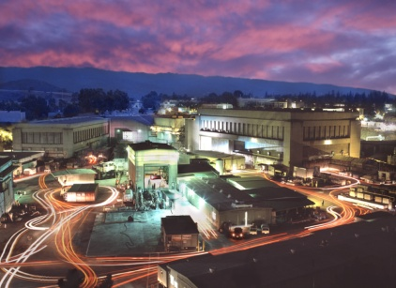
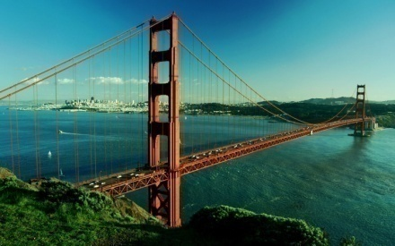
Welcome to the 40th SLAC Summer Institute
JoAnne Hewett, Tom Rizzo
Stefan Funk, Su Dong
Notes:
1

Slide 2
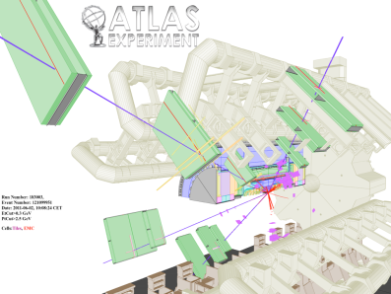
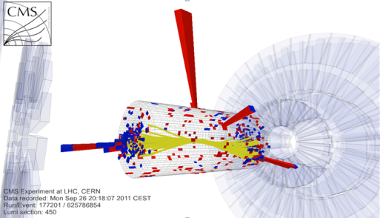

A Special Year
Higgs Discovery ?
50th Anniversary of SLAC
40th Anniversary of the SSI

Slide 3
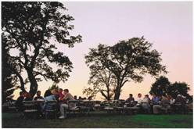
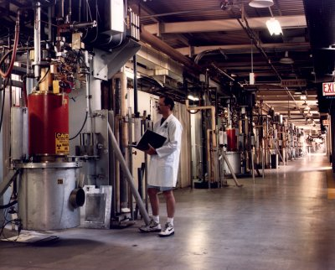
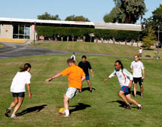
Event Signup
Dinner:
Tuesday Jul/24 – Only limited tickets left
Monday Jul/30 – Sign up by noon Wed. Jul/25
Thursday Aug/2 – Sign up by noon Wed. Jul/25
Tour of LINAC Klystron Gallery:
Thursday Jul/26, Tuesday Jul/31
Tour of Kavli Visualization Lab
Thursday Aug/2
=> Signup board outside Kavli auditorium
SSI vs SLAC soccer game
Wednesday Aug/2
=> Signup board outside Kavli auditorium

Slide 4
Daily Operations
Lunch is on yourself at cafeteria
Check program page for evening social events, poster sessions.
Practical Information
  Check for updates on the “SLAC Campus” page on the SSI web page for updates.
    Printing, ATM machine, late night food access etc.

Slide 5
Lectures
Lecture and topical conference slides can be found at both the Indico upload site and the program page.
Qestions on lectures should be submitted through online form on top of the Program/Indico page to discuss at the Tuesday/Thursday Q&A sessions.
Contest question for this year’s SSI:
“What’s the meaning of the discovery of the Higgs boson ? If it is the ‘Higgs’, how would you name it ?”
Submit answers in paper box “Contest question” by Wednesday Aug/1. Award announcement Aug/2.

