Slide 1
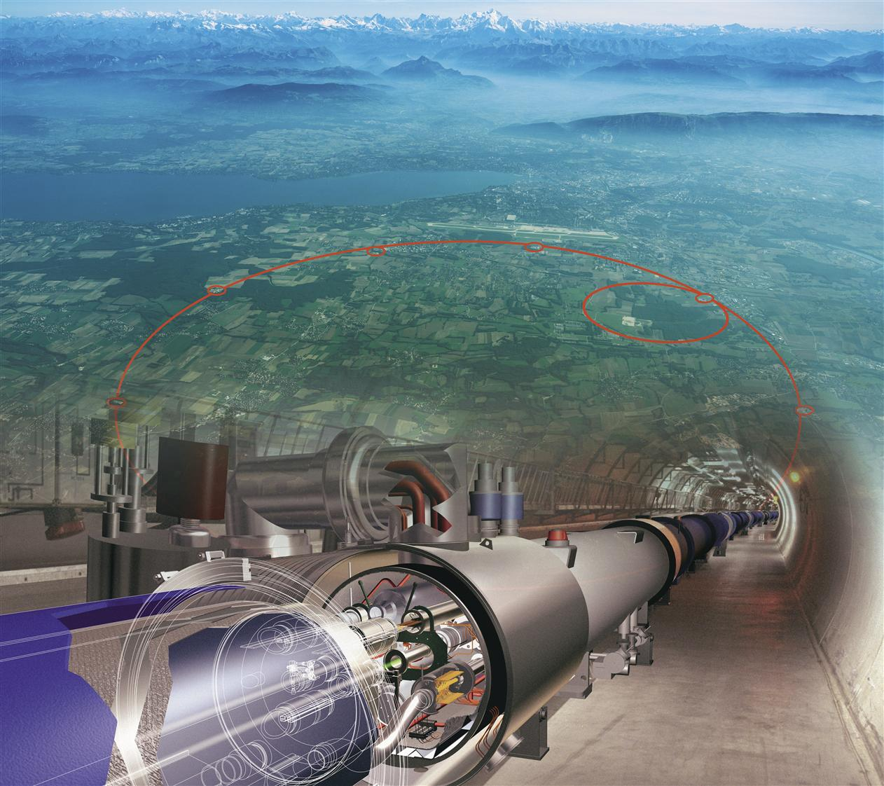
The Hunt For The Higgs Boson
Vivek Sharma
University of California, San Diego

Slide 2
Landscape of The Hunt Circa 2010
Excluded mass range from direct searches :
Tevatron
158
175
LEP
0
100
200
300
400
500
600
700
800
900
1000
114
Hypothetical Higgs mass ( GeV)
LHC designed to search for Higgs with mass >100 GeV

Slide 3
Higgs Decay Rate Vs M_{H}

Slide 4
[Production Cross section × Decay Rate] Vs M_{H}
Significance of a search depends on ability to trigger on event
& restrict background processes that mimic Higgs signature

Slide 5
Higgs Search Sensitivity: By Mass & By Mode
For a given M_{H}, sensitivity of search depends on
  Production cross section
  Its decay branching fraction into a chosen final state
  Signal selection efficiency (including trigger)
  Mass resolution (intrinsic and instrumental)
  Level of SM background in same or similar final states
In low mass range:
  H→ γγ and H→ ZZ → 4l play a special role due to excellent mass resolution for the di-photon and 4-lepton final state
  H→ WW→ (lν)(lν) provides high sensitivity but has poor mass resolution due to presence of neutrinos in the final state
  Sensitivity in H→ bbbar and H → ττ channels is reduced due to large backgrounds and poor mass resolution (jets or neutrinos)
In High mass range:
  search sensitivity dominated by H → WW, ZZ in various final states

Slide 6
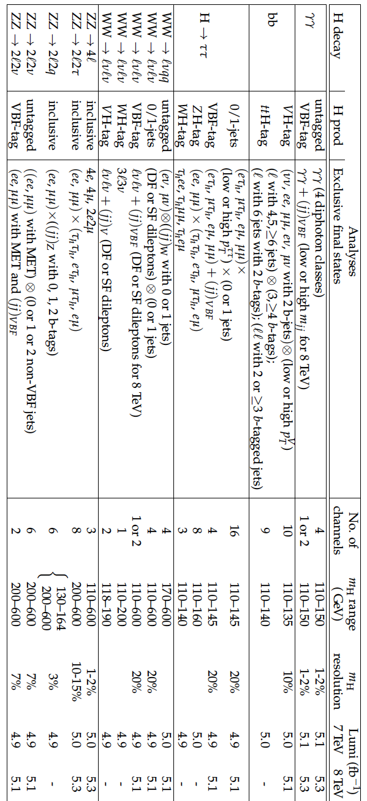
CMS Searches
Most analyses updated with 8 TeV data
References:https://twiki.cern.ch/twiki/bin/view/CMSPublic/PhysicsResults

Slide 7
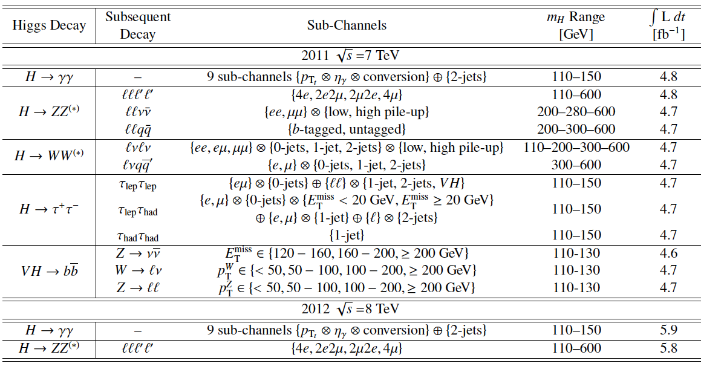
ATLAS Searches
July 17th, H→ WW→ (lν)(lν) mode updated with 5.8 fb⁻¹ 8 TeV data
References: https://twiki.cern.ch/twiki/bin/view/AtlasPublic

Slide 8
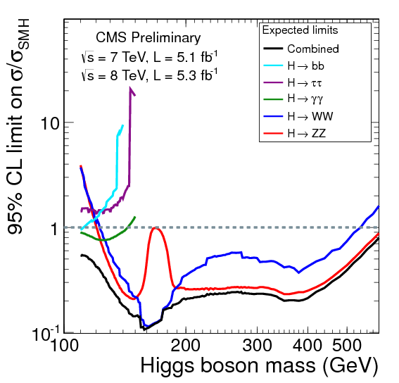
Exclusion Expectations with ≈10 fb⁻¹ Data
The median expected 95% CL upper limits on the
cross section ratio σ/σ_{SM} Vs M_{H}
Similarly
for ATLAS

Slide 9
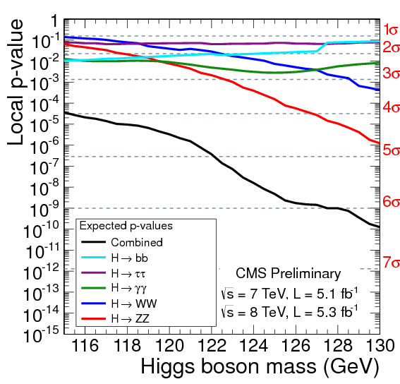
Discovery Expectation with ≈10 fb⁻¹ Data
Median expected p-value for observing an excess at
mass m_{H} in assumption that the SM Higgs boson with that mass exists

Slide 10

Blind Analyses
To avoid unintended experimenter’s bias in search for the Higgs boson
The analysis strategy, event selection & (re)optimization criteria for each Higgs search channel were fixed by looking at data control samples before looking at the signal sensitive region
  Logistically quite painful
  But the right thing to do !
Analyst
cuts

Slide 11
Description Of Search Results
Too many modes, too little time !
  To digest & to report here coherently
Will focus on the important SM Higgs channels only
ATLAS & CMS search strategies are mostly similar but differ in several details
  Will try to provide a generic and pictorial description
  Use CMS searches as an example
    Most comprehensive & updated set of searches
    It’s the experiment I know best
      My apologies for the bias !
In any case you have already seen ATLAS results (Wu)

Slide 12
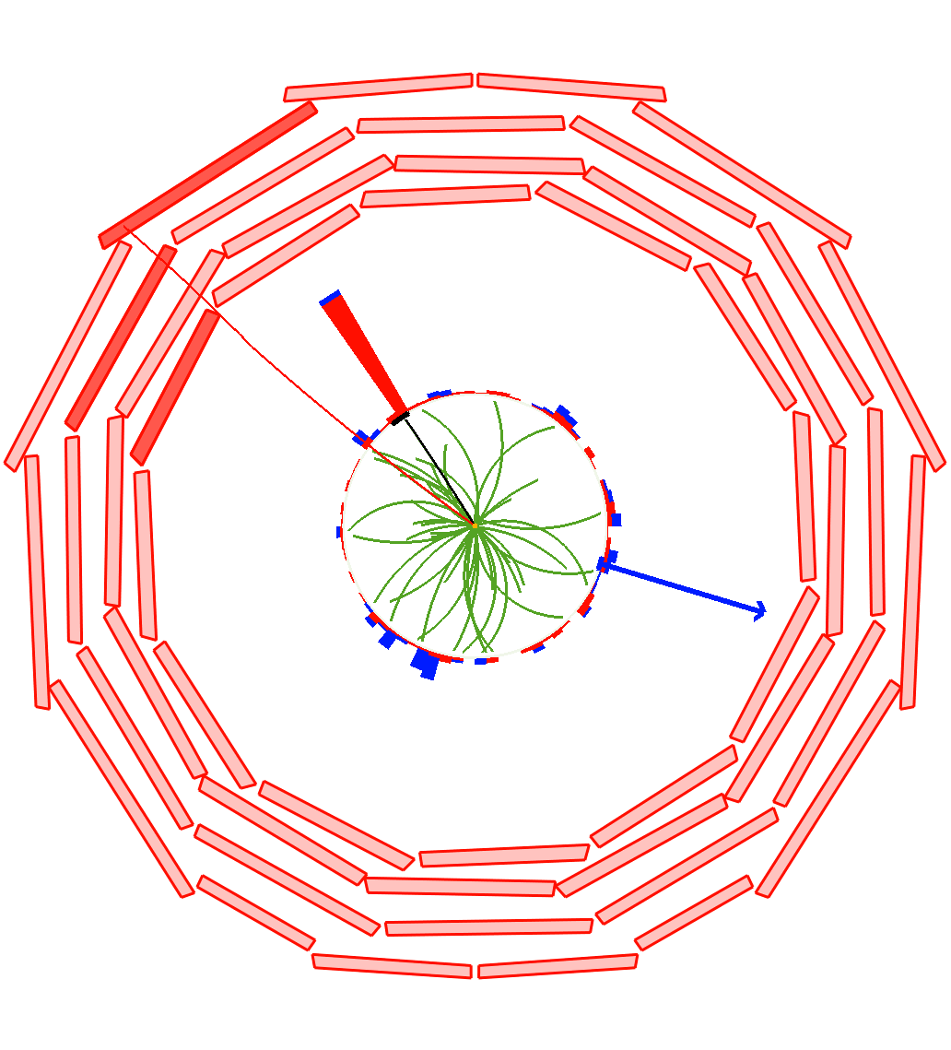
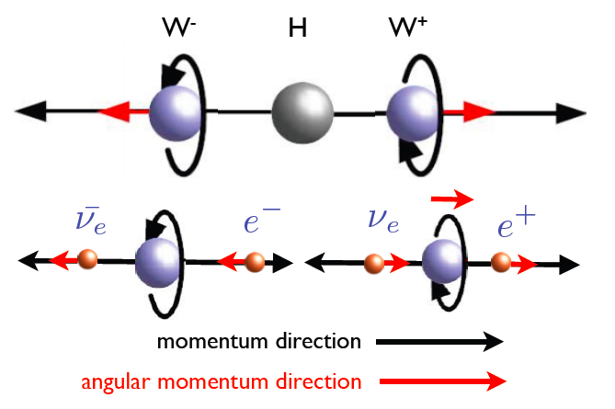
H → WW^{(*)} → (l ν) (l ν) : The Workhorse
Events with two energetic & isolated leptons and missing energy (due to neutrinos)
e
P_{T}= 34 GeV
μ
Higgs boson has spin = 0
➔ Leptons spatially aligned
P_{T}=32 GeV
ME_{T}
47 GeV
Poor Higgs mass resolution (20%) due to escaping neutrinos
➔ Counting experiment, look for excess over backgrounds

Slide 13
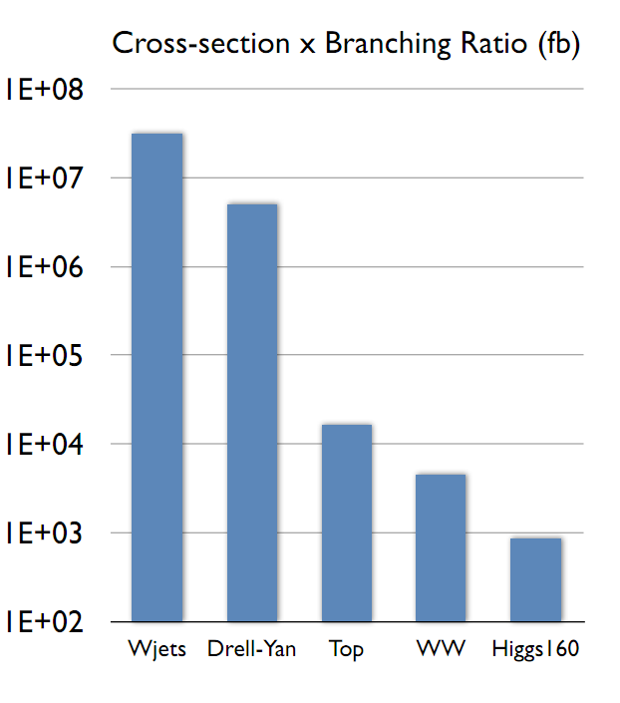
Backgrounds In H → WW → (l ν) (l ν) Search
Reducible backgrounds:
  (DY) Z → ll + (jets faking MET)
  W→ l ν + (jets faling lepton)
  tW and ttbar production
  W+ γ^{(*)}
  WZ→ 3l + MET
Irreducible background:
  pp → WW → (l ν) (l ν)
    Non-resonant production
Challenge is to kill off as much background & measure residual contributions using data-driven techniques and control samples

Slide 14
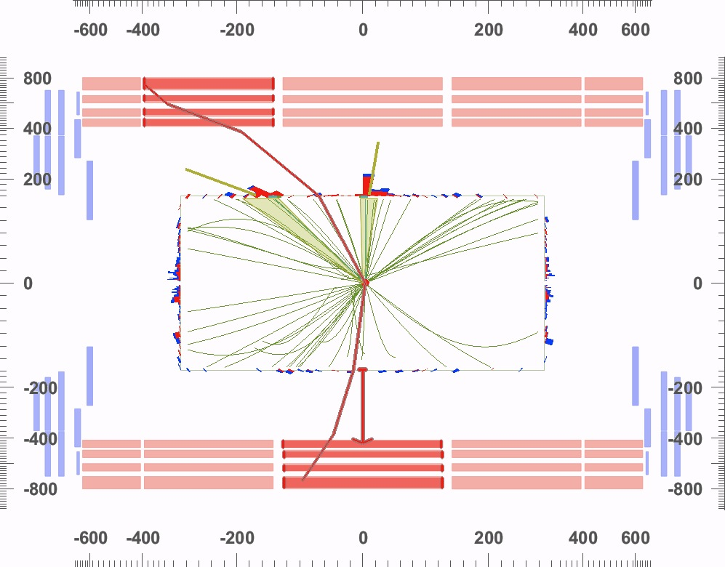
Backgrounds Faking Signature Of Higgs Boson
^{μ-}
35 GeV
b-Jet
56 GeV
b-Jet
42 GeV
Simulation
^{μ+}
39 GeV
ME_{T}
88 GeV
14

Slide 15
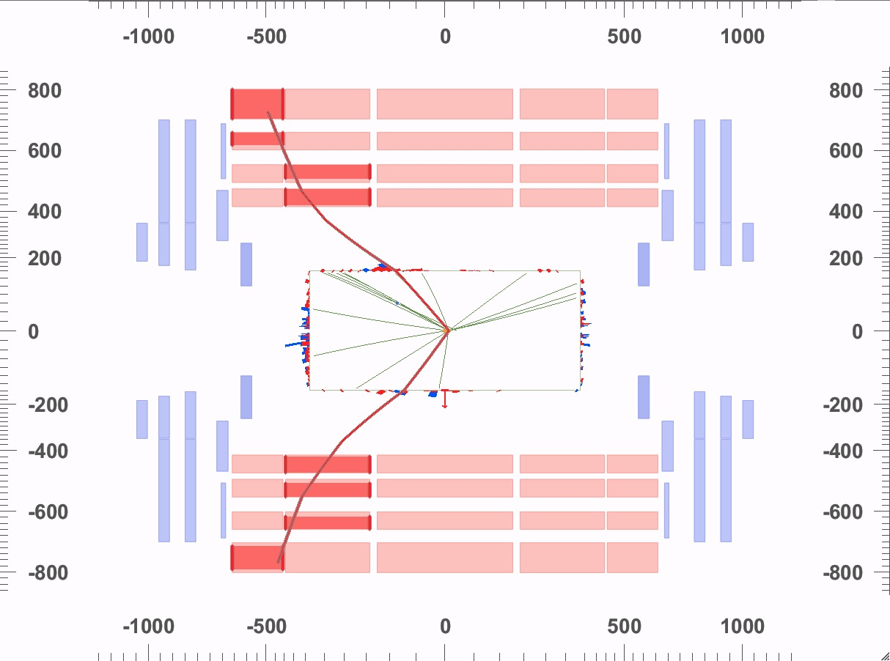
Backgrounds Faking Signature Of Higgs Boson
DY (Z + jets) "killed” by requiring missing energy in event
μ-
21.1 GeV
Simulation
ME_{T}
6.9 GeV
^{μ+}
22.7 GeV
Pile up worsens MET resolution substantially, making it hard to eliminate this background➔ Reduced sensitivity for ee,μμ channels

Slide 16
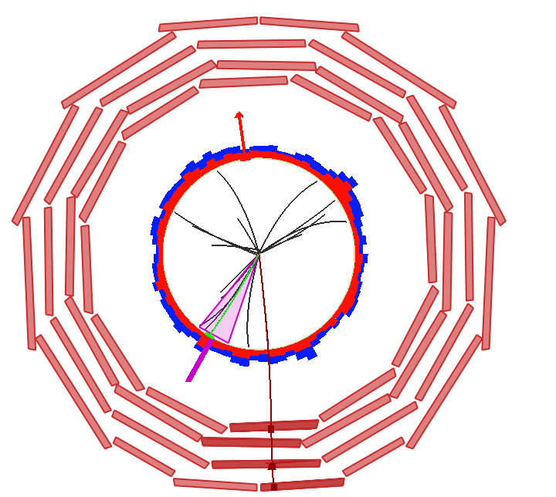
W + Jets Background Faking H→ WW Signature
Simulation
Removed by tight
lepton ID and
isolation requirement
Missing E_{T} = 39 GeV
Jet E_{T} = 41GeV
Electron p_{T} = 18 GeV
Muon p_{T} = 56 GeV

Slide 17
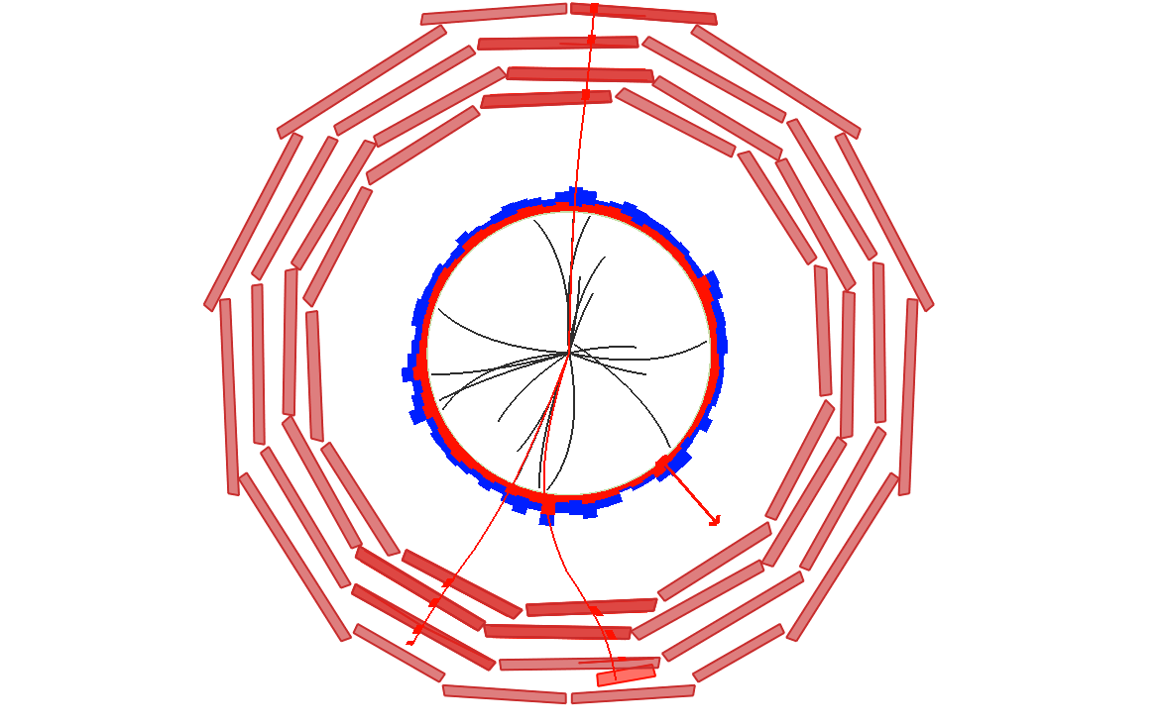
W+γ*; γ*→μ⁺ μ⁻
Rate estimated
from data
Muon p_{T} = 50 GeV
Missing E_{T} = 49 GeV
Muon p_{T} = 20 GeV
Muon p_{T} = 5.8 GeV
M_{μμ} = 0.1 GeV

Slide 18
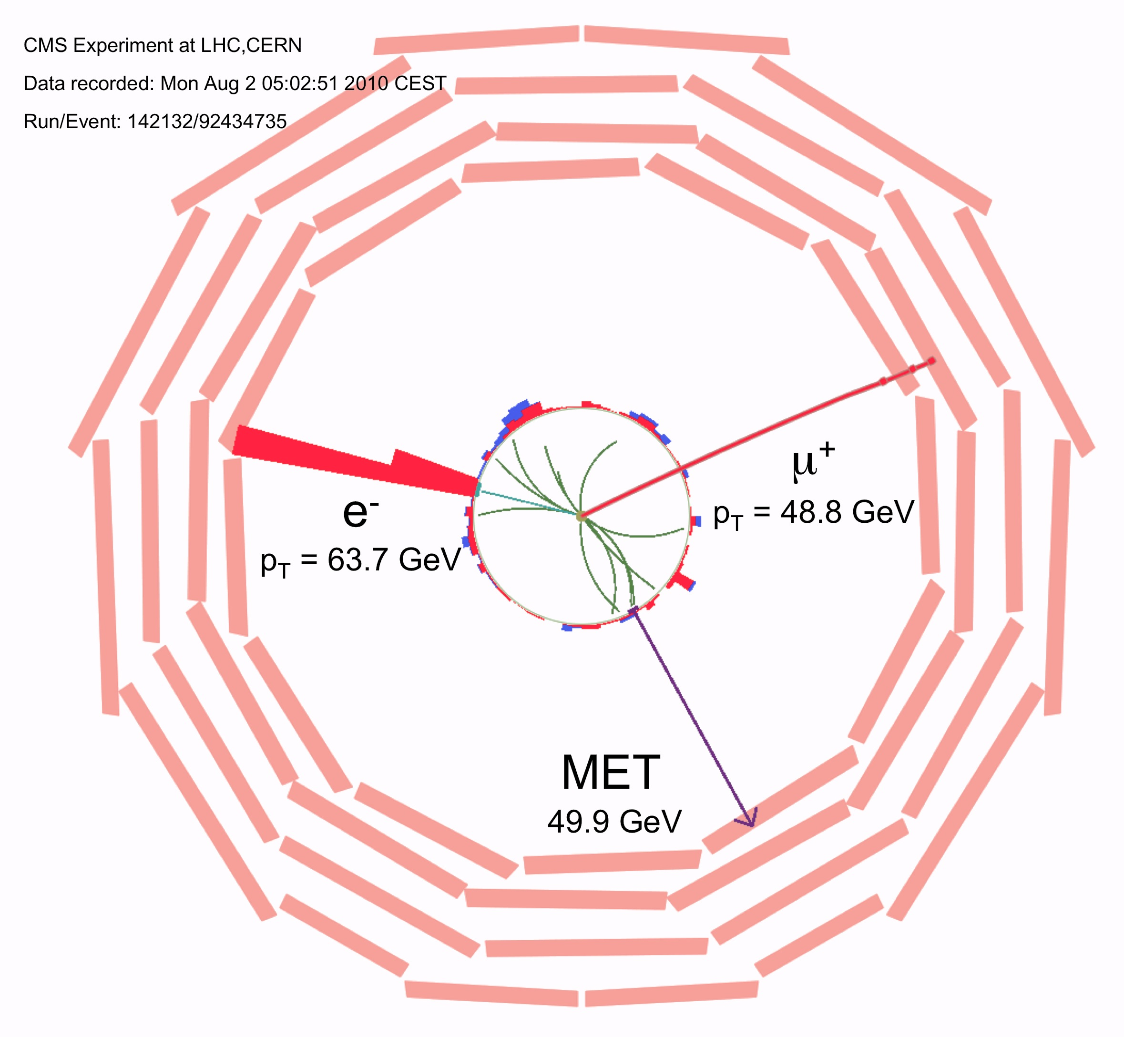
Backgrounds Faking Signature Of Higgs Boson
too large ΔΦ_{ll}
An irreducible
background

Slide 19
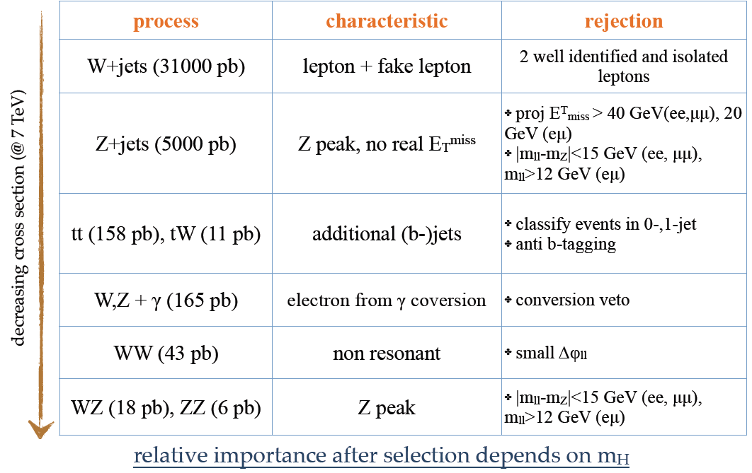
Background Alleviation Strategy

Slide 20
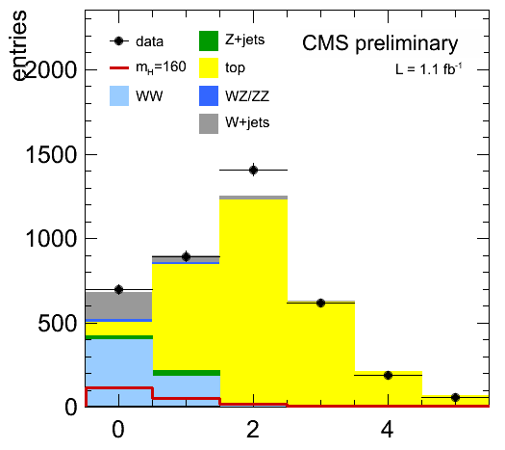
Event Catagorization By Accompanying Jets
Catagorize events by jet multiplicity
  P_{T}> 30 GeV, |η| < 4.7
0-jet: Most sensitive category
  For mH <130 GeV:
    W+jets, DY backgrounds dominant
  eμ final state quite pure
1-jet: dominated by tt+tW
2-jets: specific selections to isolate VBF production
  Δη(j1-j2)>3.5, mj1,j2>450 GeV
  No central jets
  Dominated by ttbar background
N_{Jets}

Slide 21
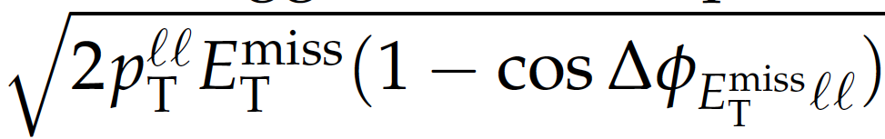
Key Kinematic Observables
P_{T} of leading and sub-leading leptons
Azimuthal angle difference (ΔΦ_{ll})
P_{T}(ll)
Dilepton invariant mass ( M_{ll})
M_{T}=
e
μ
ME_{T}

Slide 22
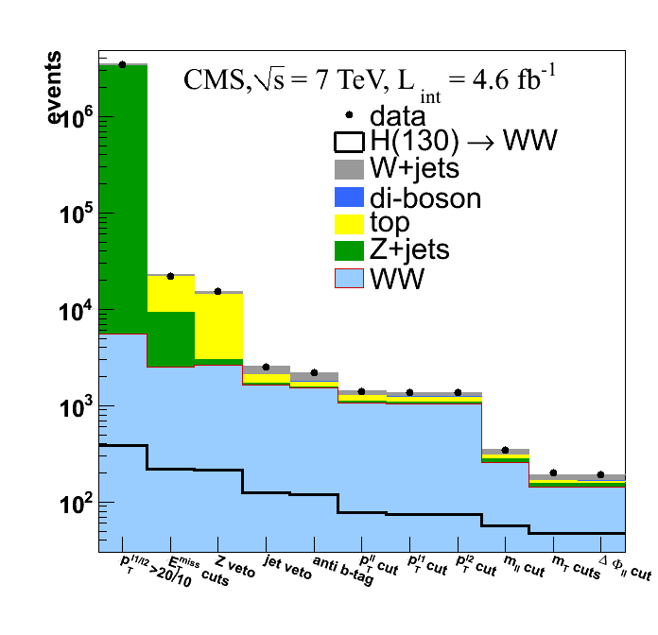
Digging Out Tiny Signals Over Large Backgrounds
H → WW → (e υ) (μυ) : 7 TeV (5 fb⁻¹) data
μ
e
Predicted Vs Observed Yield Vs Cut
ME_{T}
Data
Higgs signal
~200 background events
expect~40 Higgs events
for M_{H}=130 GeV

Slide 23
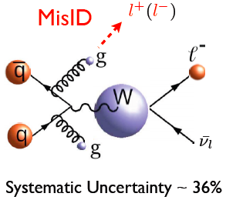
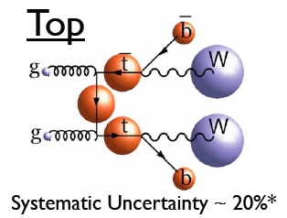
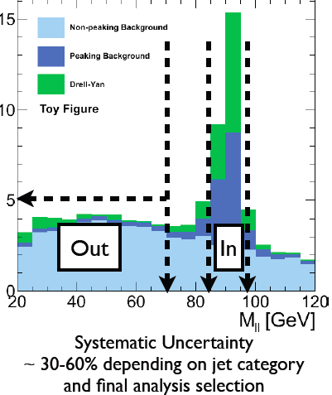
Background Estimates
Most background estimates are obtained from control samples established in data
  W+jet background estimated from dilepton control samples enriched in misidentified leptons
  ttbar background from samples enriched with identified b-jets
  Z+jets background by extrapolating from a narrow Z mass window
  WW background
    from signal free region (mll>100 GeV for mH < 200 GeV)
    For high mass H, no signal-free region → taken from simulation)
Systematic uncertainties on these estimates vary from 20-60 %

Slide 24
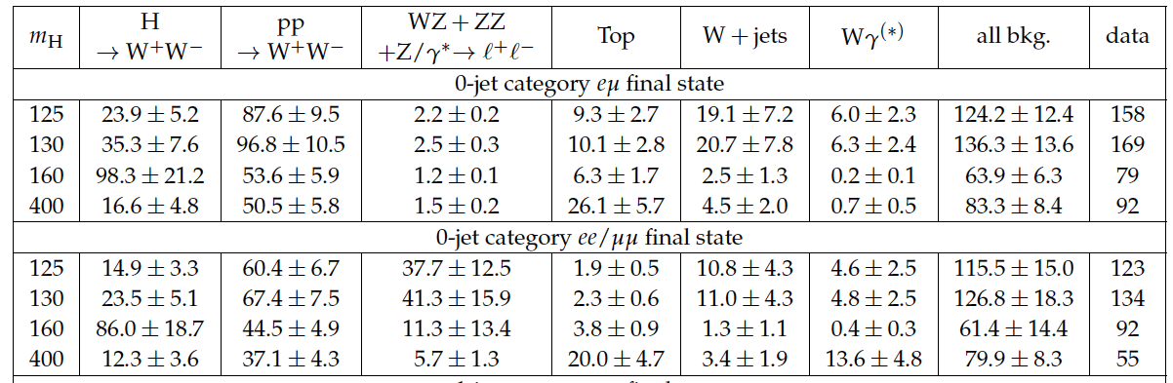
Compare Background Prediction and Data Yields
CMS 2012 : 5.1 fb⁻¹ , Cut-based Analysis, 0-Jet catagory
Mild excess over background is observed at low mass

Slide 25
H → WW^{(*)} → (l ν) (l ν) Results (CMS)
Expected Exclusion@ 95% CL: 122-450 GeV
Observed Exclusion@95% CL: 129-520 GeV
Small excess makes limits weaker than expected

Slide 26
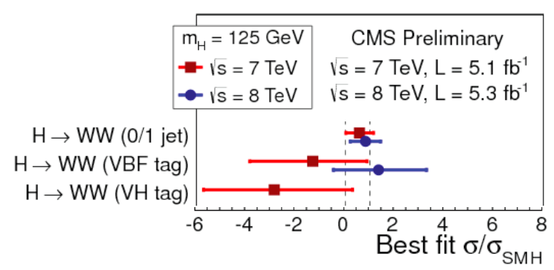
What Would a 125 GeV Higgs Signal Look Like ?
Perform toy-experiments
  Inject SM-like signal at M_{H}=125 GeV, what excess over background-only expectation would appear ?
Characterizing observed excess in units of σ_{SM}
Nothing terribly exciting

Slide 27
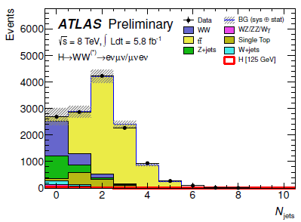
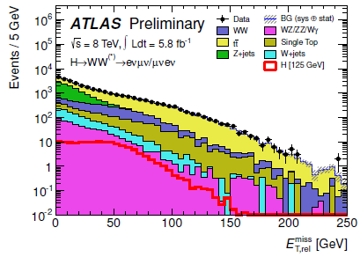
ATLAS H→WW* Analysis strategy
Search in range 110 < m_{H} < 190 GeV with 2012 data.
Analysis in 3 jet bins: 0-jet, 1-jet, at least 2 jets
Large pile-up in 2012 results in larger fake MET compared to 2011 data
  Drell-Yan background much worse in ee, μμ final states
So only opposite-flavor final states used in 2012 analysis (µe, eµ)
N_{jets}
E_{T} miss, rel.

Slide 28
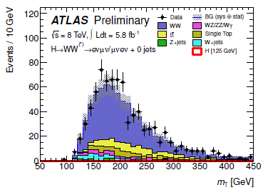
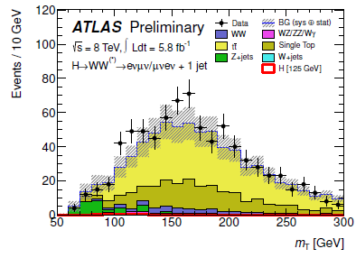
H→WW* → eµvv Backgrounds
Major backgrounds determined and/or validated using data control regions (CRs)
W+jets: fully data-driven; CR defined using loosely identified leptons
WW: data CR defined using m_{ll} > 80 GeV, extrapolated to signal region using MC-derived scale factor
Top: data CR defined by requiring b-tagged jet, extrapolated to signal region using MC-derived scale factor
Z+jets: estimated from MC prediction
Dibosons other than WW: estimated from MC prediction (validated using same-sign CR in data)
0-jet WW CR
m_{T} [GeV]
1-jet top CR
  The transverse mass:
  with
m_{T} [GeV]

Slide 29
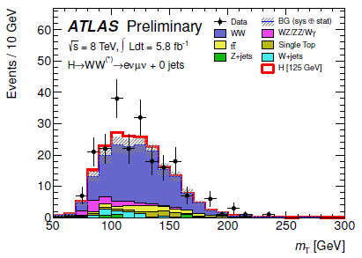
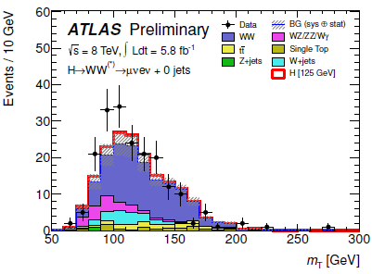
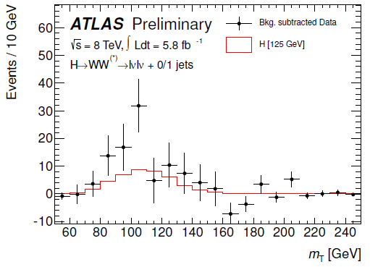
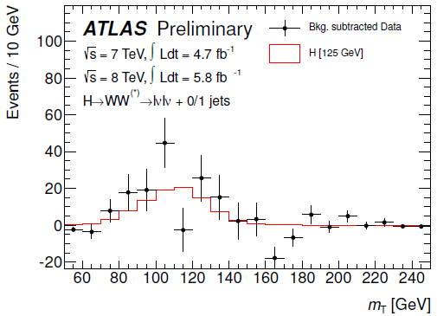
H→WW*→eµvv : M_{T} distributions in signal region
m_{T} shape (after cuts on other variables) is fitted to search for signal
eμ, 0-jet
signal is stacked
μe, 0-jet
signal is stacked
m_{T} [GeV]
m_{T} [GeV]
Bkg-subtracted data, 2012 only.
0/1 jets
Bkg-subtracted data, 2011 + 2012
0/1 jets
m_{T} [GeV]
m_{T} [GeV]

Slide 30
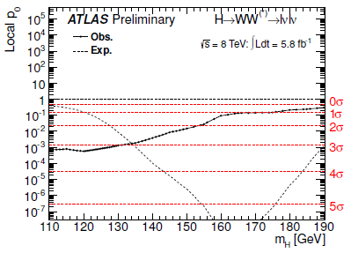
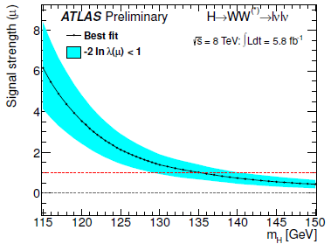
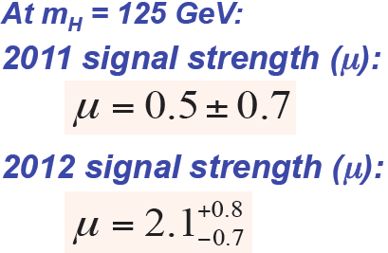
H→WW*→eµvv : Results with 2012 data
2012 Data
m_{H} = 125 GeV
p₀ | Observed significance | Expected significance
8×10⁻⁴ | 3.1 σ | 1.6 σ
2011, 2012 signal strengths compatible within 1.5σ

Slide 31
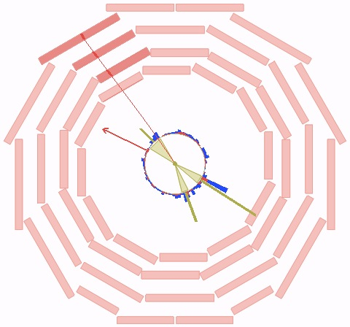
H → WW^{(*)} → (l ν) (jj)
Simulation
μ
P_{T}= 60 GeV
ME_{T}
87 GeV
Jet1
P_{T}= 112 GeV
Jet 2
P_{T}= 54 GeV
Due to large W+ jets background, this search mode is most sensitive
when both W bosons are on-mass-shell ; e.g. M_{H} ≈ 400-500 GeV
Kinematic fit allows reconstruction of (l ν) (jj) mass
W+jets suppressed using angular info in H → WW decay
Search for mass peak over W+jets continnum background (hard !)

Slide 32
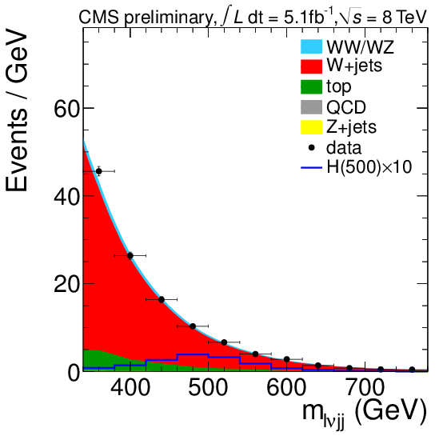
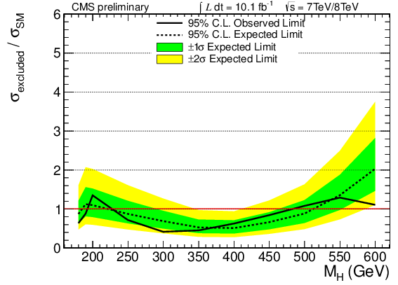
H → WW^{(*)} → (l ν) (jj) Search Results
CMS: With ≈ 10 fb⁻¹ data , exclude at 95 % CL
M_{H} in the range [240-450] GeV

Slide 33
High Mass Higgs Search Specialist: H → ZZ → 2l 2ν
2υ in final state → Higgs mass not precisely measured

Slide 34
H → ZZ → 2l 2ν
Identify On-shell Z→ ll with MET >≈ 60 GeV
Compute Transverse mass M_{T}:
Build two exclusive catagories:
  VBF:
    search for 2 jets with Δη > 4 and M_{jj}>500 GeV
    No central jets in between
  Everything else, subclassified by jet multiplicity
Selection optimized for different Higgs masses
  M_{H} > 250 GeV

Slide 35
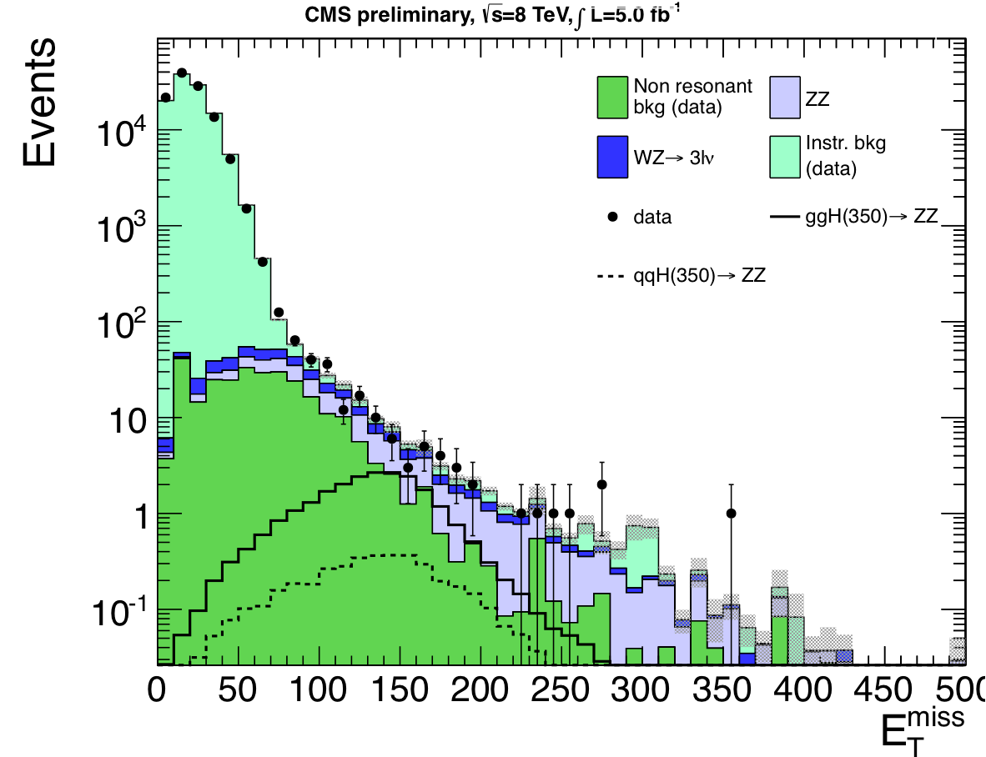
H → ZZ → 2l 2ν
Major backgrounds: Z+Jets, ttbar, WW & WZ
  Large ME_{T} requirement to suppress Z + jets by x10⁵
  Anti b-tag to suppress ttbar
Backgrounds estimated from data control samples
  γ + jets (for Z+Jets→fake MET)
  eμ sample (for ttbar +WW)
Residual ZZ, WZ background estimate from MC

Slide 36
γ+ Jets Control Sample To Estimate MET from Z+jets
Reweight γ+ Jets spectrum to simulate Z + Jets spectrum
γ
Jet

Slide 37
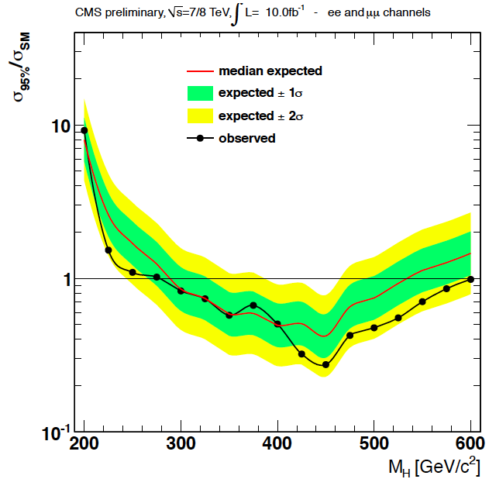
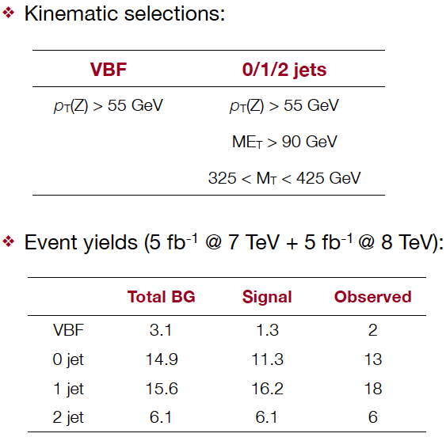
Limits From H → ZZ → 2l 2ν Search
Selection for M_{H} = 400 GeV
Observed Exclusion : 278 < M_{H} < 600 GeV
Expected Exclusion : 291 < M_{H} < 534 GeV

Slide 38
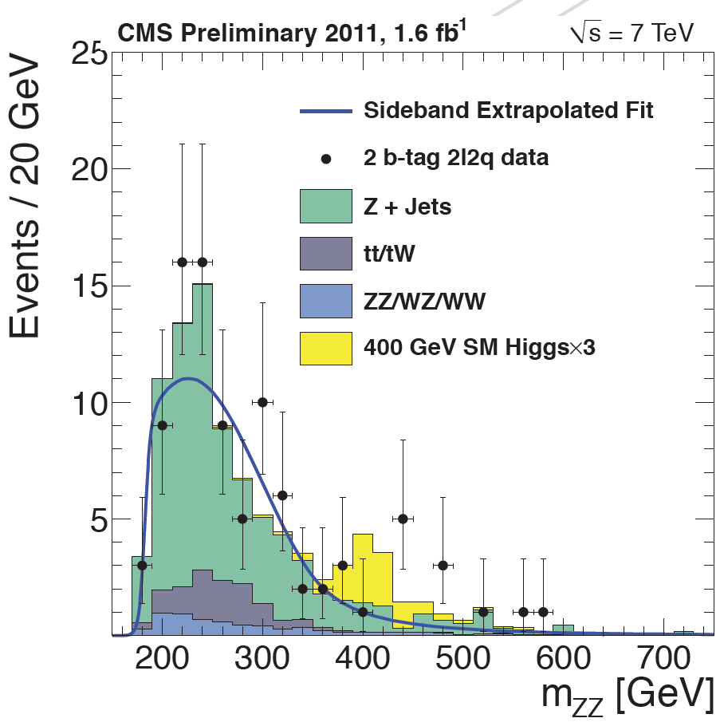
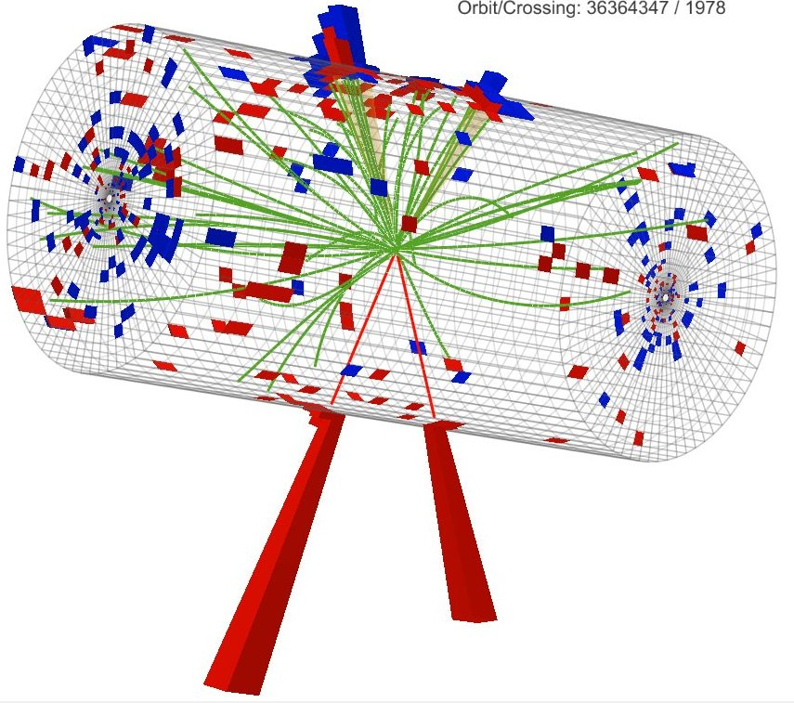
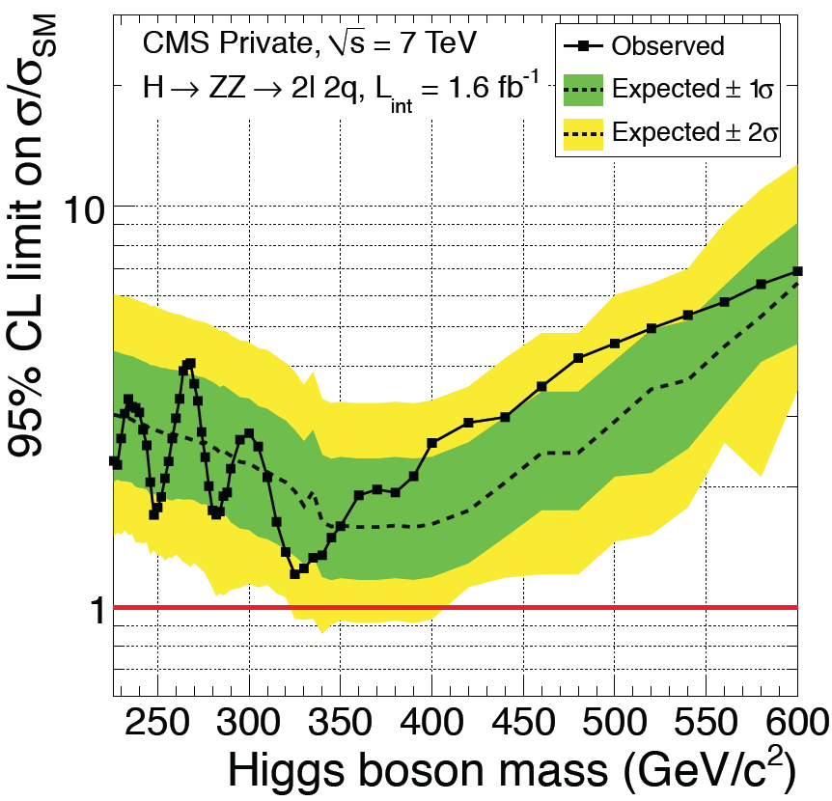
High Mass Higgs: H → ZZ → 2l 2q ( or 2b)
Jet: 207 GeV
Jet: 114 GeV
CMS
Preliminary
e: 177 GeV
e: 114 GeV
M_{2l2j} = 580 GeV
Highest rate amongst all H → ZZ final states
Search for a peak (σ~10 GeV) in M_{2l2j} distribution
Events categorized by presence of 0, 1, 2 b-jets
Require 75< M_{jj}<105 & 70 <M_{ll}<110 GeV
Major background: Z+jets ; ttbar suppressed by ME_{T} requirement
Use 5 angles of scalar H → ZZ → 2l 2q in a likelihood discriminant
Background shape, normalization ← data sideband
CMS Prelim

Slide 39
High Mass Higgs: H → ZZ → 2l 2τ

Slide 40
H → ZZ → 2l 2τ : Another Drop In The Bucket
Quite faraway from sensitivity to SM-like Higgs

Slide 41
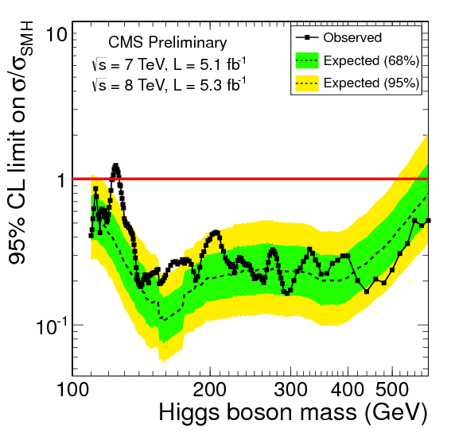
Bottomline On High Mass Higgs Searches
A SM-like Higgs boson excluded at 95% CL for 127 < M_{H} < 600 GeV
Focus next on low-mass Higgs searches

Slide 42
H→ bb
Important mode for measuring Higgs coupling to fermions
H → bb production via gluon fusion and VBF are quite large but are buried (10⁷) under QCD production of b bbar pairs
Most promising channel is H → bb production associated with a Vector (V=W or Z) boson
V reconstruction: W → l ν, Z→ νν, Z → ll
H→ bb reconstructed as two b-tagged jets recoiling against a high P_{T} W/Z boson
  Large W/Z P_{T} ➔ smaller background & better di-jet mass resolution
VH analysis targets Higgs mass range 110 < M_{H} < 135 GeV

Slide 43
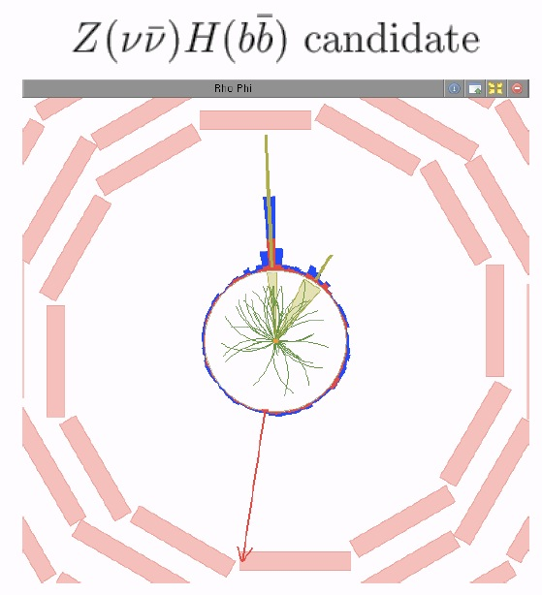
b-jet
P_{T}=210 GeV
Two clean b-jets
M_{bb} = 120 GeV
P_{T,bb} = 248 GeV
Recoiling against
Z→νν
b-jet
P_{T}=46 GeV
Z→νν
MET
243 GeV

Slide 44
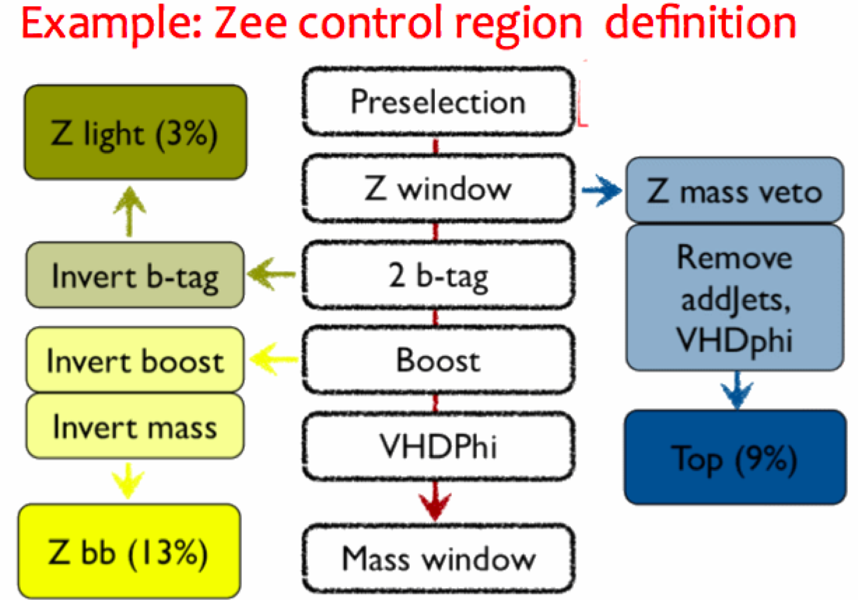
Background Estimate From Control Regions
Main backgrounds are the usual suspects:
  Reducible: W/Z + jets (light and heavy flavor jets) & ttbar
  Irreducible : WZ, ZZ and single top (taken from simulation)
Background yields/shapes determined from signal-depleted control data samples using kinematic selection close to signal region

Slide 45
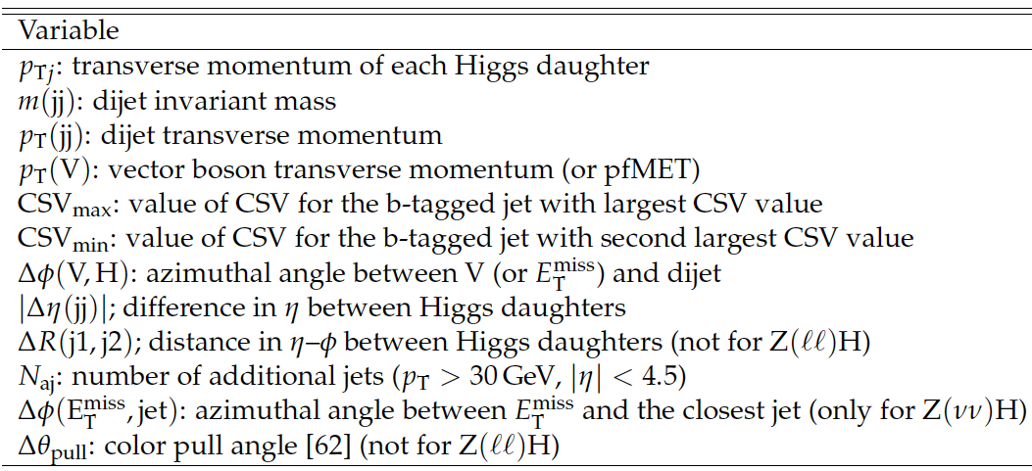
Separating Signal From Backgrounds
A multivariate algorithm trained at each Higgs mass hypothesis
Variables used:

Slide 46
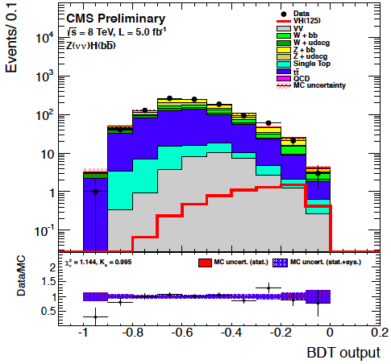
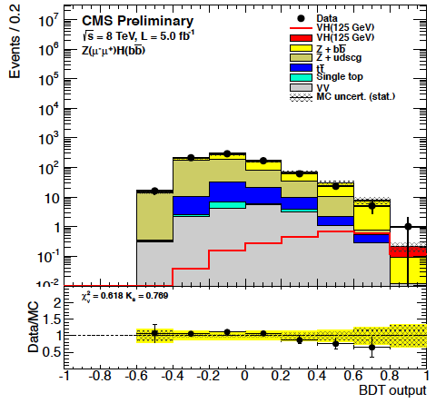
Searching For Low Mass Higgs
A Higgs signal in the mass range [110-135] GeV is searched for as an excess in MVA classifier using predicted shapes for signal & bkgnd
No significant excess seen over predicted background yields

Slide 47
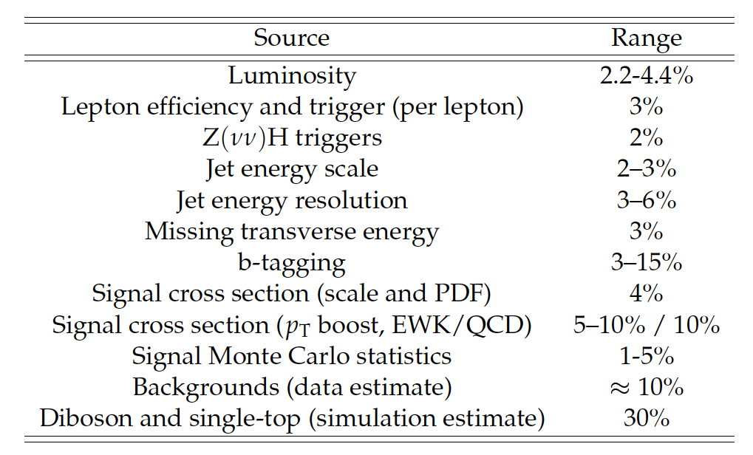
Systematic Uncertainties

Slide 48
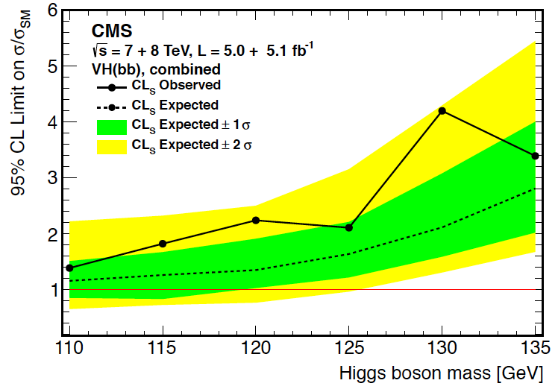

Limits From VH, H → bb Searches
Approaching SM Higgs Sensitivity but no Cigar (yet) !

Slide 49

Tevatron VH, H →bb Searches
Corresponds to a global significance of 2.9σ
See Kyle’s talk on Tevatron results

Slide 50



H → ττ : Another Low Mass Specialist
Most promising mode for measuring Higgs coupling to leptons
Searched for in three Higgs production modes
And subsequent decay of τ lepton
  τ →eνν , τ →μνν, τ→ hadrons
Four signatures considered : eμ, μμ, eτ_{h,} μτ_{h}
Due to missing neutrinos, Higgs signal appears as a broad excess in reconstructed τ-pair mass ( Mass resolution ≈ 20%)
Major backgrounds arise from
  ttbar
  W & Z (+jets), dibosons

Slide 51




Anatomy of the H→ ττ Analysis
DY→ττ – Efficiency measured using τ embedded µµ events
DY→ll – Taken from MC corrected for measured l→τ fake rates
e-τ
EWK – Mostly W+Jets, measured from high M_{T} sideband
QCD – Estimated from SS data
Sig
Sdbd
µ-τ
e-µ
µ-µ
Plots are pre-fit

Slide 52

H → ττ Search Strategy
Analysis divided into 5 categories based on mass resolution & S/B
All categories are fit simultaneously
Jets p_{T} > 30 GeV
τ_{h}
or
μ
p_{T}
0 Jet, Low p_{T}
High Background Constrains fit
1 Jet, Low p_{T}
Enhancement from Jet Requirement
VBF
2 Jets, Rapidity Gap Veto, MVA Selection
0 Jet, High pT
Lepton p_{T} spectrum harder from H
1 Jet, High p_{T}
Enhancement from p_{T} and Jet requirement

Slide 53


Tau-Pair Mass Distributions In 0 &1 Jet Catagories
μ+τ_{h}
1-jet
μ+τ_{h}
0-jet
Possible Signal
overwhelmed by backgrounds !

Slide 54

VBF (2jets) Category Has Best S/N
Jet₂ E_{T} =46 GeV
Jet₁ E_{T} = 177 GeV
→ π⁺π⁰ ν
τ P_{T} = 70 GeV
μ P_{T} =20 GeV
Missing E_{T} = 97 GeV
_{Visible Mass(ττ) = 75 GeV}
_{Mass ( jj ) = 580 GeV}
_{Δη (jj) = 3.5}

Slide 55


Yields & Expectations in VBF Catagory

Slide 56

Background & Expected Signal in VBF Catagory
No significant excess over expected backgrounds

Slide 57

Limits From H → ττ Search
Expected exclusion @ M_{H} = 125 : 1.3 σ_{SM}
Observed exclusion @ M_{H} = 125 : 1.1 σ_{SM}

Slide 58

Improvement In H → ττ Sensitivity In Just 1 Year
ATLAS & CMS sensitivities similar
Look forward to more data this year

Slide 59
Tomorrow:
High Mass Resolution Modes

Slide 60

Quantifying Excesses & Deficits: Cartoon
( without Higgs)

Slide 61

Quantifying Higgs Search Result: An Illustration

