Slide 1

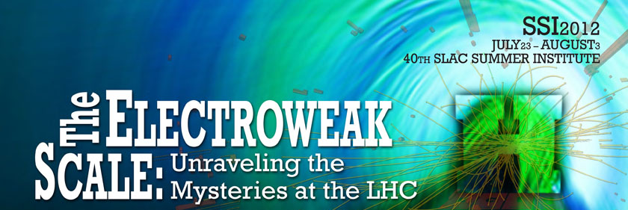
Heavy Flavour Physics at the LHC
Niels Tuning (Nikhef)
23 July 2012
On behalf of the LHCb collaboration
including results from ATLAS and CMS

Slide 2

Why Flavour Physics??

Slide 3
Motivation 1: New Physics in loop diagrams?
Precision measurements
Find deviations from the Standard Model
Sensitive to heavy particles in loop diagrams
“Box” diagram: ΔB=2
“Penguin” diagram: ΔB=1
s
b
s
b
b
μ
s
μ

Slide 4
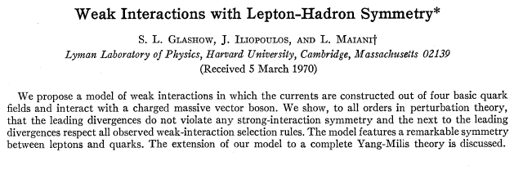
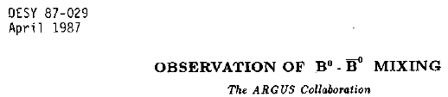


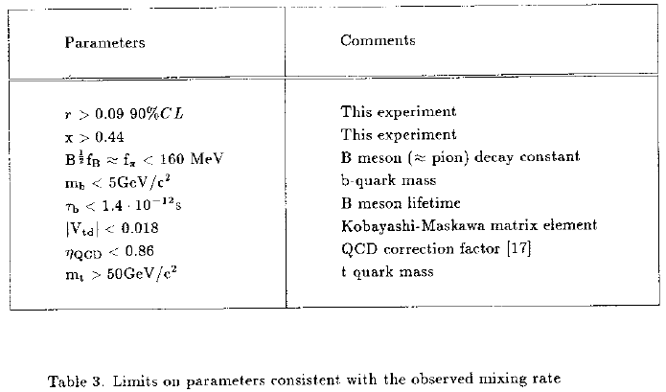
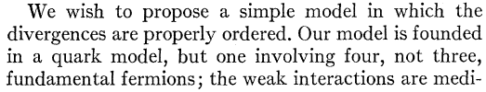
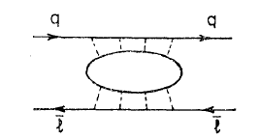
Flavour physics for discoveries
K⁰ →μμ pointed to the charm quark:
B⁰ mixing pointed to heavy top quark:
GIM, Phys.Rev.D2,1285,1970
ARGUS Coll, Phys.Lett.B192:245,1987
…
…
…
d
s
b
d
μ
d
b
μ

Slide 5






Motivation 2: at the heart of the SM
Charged current:
flavour diagonal
Yukawa couplings:
mix between generations

Slide 6




Motivation 2: at the heart of the SM
Charged current:
flavour diagonal
Yukawa couplings:
mix between generations
Diagonalize Yukawa matrix:
Off diagonal in CC Mass terms

Slide 7
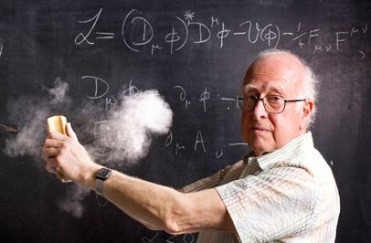
Motivation 2: at the heart of the SM
Flavour physics closely connected to Higgs??

Slide 8
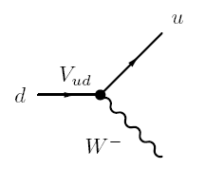


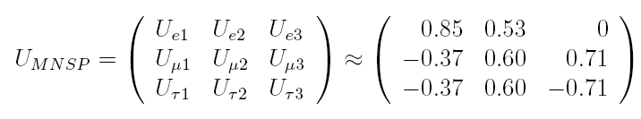
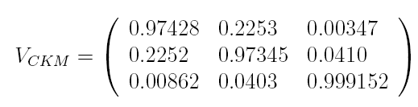
Motivation 3: CKM magnitude mysterious
CKM matrix:
Coupling strength of charged current
Completely different hierarchy !
vs
flavour
mass
flavour
mass

Slide 9
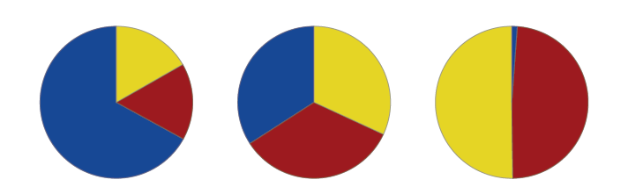
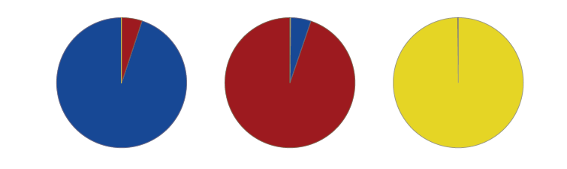
Motivation 3: CKM magnitude mysterious
CKM matrix:
Coupling strength of charged current
Completely different hierarchy !
vs
flavour
mass
flavour
mass
ν₁
ν₂
ν₃
d
s
b
ν_{e}
d'
PhD thesis R. de Adelhart Toorop

Slide 10
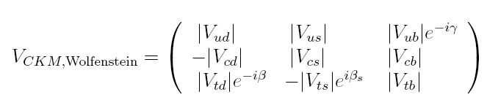
CKM matrix: phases
CKM matrix:
Coupling strength of charged current
Complex matrix: phases!

Slide 11
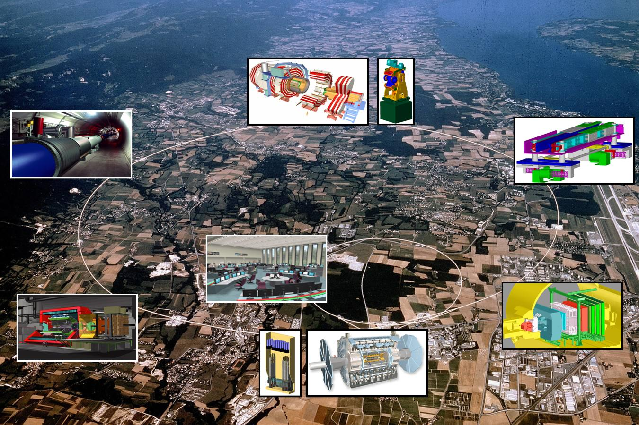
CMS
LHCb
ATLAS

Slide 12
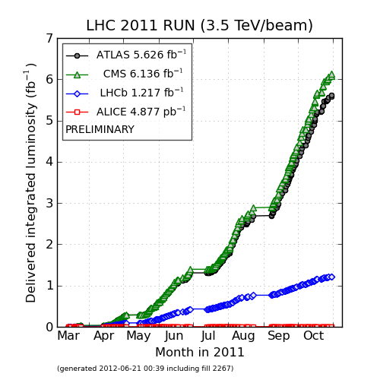
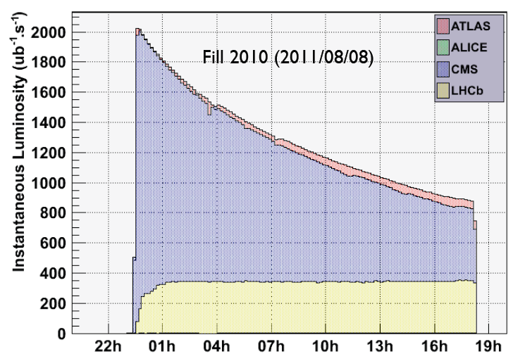
LHC
LHC and experiments show excellent performance
LHCb collected 1 fb⁻¹ in 2011
Aim for 2.2 fb⁻¹ in 2012 (now 0.7 fb⁻¹)
10¹²‾bb-pairs produced!
CMS
ATLAS
x 5
LHCb
Optimal use of LHC beam:
  “Lumi levelling” at 4 x 10³²
  Design was 2 x 10³² with half the #bunches
  Max. luminosity for entire fill
  With maximum detector occupancy
Disclaimer:
Most results shown, from LHCb

Slide 13
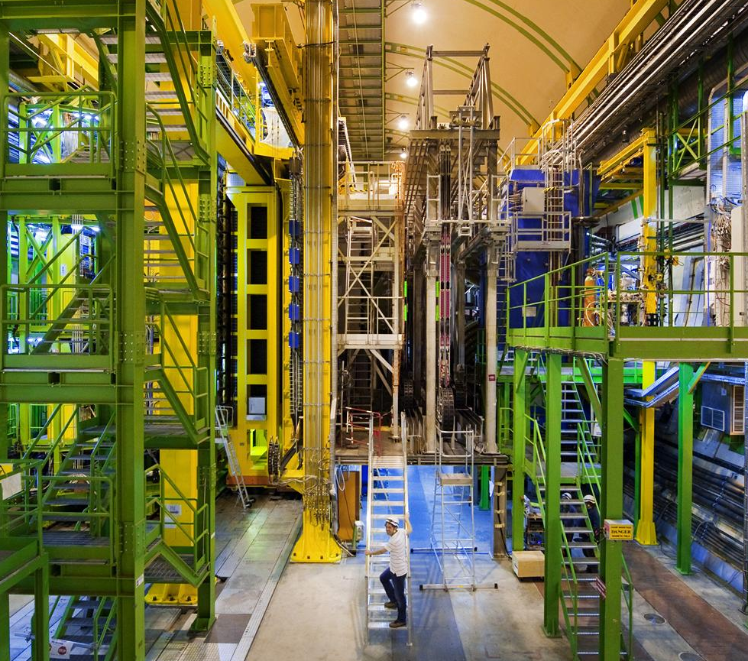
The LHCb Detector

Slide 14
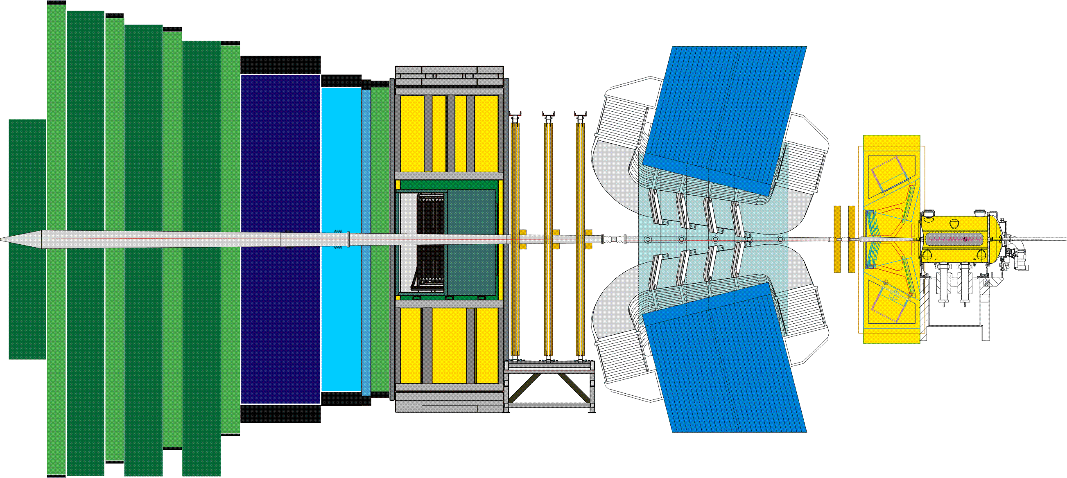
The LHCb Detector
MAGNET
OT
MUON
IT
RICH1
CALO
RICH2
TT
VELO

Slide 15
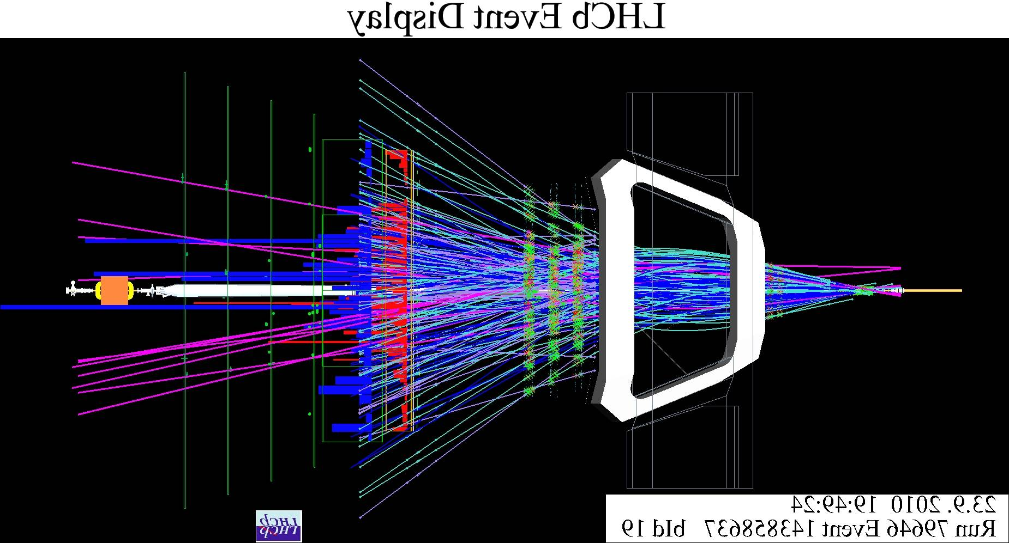
The LHCb Detector
23 sep 2010 19:49:24
Run 79646 Event 143858637

Slide 16
Outline
LHC
γ
φ_{s}
CPV in charm
CPV in B_{s}
Super Rare
A_{FB}
Radiative decays
CP violation
FCNC

Slide 17
Heavy flavour spectroscopy
LHC
γ
φ_{s}
CPV in charm
CPV in B_{s}
Super Rare
A_{FB}
Radiative decays
CP violation
FCNC

Slide 18
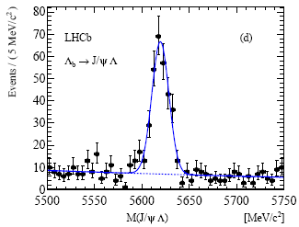
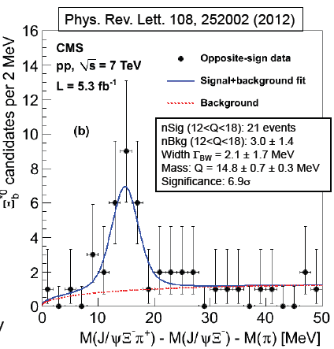
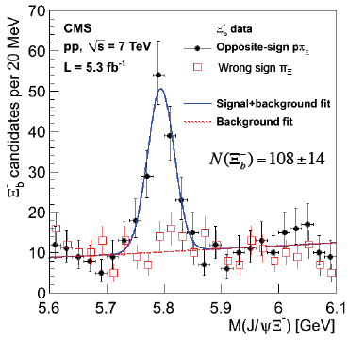
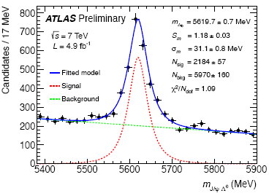
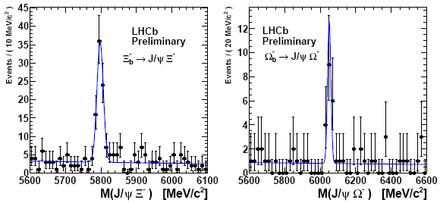
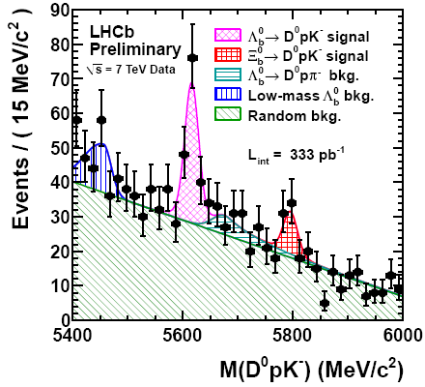
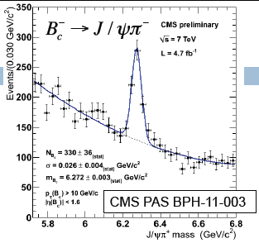
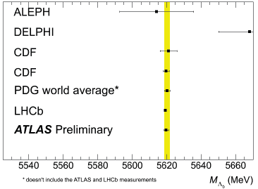
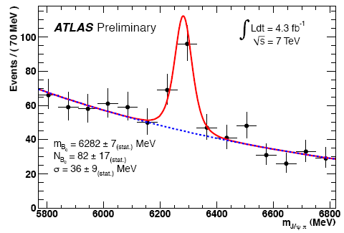
Heavy Flavour Spectroscopy
Λ_{b}→J/ψΛ⁰
LHCb:
m(Ξ_{b}⁻)=5796.5±1.2±1.2MeV
m(Ω_{b}⁻)=6050.3±4.5±2.2MeV
m(Ξ_{b}⁰)=5802.0±5.5±1.7MeV
m(Λ_{b}⁰₍₅₉₁₂₎)=5911.95±0.7MeV
m(Λ_{b}⁰₍₅₉₂₀₎)=5919.76±0.7MeV
CMS:
m(Ξ_{b}*)=5945.0±0.7±0.3±2.7MeV
LHCb arxiv:1205.3452
Ξ_{b}*
Ξ_{b}⁻→J/ψΞ⁻
Ω_{b}⁻→J/ψΩ
Λ_{b}→J/ψΛ⁰
Ξ_{b}⁻→J/ψΞ⁻
ATLAS‐CONF‐2012‐055
Ξ_{b}⁰→D⁰pK
B⁺_{c}→J/ψπ⁺
K.Ulmer, ICHEP2012
B⁺_{c}→J/ψπ⁺
ATLAS‐CONF‐2012‐028
M(Λ_{b})

Slide 19
LHC
γ
φ_{s}
CPV in charm
CPV in B_{s}
Super Rare
A_{FB}
Radiative decays
CP violation
FCNC

Slide 20
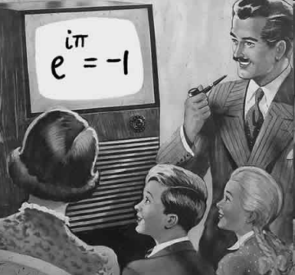
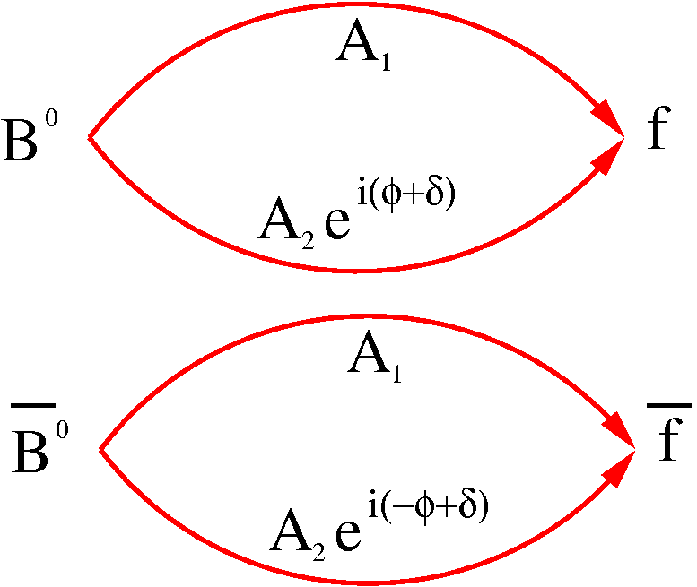
How to measure a phase??
Γ( B→ f ) = |A₁+A₂e^{i(φ+δ)}|²
Γ(‾B→‾f ) = |A₁+A₂e^{i(-φ+δ)}|²
A₁
Necessary ingredients for CP violation:
Two (interfering) amplitudes
Phase difference between amplitudes
  one CP conserving phase (‘strong’ phase)
  one CP violating phase (‘weak’ phase)
A₂

Slide 21

γ
( )
B ⁻ → D⁰ K⁻ (Time integrated)
B_{s}⁰ → D_{s}±K⁺⁻ (Time dependent)
Necessary ingredients for CP violation:
Two (interfering) amplitudes
Phase difference between amplitudes
  one CP conserving phase (‘strong’ phase)
  one CP violating phase (‘weak’ phase)

Slide 22
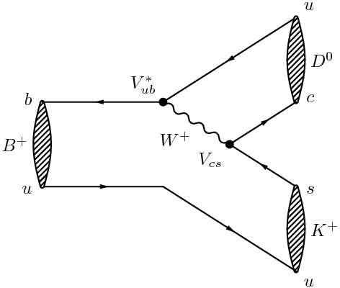
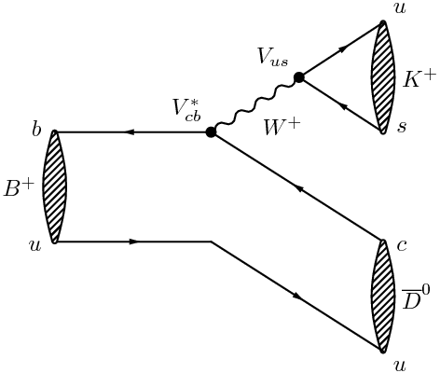


γ (GLW)
A₁
A₂
V_{ub}*
V_{cb}*
( )
B⁻ →D⁰K⁻
Relative phase: γ
b→c favoured
D⁰K⁺
Gronau, London, Wyler, PL B265 (1991) 172.
GLW:
CP eigenstate: D⁰→ K⁺K⁻(ππ)
B⁺
f_{CP}K⁺
D⁰K⁺
b→u suppressed
LHCb,1.0 fb⁻¹, 3h LHCb-CONF-2012-021
LHCb,1.0 fb⁻¹, 1h PL B712 (2012) 203

Slide 23

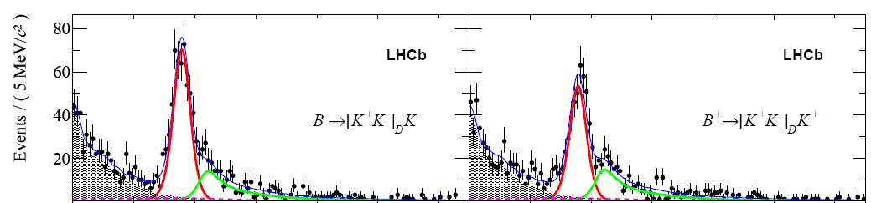



γ (GLW)
b→c favoured
D⁰K⁺
GLW:
CP eigenstate: D⁰→ K⁺K⁻(ππ)
B⁺
f_{CP}K⁺
D⁰K⁺
b→u suppressed
4.5σ
LHCb,1.0 fb⁻¹, 3h LHCb-CONF-2012-021
LHCb,1.0 fb⁻¹, 1h PL B712 (2012) 203

Slide 24
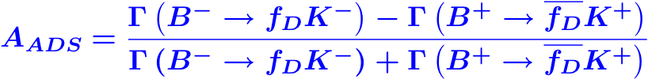
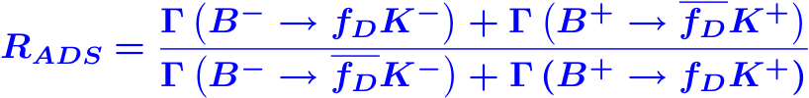
γ (ADS)
A₁
A₂
V_{ub}*
V_{cb}*
( )
B⁻ →D⁰K⁻
Relative phase: γ
b→c favoured
D⁰K⁺
Cabibbo supp.
Atwood, Dunietz, Soni , PRL 78 (1997) 3257
ADS:
B or D Cabibbo favoured: D⁰→ K⁺π⁻
B⁺
K⁻π⁺K⁺
D⁰K⁺
b→u suppressed
Cabibbo allowed.
“Difference in suppression”
LHCb,1.0 fb⁻¹, 3h LHCb-CONF-2012-021
LHCb,1.0 fb⁻¹, 1h PL B712 (2012) 203
“Average suppression”

Slide 25

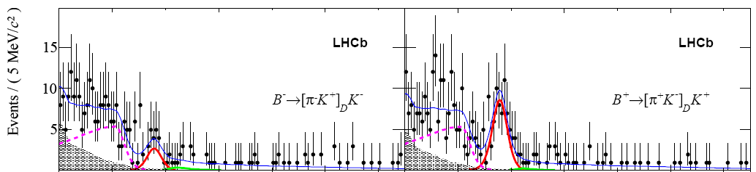


γ (ADS)
Suppressed mode for the B⁻ is relatively more suppressed than for the B⁺…
b→c favoured
D⁰K⁺
Cabibbo supp.
ADS:
B or D Cabibbo favoured: D⁰→ K⁺π⁻
BR~ 2 x 10⁻⁷
First observation of suppressed mode
B⁺
K⁻π⁺K⁺
D⁰K⁺
b→u suppressed
Cabibbo allowed.
4.0σ
LHCb,1.0 fb⁻¹, 3h LHCb-CONF-2012-021
LHCb,1.0 fb⁻¹, 1h PL B712 (2012) 203

Slide 26
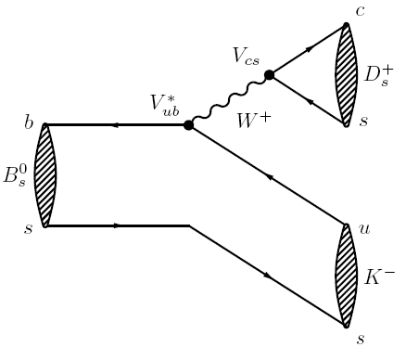
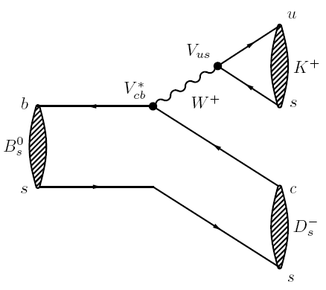
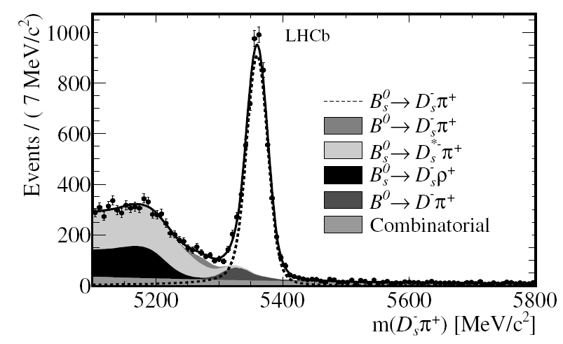
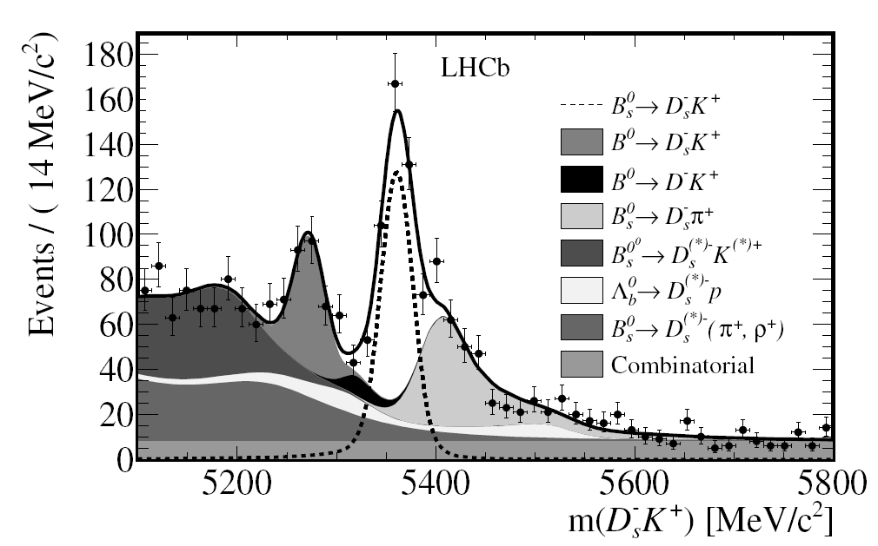

γ (Time dependent)
A₁
A₂
V_{ub}*
V_{cb}*
B⁰_{s} →D_{s}⁺K⁻
Relative phase: γ
First step: BR!
(best known B⁰_{s} decay!)
LHCb,0.37fb⁻¹,
JHEP06(2012)115

Slide 27

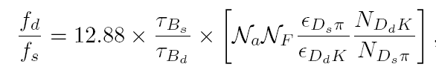


Intermezzo: how many B⁰_{s} are produced? f_{d}/f_{s}
To determine any B_{s}⁰ BR, need to know how many are produced
Relative to B⁰ or B⁺ decay
e.g.:
Measured f_{d}/f_{s} at LHCb:
Hadronic:
  Compare yields of B⁰_{s} →D_{s}⁺π ⁻ and B⁰ →D⁺K⁻
  Theoretically we can estimate ratio of BR!
Semi-leptonic
  Compare yields of B⁰_{s} →D_{s}⁺Xμν and B⁰ →DXμν
Measure:
Fleischer, Serra, NT, PRD 82, 034038 (2010)
Fleischer, Serra, NT, PRD 83, 014017 (2011)
LHCb PRL 107,(2011) 211801
LHCb PRD 85 (2012) 032008

Slide 28
LHC
γ
φ_{s}
CPV in charm
CPV in B_{s}
Super Rare
A_{FB}
Radiative decays
CP violation
FCNC

Slide 29

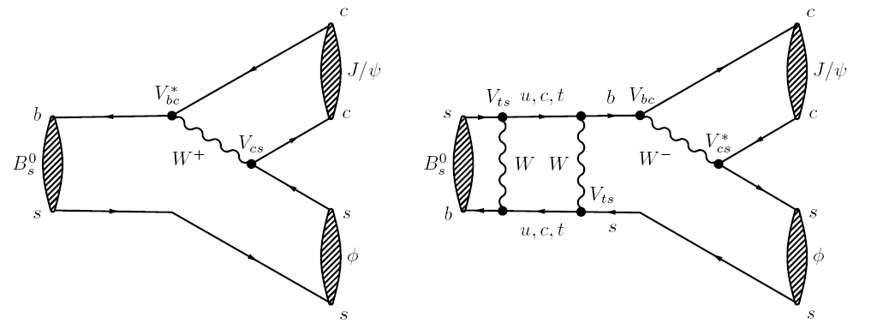
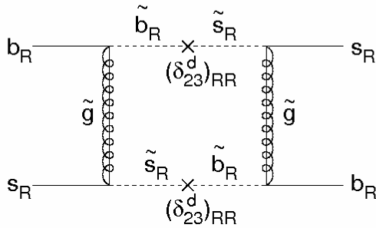
φ_{s}
A₁
A₂
V_{ts}
V_{cs}
V*_{cs}
V_{ts}
B⁰_{s} →J/ψφ
Relative phase: φ_{s}
B_{s}⁰ → J/ψφ
  φ_{s} = φ_{M} - 2φ_{D}
  φ_{s}SM = -2β_{s} = -0.036 ± 0.002 rad
    (Neglecting penguin contributions)
New physics can affect φ_{M}
A.Lenz (SM prediction), arXiv:1205.1444
e^{-iφD}
B_{s}⁰
J/ψφ
e^{iφM}
e^{iφD}
‾B_{s}⁰
?
LHCb, 1.0fb⁻¹, φ_{s}, LHCb-CONF-2012-002
LHCb, 1.0fb⁻¹ ,J/ψ ππ, arXiv:1204.5675
LHCb, 1.0fb⁻¹ ,τ_{J/ψ f0} arXiv:1207.0878
LHCb, 1.0fb⁻¹, amb, PRL. 108 (2012) 241801

Slide 30
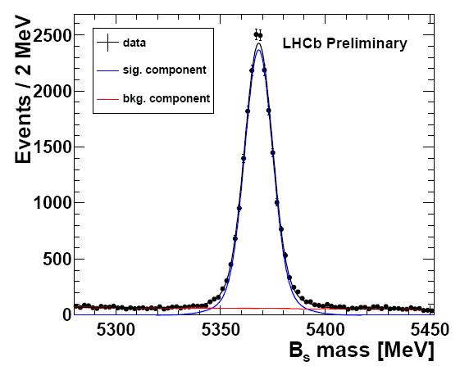
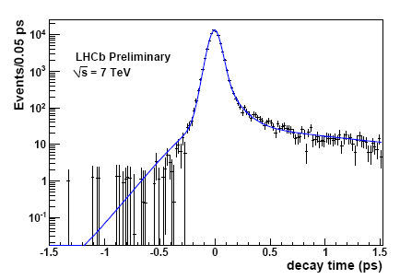
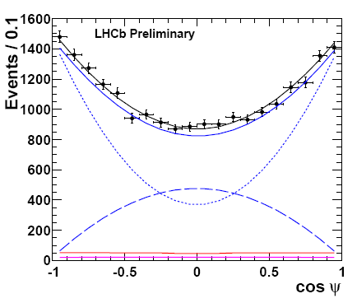
LHCb: φ_{s}
B⁰_{s}→J/ψφ
t >0.3 ps
N = 21,200
σ ~ 7 MeV
L ~ 1.0 fb⁻¹
σ_{t} ~ 45 fs
B⁰_{s}→J/ψφ
prompt
J/ψ
Angular analysis
  Pseudo-scalar → 2 vectors
  CP ~ (-1)^{L}
Tagging: εD² = 2.29±0.27%
CP +
L=1 | A┴ | CP= -
L=0,2 | A₀,A║ | CP=+
LHCb, 1.0fb⁻¹, φ_{s}, LHCb-CONF-2012-002
CP -
S-wave
LHCb, EPJ C (2012) 72:2022

Slide 31
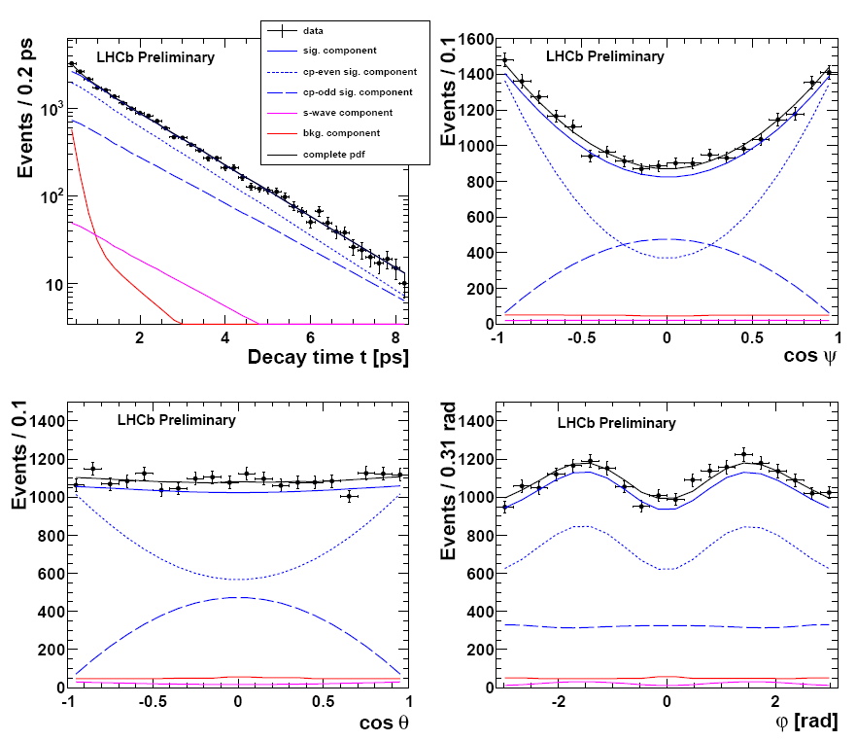
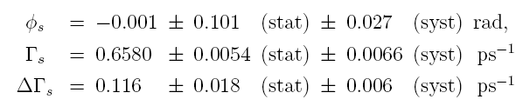
φ_{s}
CP-even
CP-odd
S-wave
Bkgd
LHCb, 1.0fb⁻¹, φ_{s}, LHCb-CONF-2012-002
preliminary

Slide 32
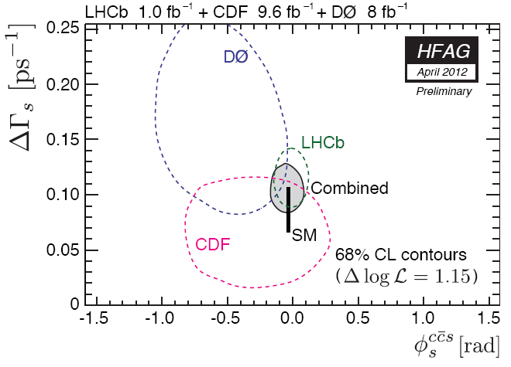
φ_{s}
LHCb 1.0 fb⁻¹
A.Lenz (SM prediction), arXiv:1205.1444
LHCb

Slide 33
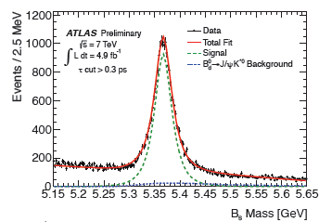



ATLAS: φ_{s}
Avg: 5.6 overlapping pp!
Luminosity: 4.9 fb⁻¹
P_{t}^{μ}>4 GeV
t>0.3ps
φ_{s}
S.Palestini at ICHEP 2012

Slide 34






φ_{s}
B⁰_{s}→J/ψππ
B⁰_{s}→J/ψππ: CP eigenstate
  Pure CP-odd, only long living B⁰_{s}
  No angular analysis needed
  Data sample smaller compared to J/ψφ
  Hadronic effects might shift φ_{s} differently
Combined fit:
  Decrease statistical unc from 0.101 to 0.083:
Effective lifetime:
f₀(980) , f₀(1370)
LHCb, 1.0fb⁻¹, φ_{s}, LHCb-CONF-2012-002
LHCb, 1.0fb⁻¹ ,J/ψ ππ, arXiv:1204.5675
LHCb, 1.0fb⁻¹ ,τ_{J/ψ f0} arXiv:1207.0878

Slide 35


B_{s}⁰ Lifetime
CP | mass | lifetime | example
+ | L | short | B⁰_{s}→ KK
- | H | long | B⁰_{s}→ J/ψf₀
LHCb, 1.0fb⁻¹, amb, PRL. 108 (2012) 241801
Combined
S.Stone at ICHEP 2012

Slide 36





Mixing Phase
A₁
B_{s}⁰ → D_{s}⁻Xμ⁺ν
  φ_{s} = φ_{M} - 2φ_{D}
  φ_{s}SM = -2β_{s} = -0.036 ± 0.002 rad
  φ_{M}SM = 0.0035 rad
New physics can affect φ_{M}
Measure:
LHCb in agreement with SM and D0
φ_{M} = arg(M₁₂/Γ₁₂)
A₂
tan φ_{M}
LHCb
D_{s}⁺μ⁻-candidates
D0 anomaly (3.4σ)
LHCb, 1.0fb⁻¹, LHCb-CONF-2012-022

Slide 37
LHC
γ
φ_{s}
CPV in charm
CPV in B_{s}
Super Rare
A_{FB}
Radiative decays
CP violation
FCNC

Slide 38





Charm
A₂
A₁
Measure difference of CP asymmetry
  CP violation from mixing largely cancels
  Direct CP violation expected to be small
D⁰ →K⁺K⁻
D⁰ →π⁺π⁻
LHCb, 0.6 fb⁻¹, PRL 108, 111602 (2012)

Slide 39


Charm
Measure difference of CP asymmetry
  CP violation from mixing largely cancels
  Direct CP violation expected to be small
D⁰ →K⁺K⁻
Cancel production and detector asymmetries
Compare D⁰ →K⁺K⁻ and D⁰ →π⁺π⁻
Same production and detector asymmetry
Charge symmetric final state: A_{D}(f)=0
D⁰ →π⁺π⁻
3.5σ
First evidence for CP violation in charm
LHCb, 0.6 fb⁻¹, PRL 108, 111602 (2012)

Slide 40
LHC
γ
φ_{s}
CPV in charm
CP in B_{s}
Super Rare
A_{FB}
Radiative decays
CP violation
FCNC

Slide 41





CP violation in B_{s} decays
A₁
First observation of direct CP violation in B⁰_{s} decays
  N( B_{s}⁰ →K⁺π⁻) ≠ N(‾B_{s}⁰ →K⁻π⁺) !
  Interference of tree and penguin diagrams
A₂
LHCb, Phys. Rev. Lett. 108 (2012) 201601
N(B_{s}⁰ →K⁺π⁻)
N(B_{s}⁰ →K⁻π⁺)
3.3σ
preliminary
Measurement of time dependent CP:
    Interference of mixing and decay
3.2σ
LHCb, 0.7fb⁻¹, CP TD, LHCb-CONF-2012-007
LHCb, 1.0fb⁻¹, BR, arXiv:1206.2794

Slide 42


Historical?
P( K⁰→‾K⁰) ≠ P(‾K⁰→K⁰)
1964 Discovery
1980 Nobel Prize
J. Cronin, V. Fitch
P( B⁰ (→ ‾B⁰)→f) ≠ P(‾B⁰ (→ B⁰)→ f )
1972 Prediction
2001 Observation
2008 Nobel Prize
M. Kobayashi, T. Maskawa
Phys.Rev.Lett. 13 (1964) 138-140
Prog.Theor.Phys. 49 (1973) 652-657
1964: CP violation in K⁰-mesons (sd)
2001: CP violation in B⁰-mesons (bd)
2011: CP violation in D⁰-mesons (cu)
2012: CP violation in B_{s}⁰-mesons (bs)

Slide 43
FCNC
LHC
γ
φ_{s}
charm
CPV in B_{s}
Super Rare
A_{FB}
Radiative decays
CP violation
FCNC

Slide 44

FCNC:

Slide 45






FCNC
γ
b
Flavour Changing Neutral Current
  Also known as “rare decays”
s
B⁰_{(s)}→K*(φ)γ
B⁰→K*μμ
B⁰_{s}→μμ

Slide 46
FCNC
γ
b
W
Flavour Changing Neutral Current
Occur in SM only through loop diagrams
New Physics can appear at same order as SM
t
s
B⁰_{(s)}→K*(φ)γ
B⁰→K*μμ
B⁰_{s}→μμ

Slide 47
LHC
γ
φ_{s}
CPV in charm
CPV in B_{s}
Super Rare
A_{FB}
Radiative decays
CP violation
FCNC

Slide 48

FCNC: B⁰→K*μμ
B⁰→K*μμ
μ⁺
θ_{l}
μ⁻
K*
A_{FB} in SM due to V-A coupling
Hadronic uncertainties cancel in forward-backward asymmetry A_{FB}
Sensitive to many NP models
  Example:
(4/3)×A_{FB}
W.Altmannshofer et al.,
JHEP 0901:019,2009

Slide 49

FCNC: B⁰→K*μμ
B⁰→K*μμ
μ⁺
θ_{l}
μ⁻
K*
Other experiments show A_{FB}>0 at low q²
SM: C. Bobeth et al. arXiv:1105.0376; JHEP 0807 106
q² [GeV²]
A_{FB}(K* μμ) LHCb-CONF-2012-008

Slide 50


FCNC: B⁰→K*μμ
B⁰→K*μμ
μ⁺
θ_{l}
μ⁻
K*
Other experiments show A_{FB}>0 at low q²
S.Stone at ICHEP 2012
NB: Size of C₇ constrained by
BR(B⁰→K*γ) but not the sign.
q² [GeV²/c⁴]
A_{FB}(K* μμ) LHCb-CONF-2012-008

Slide 51



FCNC: B⁰→K*μμ
B⁰→K*μμ
μ⁺
θ_{l}
μ⁻
K*
Hadronic uncertainties cancel in forward-backward asymmetry A_{FB}
First measurement of zero-crossing point
Unbinned
subtract F and B distributions
A_{FB}(K* μμ) LHCb-CONF-2012-008

Slide 52

FCNC: B⁰→K*μμ
B⁰→K*μμ
μ⁺
θ_{l}
μ⁻
K*
More statistics needed to distinguish NP models!
SM: C. Bobeth et al. arXiv:1105.0376; JHEP 0807 106
A_{FB}(K* μμ) LHCb-CONF-2012-008

Slide 53





FCNC: B⁰→K*μμ and friends
B⁺→π⁺μμ
First observation of B⁺→π⁺μμ
  Prediction: BR(B⁺→π⁺μμ) = 1.96±0.21 x 10⁻⁸
  Rarest B decay ever observed!
Observation of B_{s}⁰→φμμ
  Prediction: BR(B_{s}⁰→φμμ) = 1.61x10⁻⁶
Isospin asymmetry: B⁰ vs B⁺ difference?
  No isospin asymmetry in K* channels
    SM prediction: -1%
  Isospin asymmetry in K channels
    Deficit in N(B⁰→K_{s}⁰μμ)
    No precise SM prediction for A_{I} ; expect close to zero…
Song,Lu,Lu Com.Th.Phys. 50 (2008) 696
BR(πμμ) LHCb-CONF-2012-006
5.2σ
B_{s}⁰→φμμ
Geng,Lui JPG29:1103,2003
BR(φμμ) LHCb-CONF-2012-003
Isospin arXiv:1205.3422
4.4σ

Slide 54

FCNC: B⁰→K*μμ and friends
B⁺→π⁺μμ
First observation of B⁺→π⁺μμ
  Prediction: BR(B⁺→π⁺μμ) = 1.96±0.21 x 10⁻⁸
  Rarest B decay ever observed!
Observation of B_{s}⁰→φμμ
  Prediction: BR(B_{s}⁰→φμμ) = 1.61x10⁻⁶
Isospin asymmetry: B⁰ vs B⁺ difference?
  No isospin asymmetry in K* channels
    SM prediction: -1%
  Isospin asymmetry in K channels
    Deficit in N(B⁰→K_{s}⁰μμ)
    No precise SM prediction for A_{I} ; expect close to zero…
Song,Lu,Lu Com.Th.Phys. 50 (2008) 696
BR(πμμ) LHCb-CONF-2012-006
5.2σ
B_{s}⁰→φμμ
Geng,Lui JPG29:1103,2003
BR(φμμ) LHCb-CONF-2012-003
Isospin arXiv:1205.3422
4.4σ

Slide 55
LHC
γ
φ_{s}
CPV in charm
CPV in B_{s}
Super Rare
A_{FB}
Radiative decays
CP violation
FCNC

Slide 56



FCNC: radiative decays
B⁰_{s}→φγ
Measurement of BR(B⁰_{s}→φγ)
(BRSM = (4.3±1.4) x 10⁻⁵)
Ali et al, EPJ C55 (2008) 577
B⁰→K*⁰γ
B⁰_{s}→φγ
B⁰→K^{*0}γ
preliminary
Direct CP asymmetry of B⁰→K^{*0}γ
(A_{CP}SM = (-0.61±0.43)%)
Matsumori et al, PRD72 (2005) 014013
B⁰→K*⁰γ
B⁰→‾K*⁰γ
preliminary
LHCb 1 fb-1 LHCb-PAPER-2012-019

Slide 57
LHC
γ
φ_{s}
CPV in charm
Direct CPV in B_{s}
Super Rare
A_{FB}
Radiative decays
CP violation
FCNC

Slide 58
Super Rare: searches
Search for non-resonant decay:
  BR(B_{s}⁰→ μ⁺μ⁻μ⁺μ⁻)_{non-res} < 1.3 x 10⁻⁸
Rare charm (@ 90% CL):
  CMS: BR(D⁰→μ⁺μ⁻) < 5.4 x 10⁻⁷
  LHCb: BR(D⁰→μ⁺μ⁻) < 0.11 x 10⁻⁷
Rare? Forbidden!
  BR(τ⁺→μ⁺μ⁻ μ⁺) < 7.8 x 10⁻⁸
Main focus: B_{s}⁰→ μ⁺μ⁻
LHCb 4mu LHCb-CONF-2012-010
LHCb D LHCb-CONF-2012-005
LHCb tau LHCb-CONF-2012-015
CMS D CMS PAS BPH-11-017
Babar D arXiv:1206.5419

Slide 59

Super Rare: B_{s}⁰→μ⁺μ⁻
B⁰_{s}→μμ
Highly suppressed in the SM
  Higher order
  Helicity suppressed
SM: BR(B_{s}⁰→μ⁺μ⁻) = 3.2 x 10⁻⁹
  remember rarest to date: BR(B⁺→π⁺μμ) = 2.4 x 10⁻⁸
BR strongly enhanced in many models
i.e. MSSM at large tanβ: ∝ tan⁶β/m_{A}⁴
  Example: 10x higher BR for tanβ=50(20), m_{H+}=800(200) GeV
A.Buras, arXiv:1106.0998
NP?

Slide 60


Intermezzo: Subtlety regarding BR’s
Subtlety…:
  We measure the time-integrated branching ratio
  But the theoretical prediction holds at t=0
Not equal if ΔΓ_{s}≠0 !
  Different by 8.8%* depending on CP eigenvalue:
  (y_{s} = ΔΓ_{s}/2Γ_{s} = 0.088±0.014)
Example: what is BR(K⁰→ππ) ??
  Quite different for t=0 (~100%)
  Compared to time-integrated (~50%)
LHCb-CONF-2012-002
B_{s}⁰→μ⁺μ⁻ is CP-even
Independent of μ-helicity
Should compare to SM value of 3.5 x 10⁻⁹ !
Bruyn, Fleischer, Knegjens, Koppenburg,
Merk, Pellegino, NT,
arXiv:1204.1735
arXiv:1204.1737 Accepted by PRL

Slide 61

Search for B_{s}⁰→μ⁺μ⁻
LHCb preliminary 2011
√s = 7 TeV
L ~ 150 pb⁻¹
B⁰_{s}→μμ?
5.4

Slide 62
Search for B_{s}⁰→μ⁺μ⁻
LHCb preliminary 2011
√s = 7 TeV
L ~ 150 pb⁻¹
B⁰_{s}→μμ?
(Expect about 10 signal events …)
5.4

Slide 63



Search for B_{s}⁰→μ⁺μ⁻ : LHCb
“Enriched” half of the sample, BDT>0.5
Observe 11 events (m_{B}±60 MeV), expect:
  ~10.4 background
  ~5.3 SM
Few events, so strong limit:
  Comparison with SM: compatible at 1σ
  Comparison with bkgd only: p-value (1-CL_{b})=18%
SM
Close to the SM value!
LHCb 1 fb⁻¹ PRL 108 (2012) 231801

Slide 64


Search for B_{s}⁰→μ⁺μ⁻: ATLAS, CMS, LHCb
ATLAS
 | ATLAS (bar+tr+endc) | CMS (bar+endc) | LHCb (BDT>0.5)
Lumi | 2.4 fb⁻¹ | 5 fb⁻¹ | 1.0 fb⁻¹
p^{μ}_{T,min}(GeV) | 4 GeV | 4 GeV | 1.5 GeV
Mass window | ~ ±130 MeV | ±75 MeV | ±60 MeV
N_{obs} | 3 | 6 | 11
N_{exp}(sig) | ~ 1 (estimated from histos, NT) | 3.93 | 10.4
N_{exp}(bkgd) |  | 1.99 | 5.3
Publication | PL B713 (2012) 387 arXiv:1204.0735 | JHEP 04 033 (2012) arXiv:1203.3976 | PRL 108, 231801 (2012) arXiv:1203.4493
~0.5
~0.2
CMS
LHCb
~0.3

Slide 65



Search for B_{s}⁰→μ⁺μ⁻
LHCb/CMS/ATLAS LHCb-CONF-2012-017
Combination of LHCb, ATLAS and CMS
  BR(B_{s}⁰→μ⁺μ⁻ ) < 4.2 x 10⁻⁹ @ 95% CL
Slight (2σ) ‘excess’ wrt bkd: p-value (1-CL_{b}) = 5%
Compatible with SM within 1σ
4.5 4.2
Exp (SM + bkgd)
Exp (bkgd only)
SM

Slide 66
Search for B_{s}⁰→μ⁺μ⁻
LHCb/CMS/ATLAS LHCb-CONF-2012-017
Combination of LHCb, ATLAS and CMS
  BR(B_{s}⁰→μ⁺μ⁻ ) < 4.2 x 10⁻⁹ @ 95% CL
Slight (2σ) ‘excess’ wrt bkd: p-value (1-CL_{b}) = 5%
Compatible with SM within 1σ
4.5 4.2
Exp (SM + bkgd)
Exp (bkgd only)
prof. Ch.Quick:
“… unreasonable effectiveness of the Standard Model …”
SM

Slide 67
Conclusions
LHC
γ
φ_{s}
CPV in charm
CPV in B_{s}
Super Rare
A_{FB}
Radiative decays
CP violation:
  LHCb made first step towards measuring γ
  Best measurement of φ_{s}
  Mixing asymmetry a_{sl} consistent with D0 and SM
  First measurement of CP violation in charm
  First measurement of CP violation in B_{s}⁰
FCNC:
  A_{FB} in B⁰→K^{*0}μμ consistent with SM
  Isospin asymmetry in B→Kμμ
  Super rare decay B_{s}⁰→μμ around the corner
All results statistically limited!

Slide 68
Thank you!

Slide 69





Backup: OPE
Flavour changing neutral currents
Probe V-A structure of SM
In HQET expressed in terms of Wilson coeficients
B⁰_{(s)}→K*(φ)γ
B⁰→K*μμ
B⁰_{s}→μμ
O_{7γ}
O_{7γ},O_{9V},O_{10A},
O_{S},O_{P}
O_{10A},
O_{S},O_{P}
In principle both left-
and righthanded, O_{7γ} and O_{7γ}’
O_{S} : Scalar current (Higgs)
O_{P}: Pseudo-scalar
e.g. W.Altmannshofer et al., JHEP 0901:019,2009
Highly suppressed
in SM
effectively:

Slide 70

Backup: Isospin asymmetry
Isospin asymmetry: B⁰ vs B⁺ difference?
  No isospin asymmetry in K* channels
    SM prediction: -1%
  Deficit in N(B⁰→K_{s}⁰μμ)
    No precise SM prediction, expected close to zero…

