Slide 1
Oracle Real Application Clusters (RAC)
Techniques for implementing & running robust and reliable services
WLCG Service Reliability Workshop
26 November 2007
Miguel Anjo, CERN-Physics Databases
Notes:
Welcome, done with the team
Talk based on the experiment needs; solution we developed; current usage and future improvements;
Pragmatic talk, main issues and concerns will be presented,
aim is to create awareness of where we are today and work it is being done within whole IT to have a high quality service during the whole LHC run.

Slide 2
Outline
Experiments Critical services
Oracle RAC solution
  Architecture
  Monitoring
  Administrative work
  Current and future usage
  Concerns
  Future improvements
Summary

Slide 3
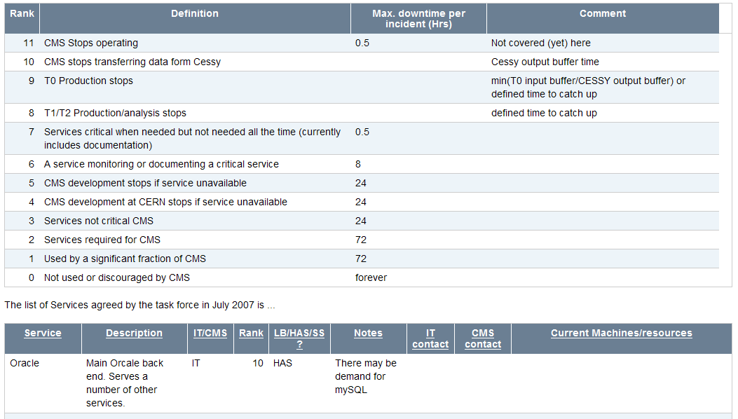
Critical Services CMS
https://twiki.cern.ch/twiki/bin/view/CMS/SWIntCMSServices
Notes:
Jamie already covered
Oracle is ranked 1st in criticality. Half hour is not human time-scale

Slide 4
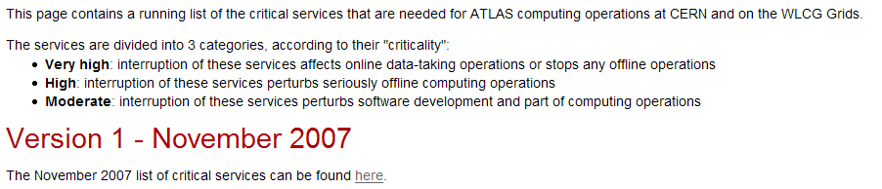
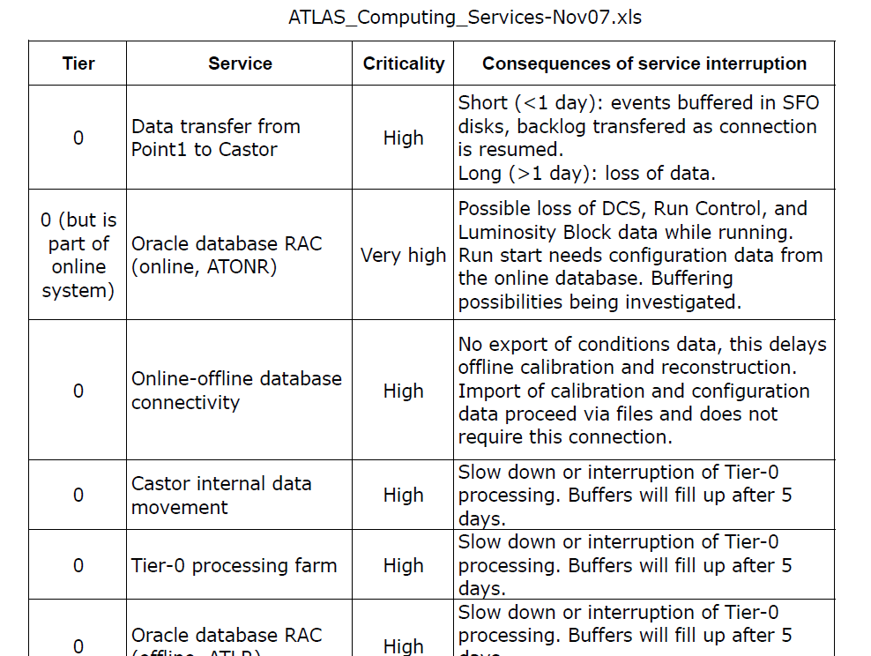
Critical Services ATLAS
https://twiki.cern.ch/twiki//bin/view/Atlas/AtlasCriticalServices
Notes:
Atlas Online RAC running in the computer centre by IT.
5 day buffer seems reasonable.

Slide 5
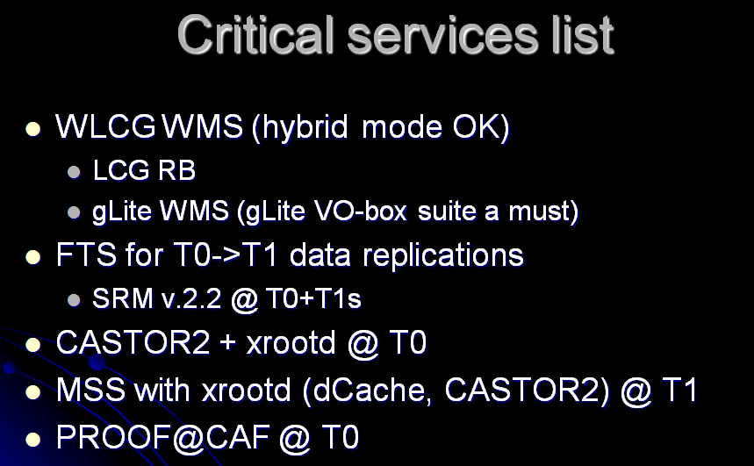
Critical Services Alice
http://indico.cern.ch/conferenceOtherViews.py?view=standard&confId=20080
Notes:
No Oracle written, but most of services here have an Oracle database behind

Slide 6
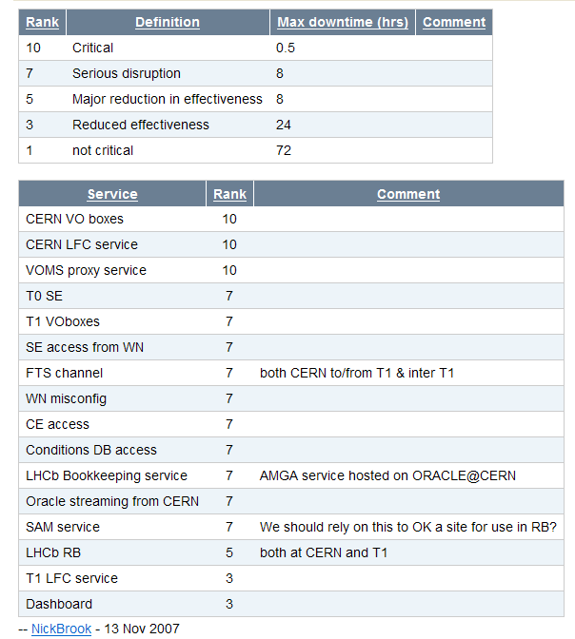
Critical Services LHCb
https://twiki.cern.ch/twiki/bin/view/LHCb/CCRC08
Notes:
- Same as Alice, LFC service backend at CERN is Oracle, FTS, Condition DB, LHCb Bookkeeping, Oracle streaming, SAM service

Slide 7
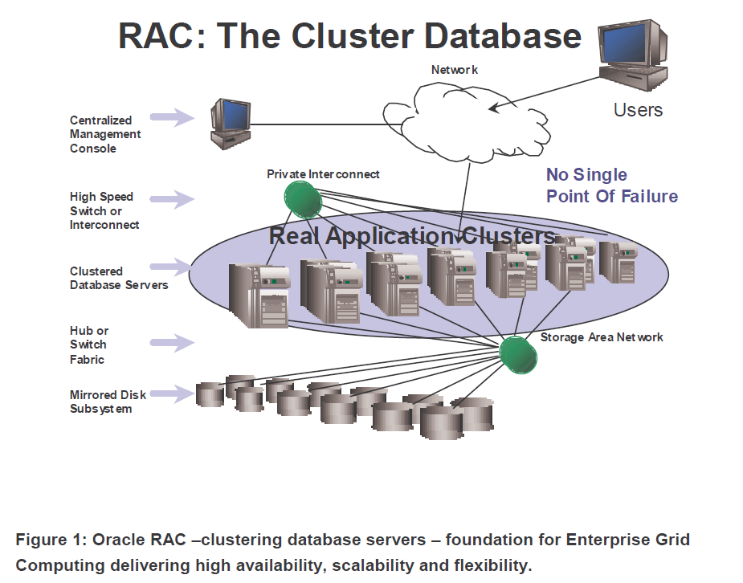
Oracle point of view
Oracle Real Application Clusters 10g - Foundation for Grid Computing
http://www.oracle.com/technology/products/database/clustering/index.html
Notes:
- Several years ago CERN had to decide for a vendor. Oracle was chosen. Few years ago we tested with success the RAC – Real Application Clusters – technology.
- Oracle uses the work ‘Grid’ with a smaller different meaning. Mostly means: HA, scalable and flexible solution. Is it true?

Slide 8
The reality at CERN (Oct07)
18 RACs up to 8 nodes running for production and integration services (LHC experiments, Grid, non-LHC)
  110 mid-range servers and 110 disk arrays (~1100 disks)
  Or: 220 CPUs, 440GB of RAM, 300 TB of raw disk space(!)
Recently connected to the 10 Tier1 sites for synchronized databases (3D project)
  Sharing policies and procedures
Team of 6 DBAs + Maria Girone service coordination and link to experiments
24x7 best effort service for production RACs
Maintenance without downtime within RAC features
  99.99% production services availability (Oct2007)
    Problems with SAM (max 3.5 hours unavailable)
  93.46% production servers availability (Oct2007)
    Patch deployment, broken hardware
Notes:
Back to CERN IT, October/November 2007:
Next slides will be showing the service we – Physics Databases team – provide to the LHC
Big infrastructure, connected worldwide within 3D project, 24x7 best effort service
Highly available for the users, <7.5 hours downtime over almost 76k hours
Even if servers had much worst availability performance >1.750 hours of server downtime
concept of services in the next slides – but mostly equivalent to application
102 production services
36 production servers

Slide 9
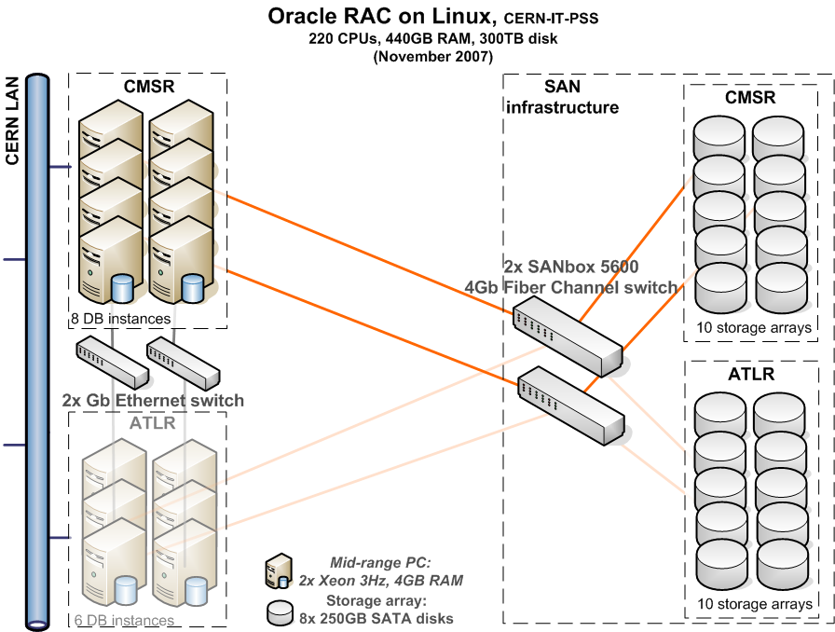
Architecture
Applications consolidated on large clusters, per experiment
Redundant and homogeneous HW across each RAC
Notes:
Tell there are other production RACs – ATLAS, CMS, LHCb, WLCG, Other physics applications (includes Alice) and Compass
redundant hardware – all machines belonging to one RAC are exactly the same
no single point of failure – every component is doubled
dual power supply (except switches) and critical power line – connected to UPS and diesel
standardized and homogeneous configuration – certified for usage by Oracle
Completely scalable within needs of the experiment

Slide 10
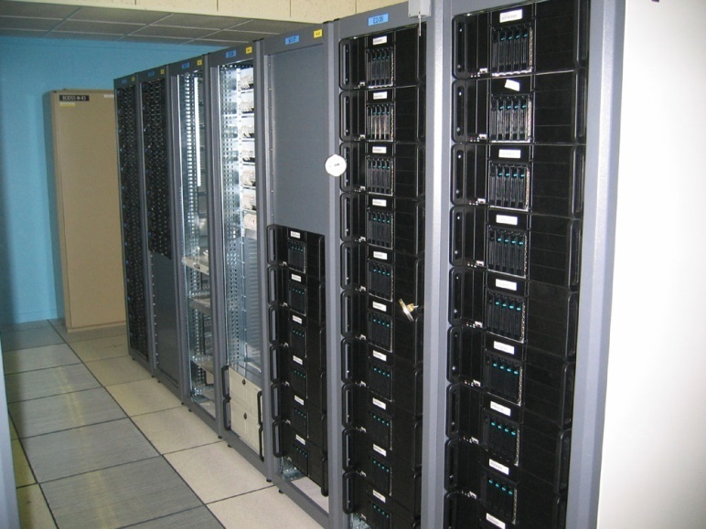
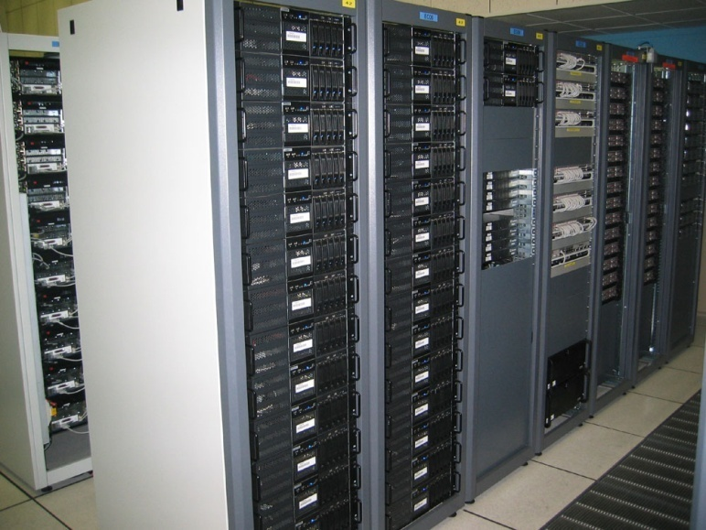
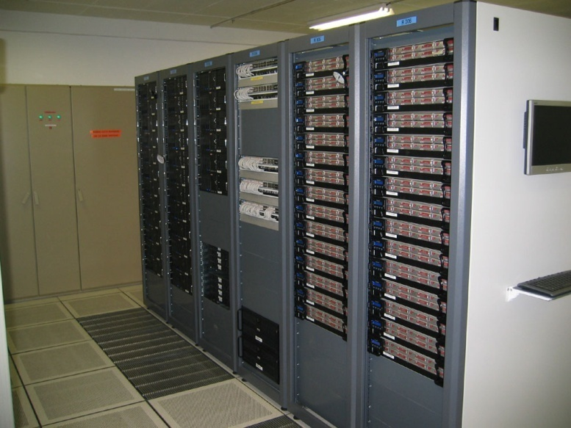
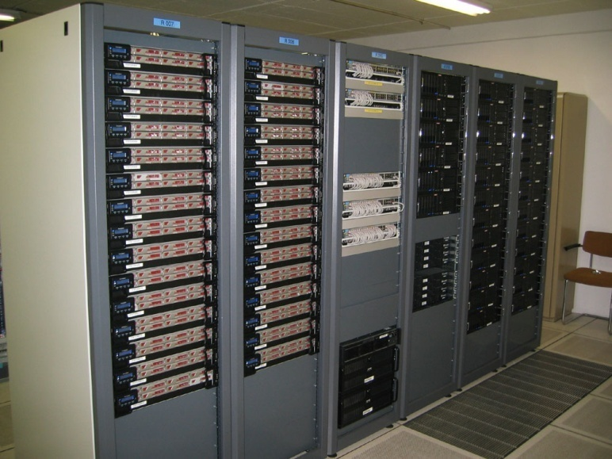
Architecture
Notes:
- RAC 1, then RAC2 and finally RAC 3 and 4, downstairs

Slide 11

Architecture (storage)
Following SAME concept:
  Oracle ASM for mirroring across arrays and striping
Two diskgroups per database (‘data’, ‘recovery’)
Destroking: most accessed data on external part of disk
Example:
DiskGrp1
DiskGrp2
Mirroring
Striping
Striping
Notes:
Some details of our configuration for HA and high performance
On the storage, for each RAC we use an Oracle product called Automatic Storage Management, to which we give raw disks, not mirrored
SAME – Strip and Mirror Everything – strip disks in small chunks which are placed anywhere in a big volume, and mirror disks to a different disk array
- Each database has a data and recovery disk group.
Use Destroking: use the external part – faster access - for data and internal for recovery (includes copy of db and archive logs)
Data automatically balanced across all disks available. When one disk fails, data automatically rebalanced.
RAID 1+0 – stripped data mirrored. Done by ASM automatically.

Slide 12

Architecture (services)
Resources distributed among Oracle services
  Applications assigned to dedicated service
  Applications components might have different services
Service reallocation not always completely transparent
Notes:
Resources in a RAC database are distributed among services.
Applications are assigned to dedicated services
Services are assigned to a set of nodes – having nodes set as preferred and an ordered available nodes
When a node fails, services on that node are assigned to the next available node
This allows to do rolling interventions like for applying patches.
When moving connections from one node to another, some transactions might fail, errors might appear before a new transaction is started.
-Is on the applications to expect re-connections and unexpected failed transactions – need to retry.

Slide 13
Architecture (load balancing)
Service’s connection string mentions all virtual IPs
It connects to a random virtual IP (client load balance)
Listener sends connection to least loaded node where service runs (server load balance)
$ sqlplus cms_dbs@cms_dbs
cmsr1-v
cmsr2-v
cmsr3-v
cmsr4-v
Virtual IP
listener cmsr1
listener cmsr2
listener cmsr3
listener cmsr4
CMS_DBS
Notes:
RAC solution also provides some kinds of load balancing
Concept of virtual IP, a second IP that is virtually assigned to a NIC and managed by the oracle clusterware
All VIP are mentioned in the connection string
Client load balanced is done by randomly connecting to a virtual IP
The listener that receives the connection, sees where requested service is running and sends connection to least loaded node – server load balancing

Slide 14
Architecture (load balancing)
Used also for rolling upgrades (patch applied node by node)
Small glitches might happen during VIP move
  no response / timeout / error
  applications need to be ready for this → catch errors, retry, not hang
$ sqlplus cms_dbs@cms_dbs
cmsr1-v
cmsr3-v
cmsr4-v
Virtual IP
cmsr2-v
listener cmsr1
listener cmsr3
listener cmsr4
CMS_DBS
Notes:
-When node is not available, the VIP moves to a different node, which responds to two different VIPs
-This is also used for rolling upgrades.
Some problems are some times seen during this move of VIPs, for few instants VIP might not be available and connections stays hanging in the TCP time out of 2 hours.
Again, on the applications to be aware of these infrequent problems.
- on the example, service moves to a different set of nodes, VIP moves also.
Existing connections are moved along with the service, active transactions are rolled back.

Slide 15

Apps and Database release cycle
Applications’ release cycle
Development service
Validation service
Production service
Database software release cycle
Production service
version 10.2.0.n
Validation service
version 10.2.0.(n+1)
Production service
version 10.2.0.(n+1)
Notes:
We have a validation service which is used to test applications in a production-like environment
Also used to application developers to test application against new database sw releases

Slide 16
Administrative work
Install and configure Oracle RAC databases
  Expertise from several groups
Apps developers support (remedy line)
Account creation, application deployment
On call rota 24x7
Oracle and Linux patches deployment and test
  /etc/nospma to avoid automatic OS updates
Application optimization in cooperation with developers and experiment DBAs
  Putting in place a policy for DB access for experiment DBAs
Active monitoring
Notes:
Work for 6 DBAs and more
RAC installation is a cross group activity, with help of FIO and CS groups. Expertise of the storage arrays on FIO team
Developers support via Remedy very demanding. Trying to write tutorials to decrease requests. Users often don’t search our web pages for solution.
-On call service 24x7 in rotational basis
-Test of quarterly Oracle patches and new OS updates before install on integration RACs
-Application optimization – experiment DBAs giving a big help, putting in place a policy for special DB access for experiment DBAs
-Active monitoring to catch potential problems before they happen

Slide 17
Monitoring
24x7 reactive monitoring
  Lemon Alarms, Operators, SysAdmins
    HW failures, OS problems, High load
  Host and, instance and service availability
    home grown monitoring
Active monitoring
  Oracle Enterprise Manager
    Execution plans, resource usage per service
  3D monitoring included into experiments dashboards
  Lemon
  Weekly reports (sent to experiment DBAs/links/3D)
    SQL changes, service usage, bad connection management, bad indexes
Notes:
We rely on two main sources of reactive monitoring – Lemon alarms, mostly for HW failures and OS problems, which follow the usual Operators-SysAdmins procedures;
and home grown scripts for DB host, instance and service availability, which sends SMS directly to a the DBA on duty.
HW failure usually does not affect the service as a DB instance or service error.
Active monitoring is done using Oracle tool called Enterprise manager, Lemon and weekly reports (also home grown), which can alert for potential problems.
These weekly reports are sent to experiment DBAs, link persons and 3D sites.
The 3D monitoring is included in experiment dashboards

Slide 18
Current and Future usage
Approached by the LHC experiments for service provision for the online database, including Online to Offline databases streaming
Notes:
When we are approached by the LHC experiment to provision service for the online databases, including streaming between them
The numbers show a double of data in the database in a 6 months period
Our work in the Physics Databases team, in cooperation with application developers of the experiments, is to make that this does not reflect in higher usage of the resources
mostly done by optimization of the application.

Slide 19
Main concerns (based on experience)
Human errors
  on administrative tasks (SAM problem on tidying up old data)
    test better the procedures, not always easy task
Human errors
  By developers (SAM dropped tables)
    Restrict access to production accounts to developers
Logical corruption / Oracle SW bugs
  VOMS/LFC data inserted in wrong VOs
    Better testing on pilot environments before deployment of new patches in production
Notes:
Main concerns based on example of recent problems in production
Both from DBAs and developers. Can be reduced but is almost unavoidable to happen if we want to improve system, correct problems
Oracle SW introduces changes when expected only security patches

Slide 20
Main concerns (based on experience)
Oracle software Security
  Quarterly security patches released by Oracle
    Firewalls, no default configuration, restrict access to essential
    Do not publish connection data on web
Increasing amount of stored data
  Tapes slow as 5 years ago, backups take longer
    Move to backup on disks
    prune old redundant data/summarizing
Notes:
Oracle databases, as main database product, aimed by hackers all over the world. CERN not yet victim but always better to protect
Repositories should not contain sensitive data. Connection parameters (host, port, db name) are sensitive data
Stored data doubled in last 6 months. Tapes are still slow, backups technology do not progress so fast
need to think on solutions – move to disk, prune redundant data, summarizing

Slide 21
Future improvements
Quad-core servers
  Smaller RACs, 1 quad-core better than 4 dual CPU single core
Data guard
  Parallel RAC with small lag (few hours)
  Fast disaster recovery
  Can be open read-only to recover from human errors
Streams replication
  Add redundancy for downstream and streams monitoring
  Automation of the split-merge (procedure used when one site needs to be dropped/re-synchronized)
Oracle 11g new features
  “SQL Replay” to have load on validation RAC
  “Data Guard - Standby snapshot” allows make a snapshot of production DB
  “SQL Plan Management” to stabilize optimizer
  “Result cache” for faster results
Notes:
First Quad-core servers are ordered – 1 quad-core dual CPU (8 cores) better than 4 servers dual CPU. Save on space, energy consumption
Data guard – disaster recovery – just apply redo log and switch
Streams as a very new technology needs still to move to HA mode, need to add redundancy, automatize common operations
Next Oracle version, currently in version 1, nice new features

Slide 22
Summary
Clustering of redundant hardware
Eliminate single points of failure
Applications mapped to ‘oracle services’ to better allocate resources and avoid starvation
Validation and production release cycles
Active monitoring by 6 DBAs, reports
Very good contact with experiment coordinators
Average service availability 99.99% (oct 07)
On-call 24x7 best effort service does not fulfill requirements from experiments
Need cooperation of the application developers to hide glitches
Notes:
Oracle RAC solution match most of the needs
Done by clustering redundant hw, eliminate single points of failures
Big work from physics database team to create a high available service,
Necessary excellent contact with experiment coordinators
Critical services of experiments are not fulfilled by 24x7 best effort service
Need cooperation of application developers to hide glitches

