Slide 1
WLCG – Worldwide LHC Computing Grid
Grid Operations:
The Current Model
WLCG Service Reliability
Workshop
November 27th 2007

Slide 2
What is Grid Operations? Well…
Infrastructures
  Production service
  Pre-production service (PPS)
Processes
  Middleware release process
  Site registration
  VO registration
Communications
  Weekly, monthly, bi-annual meetings for all stakeholders
Interoperations with other grids (OSG)
Grid security
User + Operations support
Operations tools
  CIC Portal
    Broadcast tool
    VO ID cards
  GOC database
  Monitoring
  Trouble ticketing system (GGUS)
… among other things!

Slide 3
Grid Operations Management:
Logical Structure
OCC
ROC 3.1
ROC 1
ROC 2
ROC 3.2
ROC n
ROC 3.3
Site 1
Site n
Site 1
Site n
Site 2
Site 2
Site 2
Site 1
Site n
Site 2
Site 1
Site n

Slide 4
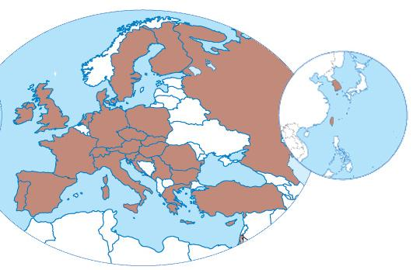
Grid Operations Management:
Physical Structure
Operations Coordination Centre
  Management, oversight, coordination
Regional Operations Centres
  Core support infrastructure
Grid User Support (GGUS)
  Coordination, management of user support
EGEE Network Operations Centre (ENOC)
  Coordination with NRENs & GEANT2

Slide 5
Day-to-day Grid Operations
Everyone contributes (or should): OCC, ROCs, sites
However, day-to-day “grid level” operations carried out by the COD teams, using COD dashboard
(COD = “CIC-on-duty”, CIC = “Core Infrastructure Centre” ??)
10 teams – 1 from each ROC. 2 teams on shift per week.
Handover at the weekly grid operations meeting
CODs are currently responsible for monitoring the grid, spotting the major problems, raising tickets and chasing resolution
But this needs to change (not scalable). Need to move more responsibility to the ROCs and sites
  Pro-activity!

Slide 6
User Support
Organized in a similar way to grid operations:
  Coordinated by the ESC (executive support committee)
  Teams of TPMs (Ticket Processing Managers) handle tickets coming into the GGUS system
  TPM teams hand over each week
  A significant difference is that some (all?) of the LHC VOs act as 1st level support and only pass tickets to GGUS when can’t be answered “in house”
Again, a significant amount of effort goes into this activity – including from the LHC experiments!

Slide 7
Tools for the job
CIC Portal := Grid Operations Portal (IN2P3)
  Central portal for grid operations
GOC DB := Grid Operations Centre database (RAL)
  Contains contact and security information for all sites + contains a “steady state” view of the sites and the services which they provide
GGUS := Global Grid User Support (FZK)
FCR := Freedom of Choice of Resources (CERN)
  Allows VOs to select sites according either to SAM results or to VO maintained whitelist / blacklist
SAM := Service Availability Monitoring (CERN)
Gstat : displays + validates the information published to the grid Information System by the sites
Accounting Enforcement Portal: show which sites are not publishing accounting data

Slide 8
Tools for the job
CIC Portal : http://cic.gridops.org/
GOC DB : https://goc.gridops.org/
GGUS : www.ggus.org
FCR : https://lcg-fcr.cern.ch:8443/fcr/fcr.cgi
SAM : https://lcg-sam.cern.ch:8443/sam/sam.py
Gstat : http://goc.grid.sinica.edu.tw/gstat/
Accounting Enforcement Portal : www3.egee.cesga.es/acctenfor

Slide 9
Interoperations: We are not alone
And not to forget interoperations with other grids around the world. Currently only OSG but NorduGrid and other will come along soon.
More than just interoperability (which is the easy bit :o)
  Cross grid trouble tickets
  Interoperability testing
  Dependency analysis
Interoperations effectively adds another dimension to the complexity matrix

Slide 10
Meetings, meetings
WLCG/OSG/EGEE weekly grid operations meeting
  Conference call every Monday at 16:00 Swiss local time (agendas: http://indico.cern.ch/categoryDisplay.py?categId=258)
  Attendees:
    Tier 0/1 sites (mandatory), Other sites (optional), WLCG coordination,
    VOs (LHC VOs mandatory), ROCs, EGEE operations team,
    OSG operations team, GGUS representative, Security representative
  Efficacy has improved enormously over last 2 years
  Further improvements in the pipeline – suggestions always welcome ☺
Bi-weekly ROC Managers meeting
  Handle longer term issues, strategic decision making for operations, tactical planning, etc.
Bi-annual (roughly) operations workshops
Sessions at WLCG collaboration workshops

Slide 11
Processes & Procedures
Middleware release process
  Formalized process to move middleware updates and new services through pre-production testing and into the production service (more on this later)
  Speed of release vs testing (reliability)
  Soon to include interoperability testing with OSG
Security Incident Response Procedure
  https://edms.cern.ch/file/867454/1/EGEE_Incident_Response_Procedure.pdf
Site registration
  https://edms.cern.ch/document/503198/
VO registration
  http://edms.cern.ch/document/503245
Grid operations procedures manual

Slide 12
Information Overload
Many sources of information on all aspects of operations (some better maintained than others). A smattering…
  GOC wiki: http://goc.grid.sinica.edu.tw/gocwiki/FrontPage
  GGUS documentation for site administrators: https://gus.fzk.de/pages/docu.php#3
  GridPP Admin Area: http://www.gridpp.ac.uk/deployment/admin/admin.html
  System Management Working Group (SMWG) wiki: http://www.sysadmin.hep.ac.uk/wiki/Main_Page
  LCG directory:
  http://lcg.web.cern.ch/LCG/Sites/the-LCG-directory.html
  EGEE SA1 Wiki: https://twiki.cern.ch/twiki/bin/view/EGEE/SA1

Slide 13
As clear as mud?
Questions
(and hopefully answers)
How can/should grid operations interact with the LHC experiments in the future?

