Slide 1
Experimental cavern movements
2nd HL-LHC PLC meeting
25.09.2012
A. Behrens, J.-C. Gayde, D. Mergelkuhl
BE/ABP/SU-EM

Slide 2
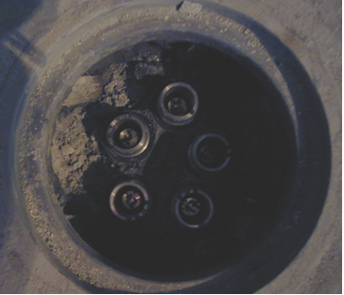
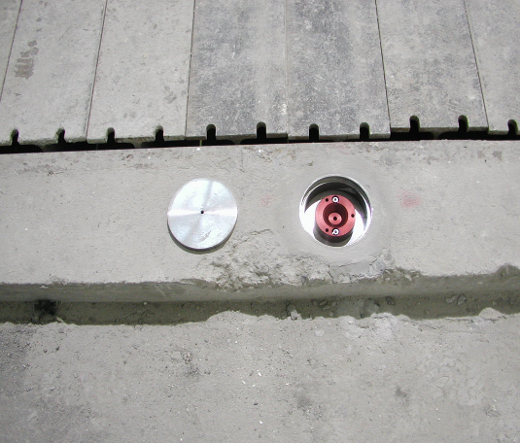
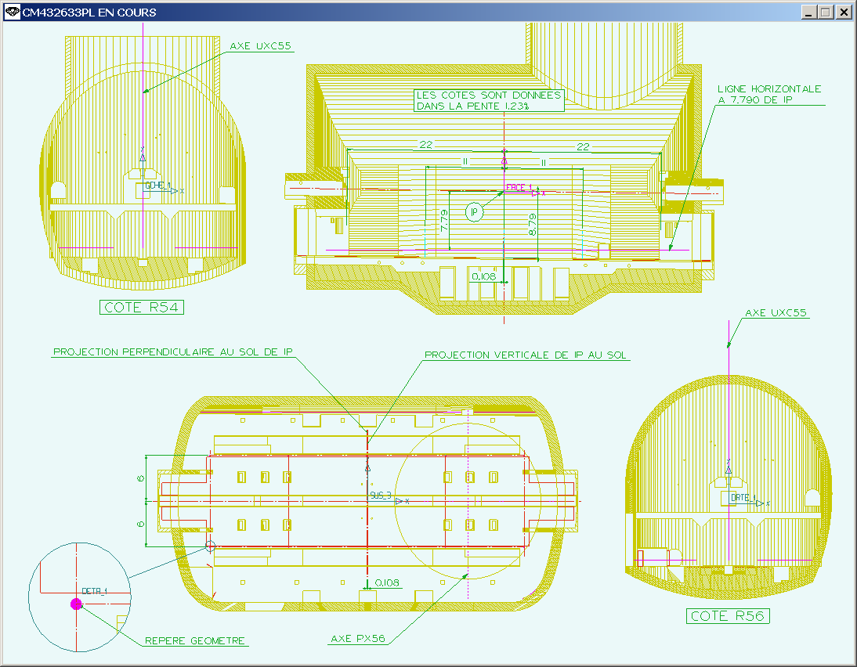
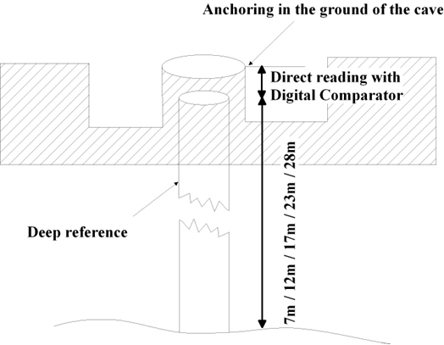
CMS Stability: Deep references and cavern floor points
Reference:
5 deep references
10 Floor points
L54 side
R56 side
ML2
ML1
M0
MR1
MR2
Xsu
CMS detector
PL2
PL1
P0
PR1
PR2
Ysu

Slide 3
CMS Stability: Cavern floor leveling
FLOOR POINTS FAR SIDE
JAN 2008
Total load 14600t
L54 Side
R56 Side
No significant movement
downwards
of floor points
during last year!
FLOOR POINTS NEAR SIDE

Slide 4
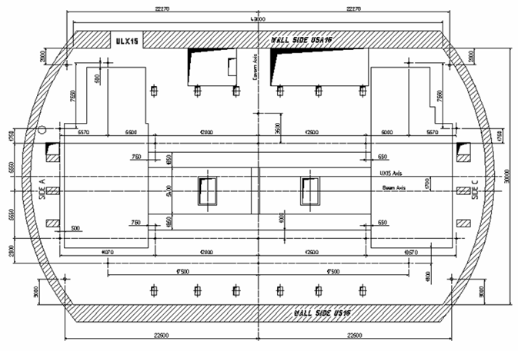
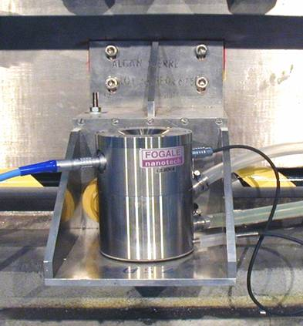
ATLAS Stability – HLS points on bedplates
TAUSA
USA side
TCUSA
A side
C side
Reference:
2 HLS points
BMUSA
BAUSA
BCUSA
Bedplate
Trench A
Trench C
Bedplate
BAUS
BCUS
BMUS
6 HLS points on the Bedplates
US side

Slide 5
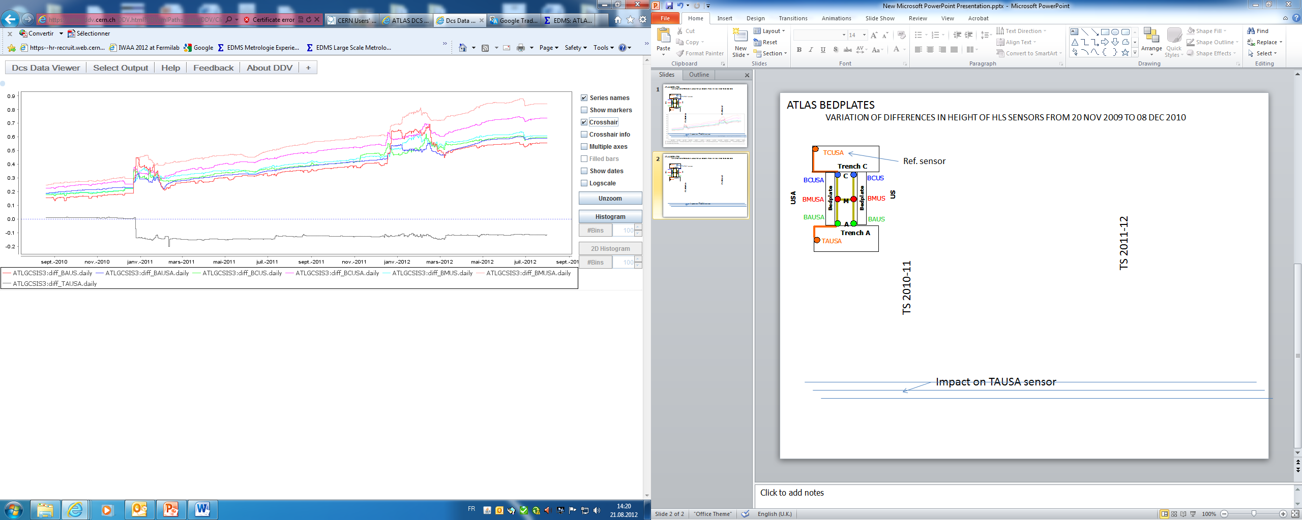
ATLAS Stability – HLS system
Max. movement upwards
of 0.6mm
during last 2 years!
VARIATION OF DIFFERENCES IN HEIGHT
OF HLS SENSORS
FROM 20 NOV 2009 TO 21 AUG 2012
TS 2011-12
TS 2010-11
0.5 mm
Values normalized to TCUSA sensor
Shock on TAUSA sensor

