Slide 1





CPT VIOLATION IN THE EARLY UNIVERSE & LEPTOGENESIS/BARYOGENESIS
Nick E. Mavromatos
King’s College London, Physics
& CERN/PH-TH
DISCRETE 2012, IST, Lisbon, December 3-7 2012
London Centre
for Terauniverse
Studies (LCTS)
AdV 267352

Slide 2
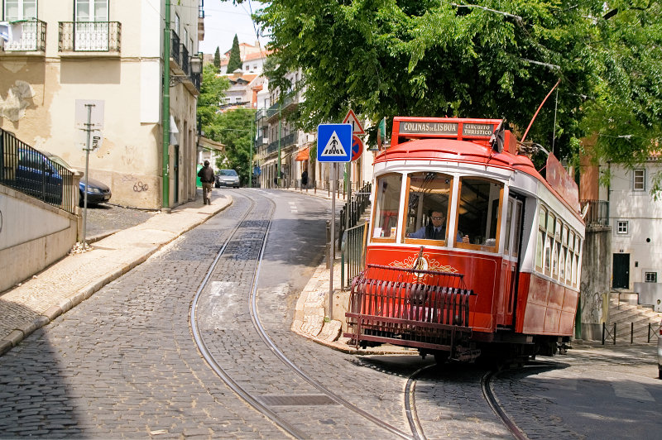

ROUTE

Slide 3
ROUTE
Matter over Antimatter Dominance : open issues
CPT Symmetry : can it be violated and how?
CPT Violation (CPTV) Scenarios in Early Universe:
Classical or Quantum Gravity?
Background-induced Breaking of CPT Symmetry
in Early Universe Geometries;
Space-time (stringy) defects and quantum
aspects of CPTV
The role of Neutrinos : Leptogenesis implies Baryogenesis
(observed Baryon Asymmetry in Universe)
Can we experimentally test such ideas?
Astrophysics, Cosmology, LAB

Slide 4
Generic Concepts
Leptogenesis: physical out of thermal equilibrium processes in the (expanding) Early Universe that produce an asymmetry between leptons & antileptons
Baryogenesis: The corresponding processes that produce an asymmetry between baryons and antibaryons
Ultimate question: why is the Universe made only of matter?

Slide 5
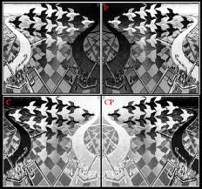
Generic Concepts
Leptogenesis: physical out of thermal equilibrium processes in the (expanding) Early Universe that produce an asymmetry between leptons & antileptons
Baryogenesis: The corresponding processes that produce an asymmetry between baryons and antibaryons
Ultimate question: why is the Universe made only of matter?
escher

Slide 6
Generic Concepts
Matter-Antimatter asymmetry in the Universe Violation of Baryon # (B), C & CP
Tiny CP violation (O(10⁻³)) in Labs: e.g.
But Universe consists only of matter
WMAP + COBE (2003)
T > 1 GeV
Sakharov : Non-equilibrium physics of early Universe, B, C, CP violation
but not quantitatively in SM, still a mystery

Slide 7

Generic Concepts
Matter-Antimatter asymmetry in the Universe Violation of Baryon # (B), C & CP
Tiny CP violation (O(10⁻³)) in Labs: e.g.
But Universe consists only of matter
WMAP + COBE (2003)
T > 1 GeV
Sakharov : Non-equilibrium physics of early Universe, B, C, CP violation
but not quantitatively in SM, still a mystery
Assume CPT

Slide 8

Within the Standard Model, lowest CP Violating structures
Kobayashi-Maskawa CP Violating phase
Shaposhnikov
<<
This CP Violation
Cannot be the
Source of Baryon
Asymmetry in
The Universe
sphaleron decoupling T

Slide 9
Beyond SM sources of CP Violation?
Several Ideas to go beyond the SM (e.g. GUT models, Supersymmetry, extra dimensional models etc.)
Massive ν are simplest extension of SM
Right-handed massive ν may provide extensions of SM with:
extra CP Violation and thus Origin of Universe’s matter-antimatter asymmetry due to neutrino masses, Dark Matter
Mohapatra, Pilaftsis
talks

Slide 10
Beyond SM sources of CP Violation?
Several Ideas to go beyond the SM (e.g. GUT models, Supersymmetry, extra dimensional models etc.)
Massive ν are simplest extension of SM
Right-handed massive ν may provide extensions of SM with:
extra CP Violation and thus Origin of Universe’s matter-antimatter asymmetry due to neutrino masses, Dark Matter
…BUT MAY NOT BE NECESSARY IF CPT VIOLATION IN EARLY UNIVERSE

Slide 11
CPT VIOLATION IN THE EARLY UNIVERSE

Slide 12
CPT VIOLATION IN THE EARLY UNIVERSE
GENERATE Baryon and/or Lepton ASYMMETRY
without Heavy Sterile Neutrinos?
CPT Invariance Theorem :
Flat space-times
Lorentz invariance
Locality
Unitarity
Schwinger, Pauli,
Luders, Jost, Bell
revisited by:
Greenberg,
Chaichian, Dolgov,
Novikov…
(ii)-(iv) Independent reasons for violation

Slide 13
CPT VIOLATION IN THE EARLY UNIVERSE
GENERATE Baryon and/or Lepton ASYMMETRY
without Heavy Sterile Neutrinos?
Kostelecky , Potting, Russell, Lehnert, Mewes, Diaz ….
Standard Model Extension (SME)
PHENOMENOLOGICAL
3-LV parameter (texture)
model for neutrino oscillations
fitting also LSND, MINOS
CPT Invariance Theorem :
Flat space-times
Lorentz invariance
Locality
Unitarity
(ii)-(iv) Independent reasons for violation

Slide 14

CPT VIOLATION IN THE EARLY UNIVERSE
GENERATE Baryon and/or Lepton ASYMMETRY
without Heavy Sterile Neutrinos?
CPT Invariance Theorem :
Flat space-times
Lorentz invariance
Locality
Unitarity
Barenboim, Borissov, Lykken PHENOMENOLOGICAL
models with non-local
mass parameters
(ii)-(iv) Independent reasons for violation

Slide 15
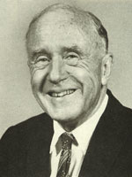

CPT VIOLATION IN THE EARLY UNIVERSE
GENERATE Baryon and/or Lepton ASYMMETRY
without Heavy Sterile Neutrinos?
CPT Invariance Theorem :
Flat space-times
Lorentz invariance
Locality
Unitarity
(ii)-(iv) Independent reasons for violation
J.A. Wheeler
e.g. QUANTUM SPACE-TIME
FOAM AT PLANCK SCALES
10⁻³⁵ m

Slide 16
CPT VIOLATION IN THE EARLY UNIVERSE
GENERATE Baryon and/or Lepton ASYMMETRY
without Heavy Sterile Neutrinos?
CPT Invariance Theorem :
Flat space-times
Lorentz invariance
Locality
Unitarity
Hawking,
Ellis, Hagelin, Nanopoulos
Srednicki,
Banks, Peskin, Strominger,
Lopez, NEM, Barenboim…
(ii)-(iv) Independent reasons for violation
QUANTUM GRAVITY INDUCED DECOHERENCE
EVOLUTION OF PURE QM STATES TO MIXED
AT LOW ENERGIES
10⁻³⁵ m
LOW ENERGY CPT OPERATOR NOT WELL DEFINED

Slide 17




NB: Decoherence & CPTV
Decoherence implies that
asymptotic density matrix of
low-energy matter :
May induce quantum decoherence
of propagating matter and
intrinsic CPT Violation
in the sense that the CPT
operator Θ is not well-defined
If Θ well-defined
can show that
exists !
INCOMPATIBLE WITH DECOHERENCE !
Hence Θ ill-defined at low-energies in
QG foam models
Wald (79)

Slide 18
NB: Decoherence & CPTV
Decoherence implies that
asymptotic density matrix of
low-energy matter :
May induce quantum decoherence
of propagating matter and
intrinsic CPT Violation
in the sense that the CPT
operator Θ is not well-defined
May contaminate initially antisymmetric neutral
meson M state by symmetric parts (ω-effect)
INCOMPATIBLE WITH DECOHERENCE !
Bernabeu, NEM,
Papavassiliou,…
Hence Θ ill-defined at low-energies in
QG foam models → may affect EPR
Wald (79)

Slide 19
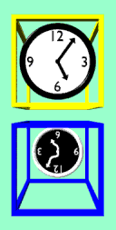
CPT VIOLATION IN THE EARLY UNIVERSE
GENERATE Baryon and/or Lepton ASYMMETRY
without Heavy Sterile Neutrinos?
Assume CPT Violation.
e.g. due to Quantum Gravity fluctuations,
strong in the Early Universe
physics.indiana.edu

Slide 20
CPT VIOLATION IN THE EARLY UNIVERSE
GENERATE Baryon and/or Lepton ASYMMETRY
without Heavy Sterile Neutrinos?
Assume CPT Violation.
e.g. due to Quantum Gravity fluctuations,
strong in the Early Universe
ONE POSSIBILITY:
particle-antiparticle mass differences
physics.indiana.edu

Slide 21



Equilibrium Distributions different between particle-antiparticles
Can these create the observed matter-antimatter asymmetry?
Dolgov, Zeldovich
Dolgov (2009)
Assume dominant contributions to Baryon asymmetry from quarks-antiquarks
High-T quark mass >> Lepton mass

Slide 22


Equilibrium Distributions different between particle-antiparticles
Can these create the observed matter-antimatter asymmetry?
Assuming dominant contributions to Baryon asymmetry from quarks-antiquarks
Dolgov, Zeldovich
Dolgov (2009)
photon equilibrium density at temperature T

Slide 23
Dolgov (2009)
Current bound
for proton-anti
proton mass diff.
ASACUSA Coll. (2011)
Too small
β^{Τ=0}
Reasonable to take:
NB: To reproduce
the observed
need

Slide 24

Dolgov (2009)
Current bound
for proton-anti
proton mass diff.
ASACUSA Coll. (2011)
Too small
β^{Τ=0}
Reasonable to take:
NB: To reproduce
the observed
need
CPT Violating quark-antiquark Mass difference
alone CANNOT REPRODUCE observed BAU

Slide 25
GRAVITATIONALLY-
INDUCED
CPT VIOLATION

Slide 26
OTHER INTERESTING IDEAS FOR
GENERATING CPT VIOLATING EFFECTS
IN THE EARLY UNIVERSE:
PARTICLE-ANTIPARTICLE DIFFERENCES
IN DISPERSION RELATIONS →
Differences in populations
freeze out → Baryogenesis or
→ Leptogenesis → Baryogenesis
B-L conserving GUT
or
Sphaleron

Slide 27
OTHER INTERESTING IDEAS FOR
GENERATING CPT VIOLATING EFFECTS
IN THE EARLY UNIVERSE:
PARTICLE-ANTIPARTICLE DIFFERENCES
IN DISPERSION RELATIONS →
Differences in populations
freeze out → Baryogenesis or
→ Leptogenesis → Baryogenesis
REVIEW VARIOUS SCENARIOS
B-L conserving GUT
or
Sphaleron

Slide 28
OTHER INTERESTING IDEAS FOR
GENERATING CPT VIOLATING EFFECTS
IN THE EARLY UNIVERSE:
PARTICLE-ANTIPARTICLE DIFFERENCES
IN DISPERSION RELATIONS →
Differences in populations
freeze out → Baryogenesis or
→ Leptogenesis → Baryogenesis
REVIEW VARIOUS SCENARIOS
B-L conserving GUT
or
Sphaleron

Slide 29
1. GRAVITATIONAL BARYOGENESIS
THROUCH
Space-time-CURVATURE/BARYON-NUMBER-CURRENT
COUPLING
Davoudiasl, Kitano, Kribs,
Murayama, Steinhardt

Slide 30


Gravitational Baryogenesis
Davoudiasl, Kitano, Kribs,
Murayama, Steinhardt
Quantum Gravity (or something else (e.g. SUGRA)) may lead at low-energies
(below Plnack scale or a scale M*) to a term in the effective Lagrangian
(in curved back space-time backgrounds):
Ricci
scalar

Slide 31
Gravitational Baryogenesis
Davoudiasl, Kitano, Kribs,
Murayama, Steinhardt
Quantum Gravity (or something else (e.g. SUGRA)) may lead at low-energies
(below Plnack scale or a scale M*) to a term in the effective Lagrangian
(in curved back space-time backgrounds):
Current e.g.
baryon-number J_{μ}^{B}
current
(non-conserved
in Standard Model
due to anomalies)
Generation (flavour) #
SU(2)

Slide 32
Gravitational Baryogenesis
Davoudiasl, Kitano, Kribs,
Murayama, Steinhardt
Quantum Gravity (or something else (e.g. SUGRA)) may lead at low-energies
(below Plnack scale or a scale M*) to a term in the effective Lagrangian
(in curved back space-time backgrounds):
Term Violates CP but is CPT conserving in vacuo

Slide 33

Gravitational Baryogenesis
Davoudiasl, Kitano, Kribs,
Murayama, Steinhardt
Quantum Gravity (or something else (e.g. SUGRA)) may lead at low-energies
(below Plnack scale or a scale M*) to a term in the effective Lagrangian
(in curved back space-time backgrounds):
Term Violates CP but is CPT conserving in vacuo
It Violates CPT in the background space-time of an
expanding FRW Universe

Slide 34


Gravitational Baryogenesis
Davoudiasl, Kitano, Kribs,
Murayama, Steinhardt
Quantum Gravity (or something else (e.g. SUGRA)) may lead at low-energies
(below Plnack scale or a scale M*) to a term in the effective Lagrangian
(in curved back space-time backgrounds):
Term Violates CP but is CPT conserving in vacuo
It Violates CPT in the background space-time of an
expanding FRW Universe
Energy differences between particle vs antiparticles
Dynamical CPTV

Slide 35
Gravitational Baryogenesis
Davoudiasl, Kitano, Kribs,
Murayama, Steinhardt
Quantum Gravity (or something else (e.g. SUGRA)) may lead at low-energies
(below Plnack scale or a scale M*) to a term in the effective Lagrangian
(in curved back space-time backgrounds):
Term Violates CP but is CPT conserving in vacuo
It Violates CPT in the background space-time of an
expanding FRW Universe
Energy differences between particle vs antiparticles
Dynamical CPTV
LIKE A CHEMICAL
POTENTIAL FOR FERMIONS

Slide 36
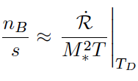
Gravitational Baryogenesis
Davoudiasl, Kitano, Kribs,
Murayama, Steinhardt
Quantum Gravity (or something else (e.g. SUGRA)) may lead at low-energies
(below Plnack scale or a scale M*) to a term in the effective Lagrangian
(in curved back space-time backgrounds):
Term Violates CP but is CPT conserving in vacuo
It Violates CPT in the background space-time of an
expanding FRW Universe
Energy differences between particle vs antiparticles
Dynamical CPTV
Calculate for
various w in
some scenarios
Baryon Asymmetry
@ T < T_{D} ,
T_{D} = Decoupling T

Slide 37


Gravitational Baryogenesis
Davoudiasl, Kitano, Kribs,
Murayama, Steinhardt
Baryon Asymmetry for w=1/3 (occuring in radiation era)
@ T < T_{D} ,
T_{D} = Decoupling T
due to interactions among massless particles
Baryon Asymmetry for w=0 (occuring in dust era)
entropy-dilution factor
included, T_{D} < T_{DR} = radiation dominance T
Other scenarios: non-thermal component w >1/3 domination etc

Slide 38
OTHER INTERESTING IDEAS FOR
GENERATING CPT VIOLATING EFFECTS
IN THE EARLY UNIVERSE:
PARTICLE-ANTIPARTICLE DIFFERENCES
IN DISPERSION RELATIONS →
Differences in populations
freeze out → Baryogenesis or
→ Leptogenesis → Baryogenesis
REVIEW VARIOUS SCENARIOS
B-L conserving GUT
or
Sphaleron

Slide 39
NB: (

Slide 40

Independent of
Initial Conditions
@ T >>T_{eq}
Standard Thermal Leptogenesis
Heavy Right-handed Majorana neutrinos enter equilibrium at T = T_{eq} > T_{decay}
Lepton number
Violation
Out of Equilibrium Decays
Produce Lepton asymmetry
Equilibrated electroweak
B+L violating sphaleron interactions
Fukugita, Yanagida,
Independent of Initial Conditions
Kuzmin, Rubakov,
Shaposhnikov,
Akhmedov, Smirnov,…
Observed Baryon Asymmetry
In the Universe (BAU)
Estimate BAU by solving Boltzmann equations
for Heavy Neutrino Abundances
Pilafsis,
Buchmuller, di Bari et al.

Slide 41
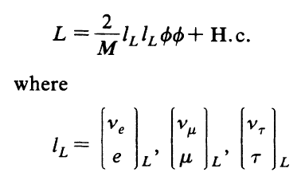
Independent of
Initial Conditions
@ T >>T_{eq}
Standard Thermal Leptogenesis
Heavy Right-handed Majorana neutrinos enter equilibrium at T = T_{eq} > T_{decay}
Lepton number
Violation
Out of Equilibrium Decays
Produce Lepton asymmetry
Equilibrated electroweak
B+L violating sphaleron interactions
Fukugita, Yanagida,
Independent of Initial Conditions
Kuzmin, Rubakov,
Shaposhinkov
Observed Baryon Asymmetry
In the Universe (BAU)
Estimate BAU by solving Boltzmann equations
for Heavy Neutrino Abundances
Pilafsis,
Buchmuller, di Bari et al.

Slide 42
CPTV Thermal Leptogenesis
No Heavy Right-handed
Majorana neutrinos
Early Universe
T > 10¹⁵ GeV
CPT Violation
Produce Lepton asymmetry
Equilibrated electroweak
B+L violating sphaleron interactions
Fukugita, Yanagida,
Independent of Initial Conditions
Kuzmin, Rubakov,
Shaposhinkov
Observed Baryon Asymmetry
In the Universe (BAU)
Estimate BAU by fixing CPTV background parameters
In some models this means fine tuning ….

Slide 43
NB: )

Slide 44
2. CPTV Effects of different Space-Time-Curvature/Spin couplings between neutrinos/antineutrinos
B. Mukhopadhyay, U. Debnath, N. Dadhich, M. Sinha
Lambiase, Mohanty
Curvature Coupling to fermion spin may lead to different dispersion relations
between neutrinos and antineutrinos (assumed dominant in the Early eras)
in non-spherically symmetric geometries in the Early Universe.

Slide 45

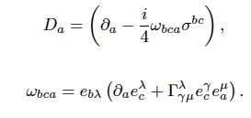

Dirac Lagrangian (for concreteness, it can be extended to Majorana neutrinos)
Gravitational covariant derivative
including spin connection
vielbeins (tetrads)
Christoffel Symbol

Slide 46


Dirac Lagrangian (for concreteness, it can be extended to Majorana neutrinos)
Gravitational covariant derivative
including spin connection

Slide 47

Dirac Lagrangian (for concreteness, it can be extended to Majorana neutrinos)
Gravitational covariant derivative
including spin connection

Slide 48

Dirac Lagrangian (for concreteness, it can be extended to Majorana neutrinos)
Gravitational covariant derivative
including spin connection
For homogeneous and isotropic
Friedman-Robertson-Walker
geometries the resulting B^{μ} vanish

Slide 49
Dirac Lagrangian (for concreteness, it can be extended to Majorana neutrinos)
Gravitational covariant derivative
including spin connection
Can be constant in a given
local frame in Early Universe
axisymmetric cosmologies
or near rotating Black holes

Slide 50
Dirac Lagrangian (for concreteness, it can be extended to Majorana neutrinos)
Gravitational covariant derivative
including spin connection
Can be constant in a given
local frame in Early Universe
axisymmetric cosmologies
or near rotating Black holes

Slide 51

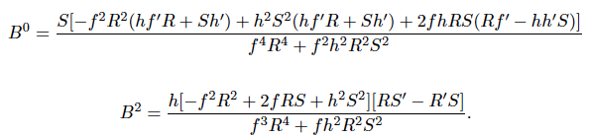
CPTV Effects of different Space-Time-Curvature/Spin couplings between ν, ν in Bianchi Cosmologies
-
B. Mukhopadhyay, U. Debnath, N. Dadhich, M. Sinha
Lambiase, Mohanty
Assumption: Neutrinos non clustering properties, dominant species in early Universe
B³ = B¹ = 0

Slide 52

DISPERSION RELATIONS OF NEUTRINOS ARE DIFFERENT
FROM THOSE OF ANTINEUTRINOS IN SUCH GEOMETRIES
± refers to chiral fields (here neutrino/antineutrino)
CPTV Dispersion relations
_
but (bare) masses are equal between particle/anti-particle sectors
NOT the Effective fermion/antifermion masses (p=0)
Abundances of neutrinos in Early Universe, then, different from those of antineutrinos
if B₀ is non-trivial.

Slide 53




Abundances of neutrinos in Early Universe different from those of antineutrinos
if B₀ ≠ 0

Slide 54

BARYOGENESIS VIA LEPTOGENESIS
@ T = T_{d} (decoupling Temp. of Lepton number (L) Violating processes) there is a
constant ratio of net neutrino/antineutrino asymmetry (ΔL) to entropy density ( ~T³)
(Leptogenesis)
Communicated to Baryon sector, and thus generates BAU either
via a B-L conserving symmetry as in GUT models or via B + L conserving
sphaleron processe → BARYOGENESIS

Slide 55





Neutrino/antineutrino asymmetry around black holes
B. Mukhopadhyay, astro-ph/0505460
Consider the metric of a Kerr (rotating) black hole
and we have

Slide 56
Neutrino/antineutrino asymmetry around black holes
B. Mukhopadhyay, astro-ph/0505460
Consider the metric of a Kerr (rotating) black hole
Mass
angular
momentum
and we have

Slide 57
Neutrino/antineutrino asymmetry around black holes
B. Mukhopadhyay, astro-ph/0505460
Consider the metric of a Kerr (rotating) black hole
and we have
Calculate the vector B^{μ} can show that it is non vanishing,
hence there is CPT Violation induced in this case

Slide 58





Consider the neutrino-antineutrino population difference
Consider Kerr black holes for which and show that
averaged over
the spatial
volume V
Then, if B⁰ << T

Slide 59


REMARKS
Asymmetry depends on the sign of B⁰
PRIMORDIAL BLACK HOLES WITH MASSES M_{BH} < 10¹⁵ gm have evaporated
today, only BH with masses M_{BH} > 10¹⁵ gm may survive today
Hawking temperature
To reproduce observed Baryon asymmetry Δn = O(10 ⁻¹⁰ ) we need 10⁶ BH
with the same sign of B⁰ → fine tuning …..

Slide 60
3. CPTV induced by SPACE-TIME
with TORSION
Generic Concepts on Torsionful Geometries
Fermionic Torsion in Einstein-Cartan theory & CPTV
Kalb-Ramond Torsion in String-Inspired Effective theories & CPTV

Slide 61

3. Gravity with TORSION
Einstein theories of gravity → postulate that torsion is absent (constraint)
Einstein-Cartan and Kibble (1961) Sciama (1964) theories , this constraint
is not used and torsion is considered as a dynamical field.
Fermions in gravitational field, when formulated in the so called first-order
formalism, where spin connection and vierbein are treated as independent
the torsion does not vanish & is proportional to the axial fermion current

Slide 62
3. Fermions in Gravity with TORSION
Dirac Lagrangian (for concreteness, it can be extended to Majorana neutrinos)
Gravitational covariant derivative
including spin connection
If torsion then Γ_{μν} ≠ Γ_{νμ}
antisymmetric part is the
contorsion tensor, contributes to
vielbeins (tetrads)
independent from
spin connection ω_{μ}^{ab}
now ….

Slide 63
3. Fermions in Gravity with TORSION
Dirac Lagrangian (for concreteness, it can be extended to Majorana neutrinos)
Gravitational covariant derivative
including spin connection
If torsion then Γ_{μν} ≠ Γ_{νμ}
antisymmetric part is the
contorsion tensor, contributes to
vielbeins (tetrads)
independent from
spin connection ω_{μ}^{ab}
now ….

Slide 64






Gravity with Torsion contains
Antisymmetric parts in the spin connection:
Contorsion tensor
Torsion decomposes in vector, T_{μ} , axial vector S_{μ} and tensor q_{μνρ} parts
Curvature tensor in first order torsionful formalism

Slide 65


Variation of the combined actions S_{G} + S_{FERMION} w.r.t. T, S and q components of torsion,
viewed as independent fields, yields:
These solutions allow for the spin connection with torsion to be written as:
torsion-free
So that torsion is associated with the spinor axial current.

Slide 66


Variation with respect to torsion yields connection of torsion to axial currents
then substitution back to fermion equations yields the higher order equation
Hehl-Datta equation

Slide 67

Variation with respect to torsion yields connection of torsion to axial currents
then substitution back to fermion equations yields the higher order equation
Hehl-Datta equation
obtained from effective lagrangian
repulsive four fermion interaction

Slide 68


Complex conjugate equation

Slide 69
Complex conjugate equation
Go compare
opposite signs

Slide 70
FERMIONIC-TORSION INDUCED CPTV
N. Poplawski, Physical Review D
Vol. 83, No. 8 (2011) 084033
Using plane wave approximation we obtain different
dispersion relations between particles/antiparticles
AT FINITE DENSITIES ASSUMING CONSTANT BACKGROUND TORSION

Slide 71


FERMIONIC-TORSION INDUCED CPTV
N. Poplawski, Physical Review D
Vol. 83, No. 8 (2011) 084033
Using plane wave approximation we obtain different
dispersion relations between particles/antiparticles
AT FINITE DENSITIES ASSUMING CONSTANT BACKGROUND TORSION
Assume condensates that preserve spatial rotations
but violate Lorentz, i.e. only temporal components
Only for chiral
matter e.g.
active neutrinos
fermion
antifermion

Slide 72
Using plane wave approximation we obtain different
dispersion relations between particles/antiparticles
AT FINITE DENSITIES ASSUMING CONSTANT BACKGROUND TORSION
fermion
antifermion
NB:
Lagrangian is C (harge conjugation) symmetric
but Hehl-Datta equation is NOT

Slide 73

BARYON-ASYMMETRY FROM TORSIONFUL GEOMETRIES?
Using plane wave approximation we obtain different
dispersion relations between particles/antiparticles
AT FINITE DENSITIES ASSUMING CONSTANT BACKGROUND TORSION
N. Poplawski,
PR D 83 (2011)
fermion
antifermion
inverse normalization
of Dirac spinor wavefunction
of order of (energy scale)³
particle/antiparticle asymmetry can
thus be generated from torsion ?
Finite T analysis of condensates pending
for the Universe
at temperature T

Slide 74
BARYON-ASYMMETRY FROM TORSIONFUL GEOMETRIES?
Using plane wave approximation we obtain different
dispersion relations between particles/antiparticles
AT FINITE DENSITIES ASSUMING CONSTANT BACKGROUND TORSION
N. Poplawski,
PR D 83 (2011)
fermion
antifermion
inverse normalization
of Dirac spinor wavefunction
of order of (energy scale)³
Has the pheno - right value if
not appropriate for neutrinos (T_{D} ≈ 10¹⁵ GeV)

Slide 75
3b. CPTV induced by SPACE-TIME
with (string-inspired) Kalb-Ramond TORSION
NEM & Sarben Sarkar, arXiv:1211.0968
Dirac Lagrangian (for concreteness, it can be extended to Majorana neutrinos)
If torsion then Γ_{μν} ≠ Γ_{νμ}
antisymmetric part yields non –zero contributions to B^{μ}

Slide 76
String Theories with Antisymmetric Tensor Backgrounds
NEM & Sarben Sarkar, arXiv:1211.0968
Massless Gravitational multiplet of (closed) strings: spin 0 scalar (dilaton)
spin 2 traceless symemtric rank 2
tensor (graviton)
spin 1 asntisymmetric rank 2 tensor
KALB-RAMOND FIELD
Effective field theories (low energy scale E << M_{s}) `` gauge’’ invariant
Depend only on field strength :
Bianchi identity :

Slide 77
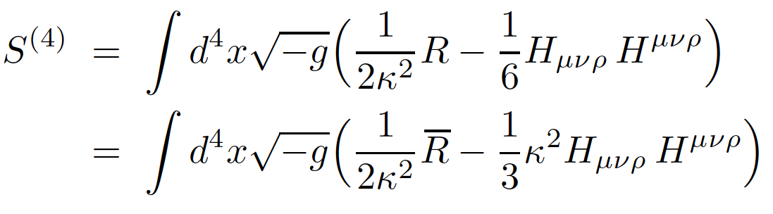

ROLE OF H-FIELD AS TORSION
EFFECTIVE GRAVITATIONAL ACTION IN STRING LOW-ENERGY LIMIT CAN BE
EXPRESSED IN TERMS OF A GENERALIZED CURVATURE RIEMANN TENSOR
WHERE THE CHRISTOFFEL CONNECTION INCLUDES TORSION PROVIDED BY H-FIELD
4-DIM
PART
Contorsion

Slide 78

ROLE OF H-FIELD AS TORSION – AXION FIELD
EFFECTIVE GRAVITATIONAL ACTION IN STRING LOW-ENERGY LIMIT CAN BE
EXPRESSED IN TERMS OF A GENERALIZED CURVATURE RIEMANN TENSOR
WHERE THE CHRISTOFFEL CONNECTION INCLUDES TORSION PROVIDED BY H-FIELD
4-DIM
PART
IN 4-DIM DEFINE DUAL OF H AS :
b(x) = Pseudoscalar
(Kalb-Ramond (KR) axion)

Slide 79



FERMIONS COUPLE TO H –TORSION VIA GRAVITATIONAL COVARIANT DERIVATIVE
TORSIONFUL CONNECTION, FIRST-ORDER FORMALISM
gauge field
contorsion
Non-trivial contributions to B^{μ}

Slide 80
FERMIONS COUPLE TO H –TORSION VIA GRAVITATIONAL COVARIANT DERIVATIVE
TORSIONFUL CONNECTION, FIRST-ORDER FORMALISM
gauge field
contorsion
Non-trivial contributions to B^{μ}

Slide 81



Exact (conformal Field Theories on World-sheet) Solutions from String theory
Antoniadis, Bachas, Ellis, Nanopoulos
Cosmological Solutions, non-trivial time-dependent dilatons, axions
In Einstein frame E (Scalar curvature term in gravitational effective action
has canonical normalisation):
Central charge of uderlying world-sheet conformal field theory
Kac-Moody
algebra level
``internal’’ dims
central charge

Slide 82




Covariant Torsion tensor
Constant
constant B⁰
Lepton Asymmetry as in previous cases , e.g. for neutrinos
Requires
@ T_{d}

Slide 83



Quantum Fluctuations of Torsion (on top of any background)
NEM, Pilaftsis arXiv: 1209.6387
Fermions:
+ standard Dirac terms without torsion
Bianchi identity
conserved
``torsion ‘’ charge
classical
Postulate conservation at quantum level by adding counterterms
Implement via constraint → lagrange multiplier in Path integral

Slide 84
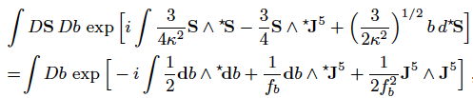

Duncan, Kaloper & Olive Nucl.Phys. B387 (1992)
NB: any H- background ignored here , if there it contributes to
the action as discussed above ….

Slide 85
partial integration

Slide 86


partial integration
Use chiral anomaly equation (one-loop) in curved space-time:
Hence, effective action of torsion-full QED

Slide 87
partial integration
Use chiral anomaly equation (one-loop) in curved space-time:
coupling
Hence, effective action of torsion-full QED

Slide 88
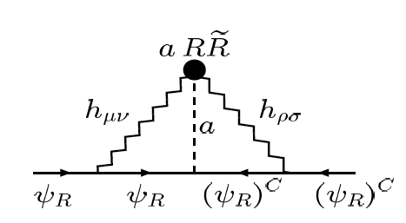
NEM, Pilaftsis arXiv: 1209.6387
b
a = axion
mixing with KR
field b
b
x
Use chiral anomaly equation (one-loop) in curved space-time:
Upon Yukawa coupling of a to
Majorana fermion → radiatively
(3-loop) generated fermion mass
coupling
Hence, effective action of torsion-full QED

Slide 89
NEM, Pilaftsis arXiv: 1209.6387
Use chiral anomaly equation (one-loop) in curved space-time:
Can give rise to fermionic
constant torsion CPTV via
LV fermion condensates
Hence, effective action of torsion-full QED

Slide 90
4. STRINGY SPACE-TIME
D(efect)-FOAM
NEM & Sarben Sarkar, arXiv:1211.0968

Slide 91
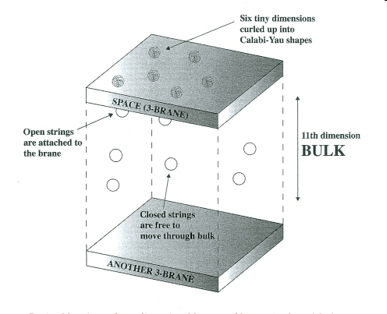

BRANE-WORLDS with D-PARTICLE (POINT-LIKE BRANE) DEFECTS
Our Universe
NO LONGER
Lorentz Invariant
Recoil of defect
(Standard Model particles)
(Gravitons)
Charge conservation:
D-foam/neutral particles
(eg neutrinos, photons)
dominant interactions
D-particle defect
J ELLIS, NEM, WESTMUCKETT

Slide 92
Space time Foam situations –
Average over both populations of defects & quantum fluctuations
Isotropic & (in)homogeneous foam
for a brane observer:
matter momentum transfer
Lorentz Invariance
on Average
Violated in flcts
Can argue that due to
forces exerted from
bulk D-particles overclosure of the
Universe can be avoided even for
sufficiently dense populations
of D-particles
NEM, Mitsou, Vergou, Sarkar
Eur.Phys.J. C72 (2012) 1956

Slide 93

Stochastic Fluctuations of D-foam & CPTV
frame
dragging
± B₀
constant > 0
if σ² ≈ const
in an era
One can thus generate a Lepton asymmetry and, then through
B-L conserving processes in the Early Universe a Baryon asymmetry.
Correct Sign for Matter
dominance over Antimatter
due to Energetics
no Fine Tuning

Slide 94

D-foam Induced CPTV for Neutrinos
One can thus generate a Lepton asymmetry and through B+L conserving
processes in the Early Universe a Baryon asymmetry.
The correct value (observed) for BAU is reproduced for
for D-foam at T_{d} ~ 10¹⁵ GeV
implying that in these scenarios, for σ² < 1, one must have M_{s}/g_{s} > 200 TeV
PHENOMENOLOGY OF EARLY UNIVERSE NEEDS
TO BE CHECKED FOR COMPATIBILITY…. IN PROGRESS

Slide 95
Effective (Anti)Neutrino CPTV D-foam Mass
No mixing
@ T_{d} ~ 10¹⁵ GeV
to generate BAU
Bounds from WMAP Cosmology (z < 1000)
Dust type
D-particles
is a safe not strong
bound on foam flcts σ² today
(within current exp errors)

Slide 96
EXPERIMENTAL TESTS?

Slide 97

Experimental Tests?
Stochastic D-foam Models: Non-trivial optical properties of vacuum, refractive index
different arrival times of cosmic photons of different
energies from localised regions in intense astrophysical
sources (GRB, AGN…)
Space-Time Defects interaction with photons would affect CMB spectrum
Primordial Black hole searches through modifications of tensor mode polarization (Planck …)
Kalb-Ramond axion field searches
Direct CPT tests today (if sufficiently large density of defects today →
decoherence effects of neutral matter could be significant →
``smoking-gun evidence’’ modifications of EPR correlations
in entangled states of mesons (?) (A Di Domenico’s talk)
…Atomic precision experiments
…Cosmological (high energy, high distance) neutrino oscillations etc
But strength of background-induced CPTV effects may be
significant only for Early Universe

Slide 98
Experimental Tests?
Stochastic D-foam Models: Non-trivial optical properties of vacuum, refractive index
different arrival times of cosmic photons of different
energies from localised regions in intense astrophysical
sources (GRB, AGN…) : higher-energy photons delayed
Space-Time Defects interaction with photons would affect CMB spectrum
Primordial Black hole searches through modifications of tensor mode polarization (Planck …)
Kalb-Ramond axion field searches
Direct CPT tests today (if sufficiently large density of defects today →
decoherence effects of neutral matter could be significant →
``smoking-gun evidence’’ modifications of EPR correlations
in entangled states of mesons (?) (A Di Domenico’s talk)
…Atomic precision experiments
…Cosmological (high energy, high distance) neutrino oscillations etc
But strength of background-induced CPTV effects may be
significant only for Early Universe

Slide 99
Experimental Tests?
Stochastic D-foam Models: Non-trivial optical properties of vacuum, refractive index
different arrival times of cosmic photons of different
energies from localised regions in intense astrophysical
sources (GRB, AGN…) : higher-energy photons delayed
Space-Time Defects interaction with photons would affect CMB spectrum
Primordial Black hole searches through modifications of tensor mode polarization (Planck …)
Kalb-Ramond axion field searches
Direct CPT tests today (if sufficiently large density of defects today →
decoherence effects of neutral matter could be significant →
``smoking-gun evidence’’ modifications of EPR correlations
in entangled states of mesons (?) (A Di Domenico’s talk)
…Atomic precision experiments
…Cosmological (high energy, high distance) neutrino oscillations etc
But strength of background-induced CPTV effects may be
significant only for Early Universe
Cosmic Photon Polarization angle
may rotate (cosmological birefringence)

Slide 100
Experimental Tests?
Stochastic D-foam Models: Non-trivial optical properties of vacuum, refractive index
different arrival times of cosmic photons of different
energies from localised regions in intense astrophysical
sources (GRB, AGN…) : higher-energy photons delayed
Space-Time Defects interaction with photons would affect CMB spectrum
Primordial Black hole searches through modifications of tensor mode polarization (Planck …)
Kalb-Ramond axion field searches
Direct CPT tests today (if sufficiently large density of defects today →
decoherence effects of neutral matter could be significant →
``smoking-gun evidence’’ modifications of EPR correlations
in entangled states of mesons (?) (A Di Domenico’s talk)
…Atomic precision experiments
…Cosmological (high energy, high distance) neutrino oscillations etc
But strength of background-induced CPTV effects may be
significant only for Early Universe

Slide 101

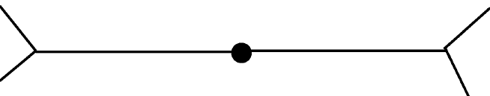
ω-effect
If foam, concept of anti-particle may be perturbatively modified, Neutral mesons no longer indistinguishable particles, initial entangled state:
K_{S}K_{L}
Φ
K_{S}K_{L}
K_{S}K_{S} ,
K_{L}K_{L}
K_{S}K_{S} ,
K_{L}K_{L}
IF CPT ILL-DEFINED (e.g. FV D-particle Foam)
Bernabeu, NEM,
Sarkar, Papavassiliou
If QCD effects, sub-structure in neutral mesons ignored, and
D-foam acts as if they were structureless particles, then for M_{QG} ~ 10¹⁸ GeV
the estimate for ω: | ω | ~ 10⁻⁴ |ζ|, for 1 > |ζ| > 10⁻² (natural)
Not far from sensitivity of upgraded meson factories ( e.g. DAFNE2)

Slide 102
If foam, concept of anti-particle may be perturbatively modified, Neutral mesons no longer indistinguishable particles, initial entangled state:
K_{S}K_{L}
Φ
K_{S}K_{L}
K_{S}K_{S} ,
K_{L}K_{L}
K_{S}K_{S} ,
K_{L}K_{L}
IF CPT ILL-DEFINED (e.g. FV D-particle Foam)
Amplification due to mass degeneracy
NB: No CPTV mass shifts for Bosons, ω-effect measures
directly fluctuations σ² in foam-distorted geometry,

Slide 103
Experimental Tests?
Stochastic D-foam Models: Non-trivial optical properties of vacuum, refractive index
arrival times of different energies of photons of different
energies from localised regions in intense astrophysical
sources (GRB, AGN…): higher-energy photons delayed
Space-Time Defects interaction with photons would affect CMB spectrum
Primordial Black hole searches through modifications of tensor mode polarization (Planck …)
Kalb-Ramond axion field searches
Direct CPT tests today (if sufficiently large density of defects today →
decoherence effects of neutral matter could be significant →
``smoking-gun evidence’’ modifications of EPR correlations
in entangled states of mesons (?) (A Di Domenico’s talk)
…Atomic precision experiments
…Cosmological (high energy, high distance) neutrino oscillations etc
But strength of background-induced CPTV effects may be
significant only for Early Universe

Slide 104






CPTV → neutrino/antineutrino mixing & oscillations
M Sinha & B. Mukhopadhyay
arXiv: 0704.2593
Assume Majorana neutrino in Weyl rep (Lepton number violation unavoidable)
Majorana mass term
violates L number

Slide 105
CPTV → neutrino/antineutrino mixing & oscillations
M Sinha & B. Mukhopadhyay
arXiv: 0704.2593
Assume Majorana neutrino in Weyl rep (Lepton number violation unavoidable)
Lead to
neutrino/antineutrino
mixing & oscillations

Slide 106
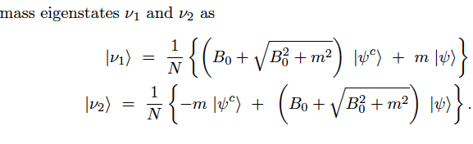




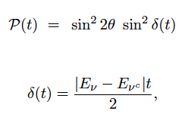

NB: neutrino CPTV mass shifts
neutrino/antineutrino mixing
oscillations

Slide 107

NB: neutrino CPTV mass shifts
neutrino/antineutrino mixing
oscillations
oscilaltion length

Slide 108
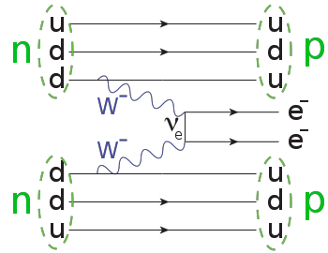

M Sinha & B. Mukhopadhyay
arXiv: 0704.2593
Majorana neutrino
ignore neutrino/
antineutrino
mixing here:
Modifications in Neutrinoless 2Beta decay rate
in 2 flavour mixing (due to CPTV
modified effective mass)
Amplitude

Slide 109
CONCLUSIONS & OUTLOOK

Slide 110

CONCLUSIONS & OUTLOOK
Discussed several scenarios for CPT Violation (CPTV) induced by curved background space-times and/or quantum gravity fluctuations
Some of them require fine tuning to reproduce the correct Baryon Asymmetry in the Universe (BAU).
One stringy Model of (brane-theory-inspired) defects in space-time can lead to background induce CPTV & reproduce the observed BAU without fine tuning
The model also predicts non-trivial optical properties of the vacuum testable in principle
Leads to consistent Cosmology avoiding overclosure of Universe & incorporating galactic growth

Slide 111
CONCLUSIONS & OUTLOOK
Discussed several scenarios for CPT Violation (CPTV) induced by curved background space-times and/or quantum gravity fluctuations
Some of them require fine tuning to reproduce the correct Baryon Asymmetry in the Universe (BAU).
One stringy Model of (brane-theory-inspired) defects in space-time can lead to background induce CPTV & reproduce the observed BAU without fine tuning
The model also predicts non-trivial optical properties of the vacuum testable in principle
Leads to consistent Cosmology avoiding overclosure of Universe & incorporating galactic growth.
Several Consistency checks pending
when embed such scenarios
in realistic cosmologies

Slide 112
CONCLUSIONS & OUTLOOK
Discussed several scenarios for CPT Violation (CPTV) induced by curved background space-times and/or quantum gravity fluctuations
Some of them require fine tuning to reproduce the correct Baryon Asymmetry in the Universe (BAU).
One stringy Model of (brane-theory-inspired) defects in space-time can lead to background induce CPTV & reproduce the observed BAU without fine tuning
The model also predicts non-trivial optical properties of the vacuum testable in principle
Leads to consistent Cosmology avoiding overclosure of Universe & incorporating galactic growth.
NEM, Sakellariadou & Yusaf, arXiv:1211.1726

Slide 113
CONCLUSIONS & OUTLOOK
Discussed several scenarios for CPT Violation (CPTV) induced by curved background space-times and/or quantum gravity fluctuations
Some of them require fine tuning to reproduce the correct Baryon Asymmetry in the Universe (BAU).
One stringy Model of (brane-theory-inspired) defects in space-time can lead to background induce CPTV & reproduce the observed BAU without fine tuning
The model also predicts non-trivial optical properties of the vacuum testable in principle
Leads to consistent Cosmology avoiding overclosure of Universe & incorporating galactic growth
Several Experimental Tests (Astrophysical,
Cosmological & at the LAB) can check the
assumptions for the validity of CPT & bound
its possible violations even at the Early Universe

Slide 114
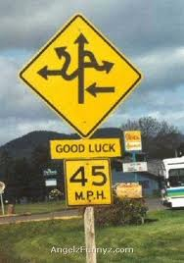

IS THIS CPTV ROUTE WORTH FOLLOWING? ….
CPT Violation
Construct Microscopic Quantum Gravity models with
strong CPT Violation in Early Universe, but
maybe weak today… Fit with all available data…
Estimate in this way matter-antimatter asymmetry in Universe.

Slide 115



Slide 116
SPARES

Slide 117
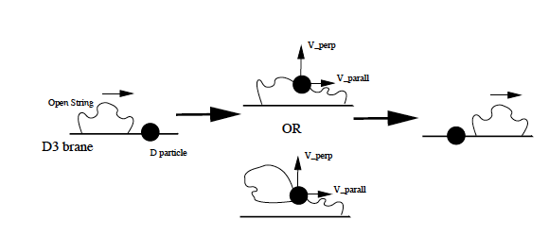
Matter/D-foam Interactions
String Splitting &
(``momentary’’) Capture by the defects
INTEMEDIATE STRING
CREATION/EXCHANGE
PURELY NON-LOCAL EFFECT

Slide 118
CHARGE CONSERVATION
MUST BE RESPECTED
DURING STRING
SPLITTING, INTERNEDIATE
CREATION AND STRETCHING:
ONLY ELECTRICALLY
NEUTRAL EXCITATIONS
(e.g. Photons, Neutrinos)
INTERACT VIA CAPTURE
DOMINANTLY WITH FOAM
ELLIS, NEM, SAKHAROV, NANOPOULOS

Slide 119
CHARGE CONSERVATION
MUST BE RESPECTED
DURING STRING
SPLITTING, INTERNEDIATE
CREATION AND STRETCHING:
ONLY ELECTRICALLY
NEUTRAL EXCITATIONS
(e.g. Photons, Neutrinos)
INTERACT VIA CAPTURE
DOMINANTLY WITH FOAM
DEFECT RECOIL OCCURS
Time Delays due to
Intermediate String Creation
& Oscillations – Subluminal Vacuum Refractive Index
J ELLIS, NEM, NANOPOULOS

Slide 120
Local Lorentz Violation due to
direction of Defect recoil velocities
Induced metric depends
on momenta as well as coordinates
(Finsler type) : e.g. u || X₁
Explicit local breaking of SO(3,1)
down to SO(2,1) rotation and
boosts in transverse directions
``Frame Dragging by
recoiling D-particle’’

Slide 121
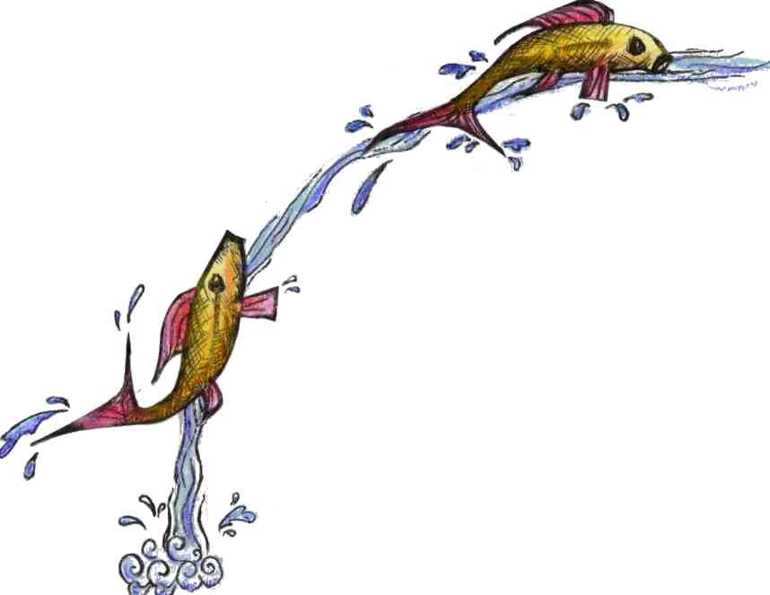
``Frame Dragging by
recoiling D-particle’’
Analogy with Gullstrand-Painlevè (GP)
metric for Schwarzschild BH metric
Hamilton-Lisle (2008)
The river Model for BH
Galilean River ←→ Galilean D-particles
Relativistic fishes ←→ Open string (SM excitations)
u_{i} << 1
GP coordinates

Slide 122
Space time Foam situations –
Average over both populations of defects & quantum fluctuations
Isotropic & (in)homogeneous foam
for a brane observer:
Lorentz Invariance
on Average
Violated in flcts
Can argue that due to
forces exerted from
bulk D-particles overclosure of the
Universe can be avoided even for
sufficiently dense populations
of D-particles
NEM, Mitsou, Vergou, Sarkar
Eur.Phys.J. C72 (2012) 1956

Slide 123
Space time Foam situations –
Average over both populations of defects & quantum fluctuations
Isotropic & (in)homogeneous foam
for a brane observer:
Lorentz Invariance
on Average
Violated in flcts
c.f. Stochastic Foam, through coherent graviton states
leading to light cone fluctuations
Ford (95)

Slide 124
Modified Neutrino dispersion relations due to locally induced metric
Interpret (Dirac hole theory ) negative energies as corresponding
to anti-particles ←→ Fermions, exclusion principle
Momentum-Energy conservation during ν scattering with D-particles
NEM, Sarkar, Tarantino
Phys.Rev. D84 (2011) 044050

Slide 125
D-foam Induced CPTV for Neutrinos

Slide 126
D-foam Induced CPTV for Neutrinos
One can thus generate a Lepton asymmetry and through B+L conserving
processes in the Early Universe a Baryon asymmetry.
The correct value (observed) for BAU is reproduced for
for D-foam at T_{d} ~ 10¹⁵ GeV
implying that in these scenarios, for σ² < 1, one must have M_{s}/g_{s} > 200 TeV

Slide 127
D-foam Induced CPTV for Neutrinos
One can thus generate a Lepton asymmetry and through B+L conserving
processes in the Early Universe a Baryon asymmetry.
The correct value (observed) for BAU is reproduced for
for D-foam at T_{d} ~ 10¹⁵ GeV
implying that in these scenarios, for σ² < 1, one must have M_{s}/g_{s} > 200 TeV

