Slide 1

Using Color Flow Observables to Constrain Color Reconnection Uncertainties
Ashley Huff
Dr. Ayana Arce
Duke UniverSity REU

Slide 2
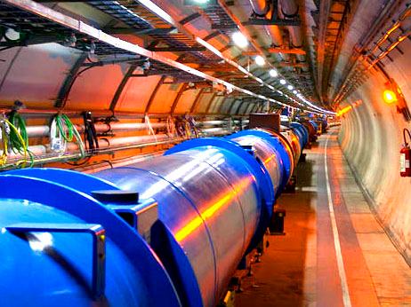
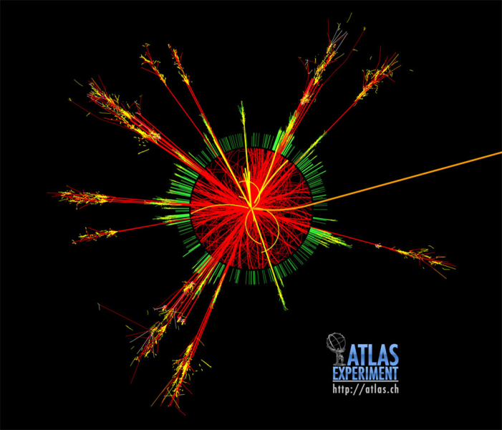
A Toroidal LHC ApparatuS
The LHC collides protons at sqrt(s) = 8 TeV
Bunches cross 30 million times per second which produces 600 million collisions per second
ATLAS is 44 meters long, 25 meters in diameter and weighs 7000 tons

Slide 3
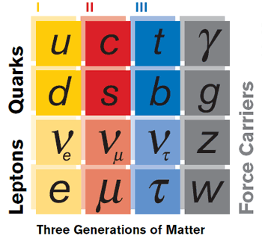



Top Quark Production at the LHC
Quarks and gluons carry an intrinsic quantum
number: color charge
Cannot observe color but color charge affects jet
shape variables
Studying the W decay, interesting charge
conservation in the LHC
Important for: H color singlet

Slide 4
Outline of Work
Main focus: Particle Jets that are produced as a result of the
hadronization of quarks
Identify top quark events
Determine what jet shape variables can be used to see color
flow reconnection models in Monte Carlo samples
Jet shape variables will then be used to tune different Monte
Carlo Generators
Determine which Monte Carlo generator produces the most
  accurate simulation based on real ATLAS data

Slide 5
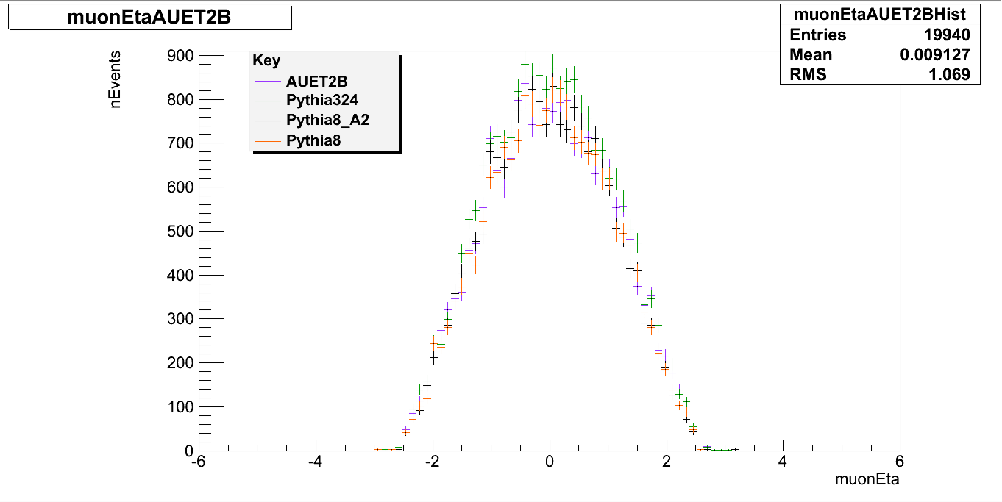
Finding Top Quark Events
Selection cuts:
  nJets >= 4
  nMuons = 1
  Jet Pt >= 25 GeV
  Muon Pt >= 20 GeV
  -2.5 <= Jet Eta < 2.5
  -2.5 <= Muon Eta <= 2.5
  Missing Et > 20 GeV
  MTW + MET > 60 GeV

Slide 6
The geometry
φ
φ_{j}
ω_{j}
jet j
ω_{i}
φ_{i}
jet i
η

Slide 7
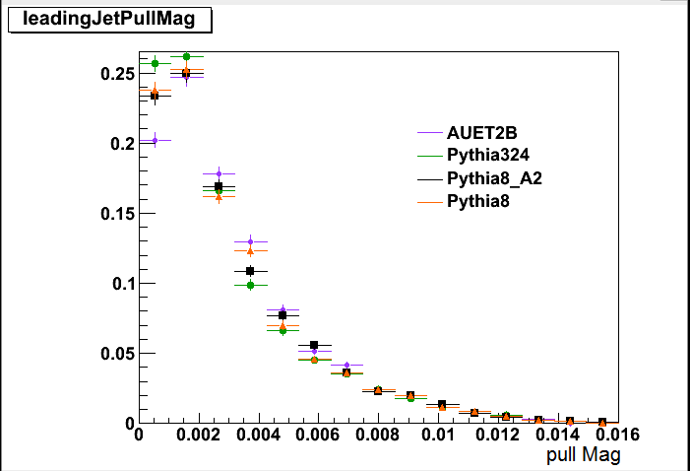
Leading Jet Pull Magnitude
Leading Jet is the jet with the highest Pt
Jet pull magnitude is the amount of eccentricity of the jet

Slide 8
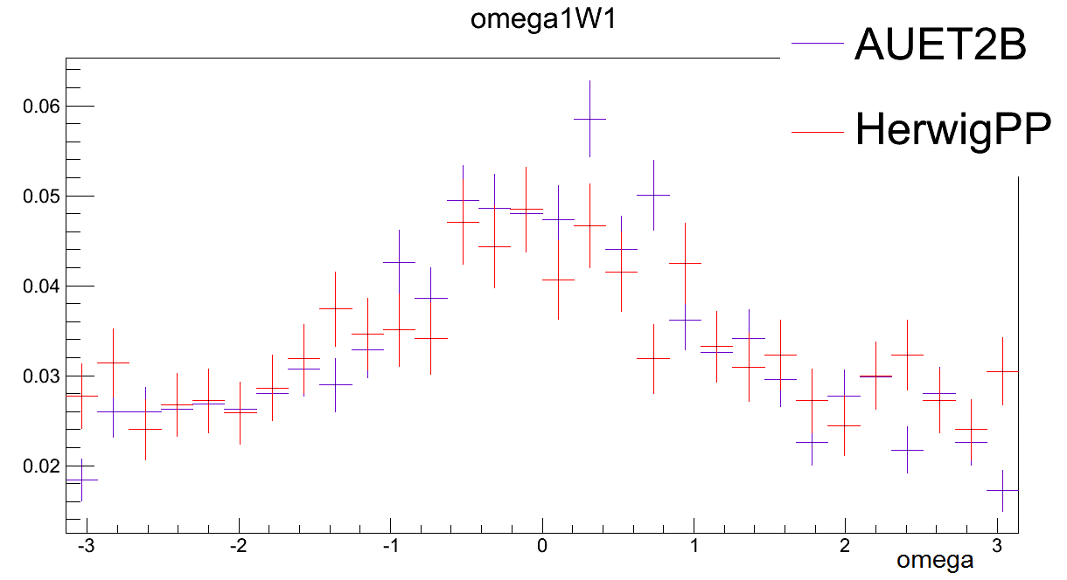
Omega
Only meaningful for W decay
Expect a peak around zero for matched pairs

Slide 9
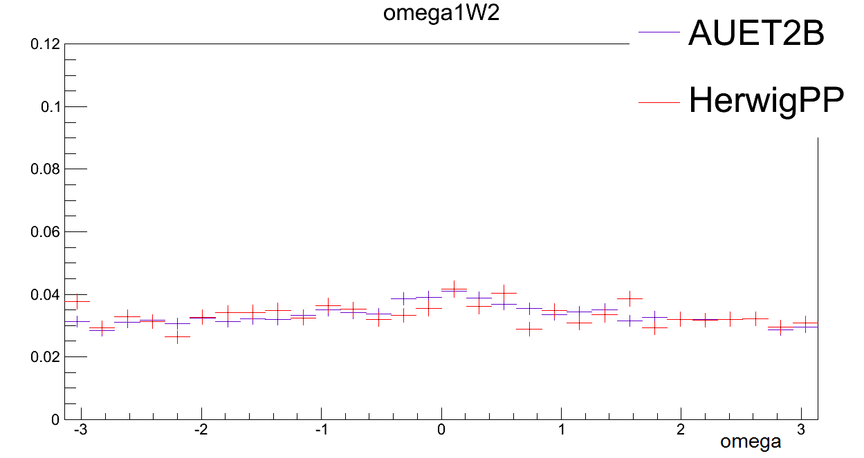
Omega con’t
Expect a flat line for unmatched pairs

Slide 10
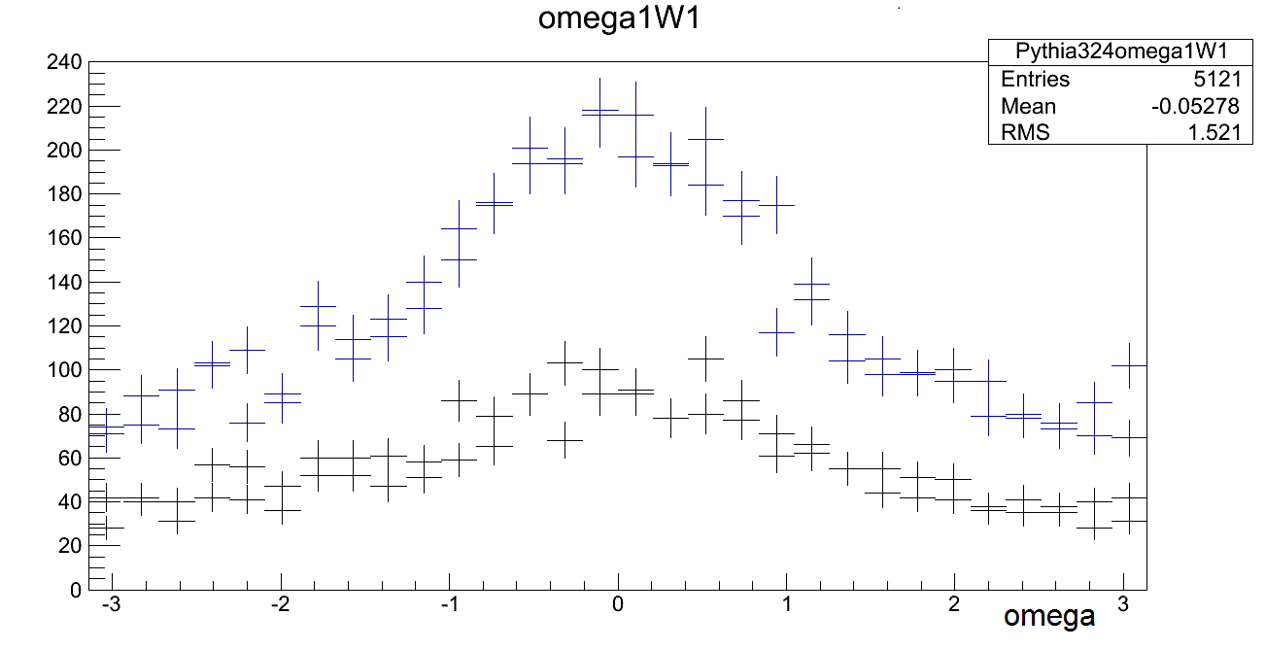
Leading Jet Omega Comparison
Fewer entries in leading jet (highest Pt jet) sample than full W sample
Is leading jet plot flatter?

Slide 11
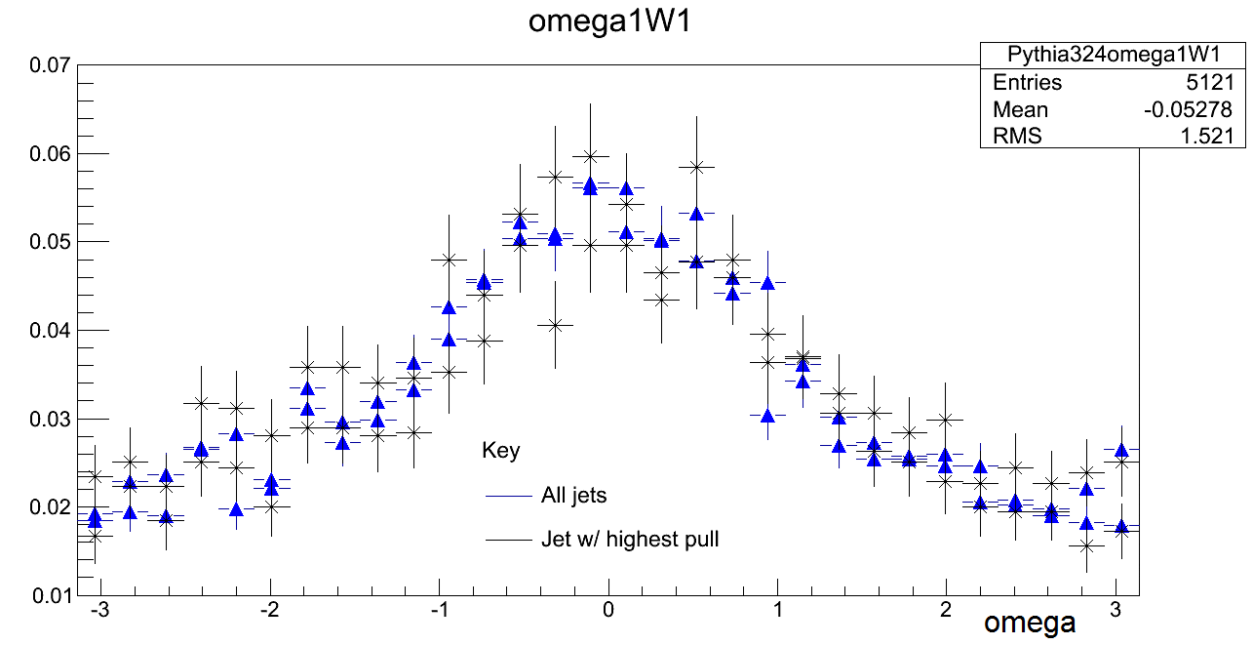
Leading Jet Omega Comparison con’t
Once normalized, see they have the same shape

Slide 12
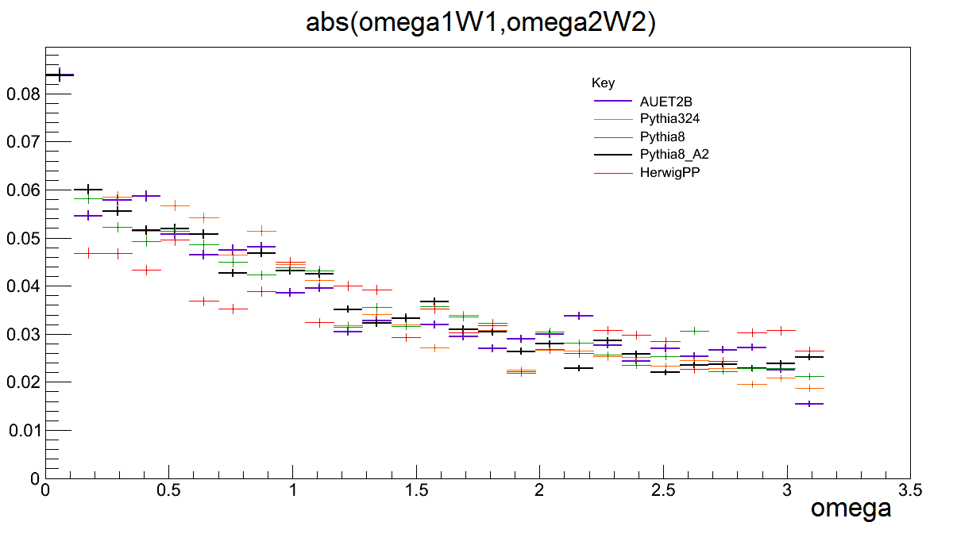
|Omega|
Since the omega plots are symmetric about zero, good to look at absolute value
Histogram filled with both omega1W1 and omega2W2

Slide 13
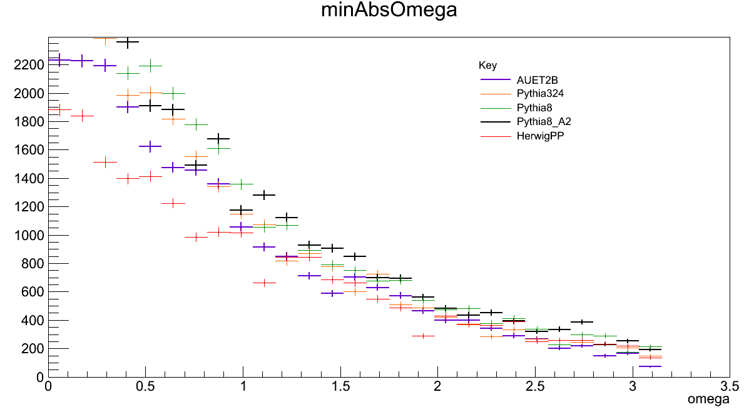
Minimum |Omega|
Minimized plot of the absolute value of omega1W1 and omega2W2
The spread is very large so we should be able to see it well in real ATLAS data

Slide 14
What’s next?
Sending the results to the Monte Carlo group so they can compare this study to real data taken from ATLAS in order to tune the Monte Carlo Generators
Implement new Monte Carlos in future studies
Continue to study how color effects jets and further
constrain uncertainties in color reconnection

Slide 15
Acknowledgements
I’d like to thank:
Duke University and TUNL for the opportunity to
participate in this program
Dr. Ayana Arce for her guidance through this project

Slide 16
Sources
http://atlasexperiment.org/atlas_photos/lhc/lhc.html
http://atlas.ch/events.html

