Slide 1
Jet Analysis in the
Quark-Gluon Plasma
Ron Malone
Duke/TUNL REU
August 2, 2012

Slide 2
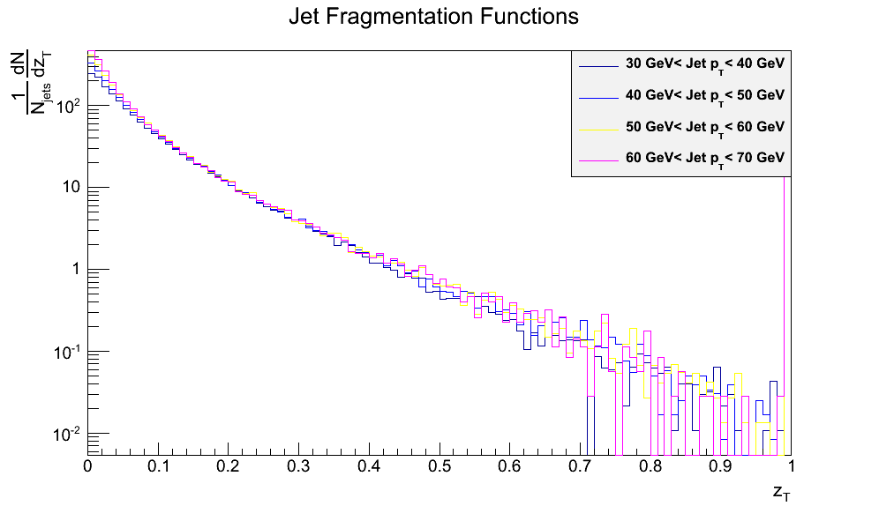
Jets as a Probe of the QGP
Study parton interactions in QGP
  Compare with vacuum case (p-p)
  Energy loss
  Di-jet asymmetries
  Alterations to the fragmentation function
  Any other alteration to vacuum case

Slide 3
What is a Jet?
Shower of particles with high transverse momentum
  Parton pair created during collision
  Must move back-to-back through QGP (momentum & energy conservation)
  Fragments into shower of hadrons
Notes:
Vacuum case – expect symmetric jets
Elastic scattering v. Radiative losses can be inferred based on pathlength dependence of energy loss
Energy loss asymmetry

Slide 4
Jet Definition
Shower of particles is poor definition
  Need something more structured and reproducible
Jet Algorithm
  Used by jet finder software (FastJet) to cluster particles into jets
  Can be used in simulations and on actual data
  Two types: Sequential recombination or Cone

Slide 5
Inclusive k_{t} Algorithm
Two calculations for every pair of particles:
Take the minimum, d_{min} of all d_{ij} and d_{iB}
  If d_{min} is a d_{ij} , merge particles i and j into a single entity
  If d_{min} is a d_{iB}, add entity i to the list of final jets
Repeat until all particles are clustered

Slide 6
Anti-k_{t} Algorithm
Same as Inclusive k_{t} algorithm, except that:
Interesting property: jets will be a circle in y - φ space.

Slide 7
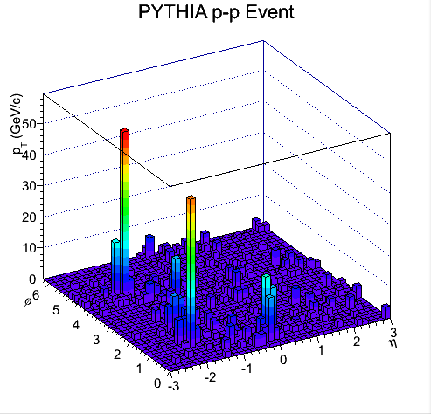
Event Background
In a proton – proton collision, jets are easy to identify

Slide 8
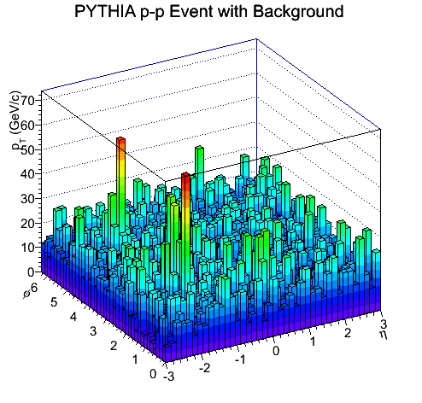
Event Background
In heavy ion collisions, the task is more difficult

Slide 9
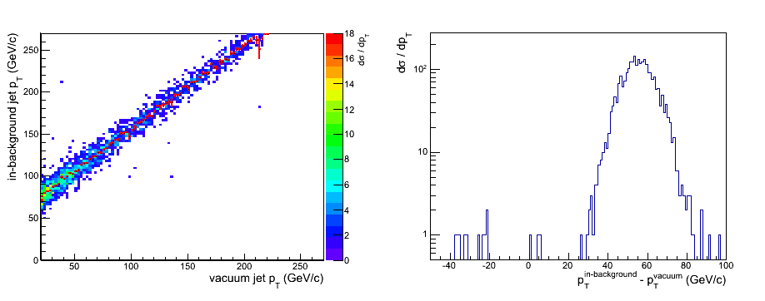
Background Effects
“Smearing” of jet p_{T} due to background

Slide 10
Background Subtraction
We can subtract the background:
Introduces uncertainty – subtracting a median
Subtraction occurs after jet finding. The background still disrupts the jet finder

Slide 11
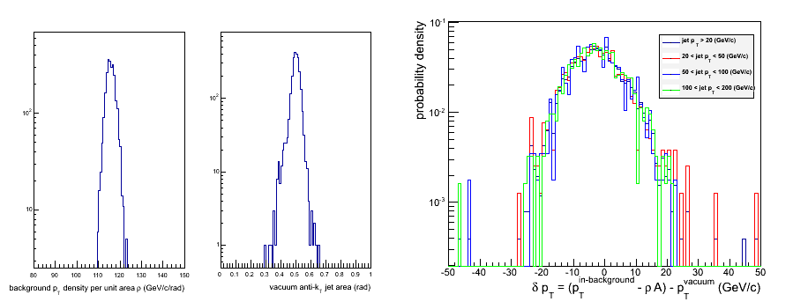
Background Subtraction
Background density ρ, jet areas, and δp_{T}

Slide 12
Subjets: A solution?
Take constituent particles of a jet and re-cluster to find subjets
Can study underlying jet structure and possibly select jets out of the background based on this
Study fraction of jet momentum carried by subjets (call this subjet z_{T})

Slide 13
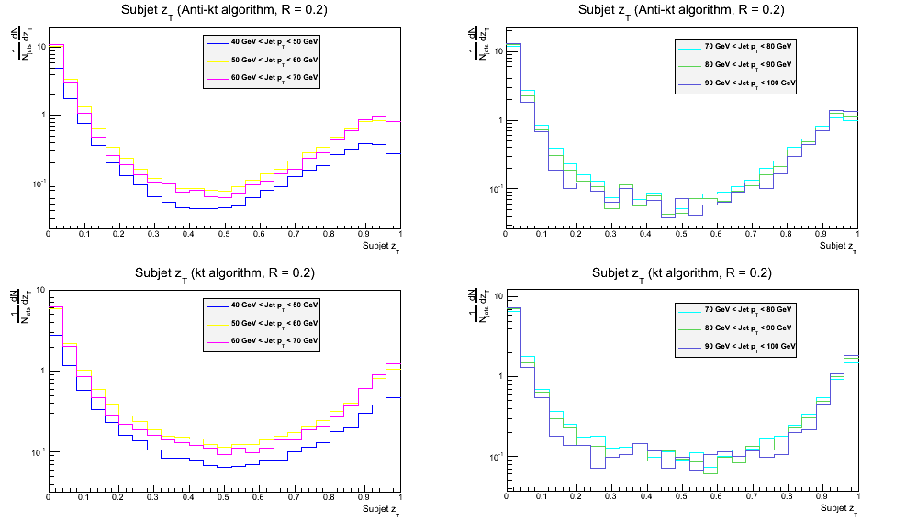
Hard Jets: Subjet z_{T}

Slide 14
Subjet z_{T}
Most hard jets have at least one subjet carrying 50 % or more of the jet’s momentum
Background jets are less likely to have a subjet with z_{T} > 0.5
Combined with a cut on transverse momentum, this could be an effective way to select jets from a large background

Slide 15
Future Work
Apply the cut on actual heavy ion data from ALICE (happening at present…)
Are there other cuts that would be better ?
  Number of subjets with r_{subjet} = R_{jet}/4 vs. r_{subjet} = R_{jet}/2
Can we combine this cut with other cuts to better identify jets?

Slide 16
Acknowledgements
Thanks to Dr. Howell for organizing this REU program
Thanks to Dr. Arce for helping us get settled in Switzerland
Thanks to Dr. Bass and Dr. Mueller for teaching me about the quark-gluon plasma and preparing me succeed at CERN
Thanks to the ALICE team at CERN for their help
Thanks to Mateusz Ploskon for his patience and enthusiasm

Slide 17
References
M. Cacciari, G.P. Salam and G. Soyez, Eur.Phys.J. C72 (2012) 1896 [arXiv:1111.6097]

