Slide 1
Analysis of D meson Production in pp and PbPb Collisions in ALICE@LHC
Peter Koufalis
Dr. Andrea Rossi
Kutztown University

Slide 2
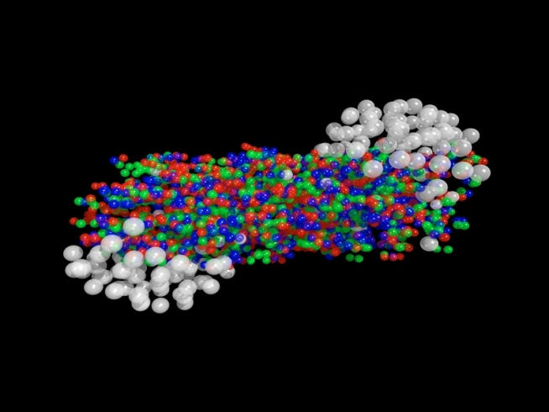
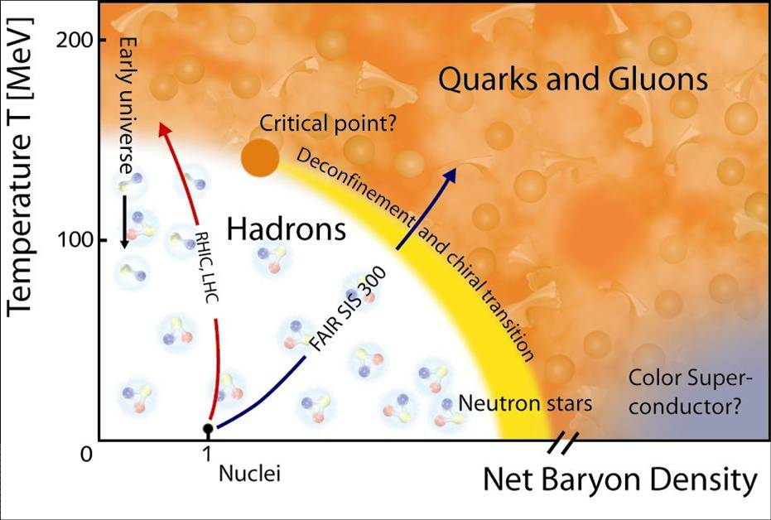
Heavy Ion Collisions: Quark-Gluon Plasma
In heavy-ion collisions, the energy density is high enough that a phase transition occurs (P and T so high protons and neutrons melt into their constituents)
Quark-gluon plasma (QGP) is formed leaving quarks color de-confined
QGP was formed at the earliest moments after the big bang

Slide 3
What we investigate: Charm Production
Charm/anti-charm quarks produced in pairs
Due to their large mass they are produced very early on in the collision
Interact with the medium as they pass through causing them to lose energy
Makes them good probes for studying properties of the QGP because their production is not effected by the medium’s characteristics
Energy loss expected to be different for gluons, light, and heavy quarks
path length L
parton

Slide 4
What we investigate: Nuclear Modification Factor
The nuclear modification factor measures the modification of the production of a given particle species in PbPb collision with respect to pp collisions
Due to the hierarchy of energy loss previously mentioned, we have:
An R_{AA} = 1 means there are no medium effects taking place
The smaller the R_{AA} , the more the production of the particle is suppressed

Slide 5
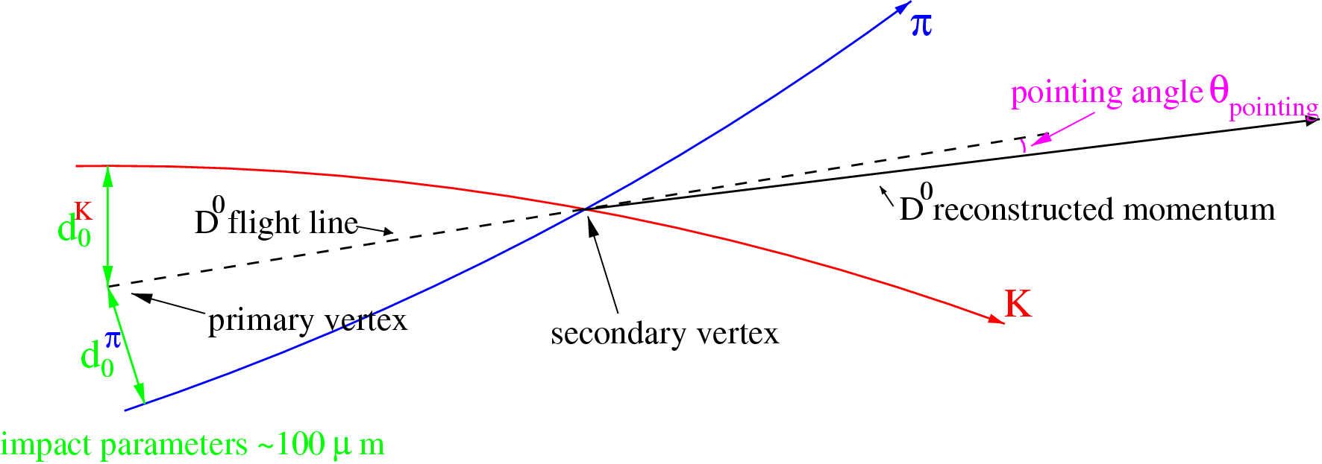
How we investigate: D-meson Production
Indirect measurement of charm quark production via reconstruction of D⁰ decays
To identify the D⁰ , we reconstruct the decay vertex via its daughter particles
  All opposite charged tracks are paired -> large combinatorial background
This is done by tracing backwards along the tracks of the daughters until a common intersection point is found
  Select secondary vertices displaced from the primary vertex to reduce the background
D⁰→K⁻π⁺

Slide 6
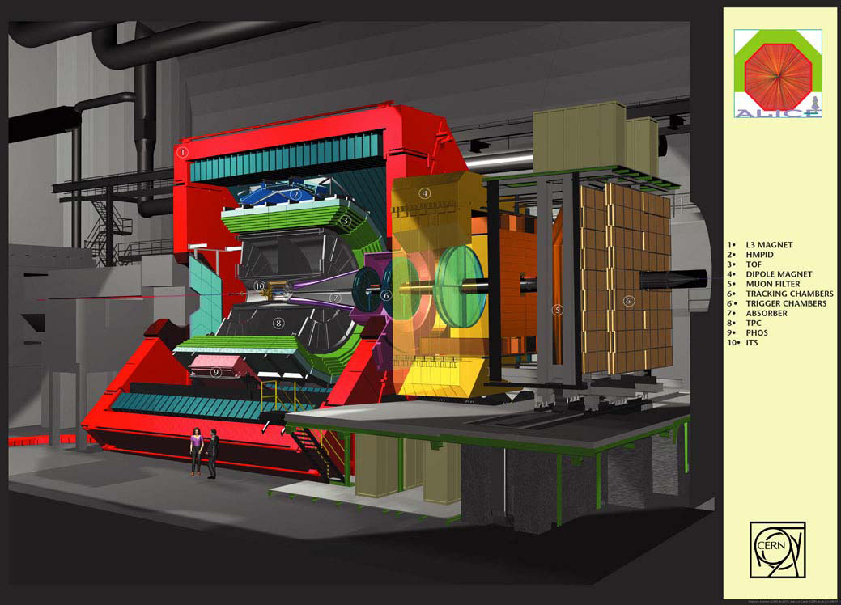
Detectors: ITS, TPC, TOF
ITS: six layers of silicon detectors, used for tracking
TPC: tracking and particle identification (PID) through energy loss measurements, dE/dx.
TOF: PID via measurements of the time-of-flight

Slide 7
Track Selection: Bayesian Approach
Bayesian formula:
where:
  s = the detector response
  C_{i} = a priori probability of a signal being a particle of type i (e,μ,π,K,…)
  r( s | i ) = probability density function
  w( s | i ) = probability that a signal, s, is being produced by particle of type i
This is used to identify tracks from the reconstructed data
Once the tracks are identified as a K or π, we check the charge of each track
Then we can accept/reject the D⁰ or D^{0bar} mass hypothesis

Slide 8
Results: Invariant Mass Spectrum
We are looking at 2010 pp collision data to test out Bayesian approach
  I developed the code to perform the D⁰ selection
  This will become a part of the official ALICE code (AliRoot)
  We spotted some issues (independent from this work) -> tuning of the procedure and finalization of the analysis will require more time
We are currently analyzing data from 2011 PbPb collisions
From the invariant mass spectrum we can extract the D⁰ signal

Slide 9
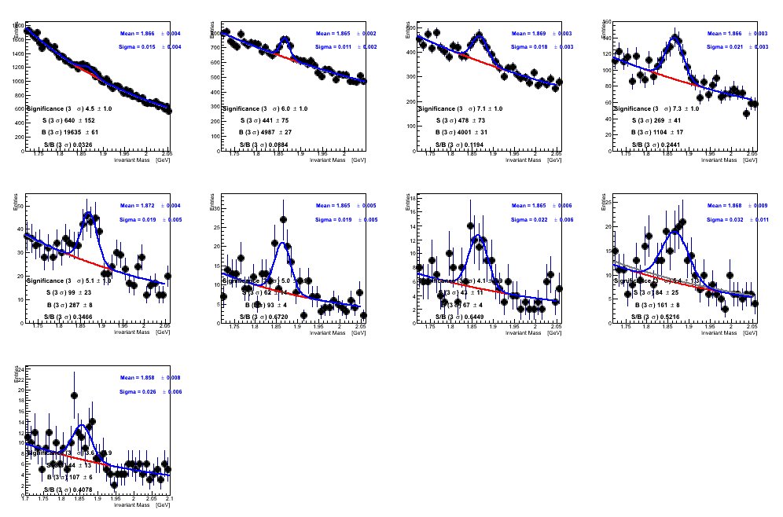
Results: Invariant Mass Spectrum
Invariant mass spectrum of the D⁰ using the Standard PID methods already in use

Slide 10
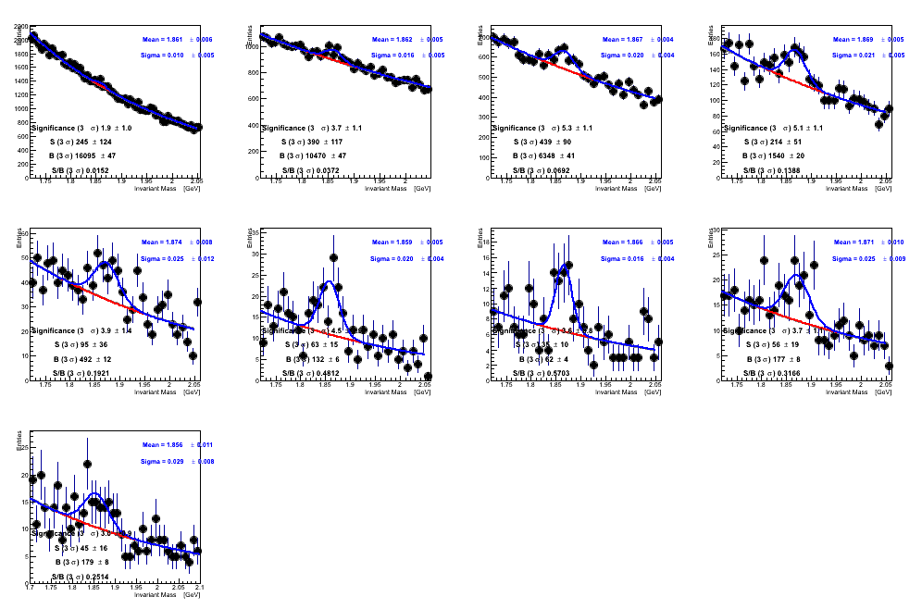
Results: Invariant Mass Spectrum
Invariant mass spectra using the Bayesian PID methods (still in debugging phase regarding other issues not related to Bayesian method)
Will increase the signal over background ratio at lower p_{t} ranges

Slide 11
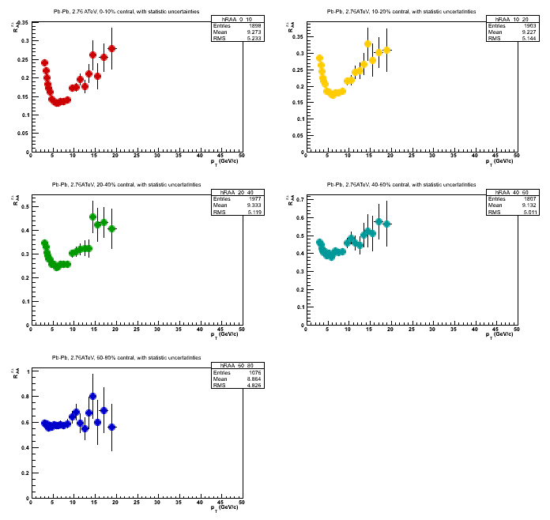
Results: Pion R_{AA} and R_{AA} Ratio
These are the R_{AA} plots for the π± for different centralities
I re-binned the pp and PbPb π± p_{t}-spectra to be able to calculate the ratio of the R_{AA} of D⁰ and π± in (2<p_{t}<5 GeV/c) and (6<p_{t}<12 GeV/c) as a function of centrality
I calculated these as input to calculate the R_{AA} ratio of the D⁰ to the π±
(coming soon)
Red -> 0-10%
Yellow -> 10-20%
Green -> 20-40%
Teal -> 40-60%
Blue -> 60-80%

Slide 12
Conclusion: Future Plans
Analyze MC and PbPb collision data using the Bayesian approach to PID for D⁰ analysis
Incorporate IsSelectedBayesianPID method into future versions of AliRoot
Complete the study of the R_{AA} ratio as a function of centrality to check whether a mass dependence of parton energy loss in the QGP can be observed
Look for differences between the PbPb and pp analysis caused by signatures of the QGP

