Slide 1
Tape Efficiency
CERN
Tim Bell
GDB February 2008

Slide 2
Metrics for Tape Efficiency
File size
  Average size of files to/from tape
Repeat mount rate
  Average number of times a tape is mounted for each tape touched that day
Data transfer per mount
  Average volume of data transferred for each mount
Total Rate
  Volume of data read/written divided by total time on drives including mount, unmount and data transfer.

Slide 3
Proposal from F2F
Experiments should
  Move to 2GB files for tape transfers
  Ensure that pre-staging is standard for all applications
Castor Operations will change policies for CCRC
  Write policy of at least one tape of data with 8 hours maximum delay
  Limit mounting for reads unless at least 10GB or 10 files requested for each read mount or if a request is 8 hours old
Monitor February CCRC performance and cover shortfall with
  Major drive purchases and dedication for experiments
    Fixed budget! Implies reduction in CPU/disk capacity

Slide 4
Changes Made to Castor
Write policy changes
  Checking for files to migrate moved from 30 minutes to 2 hours
  Migration policy changed for CMS and Atlas with Castor 2.1.6 to migrate when 500 files are available to be written
  Gradual approach to understand impacts
Read policy will be implemented after write changes have been validated
Awaiting CCRC data load to confirm results
  Automatic collection of data for metrics in place
  Weekly results available on Twiki

Slide 5
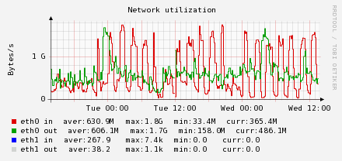
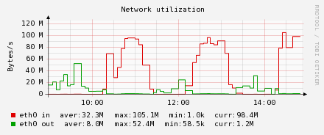
CCRC and Write Migration
Regular pulses as the CMS write migration starts
Write policy is sufficient as it drops to zero before next migration
Extra capacity available for other activities such as reading

Slide 6
Other Improvements
Atlas file sizes have increased from 150MB to 250MB average
Alice have identified the 22 byte file problem
Tape pool definitions for CCRC and production are being made with consideration for recall strategies

Slide 7
Discussion summary
Old Repeat Mount metric was confusing
  Simplified the definition as average mounts for each tape touched
Data is not representative of future load
  CCRC should be representative so full analysis will be made after on completion of CCRC
Users write small files
  Only production pools are considered in CERN reporting
Limited control on distribution on tape
  Improve writing policies to get better co-location
  Pre-staging needs to be larger than per-job to gain efficiency
Historical files are small so current file sizes are small
  Should only effect read file size and should gradually improve as write file sizes improve

Slide 8
Current Statistics

Slide 9
File size and performance
Alice | Atlas | CMS | LHCb
90 MB | 250 MB | 950 MB | 270 MB
Atlas file sizes improved from 150MB to 250MB
Awaiting CCRC for representative work load

Slide 10
File size

Slide 11
Repeat Mounting
Improved metric to ease understanding
Requires pre-staging for reading and policy changes for writing

Slide 12
Total performance to tape

Slide 13
Data transfer per mount

Slide 14
Additional Information
Metrics Definition
  https://twiki.cern.ch/twiki/bin/view/LCG/MssEfficiencyCERN
Tape Efficiency Summary
  https://twiki.cern.ch/twiki/bin/view/LCG/MssEfficiencyCERN

