Slide 1
WLCG Monitoring – some worked examples
GDB
CERN, 4th March 2008
James Casey

Slide 2
Overview
What are the actual commodity solutions we can use?
Messaging System
  How does it perform ?
How does the strategy affect existing systems?
What new systems do/might we need ?

Slide 3
Messaging Systems
Flexible architecture:
  Deliver messages, either in point to point (queue)…
  … or multicast mode (topics)
  Support Synchronous or Asynchronous communication.
Reliable delivery of messages:
  Provide reliability to the senders if required
  Configurable persistency / Master-Slave.
Highly Scalable:
  Network of Brokers

Slide 4
ActiveMQ
Mature open-source implementation of these ideas
  Top-level Apache project
  Commercial support available from IONA
Easy to integrate
  Multiple language + transport protocol support
Good performance characteristics
  See later …
Work done to integrate into our environment
  RPMs, Quattor components + templates, LEMON alarms

Slide 5
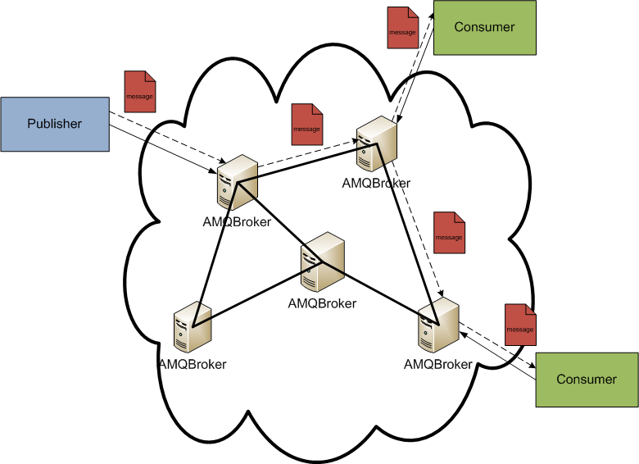
ActiveMQ

Slide 6
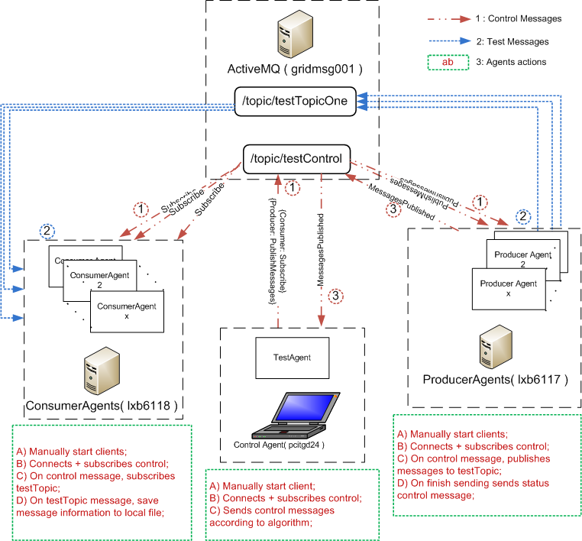

Testing of ActiveMQ performance
Evaluated Parameters:
1) Number of Producers
2) Number of Consumers
3) Message Size
4) Message Number
Measurement of timestamps:
Message Sent
Message on Broker
Message Received
Results analysis:
Logs containing all information for each message
From logs, extract messages/second…
… and messageLag
Notes:
Network topology : Peer2Peer, ClientServer, Hub and Spoke; || Store And Forward. Master/Slave. Network of Brokers
Quality of service: topics vs queues, durable vs. reliable, messaging timeout.

Slide 7
Test Summary
Results summary:
  Running for 6 weeks with no crashes
  50 Million messages of various sizes (0 to 10 kB) forwarded to consumers
  12 Million incoming messages from producers
  Up to 40 Producers and 80 Consumers connected at the same time
  Stable under highly irregular test pattern:
    Number of clients change
    Frequent client process kills
    Daily number of tests vary
Notes:
Previous rudimentary tests were run against ActiveMQ 4.1 using netcat clients.
Higher throughput;
However, frequent restarts on the broker were needed.

Slide 8
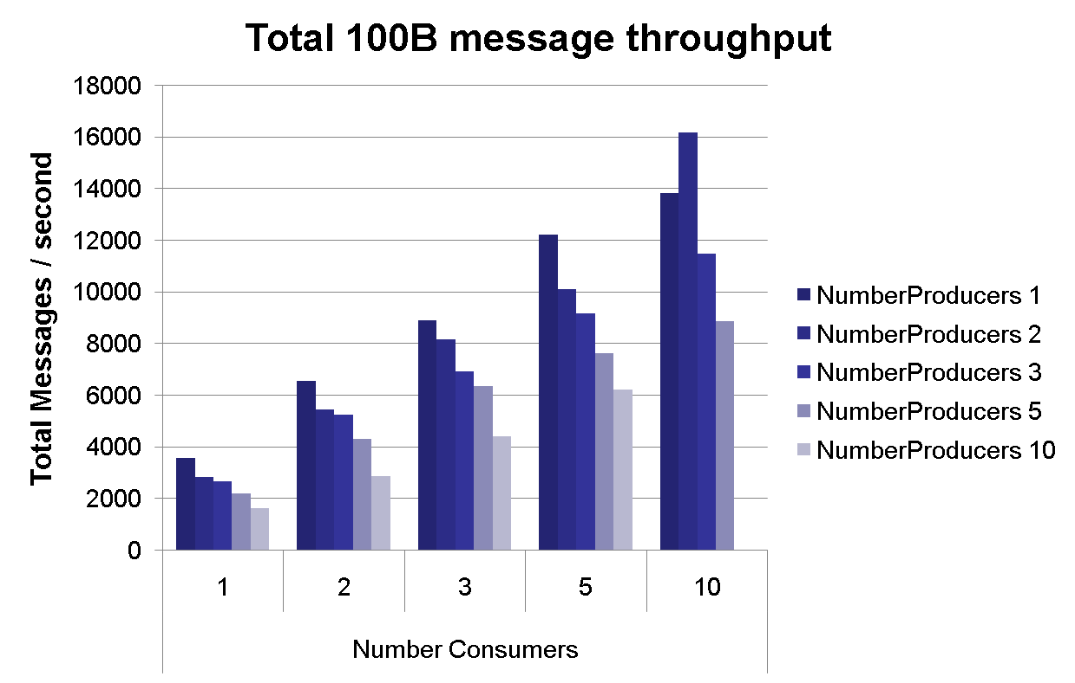
Results : Throughput
> Consumers > Throughput
??
Consumer Bottleneck! With a larger number of producers, even more messages per second saturating the consumer.
Notes:
What do we mean by messaging?
From the JMS (Java Message Service) specification:
“ The term messaging is quite broadly defined in computing(…) here, it is used to describe asynchronous communication between enterprise applications. Messages (…) are consumed by enterprise applications, not humans”
Active MQ: Apache Open Source solution.
It is an implementation of JMS 1.1 (J2EE 1.4)
Topics for broadcasting messaging
Queues for point to point
Durable subscriptions with configurable persistence
High Reliability and flow control
Different client acknowledgment modes
Asynchronous or synchronous configuration.
Active MQ features :
Virtual and Composite Destinations, WildCards
Interoperability: Stomp, OpenWire, REST, RSS
Will run with any available Java Virtual Machine
High performance journal + JDBC persistence.

Slide 9
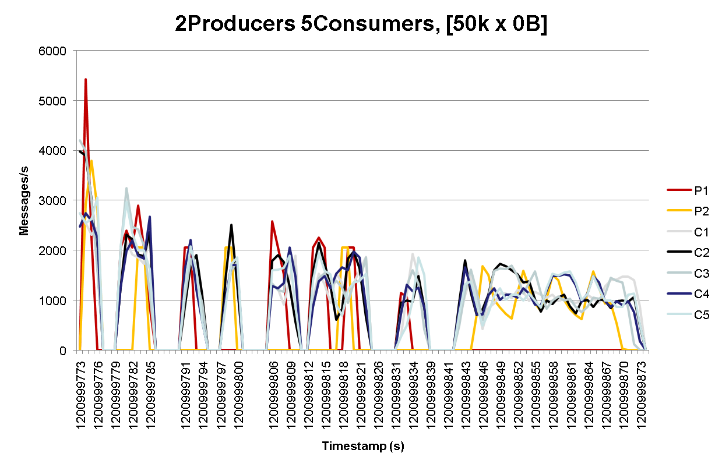
Results : Flow Control
Effective flow control
Flow Control balances load on producers and consumers

Slide 10
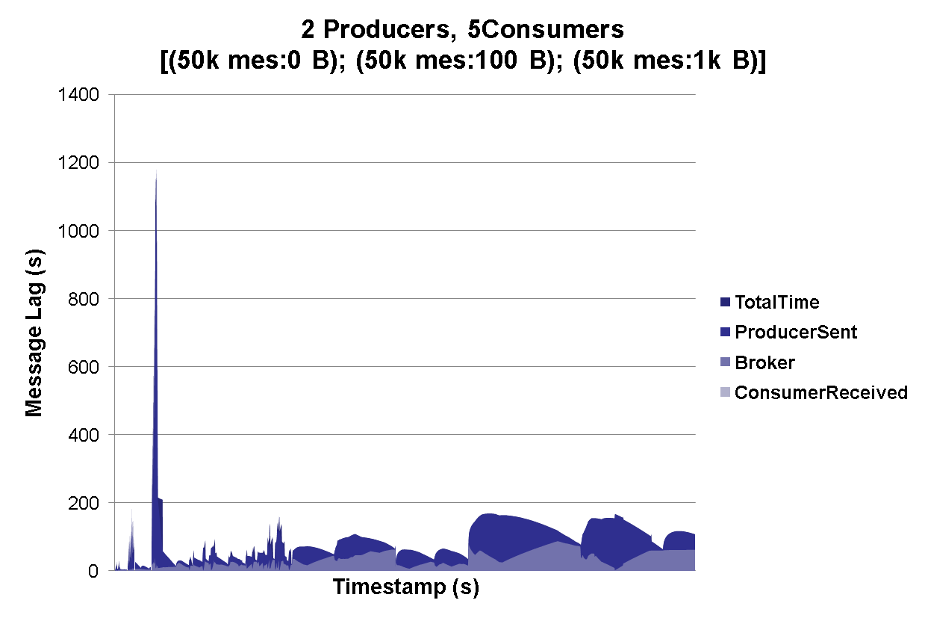
Results : Message Lag
3 Consumers Memory Overflow ( Slow consumers )
Test Run batch change
Max 180 s!

Slide 11
Failover …
Currently testing failover strategies for high-availability
  JDBC Based
  Shared Filesystem
  Pure Master-Slave
Evaluation of performance characteristics and recovery operations needed
This is an essential feature to have high-reliability service
  First tests look promising

Slide 12
Usages of Messaging
We use it as an ‘integration bus’
  Use when systems want to share information
    E.g VO transfer systems publishing data rates to WLCG
It’s another string to our bow
    When the application model fits well, then use it
      E.g. Async communications, broadcast messages
Don’t force applications to use it
  Have other solutions too
    E.g “RESTful” web services a.la SAM Programmatic Interface

Slide 13
‘Standard’ Integration Patterns
The same patterns are repeated in many of the following examples:
  Gather results at many points
  Collect the raw results and store in a database
  Perform some operation on the raw results
    Summarisation, availability calculation, …
  Publish the summarised results to many clients
    E.g. site monitoring, dashboards, …
  Store historical data in a database and visualize via web client
We provide ‘standard’ components to make this plug’n’play for many workflows

Slide 14
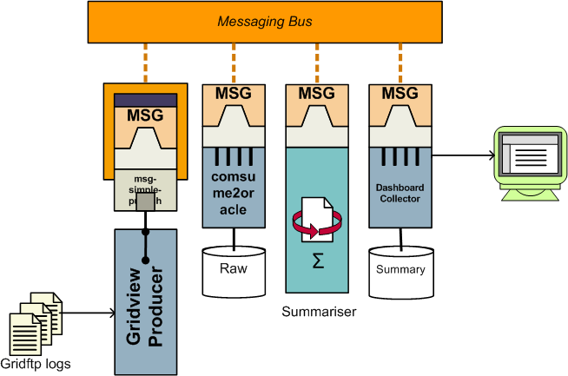
Standard Pattern Example – Gridftp log analysis
Transparent Broker Network
Messaging System Adaptor
Database archiver component
Standard components
Standard process
Application

Slide 15
Examples
Existing Systems
  Service availability monitoring
  gStat
  Site Monitoring
  Usage reporting
New systems
  Gridview report publication
  MoU reporting
  ServiceMap – VO metric integration
All fit into the standard pattern mentioned before
  Now for details…

Slide 16
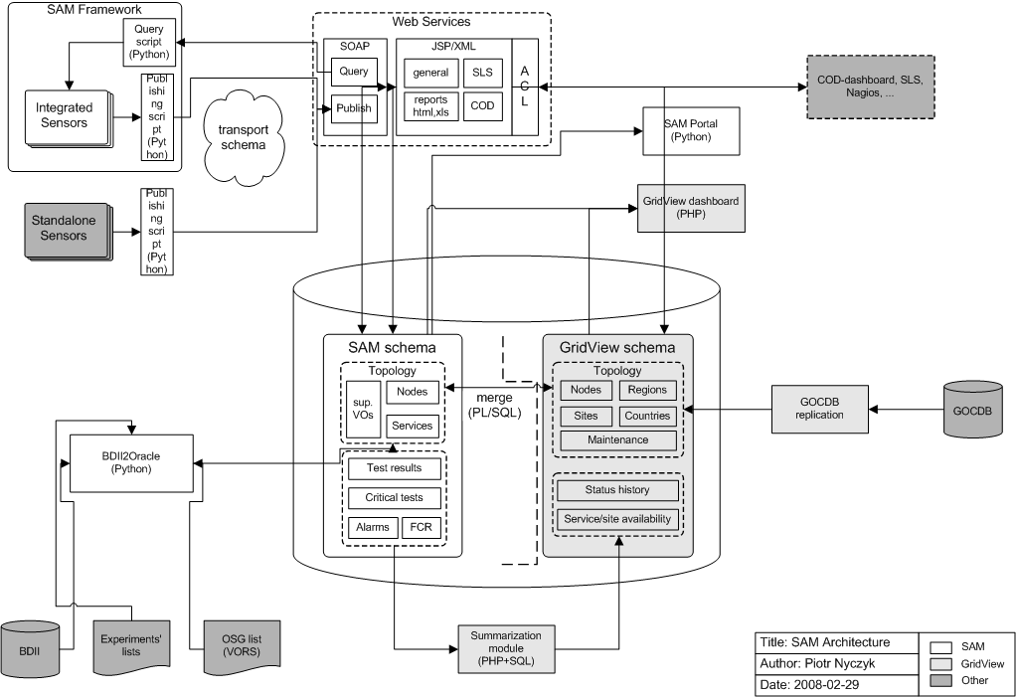
SAM – Current Architecture

Slide 17
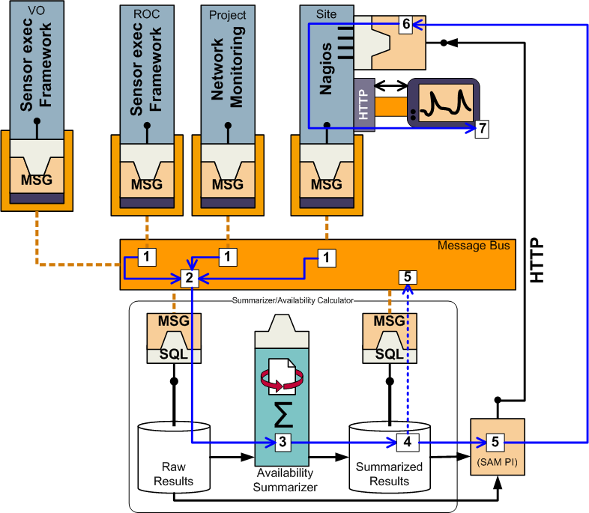
Migrating to the regions

Slide 18
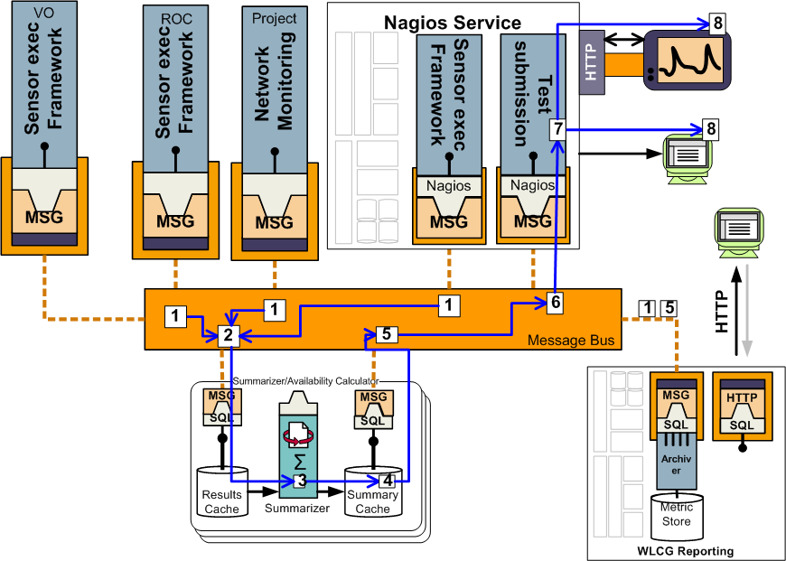
Messaging based archiving and reporting

Slide 19
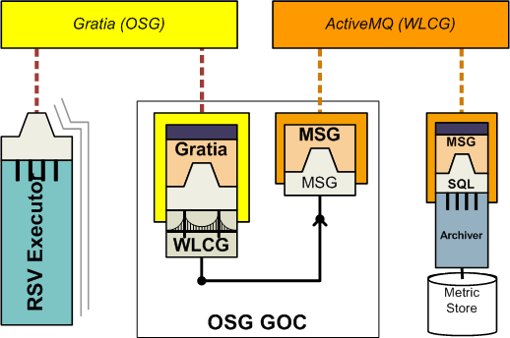
In Production - OSG RSV to SAM
RSV – Resource and Service Validation
  Uses Gratia as native transport
  And OSG GOC provide a bridge to SAM

Slide 20
Workplan
Port ‘useful’ SAM tests into WLCG probe format
  And supplement where needed
Move with 1 or 2 nagios-expert ROCs to have them run the SAM tests for their region
  Setting up a standard execution environment at ROC will be key
Slowly migrate ROCs over the course of EGEE-III
Provide VO specific nagios at CERN for experiment specific tests (where needed)

Slide 21
Site Monitoring
WLCG working group focus on site monitoring
  Problem reporting close to the source
SAM becoming regional doesn’t change this
  Hybrid monitoring strategy
Site tests often only relevant for site admin
  Not for availability/reliability calculation
Source | # checks / service | Type
Central | 1-2 | Network monitoring, Service ‘Ping’
Regional | 5-10 | User-oriented actions (e.g existing SAM tests)
Site local | 10-30 | Detailed functional tests

Slide 22
Nagios
EGEE CEE work on Nagios-based testing for grid services
  Basis for future SAM execution framework
  Uses WLCG probe format
    Compatible with tests from OSG RSV
  Publishes into ActiveMQ for subset of tests
    Can be used to augment availability
New version (ncg v2) is ready
  Meet needs of sites to integrate into existing nagios installs
    No need for gLite UI on Nagios server
    Partitioned config file generated – include what you need

Slide 23
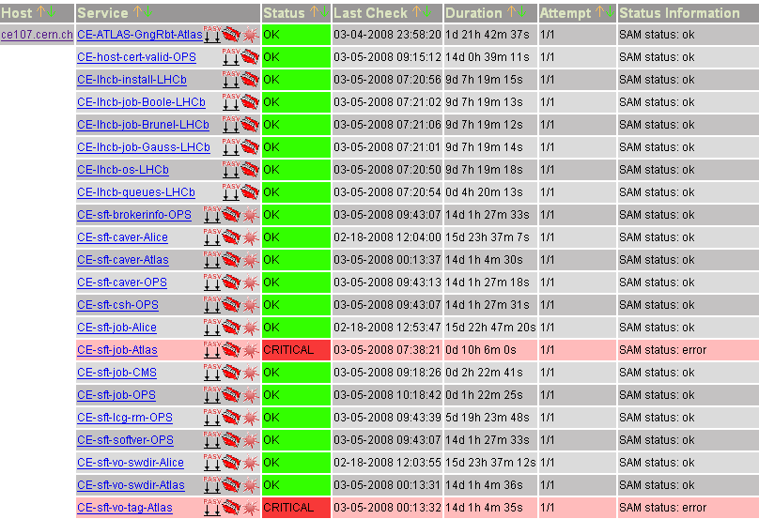
New Feature :Multiple VO reporting
All SAM tests for all VOs supported at your site

Slide 24
Workplan
Documentation to be finished
Then deployment is key
  Do we need YAIM for Nagios to help small sites?
Add features as requested from site admins
  E.g. Nagios acknowledgements become entries in a related GGUS ticket

Slide 25
Usage Reporting
Other main part of monitoring – Usage statistics
  Gridftp transfers, FTS transfers, job records, …
Used to calculate throughput and reliability
Currently handled in GridView, Dashboards
  Use messaging system to unite these efforts
Delegate parsing/routing of specific information back to experts
  L&B, FTS, …

Slide 26
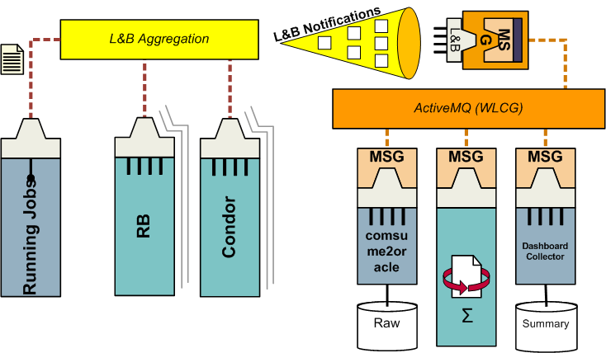
Architecture

Slide 27
Workplan
Dashboard team working on getting non-RB job information into L&B direct from Condor submission
Gridview converting gridftp publishers to messaging system
Message formats defined for records
  First records have been sent
Will add new message types, such as SRM transfers

Slide 28
MB Reporting
Currently a post-processing of results and graphs in Excel
  Trying to implement it directly on the GridView DB
Using a mature open-source reporting toolkit – JasperReports
  UI Report builder – iReports
  Web-based report server - OpenReports

Slide 29
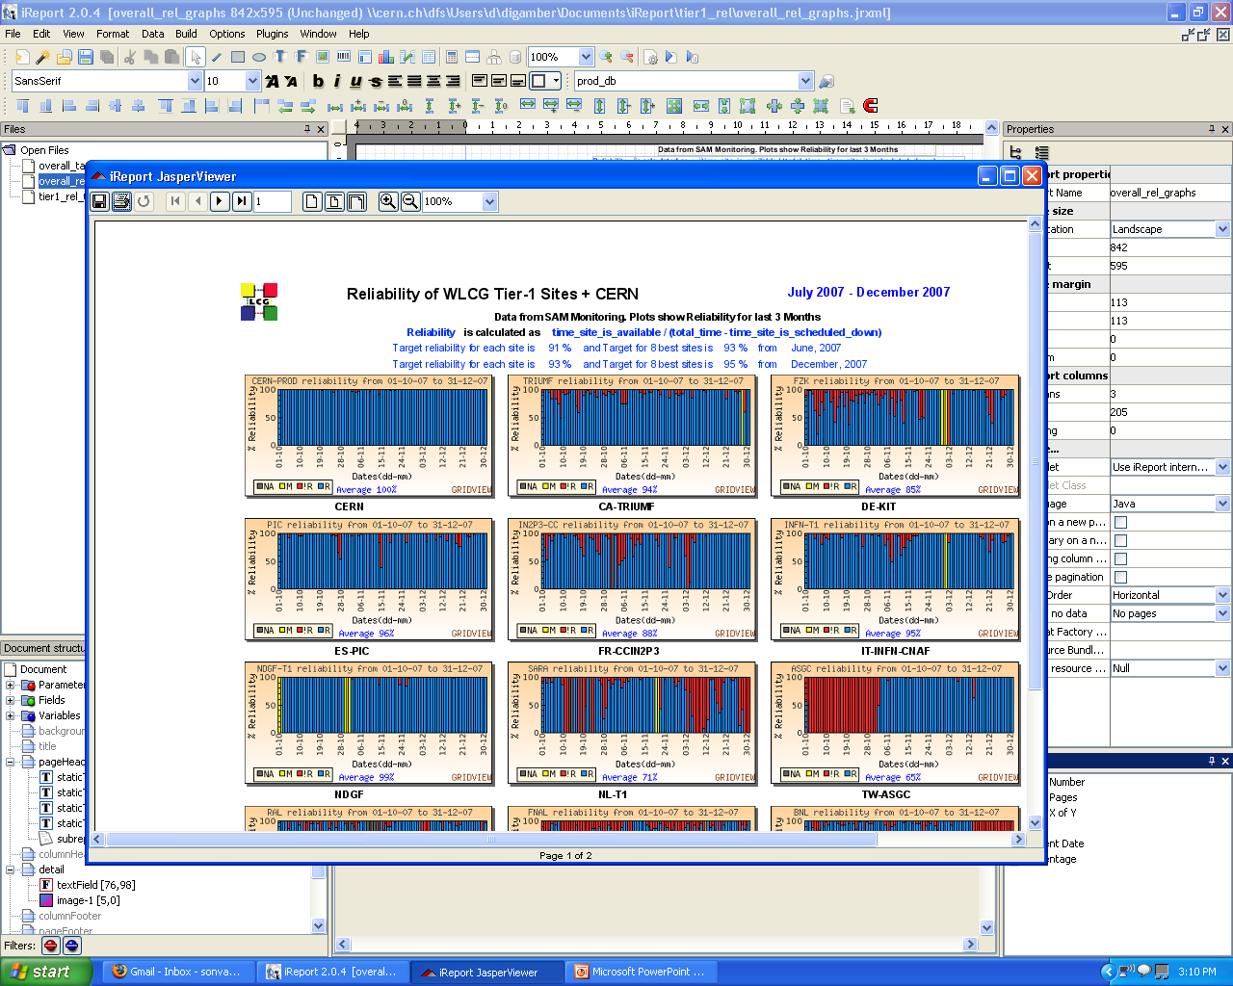
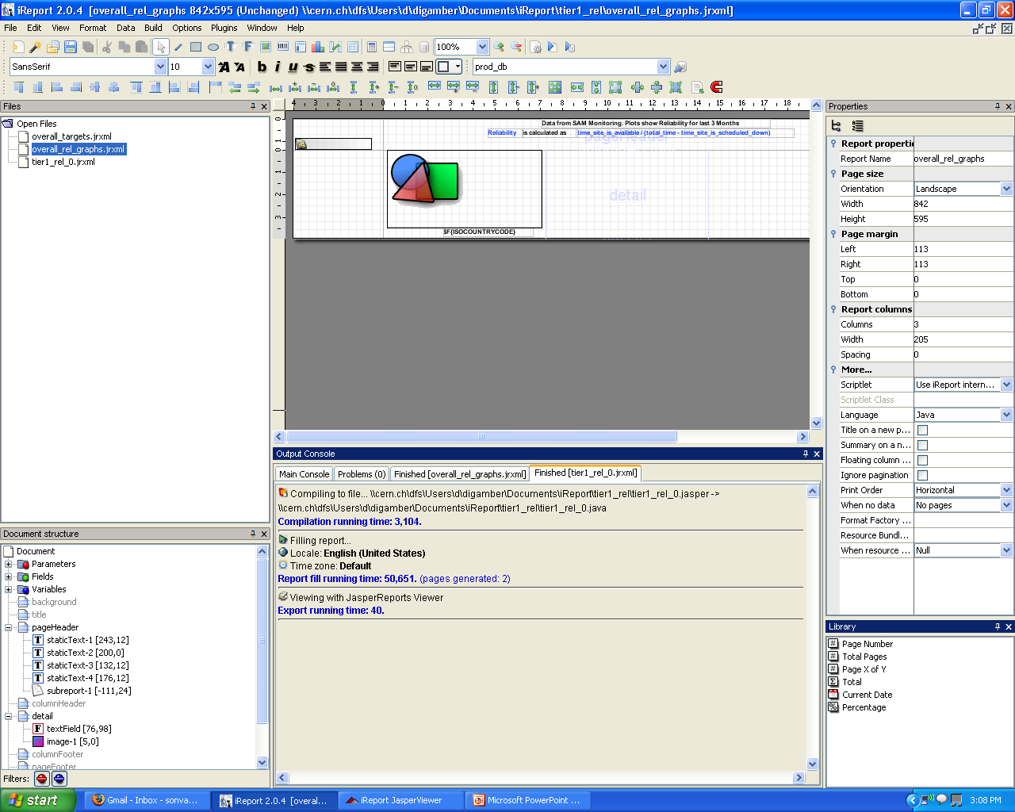
OpenReports

Slide 30
MoU compliance reporting
We agreed to try and measure MoU metrics during CCRC’08
  To evaluate if we can actually do it !
https://prod-grid-logger.cern.ch/elog/CCRC'08+Logbook/
Service | Maximum delay in responding to operational problems |  |  | Average availability measured on an annual basis
 | Service interruption | Degradation of the capacity of the service by more than 50% | Degradation of the capacity of the service by more than 20% | During accelerator operation | At all other times
Acceptance of data from the Tier-0 Centre | 12 hours | 12 hours | 24 hours | 99% | n/a
Networking service to the Tier-0 Centre during accelerator operation | 12 hours | 24 hours | 48 hours | 98% | n/a
Data-intensive analysis services, including networking to Tier-0, Tier-1 Centres | 24 hours | 48 hours | 48 hours | 98% | 98%
All other services – prime service hours | 2 hour | 2 hour | 4 hours | 98% | 98%
All other services – other times | 24 hours | 48 hours | 48 hours | 97% | 97%

Slide 31
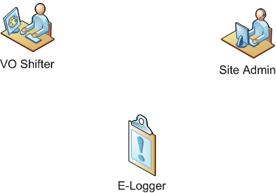
Response time reporting workflow
New Problem!
Site Acknowledge
VO Confirmed
Site Fixed
Problem Solved !
Problem Report: Issue ID #42 : 2008-02-01 10:30 :
MoU Area: CERN-PROD/ Distribution of data to Tier-1 Centres
Time to First Response : 1:00
Time to Problem resolved : 1:29
Time to VO confirmation : 2:23
2008-02-01 10:30 – New Problem. VO: Atlas, MoU Area: Distribution of data toTier-1 centres, Site: CERN-PROD - SRM not working
2008-02-01 11:30 – Site Acknowledged – working on it !
2008-02-01 11:49 – Site Fixed – We’ve found the problem in the endpoint, restarted
2008-02-01 12:43 – VO Confirmed – All working again , thanks !

Slide 32
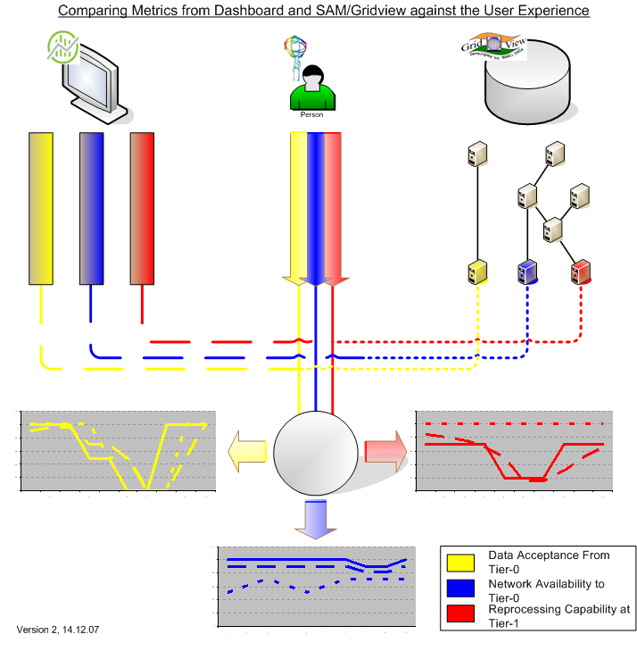
Measuring MoU availability
“Human”
` View
- the control
Experiment
Framework/ Dashboard View
Operational Testing (SAM/SLS) View

Slide 33
Mapping to MoU Services
Tier-1 |  | Grid Service
 |  | ArcCE | BDII | CE | FTS | LFC | MYPX | OSGCE | RB | RGMA | SE | SRM | SRMv2 | VOBOX | gCE | gRB | sBDII
MoU Category | Acceptance of data from Tier-0 * |  |  |  |  |  |  |  |  |  |  | • | •
 | Networking Services to Tier-0 *
 | Data-intensive analysis service, including networking to Tier-0 | • |  | • | • |  |  | • |  |  |  |  |  |  | • |  | •
 | All Other Services |  | • |  |  | • | • |  | • | • |  |  |  | • |  | •
Map grid services status (from SAM) to MoU categories
  These are “custom” service availability calculations
Use the CMS SAM portal framework as basis for implementing this ?
  And send results direct to Tier-1 Nagios

Slide 34
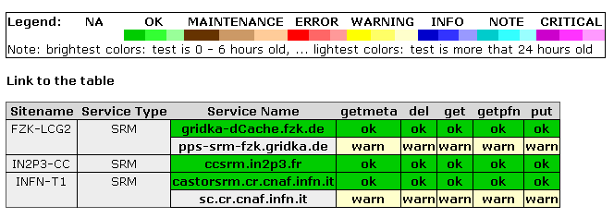
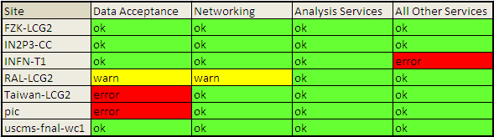
MoU Portal

Slide 35
ServiceMap
What’s a ServiceMap?
  It’s a gridmap with many different maps, showing different aspects of the WLCG infrastructure
What’s the CCRC’08 ServiceMap?
  Service ‘readiness’
  Service availability
    For VO critical services
  Experiment Metrics
A single place to see both the VO and the infrastructure view of the grid

Slide 36
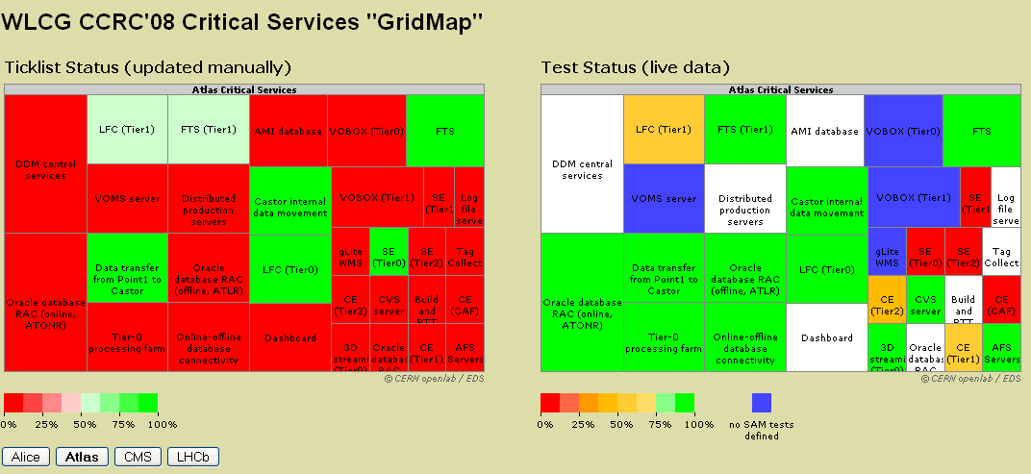
CCRC’08 ServiceMap
…Demo…
http://gridmap.cern.ch/ccrc08/servicemap.html

Slide 37
VO Metric monitoring
Use messaging as interface between VO and the ServiceMap
VO publishes statistics from dashboard /framework from their perspectice
  Job reliability
  Data transfer rates
  Links back to their application for more information
ServiceMap becomes launchpad for getting to all operational monitoring data
  For the infratructures and the VOs

Slide 38
What are the VO functional blocks ?
Functional blocks for LHC experiments are similar to a large extent
  Allows for a site to compare the service they provide for different experiments
  e.g - functional blocks for ATLAS and CMS for CCRC08
CMS
ATLAS
Data archiving at T0
Data processing at T0
Data transfer from T0
CAF
Data archiving at T0
Data processing at T0
Data transfer from T0
T0
Data archiving at Tier1
Processing at Tier1
Data transfer T1-T1
Data transfer T1-T2
T1
Processing at Tier1
Data transfer T1-T1
Data transfer T1-T2
MC production at T2
Analysis at T2
Data transfer T2-T1
T2
MC production at T2
Analysis at T2
Data transfer T2-T1

Slide 39
Monitoring of the Experiments workflows
CMS Dashboard
Phedex
UI
Based on GridMap view application
GRID
publisher
Repository for common aggregated metrics
ATLAS Dashboard
Monalisa repository for ALICE
Metrics and targets are defined and measured by the experiments according to their workflows
DIRAC

Slide 40
Example of “Gridmap” visualisation for CCRC08 workflow for CMS (random choice of colour)
Tier 0
Data archiving
At T0
Data processing
At T0
Transfer
T0-T1
CAF
CCRC08 target for number of slots
for data processing
Number of jobs running in parallel
for data processing XXX
Max, min, avg of number of
parallel jobs over last 24 hours
Data processing success rate X%
Three top errors
Subset of the same info for
every Tier1
Tier 1
New window
Data
Archiving at
T1
Processing
At T1
Data transfer
T1-T2
Data transfer
T1-T1
On click
Moving mouse
over
T1_IT_CNAF
T1_US_FNAL
Moving mouse
over
List of useful URLs to the detailed data
T1_FR_IN2P3
Tier 2
MC production
at T2
Analysis at
T2
Data transfer
T2-T1
T1_DE_FZK
T1_TW_
ASGC
T1_UK_
RAL
T1_
ES_
PIC

Slide 41
Summary
Have a standard model for many of the monitoring data/workflows
  And components that can help us
Now it’s an integration exercise
  Augment existing components to talk together
A lot of work to do
But it will benefit us in the long term
  Better sharing of knowledge/resources
  Reduce operational effort
  Easier to acquire personnel who know the commodity technologies

Slide 42
Links
ActiveMQ
  http://activemq.apache.org/
Nagios
  http://www.nagios.org/
JasperReports
  http://www.jasperforge.org/jaspersoft/opensource/business_intelligence/jasperreports/
OSG RSV
  http://rsv.grid.iu.edu/documentation/
CCRC’08 ServiceMap
  http://gridmap.cern.ch/ccrc08/servicemap.html

Slide 43
Extra Slides

Slide 44
gStat – monitoring the BDIIs
gStat focuses on monitoring at Site BDII level
Need to consider:
  Validation of information close to source (GRIS)
  Monitoring of performance of top-level BDII
New work to analyse top level BDII performance (Laurence Field/ Felix Ehm)
  Use Nagios as execution framework
  WLCG probe-format compatible probes (in progress)
  Custom presentation layer
Good example of using the commodity software approach to speed up development and deployment !

Slide 45
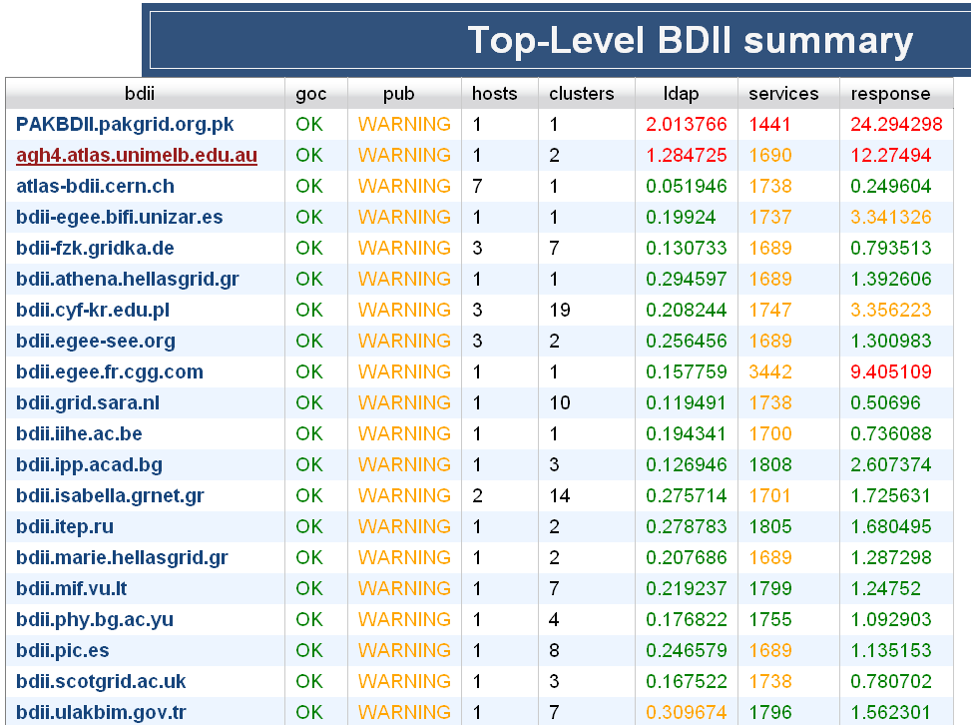
Top BDII Summary
How many hosts behind this load-balanced alias ?
How many CE clusters reference this top-level BDII?
How many services in this BDII?
Response time ?

Slide 46
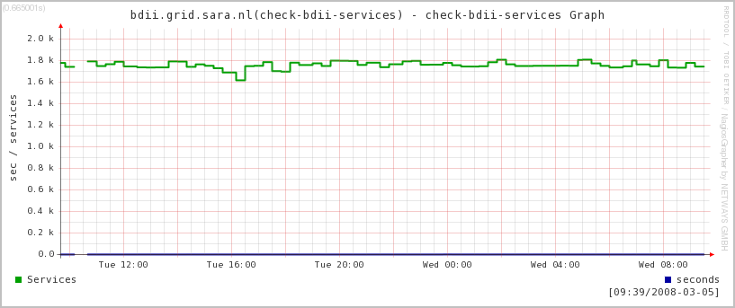
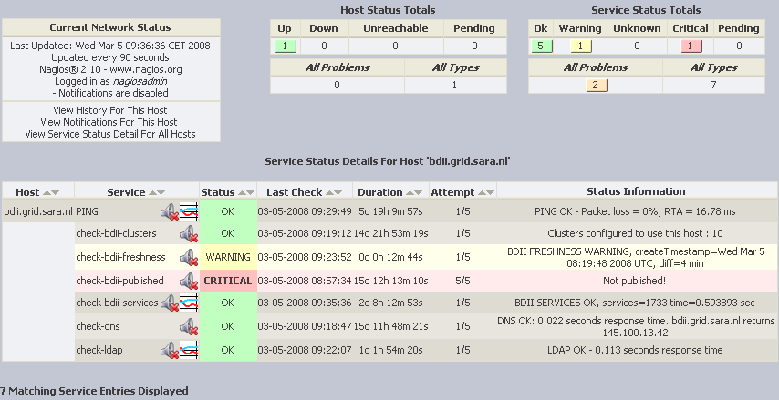
Drill to Nagios for details
Drill-down to historical view

