Slide 1
A Strategy for WLCG Monitoring
GDB
CERN, 4th March 2008
James Casey

Slide 2
The WLCG Monitoring Vision
Show stakeholders the state of the global WLCG infrastructure, and its historical evolution, in order to improve the availability and reliability of this infrastructure

Slide 3
Strategy in one line
Combine information from the many existing monitoring, accounting and reporting systems in a coherent way and pass it to all interested parties

Slide 4
Strategy in four lines
Converge to standards, but without a big bang
Leverage the underlying infrastructures rather than layer lots of systems on top
Modular and loosely coupled to adapt to changes in infrastructure and funding models
Reduce maintenance/development costs by using commodity components where possible

Slide 5
Converge to standards, but without a big bang
The starting point is what we have now:
  Availability testing framework – SAM/RSV
  Job and Data reliability monitoring – Gridview
  Grid topology – GOCDB/Registration DB
  Dynamic view of the grid – BDII/CeMon
  Accounting – APEL/Gratia
  Experiment views – Dashboards
  Fabric monitoring – Nagios, LEMON, …
  Grid operations tools – CIC Portal
They work together right now
  To a certain extent !

Slide 6
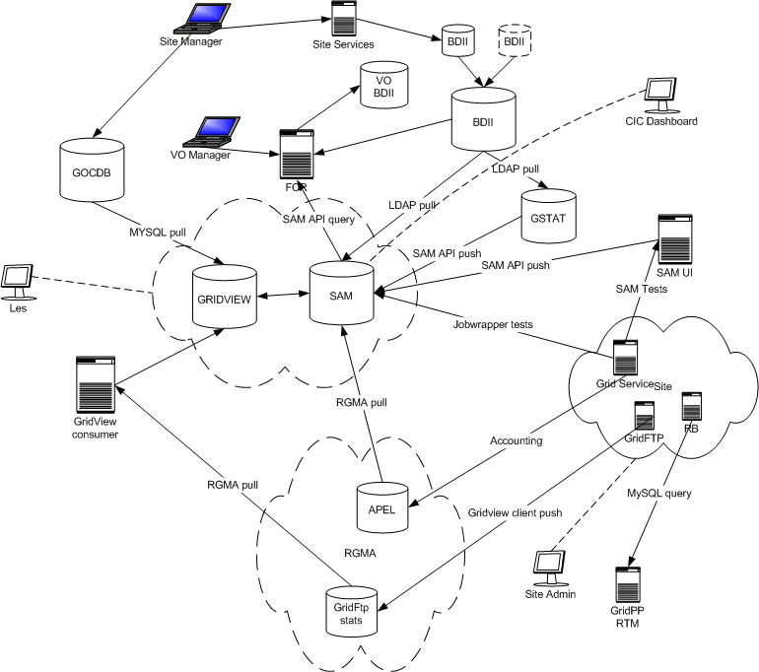
We’ve got an integration problem !

Slide 7
MoM has the answer…
We need:
  Loose coupling of systems
  Distributed components
  Reliable delivery of messages
  Standard methods of communication
  Flexibility to add new producers and consumers of the information without having to reconfigure everything
Message Oriented Middleware provides this
  And is widely used in similar scenarios

Slide 8
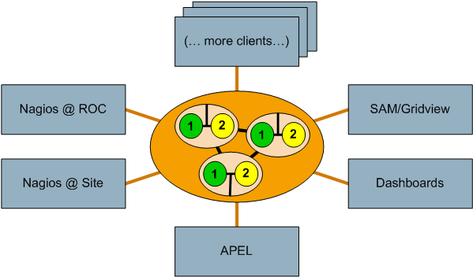
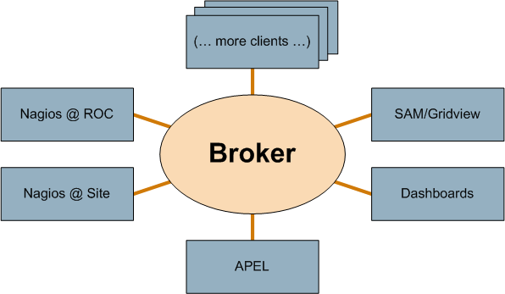
Broker at the centre ..
Reliablity and persistence of messaging built into the broker network
Mitigates the single point of failures we’ve had
with previous solutions

Slide 9
… or some of them…
Not a silver bullet
  Still can end up with spaghetti
Tight specification of interaction of components
  Message format specifications
  Standard metadata schema
  Message Queue naming schemas
  Protocols
Some worked examples in the next talk …

Slide 10
Leverage the underlying infrastructures
The WLCG WG uses the effort from OSG and EGEE to improve monitoring for all
  Nagios from EGEE CEE
  SAM from EGEE CERN
  RSV/Gratia from OSG
The “added value” is from the interoperation and exchange of components between the systems
  E.g. interchangable probes
Our MoUs should be defined related to the SLA/MoU of the infrastructures

Slide 11
Adapt to changes in infrastructure funding models
European model is moving towards regional management
  Even before EGI, EGEE COD and ROCs moving to a model with ROCs doing more regional monitoring
OSG is already a “NGI”
  Good early use-case for WLCG monitoring work of separate infrastructure doing their own monitoring but working within the WLCG framework

Slide 12
=> Distribute where possible
Strategy is:
  Distribute responsibility to regional level and below where possible
    Closer to the source of the problem to reduce response time
  Provide a toolset for the regional teams
    But allow for regional flexibility via protocols and standards
    E.g. OSG can use a different monitoring software stack, but still interoperate for WLCG reporting

Slide 13
Leverage commodity components where possible
Many custom systems
  Often for very special use-cases
  Or the “special” environment we have
If we (perhaps) sacrifice some specific functionality can commodity software solutions work for our environment ?
Examples are
  Nagios as an general execution environment
  Messaging systems (ActiveMQ) as general transport bus
  Business Intelligence systems (JasperReports) for reporting

Slide 14
Summary
This gives a very high level overview of
  where we’re going
  how we might get there
Result of experiences gained during the running of the WLCG Monitoring WG
Based on the ‘Architectural Principles’ previously presented
Next is how this strategy impacts the actual systems
  And what work there is to do…

