Slide 1
Operations Automation Strategy
James Casey
GDB, July 2008

Slide 2
Overview
EGEE MSA1.1 : Operations Automation Strategy
  Due end of PM1
  Delivered mid-June
  In review – comment welcome
https://edms.cern.ch/document/927171/1
Abstract:
In EGEE-III, within the SA1 activity, a group called the ‘Operations Automation Team’ was formed with the task of coordinating operational tools and their development, with the specific goal of advising on the strategic directions to take in terms of automating the operations effort. This will entail replacing manual processes with automated ones in order that the overall staffing level of operations can be significantly reduced in a long-term, sustainable infrastructure.
This document outlines a strategy for achieving this automation using an integration architecture based on messaging. It describes how current tools and processes, such as operational alarming and ticketing will evolve during the lifetime of EGEE-III and lays out a roadmap for this evolution.

Slide 3
Overview
Focus on
  Documenting the current model and issues with it
  What it the future model?
  How does this impact current tools?
  How do make the tools support this new model?
Initially restrict (due to time to deliver) to
  Distributed monitoring at ROC and Site (e.g. SAM, Fabric monitoring)
  Information Model
Follow up with
  Accounting
  Reporting
  SLA/SLDs
  Configuration management

Slide 4
Document Outline
Introduction
Executive summary
Project constraints on operational tools during EGEE-III
Description of core operational Tools
Current operations model
Outstanding issues arising from current operations
Future operational model
Architectural principles
Information Architecture
Tool integration architecture
Sharing system management tools
Roadmap for integration and deployment

Slide 5
Core Operational Tools
Grouped into 5 general areas
  Provision of information about resources
  Grid Monitoring and Reporting
  Grid Accounting and Reporting
  User support
  Follow-up of alarms created by monitoring systems

Slide 6
Current Operational Model
Several teams involved
  Operations Management (OCC)
  Monitoring system operators (SAM)
  Grid operators (COD)
  Regional Operations Centres (ROC)
  First line support teams (ROC)
  Resource Centres/sites (RC)
  User support team (GGUS)

Slide 7
Current operational model (s)

Slide 8
Future operational model

Slide 9
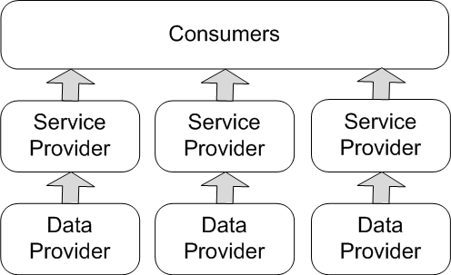
Abstract Information Model
Data providers are entities that are used as a source of information, primary or not
Services providers use this information to give a service to a set of consumers
Consumers use the data which comes from the service providers
Primary Data Provider This is the authoritative source for entities and/or relations between these entities.
Derived data provider This is a service that creates new information out of information provided by primary data providers.

Slide 10
Primary Data Providers
GOCDB
  The GOCDB is primary for the Grid infrastructure groups and services along with their relation to users and general info e.g. lists of administrators for sites, geographical location of site.
CIC DB
  Primary for VO Cards which describe a Virtual Organisation and their relations to users and services.
BDII Information System
  grid infrastructure groups e.g. services at a site
  detailed information about services e.g. endpoints for grid services
  Relationships between services and VOs and user groups e.g. Access control rules for services
VO information providers
  Currently VOs provide attributes about sites and services, such as the list of services that a VO wants to use and the pledged resources they want made available to them.

Slide 11
Secondary Data Providers
Tool | Primary Data | Derived data
SAM | Grid topology | Services metrics
SAM DB | Services metrics | Services status
Gridview | Services status, grid topology | Site availability
Accounting Portal | accounting records, grid topology, VO info | accounting reports
FCR | Services status, grid topology | list of working services for a VO
GStat | BDII | site BDII summary
Operations Portal | Site & ROC test information | Site& ROC Reports
Operations Portal | VOMS servers endpoint in VOCard | List of VOMS Users
Operations Dashboard | status, site information | Tickets

Slide 12
Service Providers
Tool | Service Provided
SAM | Monitor grid services
SAM | Provide interface to monitoring data
SAMAP | Allow real time scheduling of SAM tests
GridView | Calculate site availability
GridView | Report metrics about site availability and reliability
APEL | Provide and process accounting data
Accounting Portal | Report metrics about site accounting
Freedom of Choice (FCR) | Provide a list of working resources for a VO
GStat | Provide tests results for site information system
Operations Portal | Populate VO information
Operations Portal | Provide interface to manage VO info
Operations Portal | Provide project-wide communication tools
Operations Portal | Provide repository for operational procedures
Operations Dashboard | Provide dashboard tools for grid operators
Operations Dashboard | Provide dashboard tools for regional support
GOCDB | Populate grid topology info, users and services info
GOCDB | Provide interface to manage topology info

Slide 13
How do we distribute?

Slide 14
Aggregation models
Aggregation at project (WLCG), infrastructure(EGEE) levels
Filtering between ROC and Project

Slide 15
Messaging for integration
ActiveMQ as messaging bus to integrate systems
  Reliable + Scalable
Already in production for WLCG for OSG interoperation

Slide 16
Multi-level monitoring
Based on CEE ROC Nagios prototype
  Replace central SAM with components at ROC and site
  Tie together with the messaging system
  Regional operations dashboard and alarms DB
  Link into regional ticketing
    Perhaps via GGUS (for integration simplicity)
Follow new operational model
  Raise alarms immediately at the site
  1st level support sees them and can respond if needed
  Central COD only involved after 2-3 weeks e.g. site banning
Project/Infrastructure can aggregate data for reporting

Slide 17
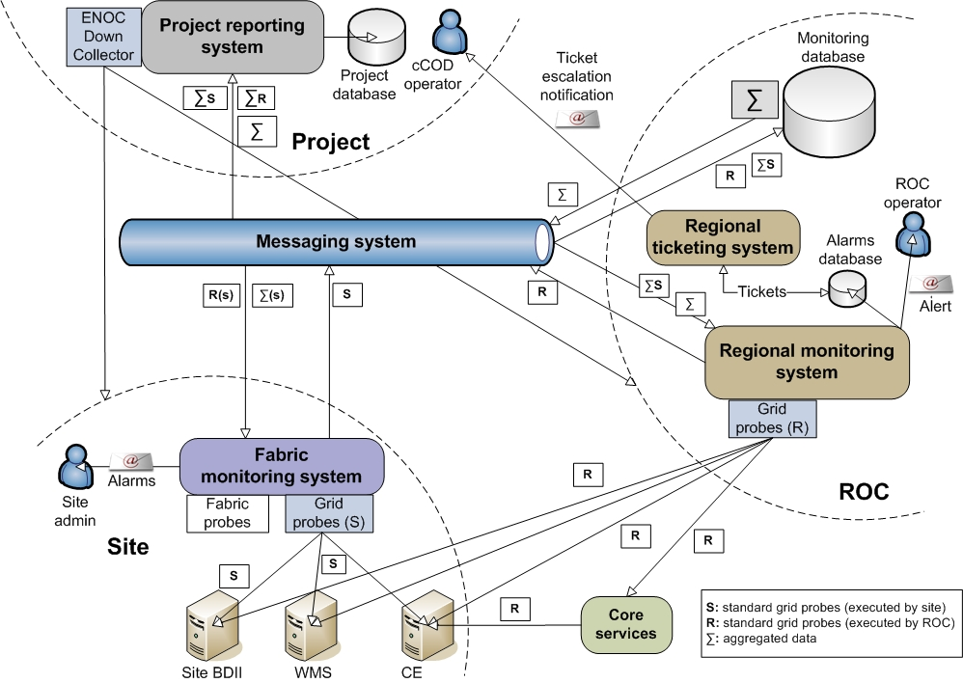
Multi level monitoring framework

Slide 18
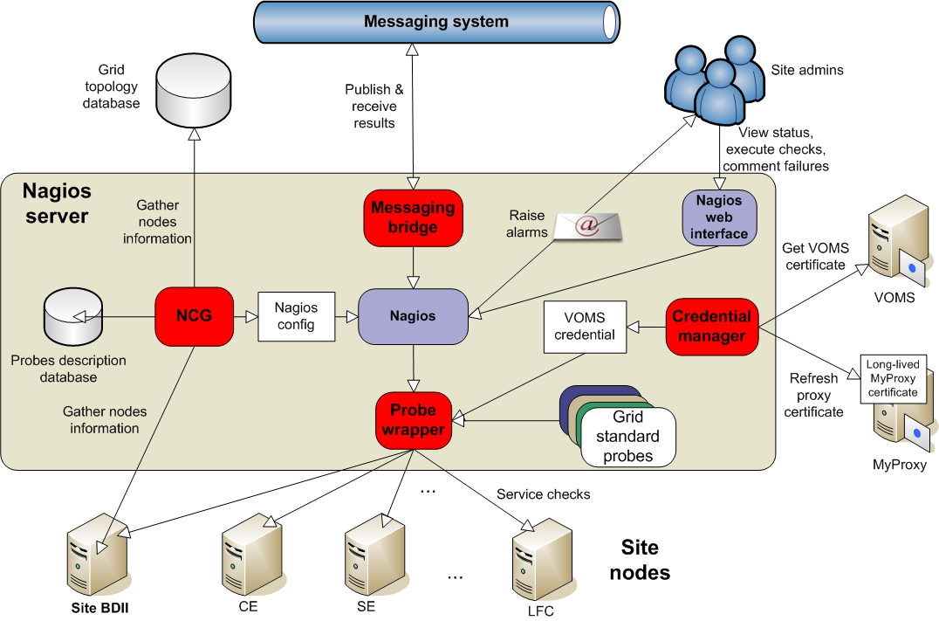
The site components

Slide 19
Sharing tools
How to use tools developed at ROCs + site more widely?
Mostly publicity…
  A ‘Lightning Talks’ session at EGEE conferences and events
  Encourage developers of tools to publish short articles in iSGTW (http://www.isgtw.org/)
Maintain repository of tools
  Build on and extend work done in Hepix/WLCG system management WG
    https://www.sysadmin.hep.ac.uk/
Integrate into EGEE releases
  Additional ‘EGEE-*’ YAIM components on top of gLite base software

Slide 20
Roadmap for distributed COD
Milestone ‘rCOD 1’: September 2008
  4 ROCs carry out r-COD and 1st line support roles directly. This will be done with a ‘regionalized’ version of the current operations dashboard, and with SAM as the alarm generation system
Milestone ‘rCOD 2’: April 2009
  4 additional ROCs carry out r-COD and 1st line support roles using the regionalized dashboard
Milestone ‘rCOD 3’: April 2009
  2 additional ROCs carry out r-COD and 1st line support roles directly using the new multi-level monitoring framework
Milestone ‘rCOD 4’: September 2009
  All 11 ROCs carry out r-COD and 1st line support roles directly. The c-COD is fully established
Milestone ‘rCOD 5’: December 2009
  All 11 ROCs carry out r-COD and 1st line support roles using the new multi-level monitoring framework

Slide 21
Roadmap for tools
Milestone ‘Messaging 1’: August 2008
  Production level messaging broker in production. This should have internal failover capabilities, but will not have the WAN failover capabilities of a network of broker
Milestone ‘Messaging 2’: December 2008
  A scalable and reliable network of brokers, consisting of a deployment over at least 3 sites is in place
Milestone ‘Site Monitoring 1’: September 2008
  A release of the site components for the multi-level monitoring, including packaging and configuration as part of a EGEE middleware release exists and is ready for deployment to the sites.
Milestone ‘ROC Monitoring 1’: December 2008
  The ROC components for the multi-site monitoring are ready for deployment to sites.
Milestone ‘ROC Monitoring 2’: February 2009
  The alarm component has been integrated with the regionalized dashboard
Milestone ‘ROC Monitoring 3’: July 2009
  The regional dashboard is now available to be deployed at the ROCs

Slide 22
Summary
First architecture for improving automation of operations
A roadmap defined for moving operational monitoring (a.la. SAM/COD) to regional model
  This is the area with potential for most gains from automation
  Other areas to follow
Comments on document welcome !

