Slide 1
Looking ahead at the LHC
Perimeter Institute
Aug 12, 2012
Joe Incandela
UC Santa Barbara/CERN

Slide 2
Acknowledgements
Many thanks to
  P.I. Director Neil Turok for his support for this meeting
  Stephanie Mohl for amazing logistics support
  Philip Schuster and Natalia Toro for an enormous amount of work in organizing the sessions and invitations
  To all those who came!

Slide 3
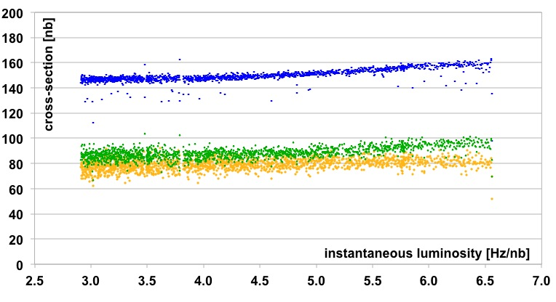
The goals
Take stock of where we are
  125.3 GeV boson discovered
  No signs of new physics
Get ideas of what we can do next
  In the very near future, when we can still alter triggers
  In the mid – term using data we collect now in core (350 Hz) and parked (300 Hz) datasets and consider whether to park even more (300 Hz)
And a bit about the longer term (in view of upgrades, ESPG and Snowmass)
  What should we focus on for the 13 TeV running ?
  What should be the focus of the upgrades?
  What do we think we can do with an HL-HLC, HE-LHC now that we have more experience with high pileup, for instance?
total
core
parking
Trigger xsecs vs L

Slide 4
Goals (continued)
Can we come up with an inspirational target (or two)?
  To help inspire the collaboration, by defining a broader program of work with a clear outcome either way?
    Higgs: find it or rule it out…
    E.g. Can we do something similar for naturalness in a meaningful way?
Finally, can we establish better communication lines with the theoretical community?
  To be sure we provide the results that are desired and information that is optimally useful?
  To make sure we take the best advantage of our data-taking.

Slide 5
LHC 2012 - summary
Mode | Days left
MD | 12
Technical stop | 5
Recovery from TS | 2
Scrubbing - 25 ns | 3
Proton running | ~131
Special runs | ~5
Ion setup | 4
Ion run | 24
TS3 moved to W38 17th September
Lost TS4 (effectively moved to Xmas)
End of proton run – 06:00 Monday 17th December
From - Mike Lamont: 11-07-2012

Slide 6
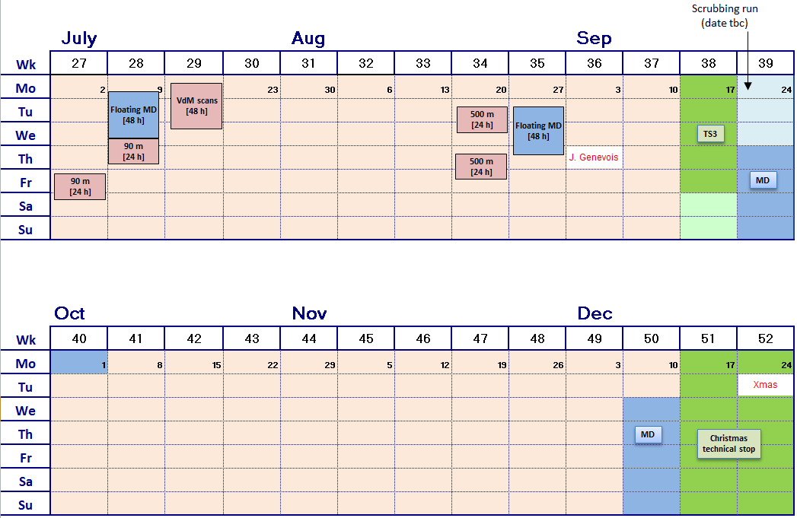
LHC 2012 Q3/Q4 - update
Place holders
From - Mike Lamont: 11-07-2012

Slide 7
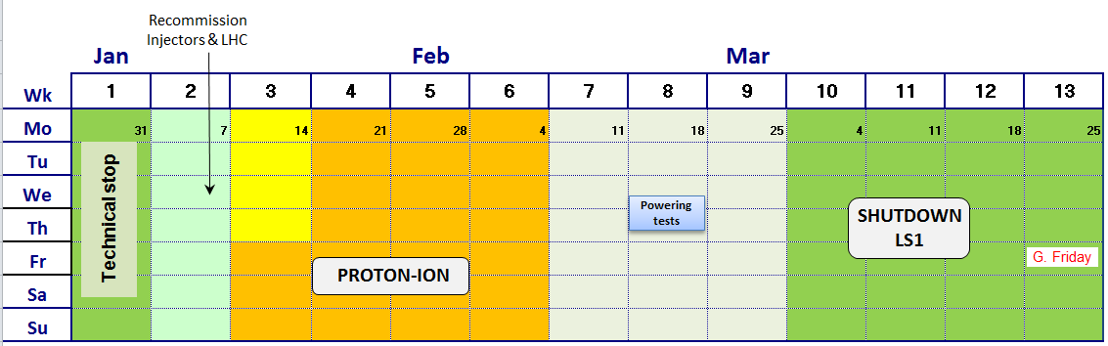
2013
End ion run 06:00
Minimum interventions before and during Xmas stop
Need both protons and lead (i.e. ion source, LINAC3, LEIR in addition…)
Non-LHC physics is not foreseen – flat line complex when beam not needed
Should foresee doing maximum p-A preparation before Christmas (pilot run, aperture measurements, test squeeze…)
From - Mike Lamont: 11-07-2012

Slide 8
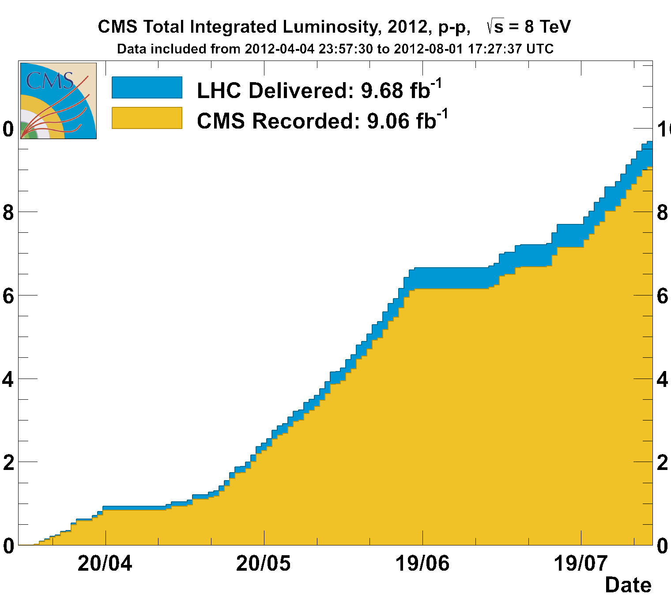
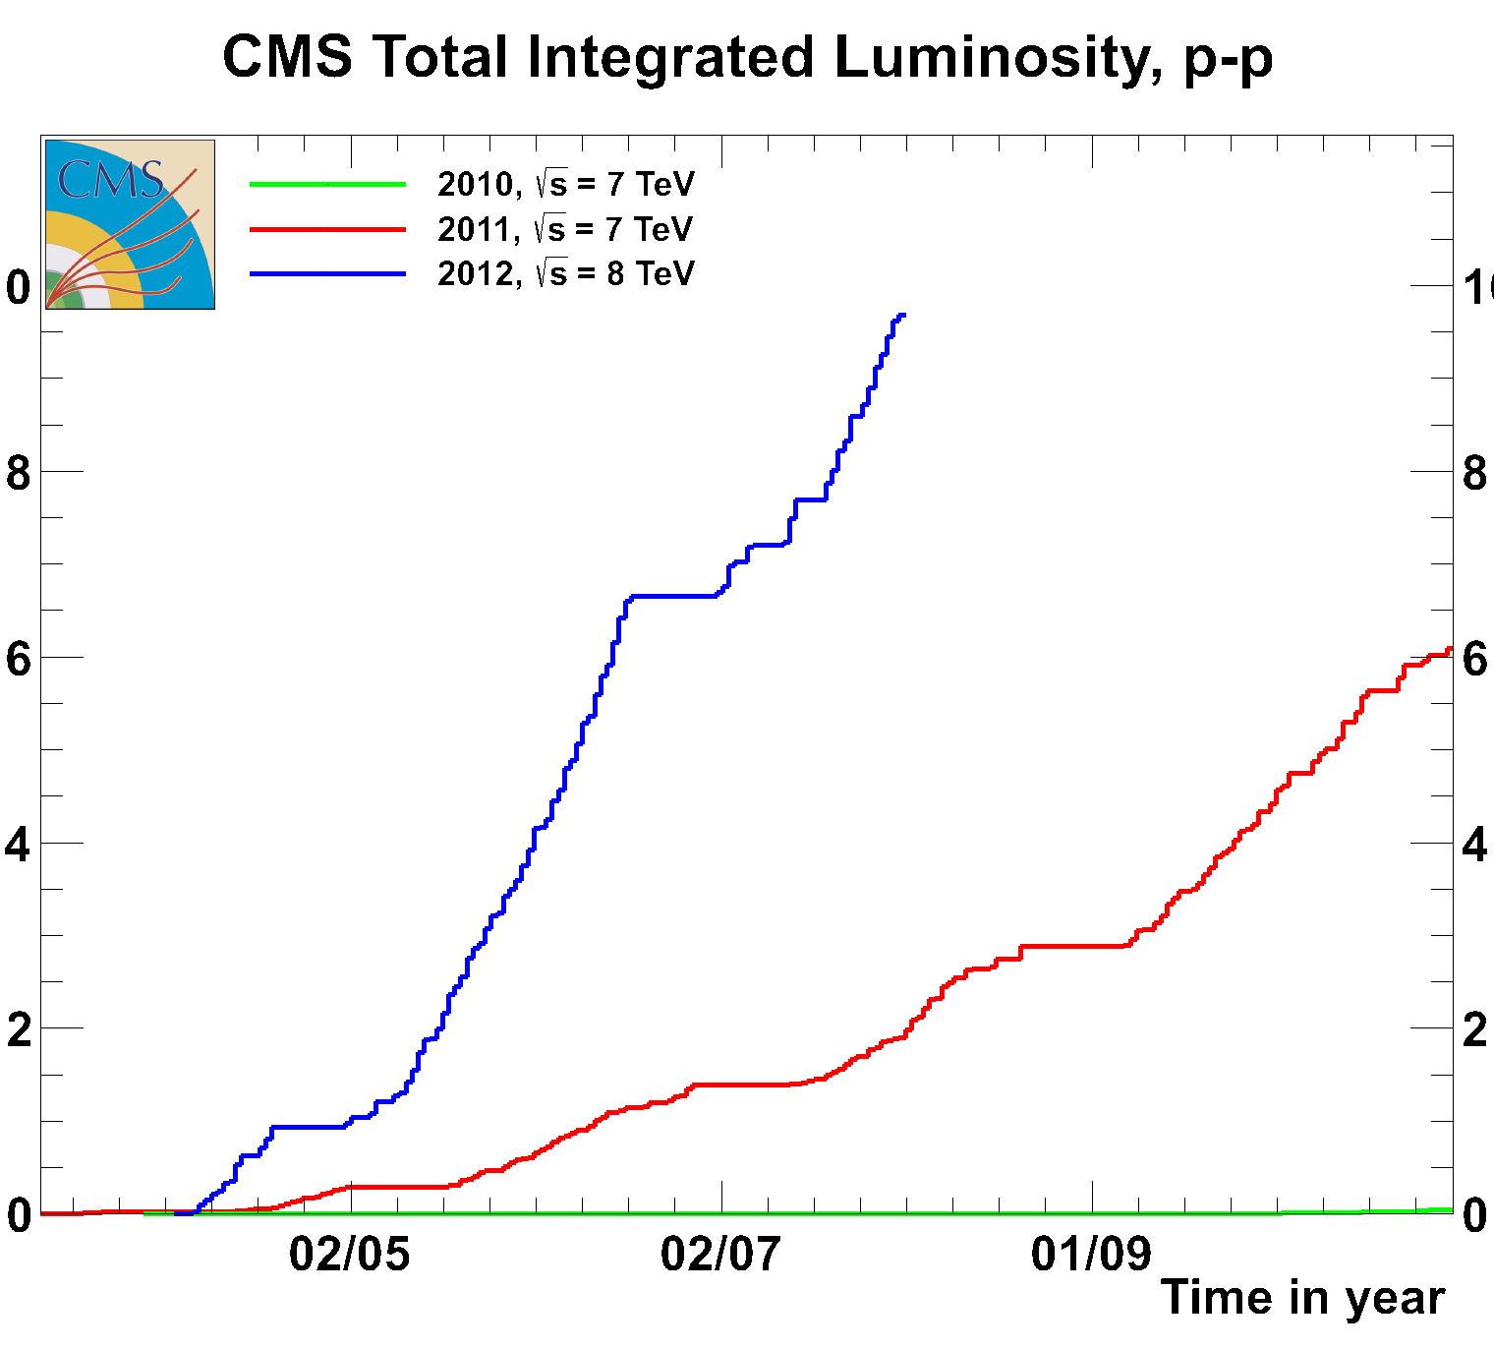
Status of CMS
Near to 10/fb so far in 2012
  Roughly 1-1.5 per week in steady running period
  Hoping for at least 25/fb this year

Slide 9
More from Greg

Slide 10
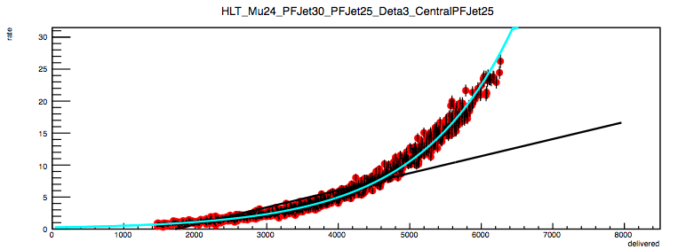
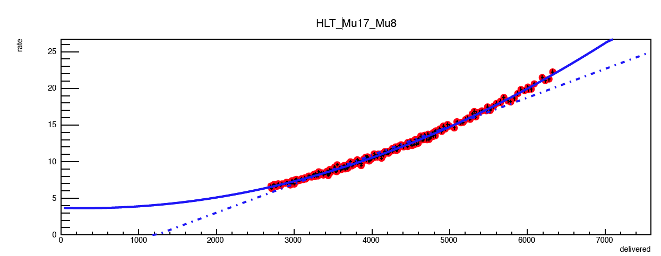
HLT status
isoMU24_PFJet30_PFJet25_Deta3_CentralPFJET25
rate
NB this trigger is in the shadow of isoMU24
V3.0 deployed with
  8, 7 and 6E33 columns (only 6E33 used so far)
  Added support to 5GeV GCT thresholds at L1
V4.0 is ready with
  Particle Flow Jet Energy Corrections
    Should improve PU dependence on some of the triggers using PFJets
  Few fixes and updates to remove some non linear dependency at high luminosity
    dZ filter reintroduced on Double Muon triggers, will reduce the overall rate and small PU dependency
  NB overall the HLT cross-section has already a pretty small PU dependency
In progress
  Improve monitoring and validation of the complex, non single-object triggers
delivered luminosity
Mu17_Mu8
rate
delivered luminosity
total
core
parking

Slide 11
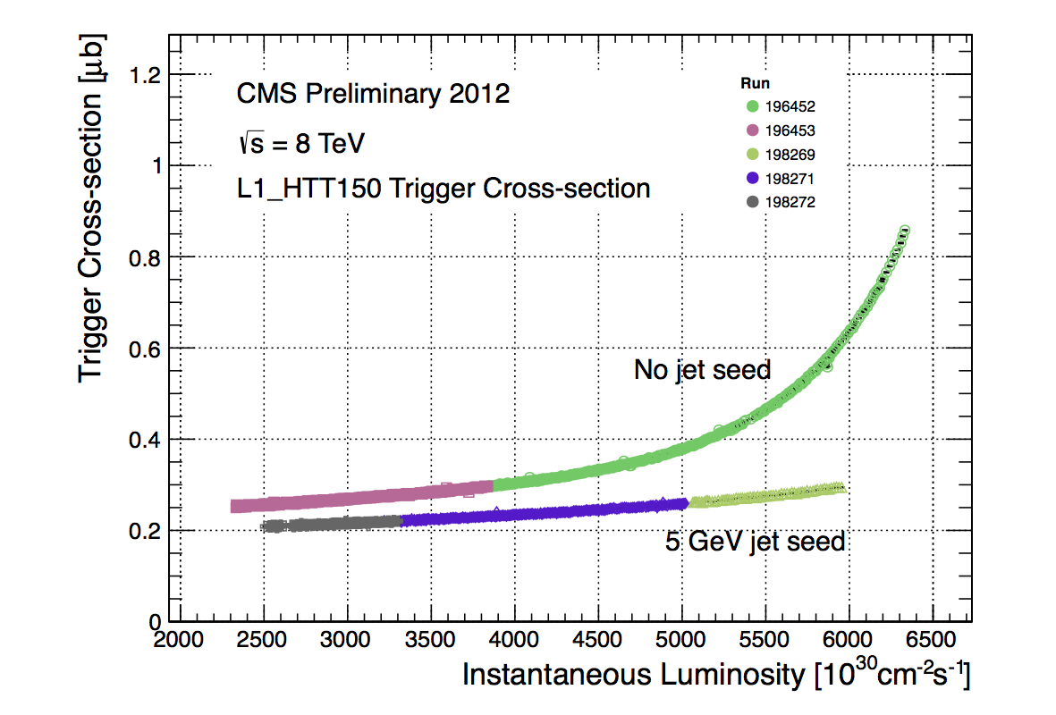
CMS L1 Trigger Status
Deployment of the new GCT jet
seed threshold has significantly
reduced the pile-up dependence
of the HTT trigger cross sections
  Nevertheless, still see high growth
  for PU>50… (i.e. L > E34)
The single μ trigger rates
have been reduced by ~15% with
the new usage of an eta flag in the DT/CSC overlap.
  Given these improvements, the L1 single muon trigger threshold has been reduced to 12 GeV with eta<2.1.
The total L1A rate with the 6E33 prescale column is very similar to that before the Tech. Stop.
Excellent performance of the L1 triggers shown at ICHEP →

