Slide 1
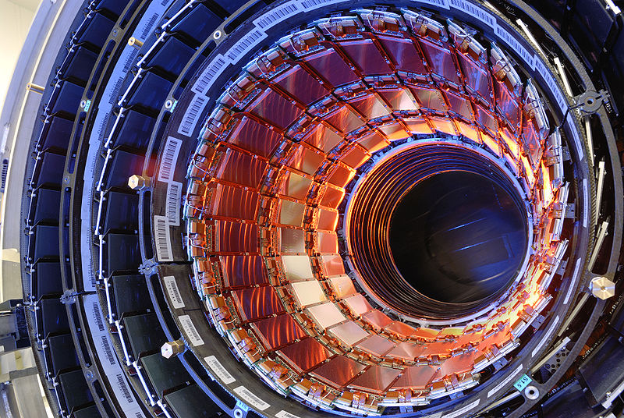
Silicon detectors in HEP
Enver Alagoz
ACCTR Meeting
18 August 2012

Slide 2
Introduction to silicon
Semiconductor material
  Used for radiation detection/imaging in
    Particle and nuclear physics experiments
    Space and ground-based telescopes
    Medical applications
    Industrial applications
    …
Interacts with radiation
  Radiation creates charge carriers
  Electric field drifts carriers toward readout electronics
  Signal integrated in frond-end electronics
  Digitize integrated signal
  Readout and store digital signal

Slide 3
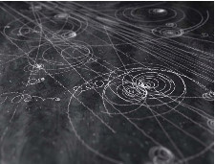
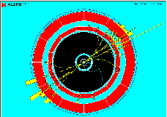
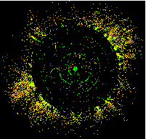
Particle reconstruction in time
Pre-silicon era
Why detectors change
  Interested in rare events
    in very high energies
    with very small uncertainties
    with very high background
Need high precision
  Very high granularity
  low material budget
High particle collision rates
  High speed electronics
  Good background tolerance
  Long term reliability
  Radiation hardness
1970s
Si + gaseous tracking
1990s
Si tracking+vertex+calorimetry
2010s
time

Slide 4
Gaseous vs silicon detectors
In silicon detector
    No multiplication → signal amplification needed
    Optimum thickness to minimize multiple scattering
Property | Gas | Silicon | Importance
Density | Low | 2.33 g/cm³ | Denser -> better spatial resolution
Charge | electrons and ions | electrons and holes
Ionization energy | 30eV per e- ion pair | 3.6 eV per e- hole pair | Lower -> better energy resolution
Mobility | 10 ns to 10 μs | few ns to 20 ns | Faster -> no dead time
Signal-to-noise | Low | High | Reliable signal

Slide 5
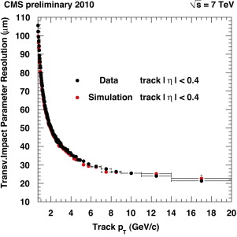


Vertex reconstruction
Outer Si layer
Outgoing particle
Inner Si layer
R1
R2
Impact parameter
Primary vertex
b
IP
If both layers have same spatial resolution (σ)

Slide 6
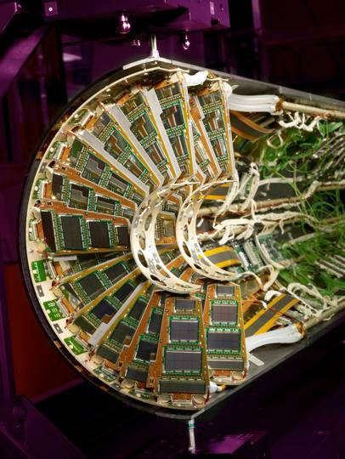
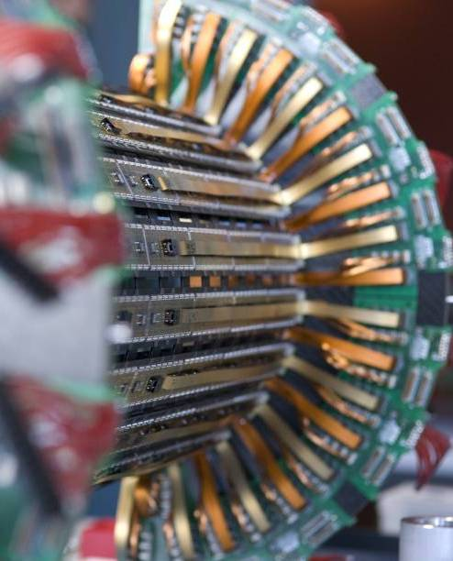
CMS pixel detector
Forward Pixel
Barrel Pixel

Slide 7
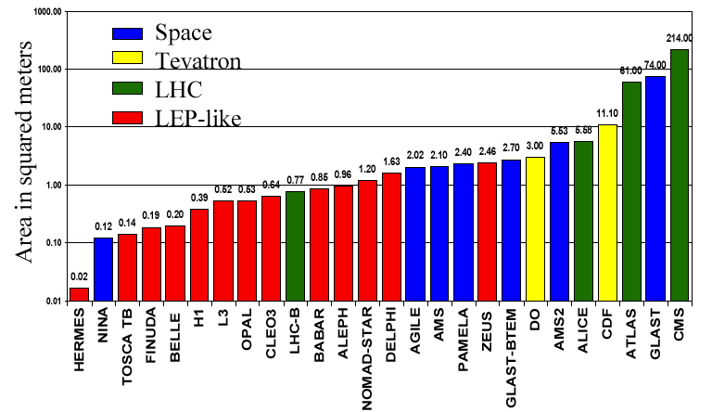
Silicon detectors in HEP
In HEP experiment
    Vertex reconstruction
    Fast detection and position resolution
    Experiments with silicon detector
E. Do Couto e Silva, Vertex 2000, Sept 10-15, National Lakeshore, MI, USA

Slide 8
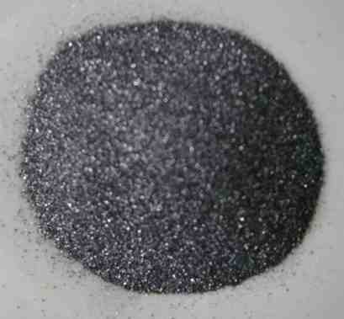
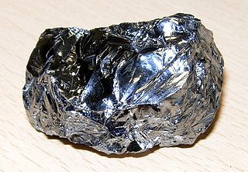
Why silicon?
2nd most abundant element in Earth (28% by mass)
Easy to process and purify to 0.001 ppb
Natural SiO₂ as insulation during fabrication
Found in form of silicate minerals and SO₂ (silica – sand)
Discovered in 1824 by Swedish chemist J.J. Berzelius
Commercially utilized since 1824
Silicon crystal
Silicon powder
Spectral lines of Silicon

Slide 9
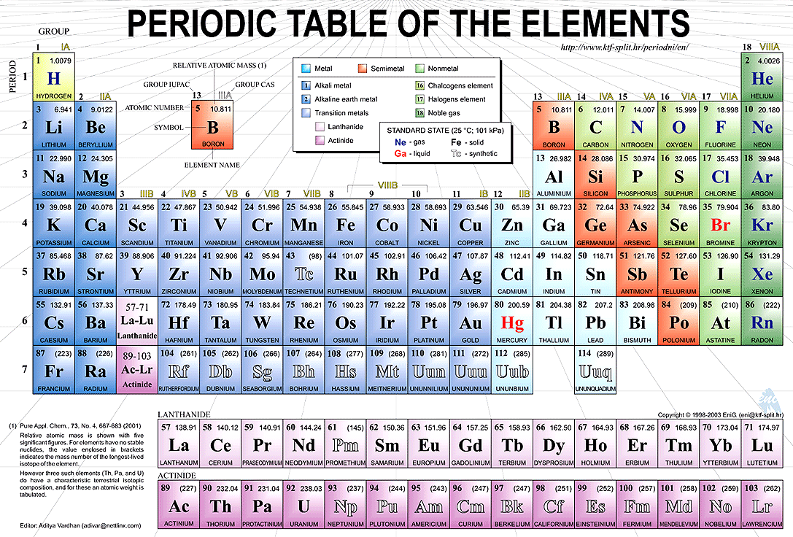
Silicon - ₁₄Si²⁸

Slide 10
Basic properties – Band gap
Insulator
Semiconductor
Conductor
Conduction band
Conduction
band
electrons
Conduction band
E_{g} ~ 6 eV
E_{g} ~ 1.12 eV
overlap
holes
Valance band
Valance band
Valance band

Slide 11
Basic properties
Very pure material
Charge carriers are created by
  thermal, optical, and other excitations or ionization
Four valance electrons (covalent bonds)
Silicon (Si) and Germanium (Ge) are common
Doped with extrinsic semiconductors
  N-type: excess electrons (e- donor), i.e. P, As etc.
  P-type: excess holes (e- acceptor), i.e. Al, B, Ga, etc.

Slide 12
Silicon PN-junction
Silicon detector are in basic form of PN-junction
N-doped silicon
P-doped silicon
E_{C}
Conduction band
Conduction band
N-type: Phosphorus
P-type: Boron
E_{g} : Band gap (1.12 eV)
E_{F}
E_{g}
E_{F}
E_{V}
Valance band
Valance band
Si
Si
Si
Si
Si
Si
Si
Si
Excess electron
Si
-
Si
Si
+
Si
Excess hole
Si
Si
Si
Si
Si
Si
Donor impurity
Acceptor impurity

Slide 13
Silicon pn-junction formation
x=0
P-type
neutral
N_{A}
N_{D}
N-type
neutral
N,P
Carrier
concentration
P
N
N_{A}: # of acceptor impurities
N_{D}: # of donor impurities
N_{A}
N_{D}
x
ρ(x)
Charge density
eN_{D}
eN_{A}
x
Electric field
E(x)
x
Φ(x)
Coulomb potential
x
d_{P}
d_{n}
Depletion zone

Slide 14
PN-junction bias schemes
W_{F}
W_{E}
N
P
N
P
E
E
_
+
V_{F}
V = 0
W_{F} : depletion width at forward bias
W_{R} : depletion width at reverse bias
W_{E} : depletion width in equilibrium
W_{F} < W_{E} < W_{R}
W_{R}
N
P
E
Reverse bias scheme is used for silicon
detectors in HEP
+
_
V_{R}

Slide 15



A real life case
Larger active area provided by n(p)-type subtstrate
Depletion with
n+
Resistivity
depleted zone
_
depletion
p-type
substrate
V_{R}
t (thickness)
+
Depletion voltage
E
undepleted zone
p+
Effective doping concentration

Slide 16
PN-junction current
W_{F}
Current
N
P
N
W_{R}
P
_
+
V_{F}
+
_
Forward current
V_{R}
V_{breakdown}
Voltage
Reverse current
(leakage)
Avalanche current
I_{PN} α T^{3/2} exp[-E_{g}/2k_{B}T]

Slide 17
Leakage current
Current α T^{3/2} exp[-E_{g}/2k_{B}T]

Slide 18

Breakdown voltage
Extracted from capacitance measurements
W = t
V_{FD}

Slide 19


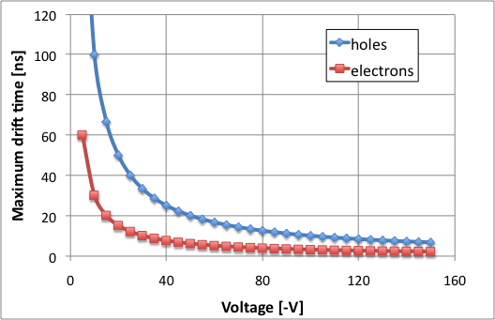
Charge collection
Carriers are drifted under the electric field
μ_{e-} = 1500 cm²/Vs
μ_{h} = 450 cm²/Vs
Total drift time for a carrier created at depth x
V_{B} = applied voltage
V_{FD} = full depletion voltage
d = detector thickness
Maximum drift time (V_{B} >> V_{FD})
For d = 300 μm ➔

Slide 20
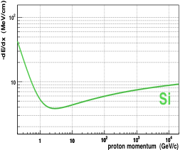
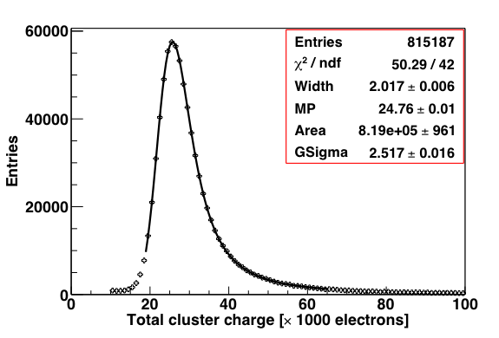
Radiation detection
Ionization energy loss:
Ionization loss follows Landau statistics
Average energy loss is 390 eV/μm of Si
Average charge is 108 e-h/μm of Si
Most probable charge 80 e-h/μm of Si
  24 ke in 300 μm thick Si
Most ionizing particle = Landau MP

Slide 21
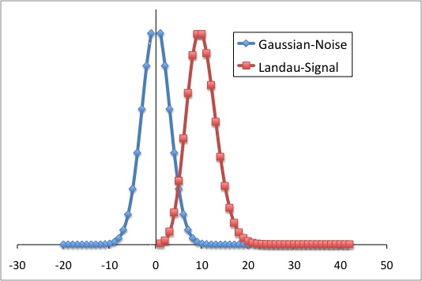
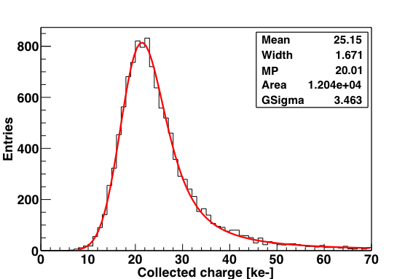
Signal-to-Noise (S/N)
Signal is Landau, noise is Gaussian
Most probable signal
S/N
=
Noise
Landau+Gaussian fit
Ionization energy loss follows
Landau statistics
Random electronic noise centered
at zero is Gaussian

Slide 22
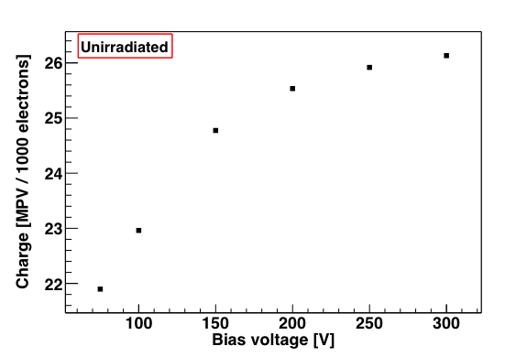
Charge vs applied bias
Collected charge increases until full depletion is reached
n+
_
depleted zone
depletion
t (thickness)
V_{R}
+
E
300 um thick
Silicon detector
undepleted zone
p+

Slide 23

Silicon wafer fabrication
Hyper-pure polysilicon chunks
Melt and add impurity to make
n-type (P) or p-type (B)
Pour into a mold to make a
polysilicon cylinder
Melt onto a mono-crystal silicon
seed by means of RF power
Seed and melted polysilicon
rotations are opposite to grow a
round shape mono-crystal ingot
Employ a grindwheel to form the
ingot into a desirable diameters
Cut ingot into wafers by means
multi-wire-sawing
Lapping to flatten wafers
Chemical etching to smoothen
wafers
Edge rounding for wafer robustness

Slide 24
Device processing
Boron implantation (p+)
UV light
n-Si
mask
800-1200 °C
SiO₂
Phosphor implantation (n+)
600 °C
etching SiO₂
n-Si
p+
p+
n+
Photo-resist layer
metal
metal
n-Si
p+
p+
n+
metal
1D silicon strip detector

Slide 25
Principle of operation
n+
+
-
+
-
+
-
+
-
E
+
-
substrate
+
-
+
-
+
-
1
4
+
-
2
3
p+
Preamplifier: amplifying small sensor signal
Pulse shaper: improving signal-to-noise ratio by filtering signal and attenuating electronic noise
Analog-to-Digital Converter (ADC)
Buffer: Store data
Front-end electronics add noise to signal (smearing). Low noise readout is essential

Slide 26
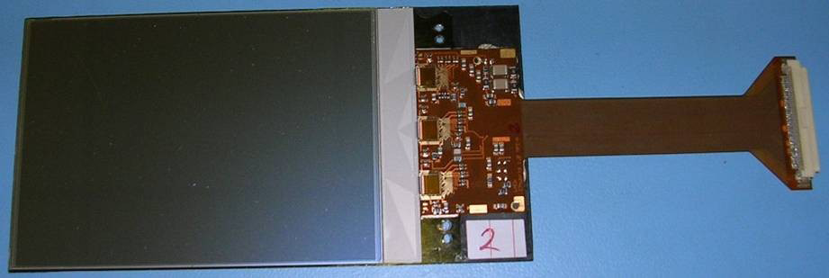
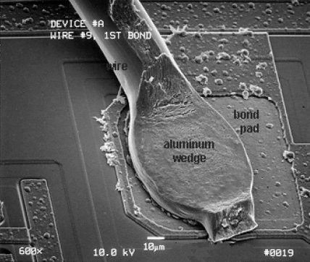
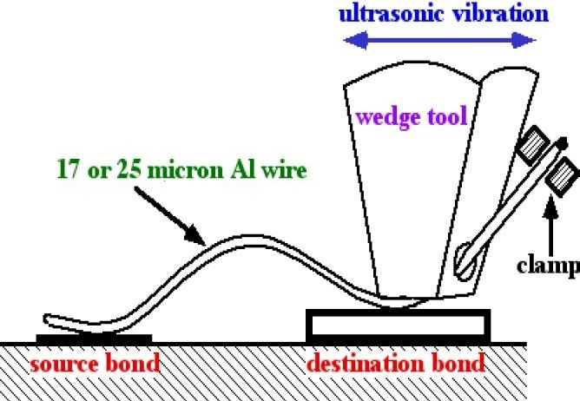
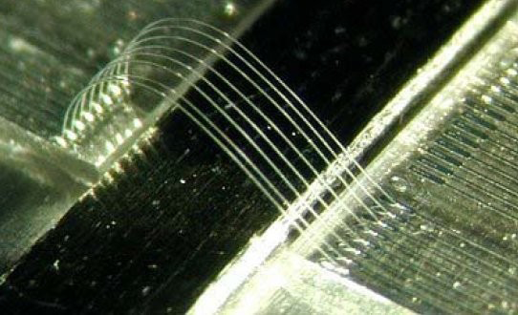
A silicon strip detector
Strip sensor
Readout electronics
Wire bond (SEM image)
Wire bond
mechanism
Wire bonds

Slide 27



Position resolution
particle track
pitch
n+
Pad sensor
E
p+
particle track
pitch
Charge interpolation improves spatial resolution
n+
n+
e-
Segmented sensor
E
p+

Slide 28
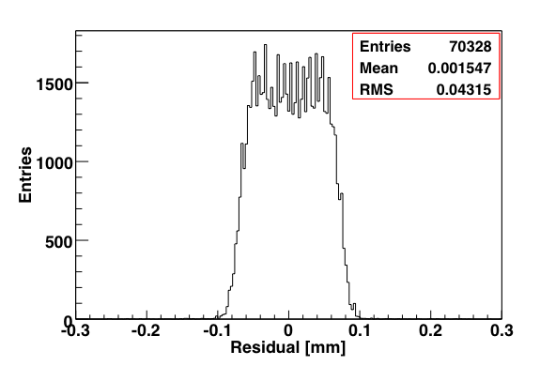
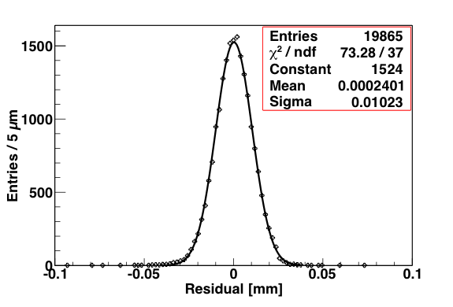
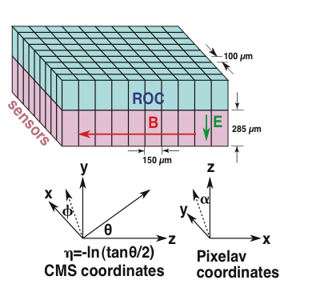
Position resolution
Charge interpolated spatial resolution
Binary spatial resolution

Slide 29
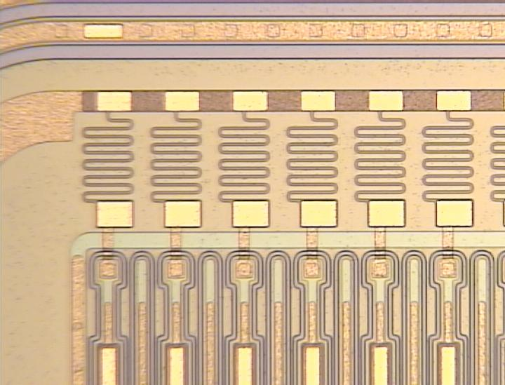
Microstrip detectors (1D)

Slide 30
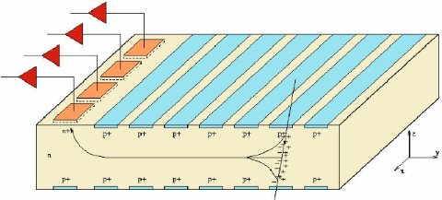
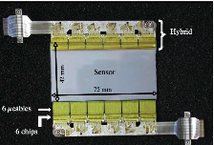
Silicon drift detector (SSD)
ALICE SSD module

Slide 31
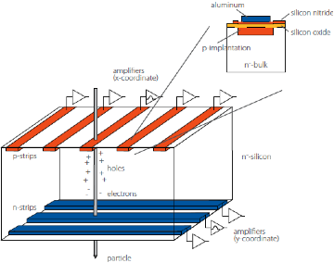
Double-side strip detector

Slide 32
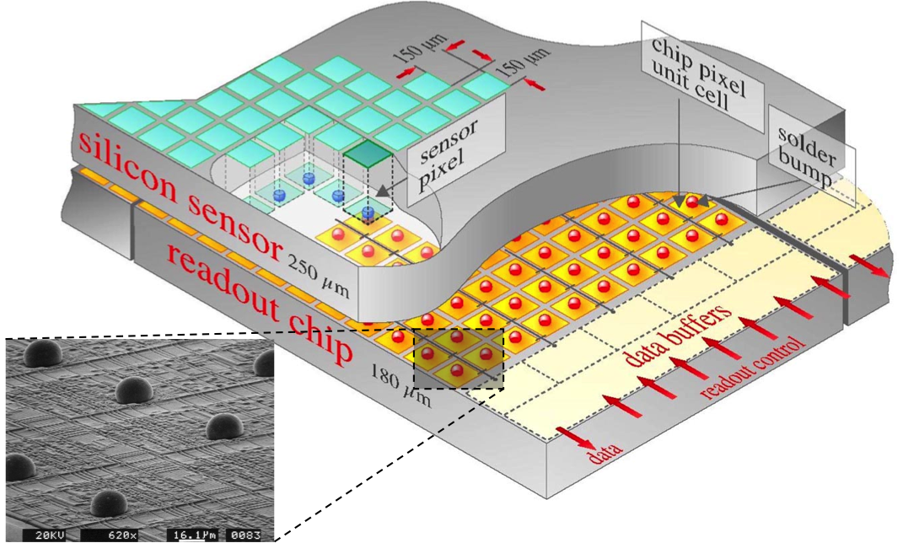
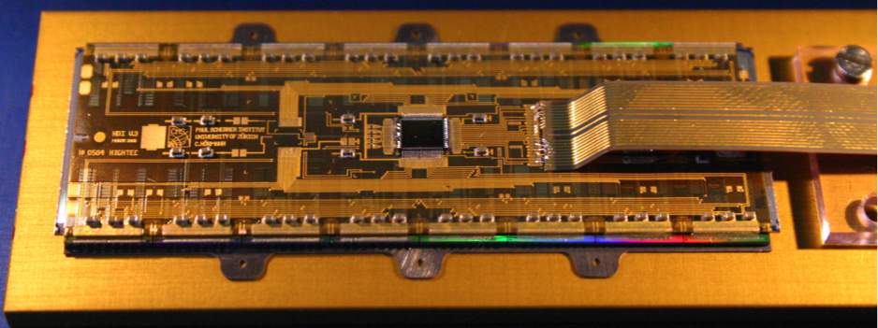
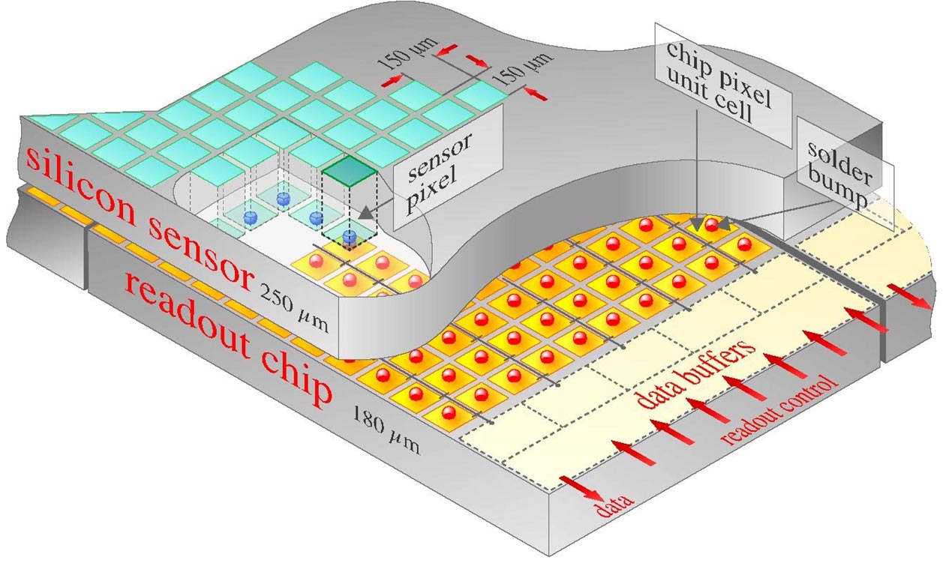
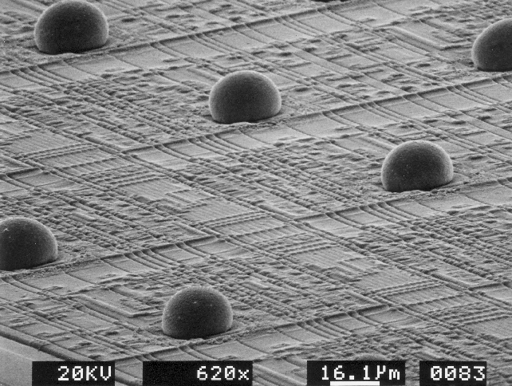
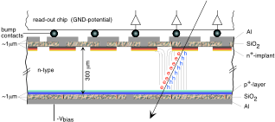
Pixel detector
CMS BPIX module
CMS barrel pixel detector

Slide 33
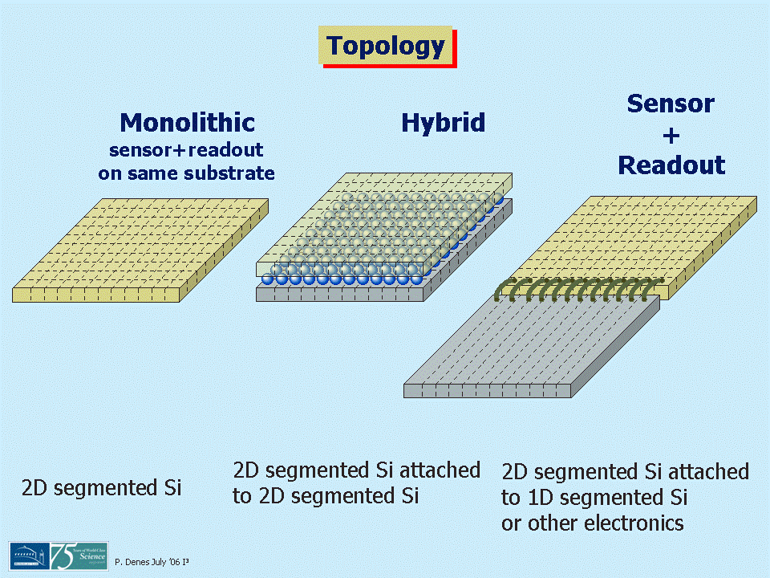
Detector topology
Marco Battaglia
Marco Battaglia, EDIT 2012, Silicon Track, February 2012

Slide 34
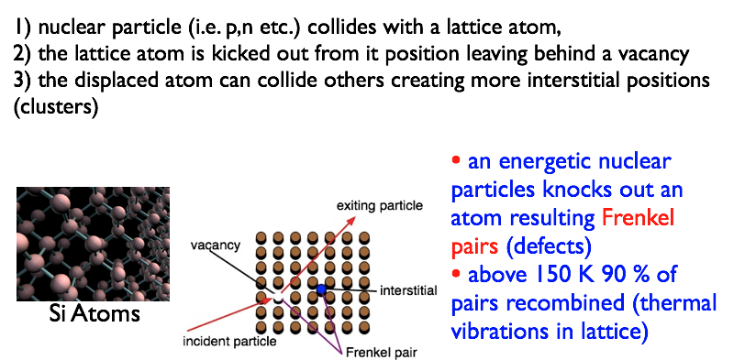
Radiation damage

Slide 35
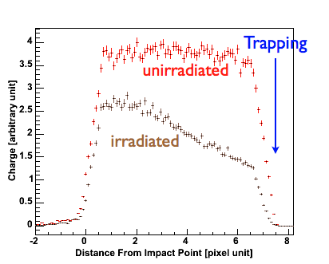
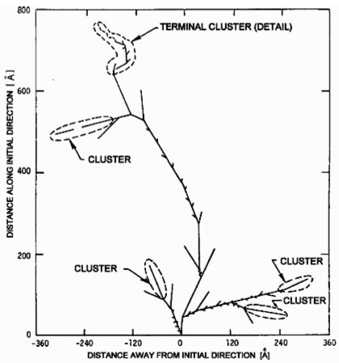
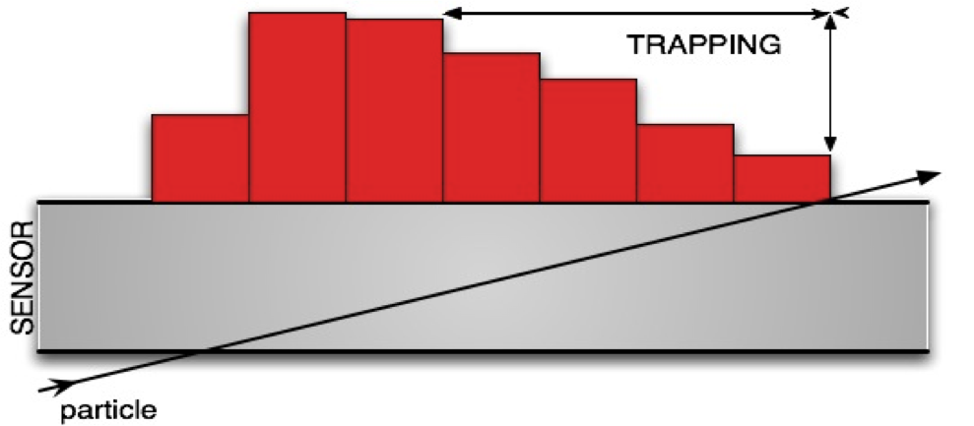
Radiation damage
Recoil after 1 MeV neutron collision
Radiation induced damages
cause severe signal losses across
sensor thickness
Signal loss can be covered partially
by increasing high voltage
But high voltage
degrades the position resolution

Slide 36
Radiation damage effects
Leakage current increases ΔI = α Φ V
  ΔI change in current in volume V
  α is damage constant
  Φ is time-integrated radiation flux
Depletion voltage increases
V_{FD} = q|N_{eff}|d² /2εε₀
  N_{eff} = |N_{donor}-N_{acceptor}|
  εε₀ permittivity
  d is sensor thickness
Charge collection degrades
Position resolution degrades

Slide 37
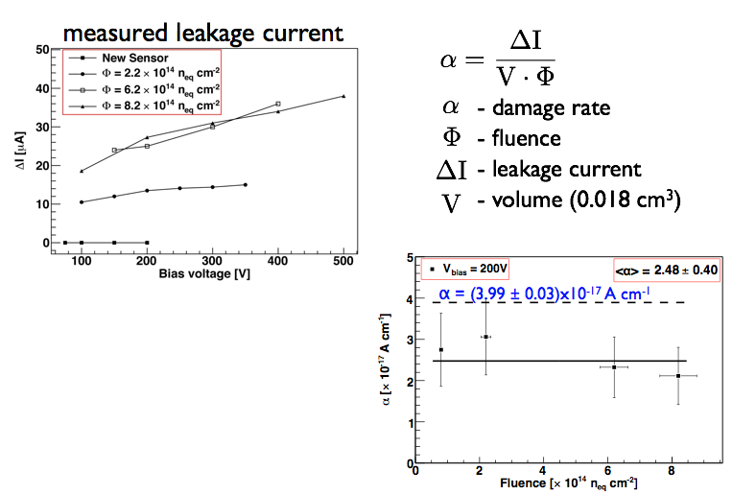
Radiation damage – leakage current

Slide 38
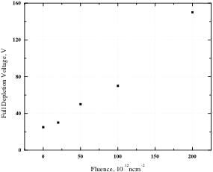
Radiation damage - V_{FD}

Slide 39
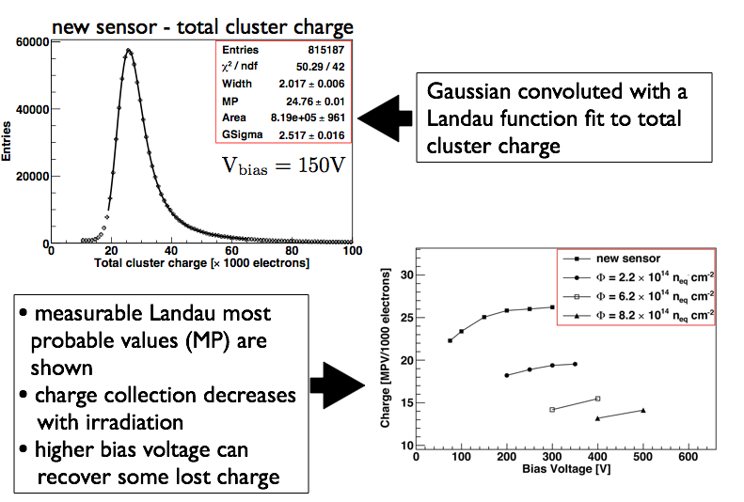
Radiation damage – charge collection

Slide 40
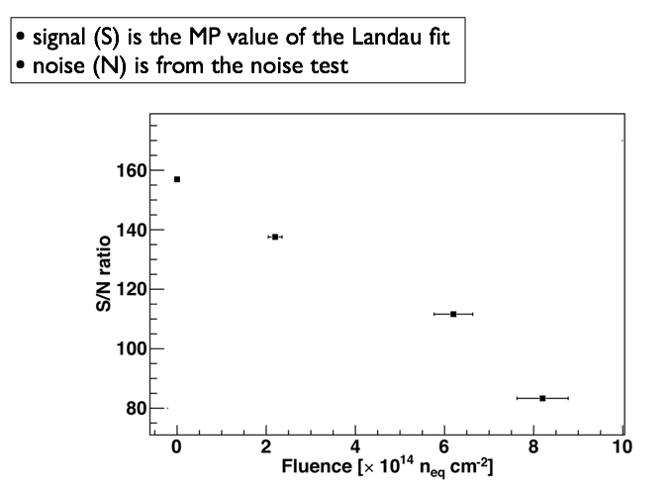
Radiation damage – S/N

Slide 41
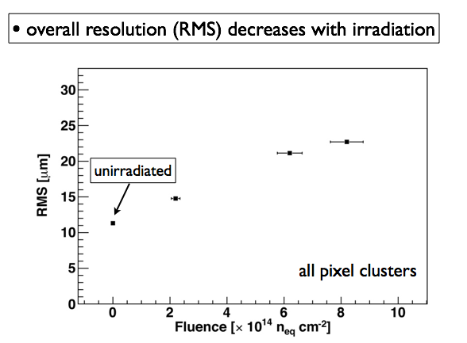
Radiation damage – spatial resolution

Slide 42
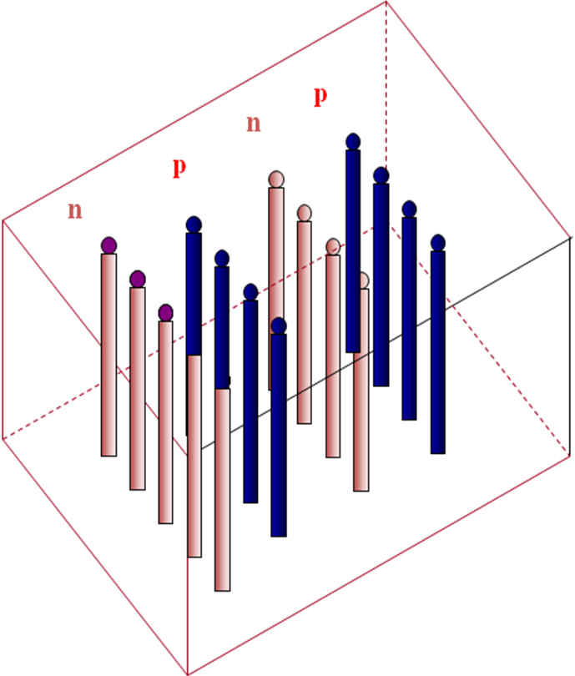
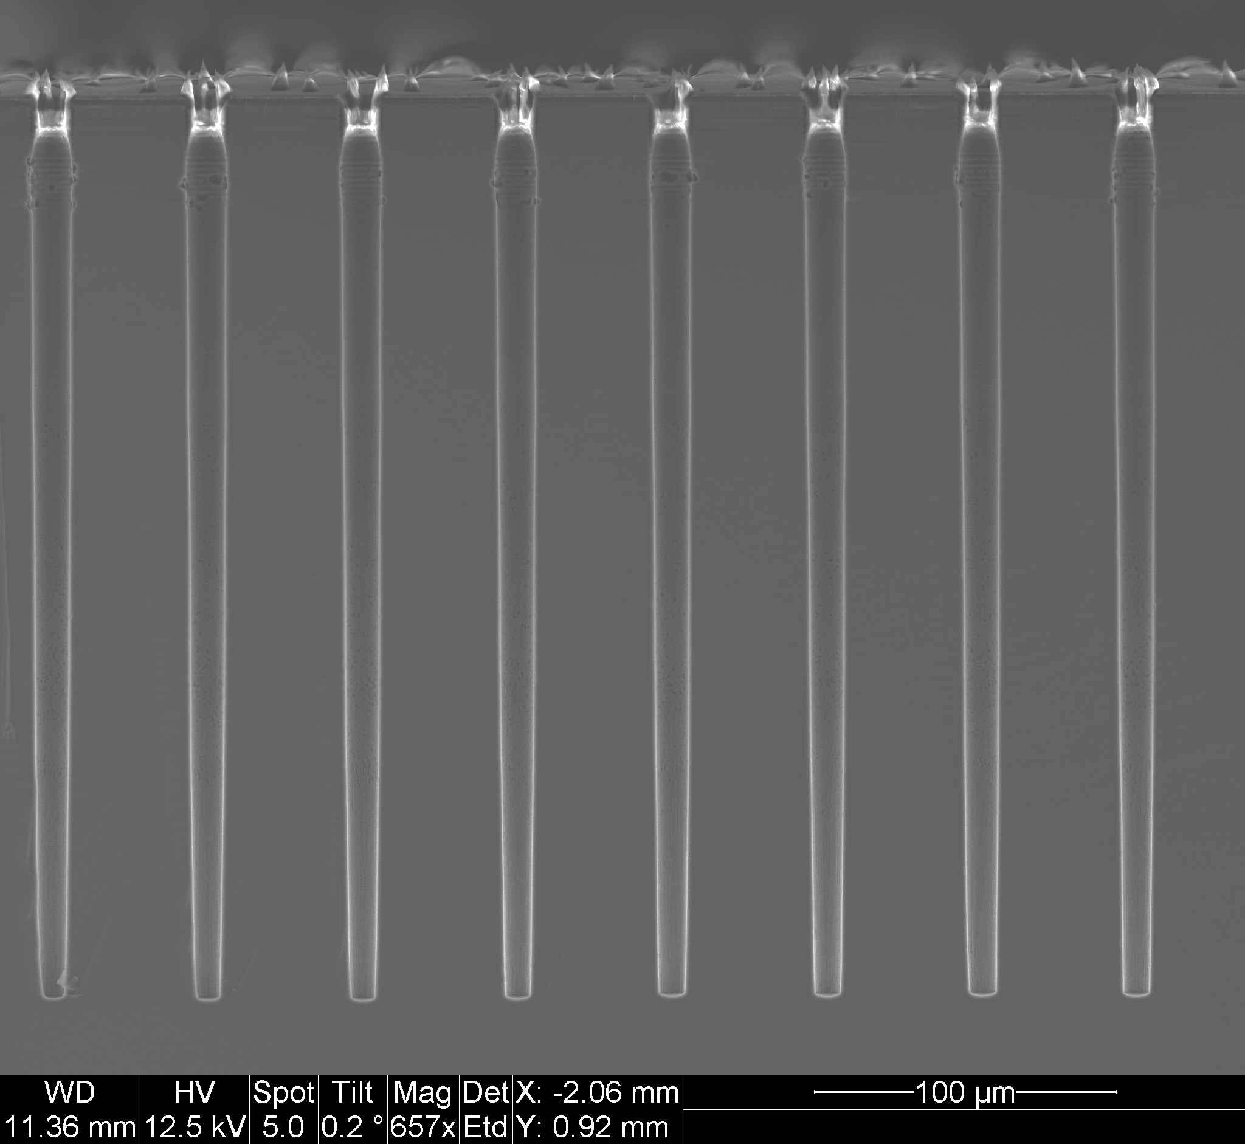
Radiation harder approaches – 3D
p+ and n+ electrodes are arrays of columns that penetrate into the bulk
Lateral depletion
Charge collection is sideways
Superior radiation hardness due to smaller electrode spacing:
- smaller carrier drift distance
- faster charge collection
- less carrier trapping
- lower depletion voltage
Higher noise
Complex, non-standard processing
SEM picture of 3D electrodes
depletion
ionizing particle
p+
n+
PLANAR:
3D:
n+
depletion
e
300µm
p-type
p-type
h
p+
50µm

Slide 43
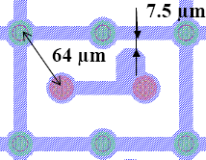
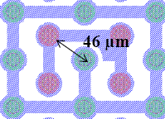
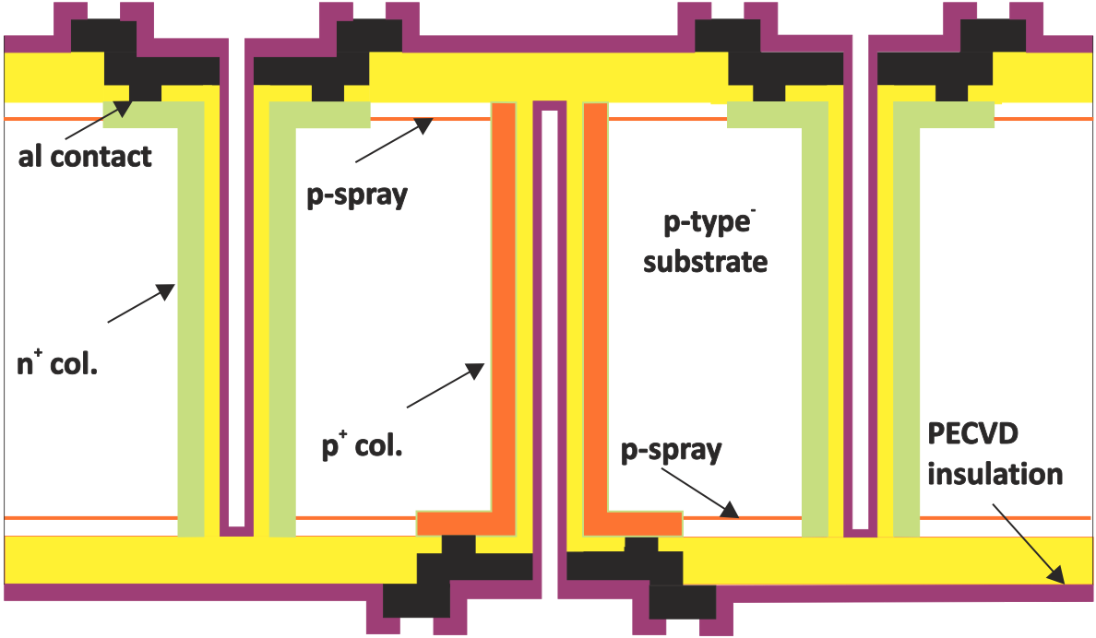
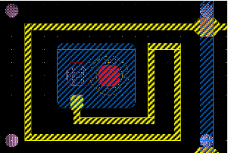
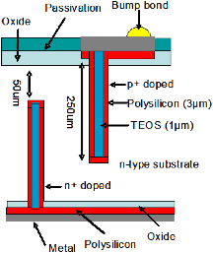

Radiation harder approaches – 3D
2E Configuration
4E Configuration
n+ (readout)
p+ (bias)
SINTEF 3D
(200 μm thick)
Single-side etching
100 μm
150 μm
1E Configuration
FBK 3D (200 μm thick)
CNM 3D (200 μm thick)
Double-side etching
Double-side etching

Slide 44

COMPLEXITY – CMS Tracker

Slide 45
References
Sze, Physics of semiconductor devices, 2nd Edition
Helmuth Spieler, Semiconductor Detector Systems
Olaf Steinkamp, Experimental Methods of Particle Physics, 2011
Enver Alagoz, Simulation and beam test measurements of the CMS pixel detector, PhD Thesis, 2009
Daniela Bortoletto, An introduction to semiconductor detectors, Vienna Conference, VCI 2004

