Slide 1



DC Spark Developments
Nick Shipman - Thursday, 16 August 2012

Slide 2
The High Repetition Rate (HRR) System

Slide 3
The High Repetition Rate System
Key Features
Repetition rates of up to 1kHz
Voltages up to 12kV (20um gap → 600 MV/m)
High Bandwidth <= 10ns
Uses solid state switch
Coaxial cables, and matched impedances used throughout
Energy is stored on a 200m long spool of coaxial cable, the “Pulse Forming Line”or PFL.
Replaces old 0.5Hz mechanical relay.

Slide 4
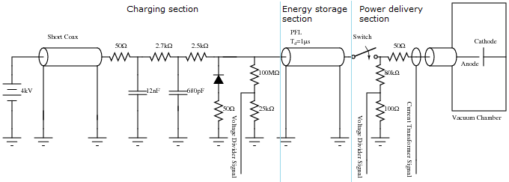
The High Rep Rate System
The circuit diagram of the HRR system. It can be thought of as consisting of three parts: the charging section; the energy storage section; and the power delivery section.

Slide 5
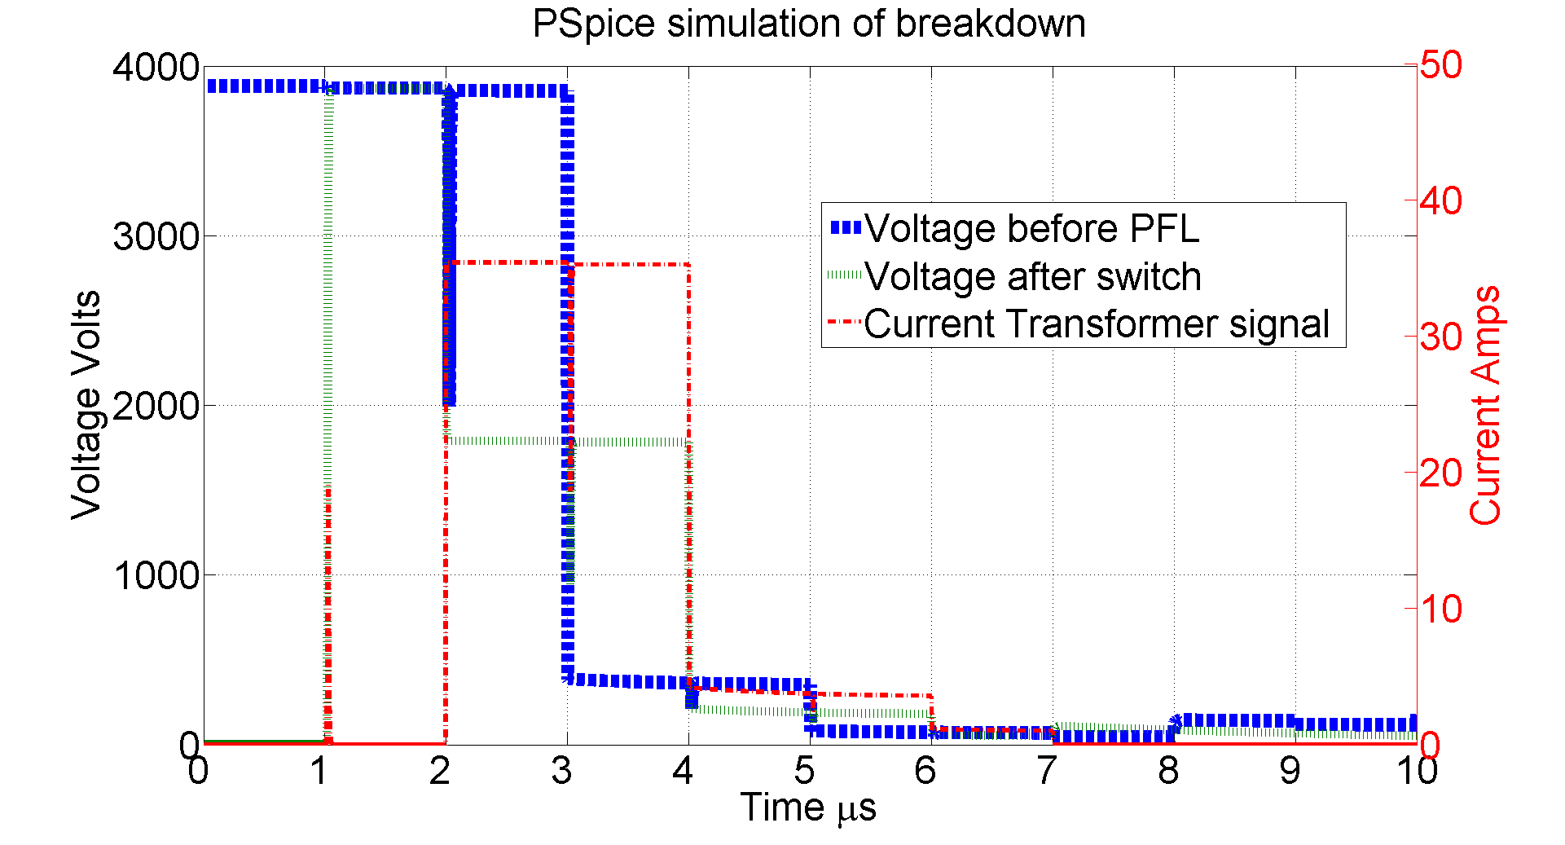
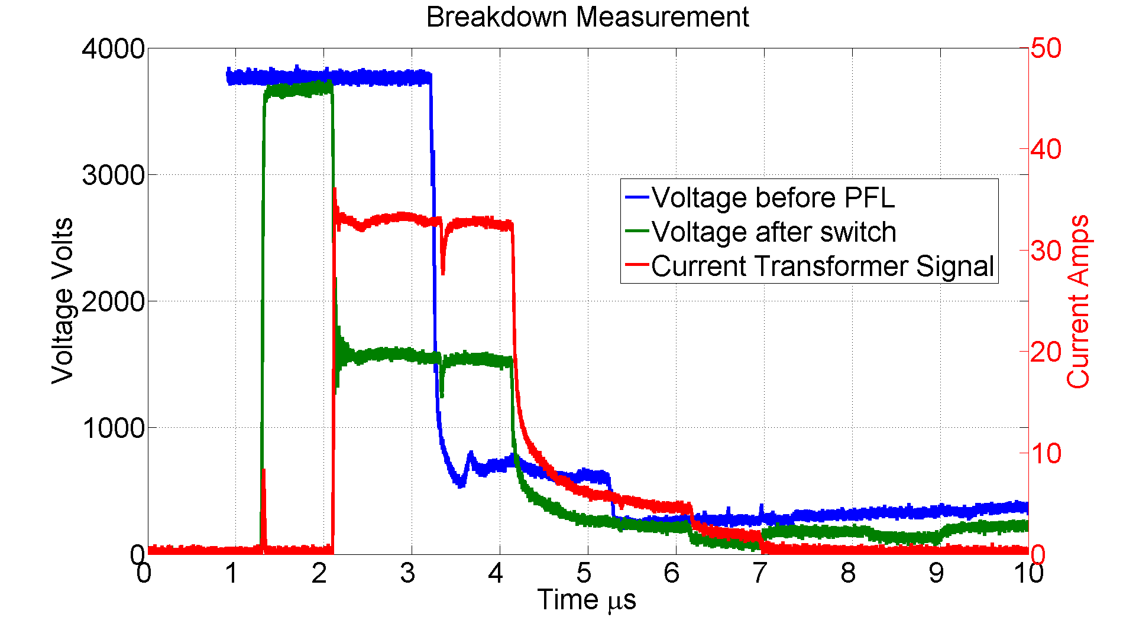
The High Rep Rate System
PSpice simulation of the HRR circuit during a breakdown. The switch is closed at 1us and the breakdown occurs at 2us.
Measured voltage and current signals in the HRR circuit during a breakdown. The switch is closed at 1us and the breakdown occurs at 2us.

Slide 6
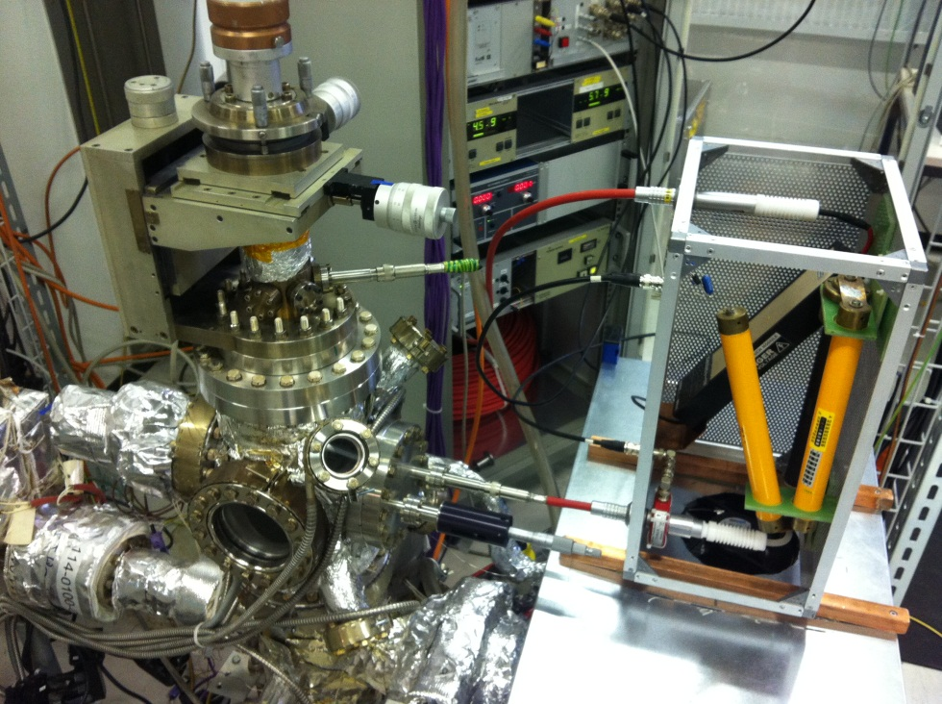
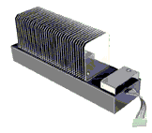
The High Rep Rate System
The picture below shows the HRR system. The metal box housing the switch is placed as close as possible to the vacuum chamber to minimise stray capacitance.
The solid state switch used is the Behlke 181 25-B, which can operate at 1.8kHz handle an open voltage of 18kV and a peak current of 250 Amps.

Slide 7
The High Rep Rate System
Problem with power dissipation
Whilst the switches can handle a high, >100A peak current they can only tolerate a relatively low average current ~3A.
We seemed to fall foul of this a couple of times which resulted in broken switches.
Now a new average current interlock has been designed, built and added to the switch controller.

Slide 8
The Fixed Gap System

Slide 9
The Fixed Gap System
Key Features
Uses disc shaped electrodes with a large active surface area ~50 cm^2
Gap size is fixed eliminating the need for measurement.
Gap size accurate to less than 1um across entire surface, even under large E-field stress (total forces of up to 500kg).
4 pick up antenna and 4 viewports
Very compact, diameter ~30cm height ~30cm.
Electrodes are interchangeable.
Ceramic spacer is interchangeable allowing different gap sizes to be selected.

Slide 10
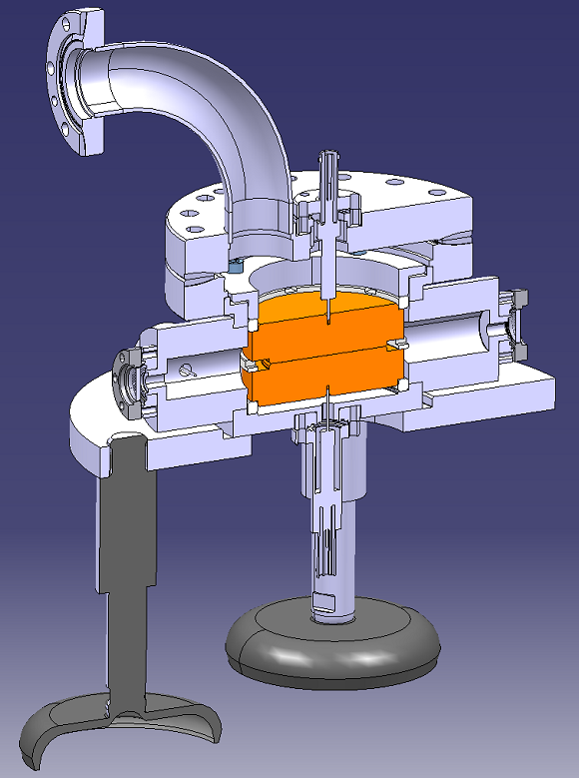
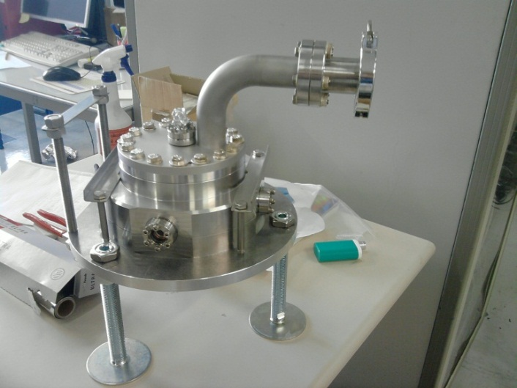
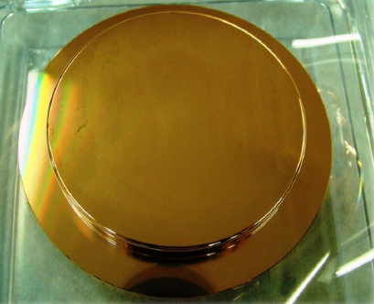
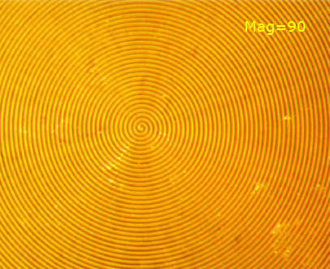
The Fixed Gap System
Despite the comparatively large size of the anodes, the system is very compact. Four antennas are included in the design to pick up the radiation from breakdowns.
The surface of the electrodes are 80mm in diameter and have a surface tolerance of <1um. The picture on the right shows the high precision turning.

Slide 11
Non-contact gap measurement

Slide 12
Non-contact gap measurement
Key Features
For use with the tip and plane geometries of System 1 and 2, not needed for fixed gap system.
Measures the absolute distance between the electrodes without them coming into contact.
Relies on the accurate measurement of the very small capacitance between electrodes.
A computer controlled stepper motor allows the measurement to be made automatically.
Has been tested successfully in air and is now been installed on system II.
Anode
Gap
Cathode

Slide 13
Measured Turn on Times

Slide 14
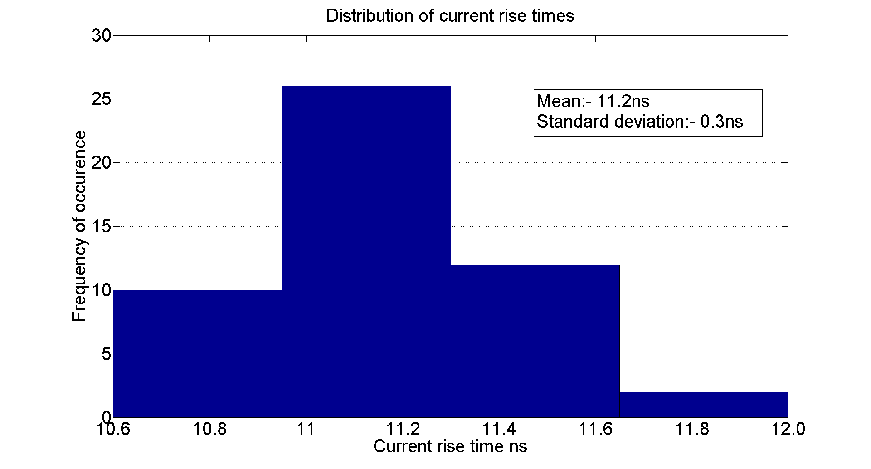
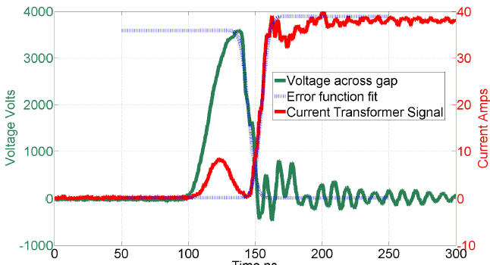
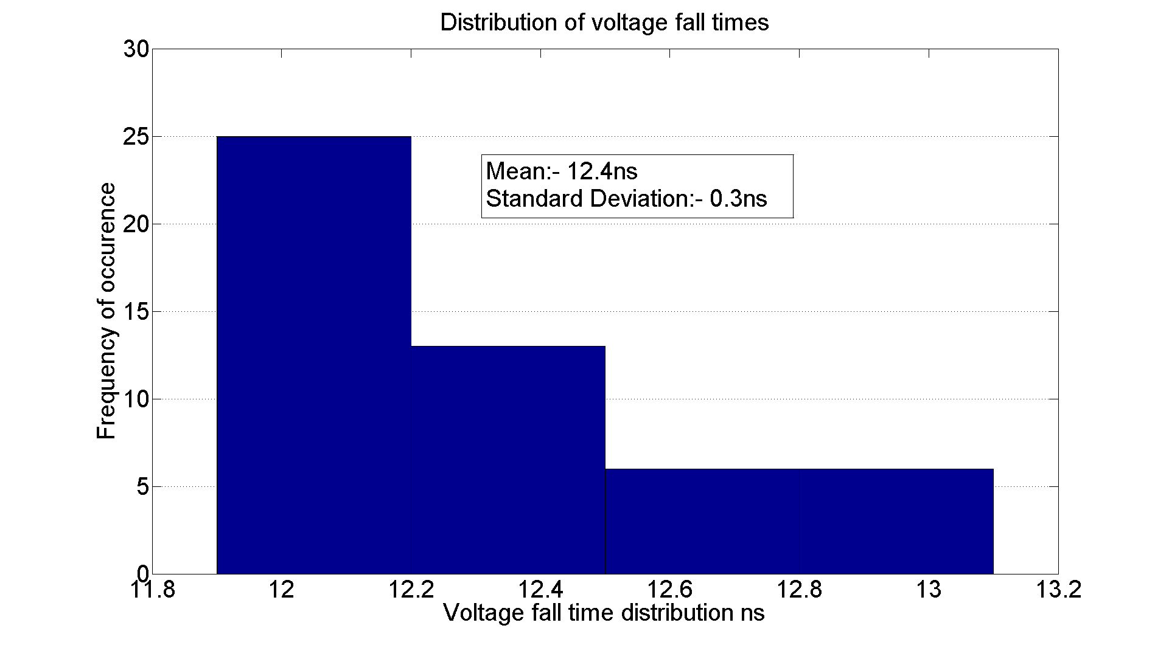
DC Spark System Turn on Time
Sample size = 50
The spread in voltage fall times (and current rise times) is extremely small compared to the RF case.
The measured current rise time always shorter than voltage fall time due to initial charging current overlap.

Slide 15
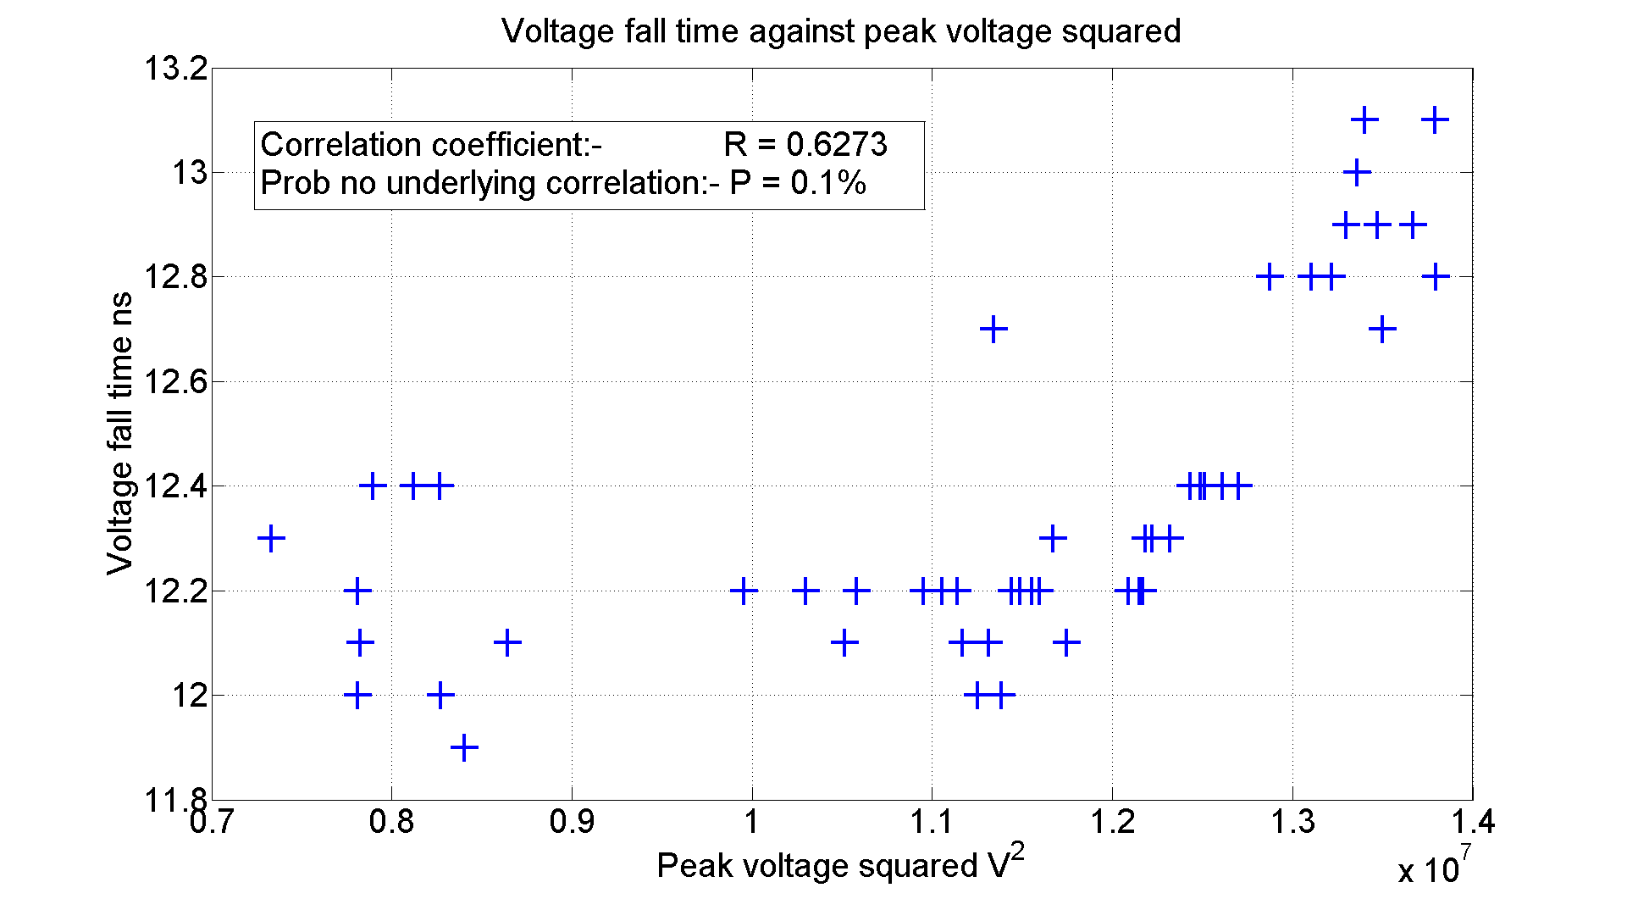
The power supply was always set at 4kV. However a breakdown often occurred before the voltage across the gap had reached this value.
The higher the gap voltage immediately before breakdown the longer the slope.
I had not expected to see any correlation as I expected the tiny variation in breakdown times to be dominated by noise or error.

Slide 16
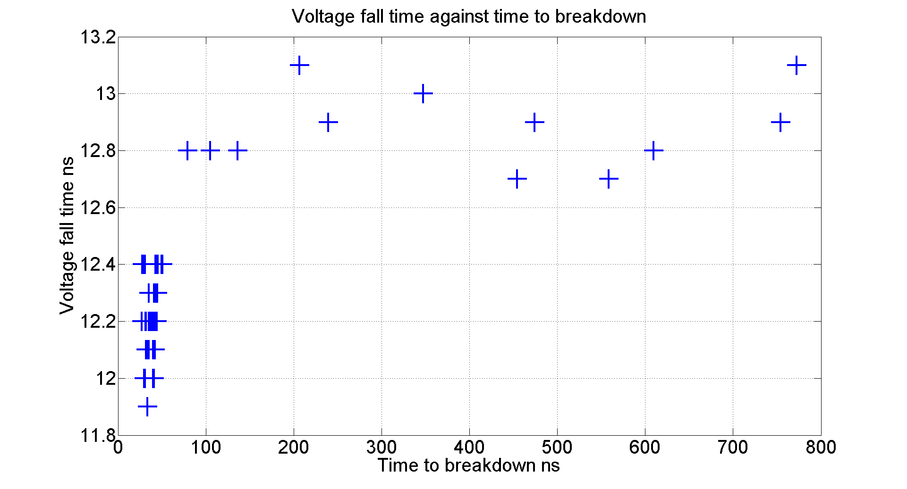
Where breakdowns occur very early the voltage across the gap is still charging up resulting in an increase in fall time.
Once the voltage across the gap is fully charged there is no discernible difference in the voltage fall time.

Slide 17
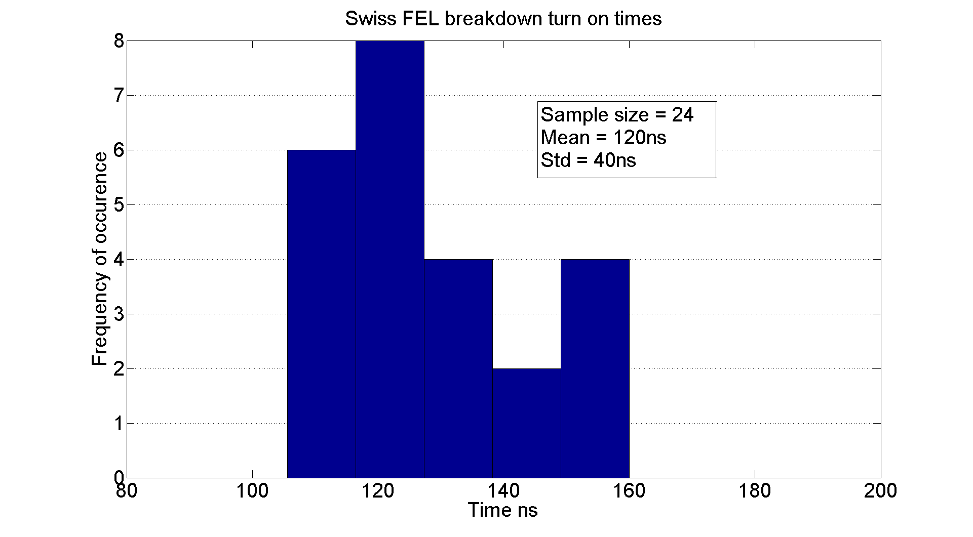
Measured Turn on Times
The Swiss FEL turn on times are much longer than in the DC case and the variation is much greater, this is keeping with other RF breakdown turn on time measurements.

Slide 18
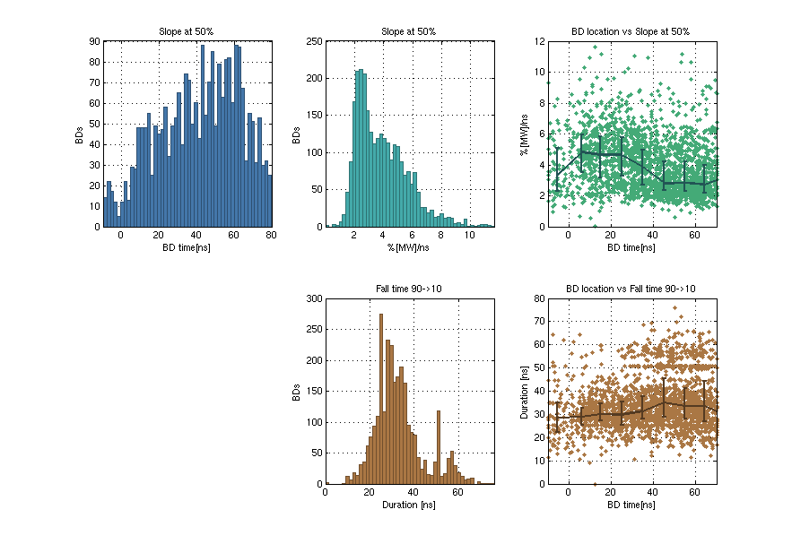
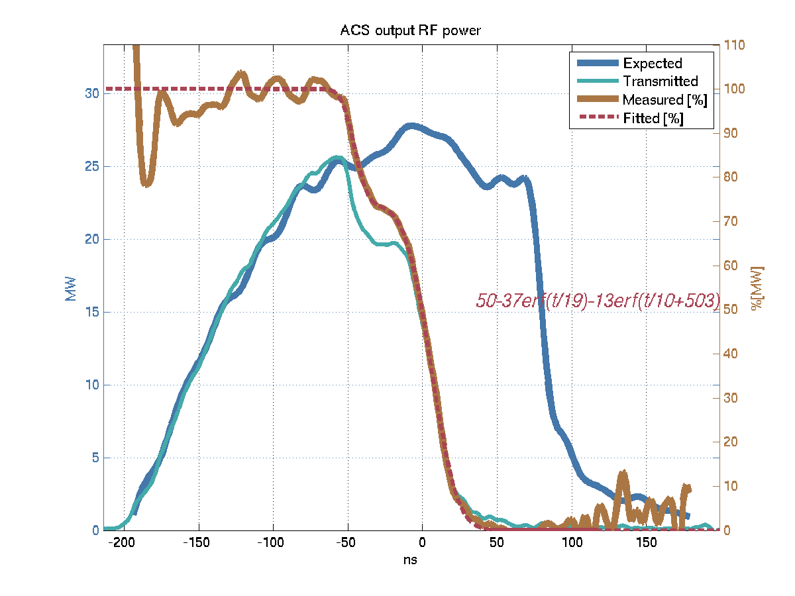
Falling edge duration - TBTS
90%
Slope [%/ns]
10%
Fall time
Slide courtesy of Alexey Dubrovskiy

Slide 19
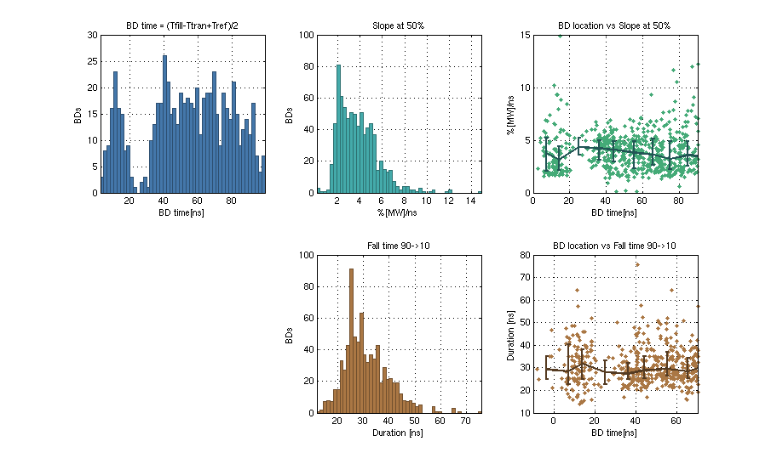
Falling edge duration - KEK
90%
Slope [%/ns]
10%
Fall time
Slide courtesy of Alexey Dubrovskiy

Slide 20
Summary of turn on times
Test | Measurement | Result
Simulation |  | 0.25ns
New DC System | Voltage Fall Time | 12-13ns
Swiss FEL (C-Band) | Transmitted Power Fall Time | 110 - 140ns
KEK (X-Band) | Transmitted Power Fall Time | 20-40ns
TBTS (X-Band) | Transmitted Power Fall Time | 20-40ns

Slide 21
Measured Burning Voltages

Slide 22
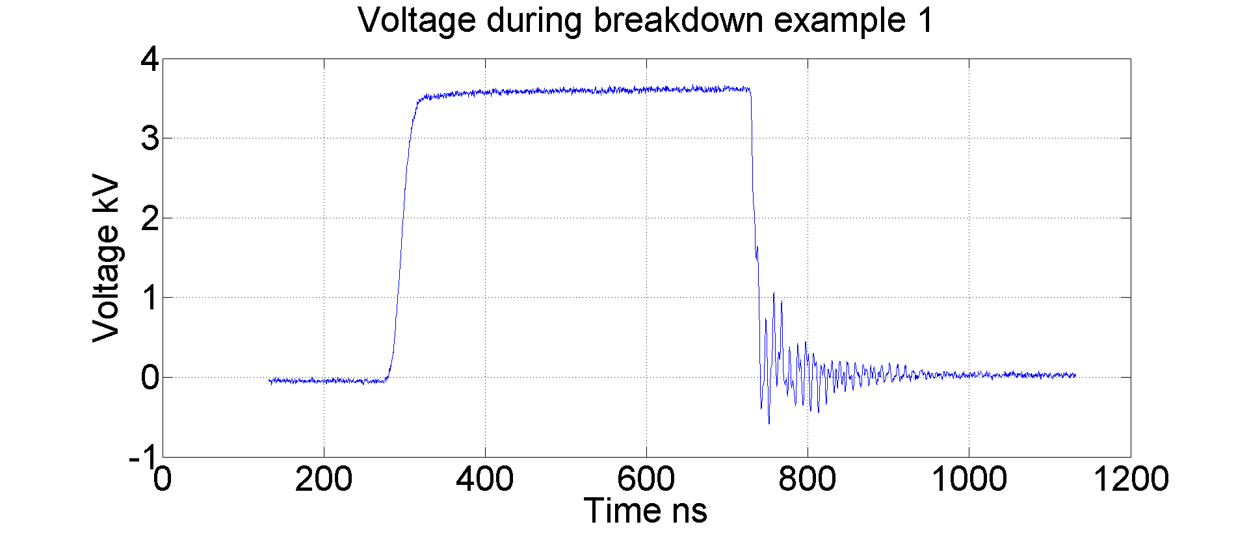
Measured Burning Voltages
The burning voltage was measured across here.
It is the “steady state” voltage across the plasma of a spark during a breakdown at which point most of the voltage is dropped across the 50 Ohm resistor. It is a property of the material.
Subtract average voltage with switch closed from
Average voltage during breakdown after initial voltage fall.

Slide 23
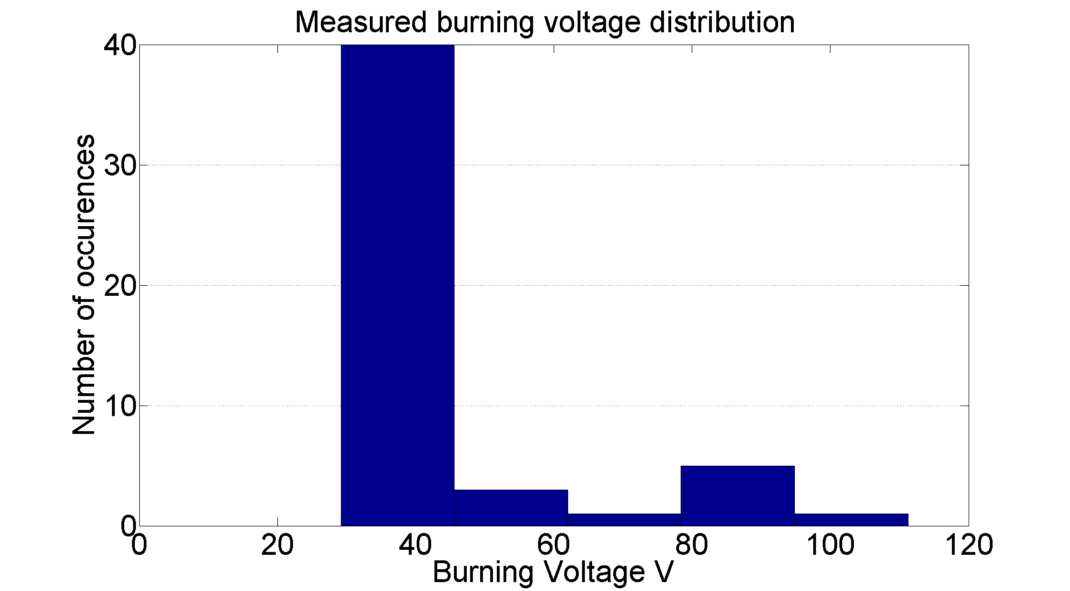
Measured Burning Voltages
The literature gives a value for the burning voltage of clean copper of ~23V. This is lower than what I have measure so far in the DC spark system. But I have not measured or corrected for the short circuit resistance of cables etc.

Slide 24
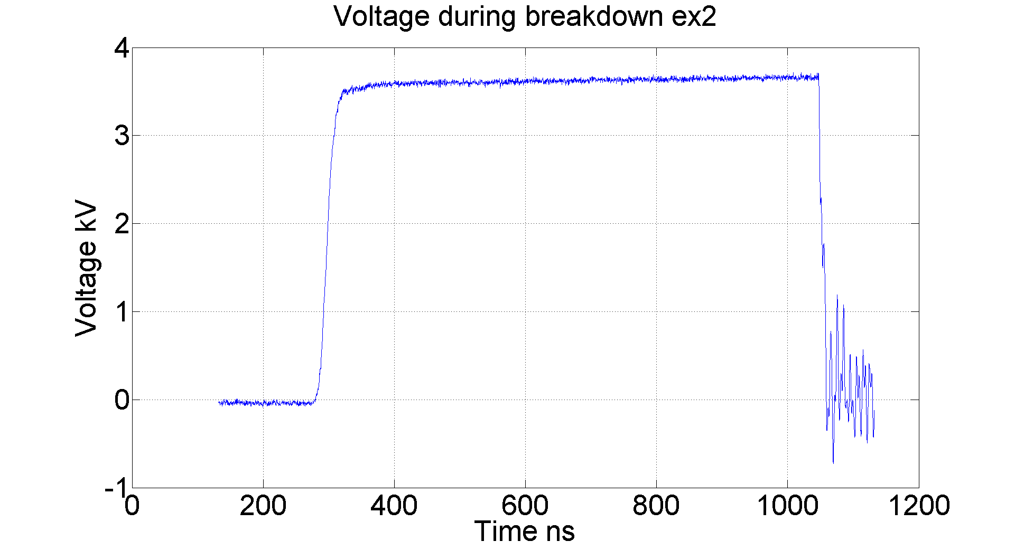
Burning Voltages
Depending on when the breakdown occurs there is sometimes a paucity of data points with which to make the average needed to acquire the burning voltage value.
It is these cases which are responsible for the higher values of burning voltages seen on the histogram.
This may suggest that the plasma burning voltage starts high and then settles to a lower value later. This will be investigated further.
The nature of the oscillations will also be investigated further, they could either be due to an LC type ringing in the powering system or due to plasma oscillations in the Arc.

Slide 25
Future Plans

Slide 26
Future Plans
Use HRR system to obtain BDR vs. E graph both for system 1 and the fixed gap system.
Investigate how BDR changes when the fixed gap system is placed in an external magnetic field (~2T)
Measure fixed gap system turn on times. Compare antenna signals to voltage fall times.

