Slide 1
CLIC Re-baselining
February 2013
D. Schulte for the CLIC collaboration

Slide 2
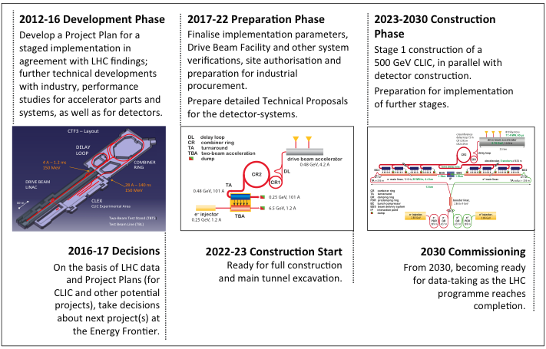
Timeline
From Steinar

Slide 3
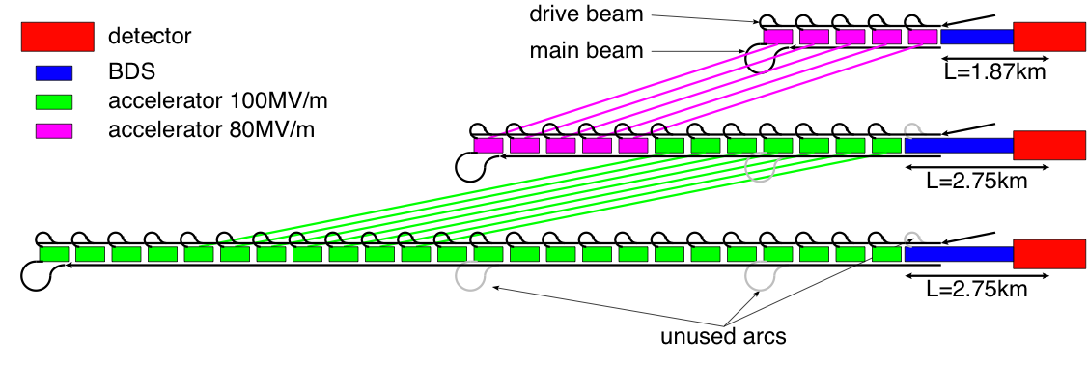
Staged Baseline Scenario
Developed example scenarios in CDR
0.5, ~1.5 and 3 TeV
Energy choices we will be updated based on further LHC findings
Design based on 3TeV technology
Scenario A with two different structures -> more luminosity at 500GeV
Scenario B with a single design -> less cost

Slide 4
Goals for Next Phase
Iterate on energy choices
  Stage optimised for 375GeV for Higgs and top
  1-2TeV depending on physics findings, will still also do Higgs
  3TeV as current ultimate energy, includes more Higgs
Focus on optimisation of first energy stage
  But consider upgrades
Identify, review and implement cost and power/energy saving options
  Identify and carry out required R&D
Re-optimise parameters (global design)
  Develop an improved cost and power/energy consumption model
  Iterations needed with saving options
Study alternatives
  E.g. first stage with klystrons
Need to remain flexible, since we are waiting for LHC findings
  But have some robustness of specific solutions and can anticipate this to some extent

Slide 5
Power Consumption 500GeV (A)
Need to review power consumption in many places
Options for savings exist
We considered this
part, which is now a much smaller fraction
Note: ILC requires
162MW total

Slide 6
Cost of the 500GeV Stage
Swiss francs of December 2010
Incremental cost for B:
4MCHF/GeV
-> Step to 1.5TeV is less than first stage

Slide 7
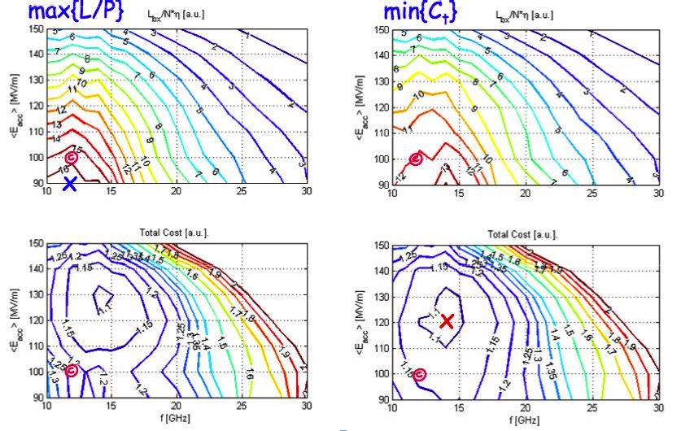
Optimisation Ingredients
Define a figure of merit (FoM) to evaluate one given CLIC design/parameter set
  e.g. FoM=-cost
Define a few free parameters to fully describe the design/parameter set
  The other parameters are unambiguously defined by the free parameters
  Currently: gradient G and a few structure parameters (f_{RF}, Δφ, a, Δa, L_{S}, …)
Use optimisation algorithm to find maximum
FoM(free parameters)
  Currently: a simple full search
Allow some human intervention

Slide 8
Simplified Parameter Diagram
Parameter Routine
Luminosity, …
Variable | Meaning | Current value
I_{drive} | Drive beam current | 101A
E_{drive} | Drive beam energy | 2.37GeV
τ_{RF} | Main linac RF pulse length | 244ns
N_{sector} | Number of drive beam sectors per linac | 4
N_{combine} | Combination number | 24
f_{r} | Repetition rate | 50Hz
N | Main beam bunch charge in linac | 3.72e9
n_{b} | MB bunches per pulse | 312
n_{cycle} | Spacing between MB bunches | 6 cycles
E₀ | MB energy at linac entrance | 9GeV
E_{cms} | Centre-of-mass energy | 500GeV
G | Main linac gradient | 100MV/m
I_{drive}
E_{drive}
τ_{RF}
N_{sector}
N_{combine}
f_{r}
N
n_{b}
n_{cycle}
E₀
f_{r}
E_{cms,} G, L_{structure}
Two-Beam Acceleration Complex
L_{module}, Δ_{structure}, …
Drive Beam Generation Complex
P_{klystron}, N_{klystron}, L_{DBA}, …
Main Beam Generation Complex
P_{klystron}, …

Slide 9
Simplified Parameter Diagram
Parameter Routine
Luminosity, …
Variable | Meaning
C_{investment} | Investment cost
C_{operation} | Operation cost/year
P | Power consumption
C_{inestment},
C_{operation},P
C_{inestment},
C_{operation},P
C_{inestment},
C_{operation},P
C_{inestment},
C_{operation},P
Two-Beam Acceleration Complex
L_{module}, Δ_{structure}, …
Infrastructure and Services
Controls and operational infrastructure
Drive Beam Generation Complex
P_{klystron}, N_{klystron}, L_{DBA}, …
Main Beam Generation Complex
P_{klystron}, …

Slide 10
Linac and Parameters
Quadrupole design
Stabilisation system
Alignment system
Instrumentation
Wakefield effects
Dispersive effects
…
Optimum lattice design
Main beam accelerating
structure design
Main linac design
N, σ_{z}, n_{cycle}, n_{b}
Main beam
parameter list
N<N_{max}
σ_{z,min}(N) < σ_{z} < σ_{z,min}(N)
n_{cycle} ≥ n_{cycle,min}
n_{b} ≤n_{b,max}
RF constraints

Slide 11
Luminosity and Parameters
Wiggler systems
Kicker systems
Instrumentation
Magnets
RF system
Vacuum
….
Collective effects:
Electron cloud
IBS
…
Magnet systems
Stabilisation systems
Alignment systems
Collimation systems
Instrumentation
….
Chromatic effects
Non-linearities
Collective effects
…
Optimum damping
ring design
ε_{x}(N, ε_{z}(σ_{z}), ε_{y},…)
Optimum beam delivery
system design
(σ_{x},σ_{y})(ε_{y}, ε_{x}, σ_{z},…)
Main beam
parameter list
Physics requirements
Beam-beam effects
Optimum trade-off L, n_{γ}
Main linac
N, σ_{z}, n_{cycle}, n_{b}

Slide 12
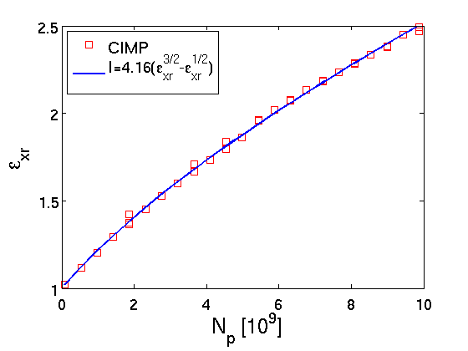
Example: Damping Ring
F. Antoniou
Y. Papaphilippou
All parameters kept constant
Only charge varied
Horizontal emittance including intra-beam scattering
Effort for the BDS
is also ongoing

Slide 13
Drive Beam Parameters
Main linac accelerating
structure defines
Chose a combination
factor
Chose a PETS
Iterate to find good set
Turn-arounds
Combiner rings
Decelerator

Slide 14
Drive Beam Parameters
Main linac accelerating
structure defines
Can reduce drive beam cost by
reducing RF pulse length below maximum -> less luminosity efficiency
reduce main linac fill factor -> main linac is longer
reduce the main lianc gradient -> the linac is longer, less luminosity efficiency

Slide 15
Discussion Animators
They should help to initiate and animate the discussion in smaller groups
Report to the re-baselining working group
Four animators are
  Main beam sources: Yannis Papaphilippou
  Drive beam generation: Roberto Corsini
  Two-beam acceleration: Alexej Grudiev
  Klystron-based first stage: Igor Syratchev
Please contact them with any good idea

Slide 16
Two-beam Acceleration Cost
Drive Beam Generation Complex
Main Beam Generation Complex

Slide 17
Two-beam Accelerator Cost Summary
Cost (LacSAS, Ecm, E0, Gac, Nsect)= 2*C1
C1 = CTBs + CPDs
CPDs = CPD * Nsect;
CTBs = CTBC + CRF + CVAC + CDBQ + CMBQ + CEND;
CRF = CRFL * Lac + CRFN * NSAS;
CVAC = CVACL * LTBA + CVACN * NDBQ;
CDBQ = CDBQL * LTBA + CDBQN * NDBQ;
CMBQ = CMBQL * LMBQ + CMBQN * NMBQ;
CEND = CENDL * LTBA;
Lac = (Ecm/2-E0)/ FRF/Gac
NSAS = Lac/LacSAS
LTBA = Lac / FTBA
NDBQ = NSAS/2/FTBA
LMBQ = LTBA – Lac
NMBQ = 120(E^{0.4} – E0^{0.4})
FRF = 0.9; FTBA = 0.786 as it is in the CDR
Post decelerators
RF systems
Vacuum
Drive beam quadrupoles
Main beam quadrupoles
Other systems (e.g. alignment)

Slide 18
Conclusion on Two-beam Acceleration
4
Example of cost dependence on gradient and structure length is shown
3
TBA cost
Good model available
Some cost reduction proposals remain to be studied
Longer module
Impact of structure tolerances on cost
Quadrant structures
2
1
0.1
0.5
Lst [m]

Slide 19
Main Beam Generation Cost
Drive Beam Generation Complex
Main Beam Generation Complex

Slide 20
Main Beam Generation
Steffen Doebert
Yannis
Papaphilippou
Andrea Latina
Injectors
Damping rings
RTML
Damping ring cost not strongly dependent on beam parameters
Cost saving can be realised by removing electron pre-damping ring
Linacs are significant cost
significant difference for N=3.72e9 and N=6.8e9 (240MCHF)
but partly due to differences in optimisation level
need optimised designs

Slide 21
Main Beam Generation (cont.)
2.86 GeV
0.2 GeV
PDR
Injector Linac
DC gun
e⁺ DR
BC1
target
e⁻ DR
gun
Booster Linac
2 GHz
6 GeV
Damping ring RF frequency of 1GHz creates cost in the sources
is it worth to change to 2GHz?
Long main beam pulses required for low energy operation
is the luminosity gain worth the cost?
More adventurous:
use booster linac to produce electron beam for positron production
or drive beam accelerator for the same purpose
could power the booster linac with the drive beam
undulator-based positron source
…
Need to carefully evaluate the consequences of such complications

Slide 22
Drive Beam Generation Cost
Drive Beam Generation Complex
Main Beam Generation Complex

Slide 23
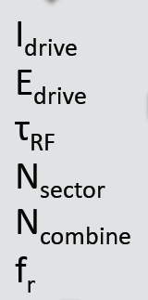
Interface and Internal Parameters
  (I_{drive} x E_{drive}) ∙ const = P_{tot}
  Instantaneous power
  N_{kly} = P_{tot} / P_{kly}
  (τ_{RF} x N_{sector} x N_{combine}) = τ_{DB}
  Initial DB pulse length
  ⇨ modulator/klystrons pulse length
  P_{tot} ∙ τ_{DB} = E_{stored}
  RF pulse stored energy
  f_{r} ∙ E_{stored} = P_{average}
  Average power

Slide 24
Drive Beam Accelerator RF Unit Cost
RF unit consists of one modulator, one klystron, one structure
  is ~70% of total drive beam generation cost
  ~90% of drive beam accelerator cost
Cost model for klystrons
  Based on high level components
  Cost(P_{klystron})
  Some refinement required
Detailed cost model for modulators
  Based on components
  Cost(P_{out}, τ_{RF} ,f_{r})
Structure cost still significant (~14%)
  Cheaper material/fabrication
I. Syratchev
D. Nisbet
D. Aguglia

Slide 25
Total Cost
Total cost [GCHF]
150
1.833
[GCHF]
100
1.571
τ [us]
50
1.178
Pk [MW]
τ [us]
10
20
30
40
Pk [MW]
Preference for higher klystron power driven by structure and modulator cost
-> consider using one modulator per two klystrons
-> consider using two klystrons per accelerating structure
Cheaper structure materials/fabrication might be possible

Slide 26
IS and COI Cost
Drive Beam Generation Complex
Main Beam Generation Complex
IS: Infrastructure and Services
COI: Controls and Operations Infrastructure

Slide 27
Linear Combination Model
Ph. Lebrun
Assume cost to be a linear combination of Lsite and Pnom
  Cost IS = a * Lsite + b * Pnom + c
  Cost COI = d * Lsite + e * Pnom + f
Available data from CDR
  500 GeV A, 500 GeV B, 1.5 TeV, 3 TeV
  Solve mathematically for 500 GeV B, 1.5 TeV and 3 TeV
  Check for 500 GeV A
Problem: strong correlation between Lsite and Pnom
  Use heuristic approach based on a priori dependencies of sub-domain costs
  Check correlations to either Lsite or Pnominal
  Re-construct linear combination of domain cost from subdomain costs

Slide 28
A Priori Functional Dependencies of Domain Costs
Domain | Sub-domain | Site Length | Power (w/o detector)
Infrastructure & Services | Civil engineering | +++ | NA
 | Electrical distribution | + | ++
 | Survey infrastructure | NA | NA
 | Fluids | + | ++
 | Transport/installation | ++ | +
 | Safety | ++ | +
Machine Control & Operational Infrastructure | Controls infrastructure | ++ | +
 | Machine protection | ++ | +
 | Access safety & control | +++ | NA
 | Technical alarm system | +++ | NA

Slide 29
IS and COI Cost Model
Determined coefficients of polynoms
Model uses
  Lsite, the total length of the site
  Pnom, the nominal total power excluding the detector(s)
  Cost IS [MCHF] = a Lsite [km] + b Pnom [MW] + c
  Cost COI [MCHF] = d Lsite [km]

Slide 30
Exploration of Klystron-based First Stage
The drive beam is necessary to reach high energies
  Substantial improvement in scalability compared to previous X-band designs
Conclusion from parameter exploration: At low energies klystrons can be competitive
  Easier to qualify components
    No need of 100A beam for module reception tests
  But klystrons loose value with energy upgrade
Technical preparation of klystron-based linac is attractive
  Need klystrons for structure testing
  Klystron-based linac is also excellent for testing most critical issues for drive beam based scheme
  Klystron-based X-band is attractive for other uses (e.g. medical and light sources)
Hence started to study a klystron-based first energy stage
  As an alternative to a baseline drive-beam based first energy stage
  Currently at 375GeV
See Igor’s talk

Slide 31
Conclusion
Have first robust staged scenarios for CLIC
  Two examples, since waiting for LHC results
  Based on the 3TeV design
Global optimisation for first stage is advancing
  Have a first cost model that can be used
    How different will the result be?
    Iterations might be required with more detailed models
  Need to develop power model
  Are reviewing beam dynamics limitations
  Optimisation procedure to be reviewed, currently have Alexej’s routine
Local optimisation is also ongoing
  E.g. remove electron pre-damping ring
  Discussion of drive beam accelerator RF unit design
  Magnet power consumption
  More ideas exist
Klystron-based alternative first stage is being pursued
  First evaluation is positive, but too early to compare with drive beam

Slide 32
Reserve

Slide 33
Parameter Comparison
 | unit | Scenario A |  |  | Scenario B
E_{cms} | TeV | 0.5 | 1.4 | 3.0 | 0.5 | 1.5 | 3.0
G | MV/m | 80 | 80/ 100 | 100 | 100 | 100 | 100
N | 10⁹ | 6.8 | 3.7 | 3.7 | 3.7 | 3.7 | 3.7
N_{sect} |  | 5 | 12 | 24 | 4 | 12 | 24
L | 10³⁴cm⁻²s⁻¹ | 2.3 | 3.2 | 5.9 | 1.3 | 1.7 | 5.9
L_{1%} | 10³⁴cm⁻²s⁻¹ | 1.4 | 1.3 | 2.0 | 0.7 | 1.4 | 2.0
P_{beam} | MW | 9.6 | 12.9 | 27.7 | 4.6 | 13.7 | 27.7
P_{wall} | MW | 272 | 364 | 589 | 235 | 364 | 589
η | % | 3.6 | 3.6 | 4.7 | 2.0 | 3.8 | 4.7

Slide 34
Some Examples of Saving Options for Current Design
Cost
  Alternative structure fabrication
  Longer main linac modules
  Maybe do not need electron pre-damping ring
  CVS overdesigned for 500GeV
  Main beam sources RF power quite high
  Shorter drive beam pulses in first stage can reduce cost of modulator (modular design)
  Combining pairs of drive beam accelerator klystrons
  …
Power
  Permanent drive beam turn-around magnets
  …

Slide 35
Parameter Drivers
Based on usual luminosity formula:

Slide 36
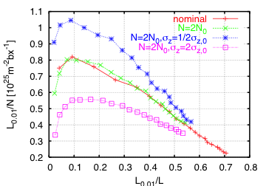
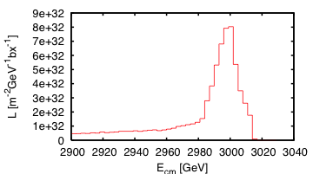
Parameter Drivers
Upper limit from
Luminosity spectrum
(classical regime)
At 3TeV maximum luminosity:
L_{0.01}/L>0.3 => n_{γ}=O(2)
N/σ_{x}≈1x10⁸/nm (for σ_{z}=44μm)
At 500GeV comparable to ISR:
L_{0.01}/L≈0.6 => n_{γ}=O(1)
N/σ_{x}≈2.5x10⁸/nm

Slide 37
Parameter Drivers
Upper limit from
main linac lattice and structure
Lower limit from Damping ring
BDS
RTML
Lower limit from all systems

Slide 38
Parameter Drivers
For fixed structure the charge is independent of energy (almost)
Upper limit from
main linac lattice and structure
Beamsizes roughly scale as
sqrt(1/E)
Lower limit from Damping ring
BDS
RTML
Lower limit from all systems
Easier to get N/σ_{x} at high energy
Ratio of 3TeV to 500GeV is sqrt(1/6)
Just what we need

Slide 39
Bunch Charge at Different Energies
Beam jitter
Accelerating structure misalignment
Quadrupole jitter

Slide 40
Variation of Drive Beam Parameters
Operation of structure at gradient G below maximum gradient G₀
  N=N₀G/G₀
  C_{ML}=C_{ML,0}G₀/G
  C_{DBA}~C_{DBA,0} (G/G₀)²
  L≤L₀G/G₀
  Cost saving if C_{ML}<2C_{DBA}
Operation at shorter than maximum pulse length
  C_{DBA}~C_{DBA,0} (τ/τ₀)
  L≤L₀(τ/τ₀)
Reducing main linac fill factor
  C_{DBA}~C_{DBA,0} (η_{fill}/η_{fill,0})
  Some increase in ML cost

Slide 41
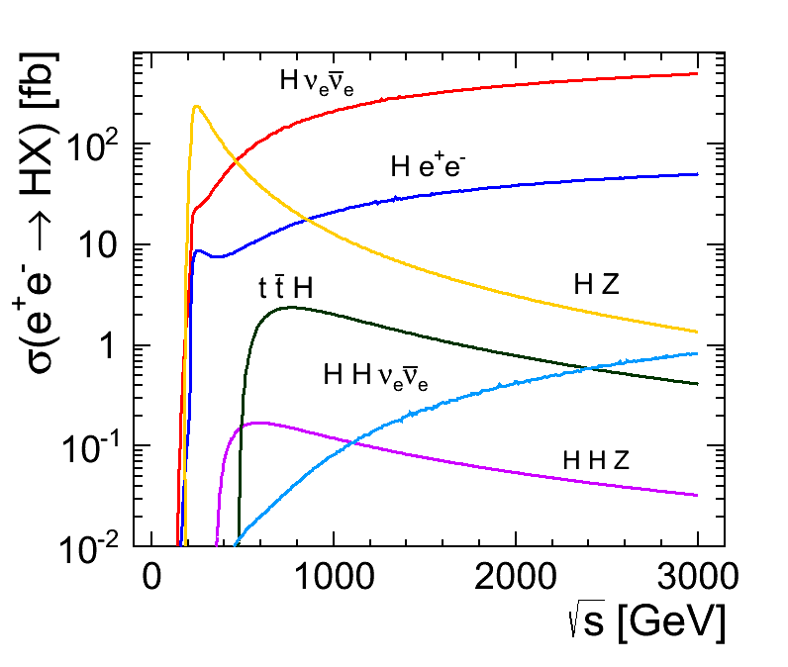
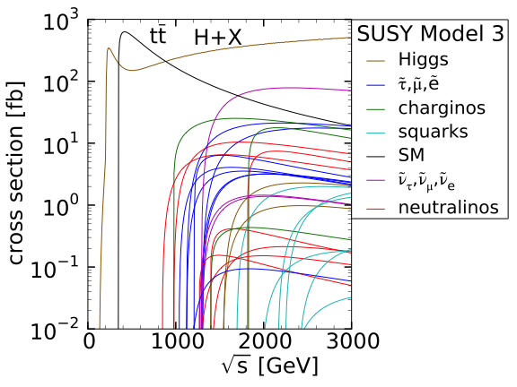
CDR Volume 3 Staging Scenarios
Illustrate stages with two cases
  0.5, ~1.5 and 3 TeV
  Energy choices we will be updated based on further LHC findings
  Design based on 3TeV technology
The examples are:
  Scenario A is optimised for the luminosity at 500GeV
  Scenario B is is cost optimised for the total project cost

Slide 42
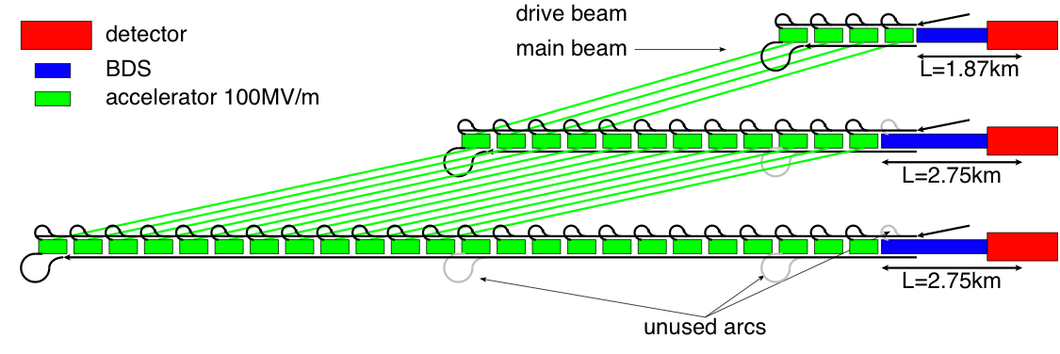
Scenario B
Scenario is chosen to reduce cost at 500GeV and the total cost of all stages
Some main beam injector complex for all stages
BDS can be one decelerator sector shorter at 500GeV, fits in 3TeV tunnel
12 sectors powered in second stage is maximum with one drive beam generation complex
Scaled 3TeV BDS design used for stage 2
Can re-use all structures up to 3TeV

Slide 43
Scenario A
Scenario is chosen for luminosity at 500GeV, L=2.3x10³⁴m⁻²s⁻¹
Special structure for 500GeV leads to
N=6.8x10⁹ vs. 3.7 x10⁹, G=80MV/m vs. 100MV/m, L=2.3x10³⁴m⁻²s⁻¹ vs. L=1.3x10³⁴m⁻²s⁻¹
Main beam RF pulse lengths are the same and power is comparable
=> can use the same drive beam generation complex
Main beam injector at stage 1 needs some additional RF power
Can use 80MV/m structure with the train for CLIC_G (the nominal 3TeV structure)
=> lose a bit of energy for stage 2

Slide 44
Power Consumption 3TeV
We optimised this
part
Largest contribution
Strongest dependence on structure design
Best understood at the time

Slide 45
Structure Parameters for Optimisation Routine
P_{G}
τ_{G}
τ_{fill}
G_{BL}
a, Δa
T_{G,τ}
W_{i}
R_{S}

