Slide 1
CLIC Power & Energy
Bernard Jeanneret & Philippe Lebrun
CLIC Workshop 2013
CERN, 28 January 2013

Slide 2
Main contributors
DB Linac : D. Aguglia, E. Jensen, G. McMonagle, D. Nisbet,
R. Wegner
Magnets and powering : M. Modena, S. Pittet, D. Siemaszko,
A. Vorozhtsov
Main Linac RF : A. Grudiev, G. Ridonne, I. Syratchev
Cool & Vent : M. Nonis
Electrical network : C. Jach
Damping ring : Y. Papaphilippou
Main beam production : S. Doebert, L. Rinolfi
BDS and Experimental area : L. Gatignon

Slide 3
OUTLINE
CLIC power in CDR Vol. I
Changes appearing in Vol. III
Power optimization - I
Power optimization - II , further studies

Slide 4
CLIC power in CDR Vol. I

Slide 5
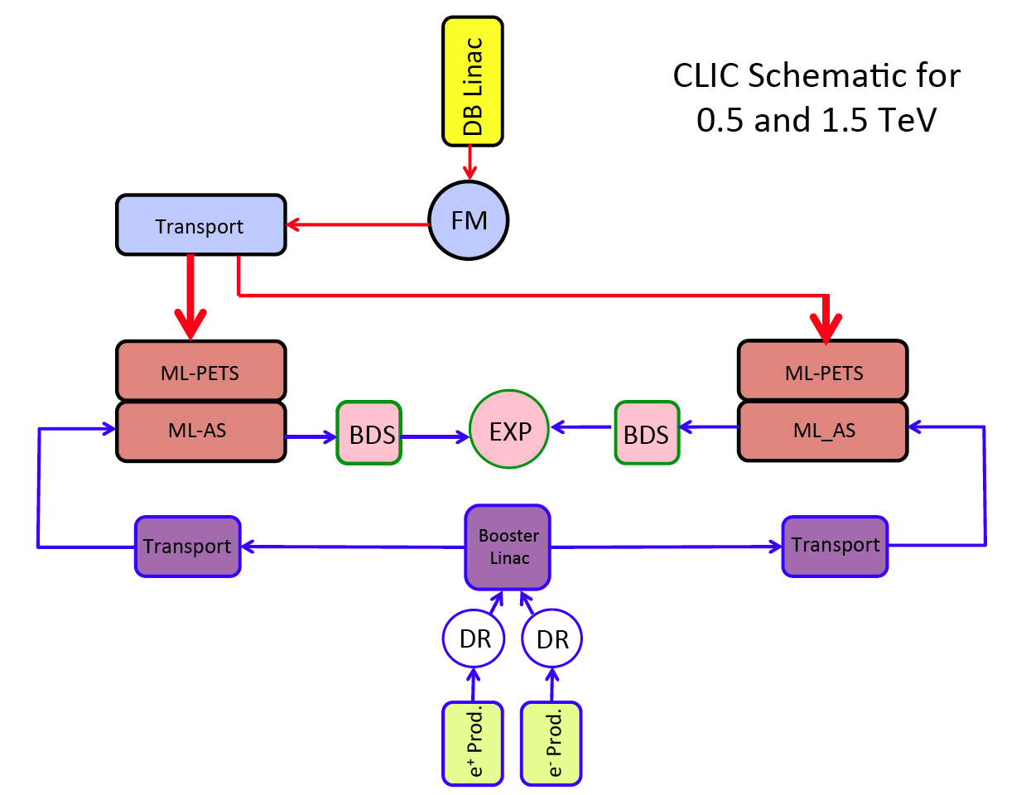
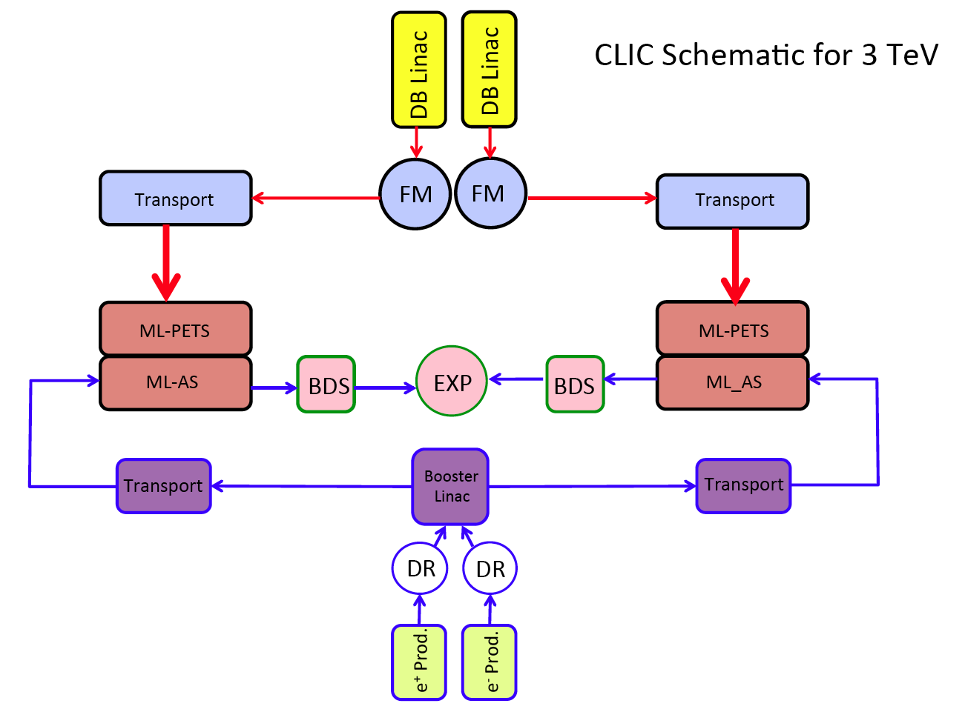
CLIC functional schematics

Slide 6
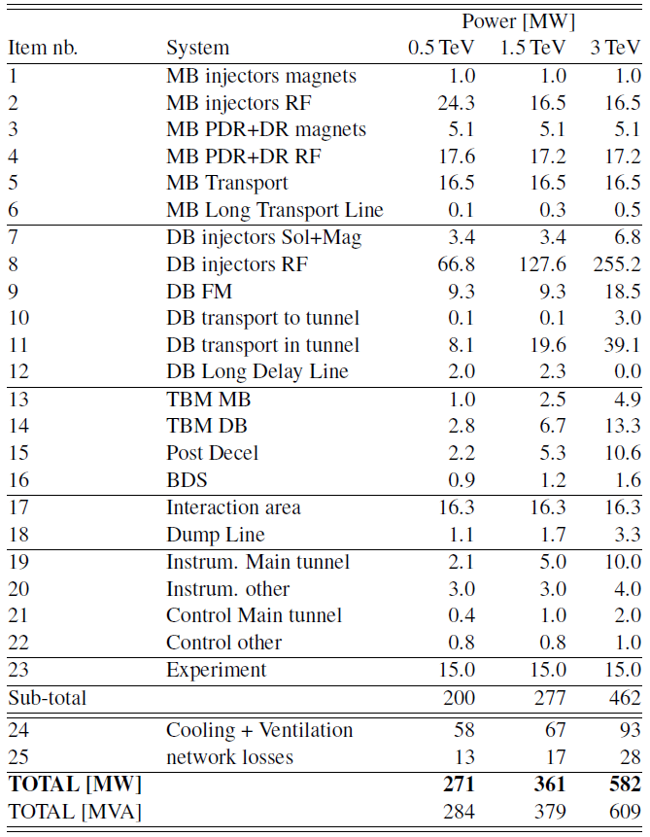
CLIC Power map
CDR Vol. I
(or Scenario ‘A’
at 0.5 TeV, see below)

Slide 7
Changes appearing in Vol. III

Slide 8
Changes proposed in CDR Vol. III
Two alternative staging scenarios
  Each with three stages: 500 GeV, ~1.5 TeV and 3 TeV
  Scenario A: « optimized for luminosity in the first stage »
  Scenario B: « optimized for lower entry cost »
  First and last stages of scenario A are identical to CDR Volume 1
  Reuse of 80 MV/m structures in scenario A limits the energy of the second stage to 1.4 TeV
Scenario B has nominal bunch charge at all stages, resulting in
  Use of final (100 MV/m) gradient structures already at 500 GeV
  Shorter main linacs (2 x 4 sectors at 500 GeV)
  Lower installed RF power in the MB and DB production complexes
  One species of ML accelerating structures
  Substantial cost reduction w.r.t. A , ~ 1GSF

Slide 9
Main Linac parameters , A vs. B
from CDR Vol III, tables 3.3 p.27 & 3.4 p.29
ECM | TeV | 0.5 | 1.4 | 3
N _{bunch} |  | 354 | 312 | 312
Q _{bunch} | 10⁹ | 6.8 | 3.7 | 3.7
G | MV/m | 80 | 80/100 | 100
Lum | 10³⁴ cm⁻² s⁻¹ | 2.3 | 3.2 | 5.9
Lum 1% |  | 1.4 | 1.3 | 2
L tunnel | km | 13.2 | 27.2 | 48.3
Total Power | MW | 272 | 364 | 589
Scenario
A
ECM | TeV | 0.5 | 1.5 | 3
N _{bunch} |  | 312 | 312 | 312
Q _{bunch} | 10⁹ | 3.7 | 3.7 | 3.7
G | MV/m | 100 | 100 | 100
Lum | 10³⁴ cm⁻² s⁻¹ | 1.3 | 3.7 | 5.9
Lum 1% |  | 0.7 | 1.4 | 2
L tunnel | km | 11.4 | 27.2 | 48.3
Total Power | MW | 235 | 364 | 589
Scenario
B

Slide 10
 | A | A |  | B | B
 | LUM_opt |  |  | Low_entry
E_CM [TeV] | 0.5 | 1.4 |  | 0.5 | 1.5
POWER [MW]
MB injectors magnets | 1 | 1 |  | 1 | 1
MB injectors RF | 24.3 | 16.5 |  | 16.5 | 16.5
MB PDR+DR magnets | 5.1 | 5.1 |  | 5.1 | 5.1
MB PDR+DR RF | 17.6 | 17.2 |  | 17.2 | 17.2
MB Transport | 16.5 | 16.5 |  | 16.5 | 16.5
MB Long Transport Line | 0.1 | 0.3 |  | 0.1 | 0.3
DB injectors Sol+Mag | 3.4 | 3.4 |  | 3.4 | 3.4
DB injectors RF | 66.8 | 127.6 |  | 49.0 | 127.6
DB FM | 9.3 | 9.3 |  | 9.3 | 9.3
DB transport to tunnel | 0.1 | 0.1 |  | 0.1 | 0.1
DB transport in tunnel | 8.1 | 19.6 |  | 6.5 | 19.6
DB Long Delay Line | 2.0 | 2.3 |  | 2.0 | 2.3
TBM MB | 2.0 | 4.9 |  | 1.6 | 4.9
TBM DB | 2.8 | 6.7 |  | 2.2 | 6.7
Post Decel | 2.2 | 5.3 |  | 2.0 | 5.3
BDS | 0.9 | 1.2 |  | 0.9 | 1.2
Interaction area | 16.3 | 16.3 |  | 16.3 | 16.3
Dump Line | 1.1 | 1.7 |  | 1.1 | 1.7
Experiment | 15.0 | 15.0 |  | 15.0 | 15.0
Instrum. Main tunnel | 2.1 | 5.0 |  | 2.0 | 5.0
Instrum. other | 3.0 | 3.0 |  | 3.0 | 3.0
Control Main tunnel | 0.4 | 1.0 |  | 0.4 | 1.0
Control other | 0.8 | 0.8 |  | 0.8 | 0.8
Cooling & Ventilation | 58.0 | 67.0 |  | 52.2 | 67.0
Network Losses | 13.0 | 17.0 |  | 11.3 | 17.0
TOTAL POWER [MW] | 272 | 364 |  | 235 | 364
Twice fewer e⁺
26% gain :
16% on beam
10% on klystrons at optimum yield
Proportional reduction
with the above
Gain : 37 MW
At 500 GeV

Slide 11
Integrated luminosity request
See CRD vol. III , Chapter 6
(0.3 &) 0.5 TeV | 500 fb⁻¹
1.4 / 1.5 TeV | 1500 fb⁻¹
3 TeV | 2000 fb⁻¹

Slide 12
From power to energy
 | Shut down & fault stops | Beam time | Split as |  | Fractional downtime
1st year | 188 days | 177 days | 59 | Commissioning Injectors & sectors 1 by 1 | 50 %
 |  |  | 59 | Commissioning Main Linac 1 by 1 | 50 %
 |  |  | 59 | Luminosity operation | 50%
2nd year | 188 days | 177 days | 88 | 1 linac at a time | 30%
 |  |  | 88 | Luminosity operation | 0%
3rd, 4th … | 188 days | 177 days | 177 | Luminosity operation, nominal | 0%
See CDR
Vol. III

Slide 13
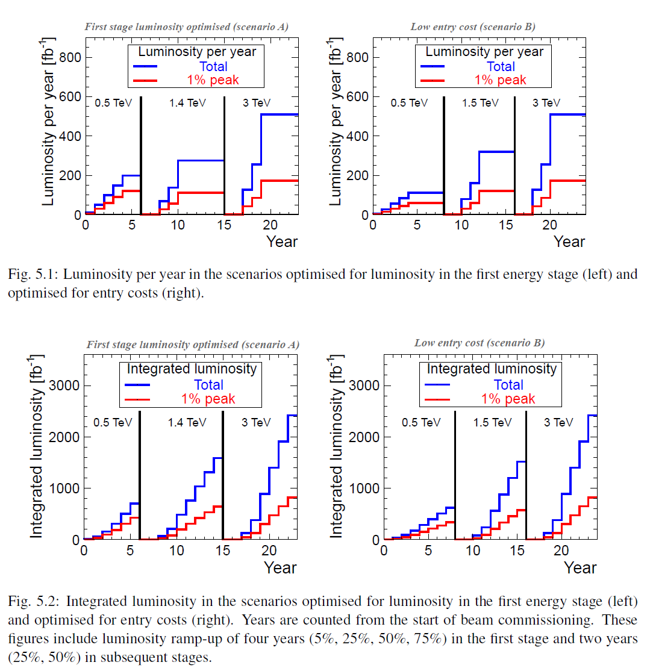
Overall :
23 yrs with A
24 yrs with B
for same
integrated
luminosity

Slide 14
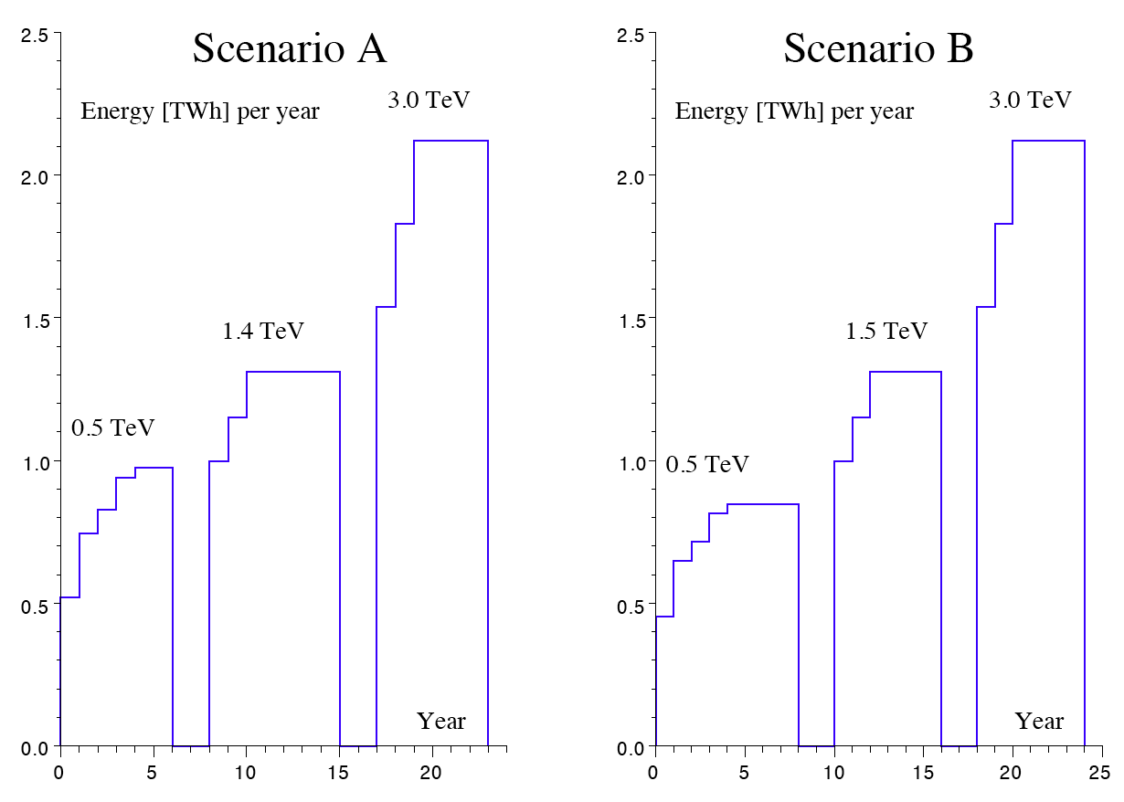
Yearly and total energy consumption
Integral over the whole programme
  Scenario A : 25.6 TWh
  Scenario B : 25.3 TWh
Nearly identical

Slide 15
Summary for A vs. B
‘A’ requires 6 yrs , and ‘B’ 8 yrs for the same integrated Luminosity as 0.5 TeV
But ‘B’ requires one year less at 1.5 TeV (higher energy → more luminosity)
Total Program 0.5 -3 TeV, A : 23 yrs, B : 24 yrs
Same total energy spent
Cost_{A} - Cost_{B} ~ 1 GSF
Simpler and more homogeneous systems with B

Slide 16
Power optimization - I

Slide 17
DB Linac , Klystron and modulator yields - I
For being the biggest power position at 3 TeV, the designers of the modulators and klystrons of the DB linac were put under strong pressure for high yields
For CDR power calculation
  A target klystron yield η_{K}=0.7 was chosen
    This was strongly questioned in Granada_2011
    Best achieved as of today η_{K}=0.68 (SLAC) , unstable beyond
  The rise and set-up times of modulators were fixed ambitiously down to τ = 5μs
    This while the jitter on output voltage need to be δV/V ≈ 10⁻⁵, with best achieved today 10⁻³ (D. Nisbet, D. Aguglia and S.Pittet)
This shall be put in perspective with the overall picture and with more emphasis on the 500 GeV case

Slide 18
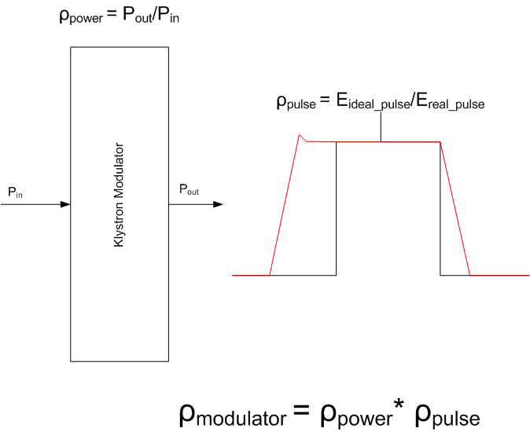
Development of high-efficiency modulators
Useful flat-top Energy | 22MW*140μs = 3.08kJ
Rise/fall time energy | 22MW*5μs*2/3= 0.07kJ
Set-up time energy | 22MW*5μs = 0.09kJ
Pulse efficiency | 0.95
Pulse forming system efficiency | 0.98
Charger efficiency | 0.96
Power efficiency | 0.94
Overall Modulator efficiency | 89%
D. Nisbet, D. Aguglia
E. Sklavonou & S. Pittet
Granada 2011

Slide 19
DB linac : Klystron & Modulator yields - II
  ΔP₁ : Change τ = τ_{rise} = τ_{τset-up} = 5μs to τ = 10μs
  ΔP₂ : Change η_{K}= 0.7 to η_{K}= 0.68
[MW] | P_{DB-RF} CDR | ΔP₁ | ΔP₂ | P’_{DB-RF} | P_{tot} CDR | P’_{tot} CDR
500 B | 69 | +2.3 | +10 | 81.3 | 235 | 247
3 TeV | 305 | +8 | +14 | 327 | 589 | 611
Fraction P_{DB-RF} /P_{tot} | CDR | relaxed
500 B | 29% | 33%
3 teV | 52% | 54%
Including
all overheads
CDR data

Slide 20
Towards future work
In the future the focus for optimization may go on for other systems, in particular
  CV , presently evaluated for low cost with the usual approach
  MB production deserves a closer look
It shall be more easy and less challenging to economize 12.3 and 22 MW respectively with these two domains
500A, total 247 MW
3 TeV, total 611 MW
RF DB linac,
RF ML
With relaxed yields
For DB K & MOD,
(see former slide)

Slide 21
Power optimization – II further studies

Slide 22
Further power savings - Sobriety
P.Lebrun
Arlington 2012
Reduced current density in normal-conducting magnets
  For given magnet size and field, power scales with current density
  Compromise between capital & real estate costs on one hand, and operation costs on the other hand
Reduction of HVAC duty
  Most heat loads already taken by water cooling
  Possible further reduction in main tunnel by thermal shielding of cables
  Possible reduction in surface buildings by improved thermal insulation, natural ventilation, relaxation of temperature limits

Slide 23
Further power savings - Efficiency
P.Lebrun
Arlington 2012
Grid-to-RF power conversion
  R&D on klystrons and modulators (DB and MB production)
  Powering from the grid at HV
RF-to-beam power conversion
  Re-optimization of accelerating structures and gradient with different objective function (present value 0.25)
  DB Linac structure (on-going, A. Grudiev)
Permanent or super-ferric superconducting magnets
  Permanent magnets
    distributed uses, e.g. main linac DB quads
    fixed-field/gradient or mechanical tuning
  Super-ferric superconducting magnets
    « grouped » and DC uses, e.g. combiner rings, Damping rings(?), DB and MB return loops in main linacs
  higher gradient :
  Shorter building,
  Less CV power
⇒ Potential for power savings at 3 TeV
- magnets ~ 86 MW
- cooling & ventilation ~24 MW

Slide 24
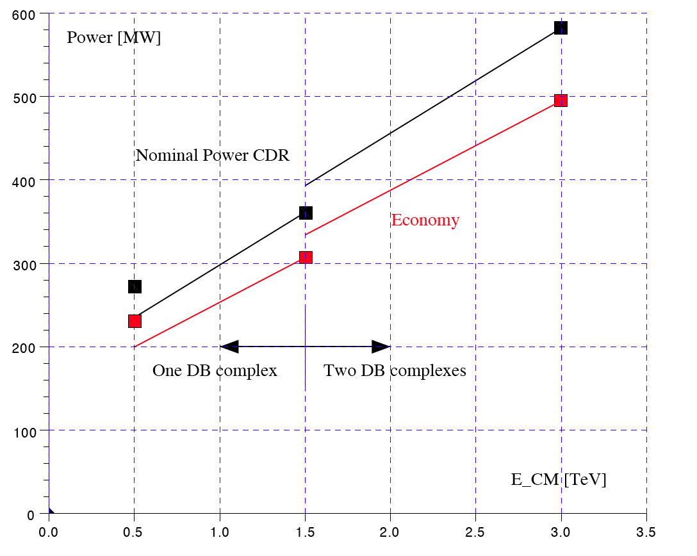
Power consumption versus E_{CM}
Option A
Option B

Slide 25
Summary
Still somebody to prefer Scenario A ?
Further optimization may decrease substantially the power needs
  Need studies on all systems, not only on RF
  Power efficiency must be full part of the design criteria

