Slide 1



First lessons learnt concerning pre-alignment on Two Beam Test Modules (TBTM)
OUTLINE
Introduction: CLIC active pre-alignment
Pre-alignment strategy on short range
Module test setup and associated results
First lessons learnt

Slide 2
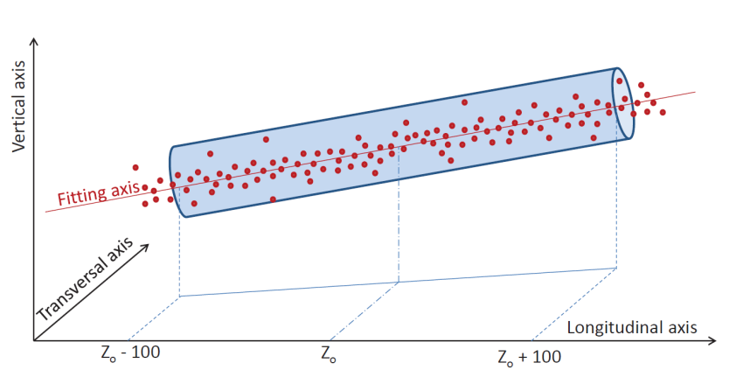
CLIC active pre-alignment
PRE-ALIGNMENT (beam off)
Mechanical pre-alignment
Active pre-alignment
Beam based alignment
Beam based feedbacks
Within +/- 0.1 mm (1σ)
Within a few microns
=
Determination of the position of the components in a general coordinate system by alignment systems
Active pre-alignment
+
Re-adjustment by actuators
The zero of each component will be included in a cylinder with a radius of a few microns:
14 µm (RF structures & MB quad BPM)
17 µm (MB quad)
Adjustment required: step size below 1 µm

Slide 3
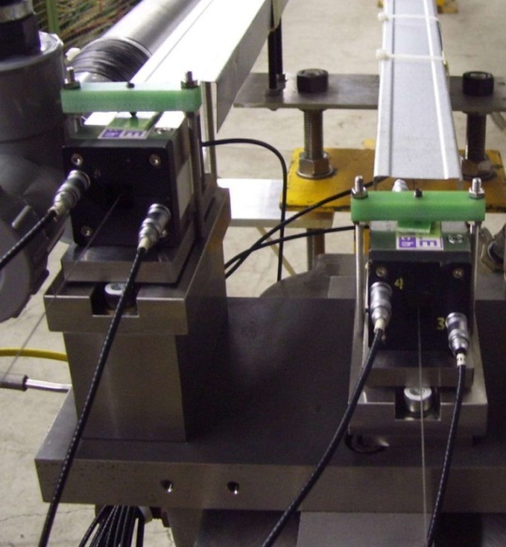

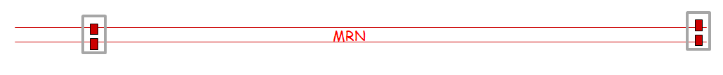
Pre-alignment strategy on long range
The position of the components will be determined in 2 steps:
The determination of a straight alignment reference line all along the main linac and BDS. As it is not possible to implement a straight alignment reference over 20 km: use of overlapping references over at least 200 m
For the CLIC CDR:
  Straight reference = 200m long stretched wire
  Sensor = capacitive Wire Positioning Sensors (cWPS), performing radial and vertical offsets w.r.t. a stretched wire, with a sub-micrometric resolution)
The measurements of WPS sensors located on the components (or on their common support) with respect to the straight alignment reference line

Slide 4
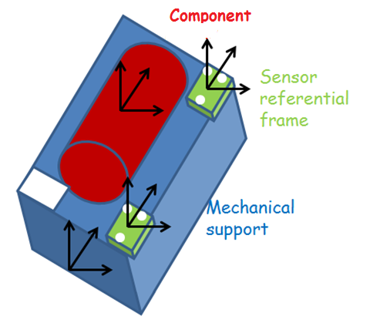
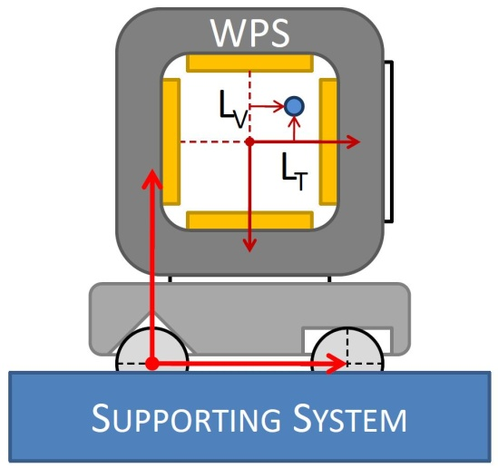
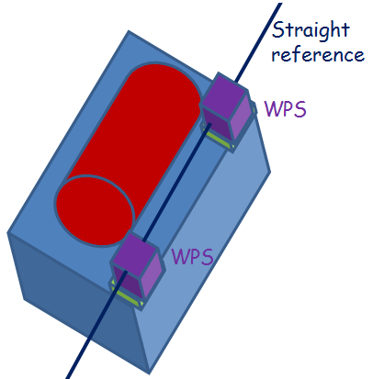
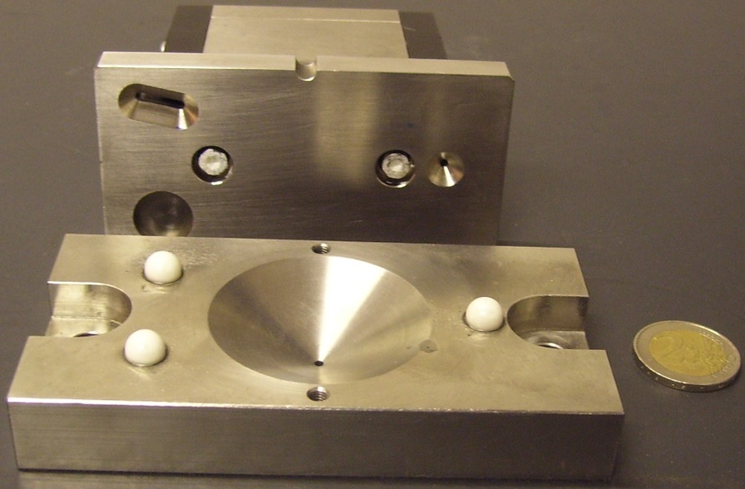
Pre-alignment strategy on short range
The pre-alignment must ensure that the beam axes of the CLIC components form a straight line along 200 m, which means the following steps:
Fiducialization of each component: the position of the alignment targets (fiducials) is determined at the micron w.r.t the reference axis of the component
In case of an assembly of components, each component is pre-aligned on the support within a few microns (and the position of its fiducials is determined within a few microns in the support coordinate system)
Sensors are associated to each support to be aligned, and the coordinate system of each sensor is known in the coordinate system of the support (or component) within a few microns
The short range strategy of pre-alignment consists of linking coordinate systems through micrometric measurements

Slide 5
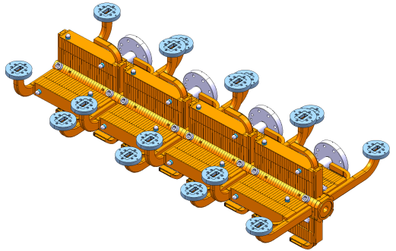
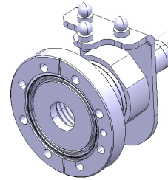
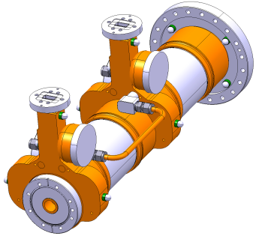
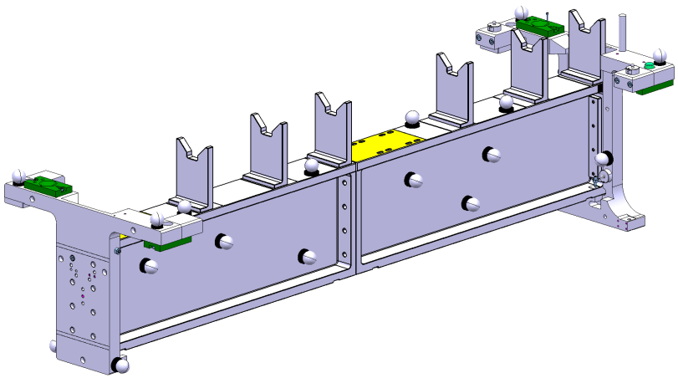
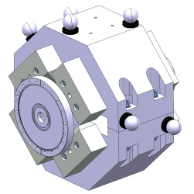
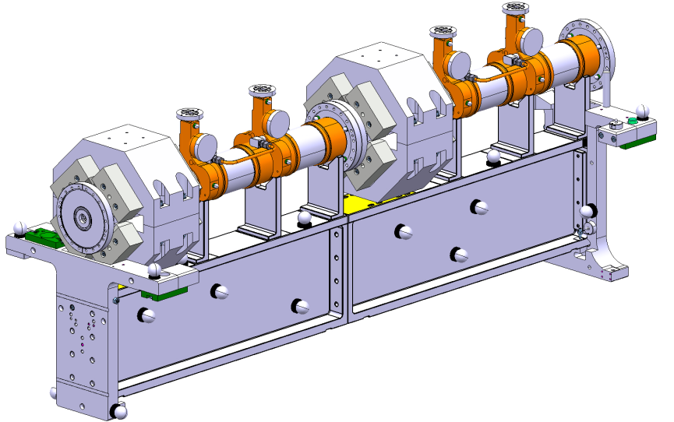
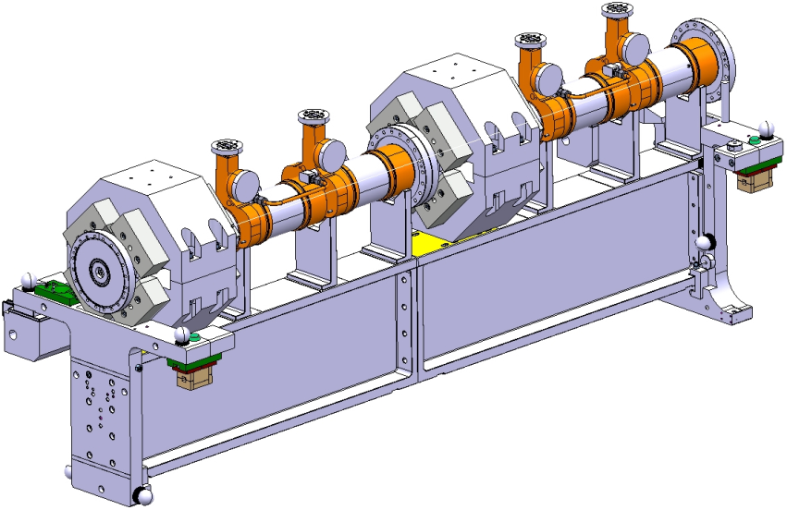
Short range strategy
Fiducialisation of components and supports
Alignment on a common support
Installation of WPS sensors

Slide 6
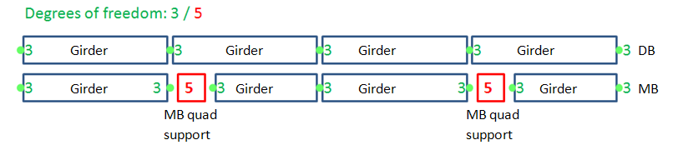


Re-adjustment strategy
Several components will be pre-aligned on supports:
➔ Along the MB: ➔ Along the DB:
  RF structures on girders ➔ PETS + DB quad on girders
  MB quad on interface plate
DB and MB girders will be interlinked with their extremities, based on so-called cradle. This allows a movement in the transverse girder interlink plane within 3 degrees of freedom (“articulation point between girders”). (Longitudinal direction adjusted using a mechanical guiding).
MB quad is mounted on an interface plate, allowing an adjustment along 5 degrees of freedom (longitudinal position will be set manually).

Slide 7
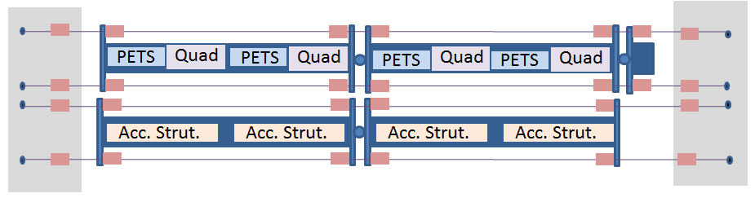
Description of Two Beam Test Modules (TBTM)
Objective: demonstration of the two beam module design:
  Assembly and integration of all the components and technical systems (vacuum, stabilization, alignment, beam instrumentation, supporting, RF components and their associated water cooling and waveguides)
  Validation of sub-systems such as vacuum, supporting and alignment
  Concerning alignment:
    Validation of the fiducialisation strategy according to different configurations of girders and actuators
    Validation of the pre-alignment strategy on short range
Current configuration:
  2 modules
  Installed in a laboratory environment (no beam)

Slide 8
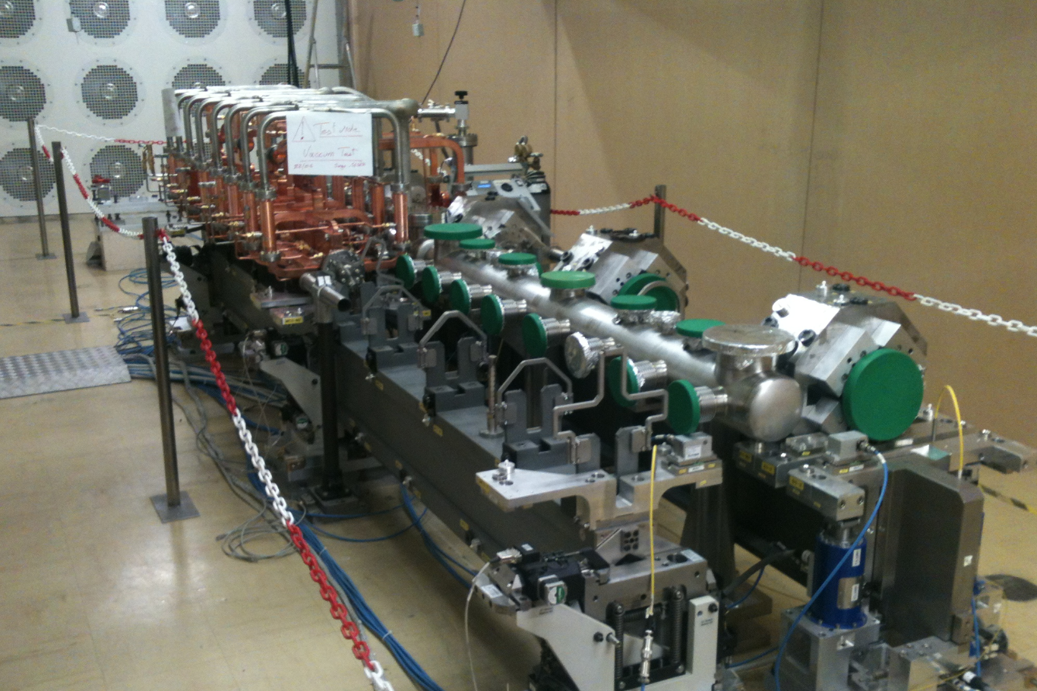
Description of Two Beam Test Modules (TBTM)

Slide 9
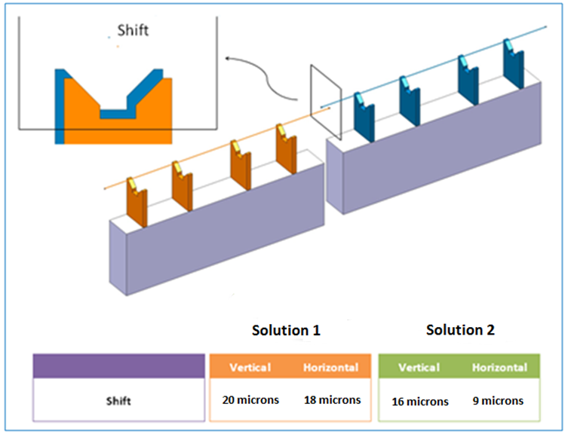
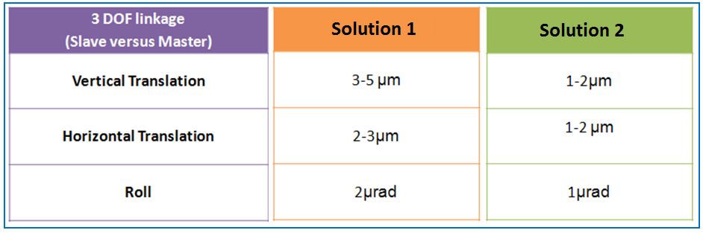
Strategy of adjustment
2 solutions of adjustment:
  Solution 1:
    Two adjacent girders are linked through a main unit acting as an articulation point
    The following side of a girder is laid on rollers of the main unit while the master side of the adjacent girder is screwed on the main unit via flexural blades
    Adjustment of the mean axis performed by playing on the clearance
  Solution 2
    Accuracy and precision needed are reached using very tight tolerances of machining for reference surfaces and components.

Slide 10
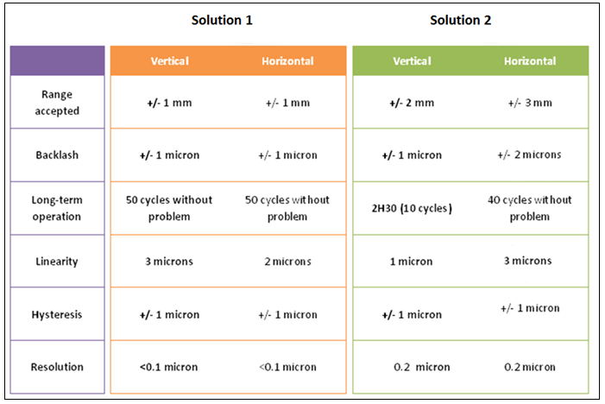
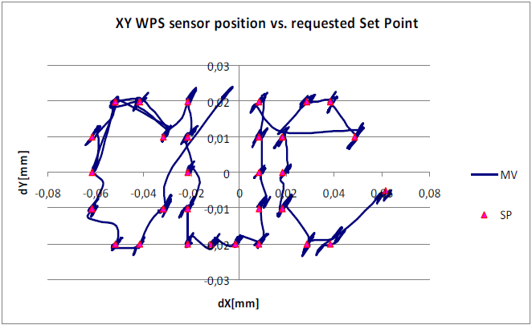
Active adjustment
All actuators (from solution 1 and 2) validated successfully, when no constraints are applied on the girders to be displaced (no vacuum, no waveguides between two girders)
Active adjustment of the master cradle and its associated girder, based on sensor readings and fiducialisation measurements, has been validated successfully for relative measurements:
➔ closed loop algorithm is convergent in maximum 2 regulation cycles at the micron level for shifts lower than ± 0.5 mm on vertical and radial axes.
The trajectory following test based on a list of coordinates of points as targets of displacements was succesfull, even though sensor noise was affecting the final regulation quality

Slide 11
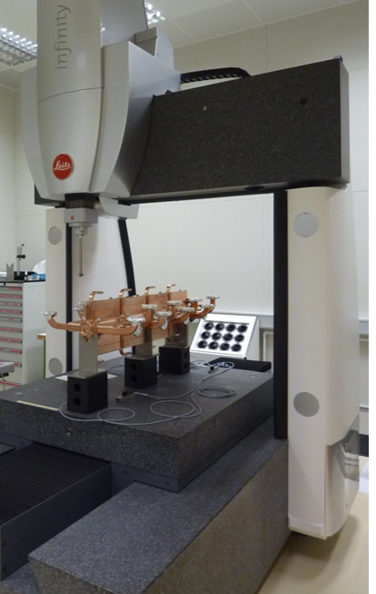
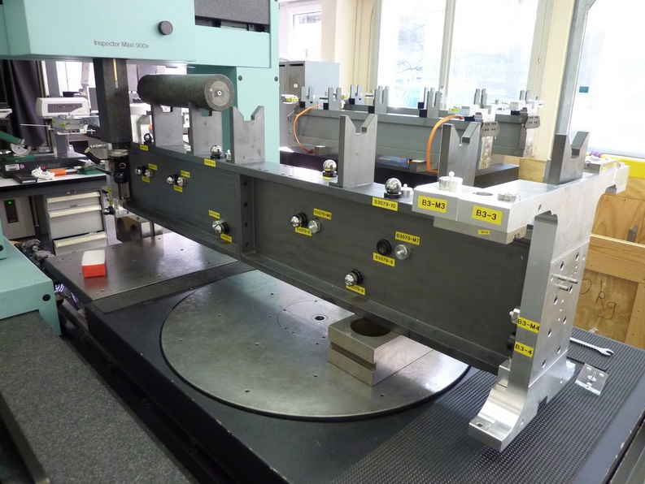
Fiducialisation and alignment on a common support
Fiducialisation of components by 3D Coordinate Measurements Machine (CMM), according to the length of components
Mean axis of the V-supports (radius of the cylinder containing the center of the V-shaped supports)
Solution 1:
  radius = 6 μm (radial),
  radius = 4μm (vertical)
Solution 2:
  radius = 7.5 μm (radial)
  radius = 5.5 μm (vertical)
Uncertainty of measurement: ± 6 μm (3σ)
MPPE: 0.3 μm + 1 ppm
Fiducialisation of the girder assembly : accuracy of measurement estimated to ± 15μm as the volume of measurement of the CMM is not sufficient.
Alignment on site: combination of AT401 (laser tracker) and Romer arm measurements, allowing a precision and accuracy below 10 μm
In some cases, the adjustment system on support did not allow a sufficient resolution (not better than 20 μm)

Slide 12
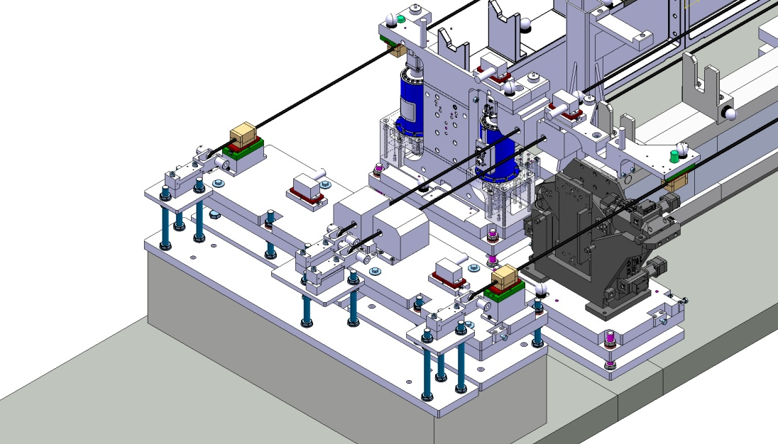
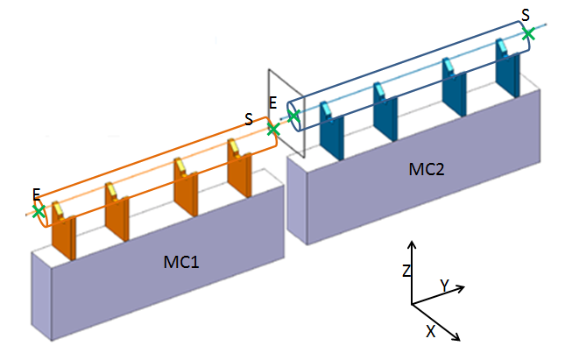
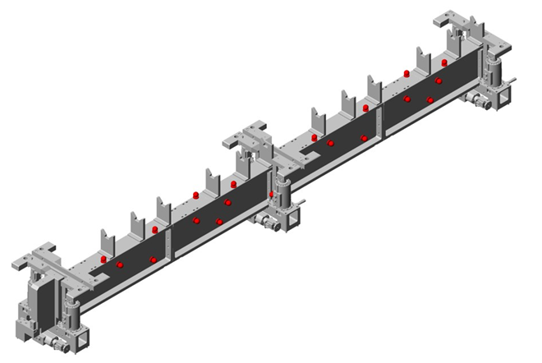
Validation of the global strategy
Determination of the mean axis of the V-shaped supports by two different methods:
AT401 (laser tracker) measurements on the fiducials measured by CMM [mean axis w.r.t. fiducials]
WPS measurements readings on the 3 balls sensor interfaces measured by CMM [mean axis w.r.t balls]
 | X (µm) | Z (µm)
MC1-E | -5 | 12
MC1-S | 10 | -5
MC2-E | -1 | -4
MC2-S | -11 | -7
Such results demonstrate the high accuracy and precision measurements performed by:
CMM
WPS sensors
AT401 measurements
Difference between coordinates of mean axis extremities calculated by 2 different methods

Slide 13
Summary: first lessons learnt
The alignment strategy on short range consists of a very accurate determination of the coordinate systems of:
  The components
  Their supports assembly
  The sensors
  combined with a micrometric adjustment
First lessons learnt:
  CMM measurements are the most precise and accurate, provided that the component or its support is shorter than the volume of measurement
  CMM measurements of fiducials as a first step combined with AT401 + Romer arm measurements as a second step provide the best solution for micrometric alignments on site. The determination of the position of components was better than 10 µm in a stable environment.
  Standard means of adjustment (shimming,…) cannot be applied without added value to micrometric alignment.
The first obtained results show that the followed strategy can be successful. The problem is that only the mechanical axis of the components was considered and not their electrical zero or magnetic axis.
➔ one solution: perform at the same time the determination of the magnetic axis and electrical zero and the CMM measurements.

