Slide 1
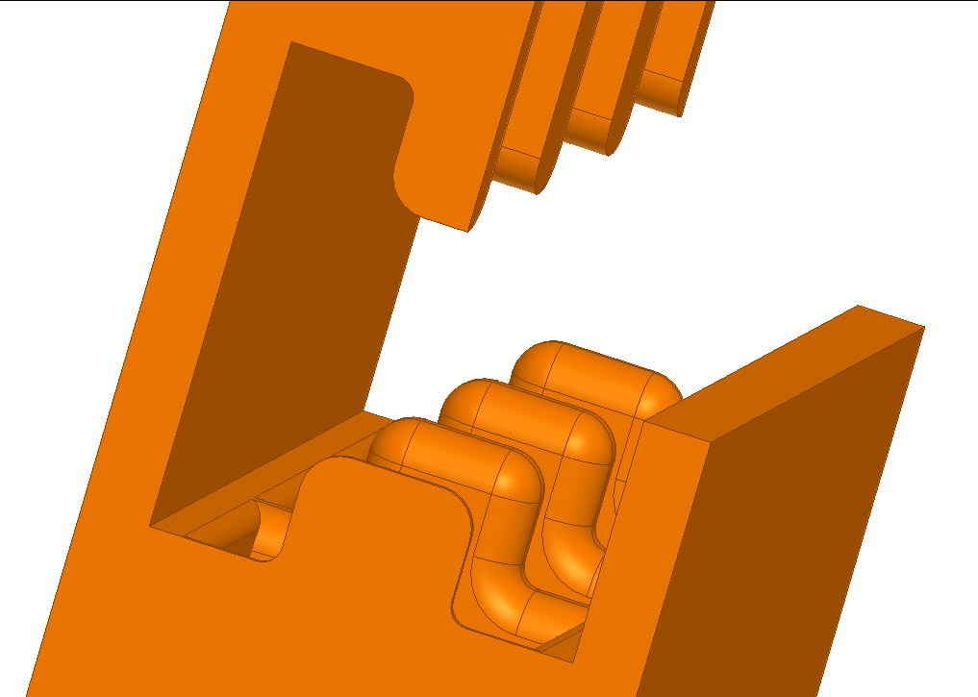


RIDGE LOADED X-BAND CRAB CAVITY FOR CLIC
Vasim Khan
30.01.2013

Slide 2


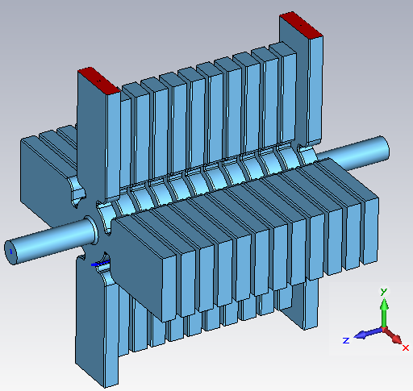
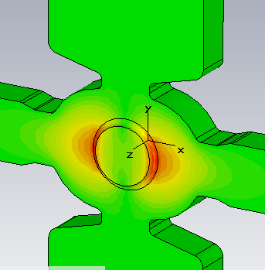
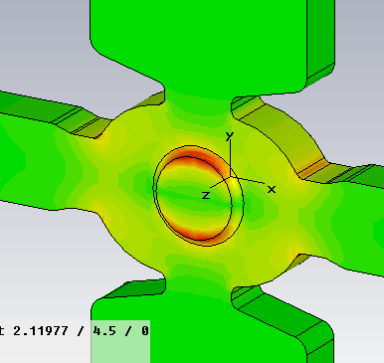
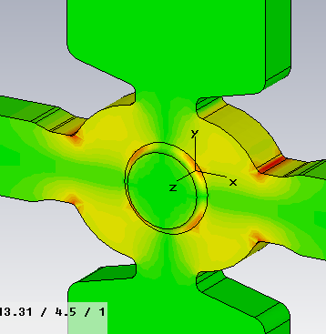
CLIC crab cavity – base line design
Racetrack cell shape
Eabs/Et | Habs/Et | Hx/Et
3.676 | 0.01169 (22 K) | 0.00605
Parameter | Value
Transverse kick (20 mrad) | 2.55 MV
Frequency, phase | 11.9942 GHz, 120 deg
Total length | 0.1 m + beampipes
Active length | 0.1 m
Iris radius, group velocity | 5 mm, -2.96 % c
Input power | 13.6 MW
Peak surface electric field | 86 MV/m
Peak surface magnetic field | 300 kA/m
Peak pulsed heating, ΔT | 20.36
Βeam loading ΔV/V_{T}(%) | Depends on beam offset
Shape | Q | R_{t}/Q | E_{s}/E_{t} | H_{s}/E_{t} | v_{gr}
Cylindrical | 6497 | 60.0 | 3.47 | 0.0126 | -2.63
Racetrack | 6524 | 61.2 | 3.68 | 0.0117 | -2.92
Courtesy of G. Burt, et. al.

Slide 3
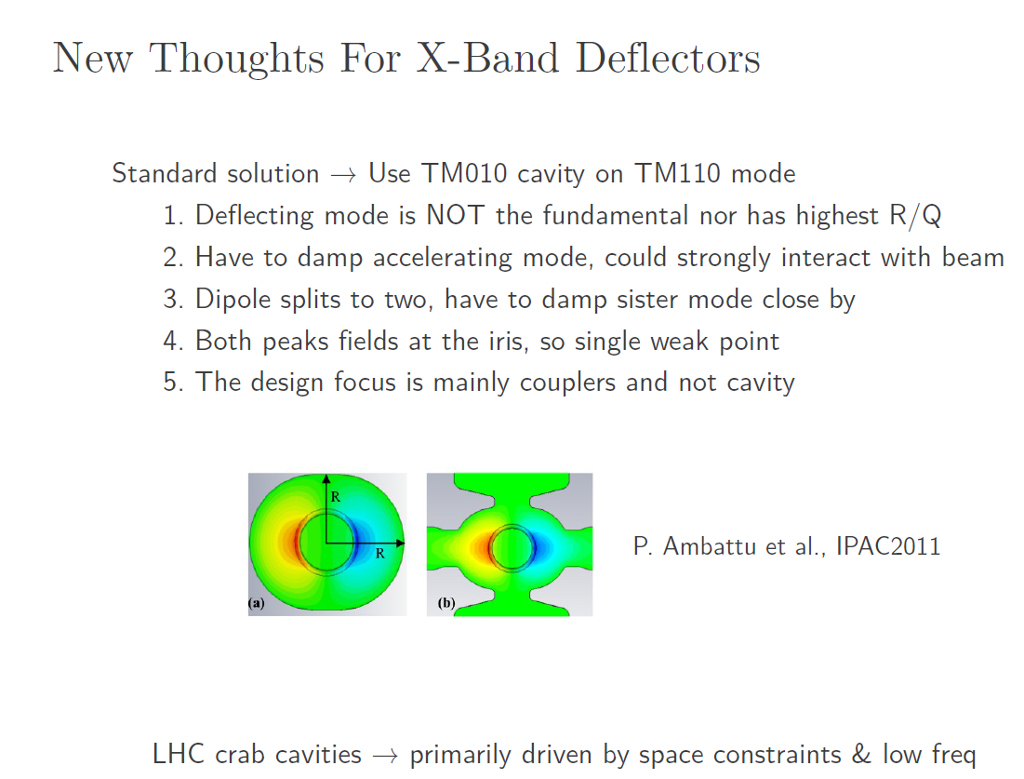
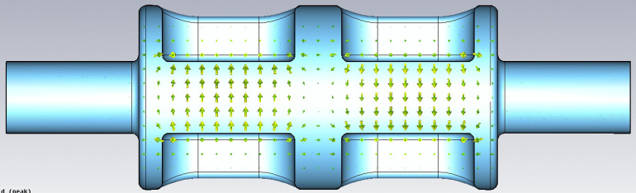
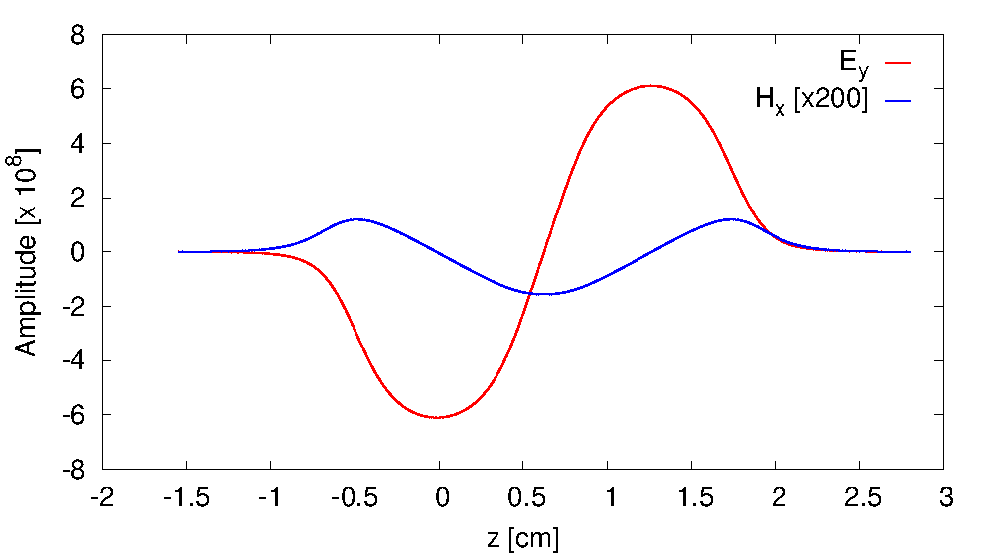
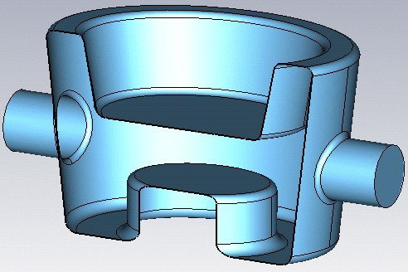
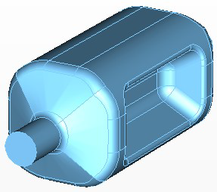
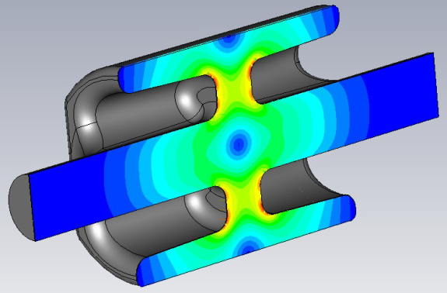
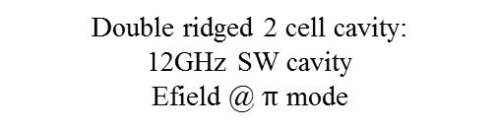
Ridge loaded waveguide structures: Rama Calaga
http://indico.cern.ch/conferenceDisplay.py?confId=178008
Double ridged 2 cell cavity:
12GHz SW cavity
Efield @ $π$ mode
12.9 mm
4.0 mm
25 mm
Three Concepts for LHC
Quarter wave
Double ridged
4-rod cavity
I. Ben-Zvi et al.
J. Delayen et al.
G. Burt et al.

Slide 4
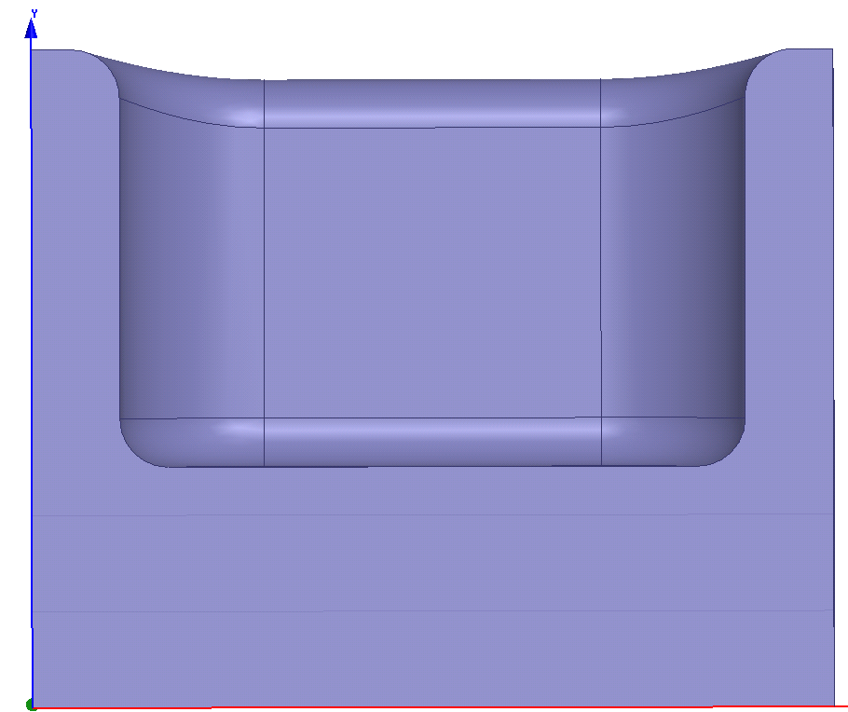
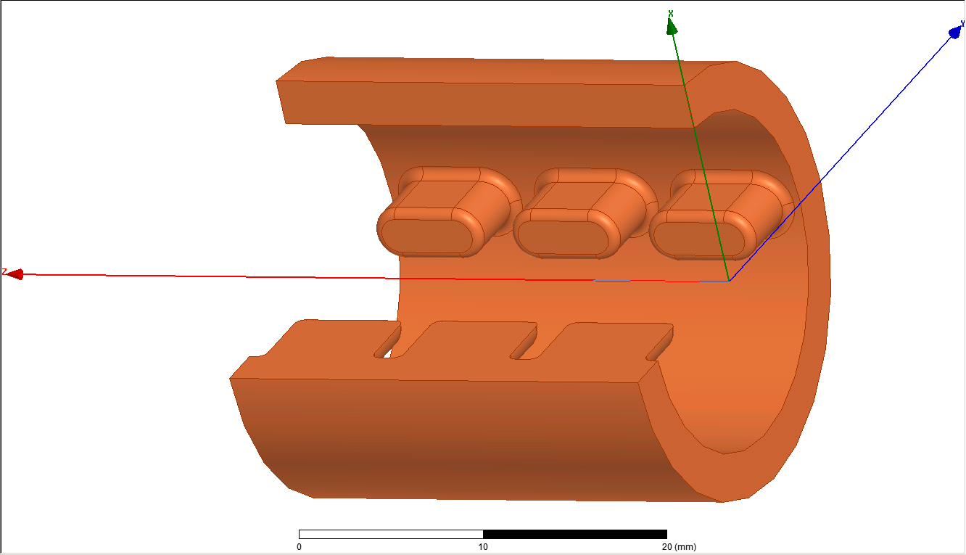
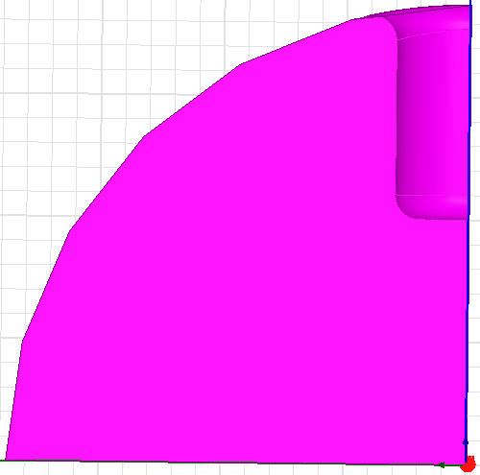
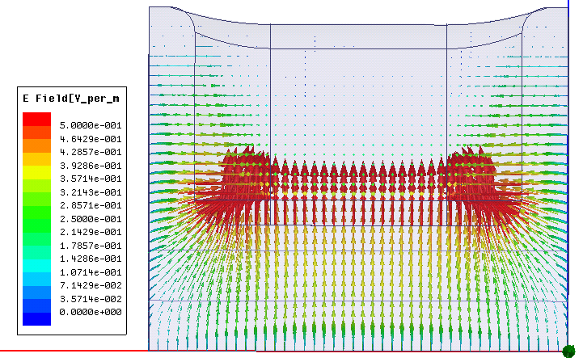
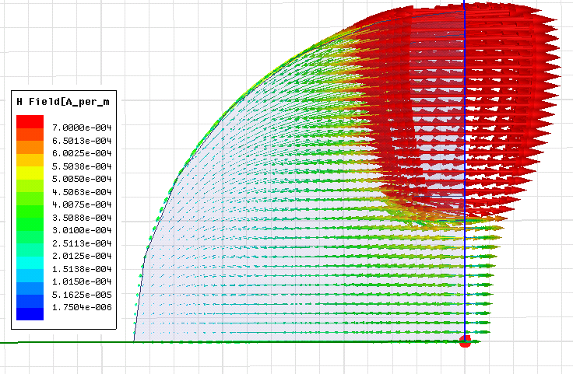
Ridge loaded crab cavity : f=12 GHz & ϕ = 2π/3
rz
t/2
Beam
Beam (z)
a
Ey
rx/2
Hx

Slide 5
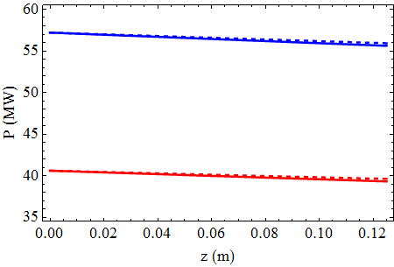
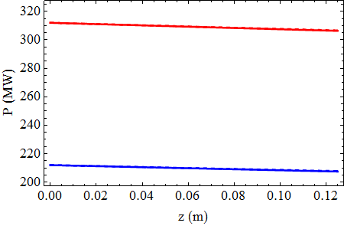
Ridge loaded crab cavity : f=12 GHz
rz (mm) | 3.5
rx (mm) | 1.5
ϕ (Deg.) | 120
a (mm) | 2.5 | 3.0
Q | 3937 | 4076
R/Q (Ω) | 112 | 83.2
v_{g}/c (%) | 32.4 | 34
rz (mm) | 3.5
rx (mm) | 1.5
a (mm) | 5.0
ϕ | 120 | 150 | 180
Q | 4556 | 5562 | 6426
R/Q (Ω) | 17.78 | 23.18 | 23.6
v_{g}/c (%) | 39.73 | 28.1 | 0
a = 3.0 mm
ϕ = 2π/3
Nc=15
ϕ = 2π/3
Nc=15
Vt= 2.55 MV
-- Unloaded
- Loaded
a=5.0 mm
Vt= 2.55 MV
a = 2.5 mm
ϕ = 5π/6
Nc=12
Beam offset = 0.4 mm
Circular shape of the cavity may not be so efficient!
Need to reduce v_{g} without much change in R/Q

Slide 6
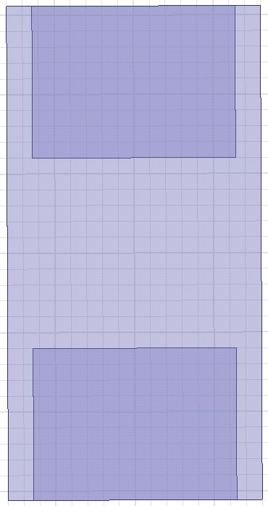
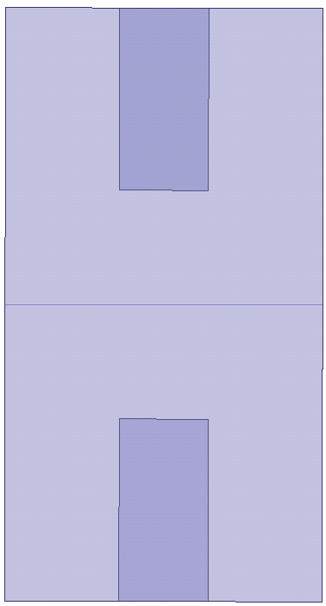
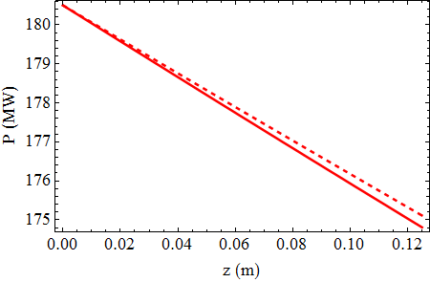
Rectangular cell: One extra handle to tune χ
where the parameter needs to be minimised is
rx
t/2
a (mm) | 5.0
t (mm) | 3.0
rx (mm) | 2.0
X (mm) | 12.0
Y (mm) | 18.24
Q | 3798
(R/Q)_{T} (Ω) | 21.26
v_{g}/c (%) | 27.31
Pin | 170.4
χ (m²/Ω/sec) | 32092.7
rz
Beam (z)
Beam (z)
Y
2a
ϕ = 2π/3
Nc=15
Vt= 2.5 MV
Beam offset = 0.4 mm
-- Unloaded
- Loaded
X
Z

Slide 7
Optimisation scan
ϕ = 5π/6
Nc=12
Et = 20 MV/m
Vt= 2.5 MV
t=6.0 mm

Slide 8
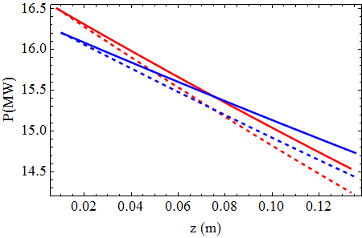
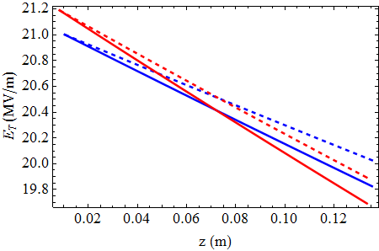
Un-damped const. imp. structure
16.5
ϕ = 2π/3
Nc = 15
Et = 20 MV/m
Vt= 2.55 MV
Loaded
-- Unloaded
Target for (ΔV/V =0.5 %) => χ = 2770
16.2
X (mm) | 8 | 9.38
a (mm) | 3.0 | 3.0
rx/X (%) | 40 | 40
Φ (Deg.) | 120 | 150
t (mm) | 6 | 6
rz (mm) | 2.332 | 4.4145
Q | 3271 | 3864
R/Q (Ω) | 68.91 | 97
v_{g}/c (%) | 7.64 | 8.6
χ (m²/Ω/sec) | 2771 | 2769
No of cells | 15 | 12
P (MW) | 16.5 | 16.2
ΔV/V (%) | 0.5 | 0.5
ϕ = 5π/6
Nc = 12
Et = 20 MV/m
Vt= 2.55 MV
Beam offset = 0.4 mm
V_{T} =2.55 MV

Slide 9
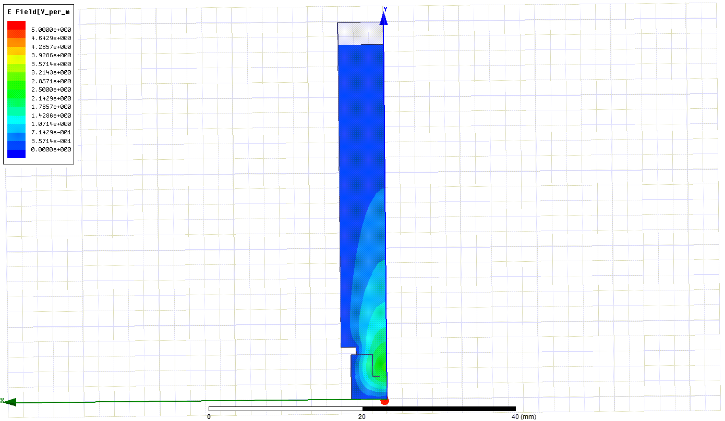
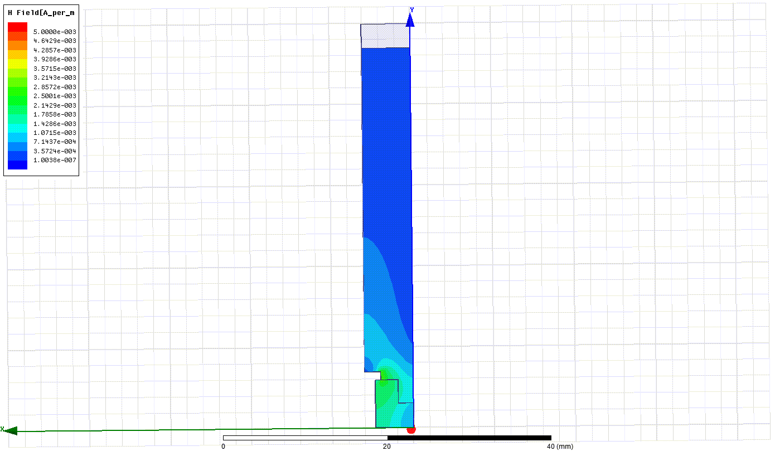
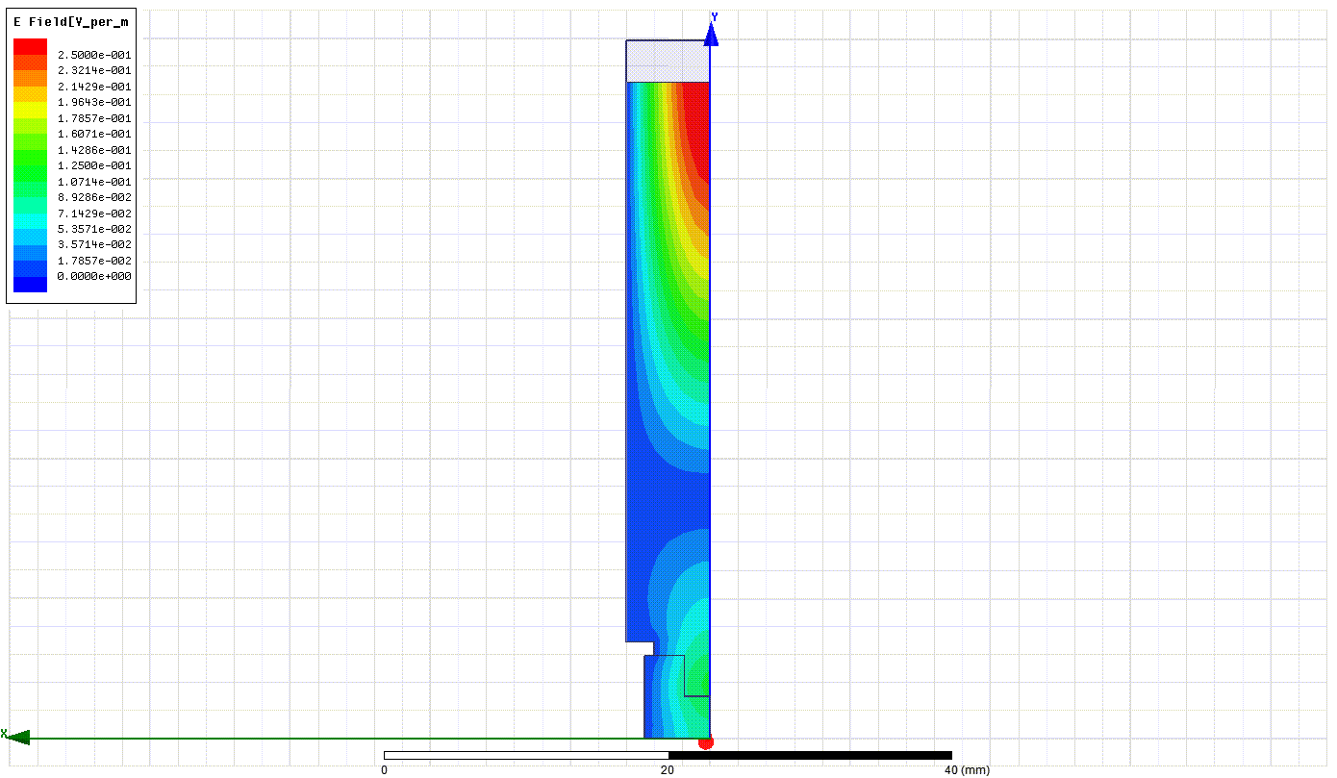
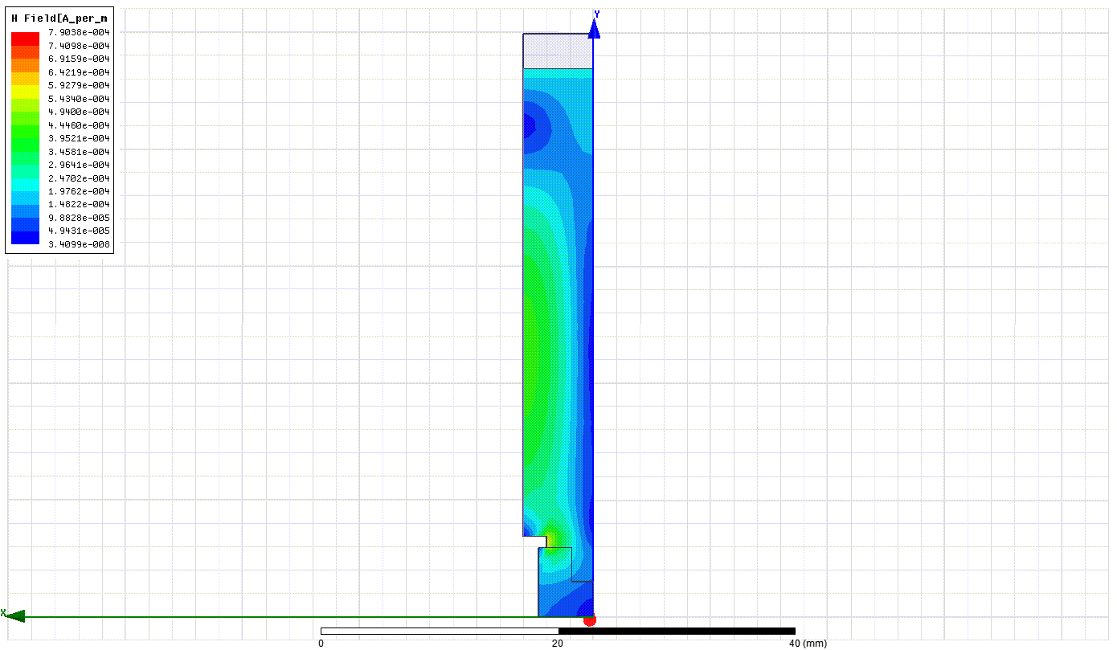
Waveguide damping
F=11.99 GHz
Q=3246
θ = 150 deg
vg/c=2.8 %
R/Q=125 Ω
χ = 693 (m²/Ω/sec)
Φ=150 deg.
F=12.8
Q=25
θ = 166 deg
X=9.38 mm
t=6 mm
rx/x=40%
WGW= 12 mm
WGH= 40 mm
CW= 8 mm
CH= 1 mm

Slide 10
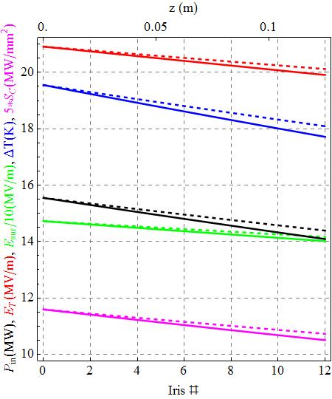
5π/6→HPA const. imp. damped structure
Φ (Deg.) | 150
a (mm) | 3.0
X (mm) | 11.72
rx/X (%) | 40
t (mm) | 6
rz (mm) | 4.4145
Y (mm) | 11.185
F (GHz) | 11.9943
Q | 4273
R/Q (Ω) | 108.5
v_{g}/c (%) | 9.45
χ (m²/Ω/sec) | 2719
No of cells | 12
P (MW) | 15.8
ΔV/V (%) | 0.51
Es (MV/m) | 147.2
ΔT (K) | 19.5
Sc (MW/m²) | 2.3
20.9
20.1
19.5
18.1
V_{T}=2.55 MV
ΔV/V=0.51 %
T_{p}=240.5 ns
15.8
14.6
147.2
Solid curves: Beam loaded
Dashed curves: Unloaded
141.6
2.3
Beam offset = 0.4 mm
2.1

Slide 11
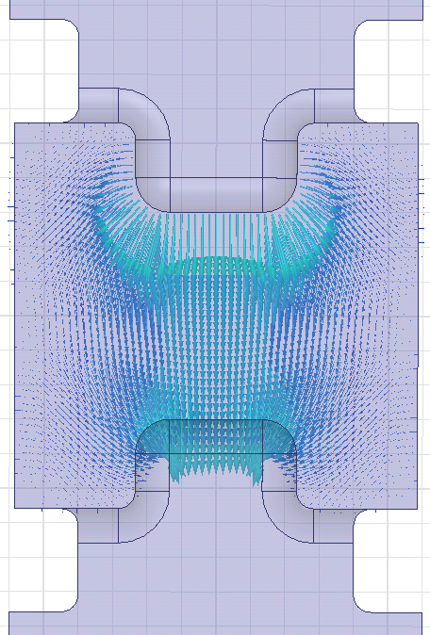
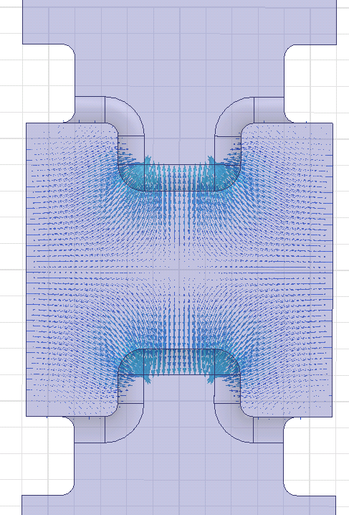

Fundamental Dipole mode
First HOM
E-field @ 12 GHz
E-field @ 12.9 GHz
HPA
Y
X
Field between
the ridges
Φ=150 deg.

Slide 12
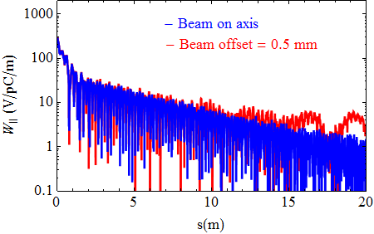
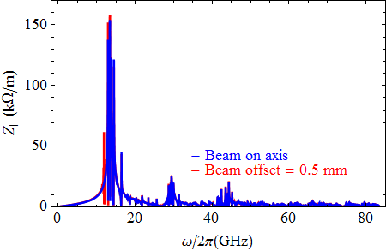
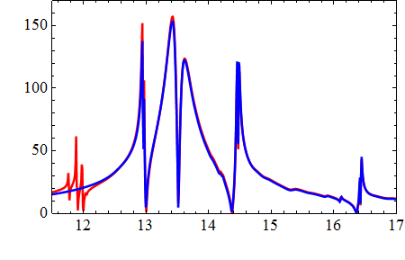
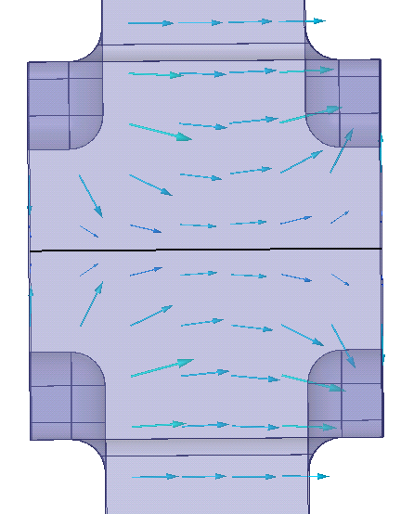
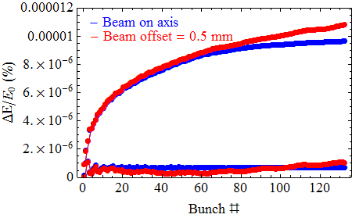
HPA: Full structure simulation
1
E-field @ 12.9 GHz
Envelope wake
Beam→
Wake with phase information
Y
Z

Slide 13
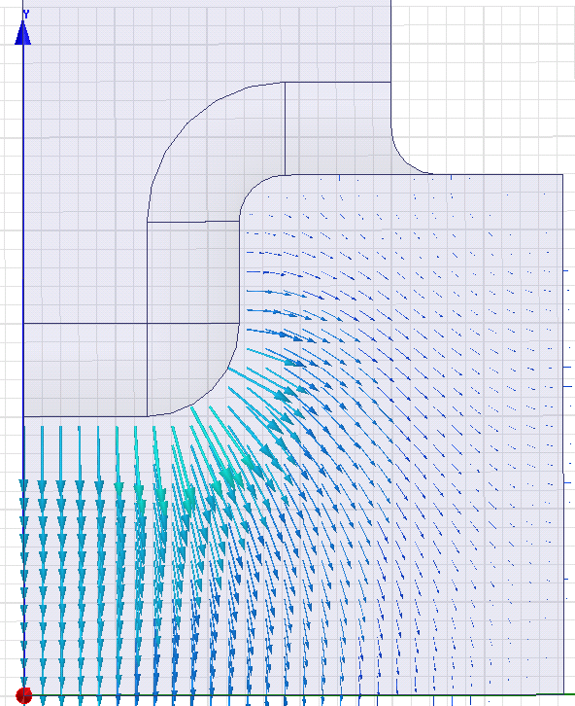
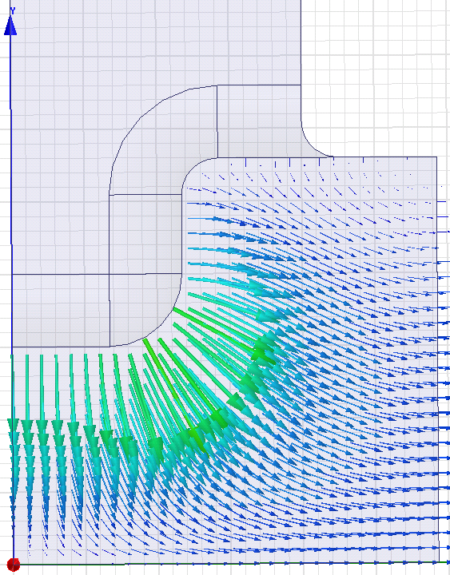
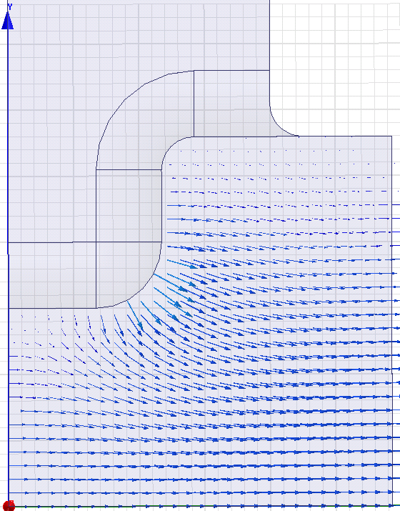
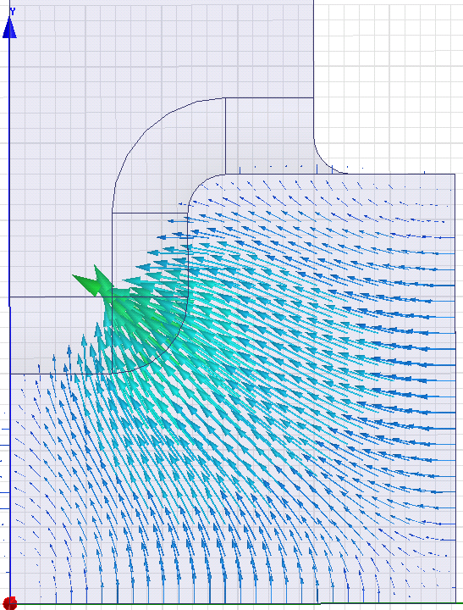
Using symmetry planes
EH : 12 GHz
HH : 12.91 GHz
E-field
HE : 17.33 GHz
EE : 23.0 GHz
Y
XY : F
X

Slide 14
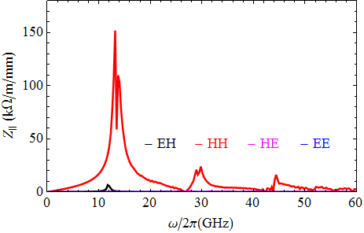
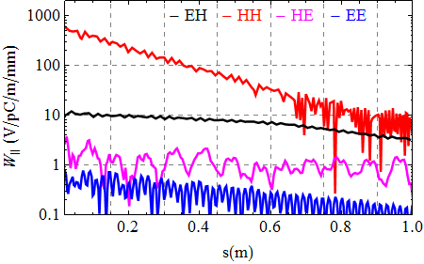
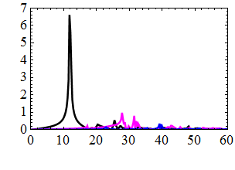
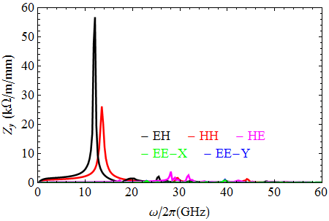
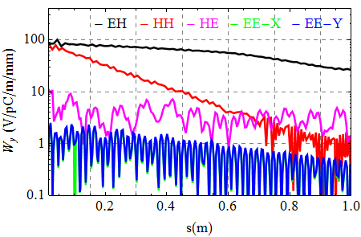
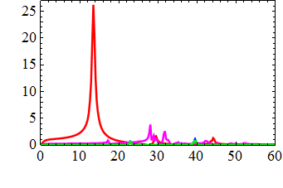
Quarter symmetry structure
Beam offset =0.5mm

Slide 15
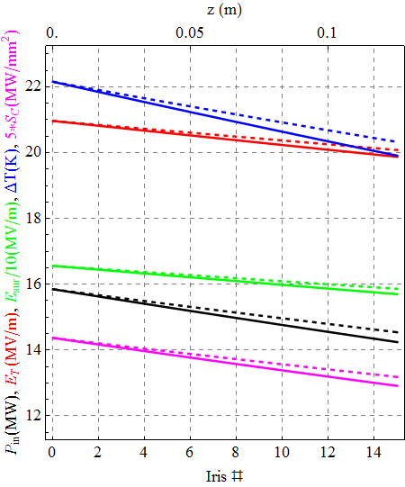
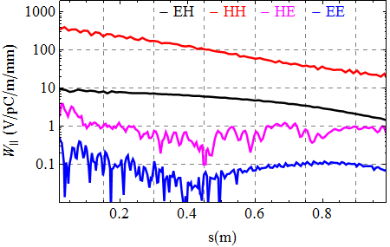
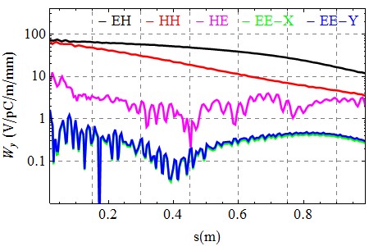
2π/3→SPA
22.2
Beam offset =0.5mm
21
20.3
V_{T}=2.55 MV
ΔV/V=0.51 %
T_{p}=240.5 ns
20.1
165.6
Solid curves: Beam loaded
Dashed curves: Unloaded
15.85
158.6
2.87
14.5
2.64
Beam offset = 0.4 mm

Slide 16
Summary
Cavity type | Base line | Ridge loaded
Φ (Deg.) | 120 | 120 | 150
a (mm) | 5.0 | 3.0 | 3.0
(R/Q) (Ω) | 50* | 87.85 | 108.5
v_{g}/c (%) | 2.96 | 9.56 | 9.45
χ (m²/Ω/sec) | 1458* | 2718 | 2719
No of cells | 12 | 15 | 12
P (MW) | 13.4 | 15.85 | 15.8
ΔV/V (%) | 0.61* | 0.51 | 0.51
Es (MV/m) | 86 | 165.6 | 147.2
ΔT (K) | 20.4 | 22.2 | 19.5
Sc (MW/m²) | * | 2.87 | 2.3
* To be checked

Slide 17
Remarks
There is no obvious difference between SPA and HPA ridge cavities
Input power requirement is comparable to the base-line design
Pulsed temp rise seems to be comparable, surface E-field is higher
Almost no contribution from the higher order dipole modes
HOMs still need to be investigated carefully!
Longitudinal wake seems just on the edge of the acceptable limit.
Detailed beam dynamics calculations to be done for beam stability
Further development in the structure: subject of discussion
Acknowledgements
Many thanks to Rama Calaga for suggesting this topic and Alexej Grudiev for his guidance!
Also thanks to Praveen Ambattu and Graeme Burt for updates on the base-line design!
Thank you!

Slide 18
Additional slides

Slide 19
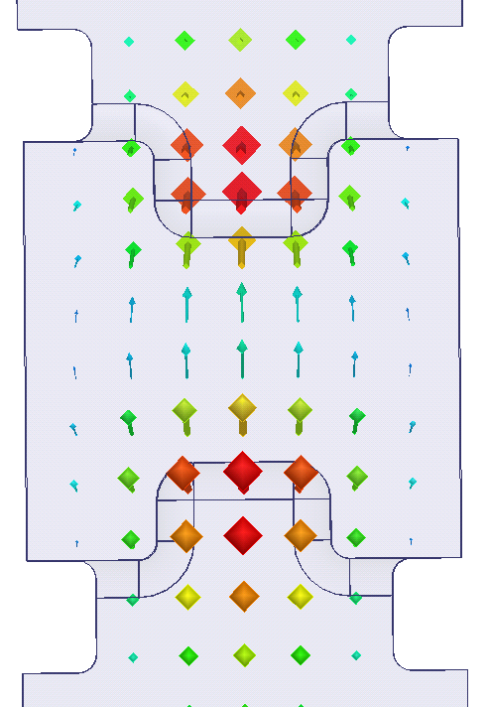

Fundamental Dipole mode
First HOM
E-field @ 12 GHz
E-field @ 12.9 GHz
HPA
Y
X
Field between
the gaps

Slide 20


ϕ = 2π/3
Nc=15
Vt= 2.5 MV
Eacc = 20 MV/m
t (mm) | 3.0
rx (mm) | 2.0
X (mm) | 12.0 | 12.0
Y (mm) | 12.97 | 18.24
a (mm) | 2.75 | 5.0
Q | 3994 | 3798
(R/Q)_{T} (Ω) | 92 | 21.26
v_{g}/c (%) | 34.66 | 27.31
Pin | 49.7 | 170.4
χ (m²/Ω/sec) | 9360.6 | 32092.7
172
143
161
150

Slide 21






HPA
Beam offset =0.0
Beam offset (Y) =0.5mm
Full structure
Beam on axis
Envelope wake
Envelope wake
Wake
Wake

Slide 22
ϕ = 2π/3
Nc=15
Et = 20 MV/m
Vt= 2.5 MV
t=2.0 mm

Slide 23




Quarter symmetry structure
Beam offset =0.5mm

Slide 24




The WG mode
E-centre
E-centre
E-front
F=12.5
Q=160
R’/Q=434 Ω/m (on axis)
=465 Ω/m (0.5m off)
θ = 159 deg

Slide 25



HPA
Full structure
Beam on axis
W_{x}
W_{y}
12.94
Z_{x}
Z_{y}
14.45
16.4
Envelope wake
Wake

Slide 26




HPA
Full structure
Beam offset =0.5mm
11.9
Z_{x}
Z_{y}
W_{x}
W_{y}
12.9
Envelope wake
Wake

Slide 27






SPA
SPA
Full structure
Beam on axis

Slide 28







SPA
Full structure
Beam offset =0.5mm

Slide 29



SPA
HPA
HHBC
offset = 0 mm

Slide 30





offset = 0.5 mm
HHBC

Slide 31




Only dipole modes: EHBC quarter symmetry
Off set = 0.25 mm
Off set = 0.5 mm
HPA
HPA

Slide 32

Target : χ = 2770 => ΔV/V_{T} = 0.5%
a | x | rx/x | t | cw | ch | wgw | wgh | f | vg/c | Q | R/Q | χ | P | ΔV/V_{T}
mm | mm | % | mm | mm | mm | mm | mm | GHz | % | -- | Ω | m²/Ω/sec | MW | %
3.0 | 12.22 | 40 | 6.0 | 8.0 | 1.0 | 12.0 | 40.0 | 11.99 | 9.9 | 3700 | 110.4 | 2795 | 16.3 | 0.49
4.0 | 11.06 | 40 | 6.0 | 8.0 | 1.0 | 12.0 | 40.0 | 12.0 | 5.5 | 3710 | 61.2 | 2800 | 16.92 | 0.49
5.0 | 10.36 | 40 | 6.0 | 8.0 | 1.0 | 12.0 | 40.0 | 11.98 | 2.9 | 3399 | 32.3 | 2824 | 18.5 | 0.48
Quarter symmetry cell
HHBC
Monopole and quadrupole
Beam on axis : Offset = 0.0 mm

Slide 33




Quarter symmetry cell
HHBC
Monopole and quadrupole
Beam offset = 0.5 mm

Slide 34


ΔE/E0 < 10⁻⁶
ΔE/E0 < 10⁻⁶
EHBC , HHBC?

Slide 35



Offset = 0.5 mm
EHBC
HHBC
HEBC
EEBC-X
EEBC-Y

Slide 36

Higher order modes with deflecting mode @ ϕ = 5π/6
X (mm) | 8
a (mm) | 3.0
rx/X (%) | 40
t (mm) | 6.0
Φ_{T} (Deg.) | 150
HOM | f | k_{T} @ 0.4mm | k_{T} @ 1mm
# | GHz | V/pC | V/pC
0 | 11.9946 | 6.8x10⁻³ | 44x10⁻³
1 | 12.73 | 0.239 | 0.273
2 | 16.27 | 1.5x10⁻¹⁰ | 2x10⁻¹⁰
3 | 20.40 | 1.3x10⁻⁸ | 7.5x10⁻⁸
4 | 20.89 | 1.6 | 1.579
5 | 22.56 | 0.025 | 0.153
6 | 24.63 | 1.8x10⁻³ | 10.7x10⁻³
7 | 27.64 | 5.9x10⁻⁸ | 5.8x10⁻⁸
8 | 30.02 | 1.8x10⁻⁸ | 1.1x10⁻⁸
9 | 30.72 | 1.2 | 0.913

Slide 37
# | Roundings |  |  |  | CH | a | b | f | E_{s}/E_{t} | H_{s}/E_{t} | S_{c}/E²_{t}
 | R₁ | R₂ | R₃ | R₄
 | mm | mm | mm | mm | mm | mm | mm | GHz | -- | mA/V | mA/V
1 | 1.0 | 0.5 | 0.5 | 1.5 | 3.0 | 3.0 | 5.5411 | 11.9945 | 8.1 | 13.96 | 13.0
2 | 1.0 | 0.5 | 0.5 | 1.0 | 3.0 | 3.0 | 5.4706 | 11.9942 | 6.95 | 14.7 | 5.9
3 | 1.0 | 0.5 | 0.5 | 0.5 | 3.0 | 3.0 | 5.4218 | 11.9943 | 7.8 | 18 | 7.38
4 | 1.0 | 0.5 | 0.5 | 1.5 | 3.0 | 4.0 | 6.7453 | 11.9936 | 10.8 | 29.5 | 12.49
5 | 1.0 | 0.5 | 0.5 | 1.0 | 3.0 | 4.0 | 6.7722 | 11.9941 | 9.1 | 26.4 | 7.48
6 | 1.0 | 0.5 | 0.5 | 0.5 | 3.0 | 4.0 | 6.8143 | 11.9941 | 9.2 | 25.1 | 9.75
7 | 1.0 | 0.5 | 0.5 | 0.5 | 3.0 | 5.0 | 8.035 | 11.9945 | 15.02 | 40.1 | 27.8
8 | 1.0 | 0.5 | 0.5 | 1.0 | 3.0 | 5.0 | 8.055 | 1.9942 | 13.7 | 36.8 | 12.44
9 | 1.0 | 0.5 | 0.5 | 1.5 | 3.0 | 5.0 | 8.0883 | 11.9945 | 14.8 | 37.4 | 17.46

Slide 38
What we need ?
or
For Nc= 15 @ 120 deg ph. adv.
Can we calculate require power same as we do in acc. str. ?
Units don’t match for the third term ☹
They do after some correction ☺
Is it correct though?

