Slide 1


Beam Loss Monitoring
S.Mallows, E.B.Holzer, J. van Hoorne M.Zingl, L.Devlin

Slide 2
Overview
CLIC BLM Considerations
  Machine Protection Strategy
  Expected Beam Losses in the 2 beam modules
Ionization Chambers as a Suitable Baseline Technology Choice
  Dynamic Range, Sensitivity
Investigation of Cherenkov Fibers as an Alternative Technology Choice
  Model for light yield
  Longitudinal Position Resolution with Fiber
  Radiation Hardness

Slide 3
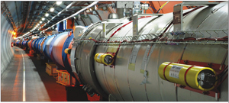
Beam Loss Monitors
  A BLM typically sits outside the vacuum chamber and measures the secondary particle shower resulting from beam loss
  Used for machine protection and beam diagnostics

Slide 4
CLIC Machine Protection Strategy
Based on Passive protection and a “Next cycle permit”
  Primary role of the BLM system as part of the Machine Protection System is to prevent subsequent injection into the Main Beam linac and the Drive Beam decelerators when potentially dangerous beam instabilities are detected
  Option of CLIC at 100Hz → Minimum Response time <8ms required by BLMs to allow post pulse analysis
Notes:
Pilot Beams
Main Beam
First injection into linac: 6 bunches, in 10ns spacing
Drive Beam
First injection: 30 bunches, 24 * 83 ps spacing

Slide 5
Standard Operational Losses
Limits in the Two Beam Modules
  Activation (Residual Dose Rates – Access Issues)
  Damage to beamline components
  Damage to electronics (SEE’s, Lattice Displacement, Total Ionizing Dose)
  Beam dynamics considerations (luminosity losses due to beam loading variations)
      10⁻³ of full intensity of the Main Beam over 21km linac
      10⁻³ of full intensity of the Drive Beam over ~875m decelerator
        How are the losses distributed over the length of the decelerator?
        → Recent discussions with Guido Sterbini, Jakob Esberg to define estimation
Notes:
that the average losses are related to the nominal beam envelope since all static errors are corrected and the jitter contribution is averaged out;

Slide 6
Loss Scenarios
  Dust particles falling into beam (‘UFOs’), misalignments, etc
  Possible failure scenarios in two beam modules under investigation (PLACET Simulations, CERN: TE-MPE-PE)
  Consider destructive limits (fraction of beam hitting single aperture).
      [ Destructive potential: not determined by Beam Power but by Power Density, i.e. Beam Charge/ Beam Size
    Main Beam (damping ring exit) 10000 * safe beam
      0.01 % of bunch – 1.16e8 electrons
    Drive Beam decelerators 100 * safe beam
      1.0% of a bunch train 1.53e12 electrons

Slide 7
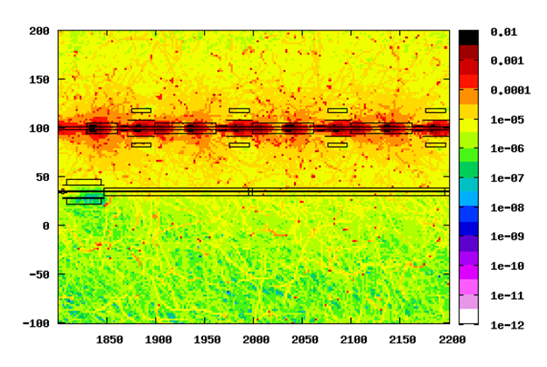
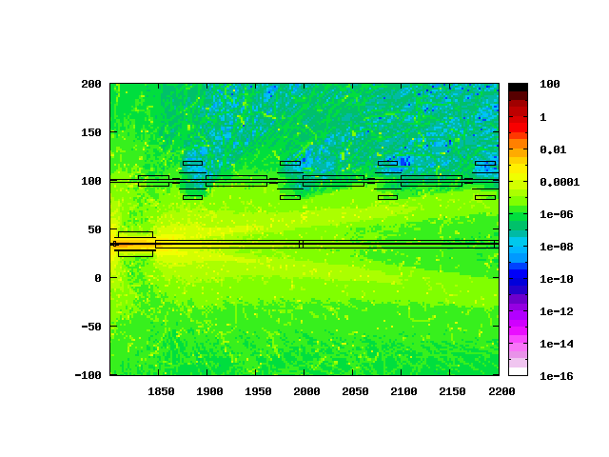
BLM Requirements (as specified in CDR )
  Sensitivity
  Standard Operational Losses
  FLUKA: Loss distributed longitudinally
  Lower Limit of Dynamic Range: 1% loss limit for beam dynamics requirements
  10⁻⁵ train distributed over MB linac, DB decelerator [NB! Assumed uniform losses along decelerators/linacs ]
  Dynamic Range - Upper Limit
  Detect onset of Dangerous losses
  FLUKA: Loss at single aperture
  Upper Limit of Dynamic Range, 10% destructive loss (desirable)
    0.1% DB bunch train, 0.001% bunch train MB
  Example: Spatial distribution of absorbed dose for maximum operational losses distributed along aperture (DB 2.4 GeV) Scaling: 10⁻³ bunch train/875m
  Example: Spatial distribution of absorbed dose resulting from loss of 0.01% of 9 GeV MB bunch train at a single aperture

Slide 8
Ionization Chambers for TBMs
Ionization Chambers fulfill necessary requirements for machine protection and diagnostics
  LHC Ionization Chamber + readout electronics
    Dynamic Range 10⁵ (10⁶ under investigation)
    Sensitivity 7e10⁻⁹ Gy
  See: CLIC CDR
But: Large number of BLMs required – cost concern
  >45 thousand quadrupole magnets over 42 km (41.5 thousand in the decelerator modules)
→ Investigate Alternative Technologies for the Two Beam Modules in the post CDR phase
  Technologies that cover a large distance along the beamline
  E.g. long ionization chambers, optical fibers
Notes:
Ionization Chambers fulfill necessary requirements for machine protection and diagnostics
LHC Ionization Chamber + readout electronics
Dynamic Range 10⁵ (10⁶ under investigation)
Sensitivity 7e10⁻⁹ Gy
See: CLIC CDR
But: High costs due to the large number of BLMs required
>45 thousand quadrupole magnets over 42 km (41.5 thousand in the decelerator modules)
→ Investigate Alternative Technologies

Slide 9
Cherenkov Fiber BLM
  Advantages
    Only sensitive to charged particles → Insensitive to gamma radiation (and therefore background from activation)
    Very small, diameter <1mm
    Quartz is radiation hard (c.f. scintillating fibers)
    Insensitive to magnetic field, temperature fluctuations.
  Disadvantages
    Lower Sensitivity c.f. scintillating fibers (which give about 1000 times more light output)
      A low proportion of the produced Cherenkov light reaches fiber end face
    Angular dependent response
    Radiation Effects: Radiation Induced Attenuation

Slide 10
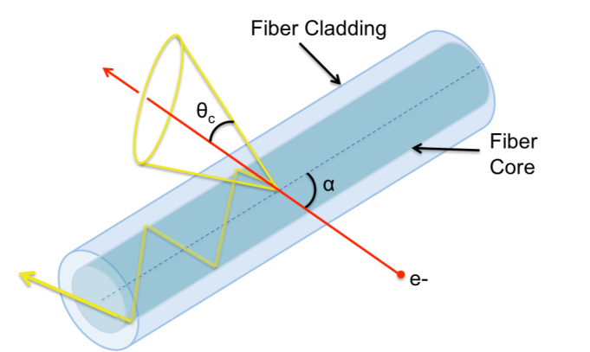
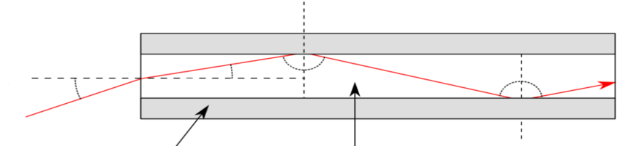
Cherenkov Fiber BLM
When a charged particle with v>c enters the fiber, photons are produced along Cherenkov cone of opening angle
Detect photons that are produced, trapped and propagate to the fiber end face and exit in the nominal acceptance cone
‘Typical’ Fiber BLM: detect upstream photons
α - angle between particle track and fiber axis
β - particle velocity
nominal acceptance
cone
t= Δ z/c
c
t=0
t=Δ z/c
+ Δ z/(c.2/3)
2/3c
2/3c
2/3c
fiber
photon detector
Notes:
Need to Consider:
The number of photons generated in fiber
The fraction of those photons transmitted
As a function of β and α
The fraction exiting the fiber (i.e. within the nominal exit cone)
for a given fiber diameter and Numerical Aperture (NA)

Slide 11
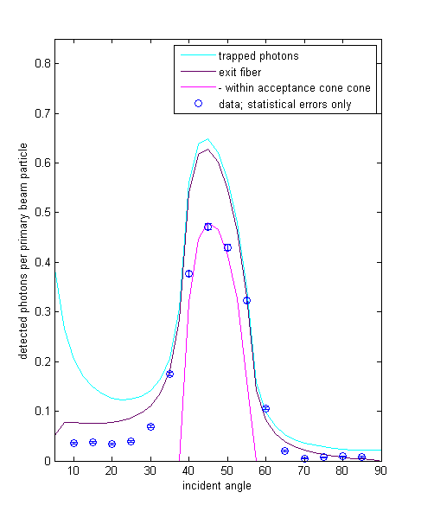
Light Yield in Fiber
J. van Hoorne
Model to calculate probability as function of incident particle velocity and angle:
  P_{t} :trapping produced photons inside the fiber
  P_{e} :photons exiting at the fiber end face
  P_{e,a}: photons exiting within ‘acceptance’ cone
Test beam measurements with 120 GeV protons to compare with model:
  Angular dependency
  Diameter dependency
  Time dispersion
Analytical expression from: S.H. Law et al.,
Appl. Opt. 45(36):9151-9159, 2006
Results Angular dependency of the photon yield in a fiber (d_{fiber}=0.365mm, NA=0.22, L_{fiber}~4m)
α - angle between particle track and fiber axis; β - particle velocity;

Slide 12
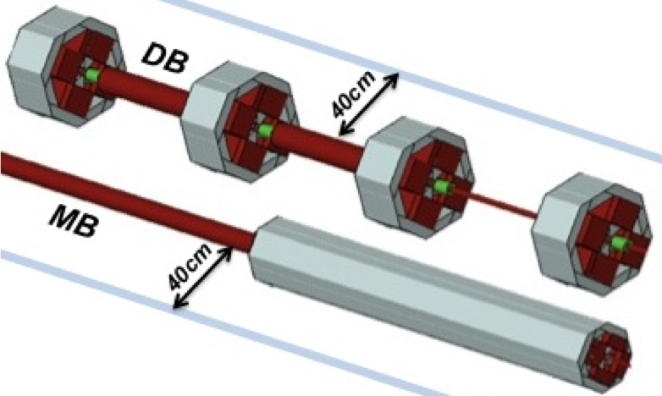
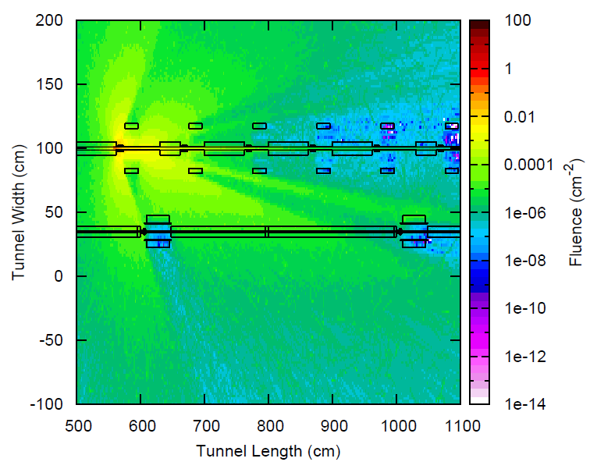
Cherenkov Fibers as a BLM for CLIC
FLUKA simulations
Score angular and velocity distribution of charged particles at fiber locations and use as input to determine the photon signal
Initial study in post CDR phase indicated fibers as feasible option in terms of sensitivity and dynamic range for drive beams (IPAC, 2011)
  Tables [Scaling: Loss assumptions as specified in CDR]
Blue lines indicate location of boundaries for scoring particle shower distribution (5cm high)
Destructive Loss | N_{ph}/train downstream | N_{ph}/train Upstream
DB 0.24 GeV | 4.3∙10⁷ | 2.8∙10⁷
DB 2.4 GeV | 5.4∙10⁸ | 3.7∙10⁸
 | Sensitivity (N_{ph}/train) | Dynamic Range
DB 0.24 GeV | 2∙10³ | 4∙10³
DB 2.4 GeV | 4∙10³ | 3∙10³
e+/e- fluence per primary electron impacting at single location
Notes:
Number of photons exiting within the acceptance cone; loss at a single aperture; d=365µm; NA = 0.22
Dynamic Range for downstream detection: Considered Arrival duration of the photons 100m fiber (410ns)
Not including Attenuation

Slide 13
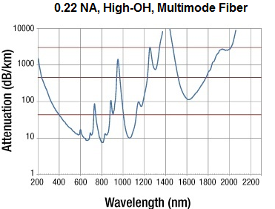
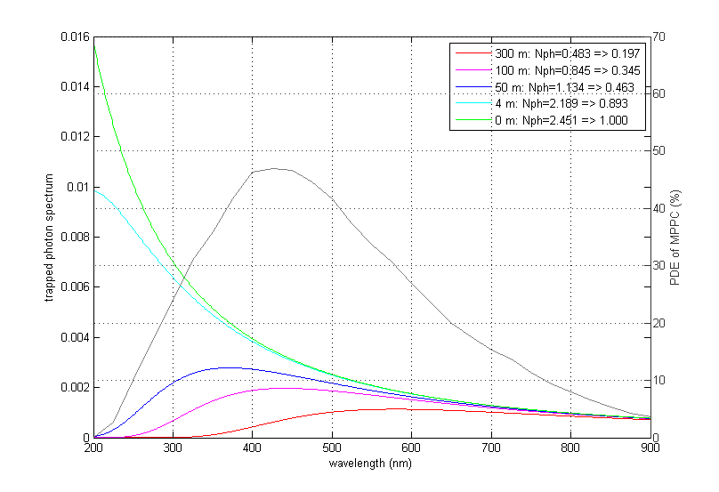
Attenuation
In the UV/VIS range (λ=300 to 700nm) the dominant attenuation effect in optical fibers is Rayleigh Scattering; attenuation coefficient is proportional to λ⁻⁴.
Therefore, for fibers longer than 200m the blue/green part of the radiation spectrum becomes insignificant
→ Fibers should not be longer than ≈100m
Photon spectra after propagation through quartz fiber
Example of photon efficiency of a Hamamatsu MPPC
Additional absorption bands from impurities
photon yield [a.u.]
Photon detection efficiency of MPPC [%]

Slide 14
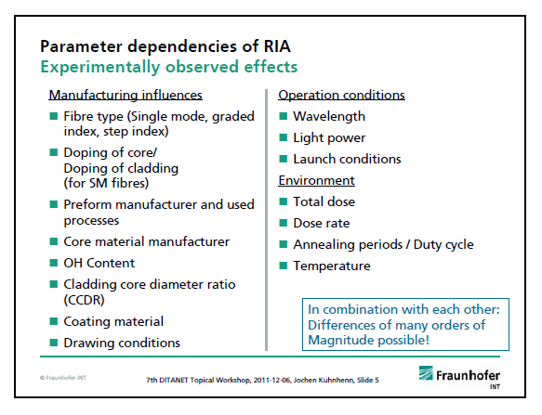
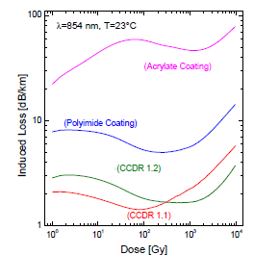
Radiation Effects in Multimode Fibers
All properties are changed (some only at high doses)
  Including Refractive Index, bandwidth, and mechanical properties
Most Important: Increase in attenuation (Radiation Induced Attenuation -RIA)
  Depends on radiation environment , fiber materials and manufacturing conditions
  Some general rules of thumb for rad hardness: Fluorine, not phosphorus-doped, High OH content, J.Kuhnhenn, 7th DTANET Topical Workshop
  → Careful selection and radiation testing is necessary
J.Kuhnhenn
Example: Coating /CCDR influence on RIA in Step Index Fibers

Slide 15
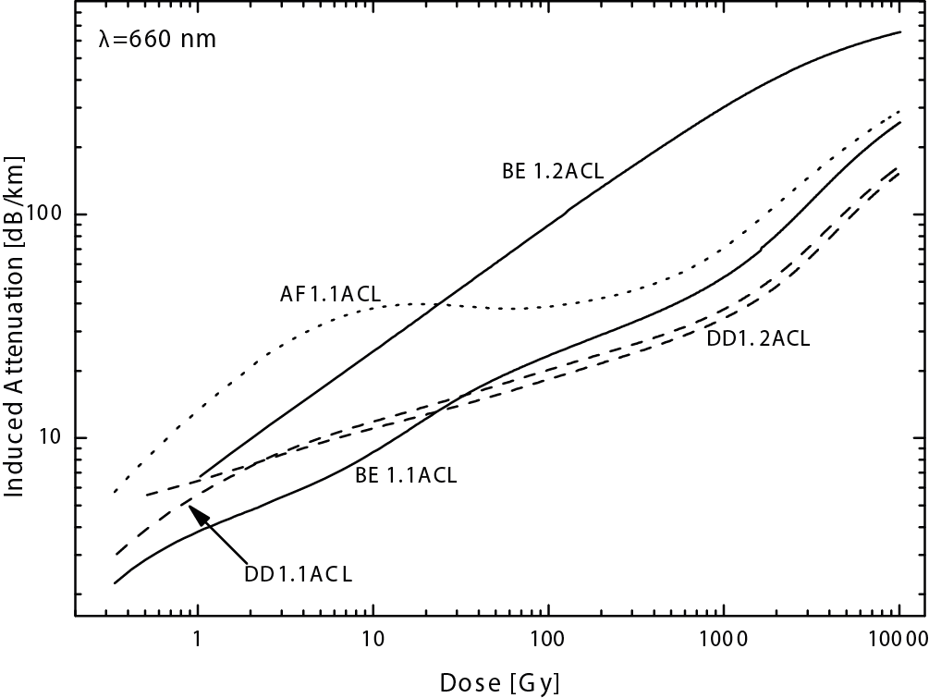
Radiation Hardness Cherenkov Fibers
CLIC radiation environment: Conservative estimates - 50kGy/yr near beam lines.
  Better estimate of loss distribution along drive beam linacs might reduce this.
Rad Hard Fibers
  CMS quartz calorimeter fibers: some tested ok up to 22 MGy (P. Gorodetzky et al., NIMA 361:161-179, 1995; and V. Hagopian, CMS-CR-1999-002) (wavelength dependence!)
  Kuhnhenn et al, RADECS 2005
  Perform tests at Frauenhofer Institute (early 2013) RIA at approx. 450nm for up to at least 10 kGy on 2 fibers: Heraeus preform (as installed at CTF-3), Ultrasol-fibers (Solarisation resistant)
  Radiation Induced Attenuation for various fibers measured at 660nm

Slide 16
Longitudinal Resolution Fibers
Required resolution
  Machine protection purposes
    Detecting the integrated loss signal is sufficient
  Beam diagnostics
    What is the desired longitudinal resolution ?
      (for which loss scenario)
    Quadrupole spacing is ~1m in drive beams
Achievable resolution
    Single short pulses: Fiber coupled to SiPM, 250MS/s ADC ~ 50cm
    What is the achievable resolution with long bunch trains ?
      Drive beam 244ns or 80m
      Main beam 156ns or 50m
c
bunch train
2/3c
2/3c
fiber
photon detector
photon detector

Slide 17
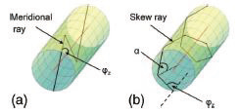
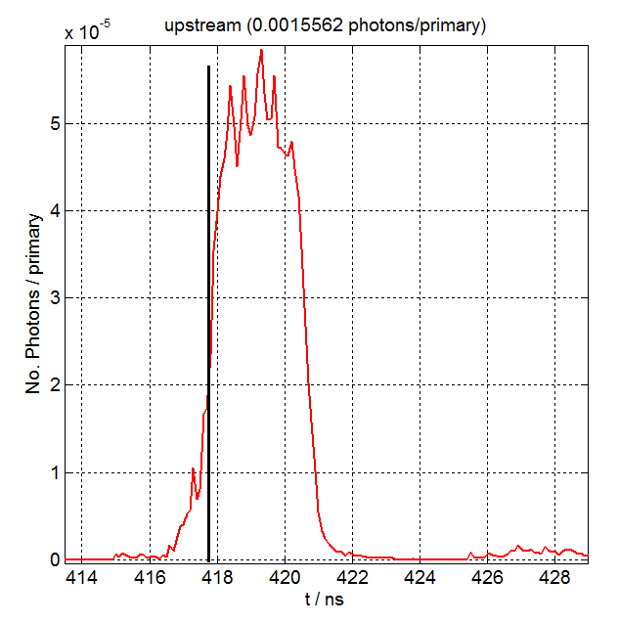
Single Bunch Trains
Dispersion effects:
  Arrival time depends on photon trajectory in fiber
  Highly skewed rays can be blocked by collimation
Single Bunch Resolution:
  Arrival time distribution of photons simulated for drive beam 2.4 GeV loss at 50m along 100m fiber
  Rising edge of the photon signal < 2 ns
M.Zingl

Slide 18
Loss Scenarios - Example Simulation
Loss at a single location

Slide 19
Loss Reconstruction
Drive Beam 2.4 GeV
Naïve (simple) back projection
Bars indicate the full extent of the rise
Furthest point is < 50cm from the real loss location
Notes:
Not ‘errorbars‘. just show the width of the rising edge. The width of the rising edge is for upstream and downstream nearly the same but the blue errorbars are bigger (signals are much more shifted together at the downstream side which can be also seen from the space time diagramms). The farest point is less than 30 cm away from the black line!

Slide 20
Multi-bunch Trains
In general it is not possible to reconstruct an arbitrary loss pattern (in position and time)
But, only few different loss patterns are to be expected
  1. Single or multiple individual loss locations
    Constant losses in time, i.e. obstructions
    Variation in time, i.e. interaction with “dust particles”
  2. Losses building up along the train, starting at a certain position
    bunch number (i.e. long range or resistive wall wake fields)
    Combined with aperture limitation
  3. Constant losses
    Beam gas scattering
    As a function of distance along decelerator
      optics mis-match
  4. Equipment failures
  5. Others?

Slide 21
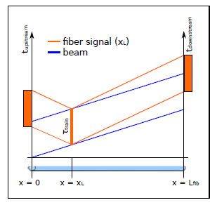
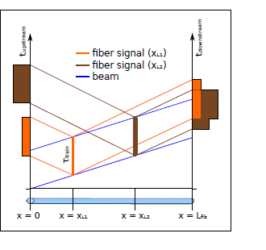
Space Time Diagrams
Loss at single location, Loss at two locations
Location of loss determined from signal rise time
Upstream signal gives a better resolution and real time sequence of losses

Slide 22
Current investigations
  Can all the expected loss scenarios be distinguished?
  With what resolution ?
    Do all scenarios require the same longitudinal resolution?
  Could additional measurements improve resolution?
    E.g. fast, localised detector every ≈ 20 - 100 m to measure loss structure within the train (e.g. diamond BLM)

Slide 23
Current Investigations
Integration into 2 Beam Modules
  Best location for fibers
Measurements at CTF-3
‘Catalogue’ of simulations for all expected loss scenarios
  E.g. UFO 100 um thick , 2.4 GeV Drive Beam

Slide 24
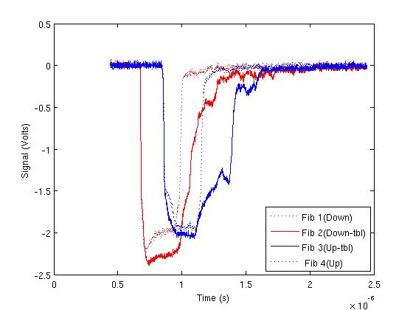
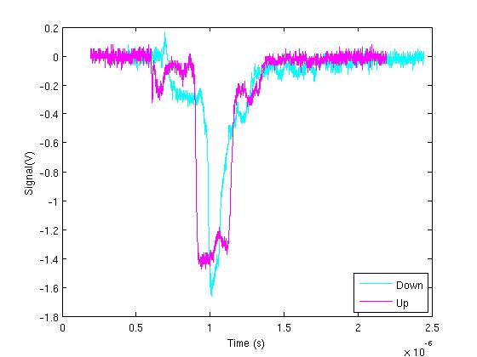
First Measurements at TBL - Fiber Signal
Layout:
SiPMs
75m
25m
Ceiling
TBL FIBER 28m
Upstream Photons
Downstream Photons
e-
Faisceau: TBL
Raw Signals
Subtraction of ‘Background’
Notes:
BEAM Conditions
Factor 4 , Stable Beam
14 A
Pulse length ~240ns

Slide 25
Summary
Ionization chambers suitable (but expensive) baseline technology choice
Cherenkov fibers seem feasible alternative for CLIC drive beams
Ongoing investigation of loss scenarios (CLIC) and corresponding simulations.
Ongoing measurements at CTF3
Determination achievable longitudinal resolution to allow comparison with other technologies

Slide 26
Spare SLIDES

Slide 27
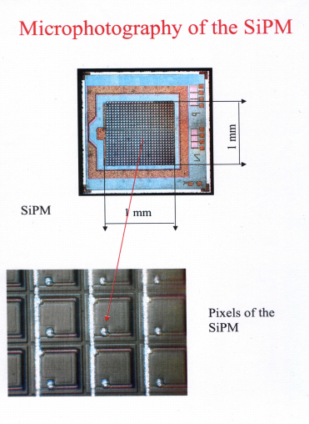
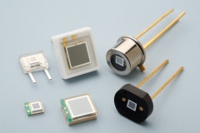
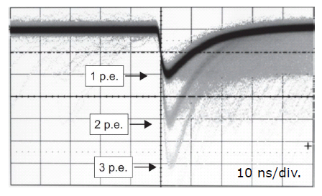
Photon Detector
What is an SiPM?
  Silicon Photomultiplier - array of APDs connected in parallel
  Each pixel is a p-n junction in self-quenching Geiger mode
  Reverse Bias causes APD breakdown
  Electron avalanche: PMT-like gain
  Pixels are equally sized and independent
  Analog output – Signal is sum of fired pixel signals
SiPM Advantages:
  Compact and light
  Low operating voltage (20-100V)
  Simple FE electronics
  Fast signal (~1ns)
  Cheap
Suitability Dynamic range, radiation hardness

Slide 28
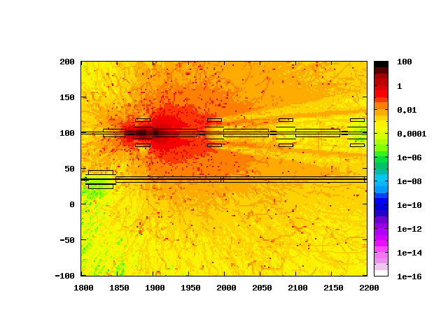
Cross Talk Issues
  Desirable to distinguish between a failure loss from each of the beams
  Spatial Distribution of prompt Absorbed Dose (Gy) from FLUKA Simulations:
  Loss of 1.0% in DB provokes similar signal as a loss of 0.01% of MB in region close to MB quadrupole.
  NOT a Machine Protection Issue – Dangerous loss would never go unnoticed
  Compare signals from both fibers each side to distinguish Main and Drive Beam losses.
Destructive DB 1.0% of bunch train hits single aperture restriction
Destructive MB 0.01% of bunch train hits single aperture restriction

Slide 29
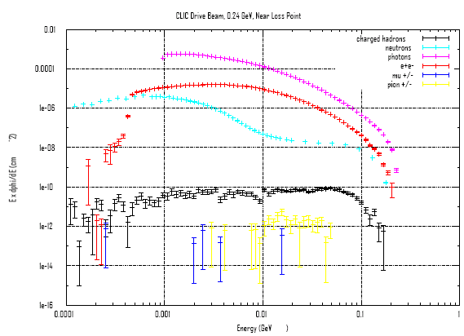
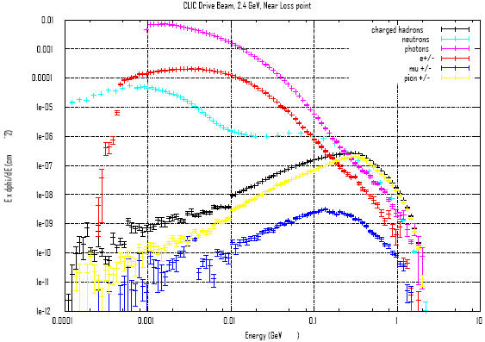
Drive Beam
Sophie Mallows
0.24 GeV
2.4 GeV
Same FLUKA - Particle fluence spectra after quadrupoles.

Slide 30
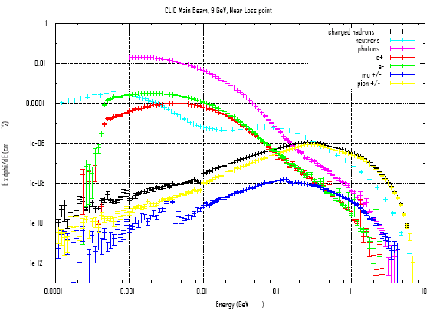
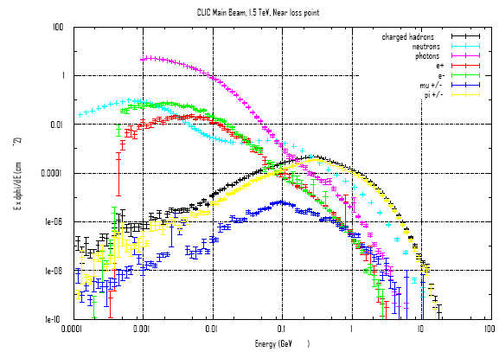
Main Beam
Sophie Mallows
9 GeV
1.5 TeV
Particle fluence spectra after quadrupoles.

Slide 31
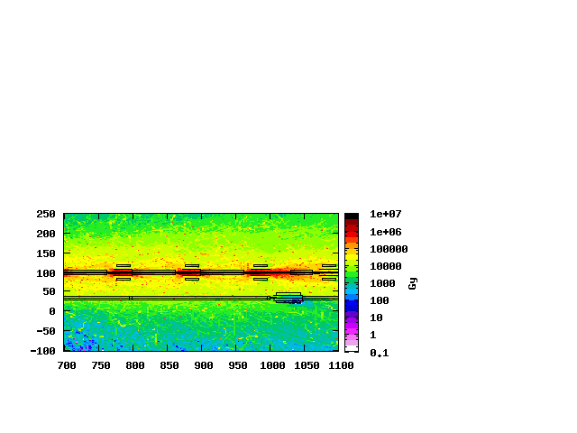
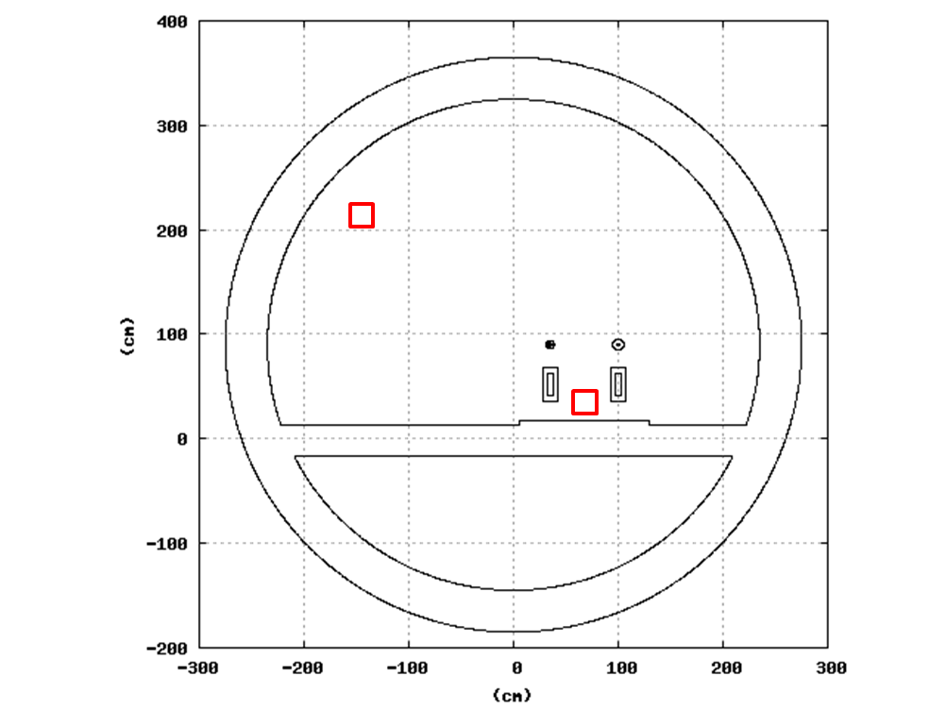
Radiation Levels
Annual Absorbed Dose from maximum permissible losses in Drive Beam at 2.4 GeV (assuming 180 days running at nominal intensity )
 | Absorbed Dose Close to accelerator 1 (Gy. year⁻¹) | Absorbed Dose Close to tunnel wall 2 (Gy. year⁻¹)
DB – 240 MeV | ≤10e4 | ≤10e3
DB - 2.4 GeV | ≤ 10e5 | ≤10e4
MB – 9 GeV | ≤10e4 | ≤10e3
MB – 1500 GeV | ≤10e5 | ≤10e4
2
1
 | 1-MeV neutron eq. fluence Close to accelerator 1 (cm⁻² year⁻¹), | 1-MeV neutron eq. fluence Close to tunnel wall 2 (cm⁻² year⁻¹)
DB – 240 MeV | 3.4e11 | 1.2e11
DB - 2.4 GeV | 3.2e12 | 1.3e12
MB – 9 GeV | 1.0e10 | 4.0e9
MB – 1500 GeV | 8.5e11 | 3.1e11

Slide 32
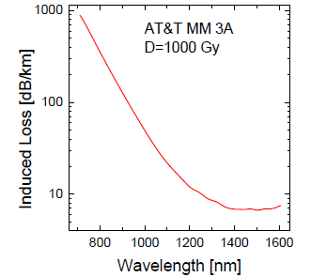
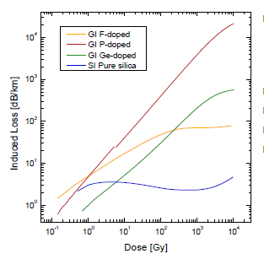
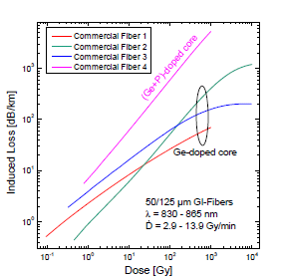
Radiation Induced Attenuation
Wavelength Dependence
Core Doping
Example Ge doped fiber
l_{fiber} 100m, for λ 830nm
Manufacturing
Manufacturing (Coating/CCDR )
Graded Index Fibers
Step Index Fibers

Slide 33
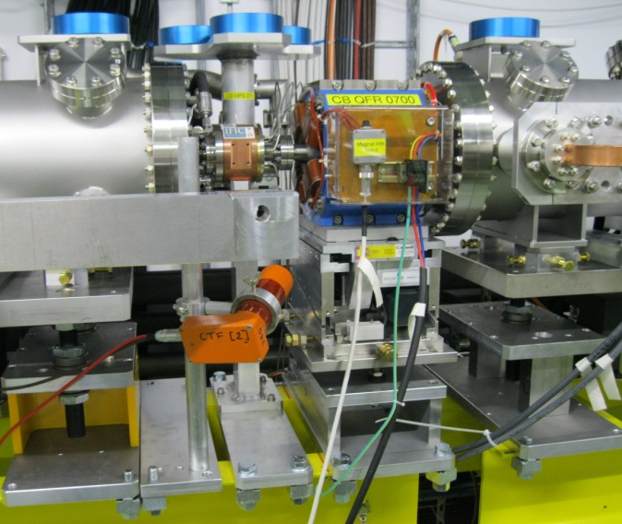
BLM Installation (ACEMs)
Signal | Detector Location
CB.TBLBLM01-AS
CB.TBLBLM02-AS
CB.TBLBLM03-AS | After quad CB.QF300
CB.TBLBLM04-AS | After quad CB.QF340
CB.TBLBLM05-AS
CB.TBLBLM06-AS
CB.TBLBLM07-AS | After quad CB.QF500
CB.TBLBLM08-AS | After quad CB.QF540
CB.TBLBLM09-AS
CB.TBLBLM10-AS
CB.TBLBLM11-AS | After quad CB.QF700
CB.TBLBLM12-AS | After quad CB.QF740
CB.TBLBLM13-AS
CB.TBLBLM14-AS
CB.TBLBLM15-AS | After quad CB.QF900
CB.TBLBLM16-AS | After quad CB.QF940
16-AS
15-AS
12-AS
11-AS
08-AS
07-AS
04-AS
03-AS
e-
CB.QF940
CB.QF900
CB.QF840
CB.QF800
CB.QF740
CB.QF700
CB.QF640
CB.QF600
CB.QF540
CB.QF500
CB.QF440
CB.QF400
CB.QF340
CB.QF300
CB.QF240
CB.QF200
ACEM installed

Slide 34
Loss Scenario – Example Simulations
Impact Points (UFO Simulation)

Slide 35
CDR Summary Table
Machine Sub-Systems | Dynamic Range | Sensitivity (Gy/pulse) | Response time (ms) | Quantity | Recommended
Main Beam
e⁻ and e⁺ injector complex | 10⁴ | 10⁻⁷ | <8 | 85
Pre-Damping and Damping Rings | 10⁴ | 10⁻⁹ (Gy per millisecond) | 1 | 1396 | Insensitive to Synch. Rad.
RTML | 10⁴ | 10⁻⁷ | <8 | 1500
Main Linac | 10⁶ | 10⁻⁹ | <8 | 4196 | Distinguish losses from DB
Beam Delivery System (energy spoiler + collimator) | 10⁶ | 10⁻³ | <8 | 4
Beam Delivery System (betatron spoilers + absorbers) | 10⁵ | 10⁻³ | <8 | 32
Beam Delivery System (except collimators) | >10⁵ | <10⁻⁵ | <8 | 588
Spent Beam Line | 10⁶ | 10⁻⁷ | <8 | 56
Drive Beam
Injector complex | 5. 10⁴ | 5. 10⁻⁶ | <8 | 4000
Decelerator | 5. 10⁶ | 5. 10⁻⁸ | <8 | 41484 | Distinguish losses from MB
Dump lines | tbd | tbd | <8 | 48

