Slide 1



Measurements and Analysis of CTF3 Phase with Different Bunch Compressor Factors (Part II)
Alexander Gerbershagen
University of Oxford, FONT group
CERN, BE-ABP-CC3 group
30/01/2013
Measurements and Analysis of CTF3 Phase with Different Bunch Compressor Factors (Part II)
1
Notes:
1

Slide 2
Content
Measurement data
Investigating the source of increasing phase error in the chicane
  Beam energy error
  Beam phase error in the accelerator
  Klystron amplitude and phase errors
30/01/2013
Measurements and Analysis of CTF3 Phase with Different Bunch Compressor Factors (Part II)
2

Slide 3
Measurement of CTF3 phase
Two data sets – from 16/11/12 and from 20/11/12
R56 values of 0.0, 0.2 and 0.45 m
16/11/12
Each R56 value measured twice for about 10 min.
0.0 -> 0.2 -> 0.45 -> 0.2 -> 0.0 -> 0.45
Total measurement time span of several hours
20/11/12
Each R56 measured once for about 10 minutes
0.2 -> 0.0 -> 0.45
Total measurement time span about four hours
(interchanged datasets?)
Select for further analysis
30/01/2013
Measurements and Analysis of CTF3 Phase with Different Bunch Compressor Factors (Part II)
3

Slide 4
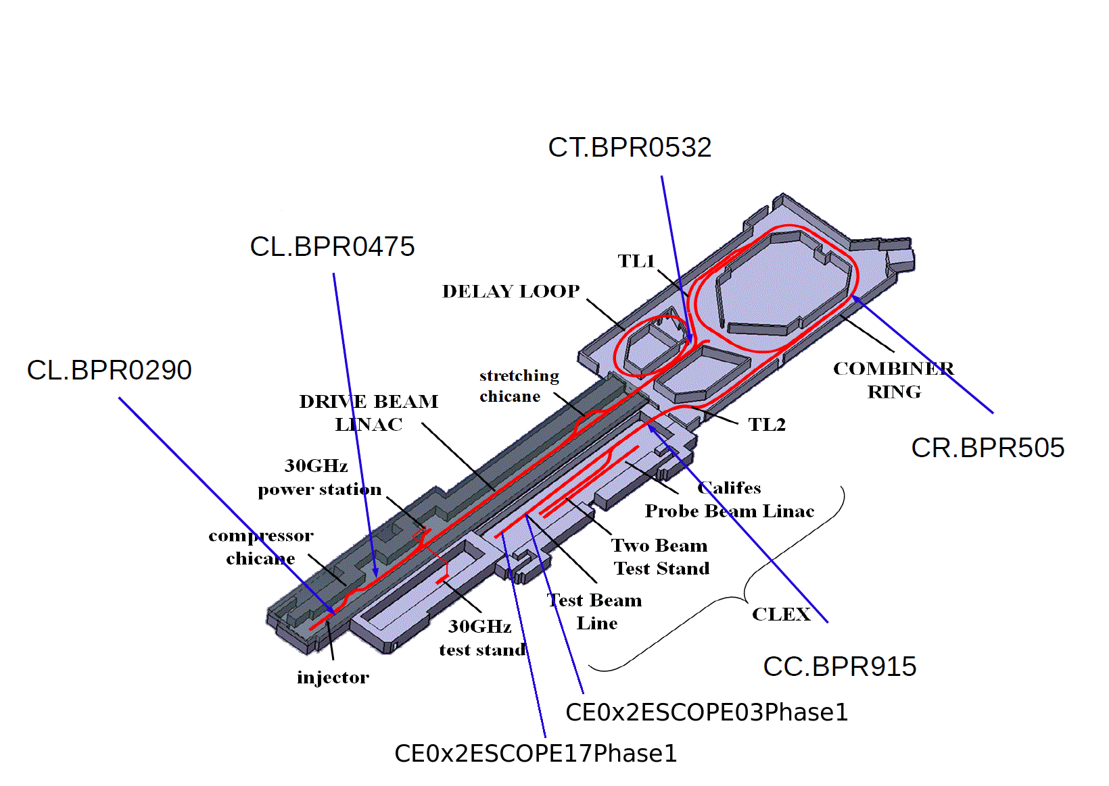
Active phase monitors
30/01/2013
Measurements and Analysis of CTF3 Phase with Different Bunch Compressor Factors (Part II)
4

Slide 5
16/11 measurement
Beam phase standard deviations
Phase in deg@12 GHz
30/01/2013
Measurements and Analysis of CTF3 Phase with Different Bunch Compressor Factors (Part II)
5

Slide 6
Phase before and after the chicane
and different R56 values
Compare the phase error σφ (in deg @ 12 GHz) introduced in the chicane with chicane’s R56 values (in m) :
R56 | σφ (CL 475) | σφ (CT 532) | σφ (CT 532) - σφ (CL 475) | [σφ (CT 532) - σφ (CL 475)] / R56
0 | 1.39 | 1.65 | 0.26
0.2 | 1.25 | 5.26 | 4 | 20.0
0.45 | 1.16 | 10.02 | 8.87 | 19.7
Hypothesis: additional phase error after the chicane
is caused by the energy error
30/01/2013
Measurements and Analysis of CTF3 Phase with Different Bunch Compressor Factors (Part II)
6

Slide 7
Beam energy error
R56 = 0.45, dataset 1
Dispersive energy measurement in the transfer line (BPI0608)
Correlation constant = -0.82
Energy error (a.u.)
Phase error change in the chicane
(deg @ 12 GHz)
30/01/2013
Measurements and Analysis of CTF3 Phase with Different Bunch Compressor Factors (Part II)
7

Slide 8
Beam energy error
R56 = 0.45, dataset 2
Dispersive energy measurement in the transfer line (BPI0608)
Correlation constant = -0.79
Phase error change in the chicane
(deg @ 12 GHz)
Energy error (a.u.)
30/01/2013
Measurements and Analysis of CTF3 Phase with Different Bunch Compressor Factors (Part II)
8

Slide 9
Beam phase errors in the accelerator
R56 = 0.45, dataset 1
Correlation constant = 0.46
30/01/2013
Measurements and Analysis of CTF3 Phase with Different Bunch Compressor Factors (Part II)
9

Slide 10
Beam phase errors in the accelerator
R56 = 0.45, dataset 2
Correlation constant = 0.79
Phase error change in the chicane
(deg @ 12 GHz)
CL 475 phase error
(deg @ 12 GHz)
30/01/2013
Measurements and Analysis of CTF3 Phase with Different Bunch Compressor Factors (Part II)
10

Slide 11
Klystron amplitude error
R56 = 0.45, dataset 1
Correlation between phase error change in the chicane and klystron amplitude error
Klystron
number
30/01/2013
Measurements and Analysis of CTF3 Phase with Different Bunch Compressor Factors (Part II)
11

Slide 12
Klystron amplitude error
R56 = 0.45, dataset 2
Correlation between phase error change in the chicane and klystron amplitude error
Klystron
number
30/01/2013
Measurements and Analysis of CTF3 Phase with Different Bunch Compressor Factors (Part II)
12

Slide 13
Klystron phase error
R56 = 0.45, dataset 1
Correlation between phase error change in the chicane and klystron phase error
Klystron
number
30/01/2013
Measurements and Analysis of CTF3 Phase with Different Bunch Compressor Factors (Part II)
13

Slide 14
Klystron phase error
R56 = 0.45, dataset 2
Correlation between phase error change in the chicane and klystron phase error
Klystron
number
30/01/2013
Measurements and Analysis of CTF3 Phase with Different Bunch Compressor Factors (Part II)
14

Slide 15
Conclusions
R56 of the stretching chicane has a large impact on the phase after the chicane (almost factor 10 error difference between 0.45 and 0.0 settings)
The measured phase error in the Combiner Ring is high even with R56=0.0
  monitor problem?
  non-zero R56 of TL1 dogleg or of the Combiner Ring?
Correlation studies show that:
  Phase error change in the chicane is strongly correlated with beam energy
  Beam phase error in the accelerator has an impact on the phase error change in the chicane
  Klystron amplitude has a low impact on the phase error change in the chicane
  Klystron phase of the first klystrons in the accelerator has some impact on the phase error change in the chicane
30/01/2013
Measurements and Analysis of CTF3 Phase with Different Bunch Compressor Factors (Part II)
15

