Slide 1
Argonne Wakefield Accelerator
-A testbed for future accelerator technologies
Wei Gai
ANL
CLIC workshop 2013

Slide 2
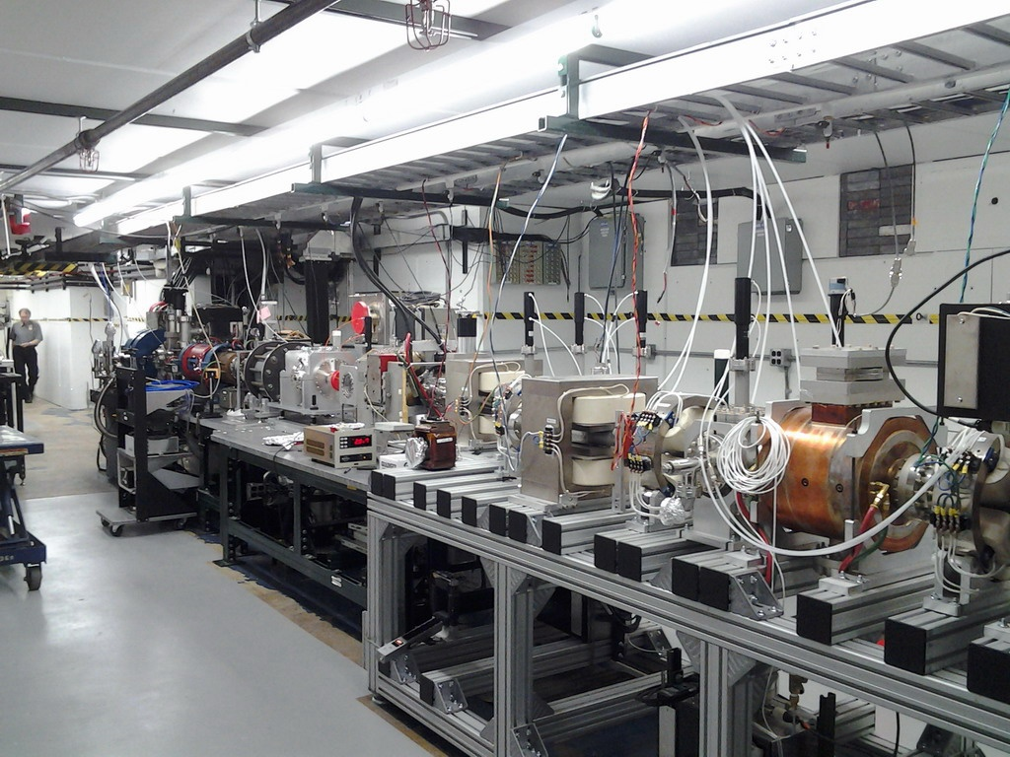
Introduction--- AWA Facility In The Past
Basic parameters:
1.3GHz Photogun w/ Mg cathode
15 MeV, 1 – 100 nC (reached 150 nC)
2 mm bunch length
norm emittance < 200 mm mrad (at 100 nC)
High Current: ~ 10 kA
Bunch train operation: 4 X 25nC or 16 X 5nC
Experimental area
½ EEX beamline
Present photogun + 1 linac
Selected results in the past 5 years:
100MV/m short pulse in an X-band DWA (dielectric wakefield accelerator)
50MW short pulse in C-band DWPE (dielectric wakefield power extractor); 20 MW in K-band
300MV/m short pulse in a K-band diamond based DWA.
Enhanced transformer ratio (R=3.4) achieved in a collinear wakefield acceleration

Slide 3
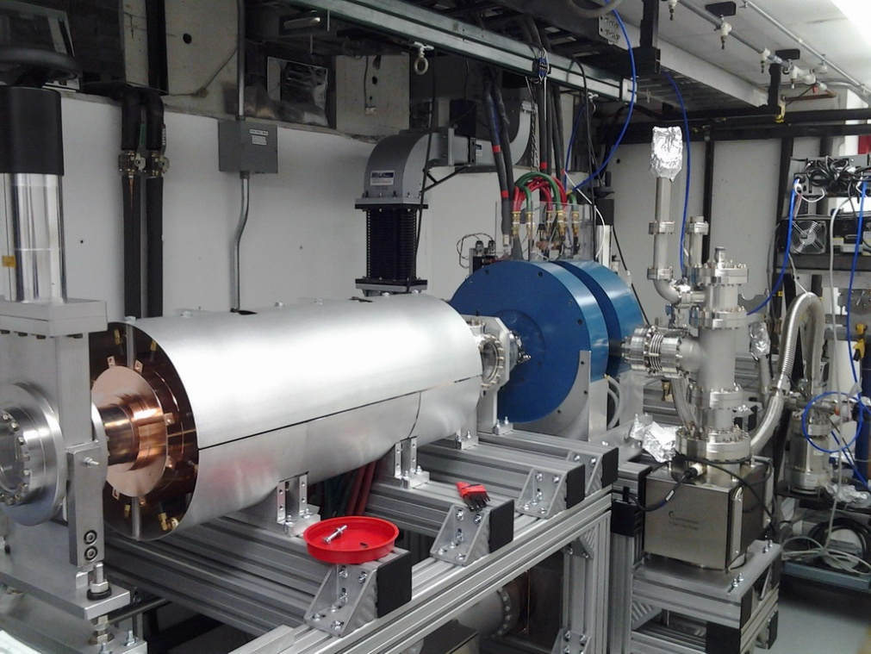
Introduction--- AWA Facility in 2013: 75 MeV Drive Beam+ 15MeV witness beam
Basic parameters for the drive beam:
1.3GHz Photogun w/ CsTe cathode
75 MeV, 1 – 100 nC (reached 150 nC)
1~2.5 mm bunch length (a bunch compressor is planned )
Normalized emittance < 200 mm mrad (at 100 nC)
Bunch train operation: 32 X 30nC or 10 X 100nC
Beam power: 3GW or 10GW
New drive gun w/ CsTe cathode
Experiments forecast in 5 years:
High power rf generation: 0.1~1GW, ~20ns duration, frequency covers cm to mm wave.
Two beam acceleration: >200MeV/m energy gain (short rf pulse, ~20ns).
Collinear wakefield acceleration: >300MeV/m energy gain.
Bunch shaping to improve efficiency for collinear wakefield acceleration

Slide 4
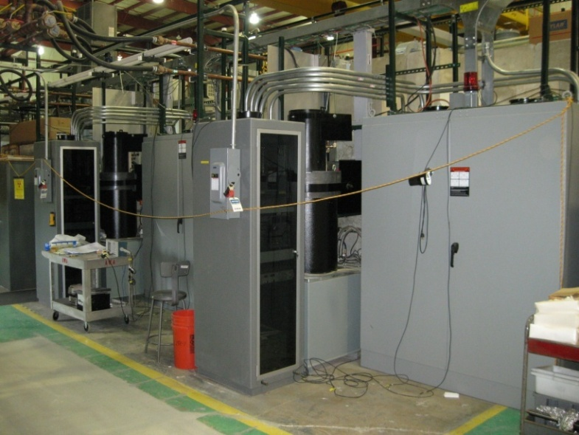
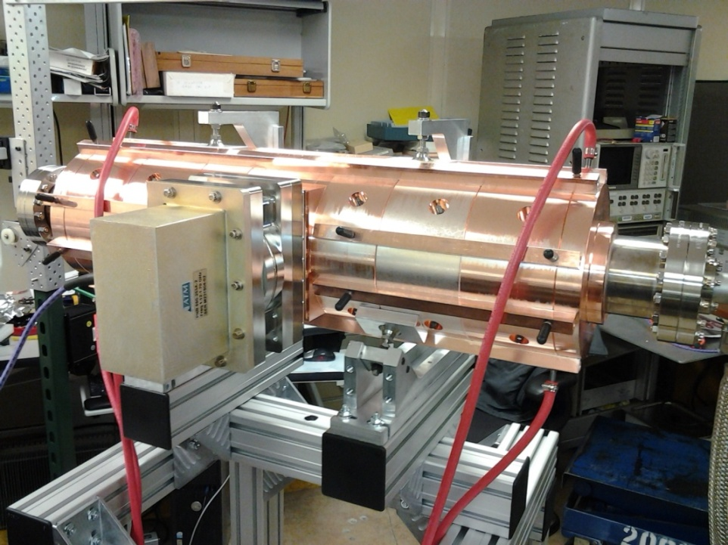
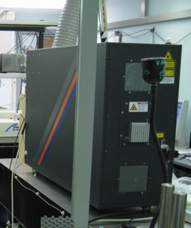
with DoE fund:
4 klystrons
6 linac tanks
RF distribution and Control systems upgrade
Laser upgrade
Klystrons Stations
6 Linacs are ready for use
New KrF UV amplifier

Slide 5
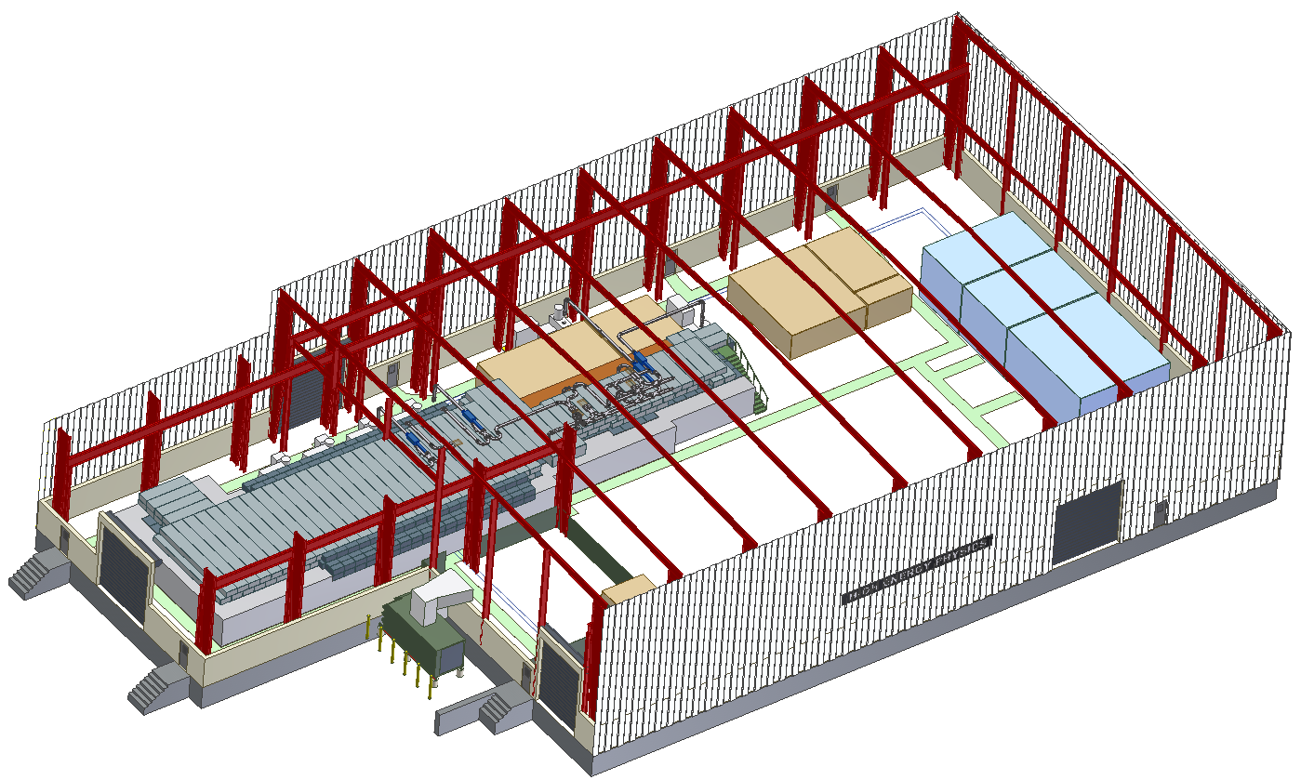
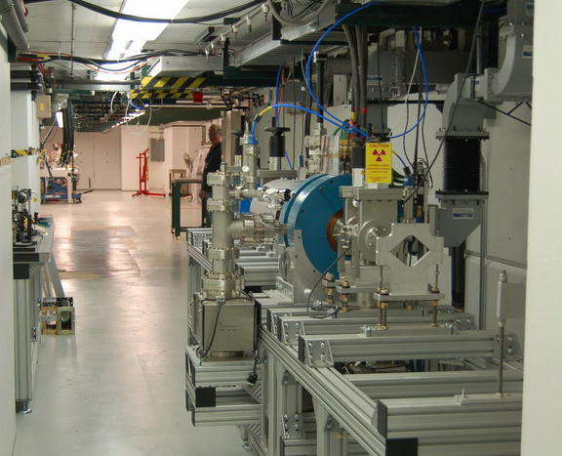
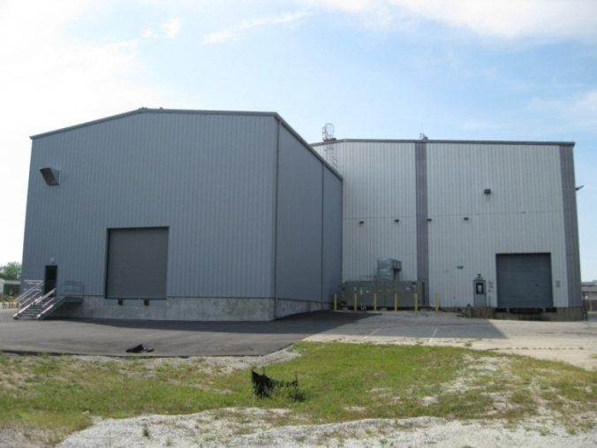
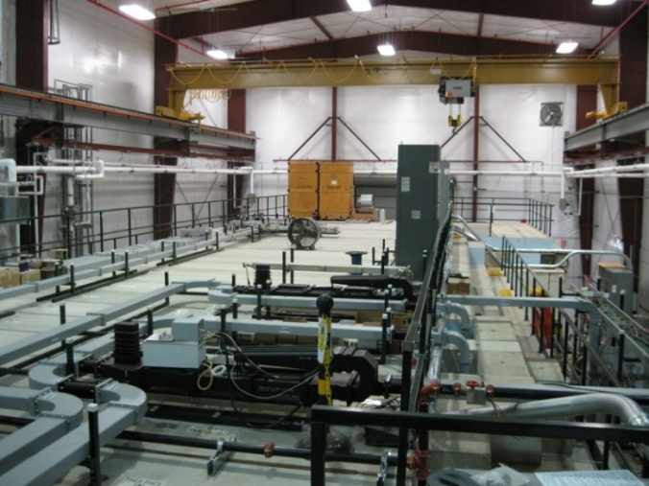
Thanks to ANL management for $2M+ construction fund:
new annex building
new SF6 recovery system
new cooling water station
new 1MW power transformer
Bunker Interior
New annex building
Roof of the new bunker

Slide 6
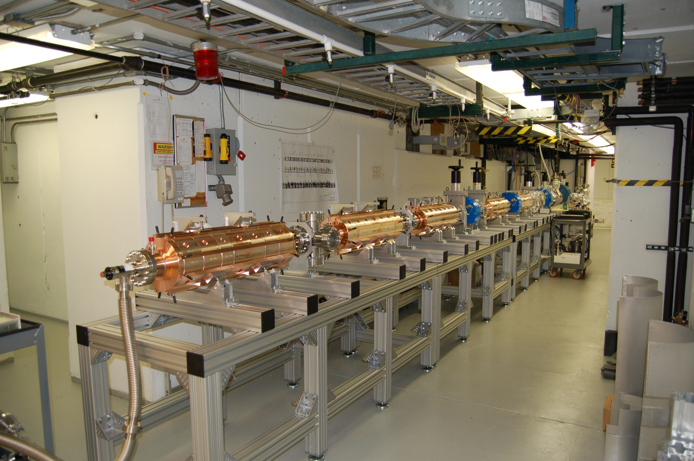
AWA Facility update (as last week):

Slide 7
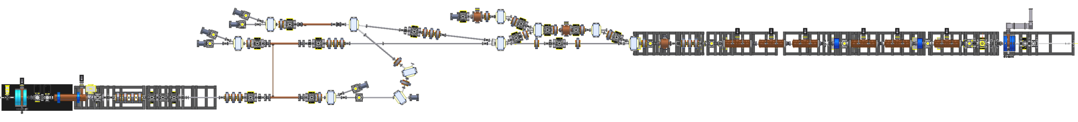
Beamline Configuration (completion in the next year)
3. EEX beamline:
Ramped bunch production
Continue EEX experiment
LPS measurements
2. Collinear wakefield beamline:
Drive bunch enters at 6 deg
Witness bunch enters at 42 deg
75MeV high current Drive beamline
15MeV witness beamline
1. Parallel (Two-beam) beamline :
High charge bunch train transmission
High RF power generation
High gradient acceleration of witness

Slide 8
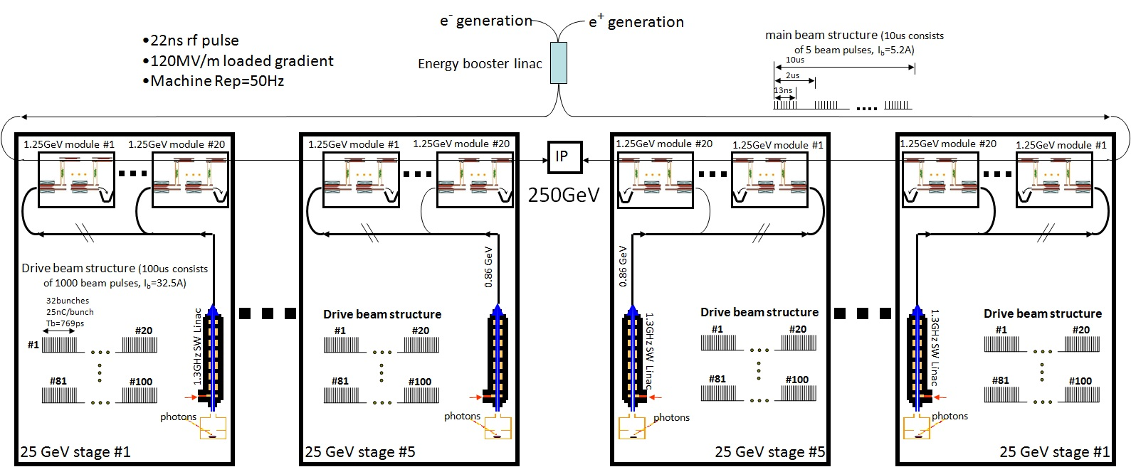
ANL K-Band 250GeV Higgs Factory
4km
1.5km linac
1.5km linac

Slide 9
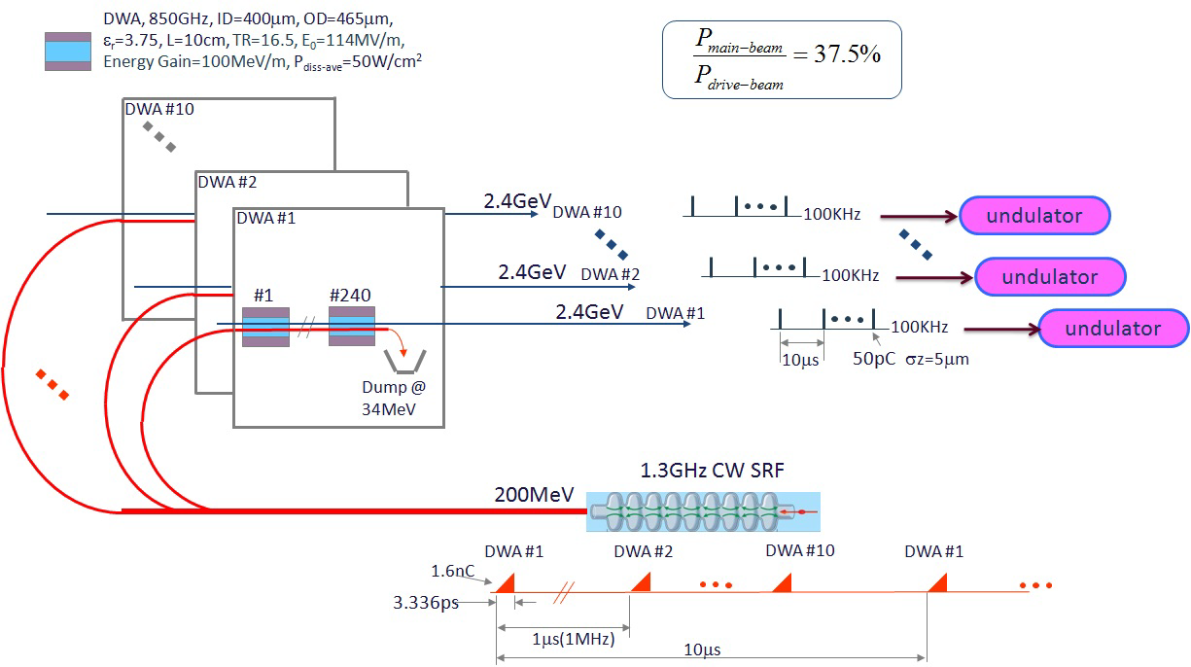
DWA Driven FEL (100MeV/m, 100kHz Rep.)

