Slide 1
FEL activities and plans at SINAP
Gu Qiang
For the FEL team
Shanghai INstitute of Applied Physics (SINAP)

Slide 2
Outline
FEL roadmap at SINAP
SDUV-FEL facility
  Linac
  FEL experiments
XFEL facility
  x-ray FEL facility (test facility)
  Hard x-ray FEL facility
Summary

Slide 3
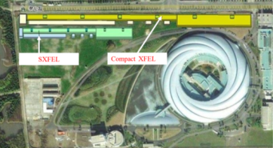
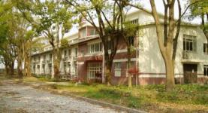
Roadmap of Shanghai FELs
nm
Hard X-ray FEL
0.1
Cons., Comm., Operation
Conceptual design
10
Soft X-ray FEL
Desi.
Cons.
Comm.
Beamline, User?
100
SDUV-FEL
FEL
experiments
Gun
Comm.
Linac
Comm.
SASE, HGHG,
EEGH, CHGHG
1000
2008
2009
2010
2011
2012
2013
2014
2015
2016
2017
2018
2019
2020

Slide 4
The Shanghai Deep Ultra-Violet FEL project
High Gain FEL test facility, since 2000.
  Being carried out by Shanghai Institute of Applied Physics in cooperation with
  Institute of High Energy Physics
  NSRL, Univ. of Science and Technology of China
  Accelerator Lab. of Tsinghua University
Fund partially supported by
  Chinese Academy of Sciences (CAS)
  Ministry of Science and Technology of China (MOST)
  National Natural Science Foundation of China (NSF)
Goal
  HGHG at the very first stage
  EEHG, CHGHG & new operation scheme of the high gain FEL

Slide 5
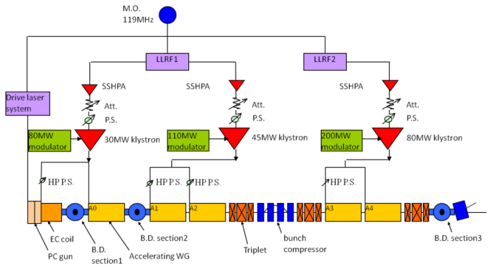
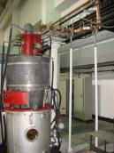
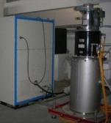
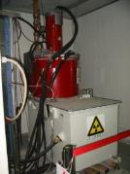
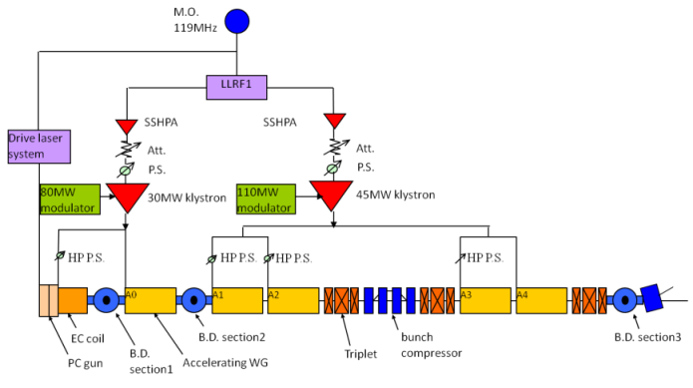
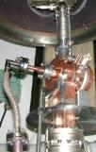
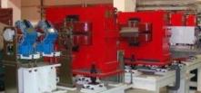
The linac
2009.4~2011.6
2011.8~2012.4

Slide 6
Beam parameters
 | 2009.4~2011.6 | 2011.8~2012.4
Beam energy (MeV) | 130 | 190
Energy spread(%) | 0.3 | 0.2
Bunch charge (nC) | 0.2 | 0.2
Beam current (A) | 100 | 100
Global norm. emittance (umrad) | ~4 | ~3

Slide 7
Milestones of FEL experiments
2009.09~12: SASE experiment
2010.01~03: Seeded FEL Installations
2010.05: Seeded FEL experiments start
2010.05.17: HGHG signal
2010.05.23: First Echo signal (‘double-peak’)
2010.07~08: Install. for high harmonics EEHG
2010.12: HGHG saturation
2011.04: EEHG amplification
2011.08~ 2012.4 : Cascaded HGHG

Slide 8
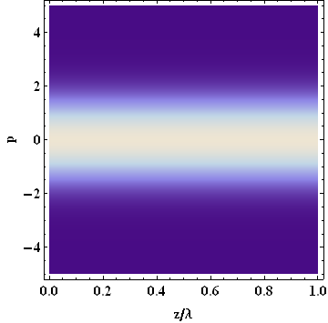
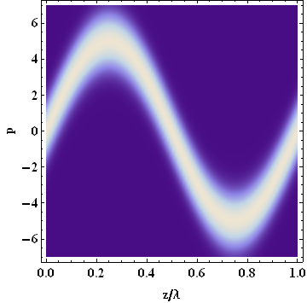
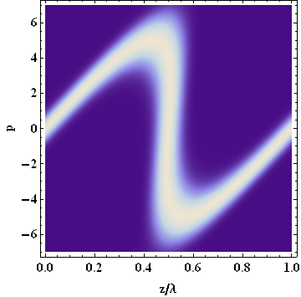
HGHG principle
L.H. Yu, PRA 44, 5178 (1991)

Slide 9
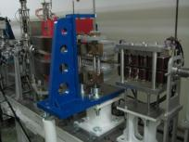
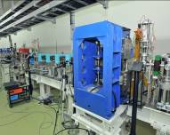
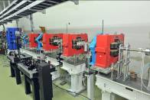
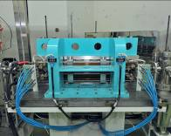
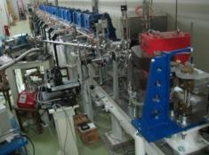
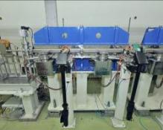
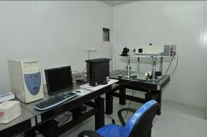
Radiator
Mod2
DS2
Linac
Exit
EMU100
PMU20
DS1
Mod1
HGHG
Seed
ODS2
ODS=Optical Diagnostics Station
ODS1

Slide 10
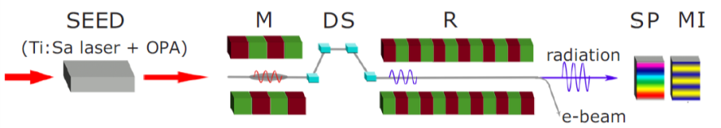
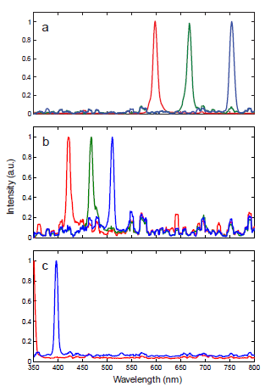
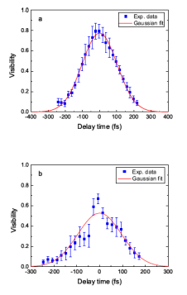
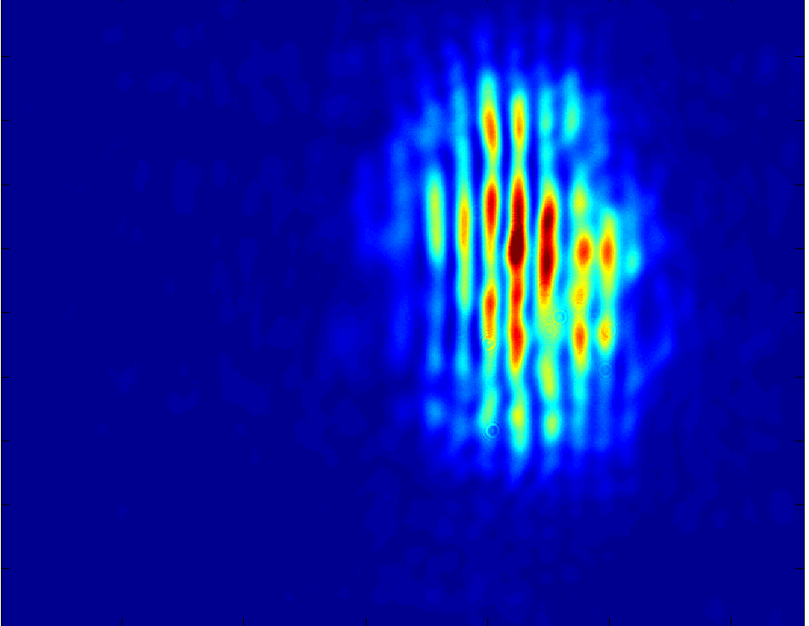
Widely-tunable and fully-coherent HGHG FEL
Paper submitted to PRL
Notes:
10

Slide 11
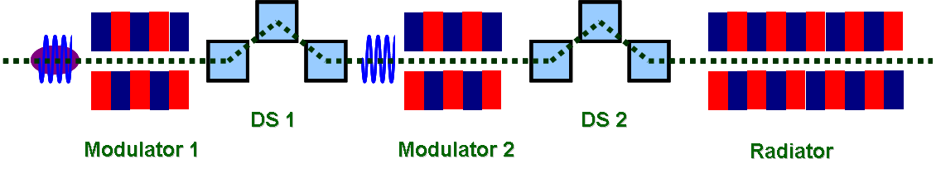
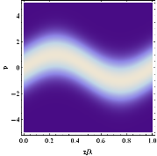
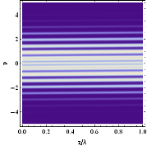

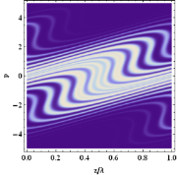
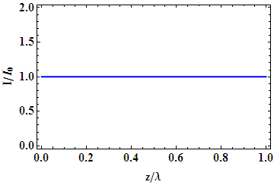
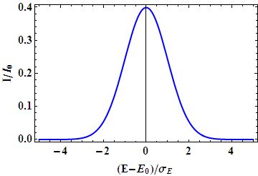
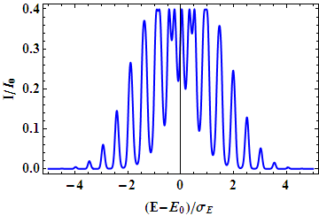
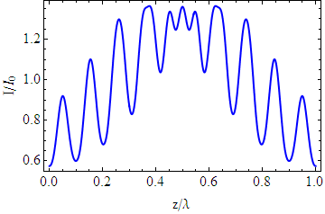
EEHG principle
G. Stupakov, PRL 102, 074801 (2009)

Slide 12
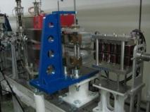


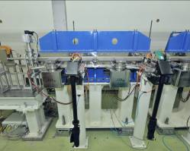
Seed1
Radiator
Mod2
DS2
Linac
Exit
EEHG
DS1
EMU100
PMU20
Seed2
Mod1
ODS2
ODS=Optical Diagnostics Station
ODS1
Notes:
12

Slide 13
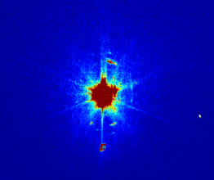
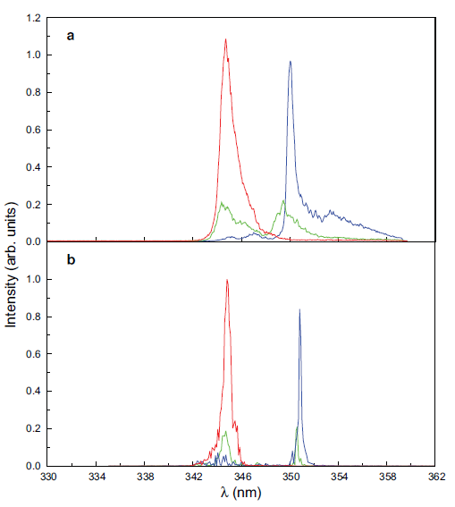
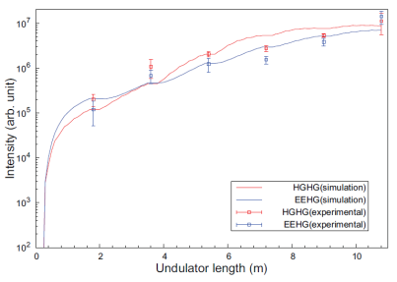
First lasing of EEHG FEL
FEL profile
Experiments
Spectrum
Simulation
Gain curves
Nature Photonics 2012.105

Slide 14
Future work on SDUV-FEL facility
Linac
  Install a new photocathode RF gun from Tsinghua University
  Install a new klystron (E3730A)
FEL experiments
  CHGHG
  Polarizing experiment with cross undulator
  ……

Slide 15
Soft X-ray FEL project
Proof test for the fully coherent X-ray FEL operation scheme
R&D on key components and technology
Test facility for the hard X-ray FEL in China for the future
Parameters | Value | Unit
Output Wavelength | 8.8 | nm
Bunch charge | 0.5 | nC
Energy | 0.84 | GeV
Energy spread | 0.1 | %
Norm. emittance | 2.5 | mm.mrad
Pulse length | 1. | ps
Peak current | ~0.5 | kA
Rep. rate | 10 | Hz

Slide 16
FEL scheme
CHGHG
1st stage
266nm =》44nm
2nd stage
44nm =》8.8nm
FEL
Diag.
84m
Seed laser
266nm
EEHG+
HGHG
1st stage
798nm =》44nm
2nd stage
44nm =》8.8nm
FEL
Diag.
84m
Seed laser
798nm

Slide 17
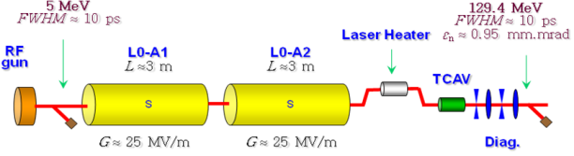
Layout of Linac

Slide 18
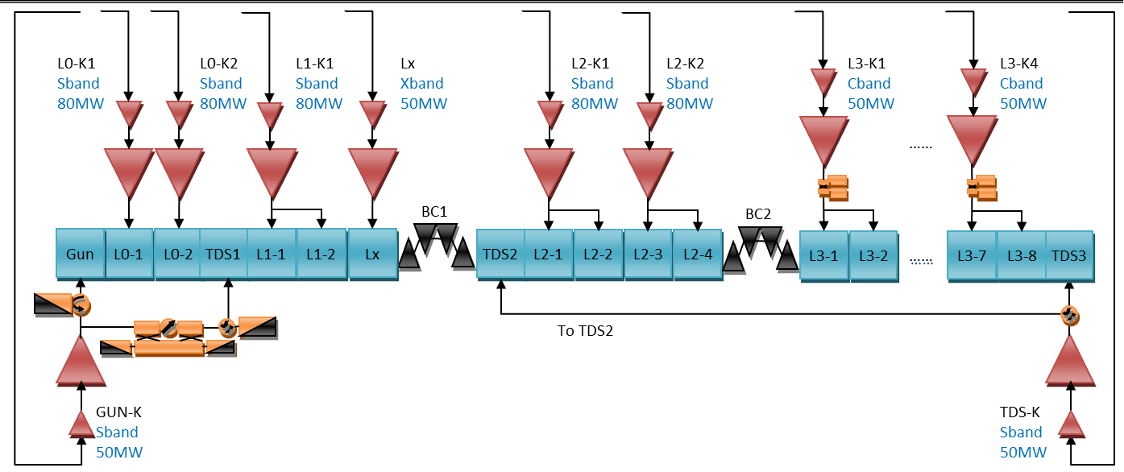
Layout of the RF system
 | S-band | S-band | S-band | C-band | X-band | unit
No. of sets | 1(+1) | 2 | 3 | 4 | 1
frequency | 2.856 | 2.856 | 2.856 | 5.712 | 11.424 | GHz
Kly. power | 50 | 80 | 80 | 50 | 50 | MW
Repetition rate | 10 | 10 | 10 | 10 | 10 | Hz
No. of acc. structure | 1(2) | 1 | 2 | 2 | 1
Gradient | 120 | 25 | 18 | 40 | 25 | MV/m
SLED | No | No | No | Yes | No

Slide 19
Longitudinal jitter budget
 | error | dE(%) | dI(%) | dt(fs)
inj_arr | 0.25ps | 0.0308 | 6.6666 | 10.3842
inj_Q | 5% | 0.0304 | 1.5227 | 23.5803
L1_pha | 0.09deg | 0.0614 | 3.2216 | 88.1103
L1_volt | 0.04% | 0.0216 | 0.0277 | 31.51897
Lx_pha | 0.4deg | 4.97E-03 | 6.2115 | 6.571162
Lx_volt | 0.1% | 8.7E-03 | 0.1438 | 12.64579
L2_pha | 0.09deg | 2.64E-03 | 0.1528 | 2.113066
L2_volt | 0.04% | 0.016 | 0.0664 | 10.23434
L3_pha | 0.18deg | 0.0482 | 1.72E-13 | 4.64E-06
L3_volt | 0.04% | 0.0199 | 4.05E-14 | 1.58E-06
BC1_R56 | 0.02% | 8.88E-03 | 0.1268 | 16.03079
BC2_R56 | 0.02% | 2.76E-03 | 0.0212 | -4.99334
total |  | 0.0963 | 9.79 | 100

Slide 20
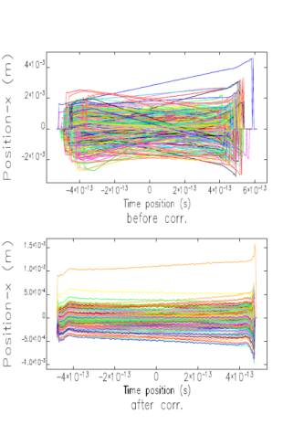
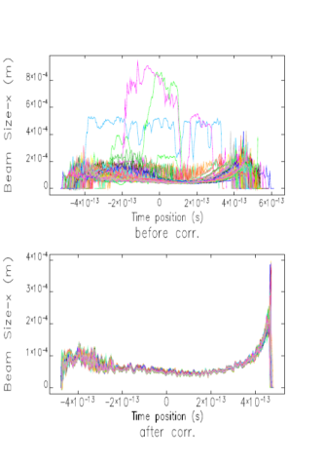
Beam break-up study

Slide 21
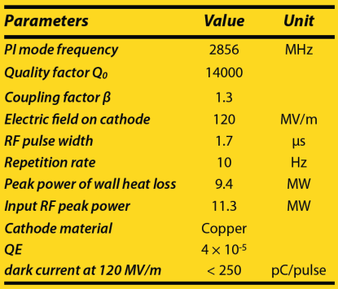
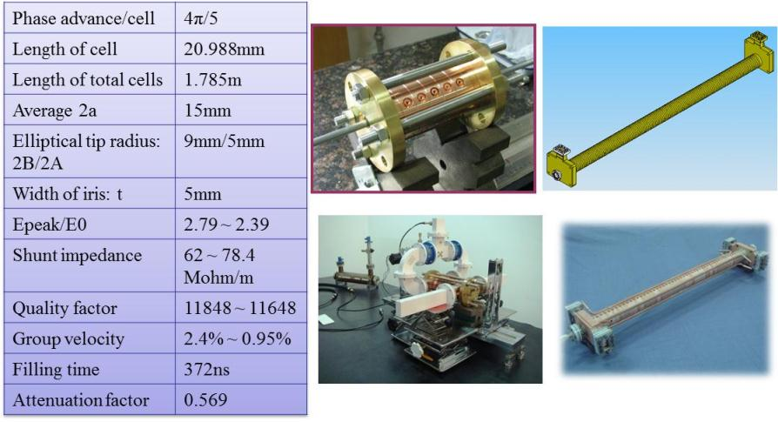
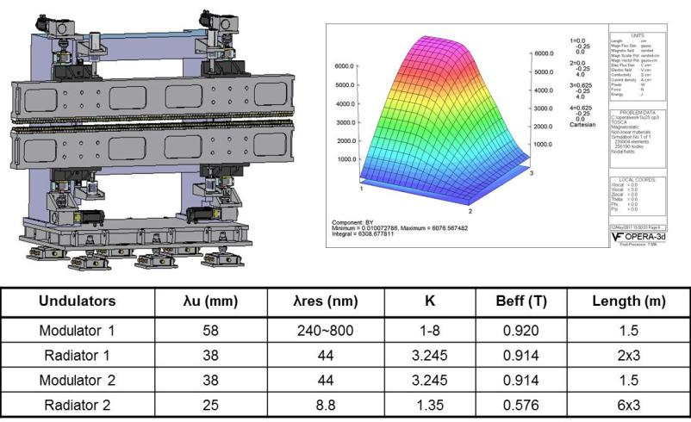
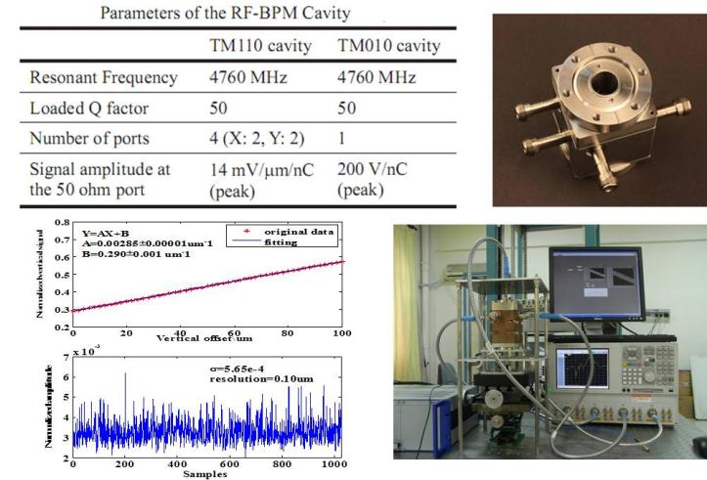
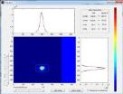
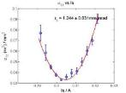
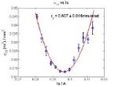
R&D of key components

Slide 22
Schedule of the soft x-ray FEL
2013.2, Approval of the feasibility study
2013.3, Approval of the preliminary study
2013.7, Ground breaking
2014.7, Utility installation starts
2014.10, Linac installation starts
2015.3, Linac commissioning starts
2015.12, First Lasing

Slide 23
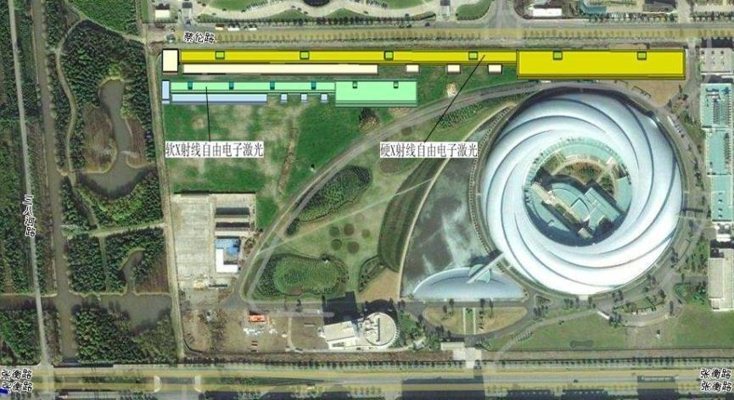
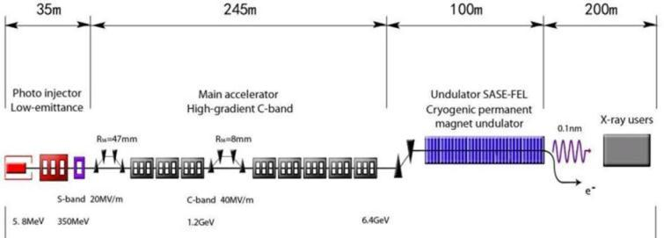
Compact hard X-ray FEL
580m
Compact XFEL

Slide 24
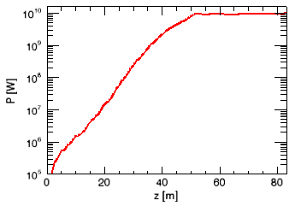


Main parameters of the compact hard X-ray FEL
Parameters | Value | Unit
Output Wavelength | 0.1 | nm
Bunch charge | 250 | pC
Energy | 6.4 | GeV
Normalized emittance | 0.4 | mm.mrad
Energy spread (sliced) | 0.01%
Pulse length (Full) | 100 | fs
Peak current | 3 | kA
Rep. rate | 60 | Hz
FEL parameter | 3.41*10⁻⁴
Peak power | 10 | GW
Peak brightness | 2*10³³
3D gain length | 2.156 | m
Saturation length | 50 | m

Slide 25
Preliminary design of the linac
21.5MV/m
0deg
57MV/m
180deg
100MV/m
30deg
20MV/m
-27.5deg
-47mm
40MV/m
-15deg
-8mm
40MV/m, 0deg
1.5m,
0.005GeV
0.1%
25A
15m,
0.125GeV
0.15%
36m,
0.321GeV
1.92%
60m,
0.321GeV
1.92%
500A
90m,
1.194GeV
0.522%
115m,
1.194GeV
0.522%
4000A
280m,
6.4GeV
0.050%
4000A
Gun
L0(s)
L1(s)
X
BC1
L2(c)
BC2
L3(c)
 | S-band | S-band | S-band | C-band | X-band | unit
No. of sets | 1 | 2 | 2 | 44 | 1
frequency | 2.856 | 2.856 | 2.856 | 5.712 | 11.424 | GHz
Kly. power | 50 | 80 | 80 | 50 | 50 | MW
No. of acc. structure | 1 | 1 | 2 | 2 | 1
Gradient | 120 | 25 | 18 | 40 | 57 | MV/m
SLED | No | No | No | Yes | Yes

Slide 26
Summary
In SINAP we are conducting an ambitious and systematic strategy on FELs in response of the rapidly growing demands for the next generation coherent photon source.
R&Ds on key FEL concepts and technologies are well integrated in the SDUV-FEL test facilities.
SDUV-FEL experiments: ongoing, and many interesting results are coming out.
SXFEL: funded, design studies under way, construction will begin at middle 2013 and complete expected in 2015.
Welcome to IPAC2013 in Shanghai!

Slide 27
Thank you for your attention

Slide 28

Cascaded HGHG
Courtesy of L.H.Yu
2-Stage cascade HGHG

Slide 29













The two-stage cascaded HGHG FEL
Stage-1
CCD Motor
MC3-A
ADC-POP2
ADC-POP1
UNPRF5
UNPRF4
UNPRF3
UNPRF2
UNPRF1
UNPRF0
BPM5
BPM4
DS1-2
B4-B7
Coll.2
DS1-1
B3
Coll.1
sRad
Q30
PMU
Q18
Q17
Q16
Q15
UDR
Q14
B15-18
Q13
B8
CH04
CV04
CH02
CV02
CH01
CV01
Q1-3
Q1-2
Q1-1
MC3-D
MC3-C
SeedInj-2
MC3-B
SeedInj-1
MC5-B
ADC-2
ADC-1
MC5-A
Stage-2
MC5-D
UN-POP1/2
UN-POP3/4
UN-POP5/6
UN-POP7/8
UN-POP9/10
UN-POP11/12
UNPRF6
MC5-C
Q19
CH19
CV19
Q20
CH20
CV20
Q21
CH21
CV21
Q22
CH22
CV22
Q23
CH23
CV23
Q24
CH24
CV24
UNPRF7
MOD2
CBPM
Delay Line
B19-B21
DS2
B22-B24
B9

Slide 30


Preliminary result
Radiation from 1st stage
Radiation from 2nd stage
Notes:
30

