Slide 1

Accelerator Activities at Tsinghua University
Jiaru Shi
Department of Engineering Physics, Tsinghua University
2013.01.31
CLIC Workshop 2013

Slide 2
Brief Introduction
Tsinghua University, Beijing
  ~7000 Faculties and Staffs
  ~35000 Students, ~14000 Undergraduate
Accelerator lab
  In Department of Engineering Physics
  16 faculties (4 full Professors) and more employee
  About 20 graduate students

Slide 3
Activities
Education (undergraduate and graduate)
Low Energy Electron Linacs and Their Applications
RF structure Research and Development
Compact X-ray Light Source (TTX)
Compact Pulse Neutron Sources (CPHS)

Slide 4
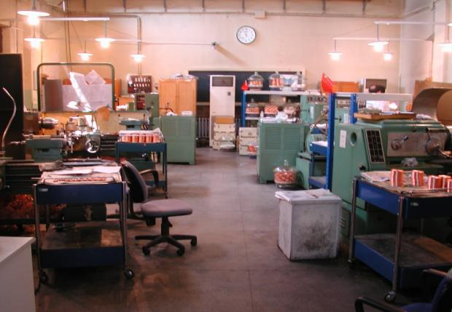
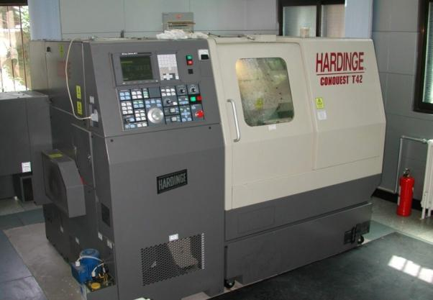
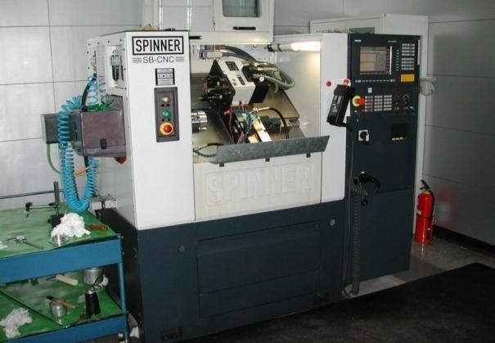
Machining Workshop
high-precision machine tools and CNC Machine
Notes:
Computer Numerical Control machine

Slide 5
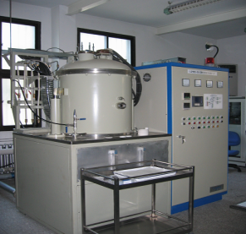
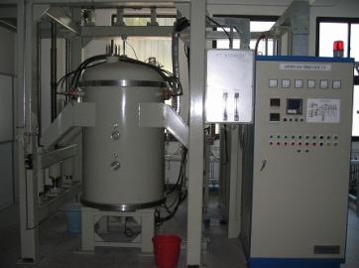
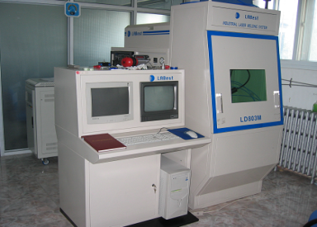
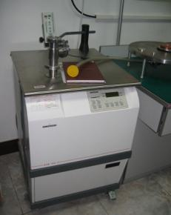
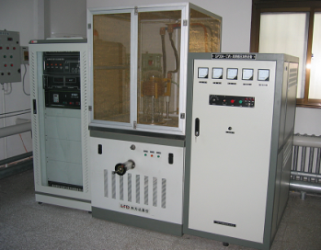
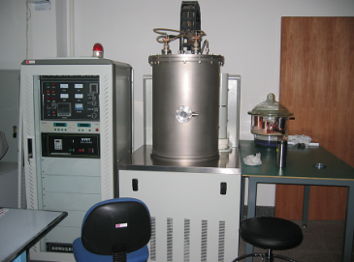
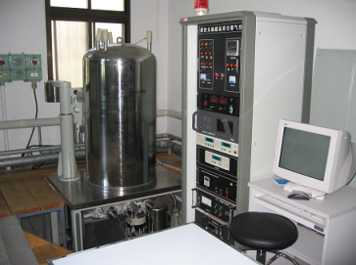
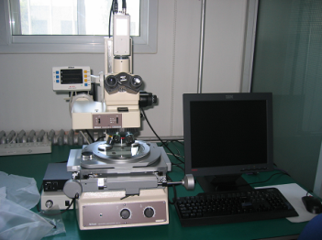
Facility for brazing and baking
High-T hydrogen furnace
Medium-T hydrogen furnace
Laser welding machine
Leak detector
Annealing furnace
Vacuum furnace
Baking oven
Tool microscope

Slide 6
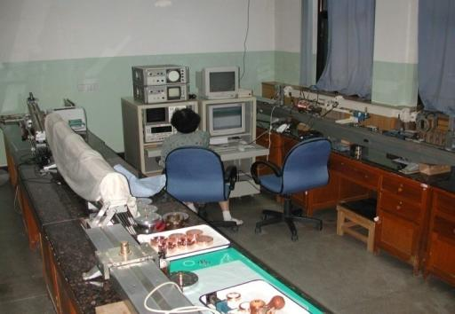
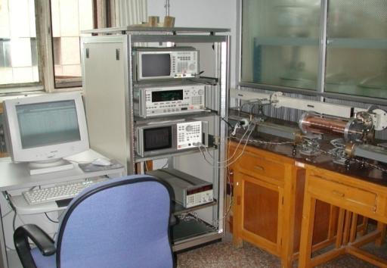
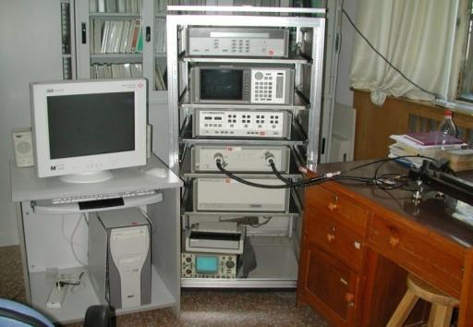
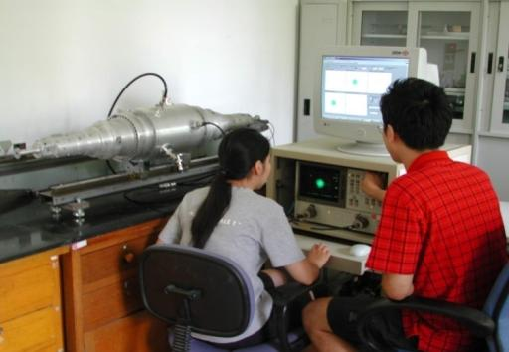
Microwave measurement for RF structure
Two based on SNA, two based on VNA

Slide 7
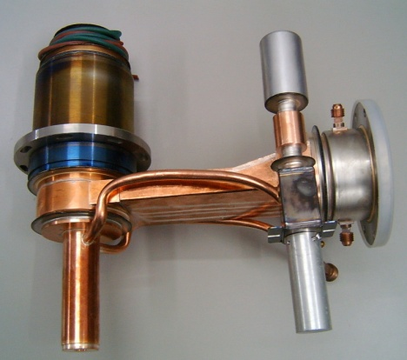
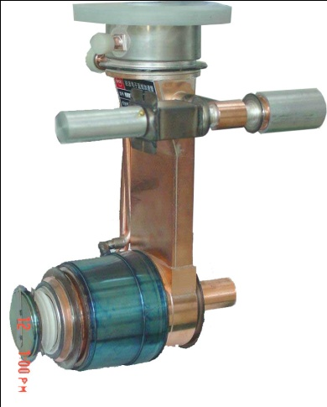
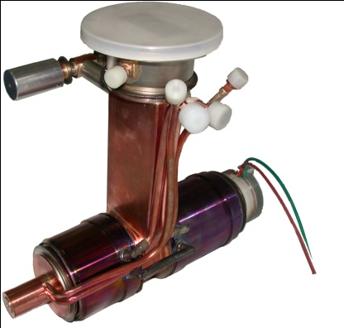
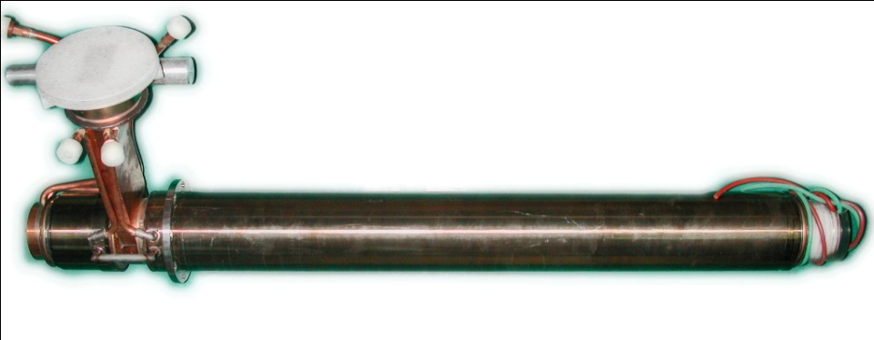
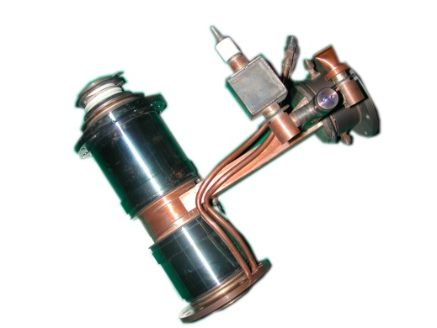
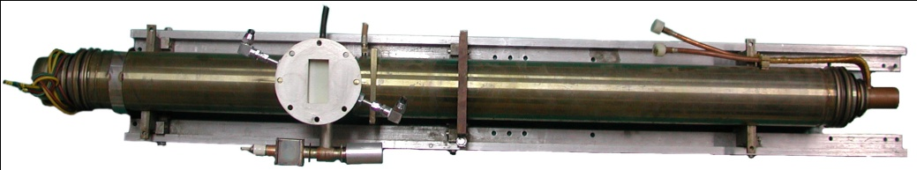
S-band Linacs for X-ray Imaging
1.5 MeV SW Linac
2 MeV SW Linac
4 MeV SW Linac
9 MeV SW Linac
15 MeV SW Linac
6 MeV SW Linac

Slide 8
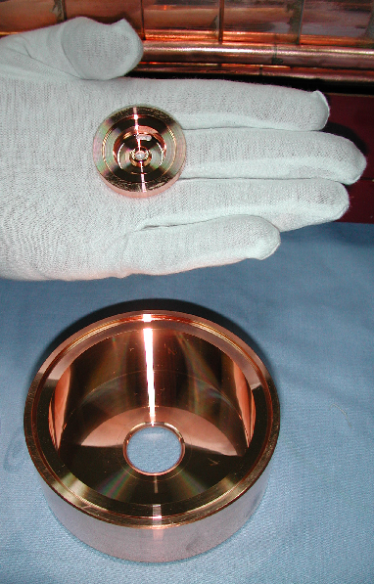
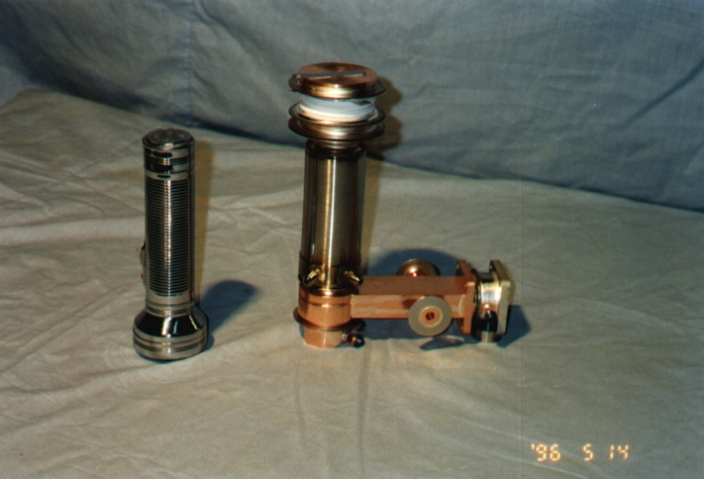
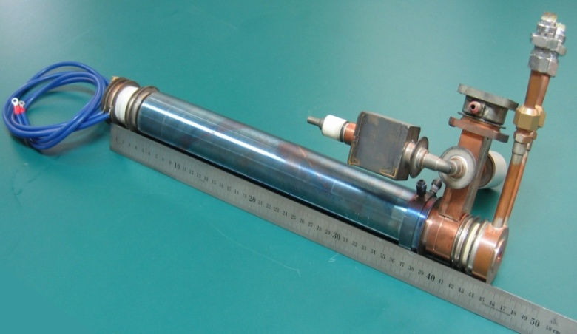
X Band Accelerating Structure
X Band
S Band
X-band 2.5MeV Accelerating tube
X-band 6MeV Accelerating tube

Slide 9
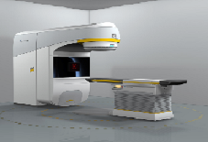
Medical Applications

Slide 10
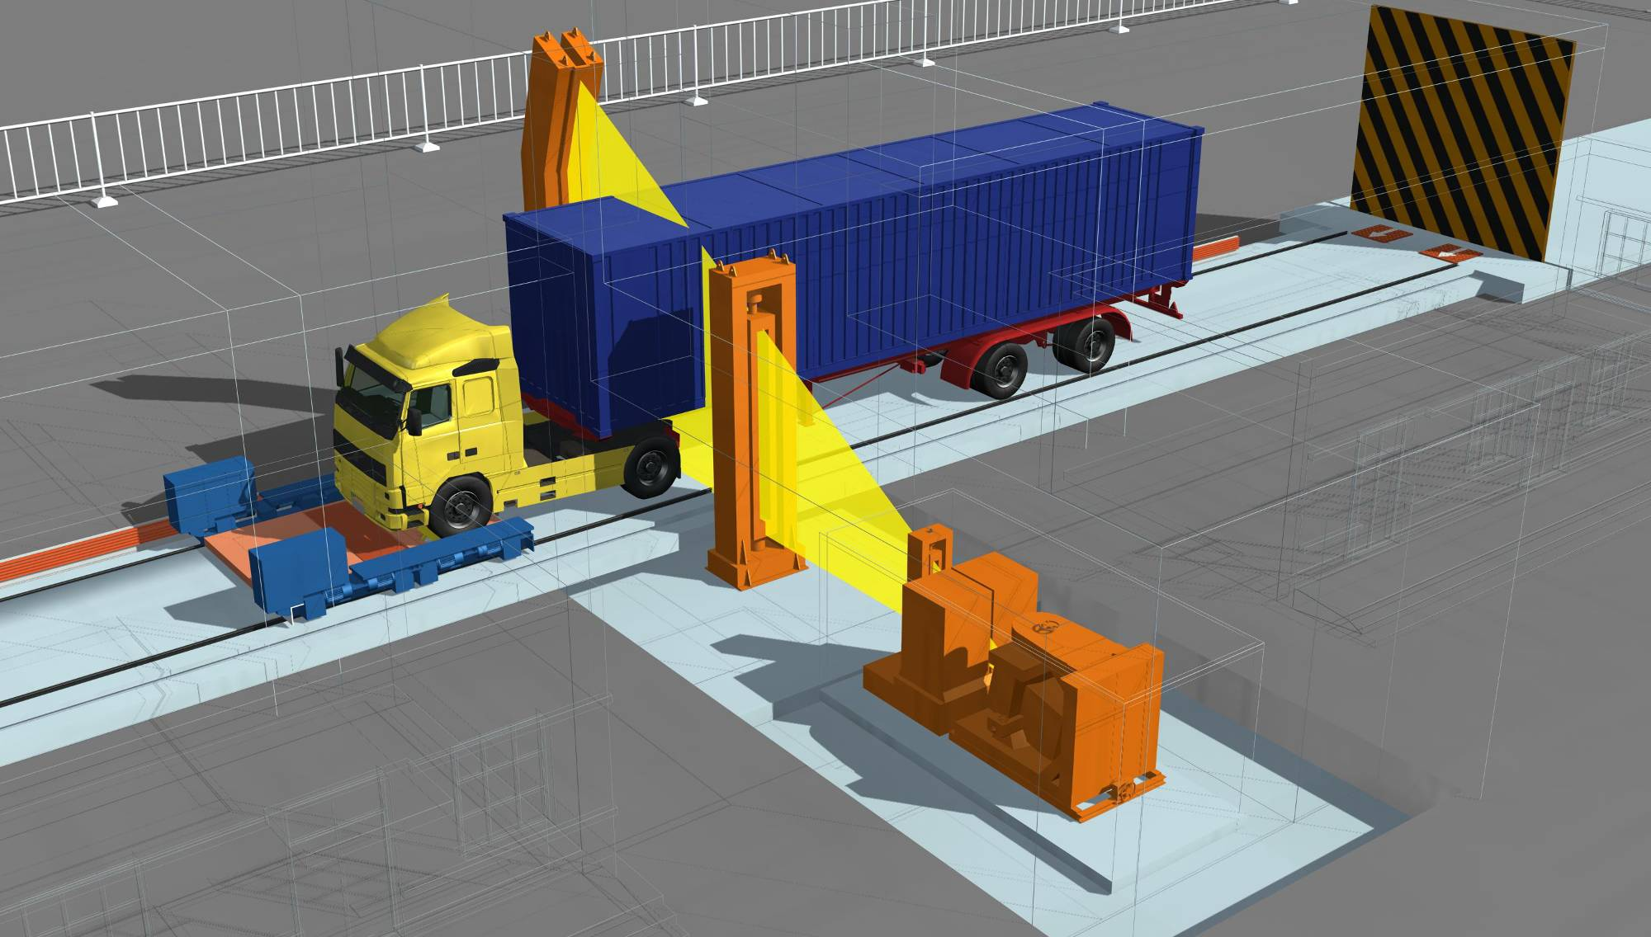
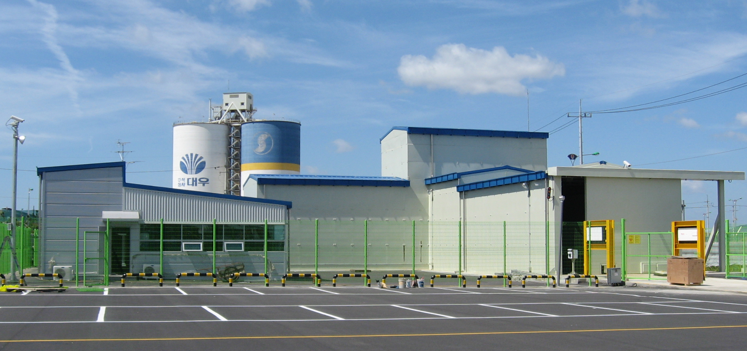
Cargo Inspection System

Slide 11
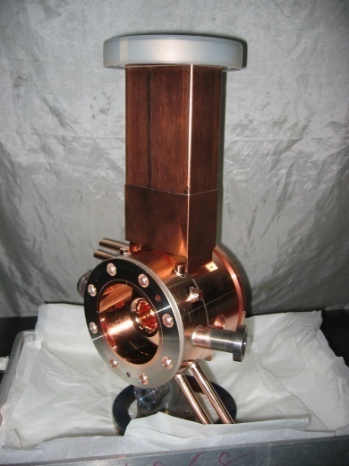
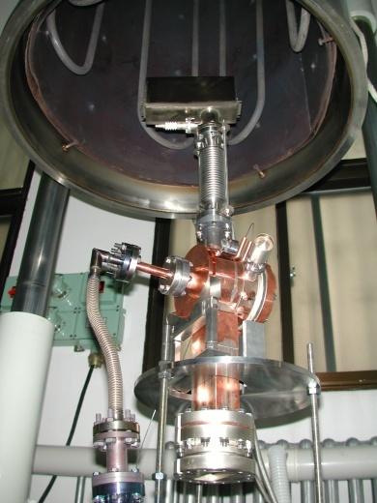
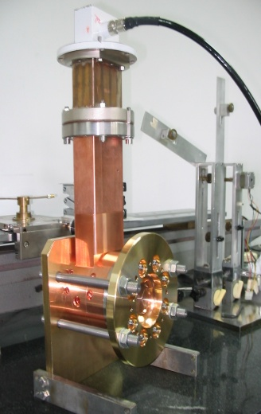
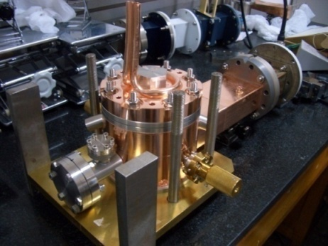
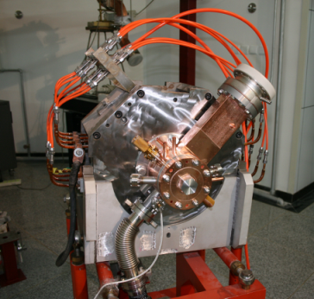
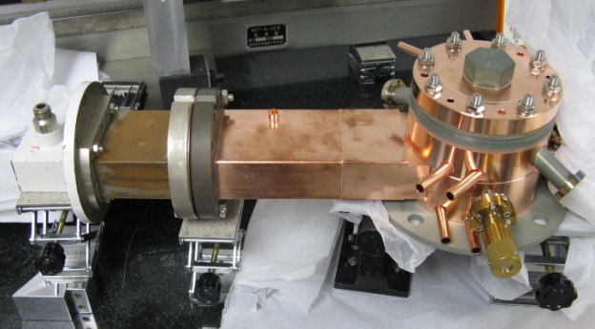
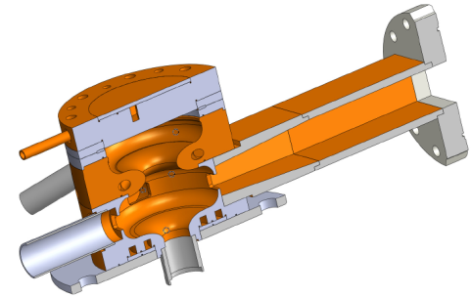
Photocathode RF gun
The 1st Gun ,
For THU
2006
The 2nd Gun,
For SSRF
2006
The 3rd Gun,
For BNL
2007
The 4th Gun,
For NSRL
2008
The 5th Gun,
For THU
2008
The 6th Gun,
For THU
2010
The THU Gun,2011

Slide 12
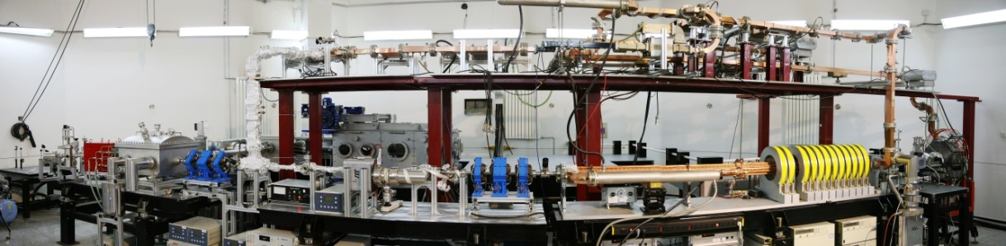
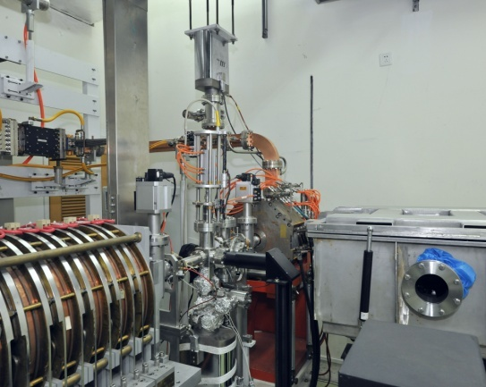
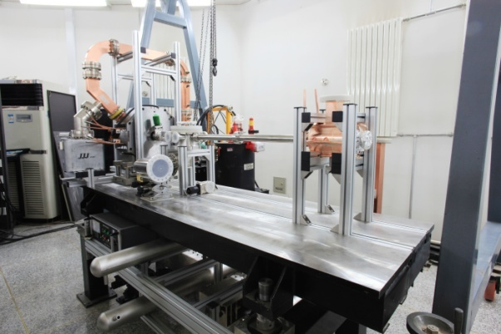
Thsomson scattering X-ray source
TTX(Tsinghua Thomson X-ray source)
Free electron laser
SDUV-FEL(Shanghai Deep-ultraviolet FEL)
SXFEL(Shanghai soft X-ray FEL test facility)
MeV Ultrafast electron diffraction
Tsinghua
BNL

Slide 13
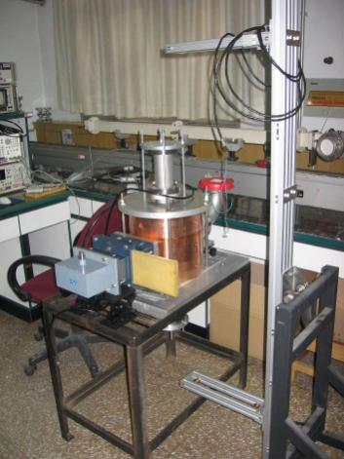
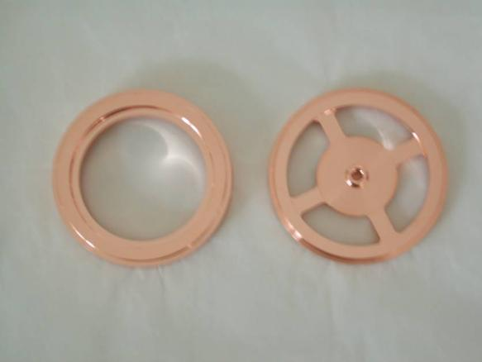
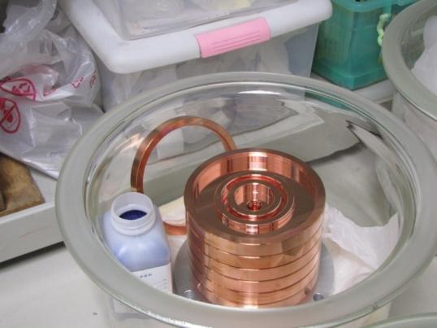
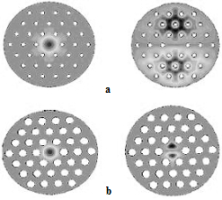
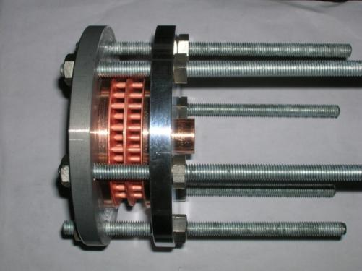
RF Structure R&D

Slide 14
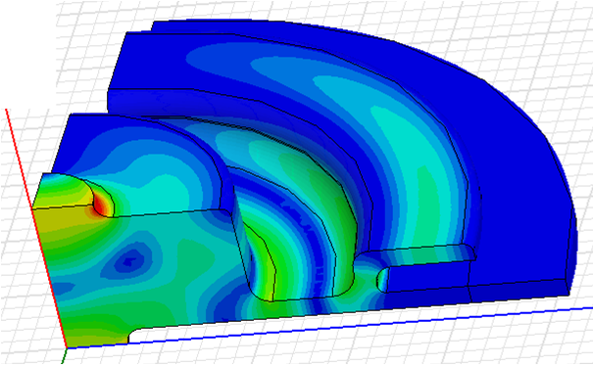
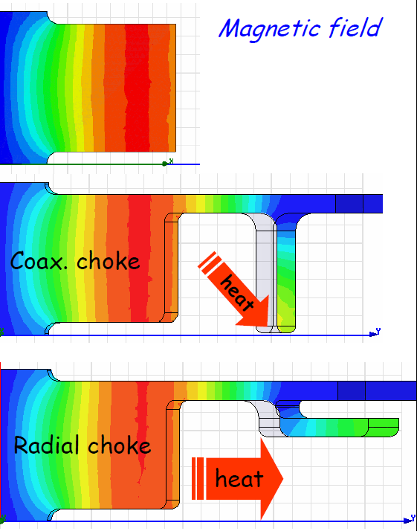
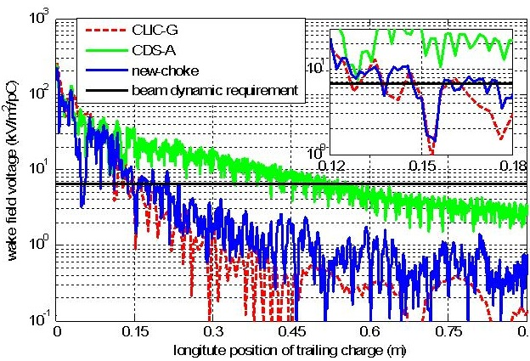
Choke-mode structure
Collaboration start from 2009
Wakefield damping

Slide 15
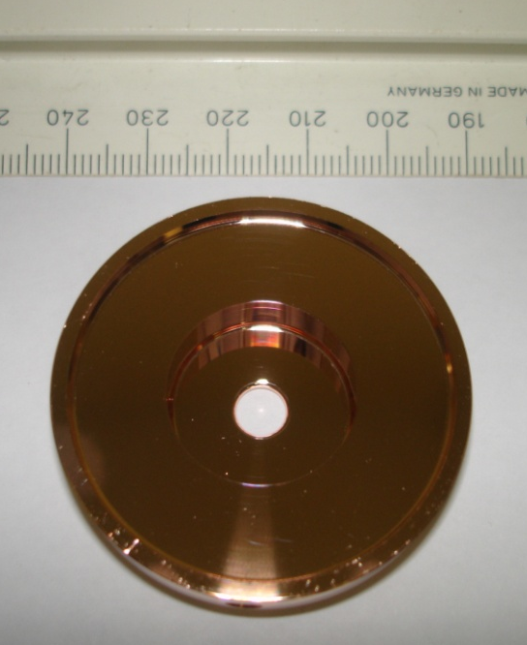
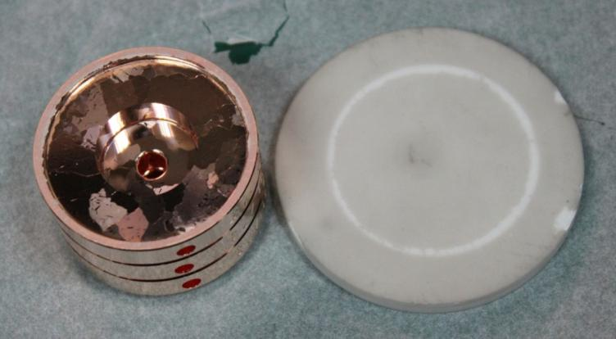
High gradient structure production
Machining, bonding
Full structure will be produced
CLIC T24 Prototype disc

Slide 16
High gradient structure study
Structure design and production
High power test @X-band
  Magnetron based power source 1.5MW peak power, ~μs pulse length
  Klystron based power source planned, ~10MW level.
Breakdown study
  Photoemission experiment

Slide 17
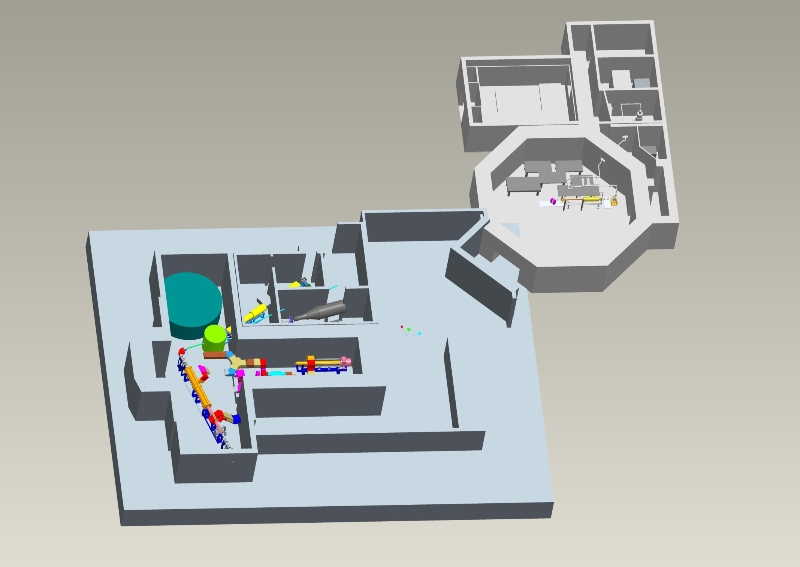
TTX: lasers, electrons & x-rays
CPHS-neutrons: Short-Pulse options: Diffraction, QENS, …
CPHS-neutrons: Long-Pulse – SANS, Imaging, …
CPHS-proton applications
CPHS Complex – approved boundary
CPHS-proton accelerator R&D

Slide 18
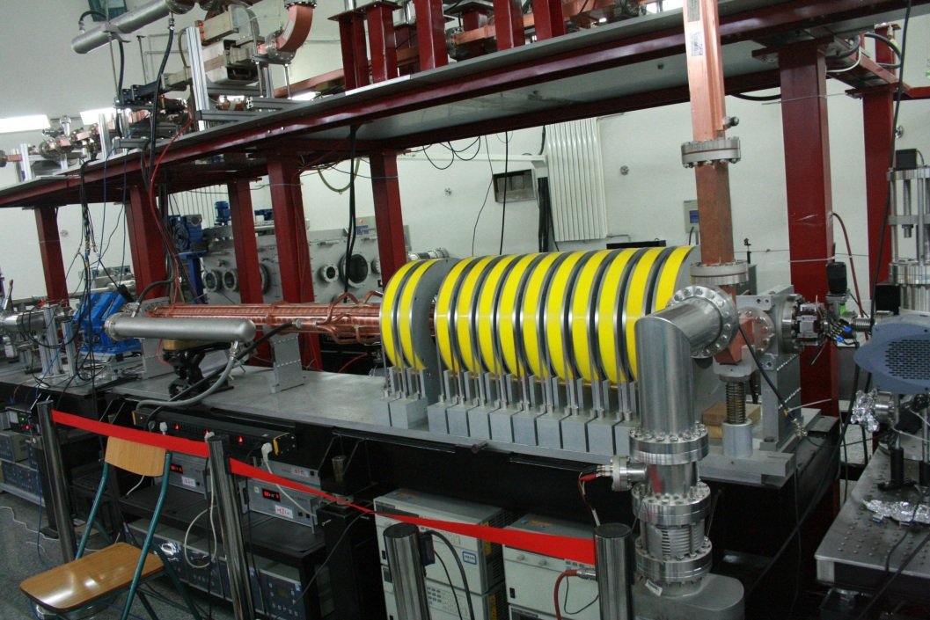
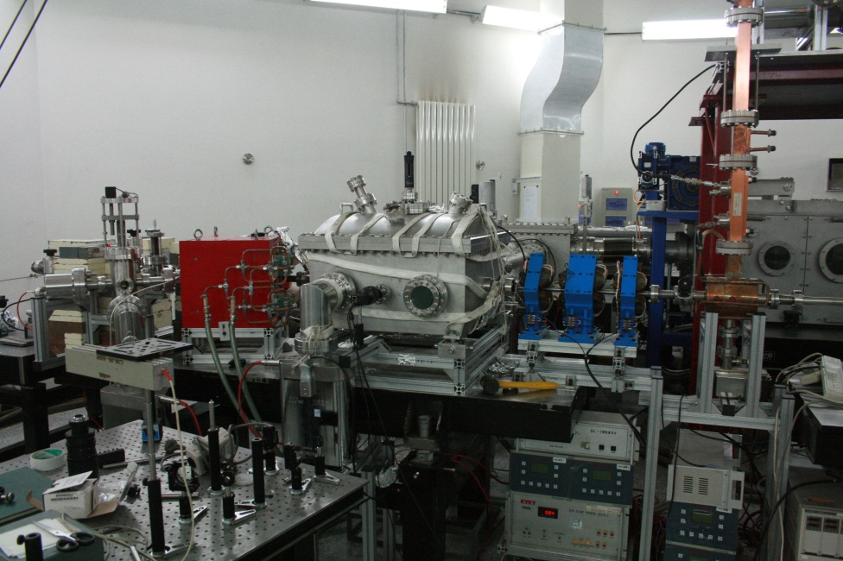

Electron beam line

Slide 19

Laser System
RF Gun
TS IP
800nm, ~20TW, ~30fs
266nm, 1mJ, 30fs~10ps

Slide 20


Thomson Scattering Experiment
X-ray profile measured by CsI screen and EMCCD
30 mm Ti window

Slide 21

Compact Pulse Hadron Source (CPHS)
CPHS project
  13MeV/50mA, 0.5ms/50Hz
  Neutron target
  Neutron instrument

Slide 22



RFQ
DT

Slide 23
Summary
Accelerator R&D
  Linac tubes
  Design and build accelerating structures on site
  High-gradient structure
Major projects
  Thomson Scattering X-ray Source
  Compact Pulse Hadron Source
Please contact us for details if interested
Thank you for your attention!

