Slide 1


PHOTOEMISSION MEASUREMENTS ON COPPER SURFACES
CLIC WORKSHOP 2013
I. Martini, E. Chevallay, V. Fedosseev, C. Hessler, M.Martyanov

Slide 2


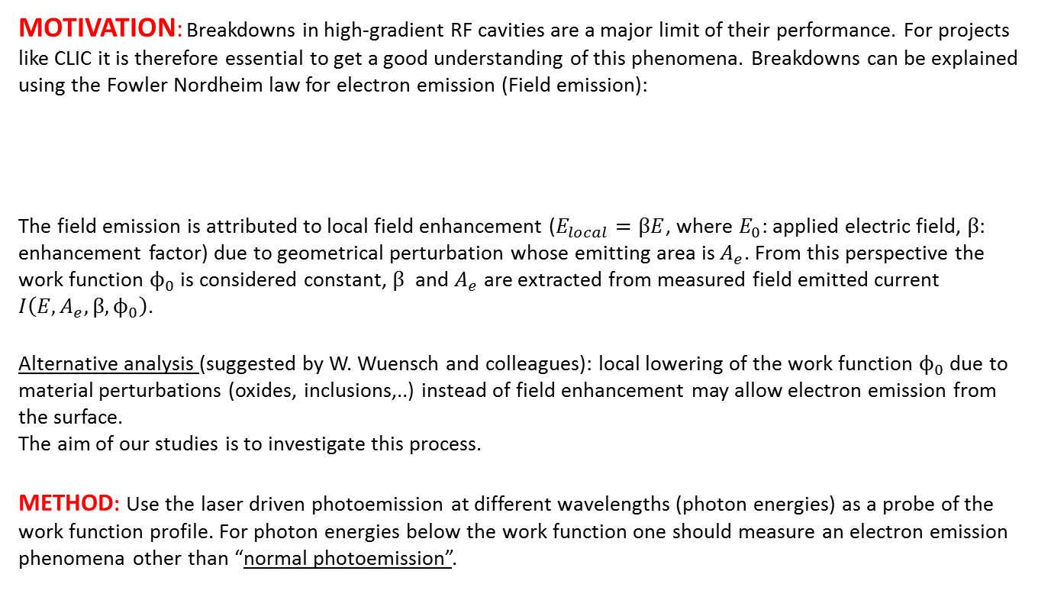
Preliminary remarks
MOTIVATION: Breakdowns in high-gradient RF cavities are a major limit of their performance. For projects like CLIC it is therefore essential to get a good understanding of this phenomena. Breakdowns can be explained using the Fowler Nordheim law for electron emission (Field emission):
  The field emission is attributed to local field enhancement ($E_{local}=βE$, where $E_{0}$: applied electric field, $β$: enhancement factor) due to geometrical perturbation whose emitting area is $A_{e}$. From this perspective the work function $ϕ_{0}$ is considered constant, $β$ and $A_{e}$ are extracted from measured field emitted current $I\left(E,A_{e},β,ϕ_{0}\right)$.
Alternative analysis (suggested by W. Wuensch and colleagues): local lowering of the work function $ϕ_{0}$ due to material perturbations (oxides, inclusions,..) instead of field enhancement may allow electron emission from the surface.
The aim of our studies is to investigate this process.
METHOD: Use the laser driven photoemission at different wavelengths (photon energies) as a probe of the work function profile. For photon energies below the work function one should measure an electron emission phenomena other than “normal photoemission”.
F-N Equation (RF field)
$$\overline{I}= \frac{5.79 ∙ {10}^{−12}exp⁡(9.35 {ϕ_{0}}^{0.5})A_{e}{(βE_{0})}^{2.5}}{{ϕ_{0}}^{1.75}}exp⁡(\frac{−6.53∙ {10}^{9}ϕ_{0}}{βE_{0}})$$

Slide 3
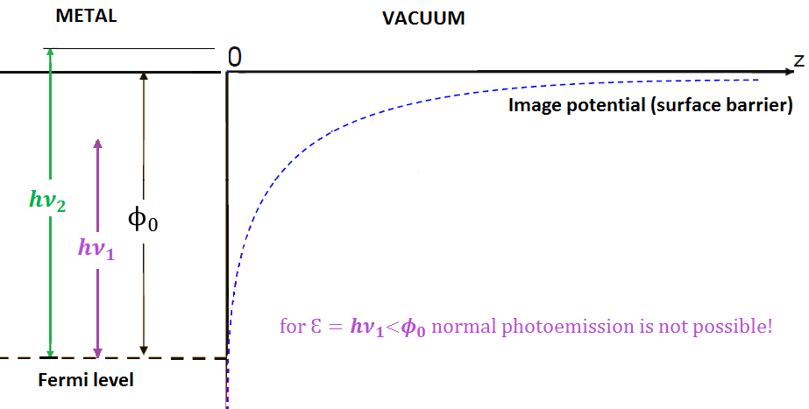





Photoemission processes
“NORMAL PHOTOEMISSION”: THREE STEPS MODEL
  1. Absorption of a photon of $energy Ɛ=hν$⇒ electron excitation.
  2. Motion of the electron to the vacuum interface
  ⇒ IN METALS: the electron mainly losses energy by scattering with others electrons.
  3. Escape of the electron over the surface barrier
  IN METALS: the surface barrier is determined by the work function $ϕ_{0}$, i.e. the minimum energy needed to remove an electron from a solid to a point immediately outside the solid surface ⇒ Photoemission threshold:
The photocurrent j_{p} increases as the light intensity I increases(${ k}_{1}$(Quantum Efficiency) ):
$$hν\text{>}φ_{0}$$
$${Ɛ=hν}_{1}$$
For the electron can’t overcome the surface barrier
For the electron can escape
$${Ɛ=hν}_{2}$$
$j_{p}=k_{1}∙$I

Slide 4
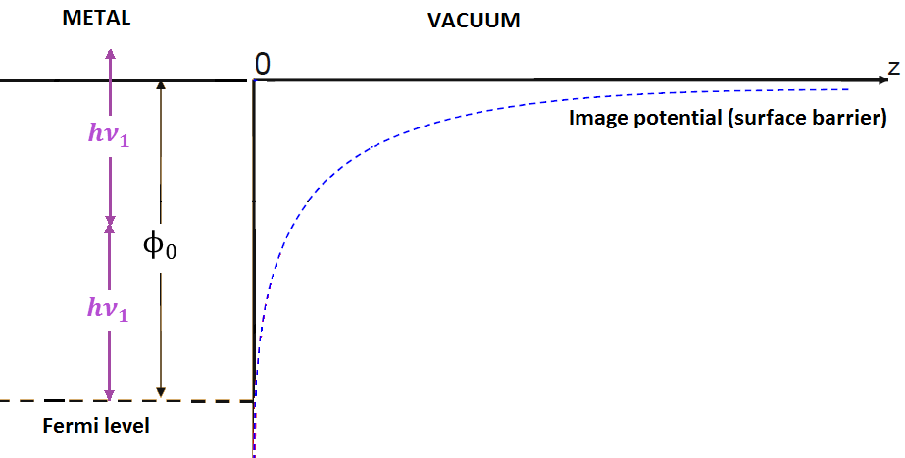




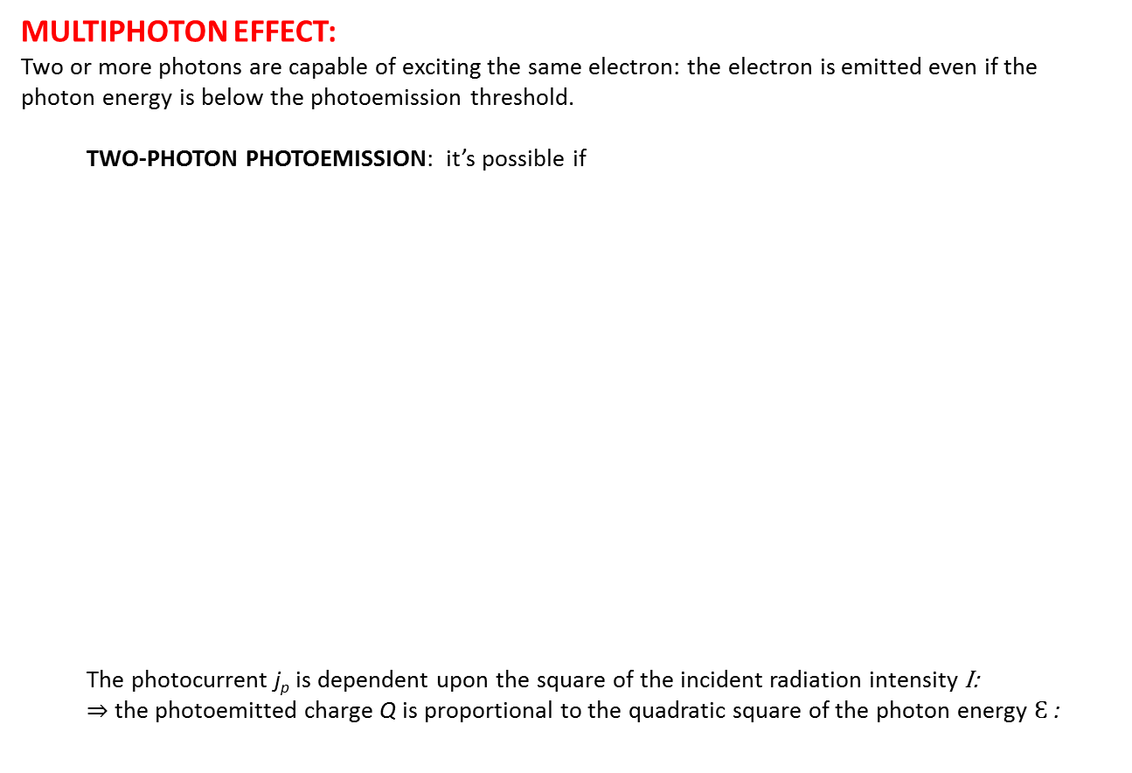
Photoemission processes
MULTIPHOTON EFFECT:
Two or more photons are capable of exciting the same electron: the electron is emitted even if the photon energy is below the photoemission threshold.
  TWO-PHOTON PHOTOEMISSION: it’s possible if
  The photocurrent j_{p} is dependent upon the square of the incident radiation intensity I: ⇒ the photoemitted charge Q is proportional to the quadratic square of the photon energy $Ɛ$:
$$\frac{φ_{0}}{2}<hν\text{<}φ_{0}$$
$${Ɛ=2hν}_{1}$$
For the electron has enough energy to escape
$${j_{p}=k_{2}∙I}^{2}$$
$${Q=k_{3}∙Ɛ}^{2}$$

Slide 5
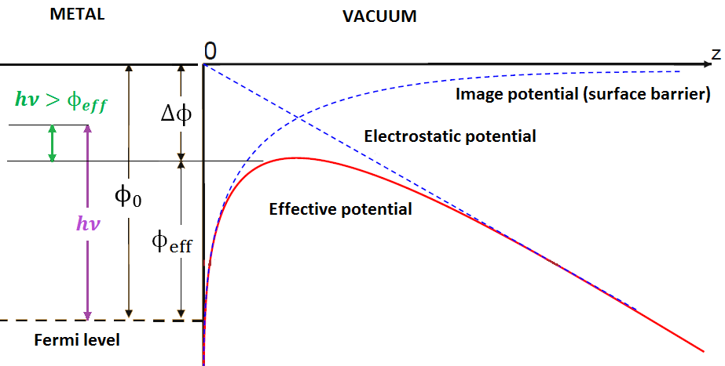
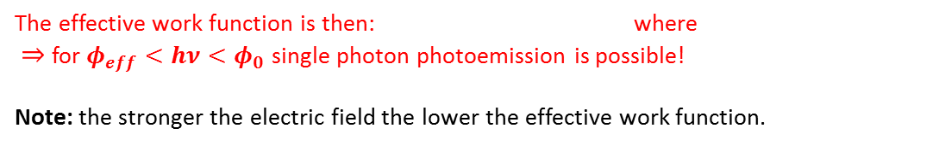



Photoemission processes
SCHOTTKY ENABLED PHOTOEMISSION
The same phenomena which causes Field Emission could lead to single-photon photoemission even if .
The high electric field lowers the potential barrier outside a metal surface.
$$hν<φ_{0}$$
$$Δϕ= \sqrt{\frac{E∙e^{3}}{4πε_{0}}}$$
$$ϕ_{eff}=ϕ_{0}−Δϕ$$
The effective work function is then: where
⇒ for $φ_{eff}<hν<φ_{0}$ single photon photoemission is possible!
Note: the stronger the electric field the lower the effective work function.

Slide 6
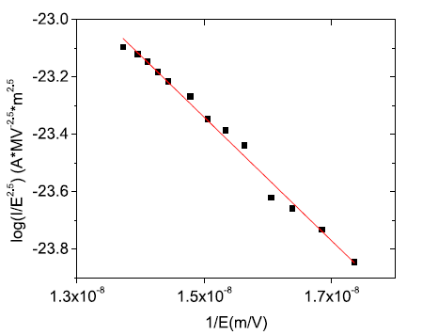
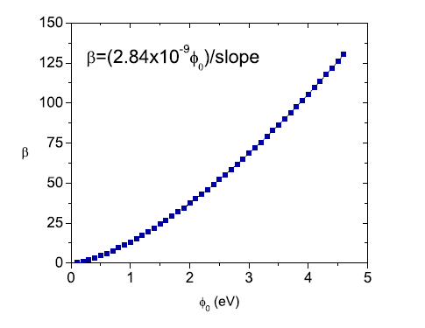
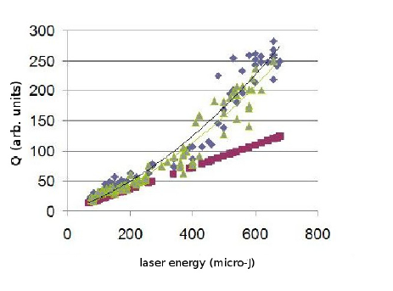




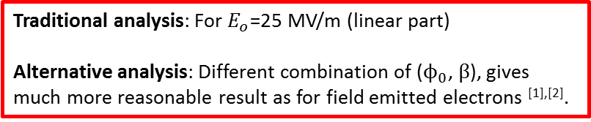

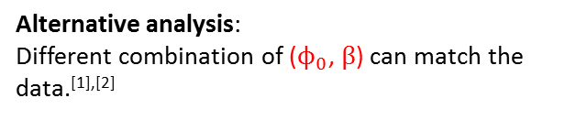

Measurements at Tsinghua Facility
FIELD EMISSION (Fowler-Nordheim plot)
Traditional analysis: $ϕ_{0}$=4.6 eV (nominal COPPER work function)
      $β=130$ (Extracted from the fit) ^{[1],[2]}
Alternative analysis:
Different combination of ($ϕ_{0}$, $β$) can match the data.^{[1],[2]}
This result is considered unrealistic for the such surface leading to unphysical emission features 10 nm tall by 1 nm wide^{[1],[2]}.
$$β$$
[Courtesy of
E.E.Wisniewski et al.]
[Courtesy of
E.E.Wisniewski et al.]
$$ϕ_{0}(eV)$$
SCHOTTKY ENABLED PHOTOEMISSION
$E_{o}$= 25MV/m
Schottky enabled photoemission was observed for λ=400 nm (3.1 eV) and different value of accelerating field $E_{o}$^{[1],[2].}
Q (arb. unit)
$β$ = 60
Traditional analysis: For $E_{o}$=25 MV/m (linear part)
Alternative analysis: Different combination of ($ϕ_{0}$, $β$), gives much more reasonable result as for field emitted electrons ^{[1],[2]}.
[Courtesy of
E.E.Wisniewski et al.]
Laser energy (μJ)
[1] J. Power et al., Schottky Enabled Photoemission & Dark Current Measurements at the S-band RF Gun Facility at Tsinghua, MeVArc Workshop, Finland (2011)
[2] E.E. Wisniewski et al., TUPPD069, Proceedings of IPAC2012, New Orleans, Louisiana, USA

Slide 7
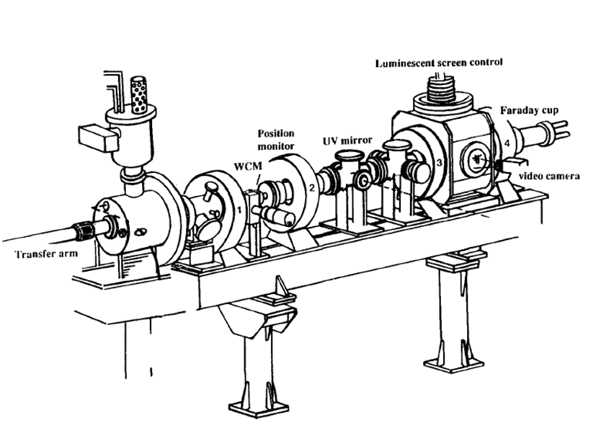
CERN Lab measurement setup
We tried to reproduce the Schottky Enabled photoemission measurement with this setup:
DC GUN:
70.1 kV supplied voltage
(7 MV/m electric field)
Bunch charge measured by:
Wall Current Monitor (WCM)
Faraday Cup (FC)
e-
LASER:
Q-switched Nd (YAG)
λ=355 nm or λ=266 nm 10 Hz repetition rate
5 ns pulse duration
COPPER SAMPLES:
6A44 (diamond turning) 2nd PLUG
6A22 (diamond powder polishing) 3rd PLUG

Slide 8
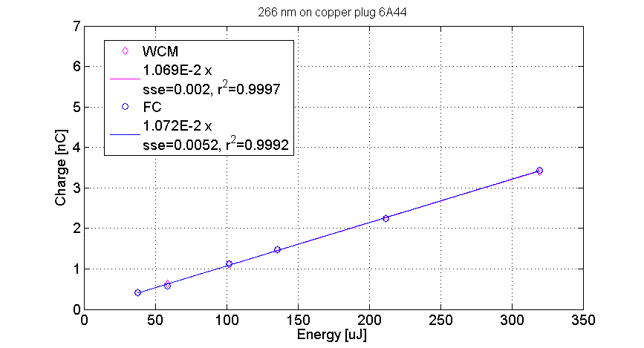
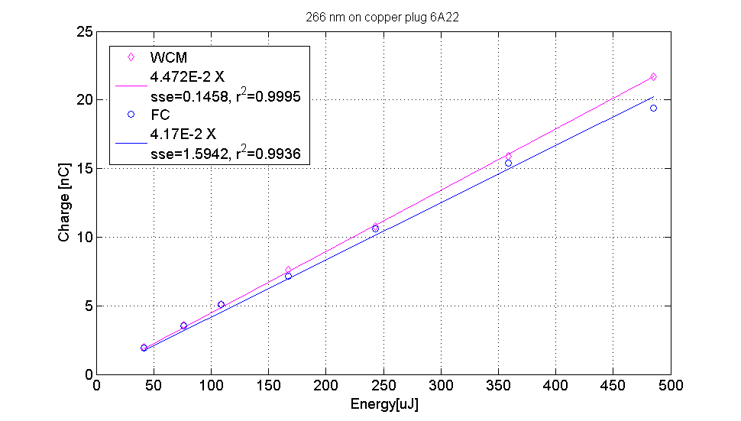

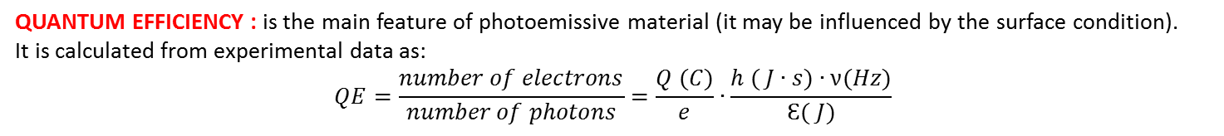
MEASUREMENT WITH 266 nm (4.7 eV)
hν>$φ_{0}$
2nd plug
3rd plug
Linearity => Normal single-photon photoemission
QUANTUM EFFICIENCY : is the main feature of photoemissive material (it may be influenced by the surface condition).
It is calculated from experimental data as:
$$QE=\frac{number of electrons}{number of photons}=\frac{Q (C)}{e}∙\frac{h ( J∙s)∙ν(Hz)}{Ɛ( J)}$$
2nd plug: QE(266nm)= 5E-5 3rd plug: QE(266nm)= 2E-4 Copper QE(266nm)*=3E-5
*Previous measurement on copper with 266 nm (CERN-PSI, 2007)

Slide 9
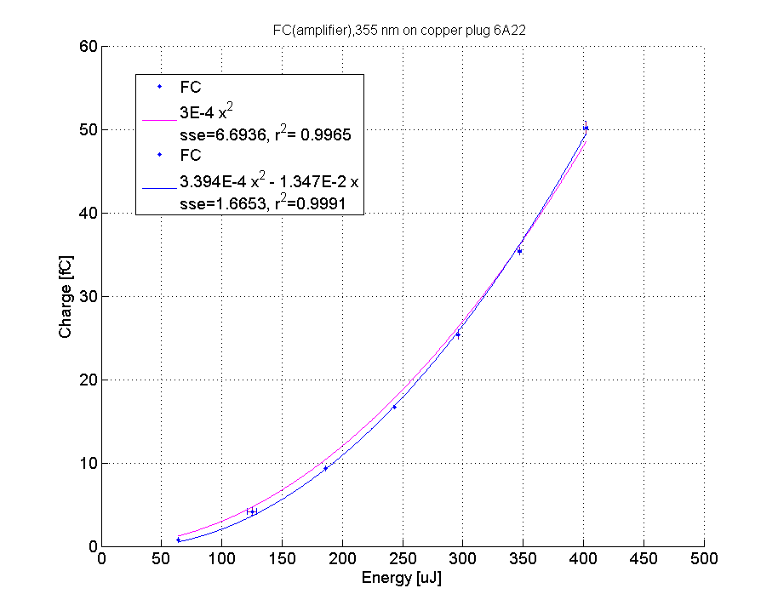
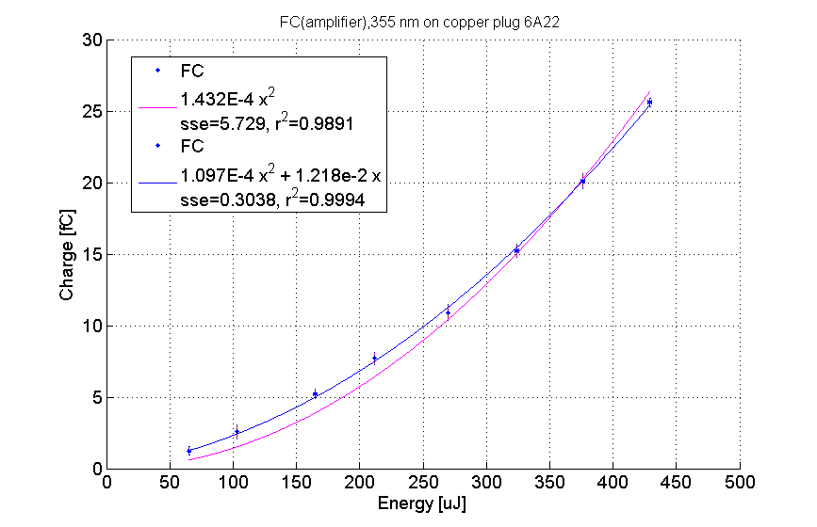

MEASUREMENT WITH 355 nm (3.5 eV)
$\frac{φ_{0}}{2}$<hν<$φ_{0}$
2nd plug
3rd plug
Note: error bars, charge [fC],
energy [µJ].
Note: error bars, charge [fC],
energy [µJ].
Non linear trend: two-photon photoemission is predominant.
For pure two-photon photoemission a pure quadratic trend is predicted by the theory, but the equation with the linear term (blue line) fits better the data.

Slide 10
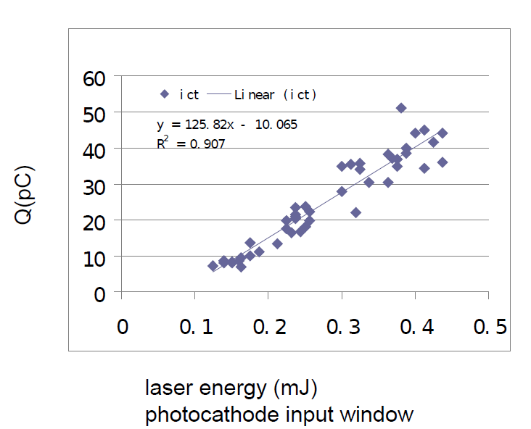








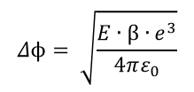

COMPARISON
REMARK: Effective wavelength $λ^{′}$
$$Δϕ= \sqrt{\frac{E∙β∙e^{3}}{4πε_{0}}}$$
$$Δϕ+hν=\frac{hc}{λ^{′}}$$
Work function lowering due to electric field (Schottky Effect)
CERN Lab: 7 MV/m
355 nm
$Δϕ$ $\sim$ 0.10 eV
$λ^{′}$ $\sim$ 346 nm (β=1)
$λ^{′}$ $\sim$ 335 nm (β=5)
Tsinghua Facility: 54 MV/m
400 nm
$Δϕ$ $\sim$ 0.28 eV
$λ^{′}$ $\sim$ 368 nm (β=1)
$λ^{′}$ $\sim$ 334 nm (β=5)
Tsinghua Facility
CERN Lab
$E_{o}$= 54 MV/m
Charge (fC)
[Courtesy of J. Power et al.]
Laser energy (mJ)
Laser energy (μJ)
Linear trend
Quadratic trend
Same range of energy but 3 orders of magnitude difference in charge.

Slide 11

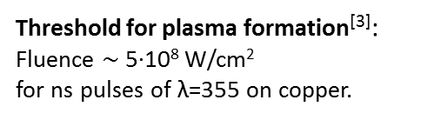
COMPARISON
The difference between the Schottky enabled photoemission data taken at Tsinghua Facility and at CERN could be maybe explained by the different laser fluence involved in the two experiments.
CERN Lab: 1 mJ
1 mm²
5 ns
$Fluence$ $\sim$ 2∙10⁷ W/cm²
Threshold for plasma formation^{[3]}:
Fluence $\sim$ 5∙10⁸ W/cm²
for ns pulses of λ=355 on copper.
Tsinghua Facility: 100 µJ
1 mm²
1 ps
$Fluence$ $\sim$ 10¹⁰ W/cm²
Intense electron emission due to plasma formation:
For ps laser pulses and high electric field gradient: laser-induced plasma formation has been observed with subsequent emission of intense electrons (several orders of magnitude higher than normal photoelectrons)^{[4]}. The thresholds for this phenomena are: 10⁹ W/cm² (for 70 MV/m peak electric field, rf gun)
10¹¹ W/cm² (for 7 kV/m, dc gun).
[3] W. Zhang et al., “Modelling and Analysis of UV Laser Micromachining of Copper”, Int J Adv Manuf Technol (2001) 18:323–331
[4] X.J. Wang et al., “Intense electron emission due to picosecond laser-produced plasmas in high gradient electric fields”, J. Appl. Phys. 72 (3), 1 August 1992

Slide 12
CONCLUSION AND OUTLOOK
1) For measurement driven by λ=266 we observed a single photon photoemission and a QE consistent with previous measurement on copper.
2) We observed non linear behaviour in photoemission measurement on copper for λ=355 nm and a very small charge (fC).
3) The Schottky Enabled Photoemission measurement done at Tsinghua Facility [1],[2] can maybe be explained by intense electron emission due to picoseconds laser-produced plasmas.
4) The photoemission data at λ=355 nm is very well fitted by a parabola with a linear term.
This linear term may be connected to some experimental drift but may be also related to a single-photon photoemission phenomena. This contribution could be due to some local lowering of the workfunction (as suggested by W. Wuensch and colleagues).
We have pushed our experimental setup to its limits: using an electrical amplifier we could measure in the range of femtoCoulomb (10⁴ electrons!)
To further investigate the source of the linear term in the parabolic fit we need to scan over the wavelengths (266 nm→355 nm). The eventually presence of low workfunction spot would give a measurable contribution at intermediate photon energy (between two-photon photoemission and single-photon photoemission).
To do the scan an OPO (Optical Parametric Oscillator) is needed: this tunable laser system can provide a wide range of wavelengths with easy maintenance and reliability.

Slide 13
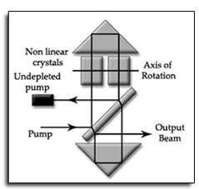
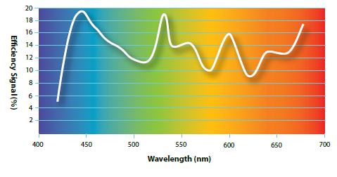
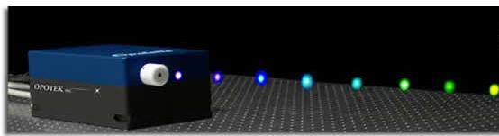
CONCLUSION AND OUTLOOK
OPTICAL PARAMETRIC OSCILLATOR SETUP
Pump laser with 3rd harmonic
Tunable OPO&OPA module
2nd harmonic conversion
of the signal
Pump laser
3w
OPO
OPA
2w
Nd:YAG 1064 nm
Pump 355 nm
Signal 680-520 nm
Idler 740-1120 nm
340-260 nm
Energy ~ mJ
Pump laser
OPO scheme
Signal efficiency
Estimated cost of the whole setup: 120 kchf

Slide 14


Acknowledgment
We would like to thank:
  Walter Wuensch and colleagues for valuable discussions.
  -
  - You all for your attention!
LA3NET is funded by European Commission under Grant Agreement Number GA-ITN-2011-28919

Slide 15
Bibliography
[1] J. Power et al., Schottky Enabled Photoemission & Dark Current Measurements at the S-band RF Gun Facility at Tsinghua
[2] E.E. Wisniewski at al., TUPPD069, Proceedings of IPAC2012, New Orleans, Louisiana, USA
[3] W. Zhang et al., “Modelling and Analysis of UV Laser Micromachining of Copper”, Int J Adv Manuf Technol (2001) 18:323–331
[4] X.J. Wang et al., J. Appl. Phys. 72 (3), 1 August 1992
[5] A.H. Sommer, Photoemissive Materials (Wiley, New York, 1968)
[6] R. L. Smith, Phys. Rev. 128, 5 (1962)
[7] W. E. Spicer, Phys. Rev. B 112, 114 (1958)

Slide 16
Backup slides

Slide 17
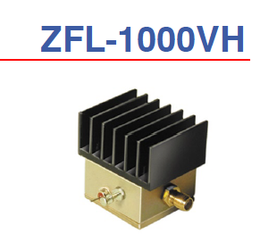

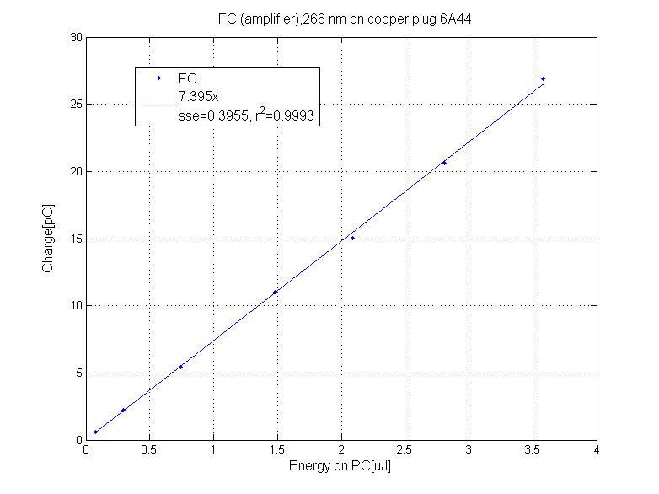
Amplifier linearity
Amplifier response
(input signal from waveform generator)
FC signal with amplifier for 266 nm on copper plug 6A44 : the amplifier doesn’t distort the actual linear trend.

Slide 18
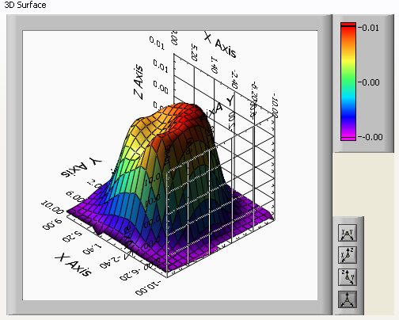
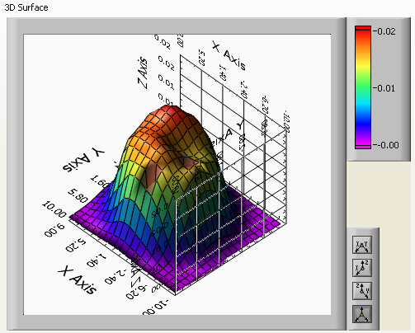
3D scan: QE over the surface
2nd plug
3rd plug
(266 nm and pencil beam)
(266 nm and pencil beam)

Slide 19
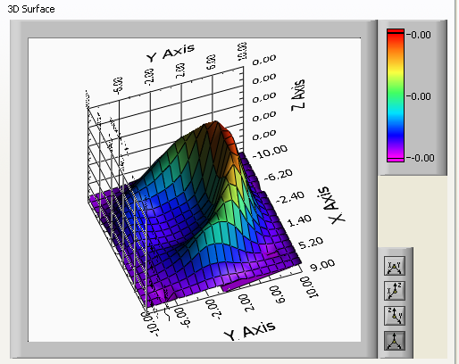
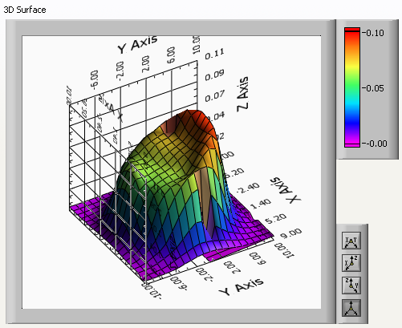
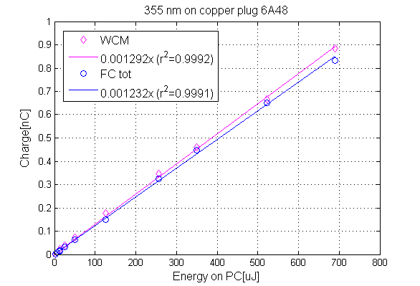
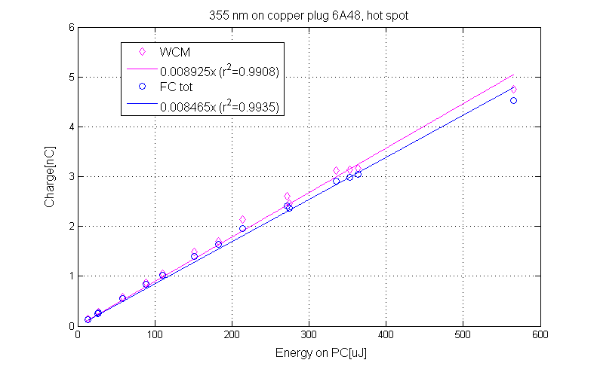
First plug: possible contamination
3D scan (QE over the surface)
with 355 nm
and pencil beam
3D scan with 266 nm
and pencil beam
355 nm, pencil beam, in the middle of the PC
355 nm, pencil beam, on the hot spot

Slide 20
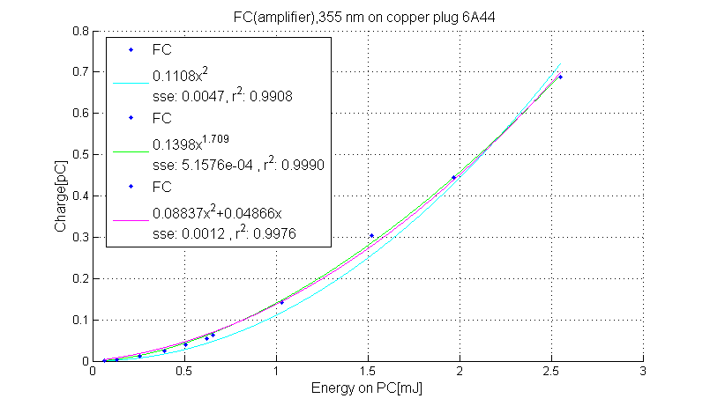
355 nm (3.5 eV)
1st plug
2nd plug (Amplifier introduced, only FC signal available. )
LINEAR TREND
NON LINEAR TREND
Note: charge [pC[,
energy [mJ] .

