Slide 1



ATLAS High p_{T} Measurements in Pb+Pb Collisions
בס"ד
Zvi Citron
Strangeness in Quark Matter
25 July 2013

Slide 2
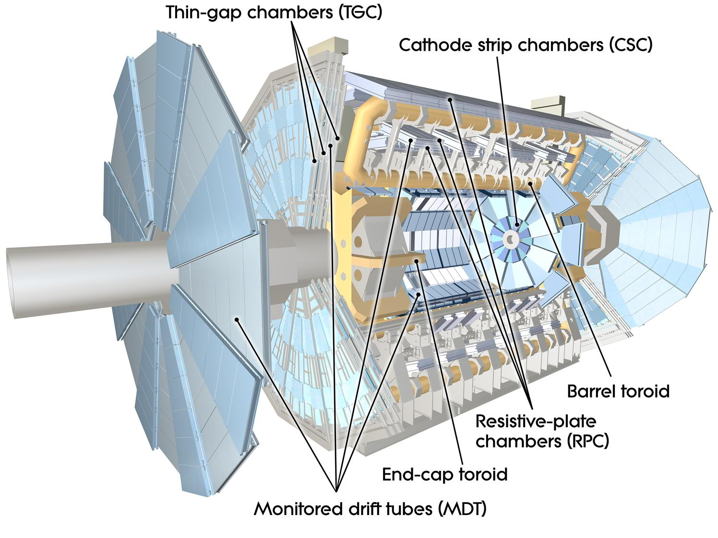
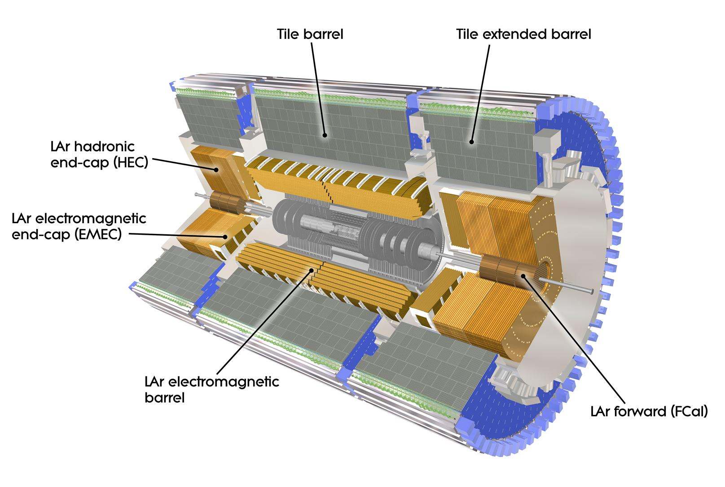
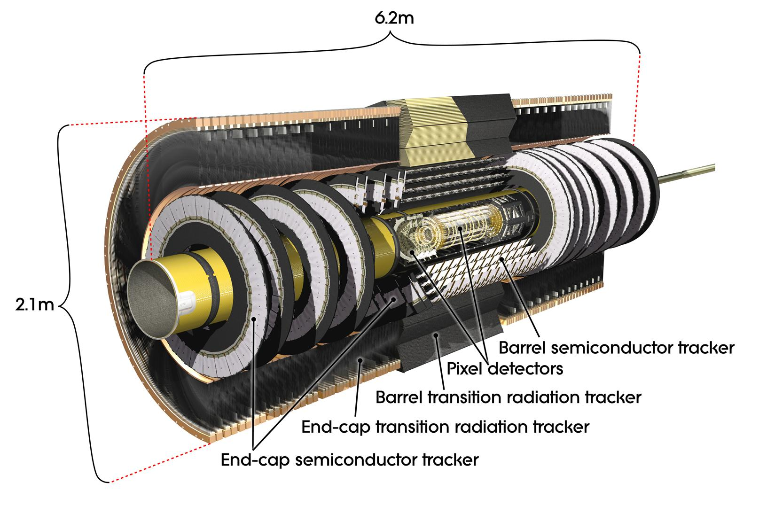
HI at ATLAS
ATLAS has excellent jet, photon, electron, and muon reconstruction using charged tracking + calorimetry/muon spectrometry
Pb+Pb runs at √s=2.76 TeV in 2010 (8 μb⁻¹) and 2011 (.15 nb⁻¹)
Lar-Pb EM calorimeter (|η|<3.2)
e/γ trigger, identification; measurement
Granularity: 0.025x0.025 in Φxη
3 long. layers + presampler(0 <|η|<1.8) 180x103 channels
Muon spectrometer (MS)
Air-core toroid magnetic field
Covers up to |η|=2.7
Triggers
Filtering provided by the calorimeters
Tracking in B field for momentum
Measurement matching with Inner Detector (ID) to improve resolution and vertex capabilities
Tracking
Precise tracking and vertexing
coverage: |η|<2.5
B (solenoid) =2T
Pixels (Si): σ = 10 μm [rφ]
80M channels ; 3 layers and 3 disks ;
SCT (106 Si strips ): σ = 17 μm [rφ]
Transition Radiation Tracker
Hadronic Calorimeter
|η|<1.7: Fe/scint. Tiles (Tilecal)
3.2 <|η|<1.5: Cu-Lar (HEC)
3.1<|η|<4.9: FCAL Cu/W-Lar
Notes:
SCT= silicon microstrip (semiconductor tracker)

Slide 3
High p_{T} Probes in Pb+Pb
Electroweak Bosons
Hadrons, Jets
Do not interact with the QCD medium – standard candles for energy loss
Production expected to scale with <N_{coll}>
Check pQCD predictions
Check for modification, effects of nuclear PDF
Access to quarks, glouns
Interact with the QCD medium
Modification of color sensitive objects in the medium
Quantify and understand where energy goes, what happens in medium interactions

Slide 4
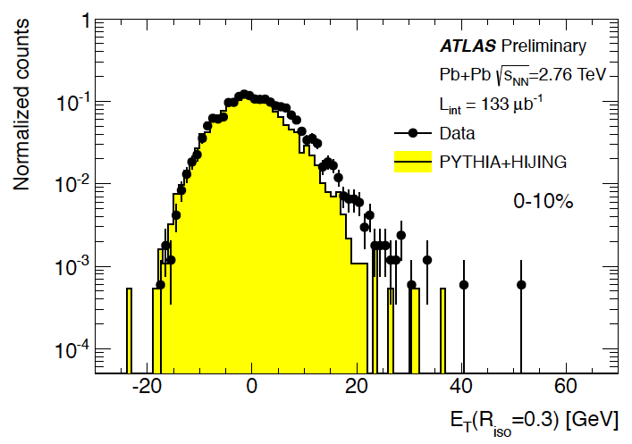
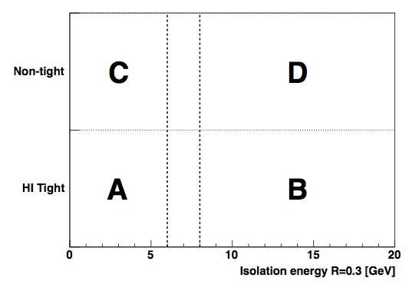
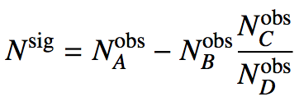
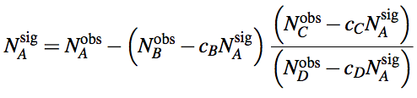
Direct Photon Measurement
Subtract underlying event
  Iterative subtraction in Δη=0.1 slices, excluding jets
  Elliptic flow sensitive
Isolated photons
  Cut on a maximum energy in cone around photon
  Fragmentation photons reduced
Shower shape cuts
  Multiple layers of EM calorimeter, and hadronic calorimeter
  Rejection of jet fakes
Signal Extraction
  “Double sideband” method
Isolation E
https://cdsweb.cern.ch/record/1451913

Slide 5
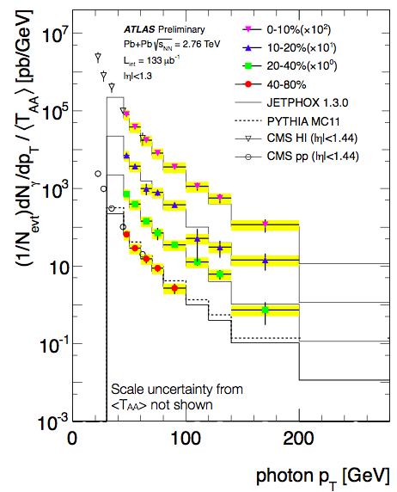
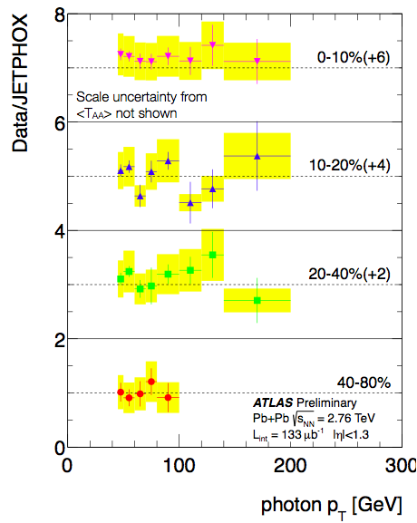
Direct Photon Spectra
Agreement with pQCD model, binary collision scaling observed to 200 GeV!
Corrected yield scaled by nuclear thickness ~ <N_{coll}>, and compared to JETPHOX predictions
https://cdsweb.cern.ch/record/1451913

Slide 6
Z→ee, Z→μμ Mass
Select leptons (underlying event subtraction for electrons)
Pair the selected leptons
Select Z boson in mass window 66-102 GeV
Signal Purity ~ 95% in Z➔ee and ~99% in Z➔μμ
Simulation is PYTHIA in HIJING events, reconstructed
Phys. Rev. Lett 110, 022301 (2013)

Slide 7
Z→ll Corrected Yields
Model is composed of Pythia
events normalized to the Z → ll cross section in p + p taken from next-to-next-to-leading-order (NNLO) calculations and scaled by ⟨TAA⟩.
Good model agreement in y shape and binary collision scaling observed!
Phys. Rev. Lett 110, 022301 (2013)

Slide 8
Jets as a Probe of the Medium
Qin and Müller QM2011
Partonic jet shower in vacuum composed of: Leading Parton and Radiated Gluons
Add the medium:
E transfer to medium via elastic collsions
Gluons radiated due to medium interactions
E transfer to medium via elastic collsions
Shunted out of jet cone from multiple scattering

Slide 9
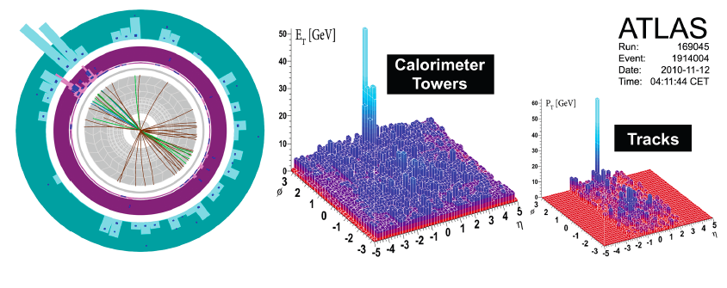
Full Jet Reconstruction
Anti-k_{t} (R=0.2 – 0.6) reconstruction algorithm
Event-by-event background subtraction:
  Anti-k_{t} reconstruction prior to a background subtraction
  Underlying event estimated for each longitudinal layer and ƞ slice
Jets corrected for flow contribution to background
Underlying event fluctuations rejected by matching jets to track jets or electron/photon

Slide 10
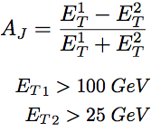
Di-Jet Asymmetry
Full jet reconstruction with anti-k_{t} algorithm (R=0.4)
Azimuthal correlation consistent in all systems p+p, MC, and peripheral Pb+Pb consistent – asymmetry peaked at zero
Central Pb+Pb has peak away from zero
Momentum balance from hard scattering not kept within di-jets
Direct observation of jet quenching – jets still back to back!
Phys. Rev. Lett. 105, 252303 (2010)

Slide 11
Jet Nuclear Modification Factor
Centrality dependent suppression of inclusive jet production!
Inclusive jet production measured
Increasing suppression with centrality
Roughly flat in p_{T} for central events
Phys. Lett. B 719 (2013) 220-241

Slide 12
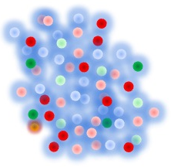
Azimuthal Distribution of Jets
Δϕ
Φ₂
Jet v₂ is not “Jet hydrodynamic flow”
Rather, a look at the jets as a function of the amount of medium they traverse
https://cdsweb.cern.ch/record/1472938

Slide 13
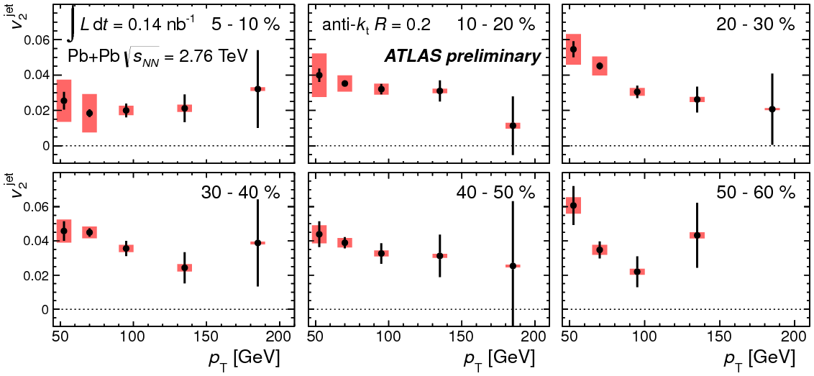
Azimuthal Distribution of Jets
Signifcant v₂ in jets
Compare to null result in Z boson no quenching case
Jet yields show significant variation in angle with respect to reaction plane, i.e. quenching varies with path length traversed
Z boson v₂
https://cdsweb.cern.ch/record1472938

Slide 14
Jet Cone Size Dependence
Is lost energy hiding in larger cones?
Vary cone sizes (R) in anti-k_{t} algorithm
R dependence seen at lower p_{T}
Small but significant increase in R_{CP} with larger cone size – jets broadened?
Phys. Lett. B 719 (2013) 220-241

Slide 15
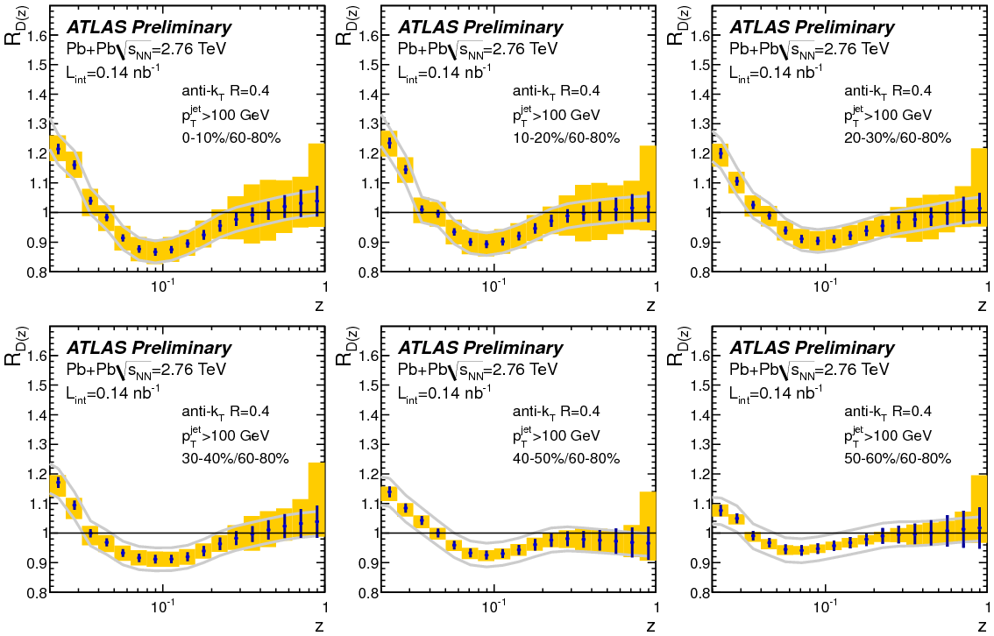
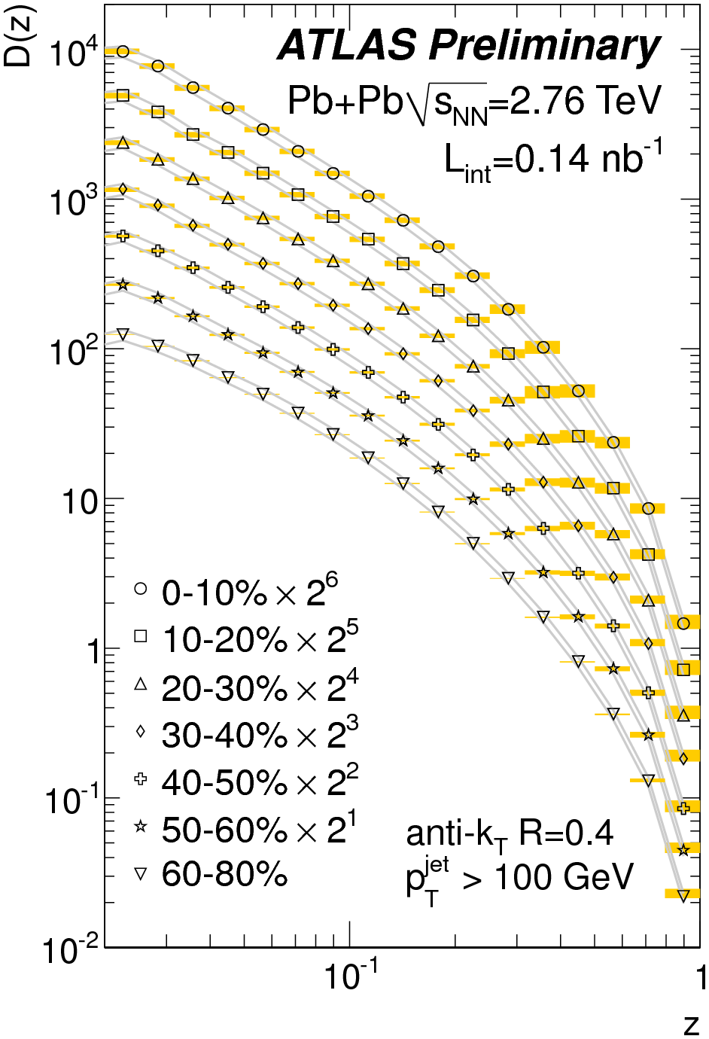
Internal Jet Structure
Significant modification of jet structure
Apparent push to low p_{T} (at large angle?)
D(z) are background subtracted and unfolded
Enhancement at low z
Suppression at intermediate z
No change at high z - leading particle unaffected?
http://cdsweb.cern.ch/record/1472936

Slide 16
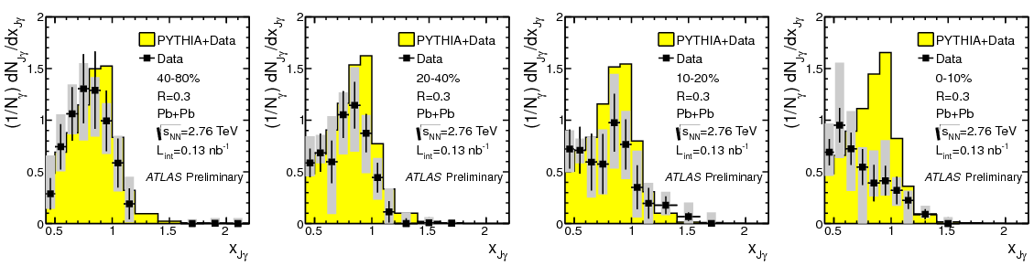
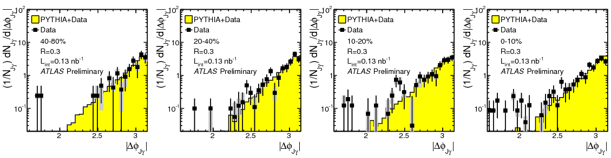
Photon+jet
Back to back correlation preserved, momentum ratio of jet/photon reduced in central events
Fully unfolded and corrected data
https://cdsweb.cern.ch/record/1473135

Slide 17
…and Z+jet
Low statistics but intriguing qualitative observation
Fully unfolded and corrected data
Back-to-back correlation preserved
Reduction in the momentum ratio of jet / Z boson
https://cdsweb.cern.ch/record/1472941

Slide 18
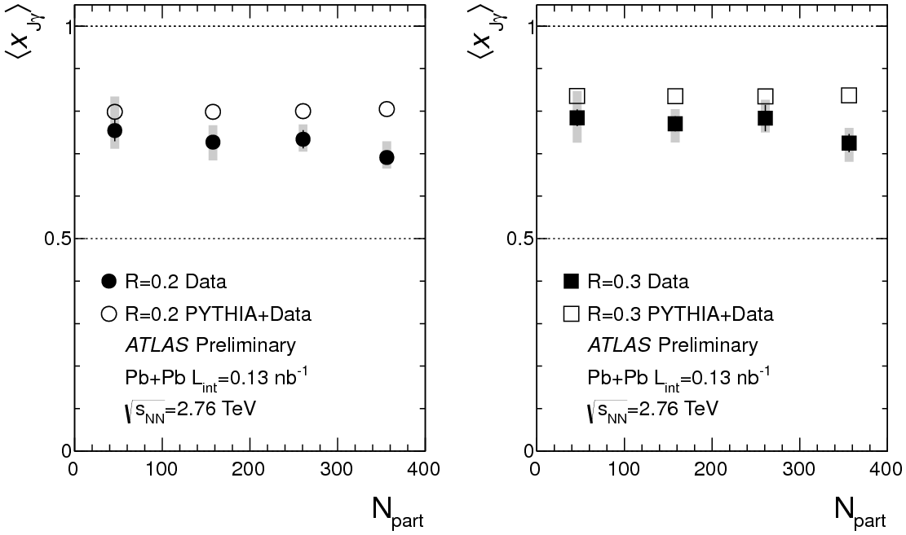
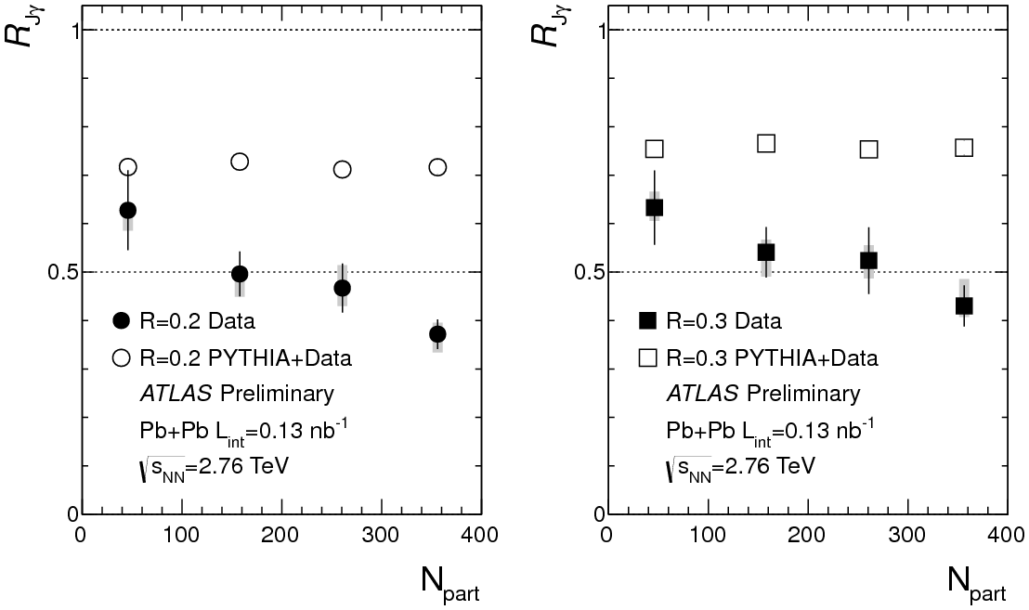
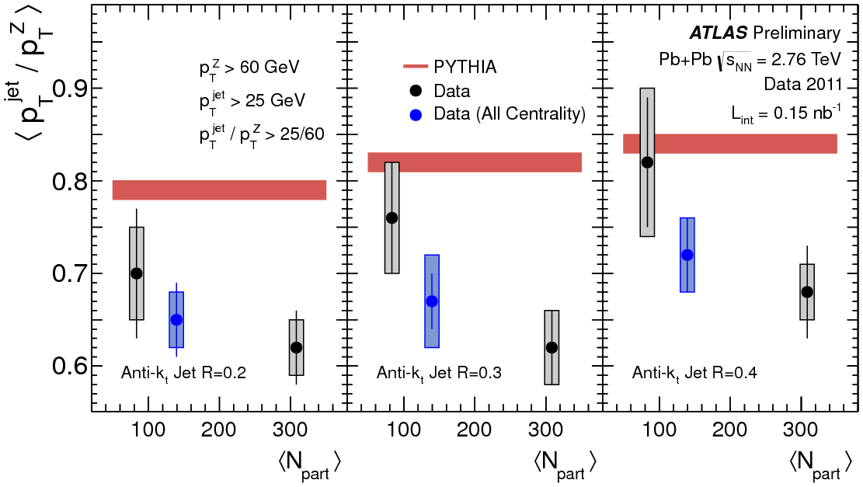
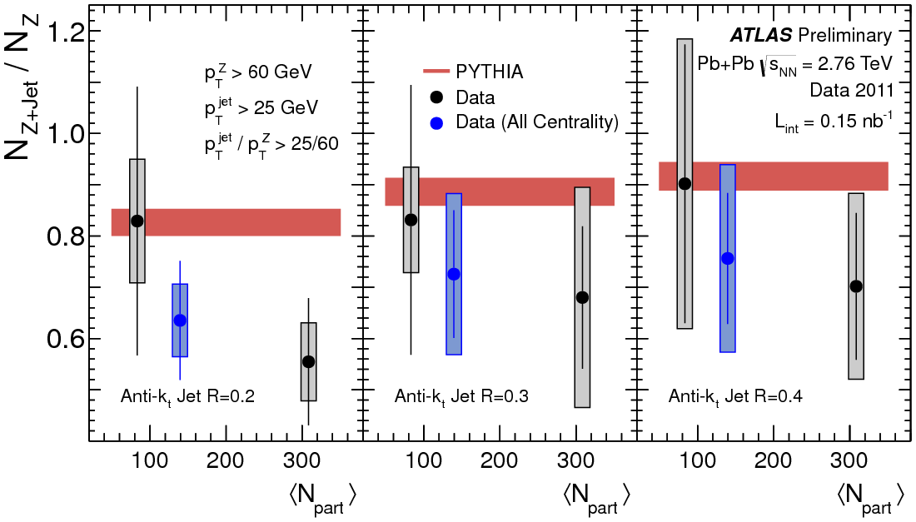
Boson+Jet
Reduction in momentum ratio and jet yield per boson increasing with centrality
ATLAS-CONF-2012-121
Consistent results from jet correlations with photon and Z
Reduction in momentum ratio
Reduction in jet yield per boson
https://cdsweb.cern.ch/record/1473135 , https://cdsweb.cern.ch/record/1472941

Slide 19
Summary
  Electroweak bosons - Direct photons, and Z➔ee,μμ measured consistent with binary collision scaling
    Confirms understanding of collision geometry
    Provides ‘standard candle’ for energy loss
Suppression of particles sensitive to color interactions
  Di-Jet asymmetry for a direct look at quenching, but di-jets still back to back
  Jet rate suppression, and path length dependence observed
  Cone size dependence of jet suppression may hint at broadening
  Fragmentation measurement shows modification of parton showering
EW boson + jet – the ‘Golden Channel’
  Attenuation of jet momentum and reduced yield compared to boson
  Back to back correlation maintained

Slide 20
Backup Information

Slide 21
Charged Hadron Suppression
Apparent flattening at highest measured p_{T}
High p_{T} charged particle suppression
Increase hinted at in RHIC data, dramatically measured
Charged particle production (suppression) mapped to ~100 GeV!
At limit that HI peripheral≈p+p,
generally R_{CP}>R_{AA}
https://cdsweb.cern.ch/record/1355702

Slide 22
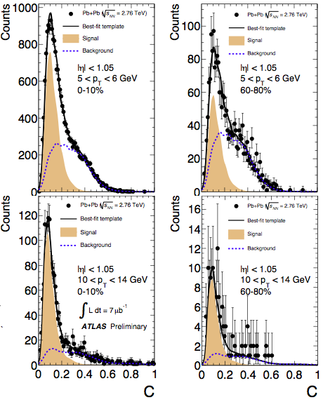
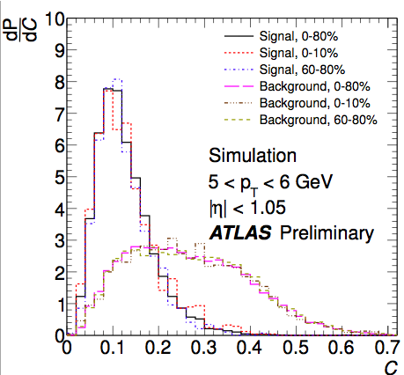
Heavy Quark Measurement with μ
Inclusive muon spectrum dominated by heavy flavor decays
Decompose muons (4<p_{T}<14 GeV) into those from HF and background
Ability to select muons from heavy flavor decay, with good purity
p balance
Scattering angle significance
https://cdsweb.cern.ch/record/1451883

Slide 23
Heavy Quark Yield
Suppression of muons from heavy flavor, but less suppression than unidentified hadrons!
R_{CP}^{hadrons}
Roughly flat in p_{T}
Somewhat different from inclusive hadrons – HF acting ‘heavy’?
https://cdsweb.cern.ch/record/1451883

Slide 24
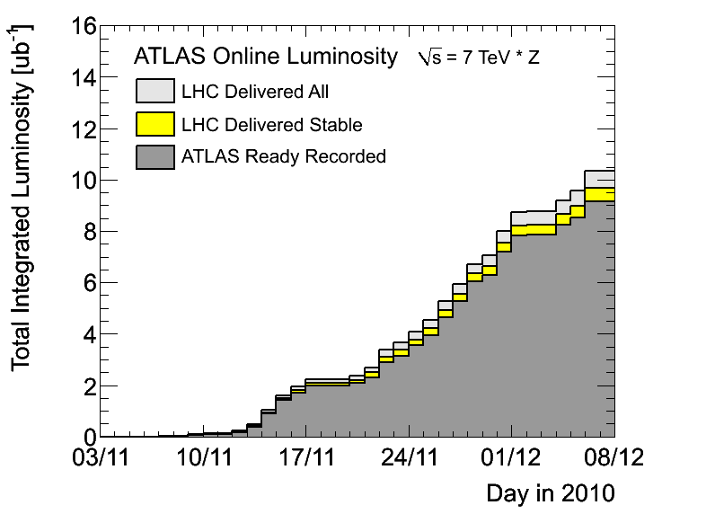
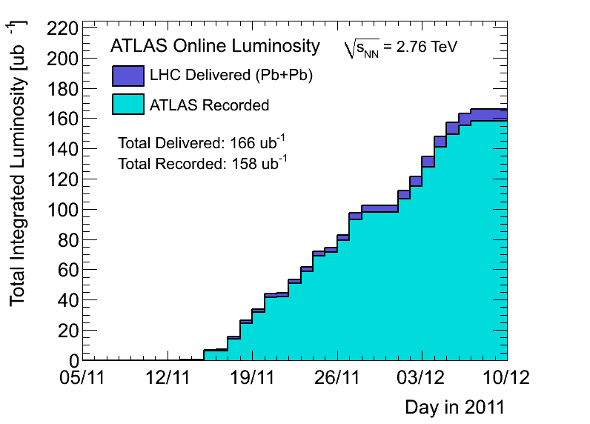
Data Samples
2010
2011
Run: | 2010 | 2011
L_{int} | 8 ub⁻¹ | 0.15 nb⁻¹
Triggers | Min Bias | γ(e), μ, jets, Min Bias, UPC
N_{events} (0-80)% | 30-40M | 750-800M

Slide 25
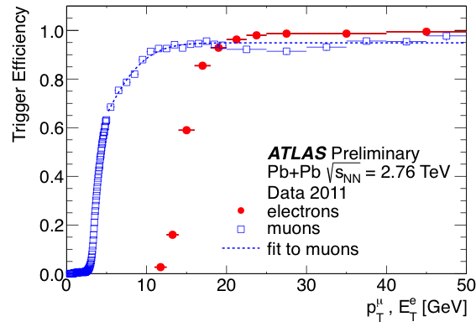
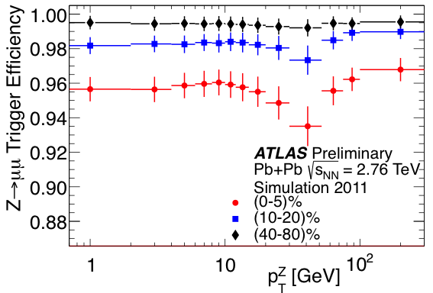
Triggers in Run 2011
Photon (e) triggers are based on LAr
For E_{T}>20 GeV, efficiency = 98.1 ± 0.1%
Pair efficiency:
99.9 ± 0.1%
Muon triggers is a combination:
L1 trigger with p_{T}>4 GeV
HLT trigger with p_{T}>10GeV
95-99% weak centrality dependence
>90%
MB triggers: (LAr E_{T}>50GeV) OR (ZDC & track)

Slide 26
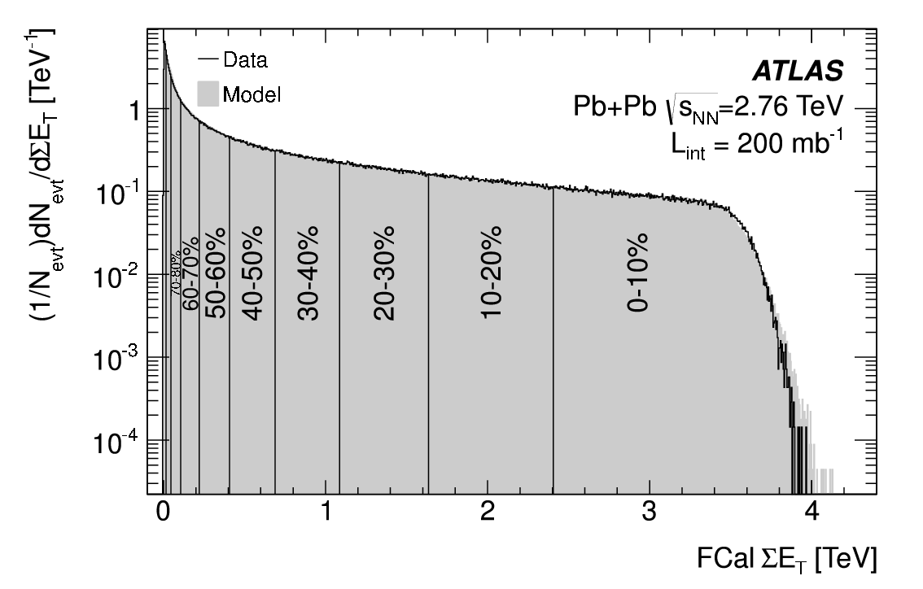
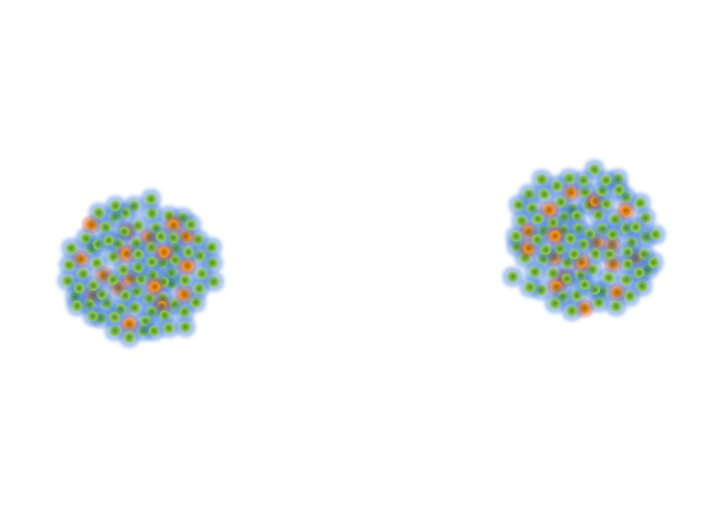
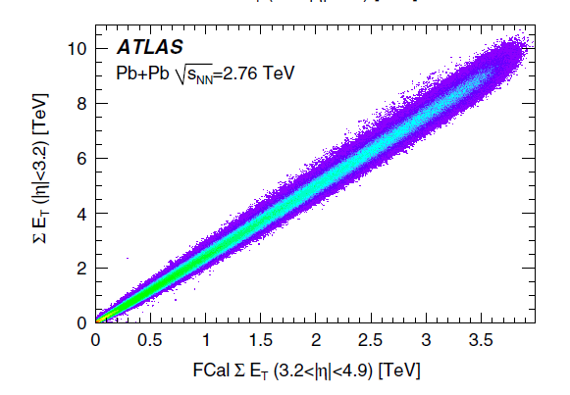
Centrality
Phys.Lett. B707 (2012) 330-348
Spectators
Participants
Binary
Collisions
Precise control over collision geometry!
 | <N_{part}>
0-5% | 382 ± 1%
5-10% | 330 ± 1%
10-20% | 261 ± 2%
20-40% | 158 ± 3%
40-80% | 46 ± 6%
<N_{coll}>
1683 ± 8%
1318 ± 8%
923 ± 7%
441 ± 7%
78 ± 9%
26

Slide 27
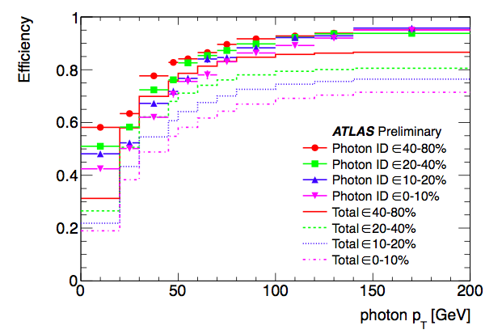
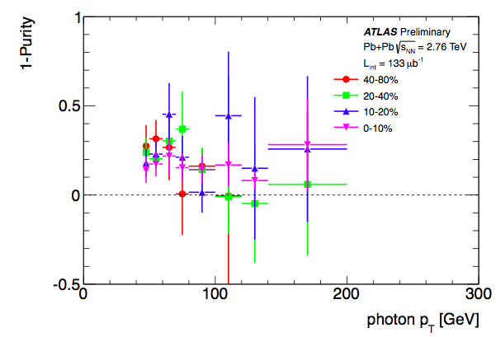
Direct Photon Efficiency & Purity
Efficiency for reconstruction, identification, and isolation
1-Purity = 1-NsigA/NobsA, correction for residual background

Slide 28
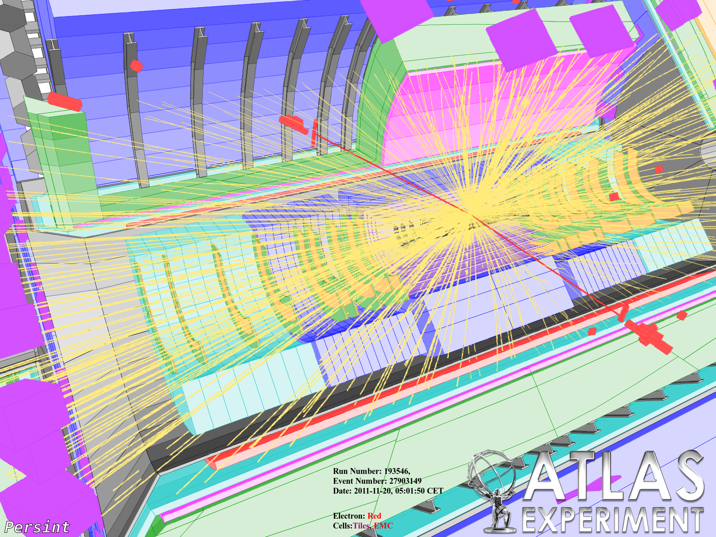
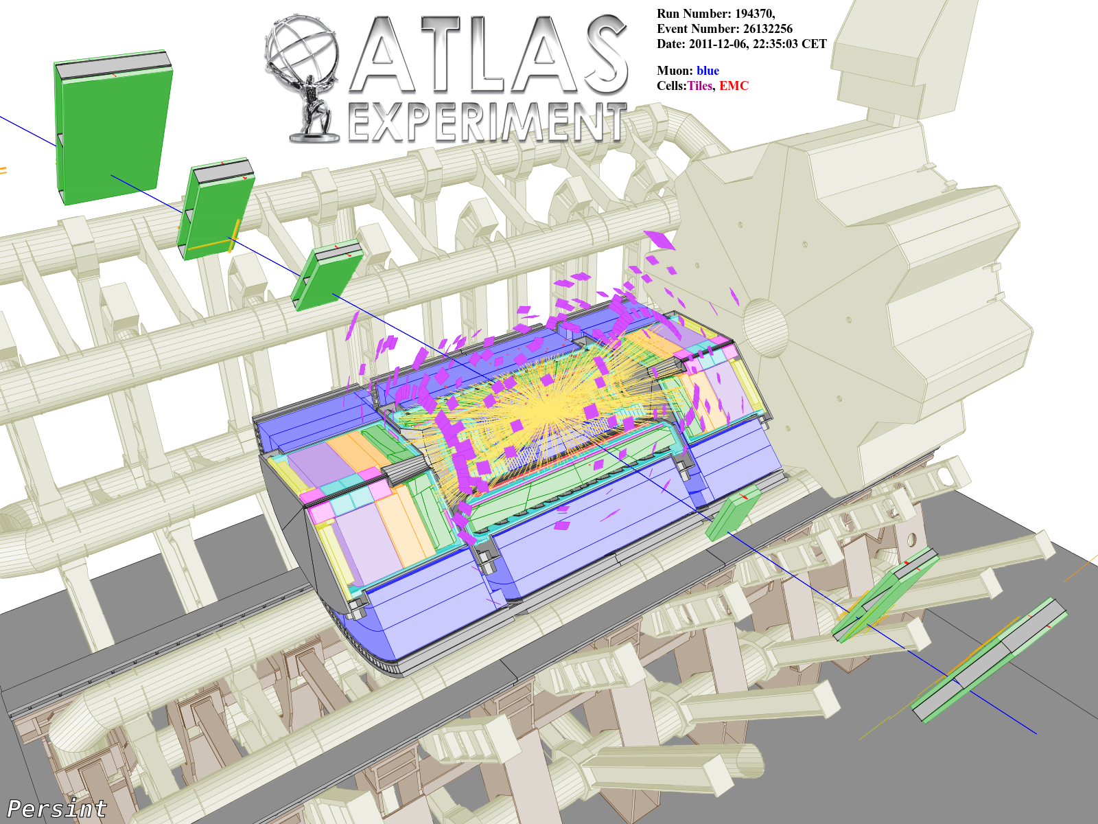
Z→ee, Z→μμ Measurement
10-20% Centrality, m_{ee} = 92.2 GeV, p_{T}^{Z} = 4.8 GeV
10-20% Centrality, m_{ee} = 102 GeV, p_{T}^{Z} = 5.0 GeV
Electron Selection
  E_{T} >20 GeV
  |η|<2.5
  Shower shape and energy cuts in calorimeter
  Subtract underlying event energy from each electron
Muon Selection
  p_{T} > 10 GeV
  |η|<2.7
  Track quality cuts

Slide 29
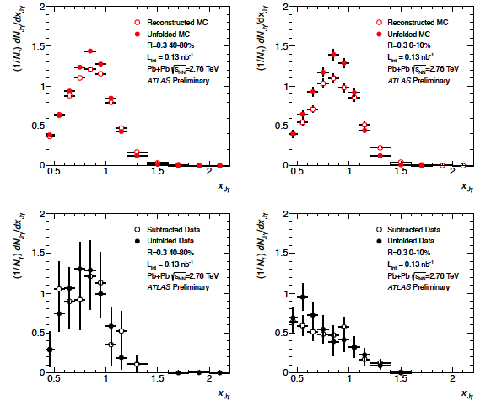
Photon-Jet Effect of Unfolding
No big changes from unfolding

Slide 30
Z Boson-Jet Effect of Unfolding
Basic physics observable even without unfolding

Slide 31
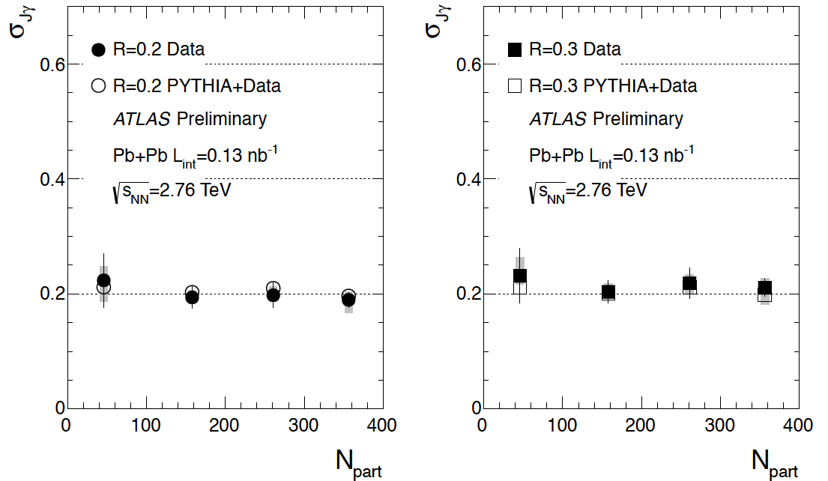
Photon – Jet Δφ Summary

