Slide 1




Latest PHENIX Results on Heavy Quarks and Quarkonia
Denis Jouan / PHENIX collaboration and

Slide 2
outlines
Introduction
Experimental set up
Quarkonia
Open heavy flavor
p-p, A-A , dAu , CuAu

Slide 3
Heavy flavors as a probe of QGP
As suggested by T.Matsui and H.Satz (1986)
Heavy flavors c and b quark production have special interest for testing the beginning of the collision process
Produced in the begining of the collision (mainly gluon fusion)
Quarkonia sensitive to QGP screening effect
Open charm and beauty also probe the hot matter produced (at RHIC: perfect liquid)
Notes:
Gluon shawoning less known that quark PDF
Initial production of Open heavy flavor and quarkonia are related

Slide 4
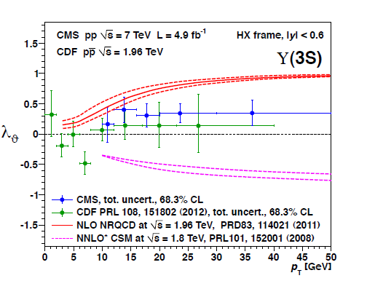
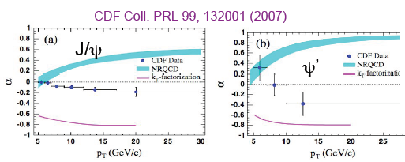
Heavy flavors mesons are good probes of many phenomenon
pp the reference for the production process
dAu nuclear effects (cold nuclear matter)
A-A hot QCD medium
Inversely, even if discovered 40 years ago, quarkonia & heavy productions have still been subject to surprises in the last 20 years
V. Kartvelishvili EPJconf49 13008 2013
There is still to learn on the tool itself
(see for instance: R.Vogt N.P.B214(2011)147)

Slide 5

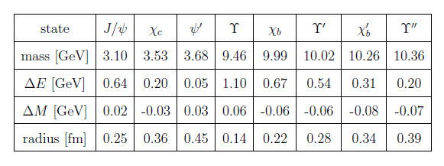
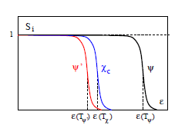

Quarkonia : thermometers of QGP
Melting from color screening in QGP (radius)
But also
H.Satz hep-ph 0609197v1 2006
Initial stage effects
Nuclear parton distributions
collisions, all Cold hadronic matter effects
Recombinations ?
- Competing effect,
Competing viewpoints ?
(ex: shadowing vs thermal,
with/without time evolution)
What cocktail in what proportions ?
This needs a set of equations
(=> detailed measurements)

Slide 6
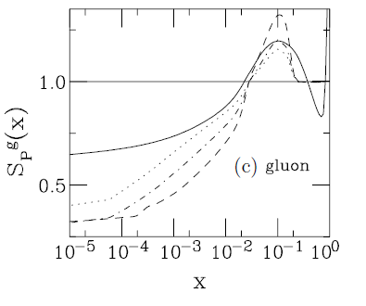
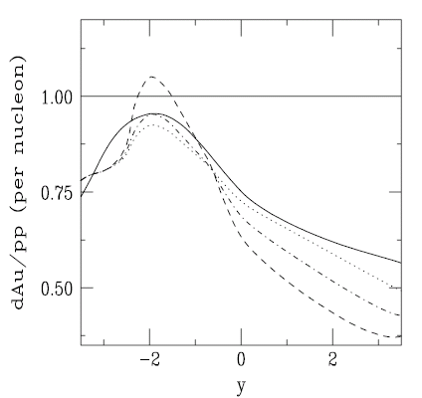
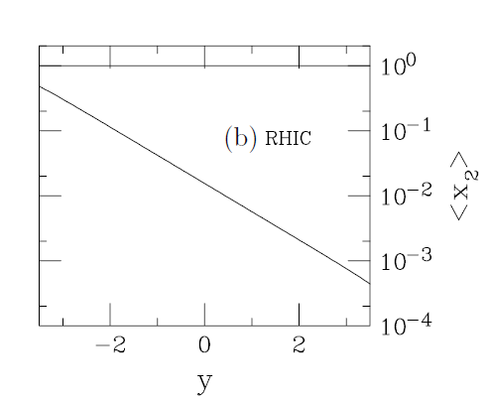
nucleus parton distribution
Anti-shadowing
Starting from parametrization shadowing-antishadowing EMC ,
for gluons
shadowing
From R.Vogt PRC 71, 054902 (2005)
EMC
Using
(Y, Pt) -> Xt or XP
One finaly transforms the effect as a function of rapidity

Slide 7

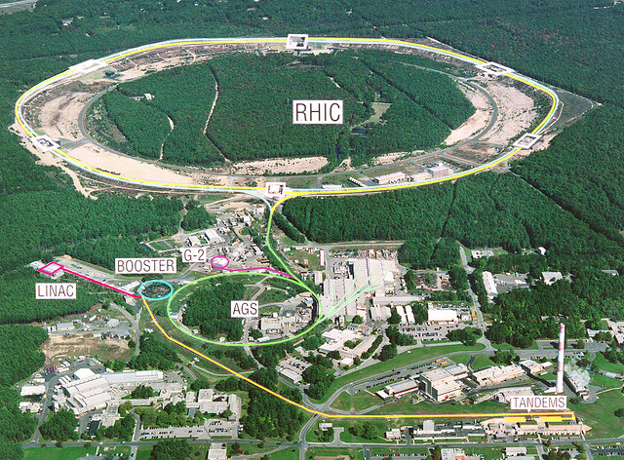


RHIC at Brookhaven National laboratory
Collider
from p to U,
3 to 500 GeV/n,
p polarized
Impressive increase of luminosity during the last decade

Slide 8
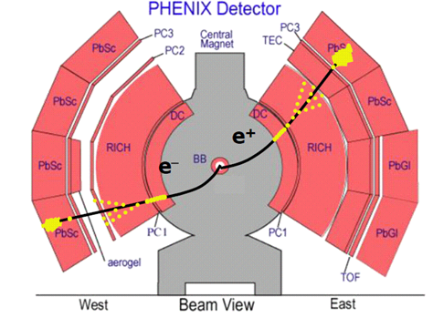
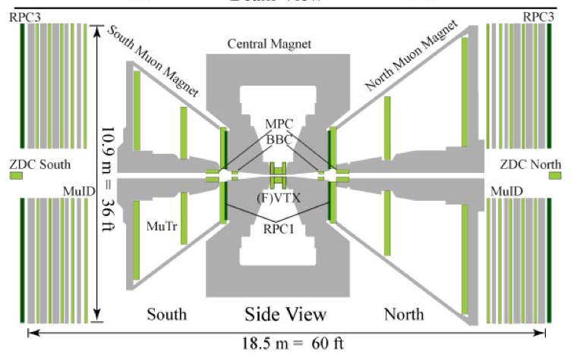
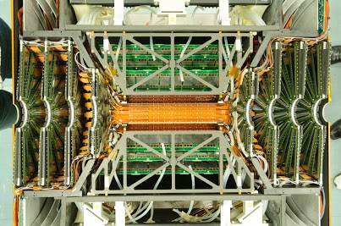
µ⁺µ⁻
|η|<.35
1.2>η>2.2
Energy in calorimeter
electron ID in RICH
Tracking in Drift chamber
Au
d
FVTX and VTX :
full forward and central vertex trackers in run 14

Slide 9
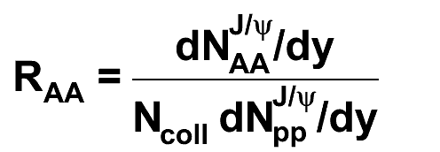
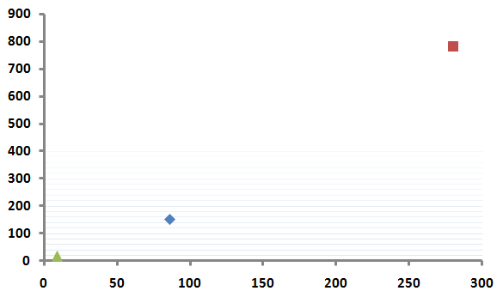
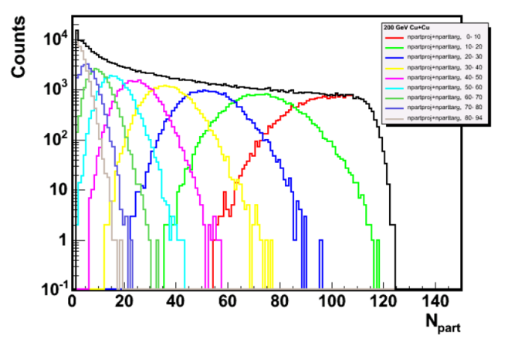
R_{AA}
Ncoll = Σ ncoll
ncoll
Npart
Npart reflects the total energy available (->soft)
Ncoll an estimate of the number of parton collisions (->hard)
( Ncoll ~ α Npart^{4/3})
Ncoll
Au-Au
Cu Cu
Cu-Cu
d-Au
Npart

Slide 10
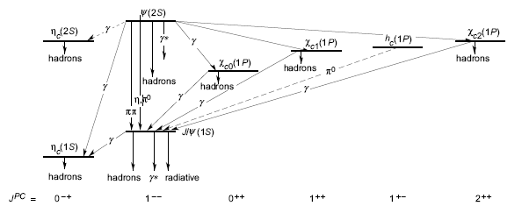
Charmonia
Heavy quarks pairs:
good probes: rare, weak light mesons coupling, various states and binding energies
But
χ_{c} and Ψ’ feeding of J/Ψ
(also from open beauty)
Denis Jouan

Slide 11
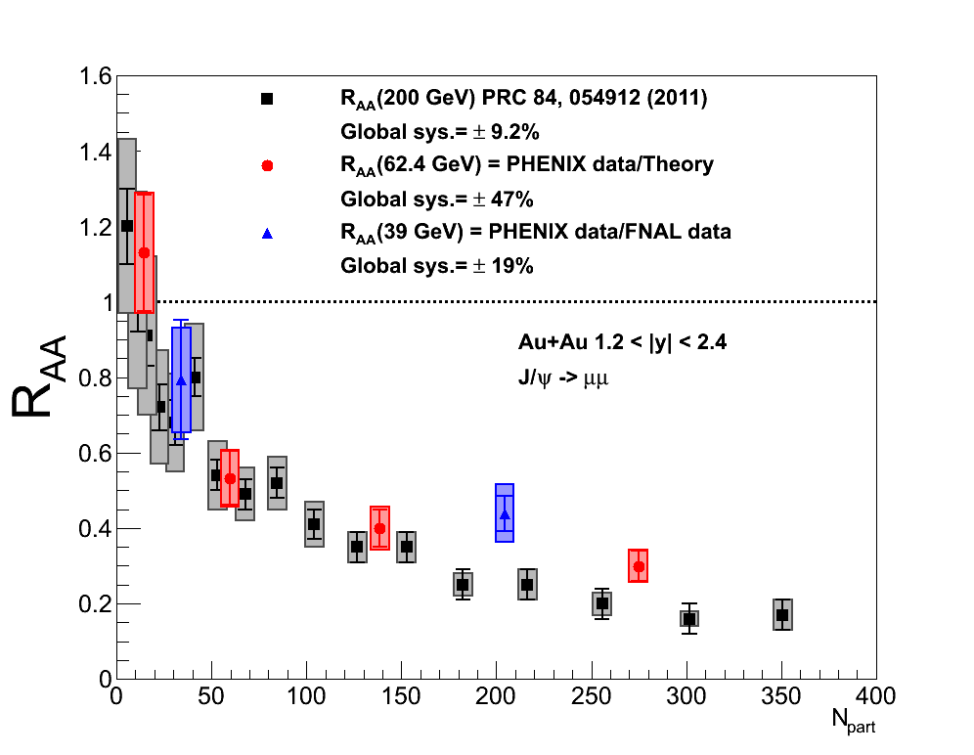
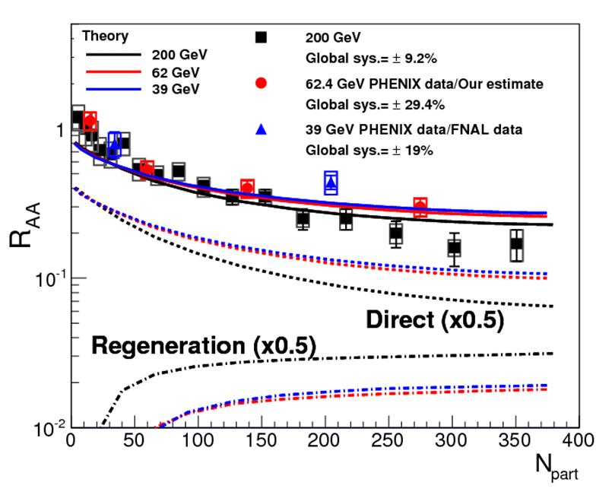
From SPS to RHIC, and back: the suppression is stable
Suppression and regeneration compensate
(Zhao & Rapp PRC 82 064905 2010)

Slide 12
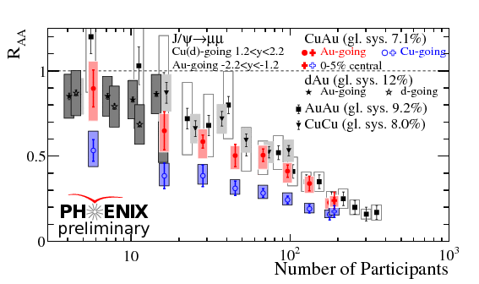
Assymetric ions collision
- Au going: close to Au-Au
Cu going : stronger start, but closer for most central (whereas Cu completely absorbed: contradictory with corona effect)
- small Npart: more suppression with Cu than with d
Unexpected ?

Slide 13
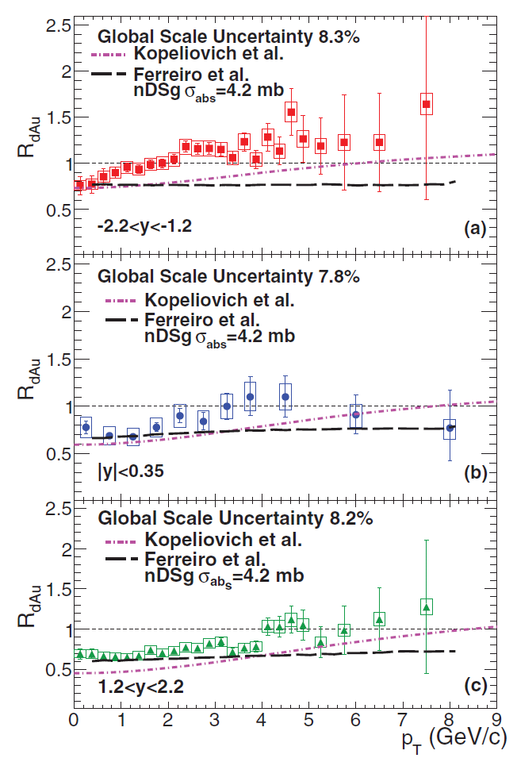
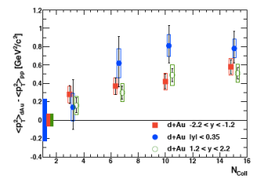
Cold nuclear matter reference: d-Au
Increase with Pt.
Cronin multiple scattering effect
- Increase in most of the Au-going Y region
_{PHENIX PRC87, 034904 (2013)}
gluon distributions are not very well known, but even assuming shadowing antishadowing as for quarks, the assymetry backward/forward and Pt distribution is not simultaneously reproduced

Slide 14
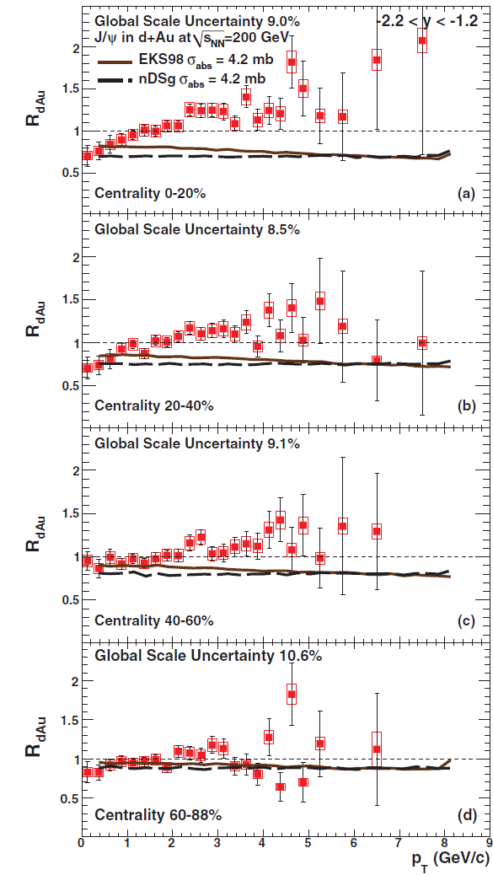
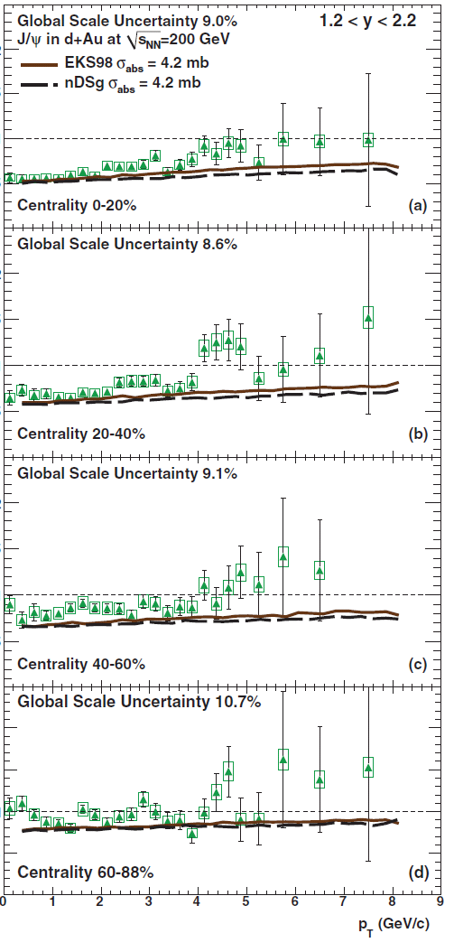
Similar in peripheral reactions, backward and forward RdAu have different evolution
In the backward region the shadowing model leads to a decrease with Pt
(Perhaps the use of x1, x2, should be upgraded ?)
Notes:
Cf upsilon

Slide 15
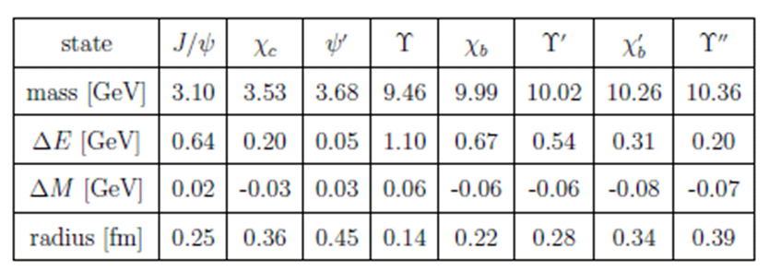
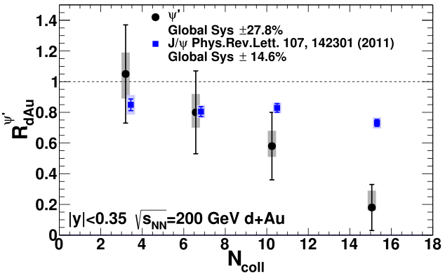
PHENIX arXiv:1305.5516
Ψ’
Another surprise: much more important suppression for Ψ’ than for the Ψ
The Ψ’ is expected to melt before the J/Ψ, due to its larger radius and smaller binding energy. It is observed in SPS H.I.collisions, but not expected in d-Au at RHIC due to the smaller available time

Slide 16
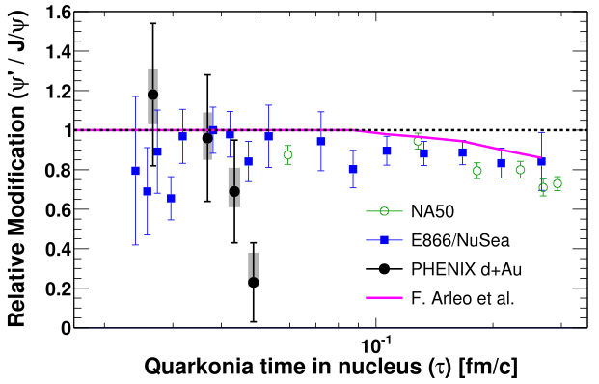
arXiv:hep-ph/9907286
Unexpected difference between Ψ’ and Ψ suppression at the beginning of the formation process.

Slide 17
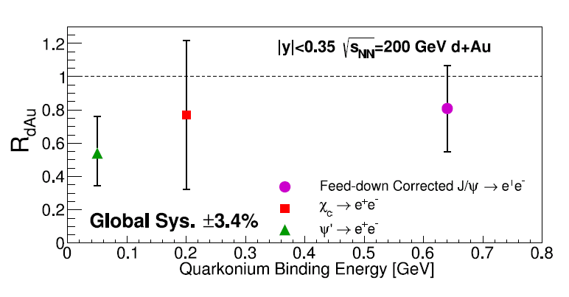
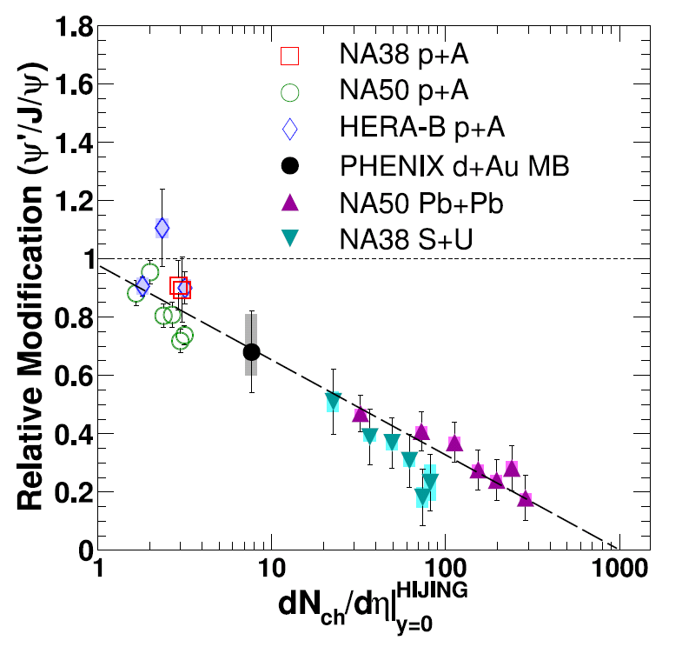
PHENIX arXiv:1305.5516
Opening of new dimensions
more quarkonia species become available
prospects for the study of the quarkonia
suppression with respect to their binding energy
A consistent overall pattern of the relative suppression
Too soon to determine if there are several regimes here

Slide 18
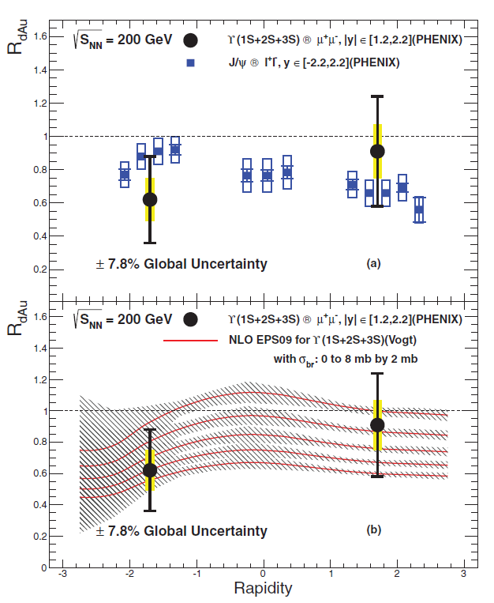
Υ
Low statistics, then no significant constraint. Reasonable agreement with NLO calculations
Suggests a backward suppression,
also induced by the parton distributions (EMC effect)
A possible atypical behaviour of hard production (%soft)
and a unique PDF effect
(+cf J/psi ?)

Slide 19
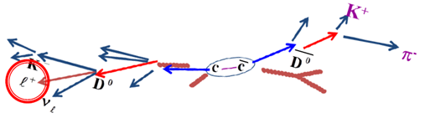
Open Heavy Flavor
  Open flavor originates from the same production mechanism as quarkonia
  (R.Nelson, R.Vogt, A.D.Frawley arxiv:1210.4610 : aim at calculating quarkonia from model tuned on open flavor production)
  Harder than quarkonia to extract: must be separated from the contribution from low masses mesons
c -> D (*, ̅, 0, +,s ….)
-> D^{+,-} or D⁰ or D_{s}^{+,-}
(~16%) (~7%) (~7%) -> lepton + anything
(also b-> B->D + X ) [*]
[*] a correlated component of like sign dimuons has been extracted (L.Patel, DIS2013)

Slide 20

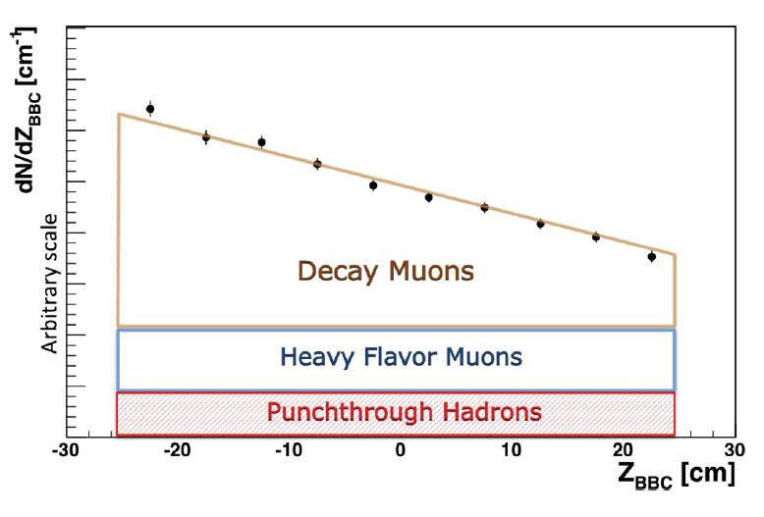
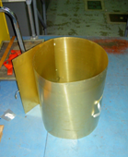
Extracting the heavy flavor component in the single lepton spectrum
Pions, Kaons , produce muons, but their decay length is several meters, whereas B and D particles are at the 0.1-0.5 mm level
-> determine the corresponding fraction, related to the slope of the production rate as a function of the distance to the absorber
Another relative approach is used for electrons, with a converter , allowing to increase the photonic production of electrons
Monte Carlo cocktails of all sources are basic important tools

Slide 21
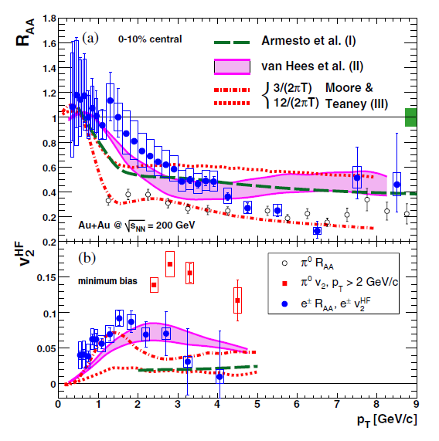
Less interaction than light quarks expected (suppression of forward gluon radiation)
Strong coupling observed
models suggest small relaxation time or diffusion coefficient
Calls for extended models: individual collisions (more important at Rhic ?), dissociation in QGP, shadowing.
toward time evolution of medium and HF mesons ? (and separate treatment for b and c)
Beside this main trend, let’s looks a some other
finer experimental details

Slide 22
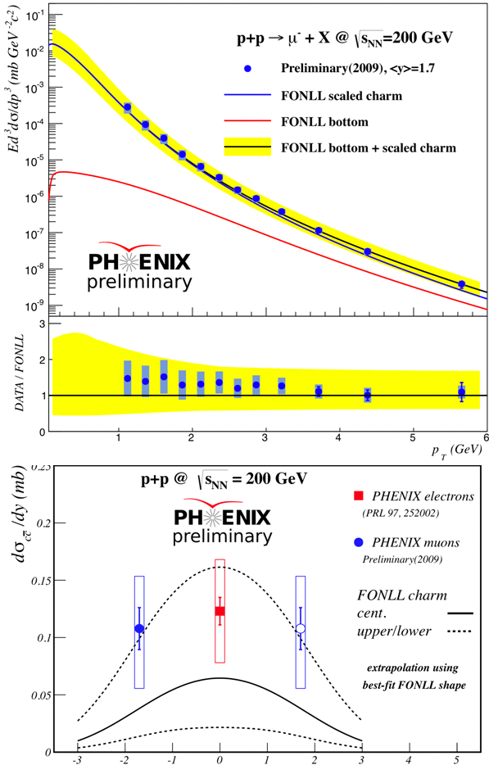
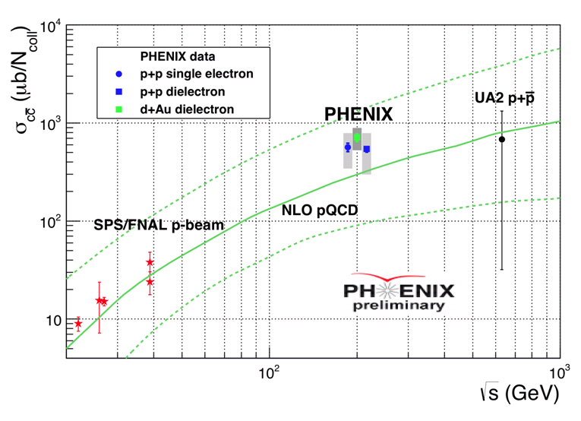
p-p
p-p is consistent with previous measurement and FONLL
y

Slide 23
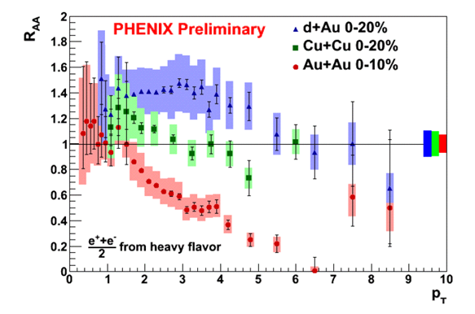
With Cu-Cu From d-Au to Au-Au
Single electrons from heavy flavor in the central region
d-Au and Au-Au : PRL 109 242301 2012
Ncoll
16
150
900
Strong change with ions:
dAu: increase, and with Pt
Au-Au decrease
Cu-Cu in between

Slide 24

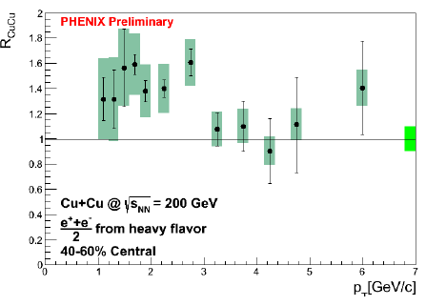
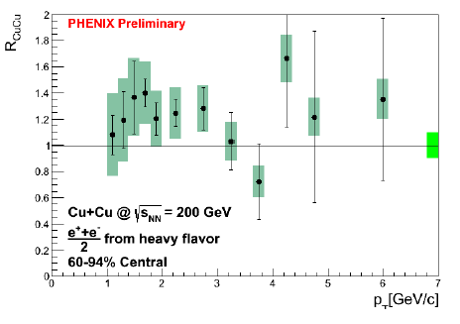
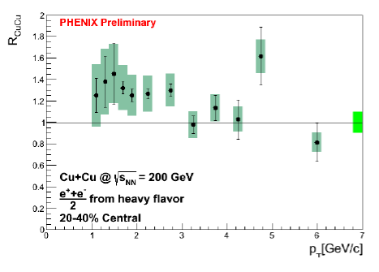
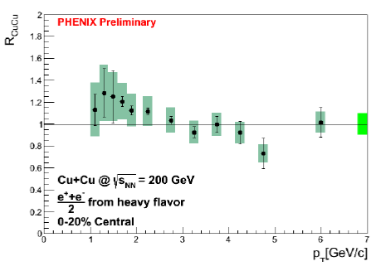
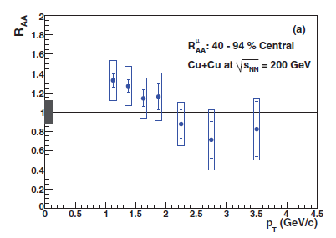
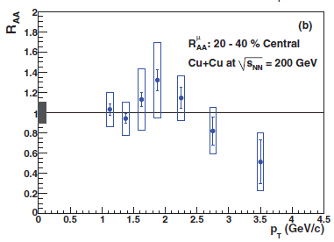
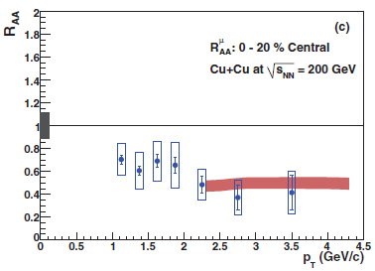
Centrality and rapidity
Enhancement in the central rapidity
A decrease with centrality, in the forward hemisphere

Slide 25

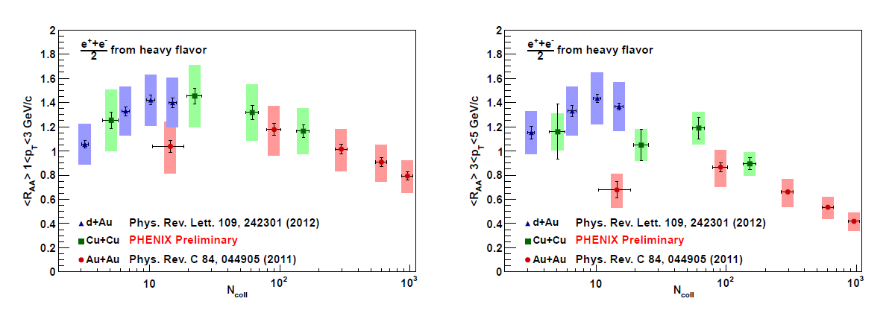
P_{T}
<R_{AA}> Displays a global trend from d-Au to Au-Au, with respect to Ncoll,
Here in the central rapidity domain
Rise of Cronin effect then damping ?
Notes:
A beautiful inversion

Slide 26
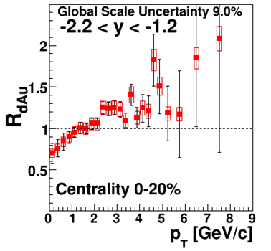
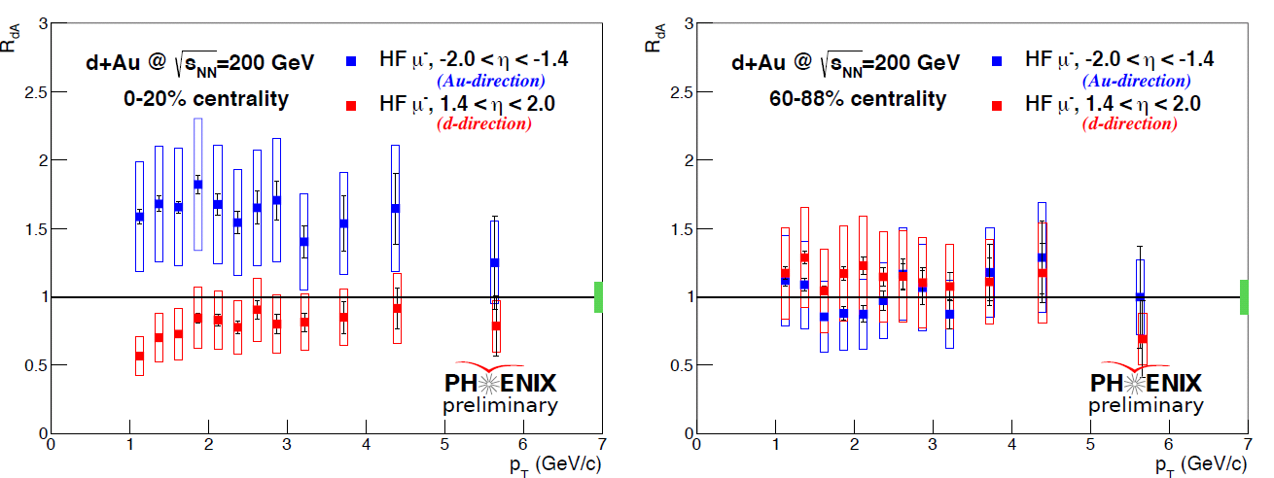
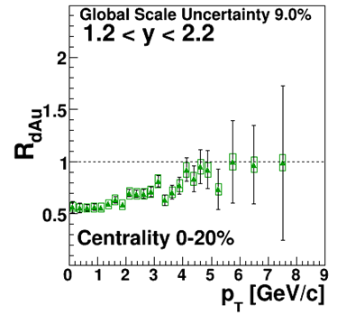
d-Au ?
Qualitatively compare with Cu-Cu,
and for the forward/backward decrease with quarkonia production
But Backward RdAu for J/psi has a reverse behaviour (decrease)
Notes:
Does not compare directly ? not only charm.

Slide 27
Summary/ final remarks
A set of extended measurement has been obtained, allowing more detailed description of the changes from pp to Au-Au, in rapidity and Pt, thank to p-dAu, Cu-Au, Cu-Cu and energy scan . This allow to follow the evolution of production processes, from pp to Au-Au and sometimes reverse behavior are observed during this evolution
Whereas a general suppression is observed for them in central AuAu collisions, Quarkonia and heavy flavor productions show partly similar trends, a global decrease of the production in the rapidity domain of the lighter nucleus, but also definite differences in particular in the backward (heavy nucleus) rapidity domain. CuAu collisions display some unexpected trends, a stronger suppression of J/Ψ than in d-Au collisions, in the forward region.
This ongoing quest for more precise and detailed results, for which new detectors will help soon, shows perhaps already signs that the characterization of the relative weight of the various effects will become reachable. Pt-Y correlations, especially in backward domain, could bring challenge for models.
New dimensions appears: time evolution of Ψ’, more quarkonia species ..
The multidimensional high precision set of equations is perhaps not so far
Notes:
RHIC (wide) energy domain is the turning point

