Slide 1


Heavy Quark Energy Loss and Bulk Physics
W. A. Horowitz
University of Cape Town
July 23, 2013
With many thanks to Andriniaina Rasoanaivo,
Razieh Morad, Miklos Gyulassy, and Yuri Kovchegov

Slide 2
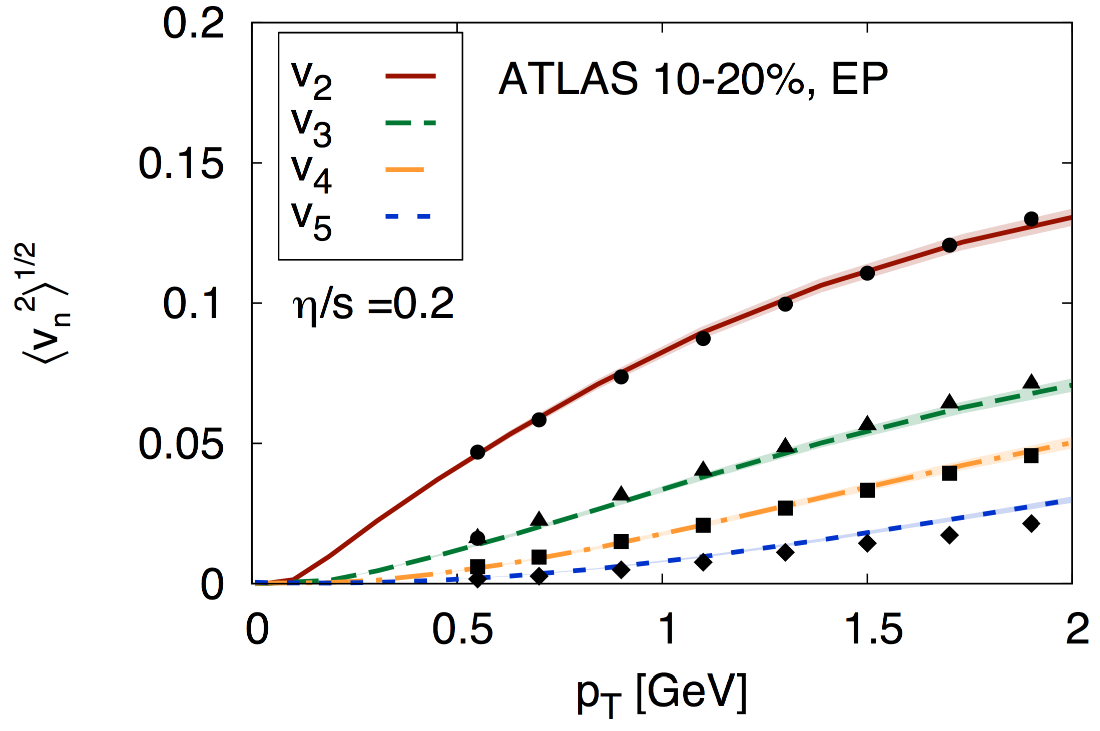
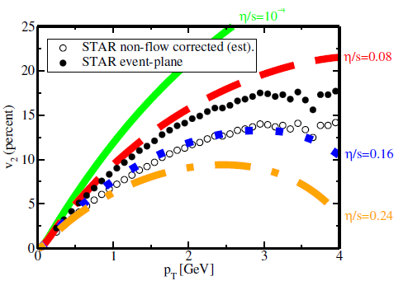
Bulk Physics => Strong Coupling
Luzum and Romatschke, PC78 (2008)
Gale et al, PRL110 (2013)
  η/s ~ 1/4π
    => AdS/CFT
    O(1/10) naïve pQCD
  T ~ 250 MeV
    g(2πT) ~ 2
      pQCD inapplicable
    λ = g²N_{c} ~ 12 ≫1
      Correct limit for AdS

Slide 3
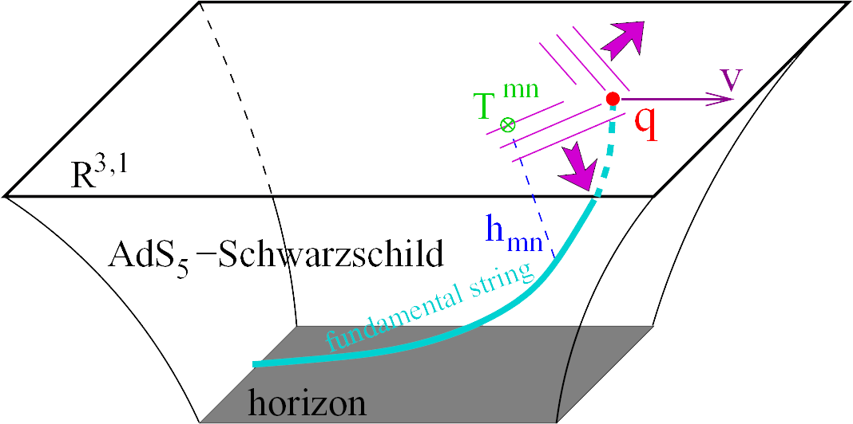
Heavy Quarks with AdS/CFT
HQ E-loss in AdS:
  dp_{T}/dt = - μ p_{T}
  μ = πλ^{1/2} T²/2M_{q}
Herzog et al., JHEP 0607 (2006)
Gubser, PRD74 (2006)
  Similar to Bethe-Heitler
    dp_{T}/dt ~ -(T³/M_{q}²) p_{T}
  Very different from usual pQCD and LPM
    dp_{T}/dt ~ -LT³ log(p_{T}/M_{q})
J Friess, S Gubser, G Michalogiorgakis, S Pufu, Phys Rev D75 (2007)

Slide 4
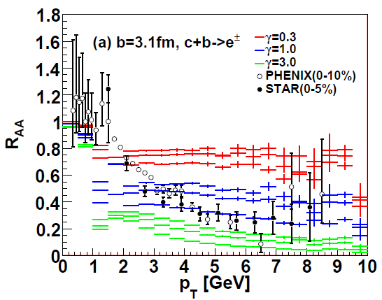
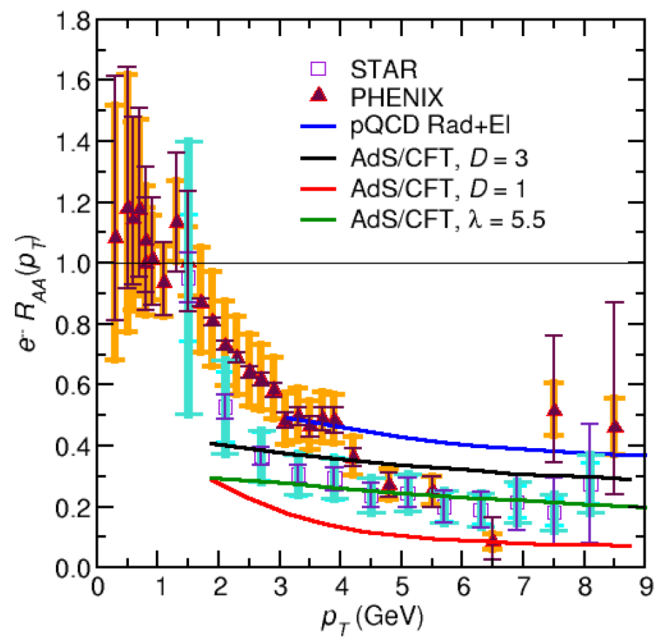
AdS and HQ
String drag: qualitative agreement at RHIC
WAH, PhD Thesis, arXiv:1011.4316
Akamatsu, Hatsuda, and Hirano, PRC79, 2009

Slide 5
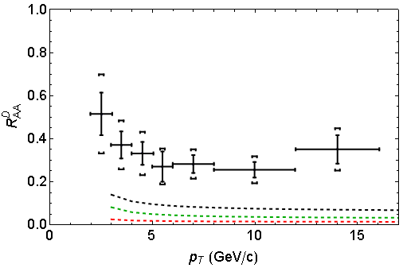
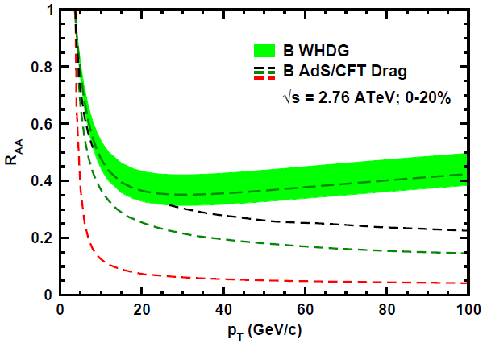
AdS and HQ at LHC
D Predictions
B Predictions
ALICE 0-20%
D
CMS B→J/ψ
(
(
]
(
(
(
WAH, PANIC11 (arXiv:1108.5876)
ALICE, arXiv:1203.2160
CMS, JHEP 1205 (2012) 063
AdS HQ Drag appears to oversuppress D
  Long. fluctuations likely important, not included
Roughly correct description of B→J/ψ

Slide 6
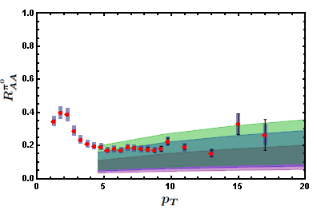
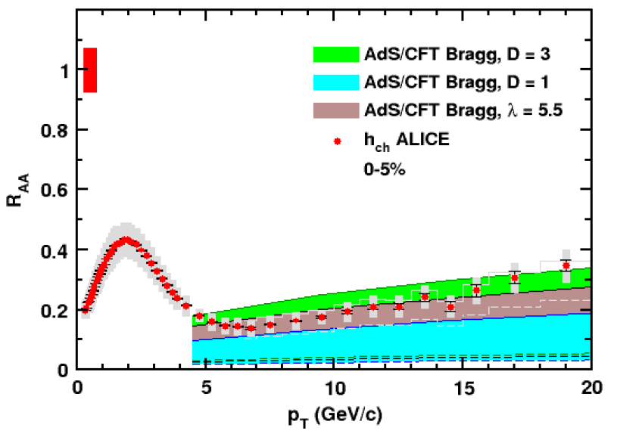
AdS/CFT Light q E-Loss
Static thermal medium => very short therm. time
  x_{th} ~ 1.8 fm
    AdS likely oversuppresses compared to data
Examine T ~ 1/τ^{1/3} geom
  x_{th} ~ 3.1 fm
HOPELESS??
0.2 TeV
2.76 TeV
WAH, JPhysG38 (2011)
Simple Bragg peak model

Slide 7
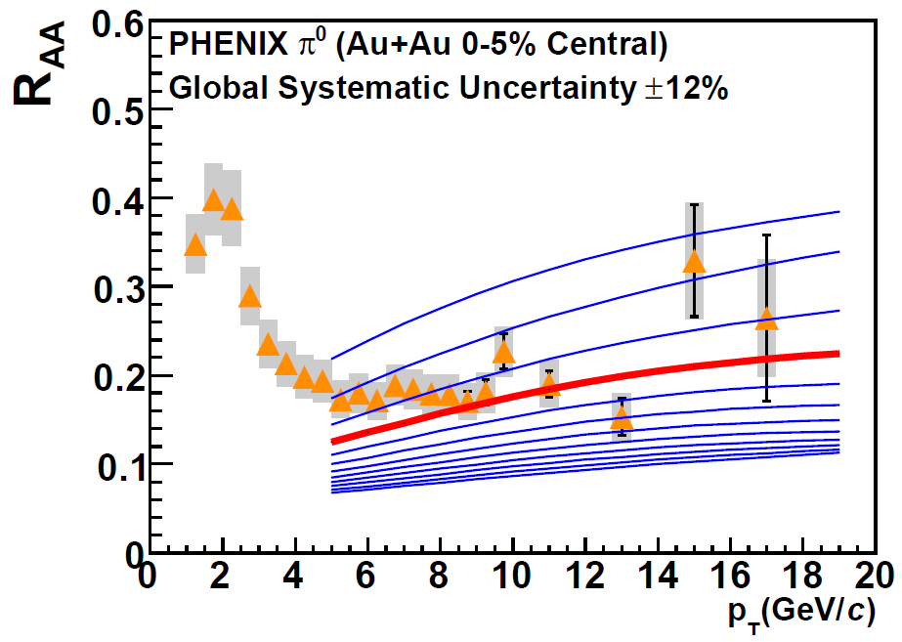
Compare to pQCD at RHIC & LHC
RHIC R_{AA}: not unreasonable ρ_{med}
  dNg/dy = 1400⁺²⁰⁰
  α_{s} = 0.3, fixed
  1400₋₃₇₅
PHENIX, PRC77 (2008)
For LHC predictions: change only ρ_{med} ∝dN_{ch}/dη

Slide 8
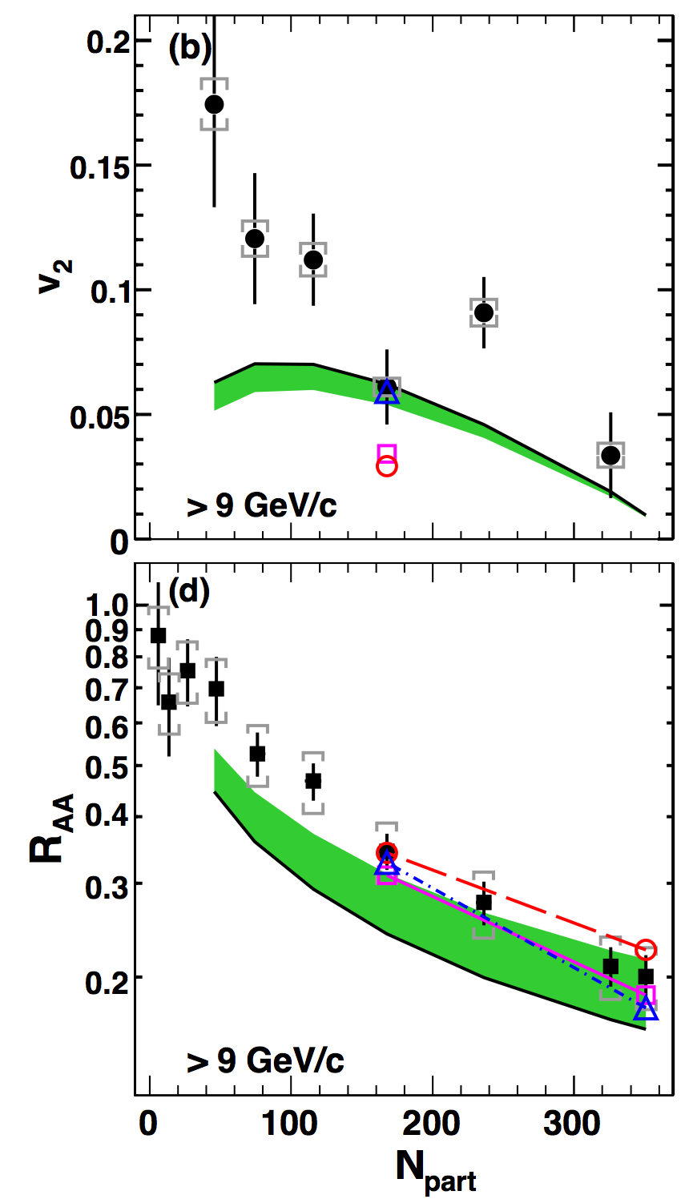
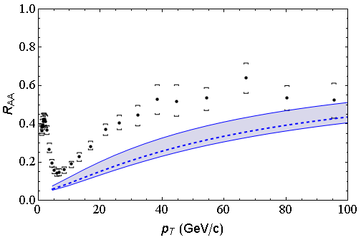
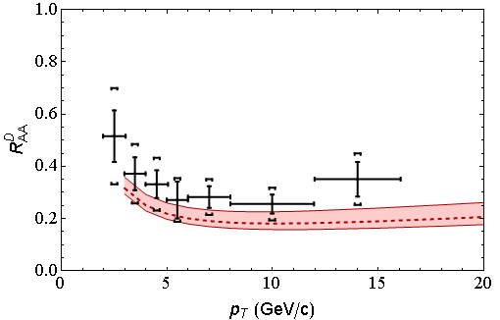
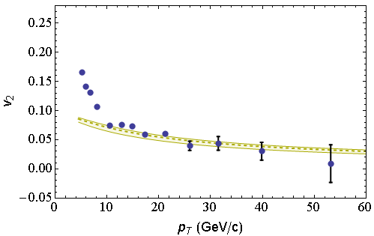
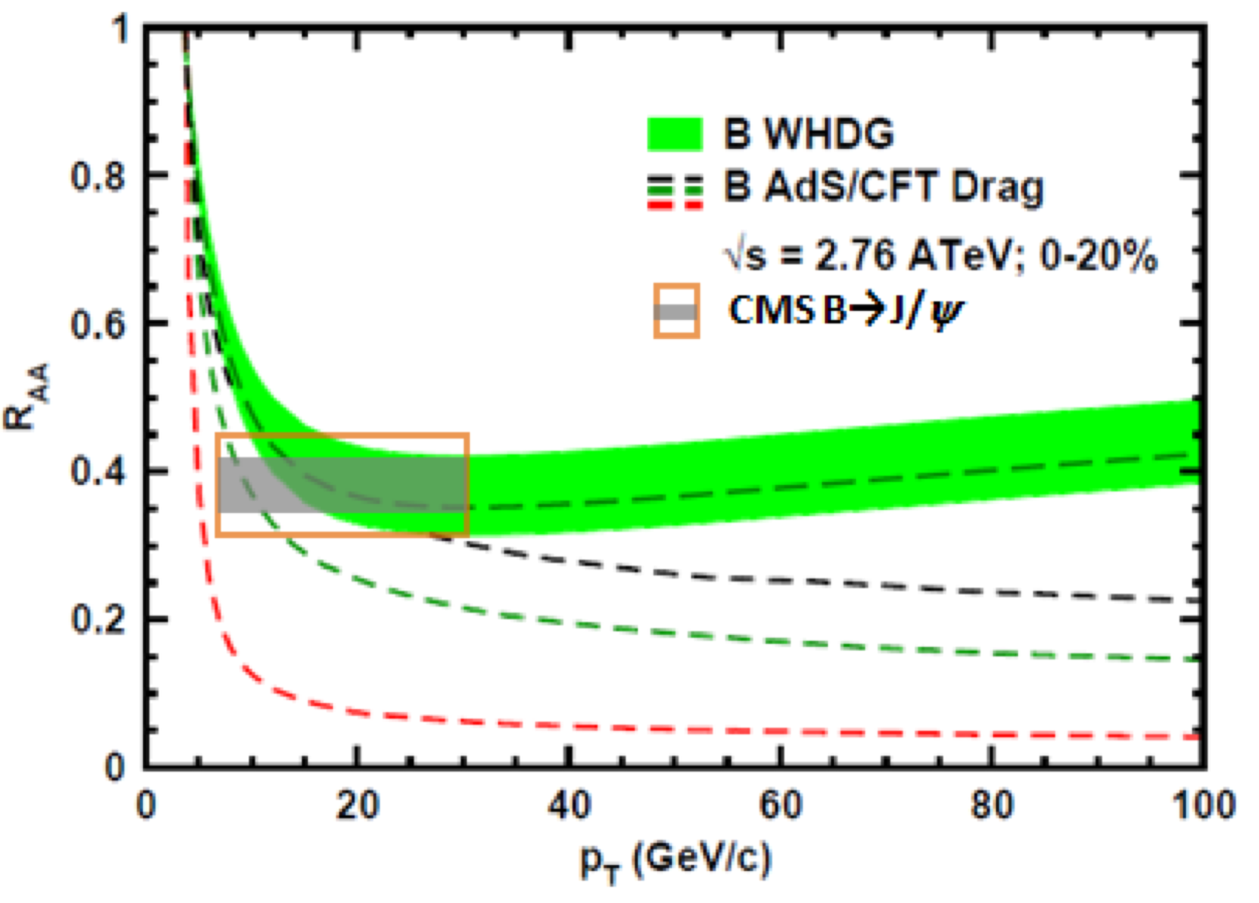
Global Qualitative Agreement
LO pQCD E-loss correct to factor ~2
LHC
CMS h± 0-5%
WHDG π⁰
LHC
ALICE D
WHDG D
RHIC
RHIC
LHC
CMS h± 40-50%
WHDG π⁰
LHC
CMS, Eur.Phys.J. C72 (2012)
CMS, arXiv:1204.1850
ALICE, arXiv:1203.2160
CMS, JHEP 1205 (2012) 063
PHENIX PRL105 (2010)

Slide 9
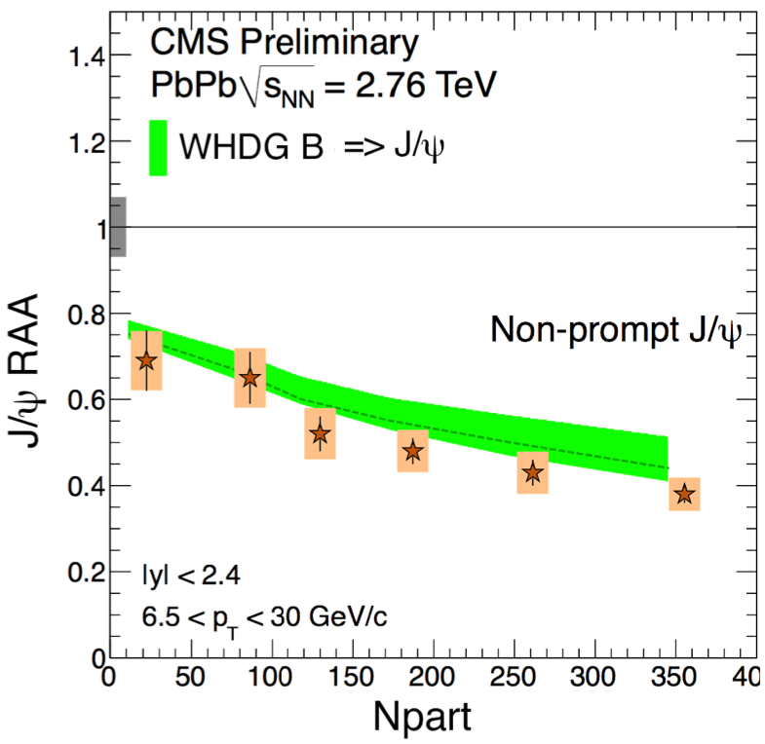
New WHDG J/ψ Comparison to CMS
WHDG B + B => J/ψ decay
      Thanks to Andrea Dainese and Zaida Conesa Del Valle
Mironov, QM2012
NPA 904-905 (2013)

Slide 10
Towards Soft & Hard Consistency
Need either:
  pQCD explanation of low-p_{T}
  AdS/CFT explanation of high-p_{T}
Attempt latter via Hybrid Soft/Hard E-Loss
  Production and early evolution: pQCD
  Final state E-loss: AdS/CFT
Match AdS IC from pQCD

Slide 11
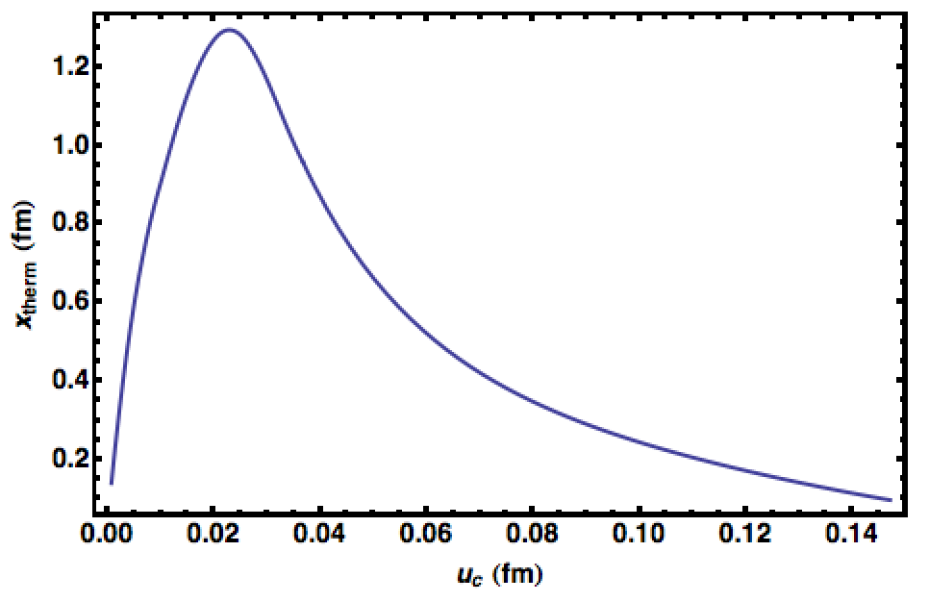
Hope for AdS E-Loss?
  Like hydro, AdS yields evolution equations
    Very little of ∞² dim IC phase space explored
    Naïve IC => v. short thermalization times
      => oversuppression
    However, strong dependence on IC
p_{T} = 100 GeV
T = 350 MeV
On-shell
Q² < 0
Q² > 0
Morad and WAH, in prep

Slide 12
Finite Time Observables
Require gauge invariant object at t = τ_{therm} ~ 1 fm
  <T^{μν}>(t,x)_{pQCD}: Schwinger-Keldysh
  <T^{μν}>(t,x)_{AdS}: linearized Einstein eqs
Scalar FT coupled to classical current:
  Sick: infinite energy emission
Off-shell Scalar QCD: almost done

Slide 13




Strongly Coupled HF and p+A
Measure open HF in p+A
  Midrapidity: test production
  Forward: test CNM HF E-loss
Embedded String in Shock
Before
After
v_{shock}
z
Q
v_{shock}
z
Q
x
x
WAH and Kovchegov, PLB680 (2009)

Slide 14
Conclusions
Want consistent low-p_{T} and high-p_{T} physics
  η/s => AdS, not pQCD
  High-p_{T} => pQCD; lights + D’s => not AdS
    Useful future measurements:
      B R_{AA}(p_{T}): rise with p_{T}?
      D, B v₂(p_{T}) for p_{T} > 10 GeV
For high-p_{T} seek Hybrid Soft/Hard Model
  Coming Soon!
p + A physics tests:
  IF high mult. ⬄ hydro, then quenching
  Forward η open HF suppression: AdS (or pQCD?) CNM

Slide 15


Slide 16


Slide 18
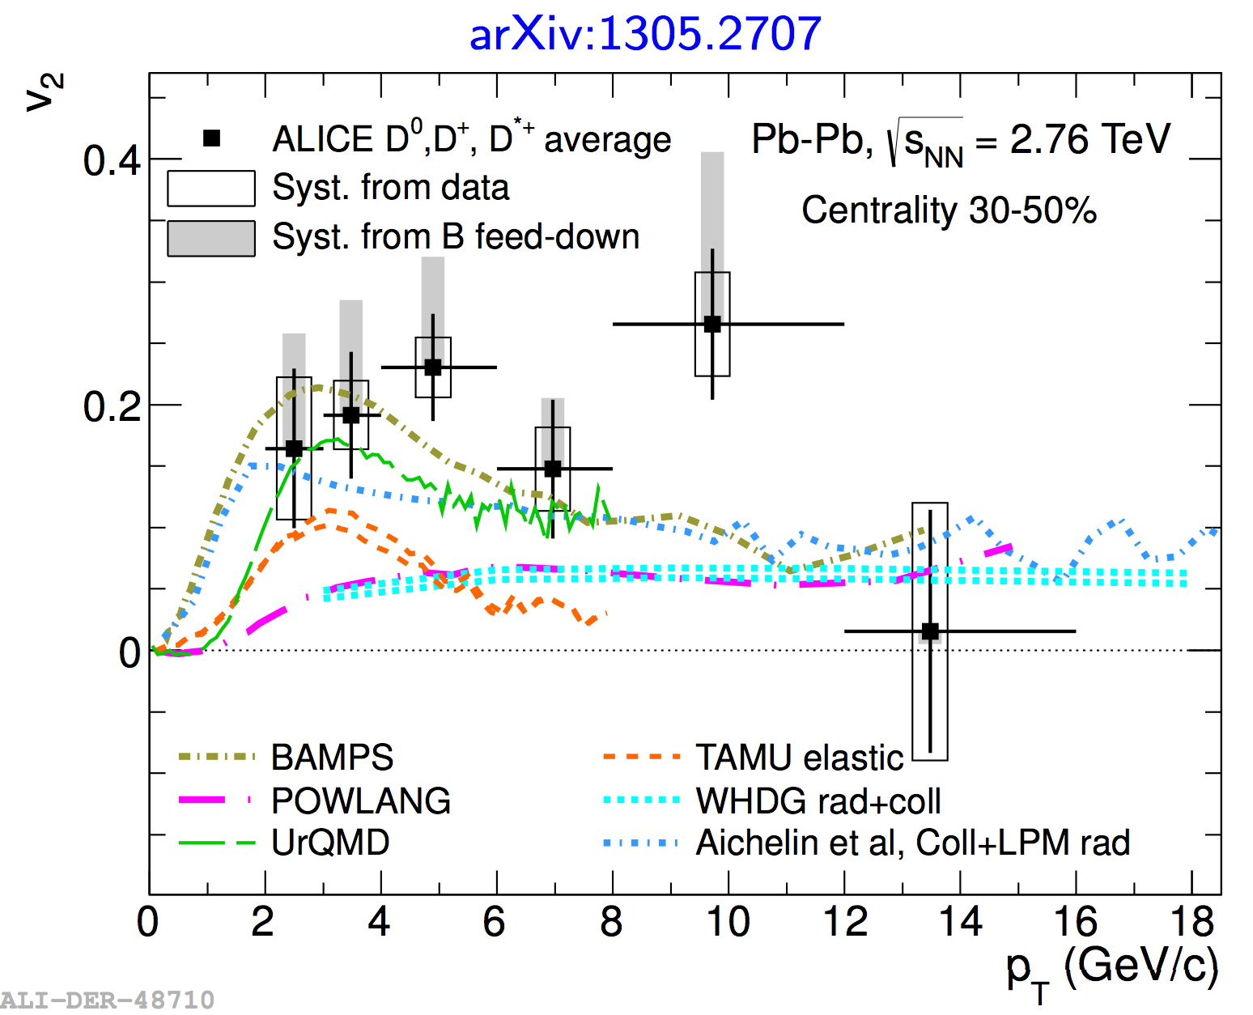

Slide 19
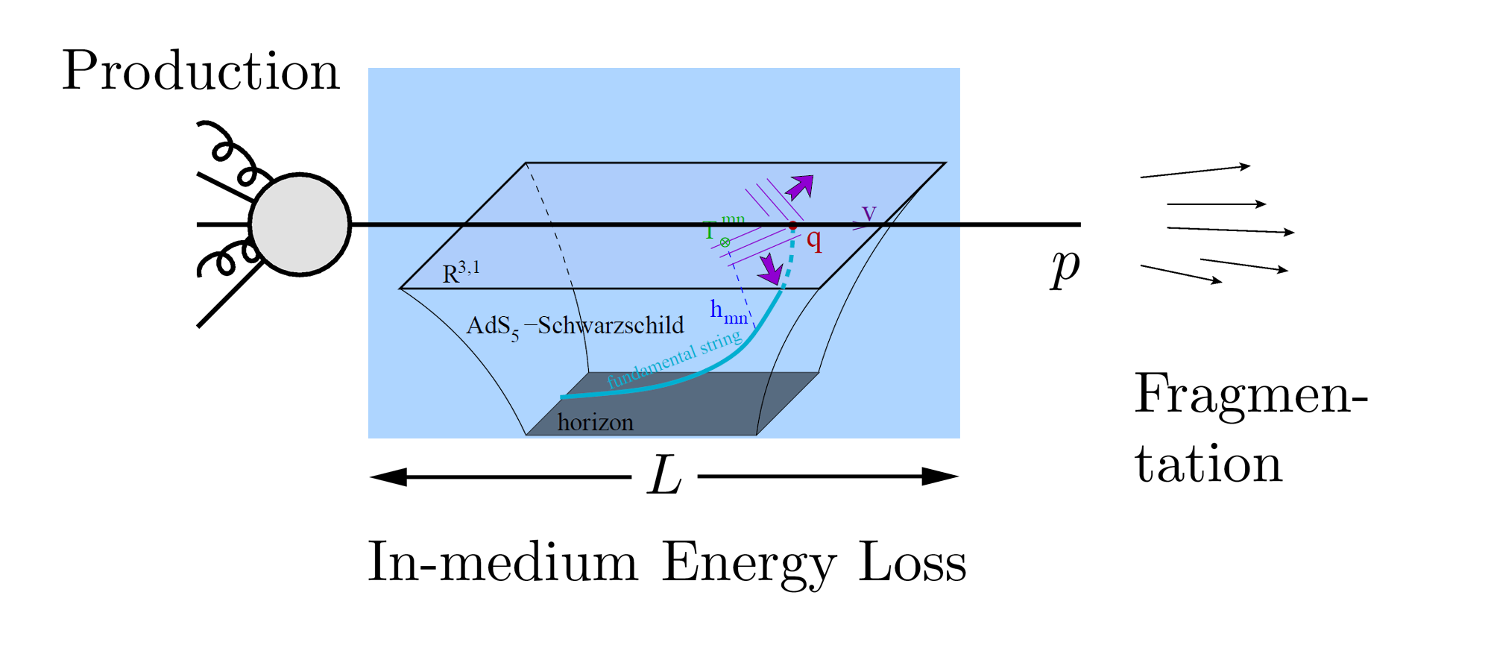
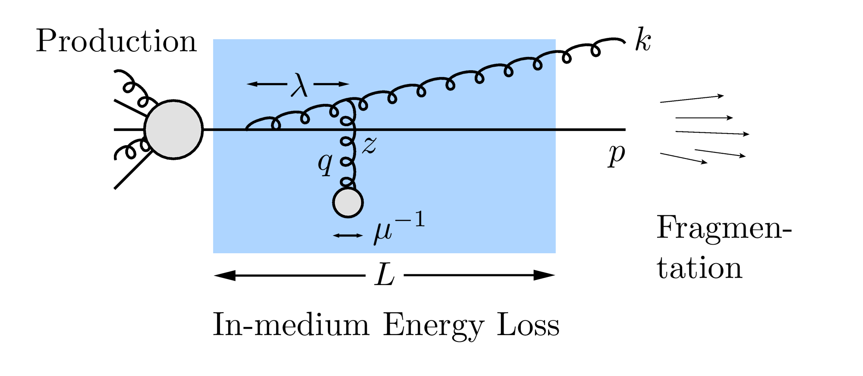
Why Energy Loss?
  Most direct probe of DOF of QGP
pQCD Picture
AdS/CFT Picture

Slide 20
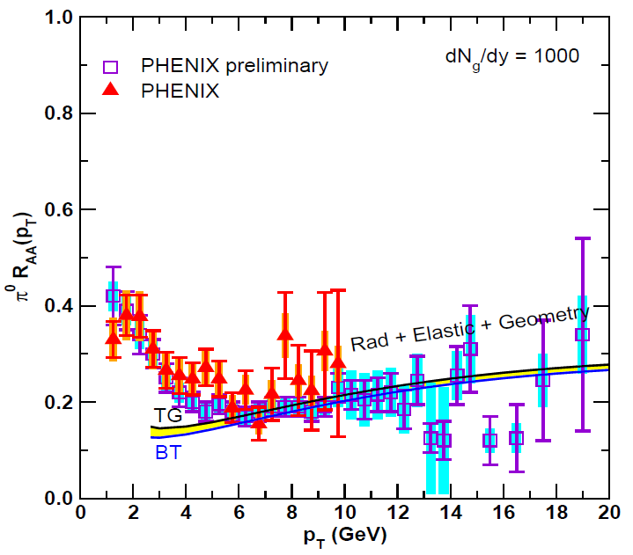
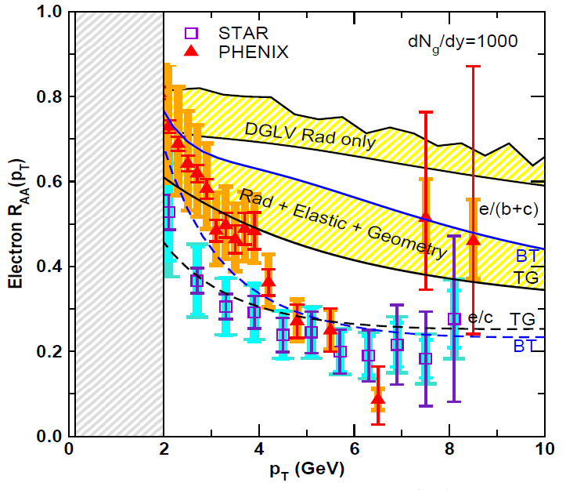
Lesson from RHIC
Extremely difficult to consistently describe all observables
  HF suppression places stringent constraint on possible E-loss mechanism
Wicks, WAH, Djordjevic, Gyulassy, NPA784 (2007)

Slide 21
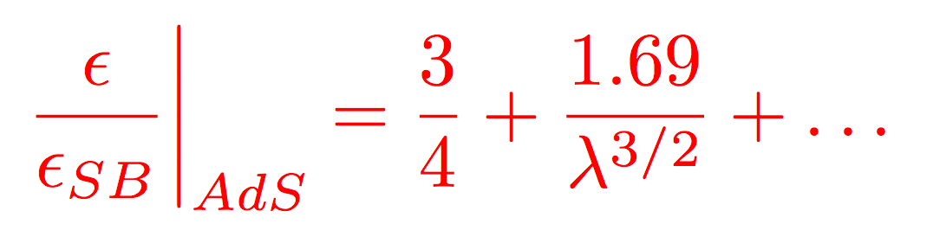
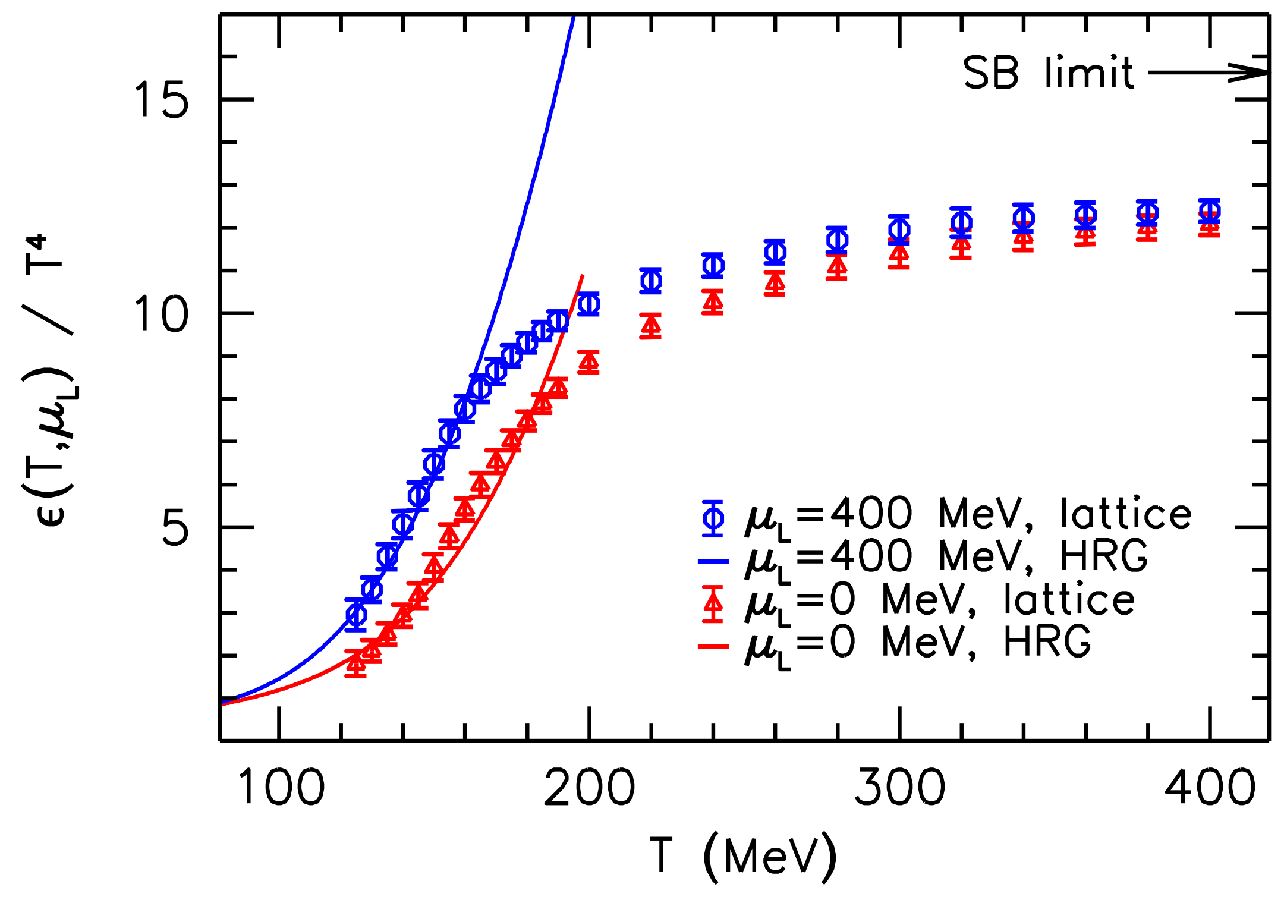
Let’s Assume Strong Coupling
Not crazy
  T ~ 250 MeV, g(2πT) ~ 2, λ = g²N_{c} ~ 12 ≫1
    Always small T scale
  T ≳ T_{c}, lattice deviates from Stefan-Boltzmann
  η/s ~ 1/4π readily explained by AdS/CFT
Luzum and Romatschke, PC78 (2008)
Wuppertal, arXiv:1204.6710

Slide 22
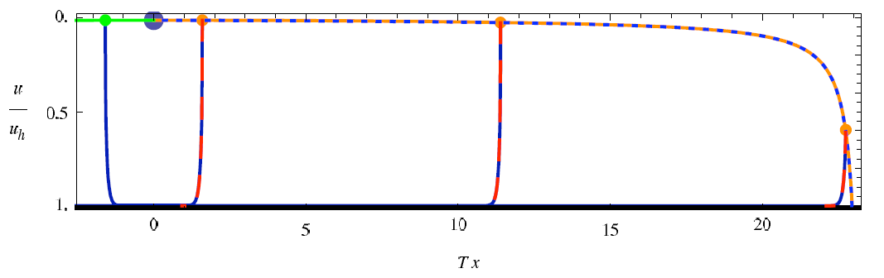
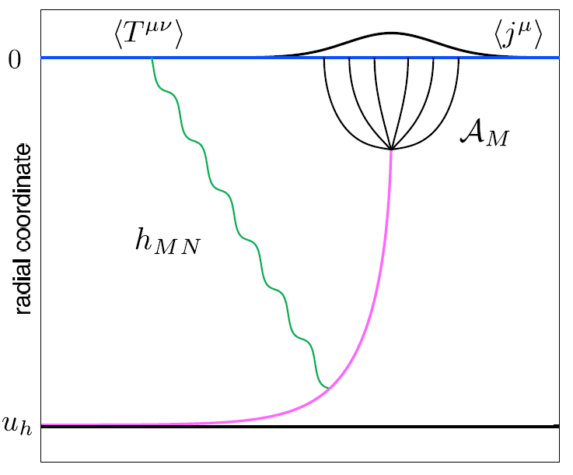
Light Quark E-Loss in AdS
Chesler et al., PRD79 (2009)
Complications:
  string endpoints fall
    => painful numerics
  relation to HI meas.
    less obvious than HQ
In principle, compute T^{μν} from graviton emission
  Extremely hard

Slide 23
Ambiguity in dE/dx Definition
Want dE/dx and/or full jet profile
  Unclear how to do the former
    Light quark E-loss prescription is not clear
Morad and WAH, in prep

Slide 24
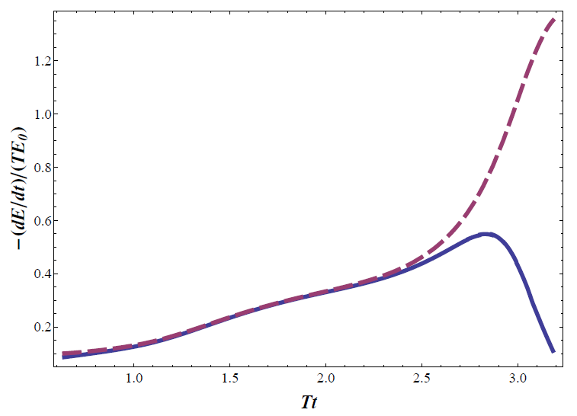
Results?
Prescription chosen has HUGE effect on E-loss
Full jet profile is very hard (determine T^{μν})
  Although potentially related to IC matching

Slide 25
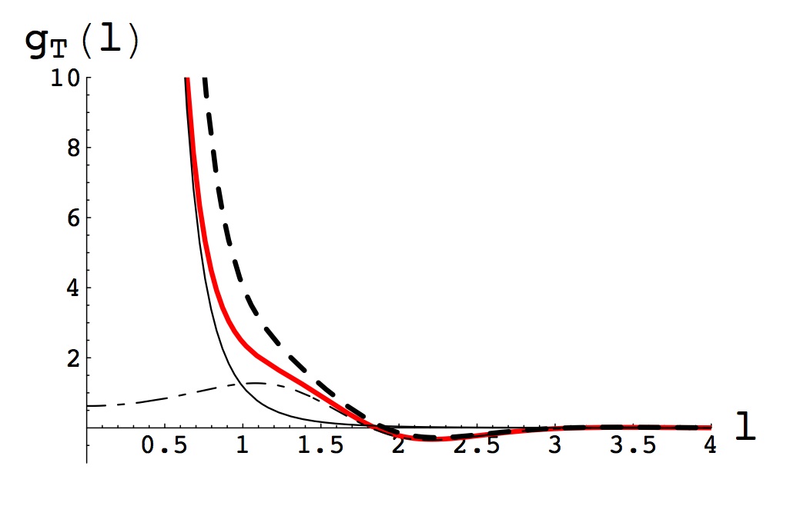
Momentum Fluctuations
String vibrations => HQ mom. fluc.
  Non-Markovian!
    Cannot use Langevin
  Estimate importance:
    Δp_{L}/μ = p_{L} => γ < (M/T)²/4
      Parametrically larger than speed limit (γ_{sl} ~ 1/λ); numerically smaller
Gubser, NPB790 (2008)

Slide 26
Let’s Assume pQCD is the Way to Go
Thermal Field Theory =>
  Debye mass μ ~ gT
  Mean free path λ_{mfp} ~ 1/g²T
Entropy/Hydro => T_{RHIC(LHC)} ~ 350 (450) MeV
  μ ~ gT ~ 0.7 (0.8) GeV => 1/μ ~ 0.3 (0.2) fm
  λ_{mfp} ~ 1/g²T ~ 0.8 (0.7) fm
  R_{Au,Pb} ~ 6 fm
1/μ << λ_{mfp} << L
  Scattering off separated, well-defined quasiparticles
  For HQ, order a few collisions, ~ 4
gluon

Slide 27
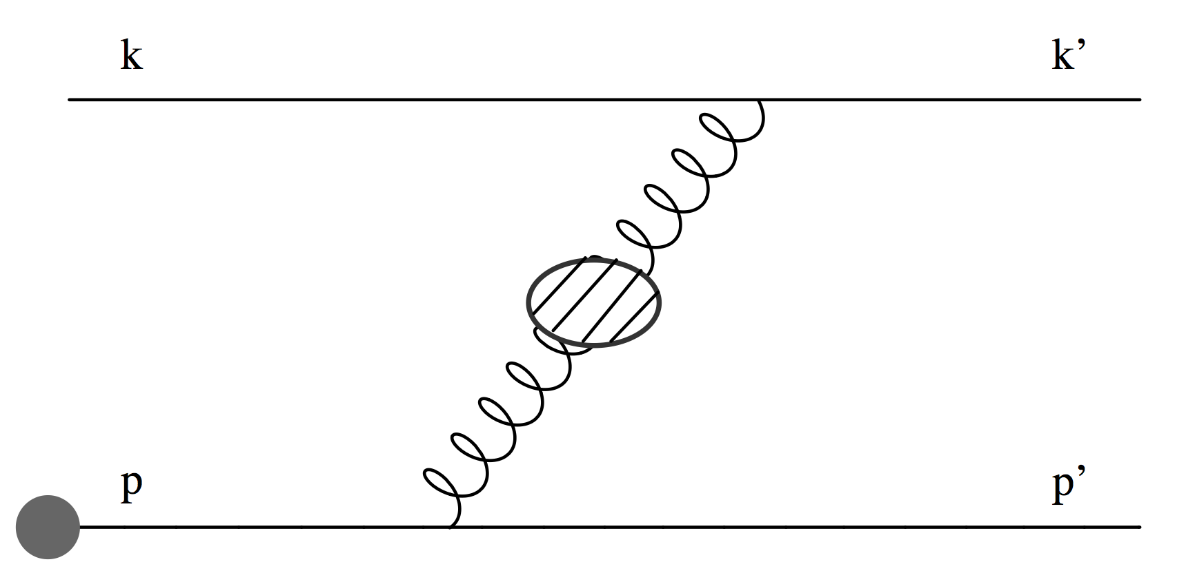
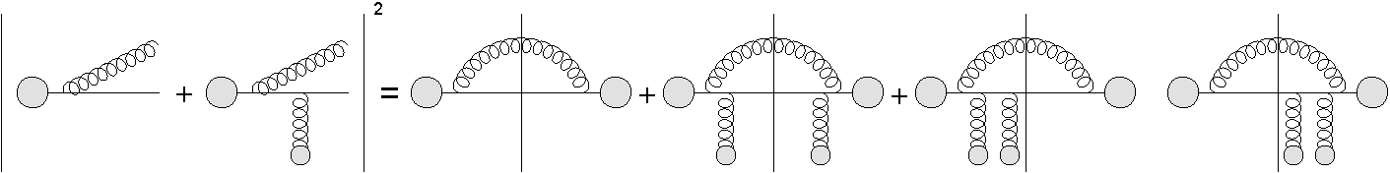
pQCD Continued
Two types of E-loss
  Collisional (elastic) 2➞2
  Radiative (inelastic) 2➞3
    Scales => ~few scatterings, mult. coh. em. => LPM
    Must include interference with production radiation
          Bjorken, FERMILAB-PUB-82-059-THY
          Braaten and Thoma, PRD44:2625–2630, 1991
          Djordjevic, Phys.Rev. C74 (2006) 064907
          Adil et al., Phys.Rev. C75 (2007) 044906
Djordjevic, PRC74 (2006)
          Majumder and van Leeuwen, PPNPA66 (2011), and refs therein

Slide 28
Asymptotic Analytic pQCD
Naively, ΔE_{el} << ΔE_{rad} as E➞∞
Elastic E-loss:
dp_{T}/dt ~ -T² log(p_{T}/M_{Q})
Radiative E-loss, in expected deep LPM regime:
dp_{T}/dt ~ -L T³ log(p_{T}/M_{Q})
  Compare to Bethe-Heitler dp_{T}/dt ~ -(T³/M²)p_{T}

Slide 29
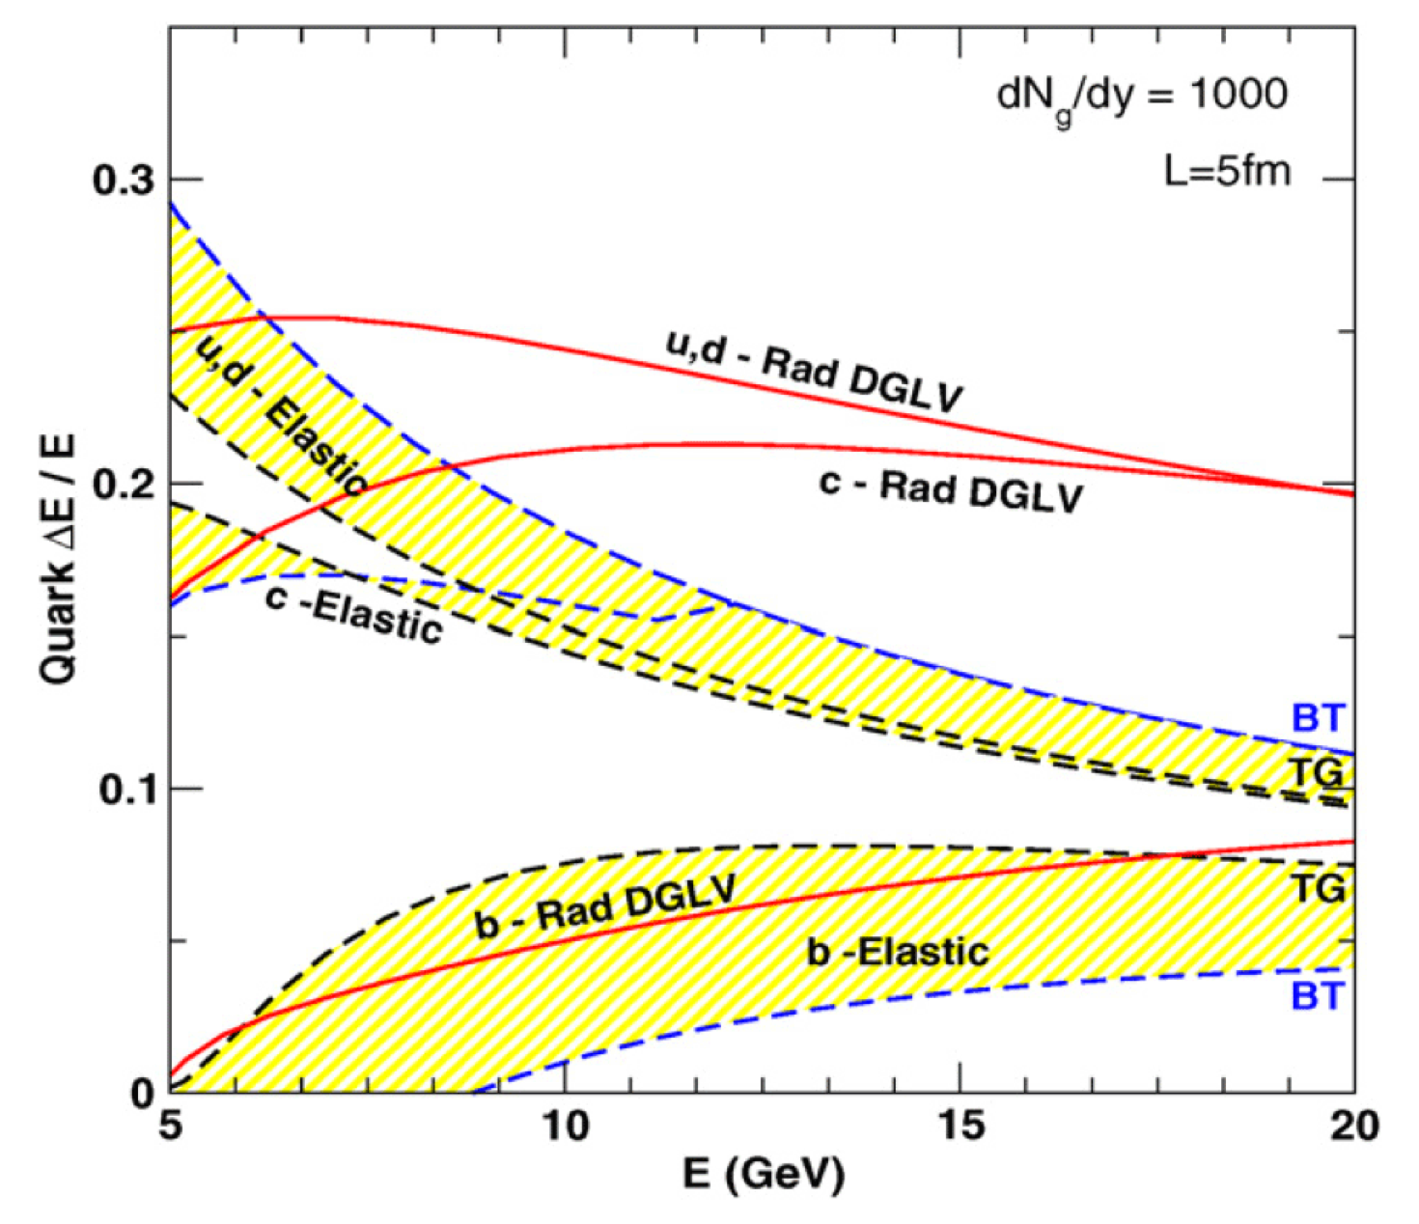
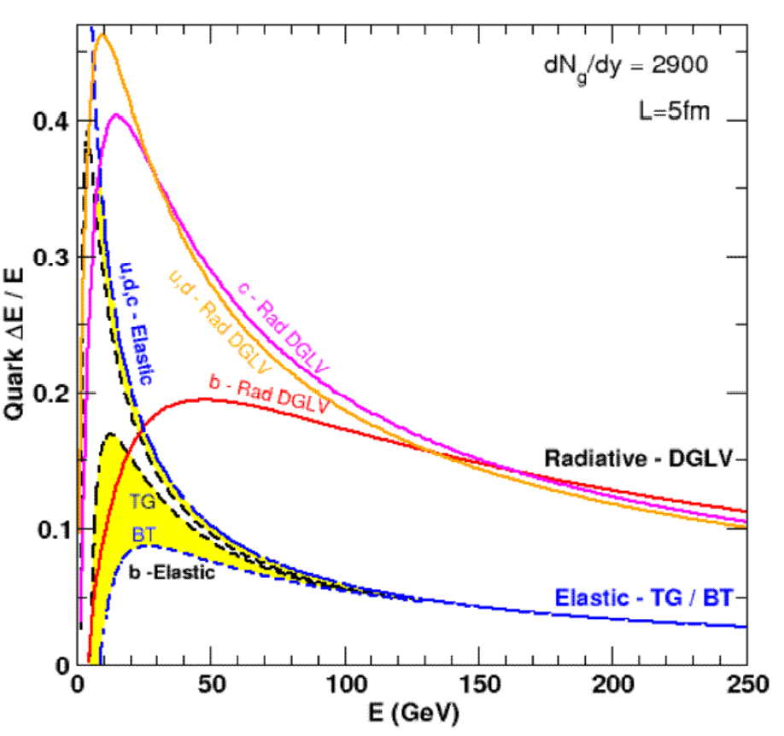
Results
Naively, ΔE_{el} << ΔE_{rad} as E➞∞
RHIC
LHC
WAH, PhD Thesis, arXiv:1011.4316
Finite RHIC/LHC kinematics: both radiative and collisional energy loss processes are important for p_{T} ~ 5 GeV/c and higher

Slide 30
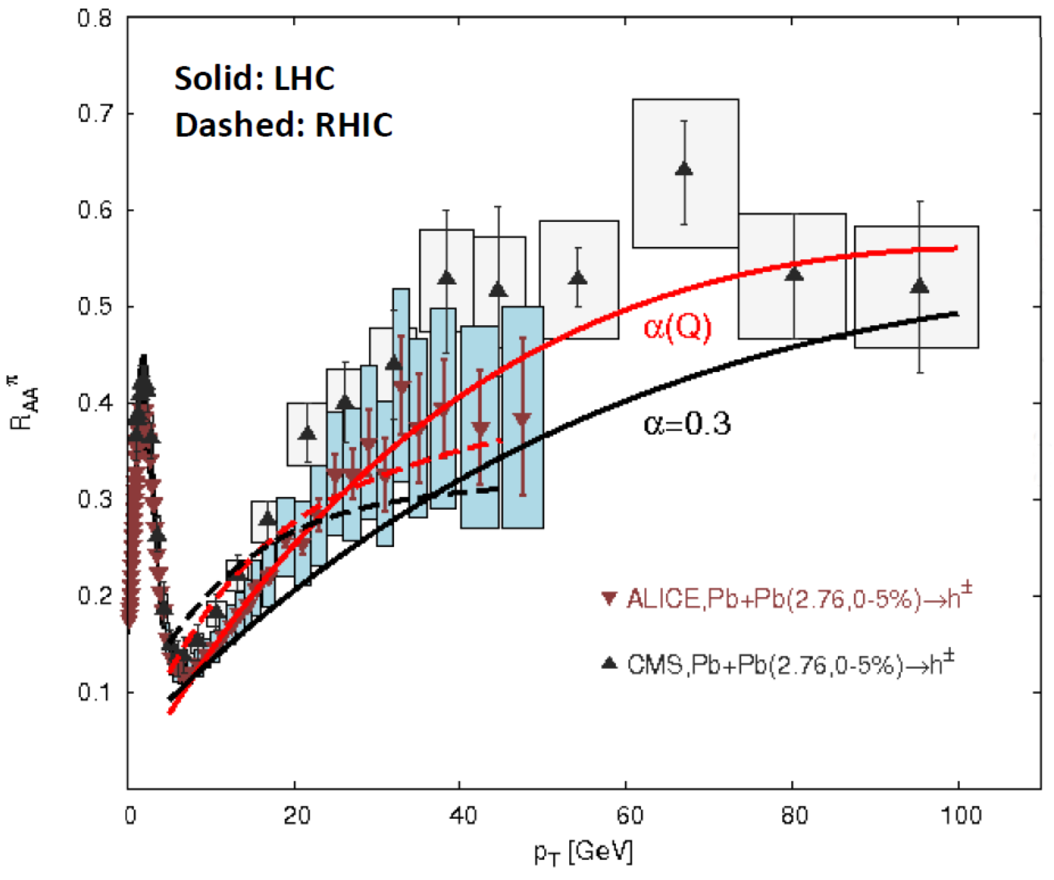
Future pQCD Work
Include neglected effects
Reduce theoretical uncertainty
  Look for new results soon!
Full jet T^{μν}?
Buzzatti and Gyulassy,
NPA 904 (2013)

Slide 31
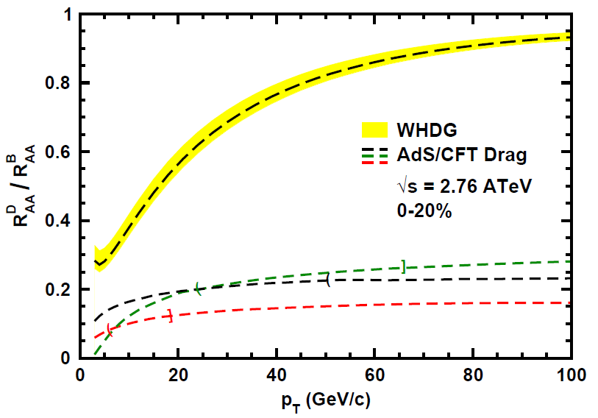
Does pQCD or AdS Yield Correct Mass & Momentum Dependecies at LHC?
WAH, PANIC11 (arXiv:1108.5876)
      T(τ₀): “(”, corrections likely small for smaller momenta
      T_{c}: “]”, corrections likely large for higher momenta
Qualitatively, corrections to AdS/CFT result will drive double ratio to unity
See also:
WAH, M. Gyulassy, PLB666 (2008)

Slide 32
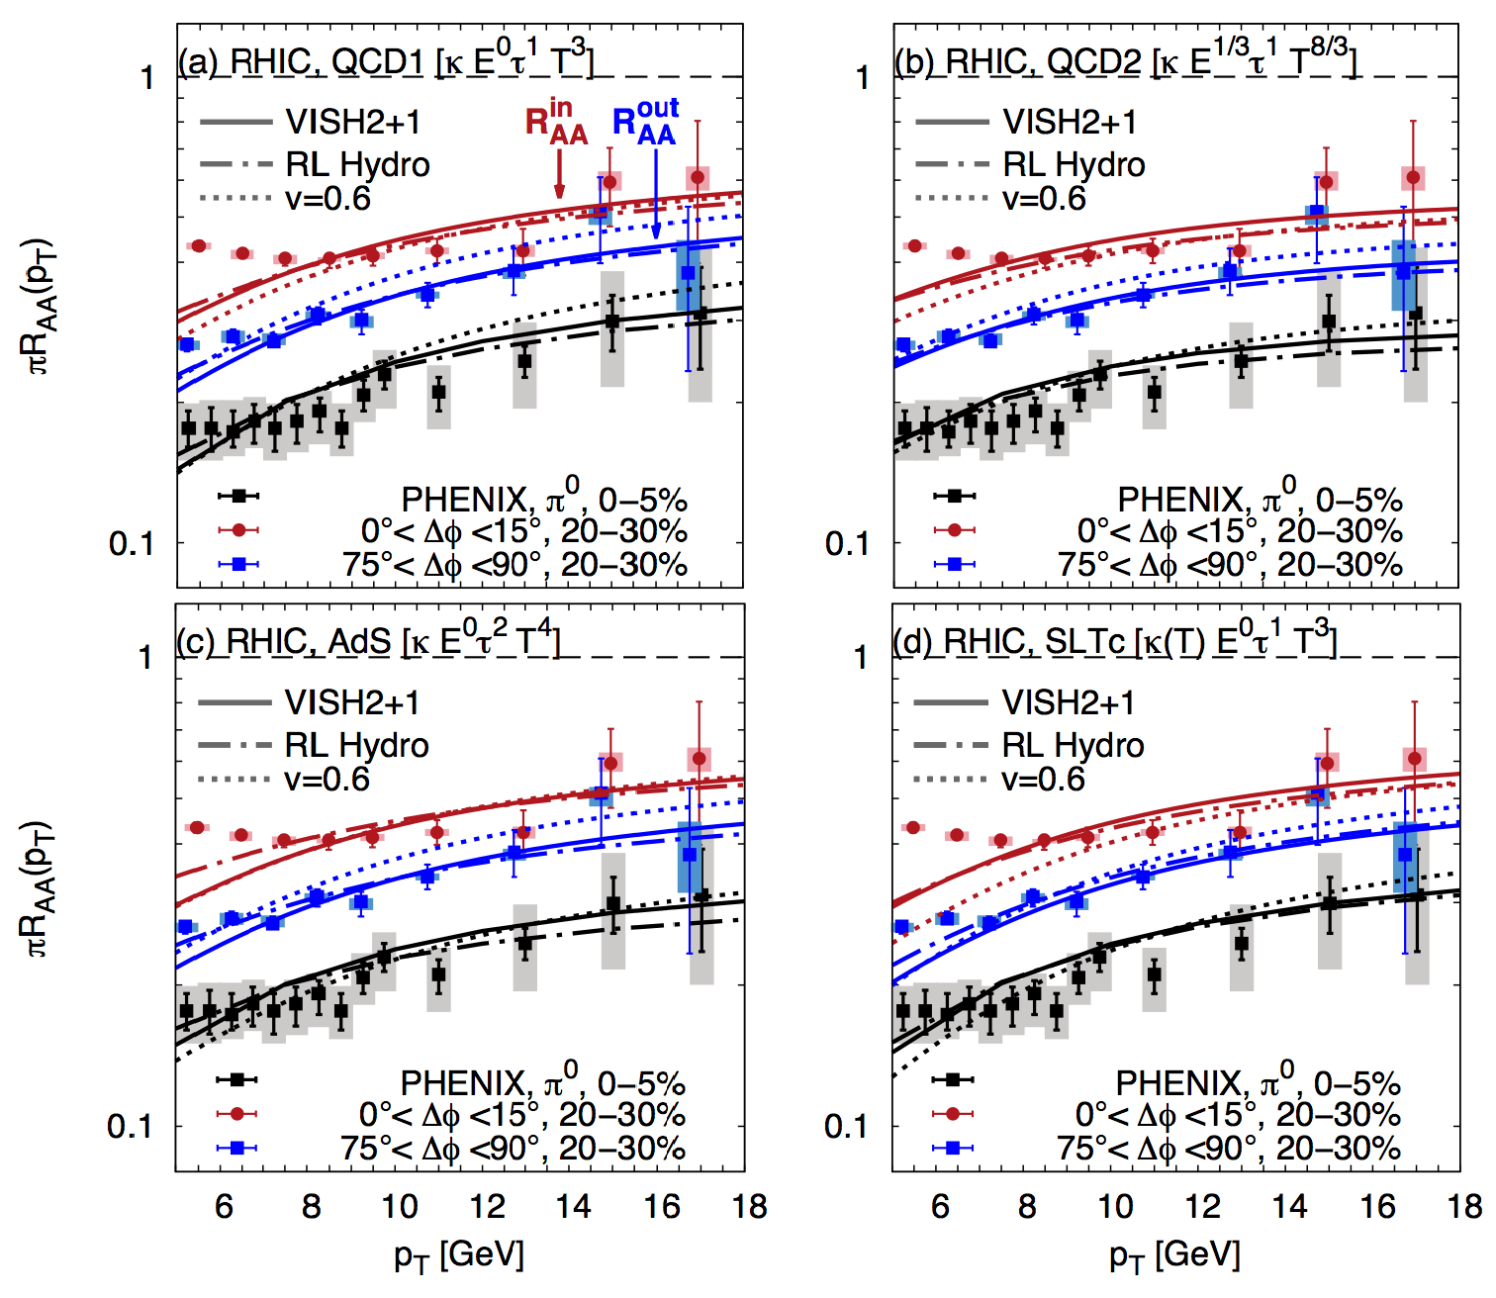
Betz and Gyulassy, arXiv:1305.6458

Slide 33
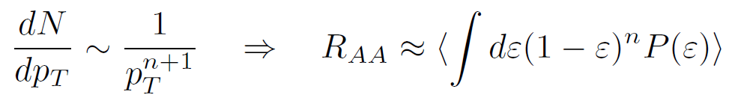
Qualitative Expectations for HF
Energy loss decreases with M_{Q}
  ΔE_{b} < ΔE_{c} < ΔE_{u,d} < ΔE_{g}
    For experts: not always true for pQCD
    (τ_{form} decreases with M_{Q})
DOES NOT IMPLY R_{AA} ORDERING
  For approx. power law production and energy loss probability P(ε), ε = (E_{i} - E_{f})/E_{i}
  Larger n => smaller R_{AA} for same energy loss

Slide 34
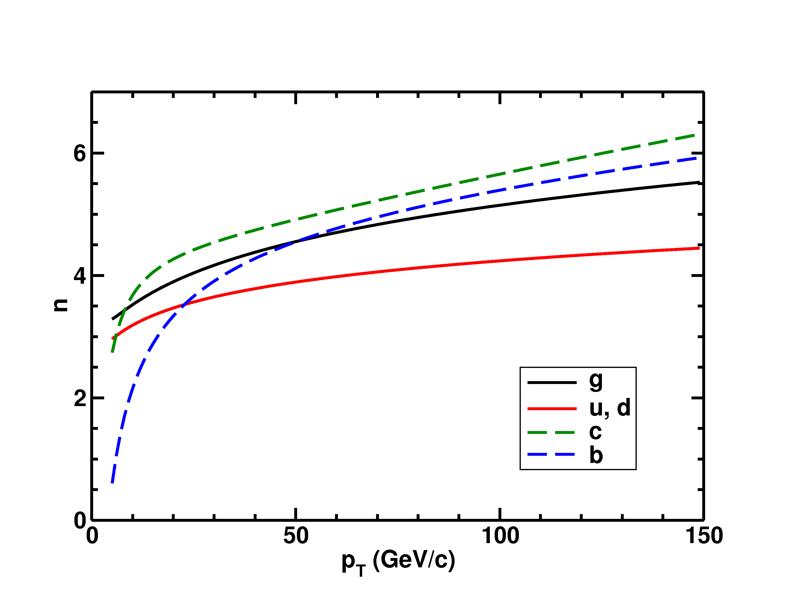
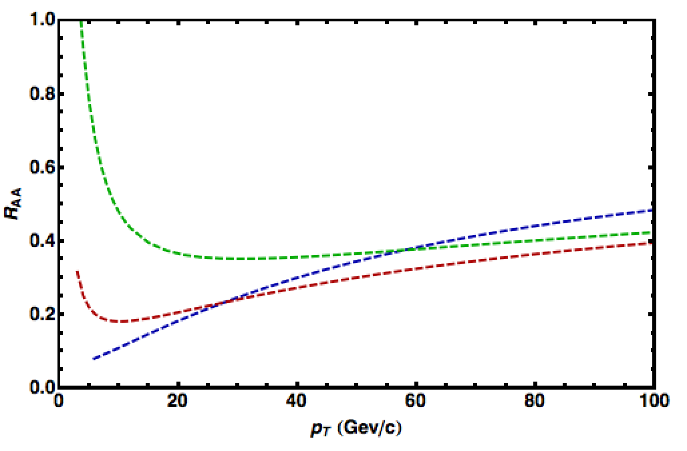
Importance of Production
HQ production spectra softer than lights
  => Nontrivial ordering of R_{AA}(p_{T})
√s = 2.76 TeV
LHC
0-20%
π⁰ WHDG
D WHDG
B WHDG
See also
Buzzatti, 5C (NB: High-p_{T} and Jets)

Slide 35
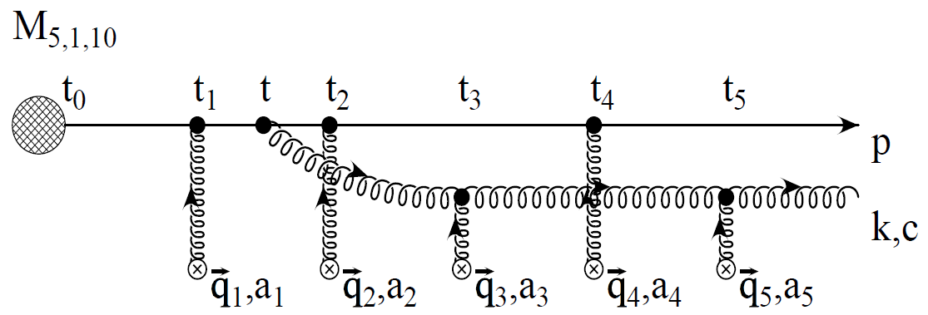
pQCD Rad Picture
Bremsstrahlung Radiation
  Weakly-coupled plasma
    Medium organizes into Debye-screened centers
  T ~ 350 (450) MeV, g ~ 1.9 (1.8)
    μ ~ gT ~ 0.7 (0.8) GeV
    λ_{mfp} ~ 1/g²T ~ 0.8 (0.7) fm
    R_{Au,Pb} ~ 6 fm
  1/μ << λ_{mfp} << L
    multiple coherent emission
Gyulassy, Levai, and Vitev, NPB571 (2000)
  LPM
    dp_{T}/dt ~ -LT³ log(p_{T}/M_{q})
  Bethe-Heitler
    dp_{T}/dt ~ -(T³/M_{q}²) p_{T}

Slide 36
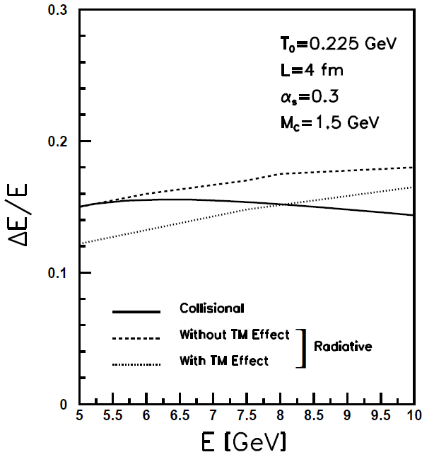
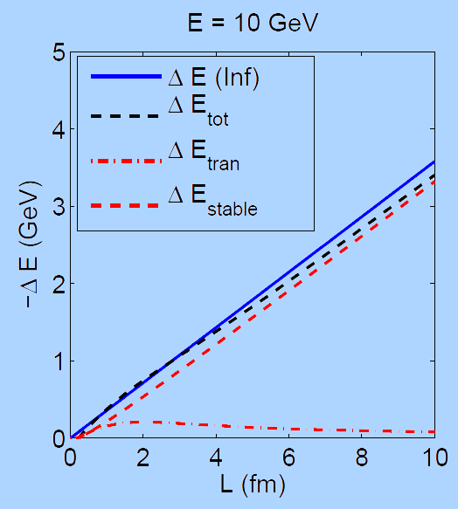
What About Elastic Loss?
Appreciable!
Finite time effects small
Mustafa, PRC72 (2005)
Adil, Gyulassy, WAH,
Wicks, PRC75 (2007)
  For pQCD comparisons with data, use WHDG Rad+El+Geom model; formalism valid for g/lq & hq

Slide 37
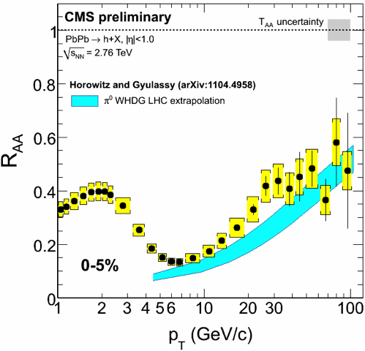
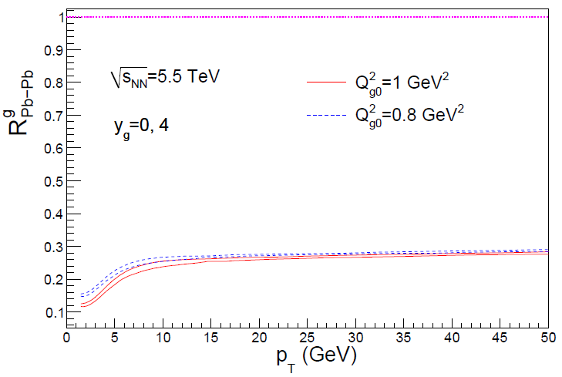
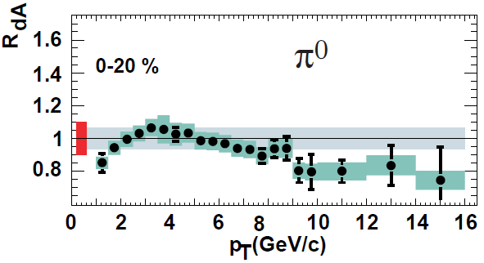
Rise in R_{AA} a Final State Effect?
  Is rise really due to pQCD?
  Or other quench (flat?)
+ initial state CNM effects a la CGC?
Y-J Lee, QM11
Albacete and Marquet, PLB687 (2010)
Require p + A and/or direct γ
PHENIX PRL98, 2007

Slide 38
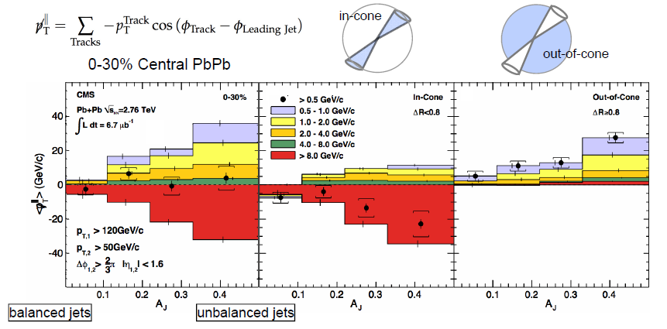
pQCD and Jet Measurements
  CMS sees redistribution of lost energy at large angles
    Naive pQCD expectation: collinear radiation
Wyslouch, CMS, QM11

Slide 39
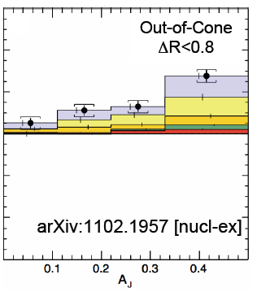
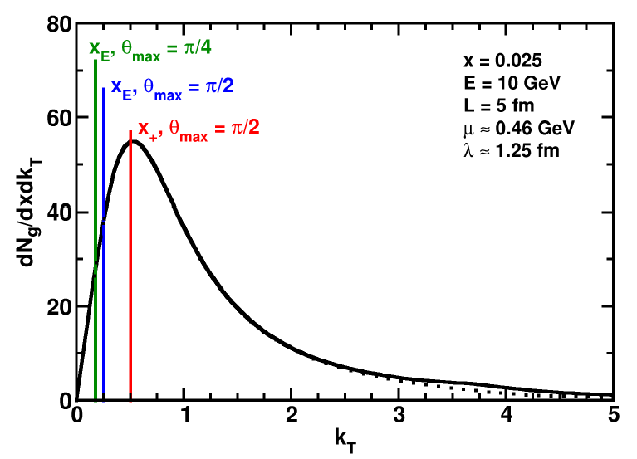
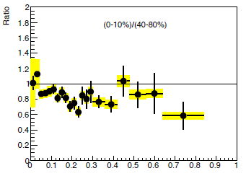
pQCD and Wide Angle Radiation
  Naively, pQCD =>
  x_{typical}, θ_{typical} ~ μ/E; μ ~ 0.5 GeV
  All current Eloss calculations assume small angle emission
  (k_{T} << xE)
  Collinear approximation is (maximally) violated; x_{typ} ~ μ/E
  pQCD is not inconsistent with data
C Roland, CMS, QM11
z
WAH and B Cole, PRC81, 2010
B Cole, ATLAS, QM11

Slide 40

Comparing AdS and pQCD
But what about the interplay between mass and momentum?
  Take ratio of c to b R_{AA}(p_{T})
    pQCD: Mass effects die out with increasing p_{T}
      Ratio starts below 1, asymptotically approaches 1. Approach is slower for higher quenching
    ST: drag independent of p_{T}, inversely proportional to mass. Simple analytic approx. of uniform medium gives
    R^{cb}_{pQCD}(p_{T}) ~ n_{b}M_{c}/n_{c}M_{b} ~ M_{c}/M_{b} ~ .27
      Ratio starts below 1; independent of p_{T}
R^{cb}_{pQCD}(p_{T}) ∼ 1 - α_{s} n(p_{T}) L² log(M_{b}/M_{c}) ( /p_{T})

Slide 41
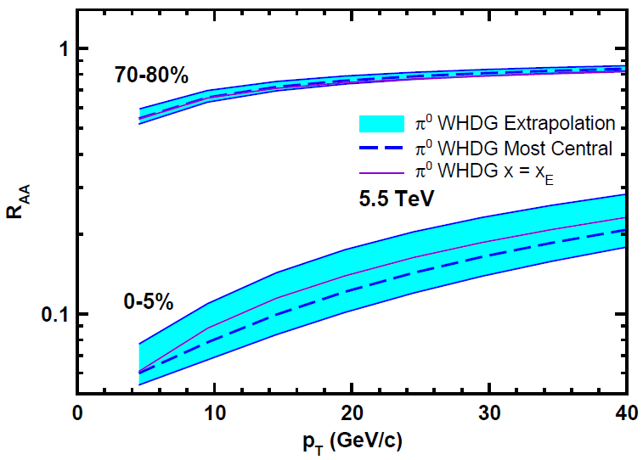
Top Energy Predictions
For posterity:
WAH and M Gyulassy, in preparation

Slide 42
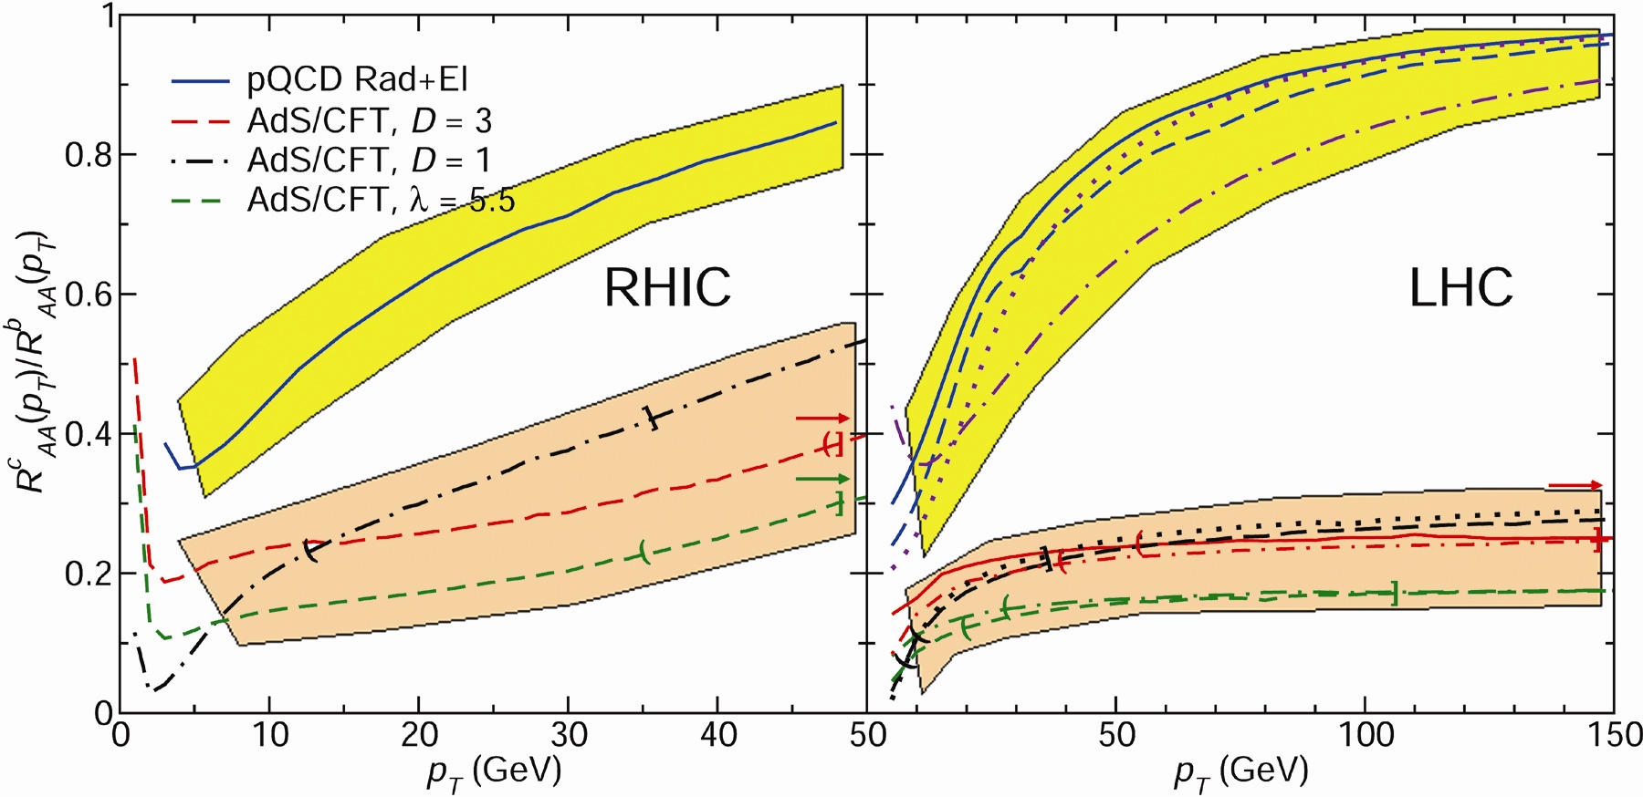
RHIC R^{cb} Ratio
pQCD
pQCD
AdS/CFT
AdS/CFT
WAH, M. Gyulassy, JPhysG35 (2008)
    Wider distribution of AdS/CFT curves due to large n: increased sensitivity to input parameters
    Advantage of RHIC: lower T => higher AdS speed limits

Slide 43


Motivating High Momentum Probes
Probe
Medium
Medium

Slide 44

Not So Fast!
  Speed limit estimate for applicability of AdS drag
    γ < γ_{crit} = (1 + 2M_{q}/λ^{1/2} T)²
    ~ 4M_{q}²/(λ T²)
      Limited by M_{charm} ~ 1.2 GeV
    Similar to BH LPM
      γ_{crit} ~ M_{q}/(λT)
  No Single T for QGP
    smallest γ_{crit} for largest T
    T = T(τ₀, x=y=0): “(”
    largest γ_{crit} for smallest T
    T = T_{c}: “]”
D7 Probe Brane
Q
Worldsheet boundary Spacelike if γ > γ_{crit}
x₅
Trailing
String
“Brachistochrone”
“z”
D3 Black Brane

