Slide 1
SQM2013 Conference at Birmingham
O. Villalobos Baillie,
School of Physics and Astronomy
July 27th 2013

Slide 2
Statistics
1 60 people registered
158 people made it to Birmingham
25 countries represented
    Frankfurt most represented city
137 talks
2 talks given by Vidyo (Unusual for a conference)
  Renu Bala (Thursday)
  Palash Khan (Friday)

Slide 3
Representation by Country

Slide 4
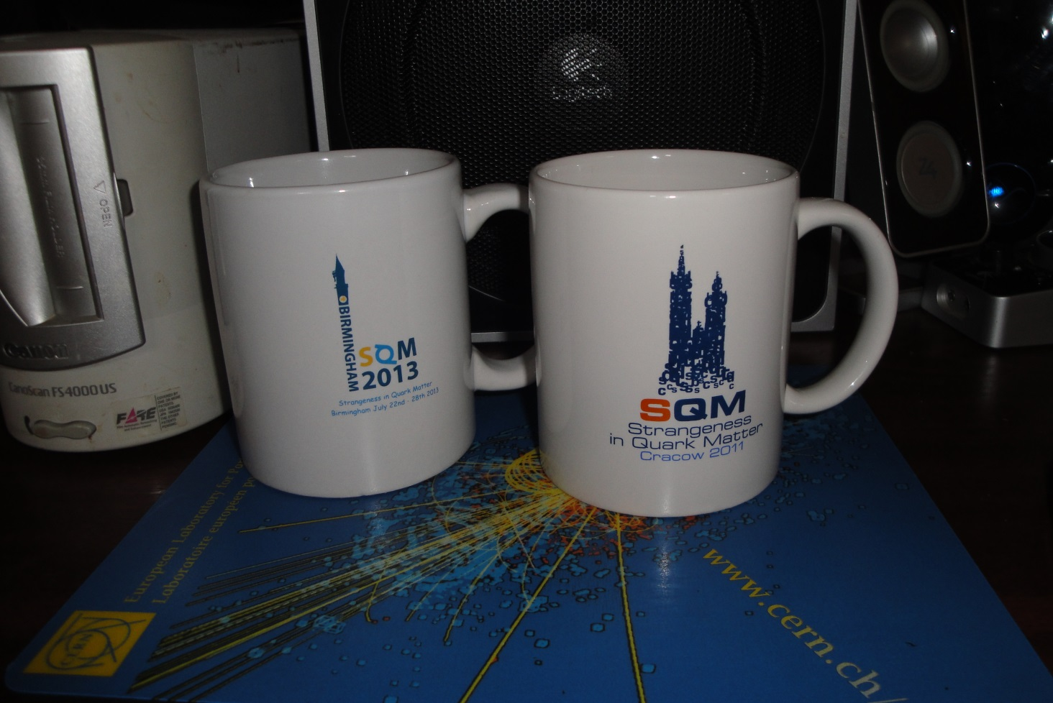
Thanks
Denitsa Petrova – logo
Pauline Trigg – Visa Letters
Rachel Taylor - Accounts
Lawrie Lowe, Mark Slater – Computing support
The School of Physics and Astronomy, especially Ian Barnett and Chaw Mughal
ATLAS students
  Benedict Allbrooke, Andrew Chisolm, Mark Levy
LHCb students
  Luca Pescatore
NA62 students and postdocs
  Karim Massri, Francis Newson, Dr Angela Romano
Birmingham University Conference Service – Rooms and Catering
City of Birmingham Convention Bureau - Hotels
Birmingham Botanical Gardens

Slide 5
Special Thanks
ALICE Students
  Didier Alexandre, Luke Hanratty, Graham Lee, Arvinder Palaha, Patrick Scott

Slide 6
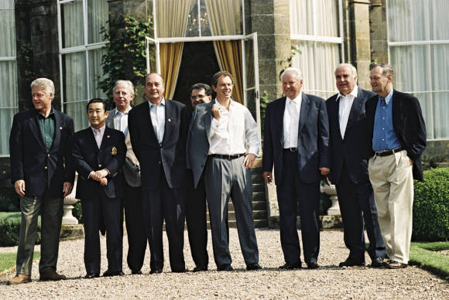
Dinner – Botanical Gardens
Not the first people to hold a conference dinner in the Botanical Gardens!

Slide 7
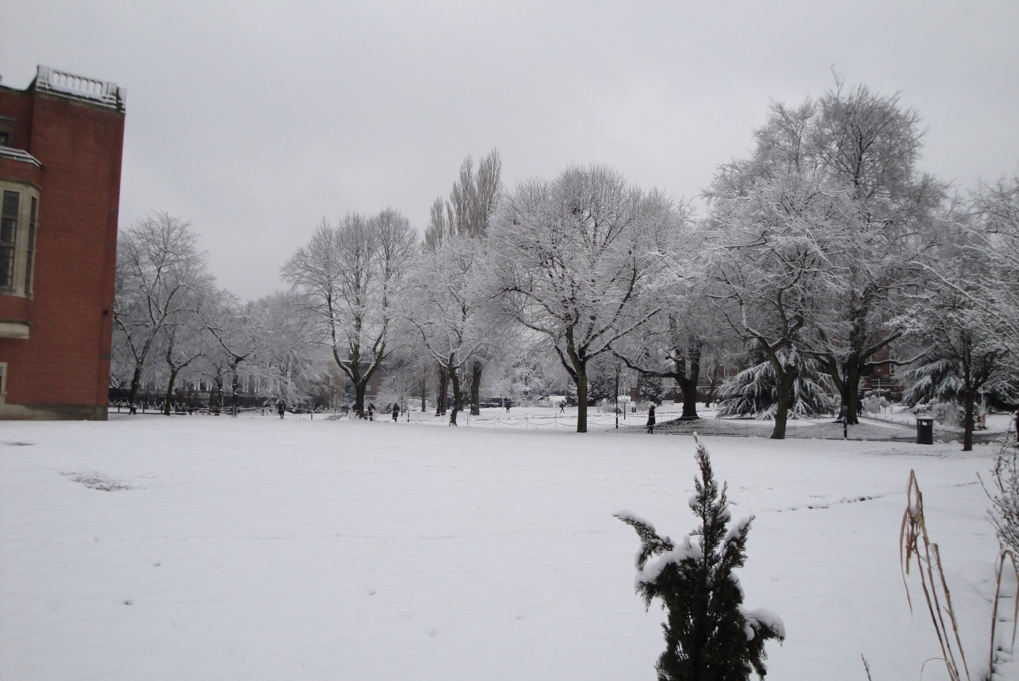
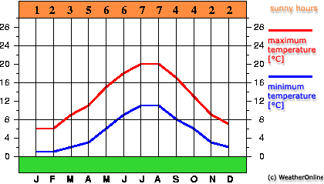
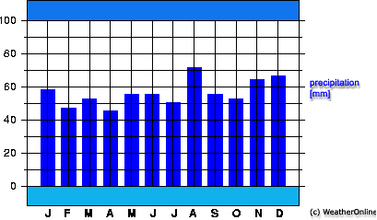
Weather
We have been very lucky
Unexpected weather given very cold spring
Temperature
Rainfall
Day we inspected Arts Faculty Buildings

Slide 8
Next Conference but one
During this meeting, the IAC decided that the conference after SQM2015 in Dubna would be held in Berkeley, probably in 2016.

Slide 9
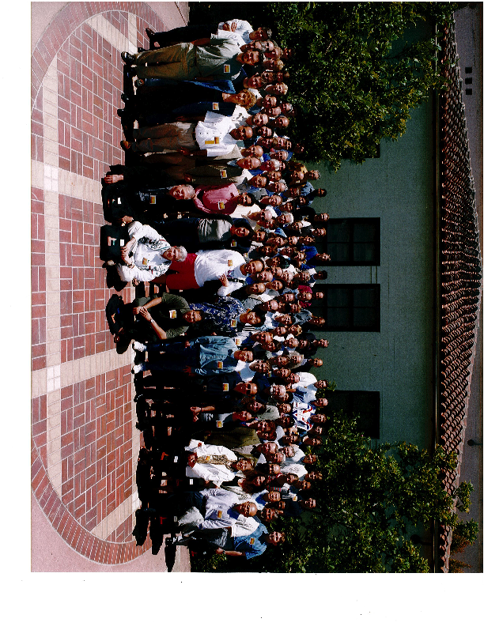
Clark Keer Campus - Berkeley
Next
conference
but one!
SQM2000 – you might have been there

Slide 10
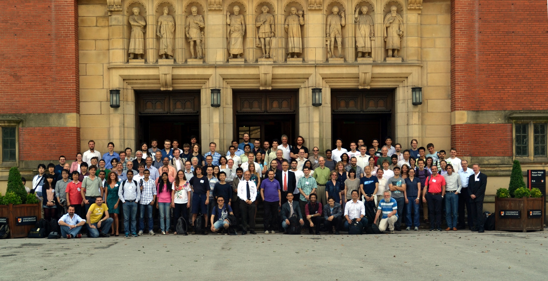
SQM2013
You were here!

