Slide 1
QGP Viscosity & Elliptic Flow for
Multi-strange Hadrons
Huichao Song
Peking University
SQM 2013
Birmingham, UK, July 22- 27, 2013
07/25/2013

Slide 2
Shear viscosity:
Bulk viscosity:
viscous hydrodynamics
Input: “EOS”
Assume zero net baryon density & heat conductivity at RHIC and LHC
Notes:
Introduction
2

Slide 3
Generic features of shear & bulk viscosities

Slide 4
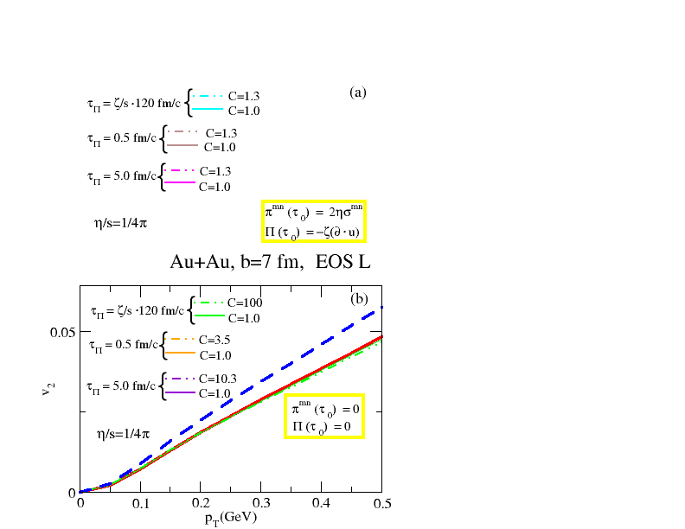
Shear viscosity:
Bulk viscosity:
acts against the buildup of flow anisotropy
acts against the buildup of radial flow
The shear viscosity leads to a significant suppression of V2 (Romatsche & Romatsche PRL07; song & Heinz PLB08, PRC08; Dusling & Teaney PRC 08; Molnar & Huovinen JPG 08 … …)
ideal
shear visc.
shear+ bulk visc.
Bulk viscous effects are much smaller than shear ones due to the critical slowing down near phase transition (Song & Heinz PRC09)
Visc. suppression
of elliptic flow
Song & Heinz PRC09
One can extract the QGP shear viscosity from exp data without large contaminations from bulk viscosity
Notes:
Introduction
4

Slide 5
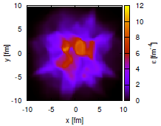
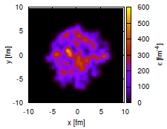
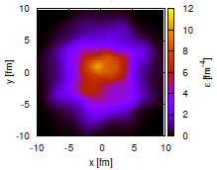
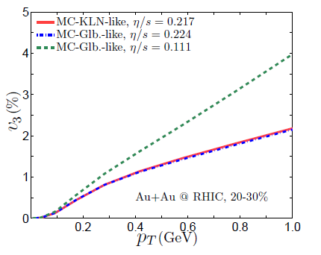
initial profile
ideal hydro evolution
(B.Schenke)
viscous hydro evolution
Qiu & Heinz 2011
Viscous suppression
of triangular flow
The shear viscosity tends to smear out the inhomogeneous structures, leading to a suppression of V3 (Schenke, Jeon & Gale PRL2011, PRC2012; Qiu & Heinz PRC2011
… … )
Notes:
Introduction
5

Slide 6
QGP viscosity at RHIC and the LHC
-results from the VISHNU hybrid model

Slide 7
VISHNU hybrid approach
H. Song, S. Bass, U. Heinz, PRC2011
Tsw=165MeV
Initial conditions viscous hydro hadron cascade
VISHNU:
Other related developments
-chemical composition of HRG
Hadron
Cascade
-3+1 d viscous hydro+ hadron cascade: Ryu et al., arXiv1210.4588 .
-transport properties of HRG
-EoS: (s95p-PCE) (Huovinen & Petreczky10)
-2+1 d vs 3+1 viscous hydro: Shen, Schenke & Heinz on going work;
-switching temperature:
Tsw=165MeV
-initial conditions
Vredevoogd &Pratt, PRC85,044908(2012)

Slide 8
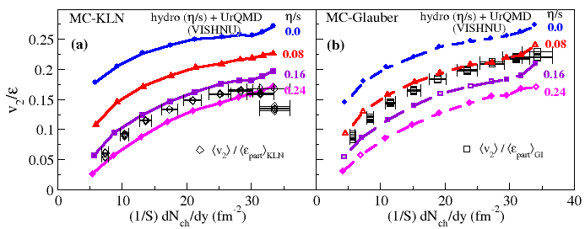
V2 and QGP viscosity at RHIC
H. Song, S. Bass, U. Heinz, T. Hirano, and C. Shen, PRL2011
MC-KLN
MC-Glauber
The analysis uses:
-integrated V2 for all charged hadrons: In contrast to V2(PT), it is less sensitive to
bulk viscosity, corrections, radial flow & chemical composition of HRG
-corrected exp. V2 data that remove non-flow & fluc. effects

Slide 9
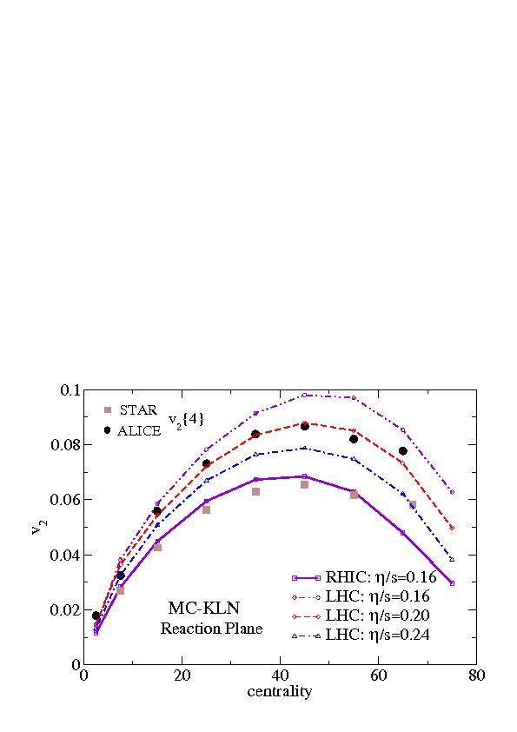
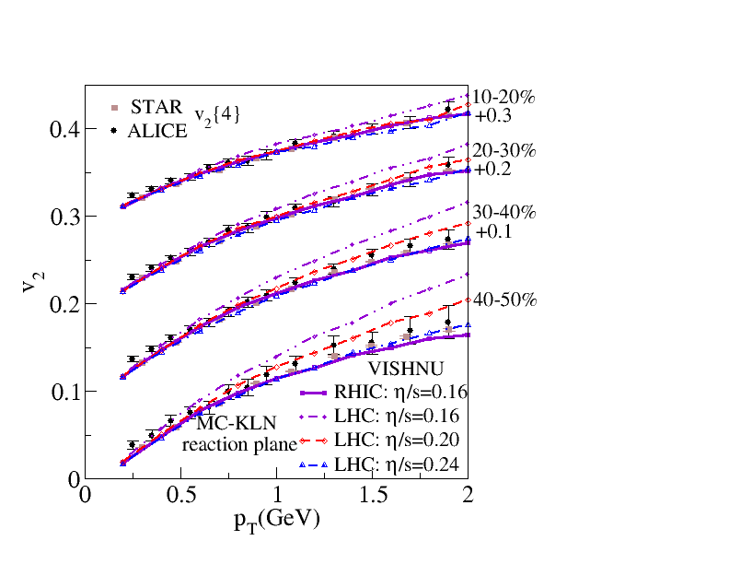
V2 and QGP viscosity at the LHC
Song, Bass & Heinz, PRC 2011
The average QGP viscosity is roughly the same at RHIC and LHC
Please also refer to C. Gale, et al., ArXiv: 1209.5330 [nucl-th]

Slide 10
Initial state fluctuations, final state correlations & the QGP viscosity

Slide 11
Uncertainties from Initial Conditions
H. Song, S. Bass, U. Heinz, T. Hirano, and C. Shen, PRL2011
MC-KLN
MC-Glauber
Main uncertainties come from initial conditions
MC-KLN, larger HIGHER value of QGP viscosity
MC-Glauber, smaller LOWER value of QGP viscosity

Slide 12
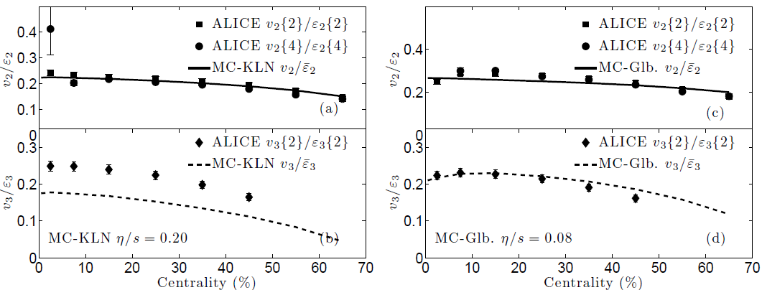
MC-KLN & MC-Glauber initializations & V3
Pure viscous hydro simulations :
Qiu, Shen & Heinz 2011
V3 prefer lower value of QGP viscosity

Slide 13
MC-Glauber & MC-KLN initializations are based on fluctuation of nucleon positions
Theoretical Development on Initialization Models:
-color charge fluctuations (IP-Glasma, correlated fluctuations）
-multiplicity fluctuations for local gluon numbers
-transverse /longitudinal flow fluctuations
- UrQMD , AMPT, EPOS/NUSES
… … … …
Related flow Data:
-elliptic flow
-triangular flow & higher order flow harmonics
-higher-order event plane correlations
-Event by event vn distributions
-Vn in ultra-central collisions
… ...
A further study of flow data in different aspects, using e-b-e VISHNU
will constrain initialization models, tightening the limit on
--Please also refer the work from B. Schenke and OSU group for recent developments

Slide 14
Multiplicity, Spectra and elliptic flow for identified hadrons

Slide 15
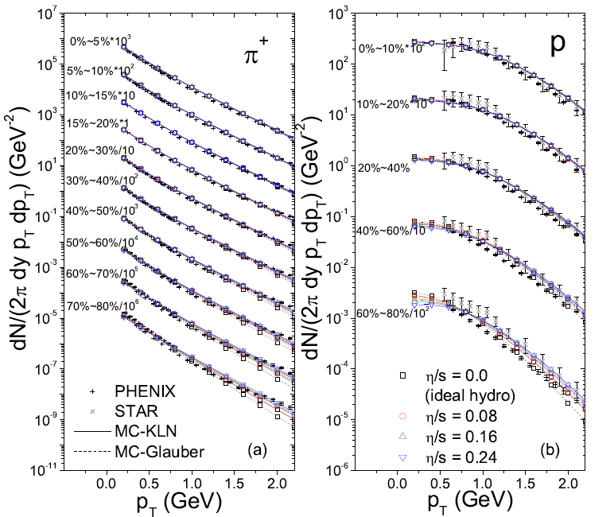
RHIC: spectra for identified hadrons
H. Song, S. Bass, U. Heinz, T. Hirano, and C. Shen,PRC2011
-a nice fit for both pion and proton spectra, insensitive to QGP viscosity

Slide 16
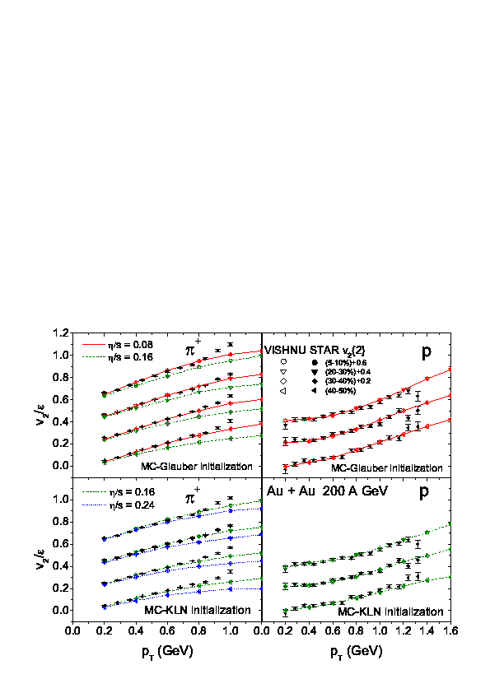
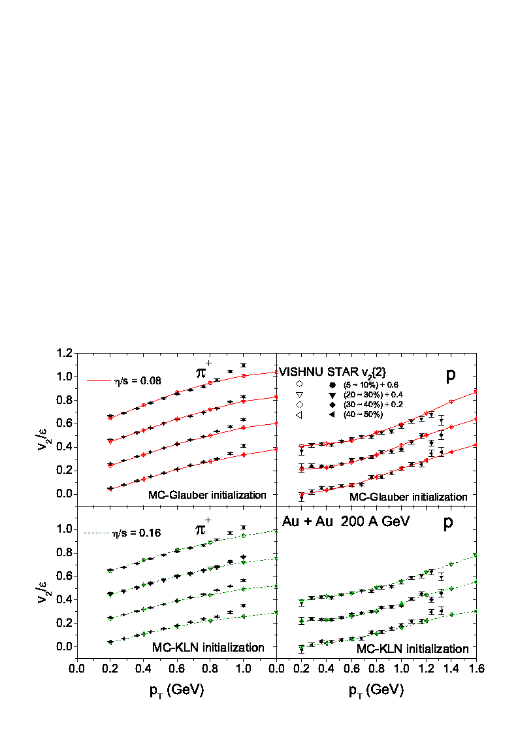
RHIC: for identified hadrons
H.Song, S. Bass, U. Heinz, T. Hirano, and C. Shen, PRC2011
5-10%
20-30%
20-30%
30-40%
30-40%
40-50%
40-50%
Glauber
Glauber
5-10%
20-30%
20-30%
30-40%
30-40%
40-50%
40-50%
KLN
KLN

Slide 17
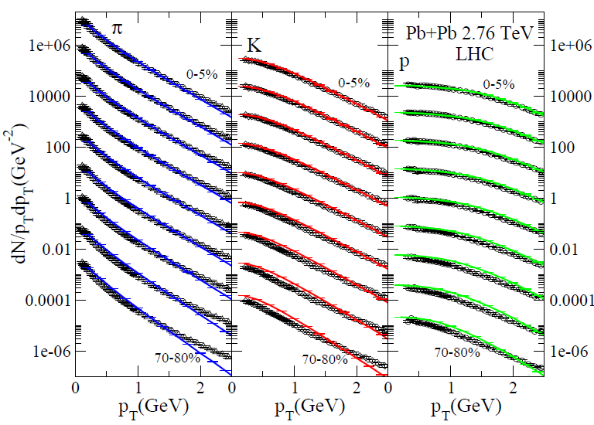
LHC: spectra for identified hadrons
H. Song, S. Bass, U. Heinz, in preparations
-a nice fit for pions, kaons and proton spectra

Slide 18
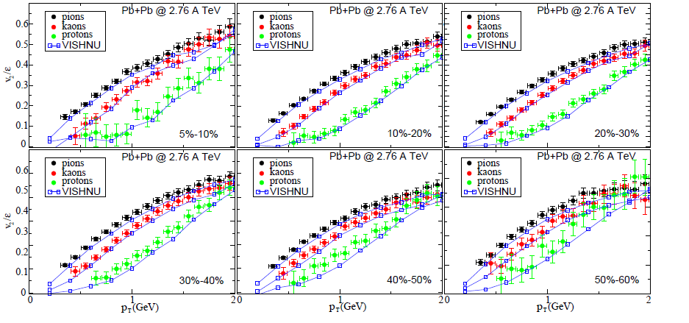
LHC: for identified hadrons
VISHNU
A very nice fit of V2(PT) for all centrality bins at LHC from VISHNU hybrid model

Slide 19
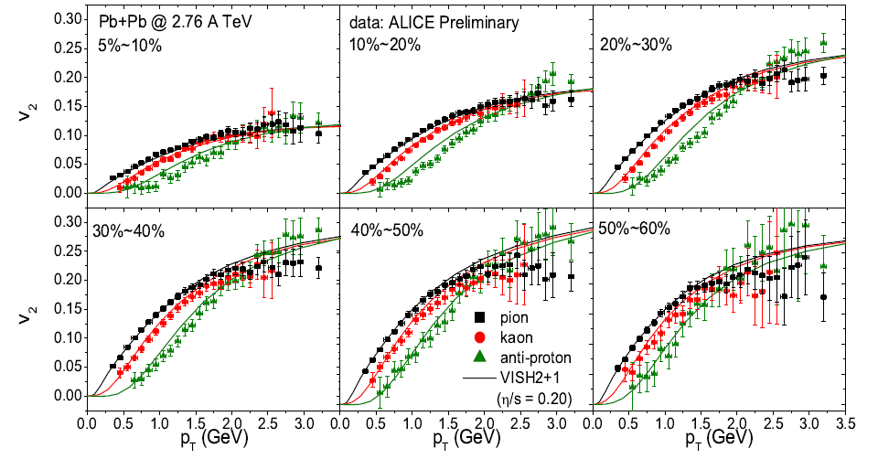
LHC: for identified hadrons
Viscous Hydro
VISHNU
A comparison between viscous hydrodynamics and VISHNU

Slide 20
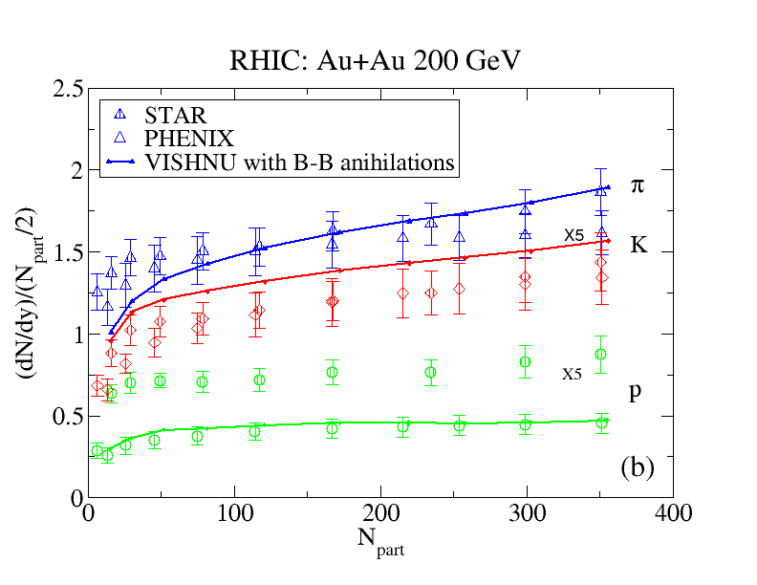
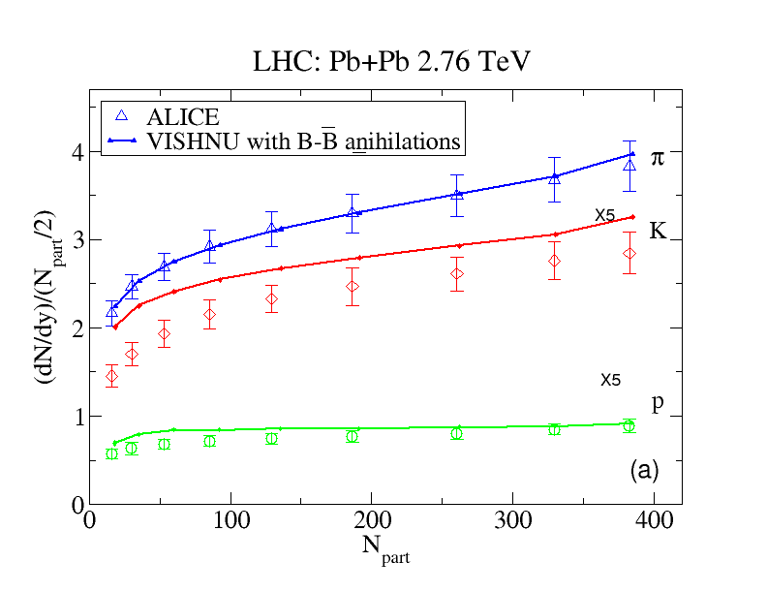
dN/dy for identified hadrons (RHIC & LHC)
RHIC : 200 A GeV Au+Au
LHC : 2.76 A TeV Pb+Pb
-VISHNU nicely describes the multiplicity for pions, kaons & protons

Slide 21
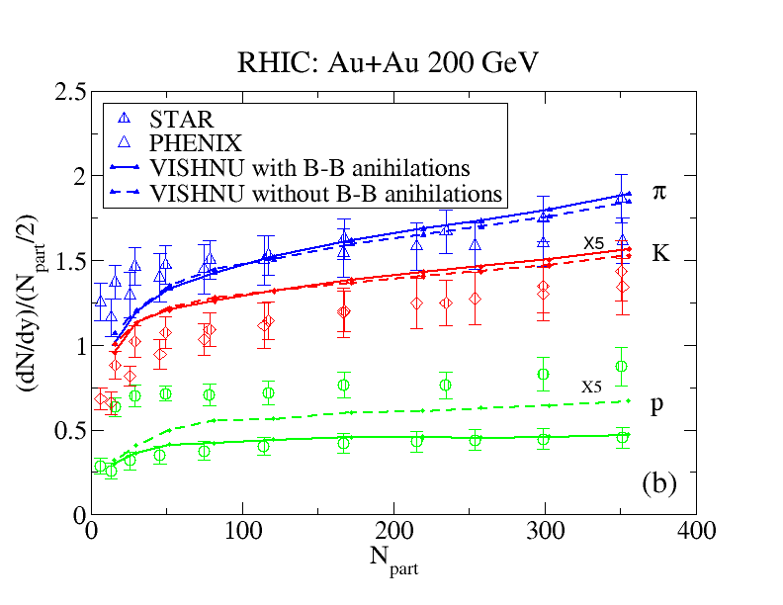
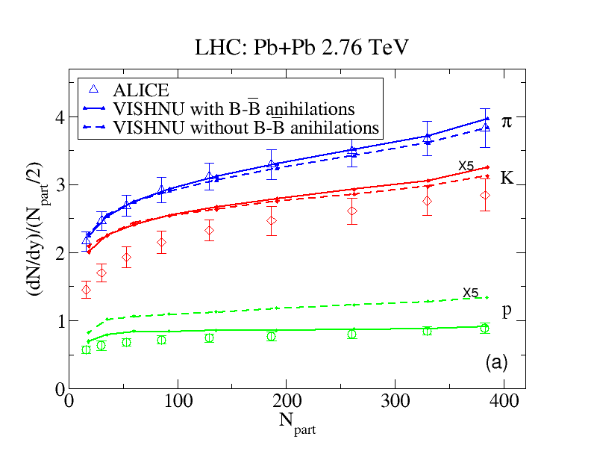
dN/dy for identified hadrons (RHIC & LHC)
RHIC : 200 A GeV Au+Au
LHC : 2.76 A TeV Pb+Pb
-VISHNU nicely describes the multiplicity for pions, kaons & protons
-B-Bbar annihilations plays an important role for a nice fit of the proton data
VISHNU : Tch= 165MeV

Slide 22
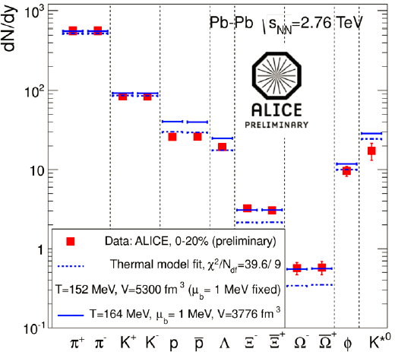
dN/dy for identified hadrons (RHIC & LHC)
LHC : 2.76 A TeV Pb+Pb
-VISHNU nicely describes the multiplicity for pions, kaons & protons
-B-Bbar annihilations plays an important role for a nice fit of the proton data
Statistical Model : Tch~ 150 MeV ?
(no B-Bbar annihilations!)
VISHNU : Tch= 165MeV

Slide 23
Elliptic flow for
multi-strange hadrons

Slide 24
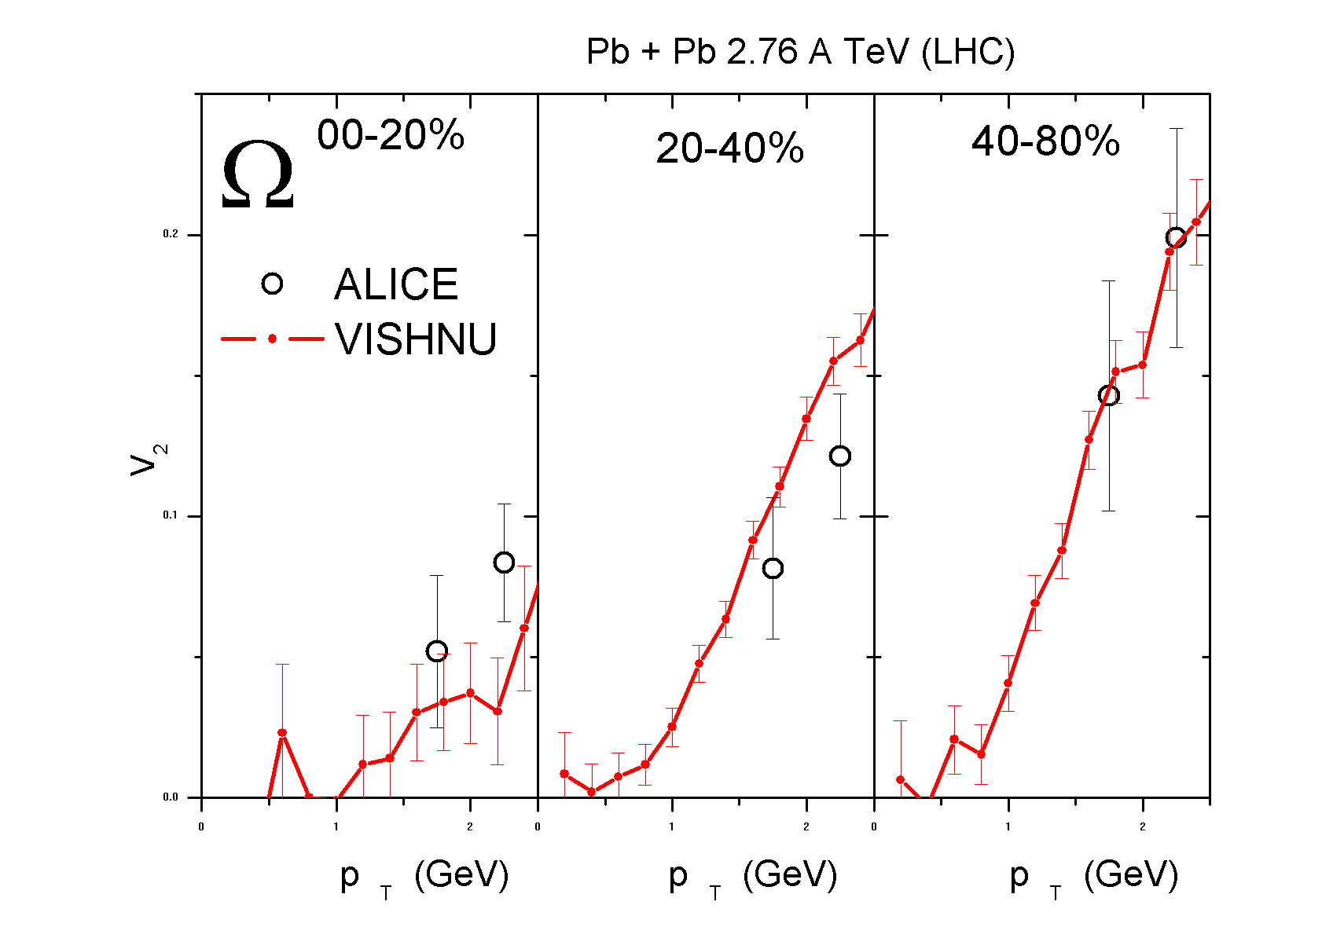
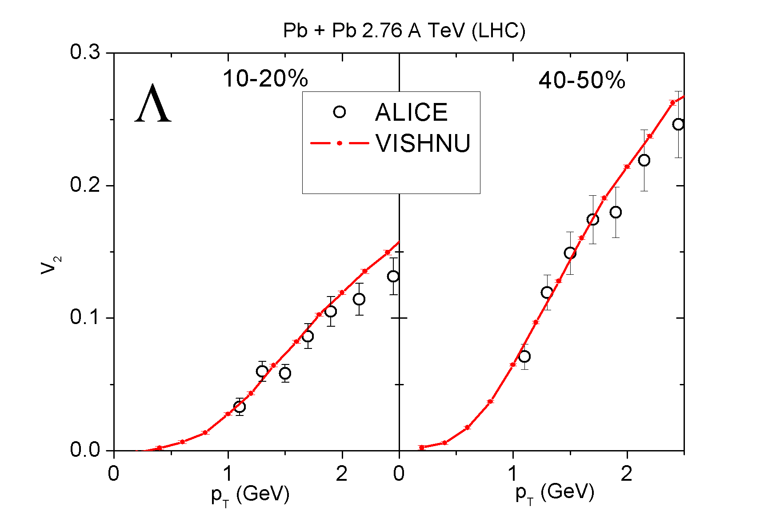
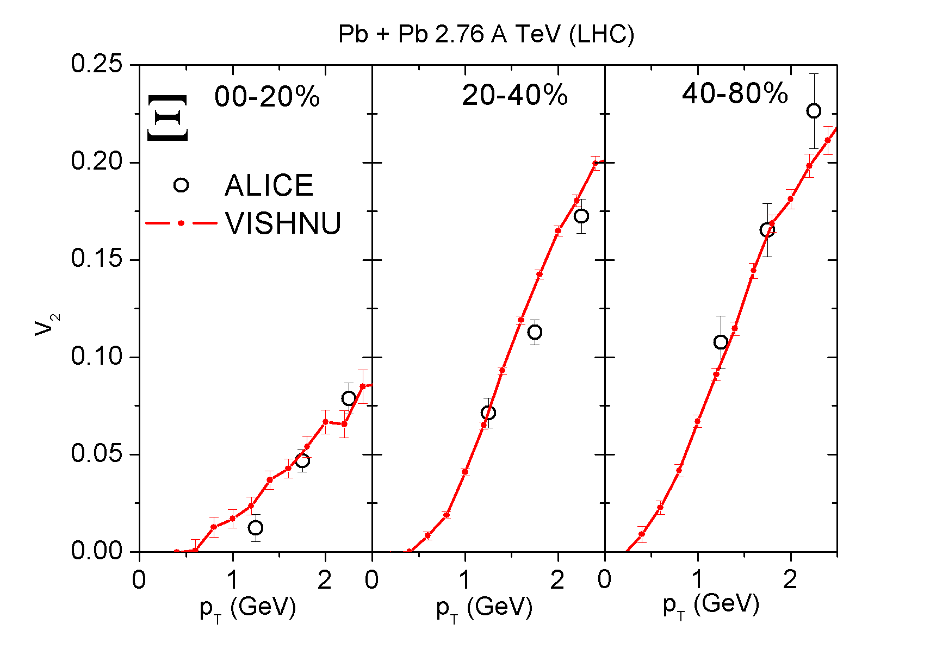
v2 for multi-strange hadrons (LHC)
Preliminary
2.76 A TeV Pb +Pb collisions
-a nice description for the elliptic flow for Lambda, Xi and Omega up to 2.5 GeV !

Slide 25
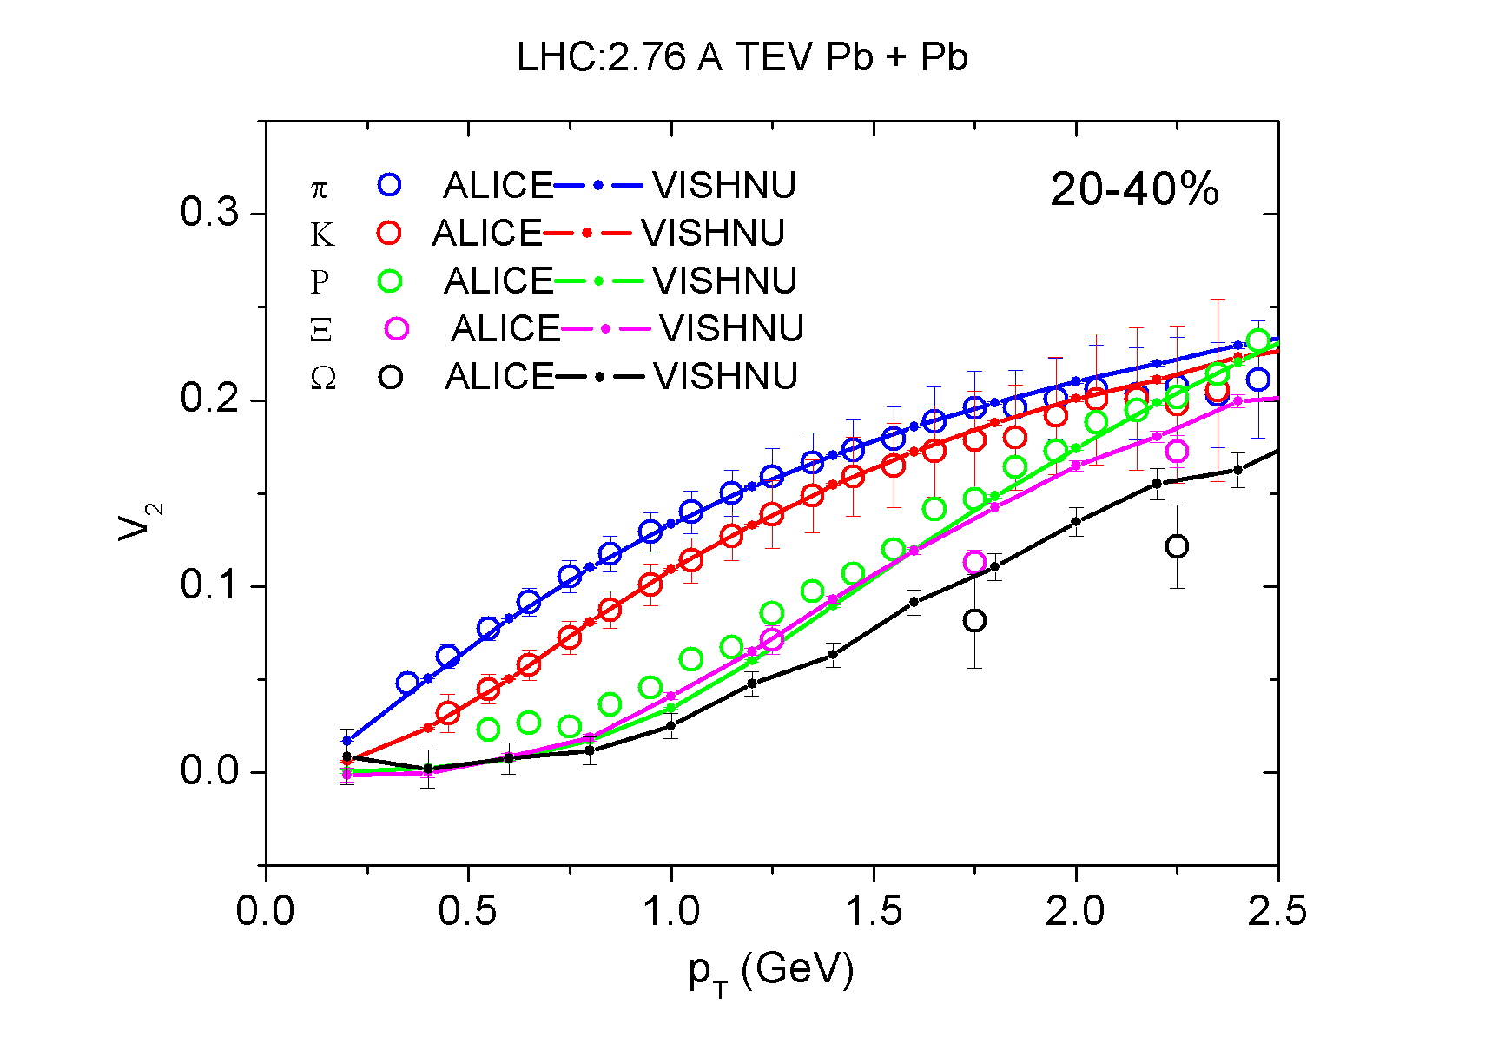
Mass ordering of elliptic flow (LHC)
LHC : 2.76 A TeV Pb+Pb
Preliminary
-Roughly reproduce the mass-ordering!

Slide 26
Do these multi-strange hadrons
decouple from the system near Tc ?

Slide 27
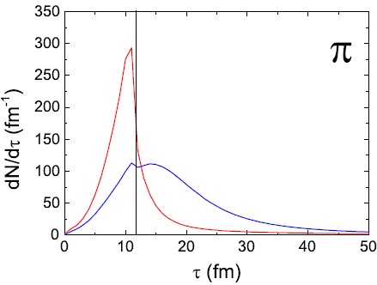
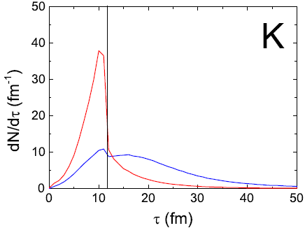
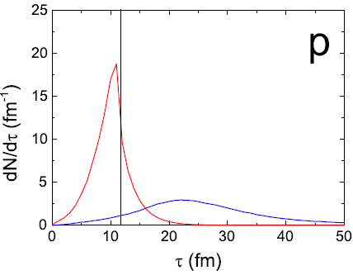
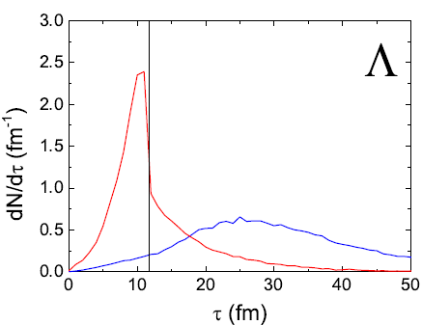
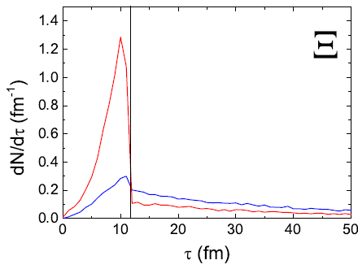
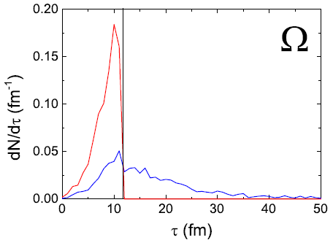
UrQMD/decay freeze-out time distributions
Preliminary
Hydro +decay
UrQMD
-These multi-strange hadrons are NOTthat weakly coupled with the medium!

Slide 28
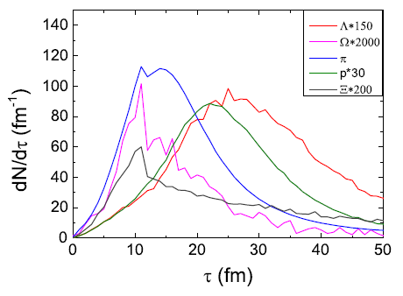
UrQMD freezeout time distributions
Preliminary
Omega
pions
proton
Lambda
Xi
-Lamba freeze-out even later than pion and protons !
-earlier freeze-out for Xi and Omega!

Slide 29
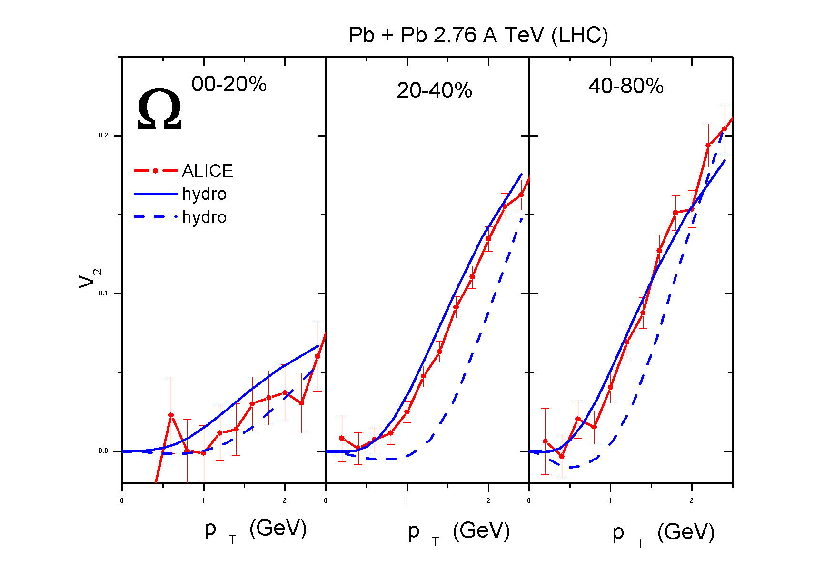
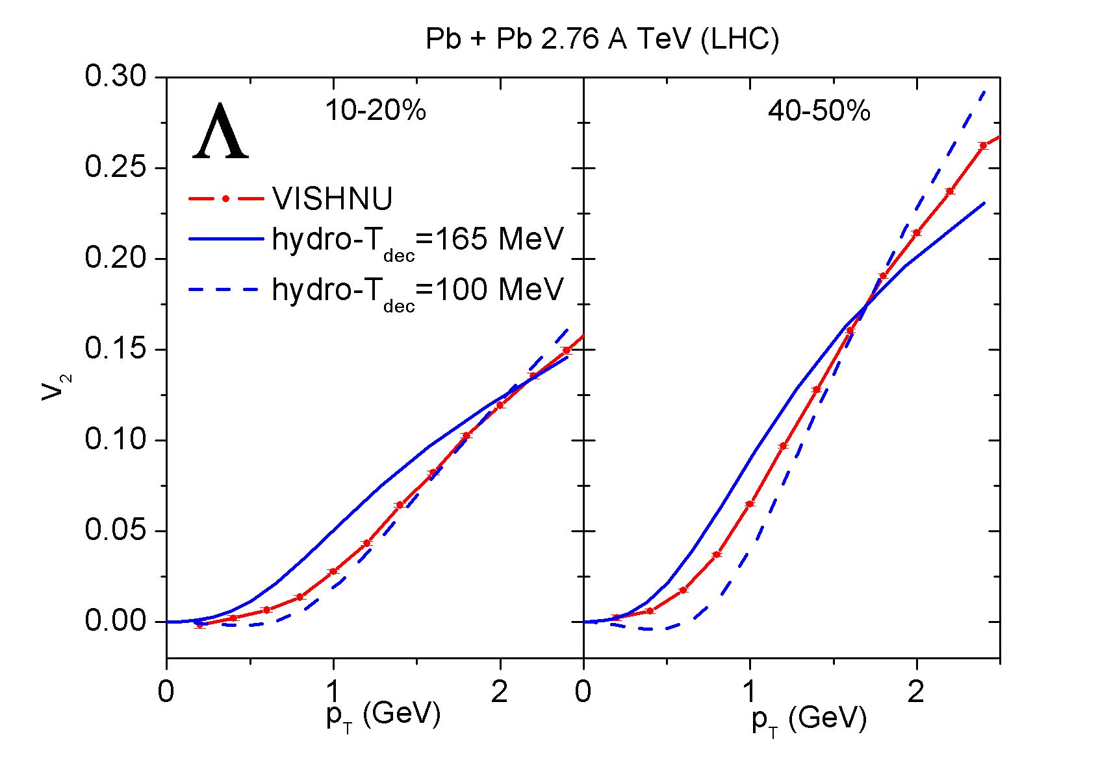
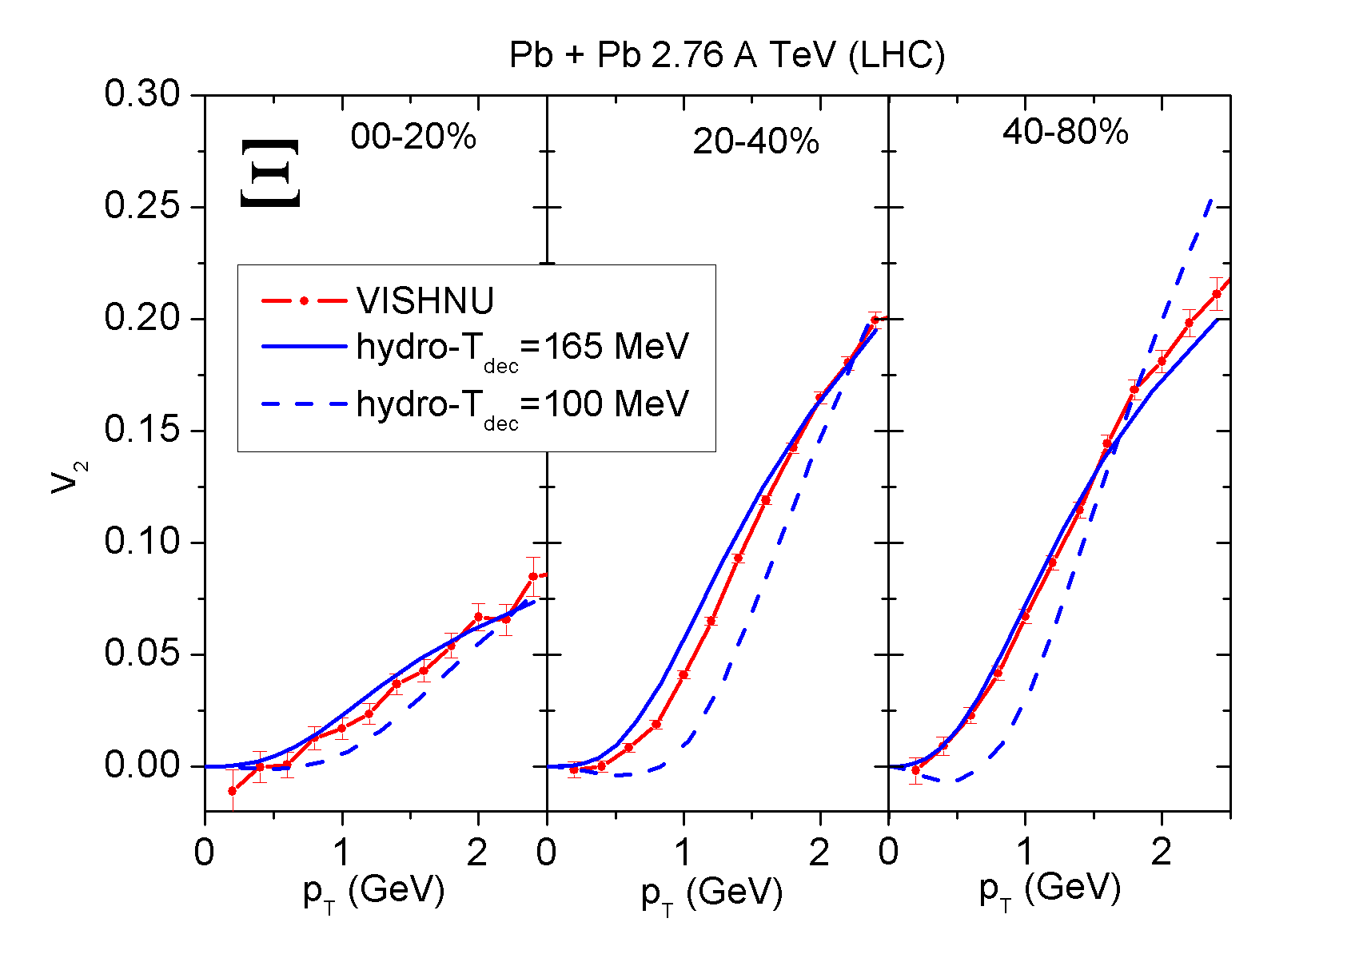
VISHNU vs Hydro with Tdec =165 & 100 MeV
Preliminary
-freeze-out temperature for Lambda is much below Tc!
-freeze-out temperatures for Omega and xi are closer to Tc!
-need more studies for firm conclusions

Slide 30
phi-meson

Slide 31
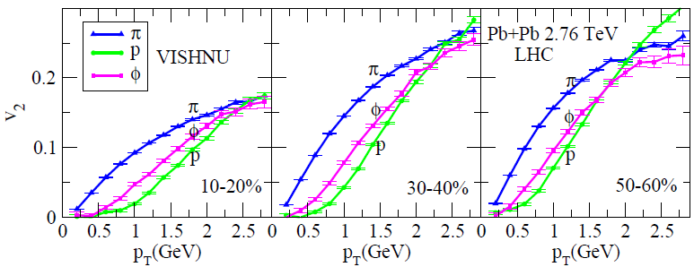
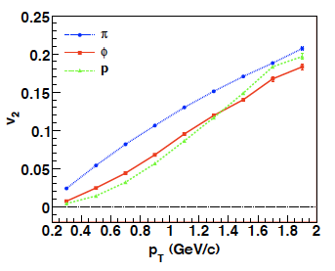
Elliptic flow for phi at the LHC
Preliminary
200A GeV
Au+Au
-Hadron cascade: small cross sections for phi
-mass ordering between phi and proton are independent of collision energies, centralities & theoretical details
T. Hirano
3+1-d ideal hydro+JAM

Slide 32
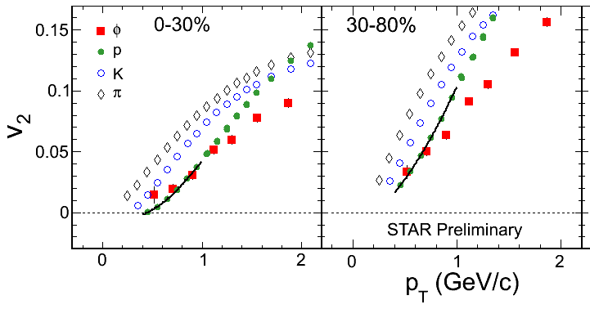
Elliptic flow for phi at the LHC
200A GeV
Au+Au
200A GeV
Au+Au
T. Hirano
3+1-d ideal hydro+JAM

Slide 33
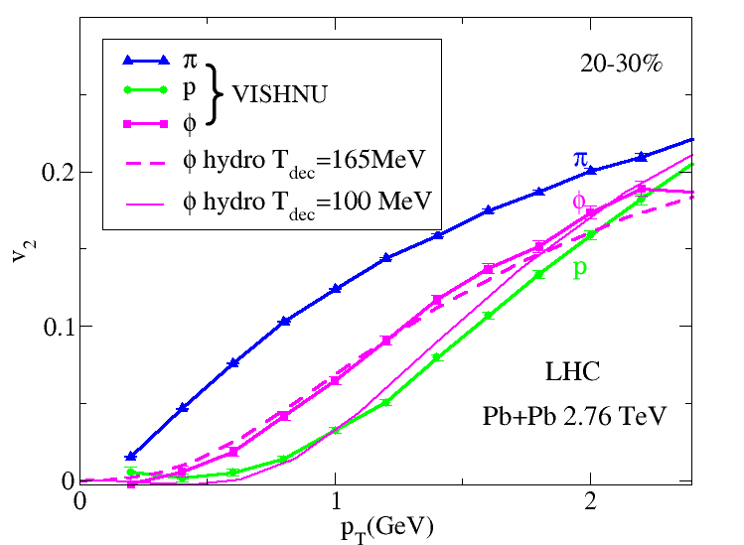
phi V2 in strong & weakly coupling limit
-hydro + Tdec =165 MeV
weakly coupling limit
-hydro + Tdec =100 MeV
strong coupling limit
VISHNU:
small cross sections for phi
Preliminary
Neither the strongly nor the weakly coupling limit nor the cases in between (VISHNU) could explain the mass-ordering between proton & phi shown in experiment
phi-meson puzzle !

Slide 34
Summary

Slide 35
QGP viscosity at RHIC and the LHC
Extraction from elliptic flow data using VISHNU indicates:
(MC-Glauber; MC-KLN)
Approximately similar averaged QGP viscosity at RHIC and LHC energies
Recent developments on initialization models:
color charge fluctuations; multiplicity fluctuations; initial flow fluctuations … …
to implement e-b-e VISHNU to further study: triangular flow & higher
order flow harmonics, higher-order event plane correlations e-b-e vn … ...
will help us to constrain initialization models, tightening the limit on
Spectra & V2 for identified hadrons (& multi-strange hadrons)
- A nice description of the pT spectra and v2 for pions, kaons and protons
- VISHNU with B-Bbar annihilations prefer Tch=165 MeV
A nice description for v2 (pT) for multi-strangeness at the LHC for various of centrality.
- Fails to describe the phi-v2 (RHIC) within the strongly, weakly coupling limit or VISHNU

Slide 36
Thank you

Slide 37
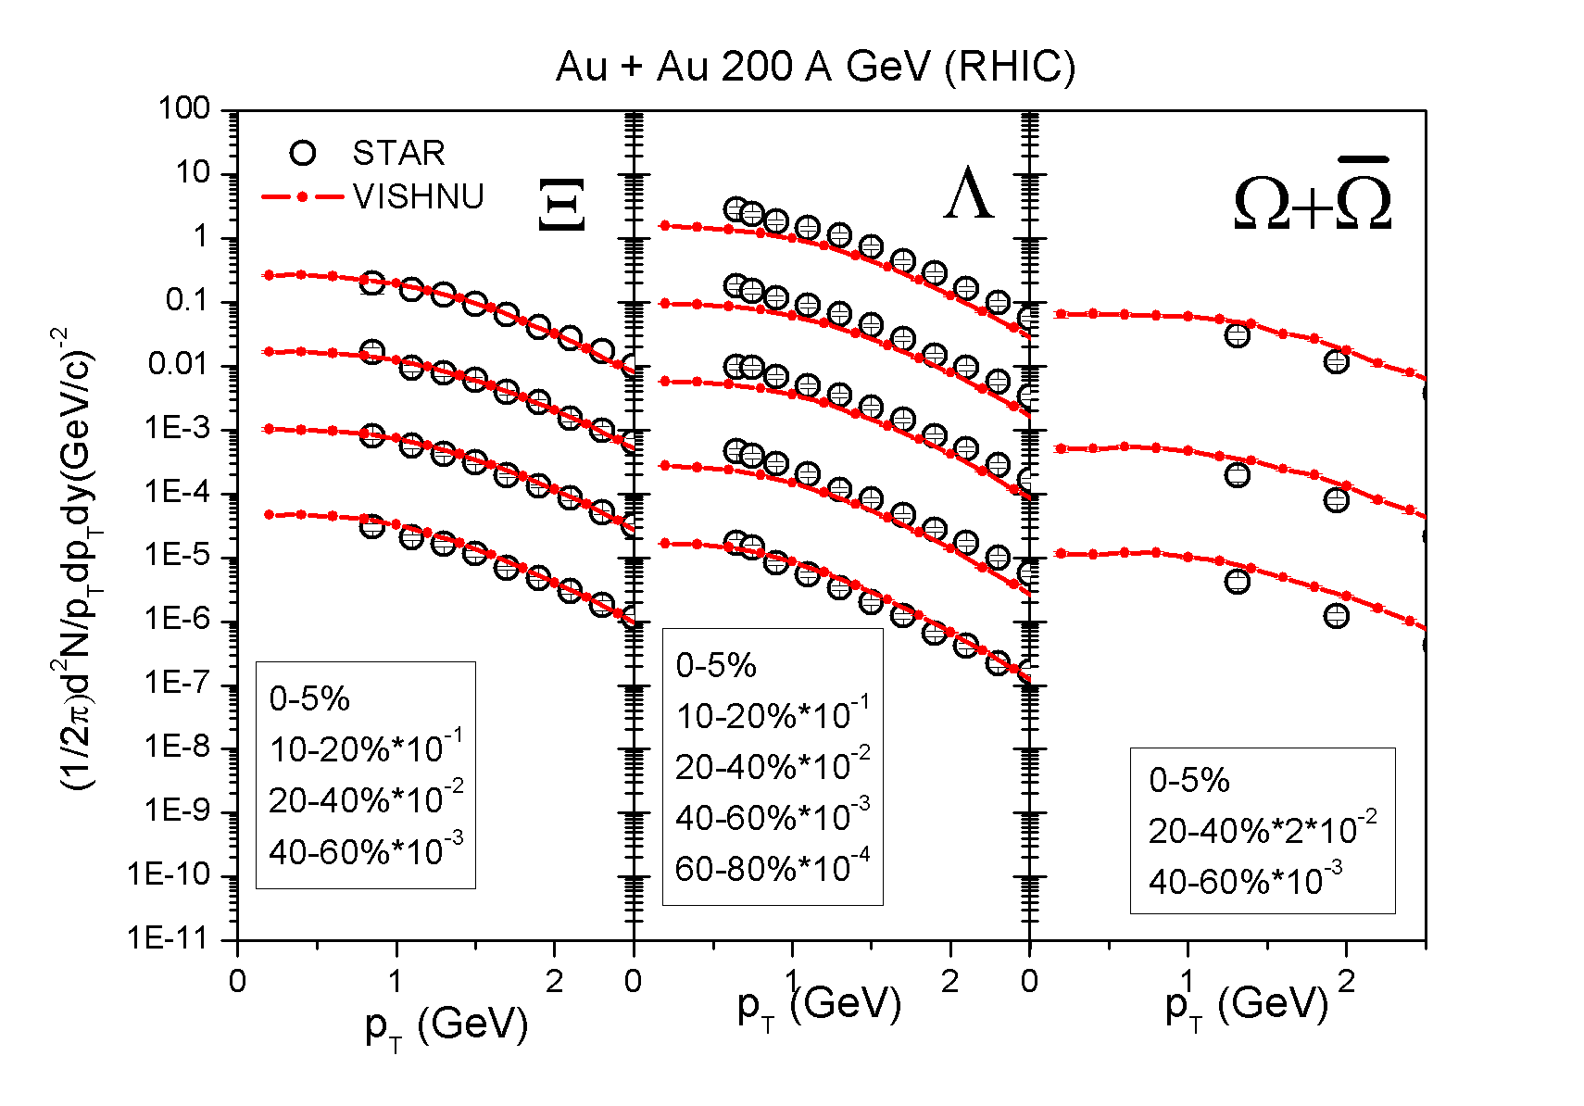
Spectra for multi-strange hadrons (RHIC)
Preliminary

Slide 38
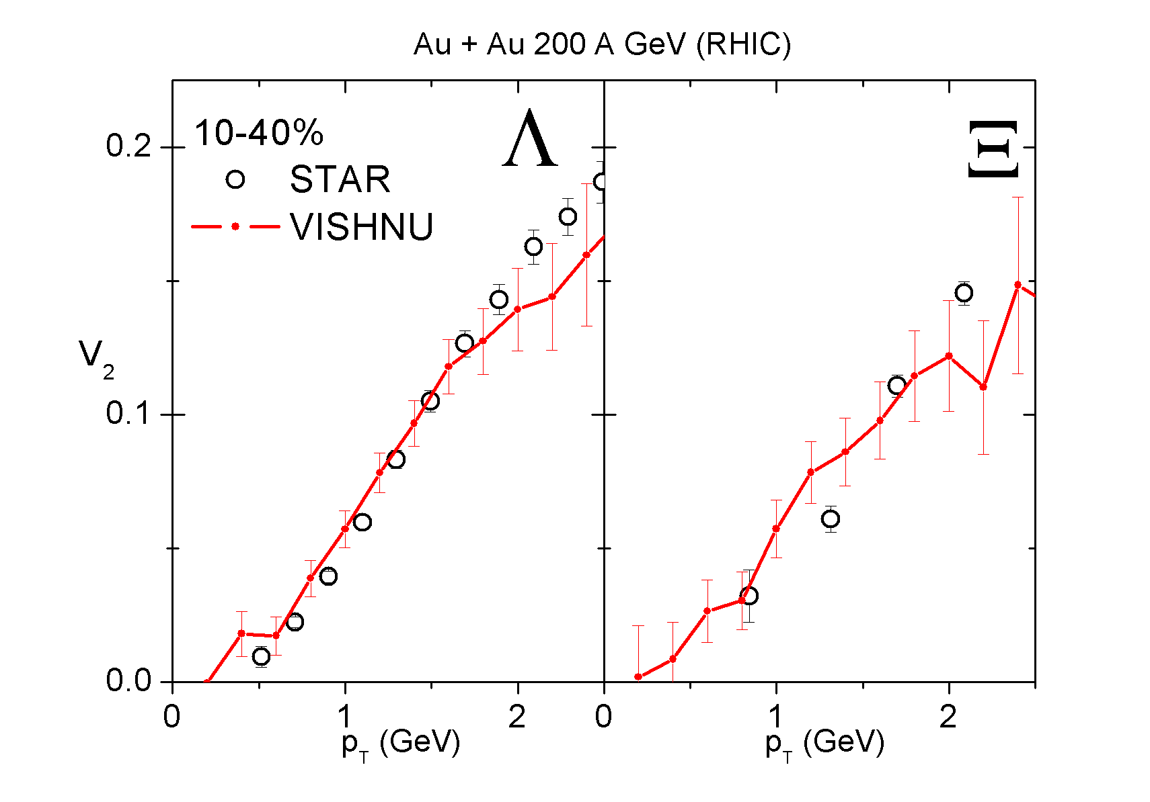
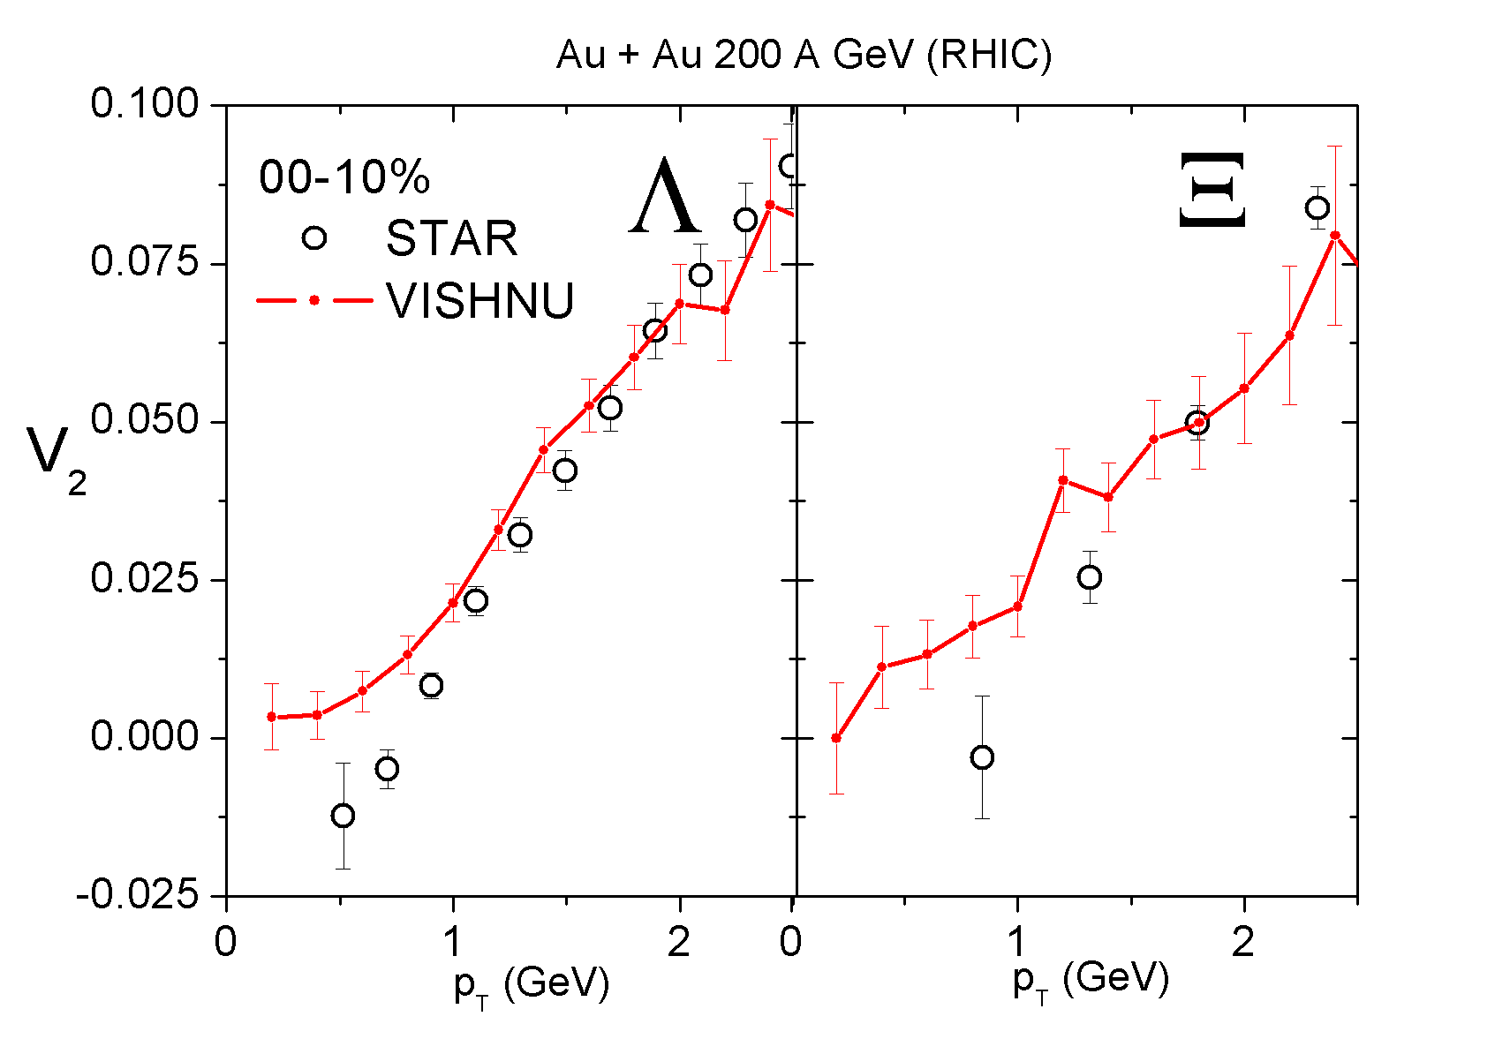
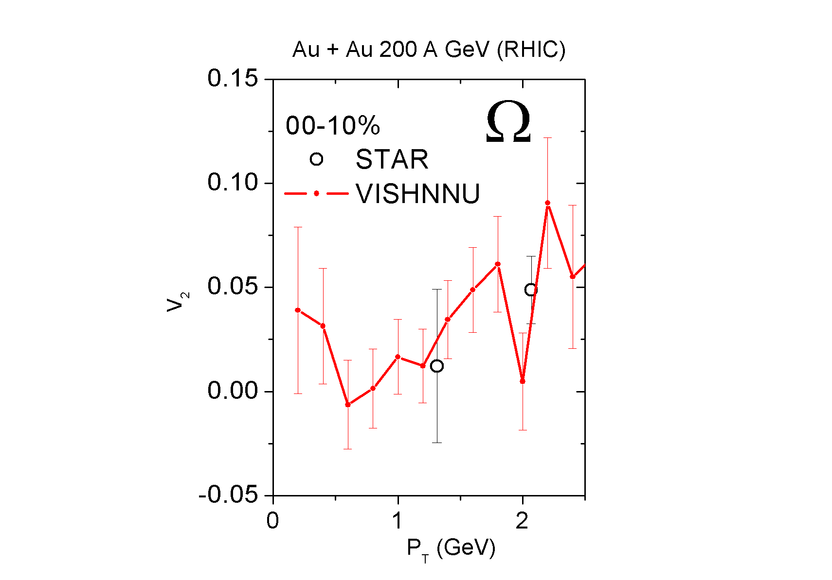
v2 for multi-strange hadrons (RHIC)
10-40% :nice description
of the experimental data
High statistic runs are
needed in the near future !
0-10% : non-flow & fluctuation effects
Preliminary

Slide 39
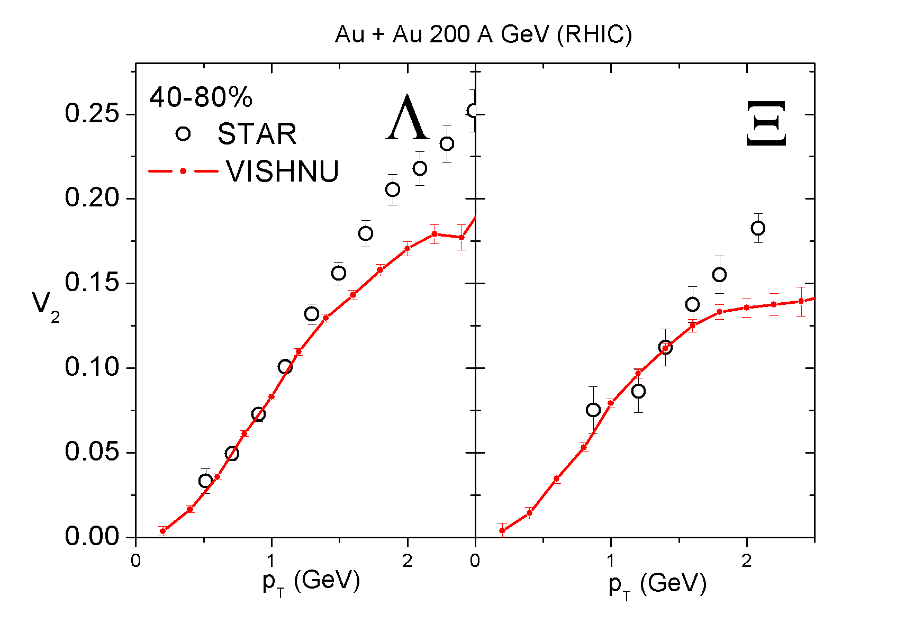
v2 for multi-strange hadrons (RHIC)
10-40% :nice description
of the experimental data
High statistic runs are
needed in the near future !
40-80%: non-flow & fluctuation effects
Preliminary

Slide 40
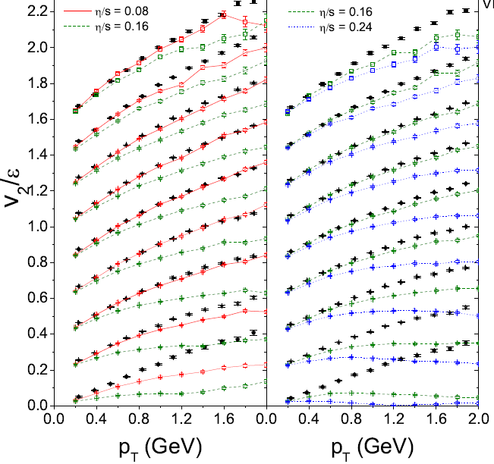
v2 for multi-strange hadrons (RHIC)
v2 {EP} for all charged Hadorns
Non –flow & fluctuations
High statistic runs are
needed in the near future !
0-5%
5-10%
40-80% non-flow & fluctuation effects
10-20%
Preliminary
20-30%
30-40%
40-50%
50-60%
60-70%
70-80%

Slide 41
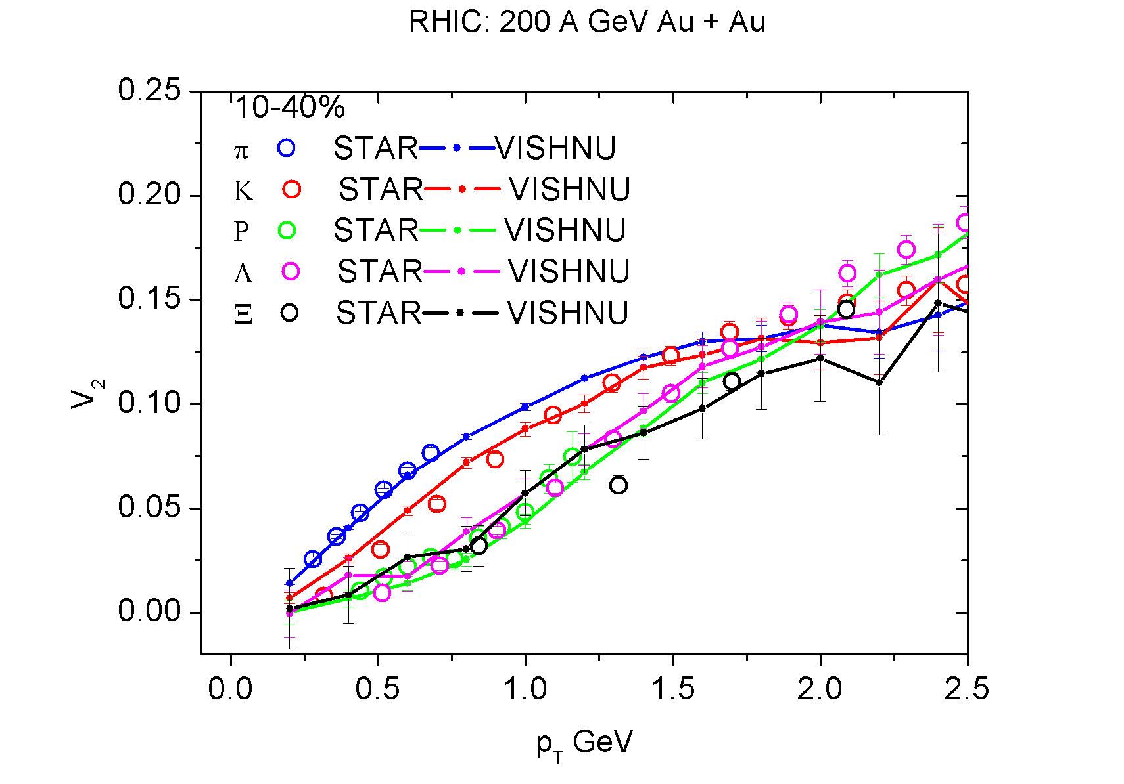
Mass ordering of elliptic flow (RHIC)
Preliminary
High statistic runs are needed in the near future !

Slide 42
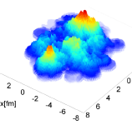
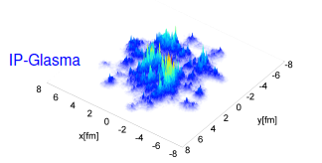
Initialization Models
-fluctuations of nucleon positions:
MC-Glauber:
T. Hirano & Y. Nara, Phys. Rev. C 79 064904 (2009)
(used in the VISHNU hybrid model)
MC-KLN:
-fluctuations of color charges (in the framework of CGC):
IP-Glasma: B. Schenke et al., arXiv:1202.6646; 1206.6805 [nucl-th]
C. Gale, et al., arXiv: 1210.5144, 1209.5330 [nucl-th].
Correlated Fluctuation: B. Muller & A. Schafer, arXiv:1111.3347 [hep-ph]
S. Moreland, Z. Qiu and U. Heinz, arXiv:1210.5508
-fluctuations of local gluon numbers (in the famework of MC-KLN):
Multiplicity fluctuations: A. Dumitru and Y. Nara, Phys. Rev. C 85, (2012) 034907
A. Dumitru, arXiv:1210.7864 [hep-ph].

Slide 43
Pre-equilibrium dynamics
Free Streaming limit: G. Qin, et. al., Phys. Rev. C82 064903 (2010); OSU, on-going work
Hydro limit: OSU group, on-going work
Pre-equilibrium dynamics smoothes out fluctuations, reducing , but building radial flow
-early flow & fluctuations from dynamical models:
URQMD initialization: H.Petersen & M. Bleicher, Phys. Rev. C81, 044906,2010
AMPT initialization: L. Pang, Q.Wang & X.N.Wang, arXiv:1205.5019 [nucl-th]
L. Pang, Q.Wang & X.N.Wang, arXiv: 1211.1579[ nucl-th]
EPOS/NEXUS initialization: K. Werner et al., Phys. Rev. C83:044915,2011;
H. J. Drescher et, al., Phys.Rev. C65 , 054902 (2002).
IP-Glasma: B. Schenke, et.al, arXiv:1202.6646; 1206.6805 [nucl-th]
C. Gale, et al., arXiv:1210.5144, 1209.5330 [nucl-th].
Except IP-Glamsa, most pre-equilibrium dynamics was studied within the ideal hydro framework. Their quantitative influences on are still unknown.

Slide 44
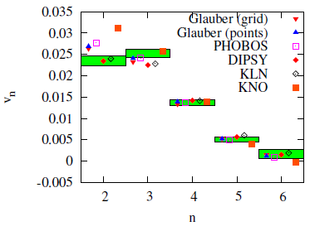
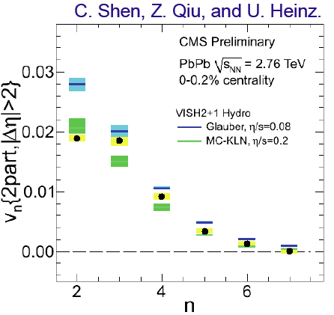
Extracting from Vn in ultra-central collisions
Luzum & Ollitrault, arXiv: 1210.8422
Viscous Hydro
-In most central collisions, fluctuation effects are dominant (Geometry effects are suppressed)
-can not simultaneously fit V2 and V3 with single (MC-Glauber & MC-KLN)

Slide 45
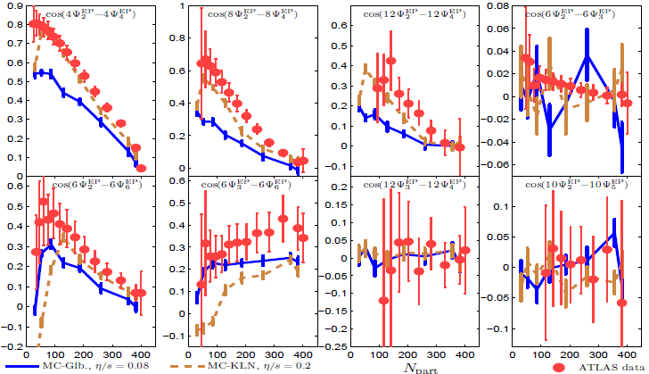
Higher Order Event Plane Correlations
Qiu & Heinz, arXiv:1208.1200[nucl-th]
EXP. data:[ATLAS Collaboration], CERN preprint ATLAS-CONF-2012-049
Pure e-b-e viscous hydro simulations :
qualitatively reproduce the measured event plane correlations

Slide 46



Vn & E-b-E Vn distributions
C. Gale et al., arXiv:1209.4330[nucl-th]

