Slide 1
STRANGENESS IN QUARK MATTER 2013
Welcome to Birmingham

Slide 2
Introduction
Practical information about the conference
Welcome by the Vice-Chancellor of the University of Birmingham, Professor David Eastwood

Slide 3
Conference Venue
Plenary talks in this room
As from tomorrow, parallel talks will also take place in rooms 125 and 127 (in the corridor)
Coffee breaks – in corridor
The Mason Lounge on the ground floor of this building is available for those who wish to have discussions
LUNCH – across the University Square in Staff House (Noble Room on second floor)

Slide 4
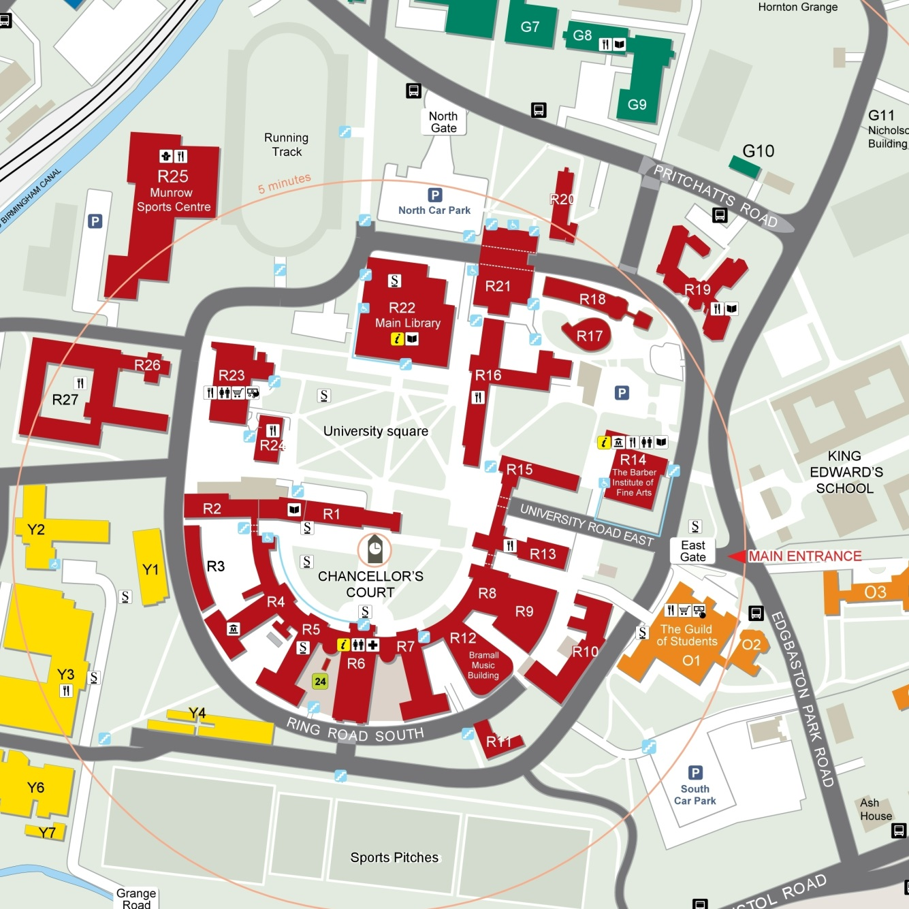
Birmingham Campus Locations
Physics Bridge
Study Room
Welcome (Sunday)
Poster Session (Tuesday)
Outside Barber Institute
Excursion Coaches
(Wednesday)
Faculty of Arts
Talks (Daily)
Staff House
(Noble Room
Second Floor)
Lunches

Slide 5
Facilities on Campus
Banks Lloyds and Barclays are near Staff House
Coffee
  Starbucks in Muirhead Tower (on right on leaving Arts Faculty
  Costa Coffee in Bramall Building in Chancellor’s Court (on left on leaving Arts Faculty on semicircle)
Shops in University Centre behind Staff House, and in Student Union

Slide 6
Uploading Talks
Talks should be uploaded onto the Indico site as soon as possible
  You should have access rights to upload your own talks
  If you have problems inform the organizers in good time.
Talks will be given using the computers provided in the lecture rooms
  Acceptable formats are Powerpoint or Adobe Acrobat

Slide 7
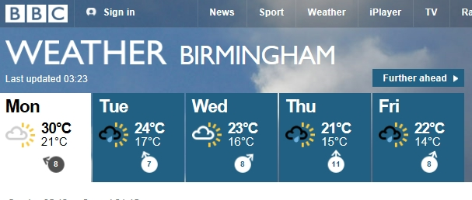
Excursion
Coaches leave from outside Barber Institute at 13:00
To gain time, on Wednesday a packed lunch is provided. Aim is to be at your destinations by 14:00
Those going on walk on Malvern Hills should bring good walking shoes
Watch the weather!

Slide 8
Conference Dinner
The Conference Dinner is in the Birmingham Botanical Gardens, Westbourne Road, Edgbaston on Thursday July 25th
Coaches will pick up delegates from the city centre at 19:30
There will be a return coach service at the end of the dinner.

Slide 9
Conference Proceedings
Proceedings will be published in the Institute of Physics Conference Series.
A link will be added to the website giving instructions for authors and deadlines
A representative from IoP Publishing will be here later in the week (Thursday)

Slide 10
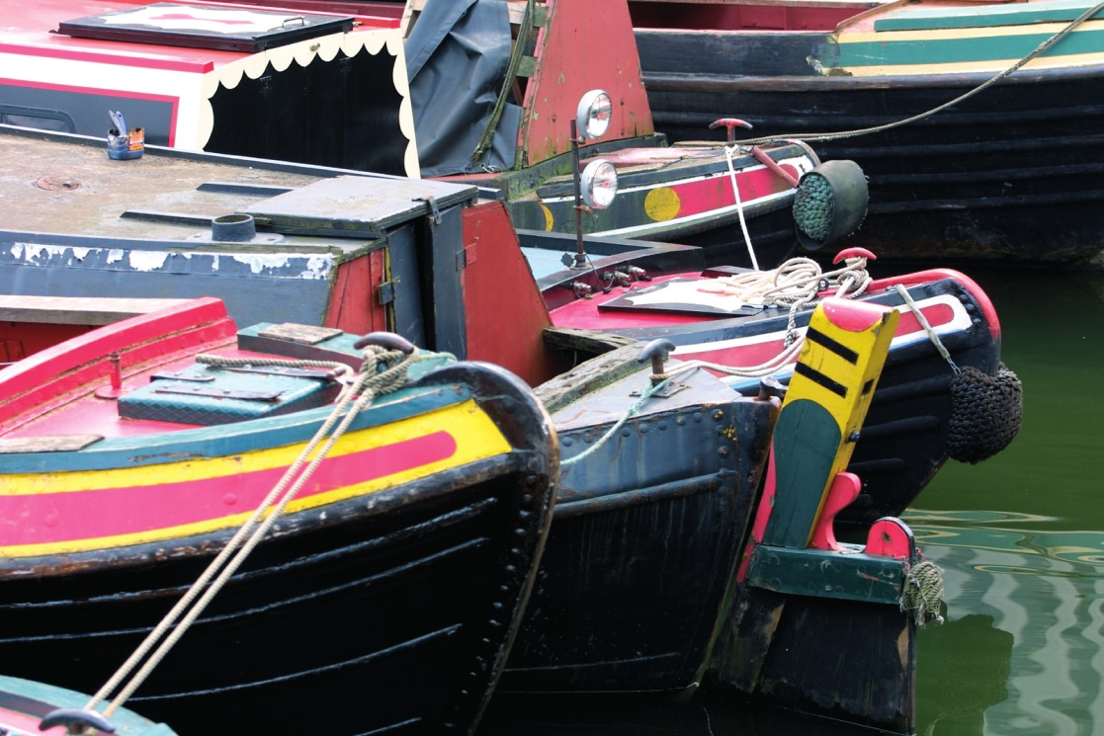

Enjoy the Conference
We are grateful to all the participants for providing us with excellent material for a stimulating physics conference
We hope you will enjoy your visit and see something of Birmingham while you are here.

