Slide 1
Project Status Report
CERN-RRB-2012-087
Ian Bird
Computing Resource Review Board
30th October 2012

Slide 2
Outline
WLCG Collaboration & MoU status
WLCG status and usage
Metrics reporting
Resource pledges
Funding & expenditure for WLCG at CERN
Planning & evolution

Slide 3
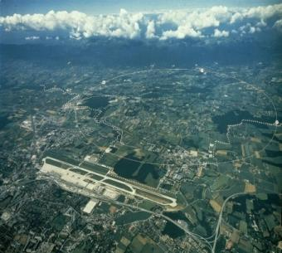
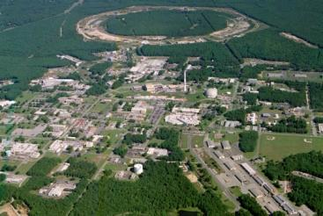
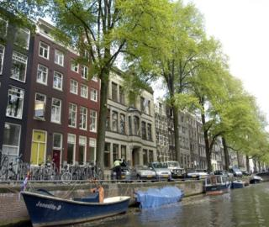
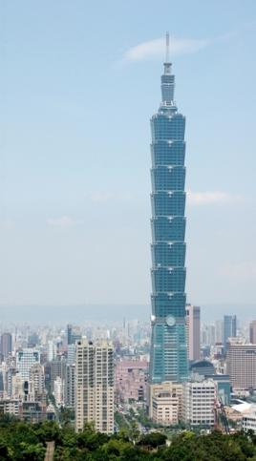

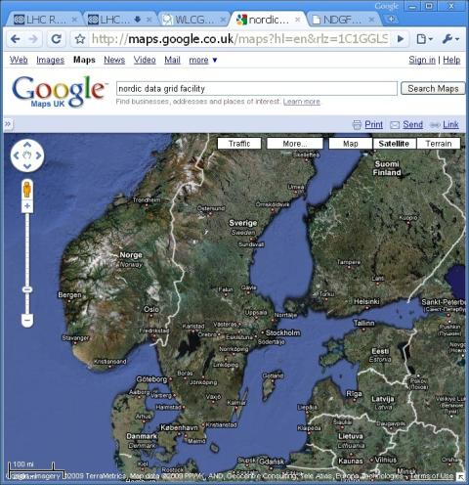
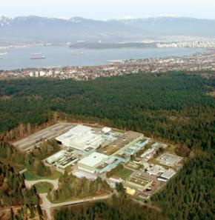
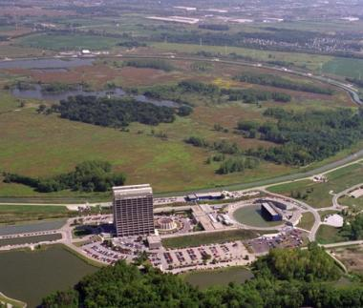
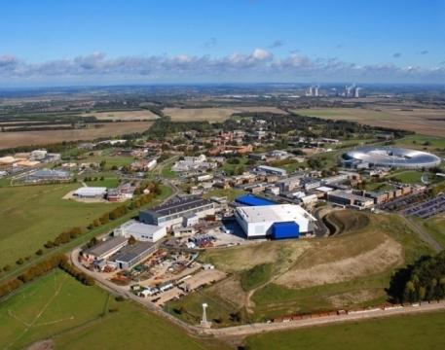
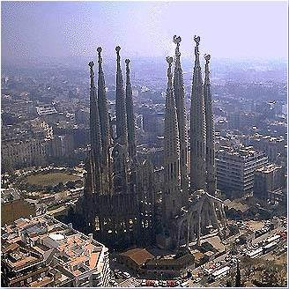
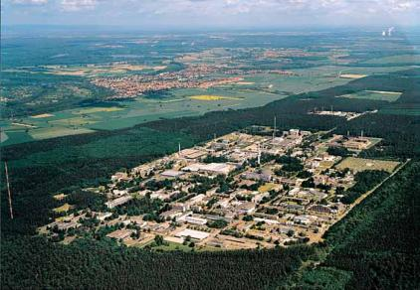

US-BNL
CERN
Amsterdam/NIKHEF-SARA
Bologna/CNAF
WLCG Collaboration Status
Tier 0; 12 Tier 1s; 68 Tier 2 federations
Ca-
TRIUMF
Taipei/ASGC
Today we have 54 MoU signatories, representing 36 countries:
  Australia, Austria, Belgium, Brazil, Canada, China, Czech Rep, Denmark, Estonia, Finland, France, Germany, Greece, Hungary, Italy, India, Israel, Japan, Rep. Korea, Netherlands, Norway, Pakistan, Poland, Portugal, Romania, Russia, (Slovakia), Slovenia, Spain, Sweden, Switzerland, Taipei, Turkey, UK, Ukraine, USA.
NDGF
US-FNAL
Barcelona/PIC
UK-RAL
De-FZK
Lyon/CCIN2P3

Slide 4
WLCG MoU Status
Additional signatures since last RRB meeting
  Rep. of Korea:
    KISTI GSDC, signed as Associate Tier 1: 1 June 2012
  Slovakia:
    Tier 2, currently being signed
Reminder:
  All Federations, sites, WLCG Collaboration Representative names and Funding Agencies are documented in MoU annex 1 and annex 2
  Please check and ensure information is up to date
  Signal any corrections to lcg.office@cern.ch

Slide 5
Russia – 2nd Associate Tier 1
Proposals presented to the WLCG Overview Board on 28 Sep 2012
  Accepted by the members
Scale: ~10% of the global Tier 1 requirement of each experiment
Timing:
  resources in place end Nov 2013
  Run for 1 year as full prototype
  Production ready for end of LS1

Slide 6
WLCG Status report

Slide 7
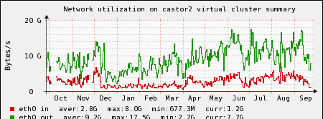
Castor data written 2010-12
2010-2012 Data written:
Total ~22 PB in 2012 (LHC data)
Close to 3.5 PB/month now
Expect close to 30 PB in 2012
(15, 23, in 2010,11)
Data rates in Castor increased
3-4 GB/s input
~15 GB/s output

Slide 8
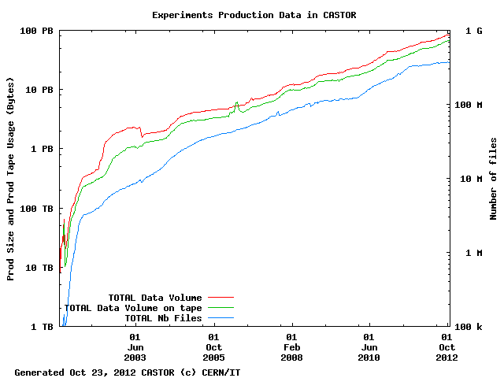
Close to 100 PB archive
Physics data: 94.3 PB
Increases at 1 PB/week with LHC on

Slide 9
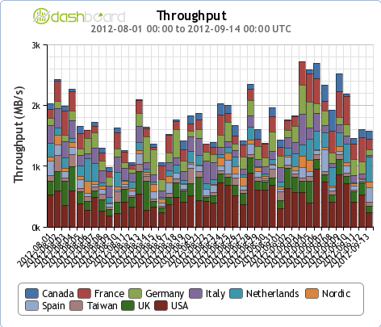
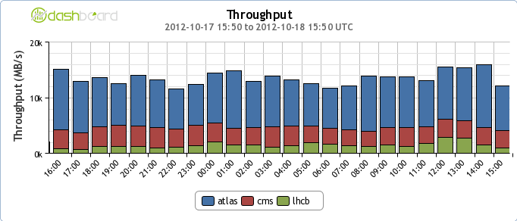
Data in 2012
CERN export: 2 GB/s
Aug – Sep 2012
Global transfers > 15 GB/s
Recent days (Oct)

Slide 10
CPU workloads
2 M jobs/day
10⁹ HS06-hours/month

Slide 11
Metrics Reporting

Slide 12
CERN & Tier 1 Accounting

Slide 13
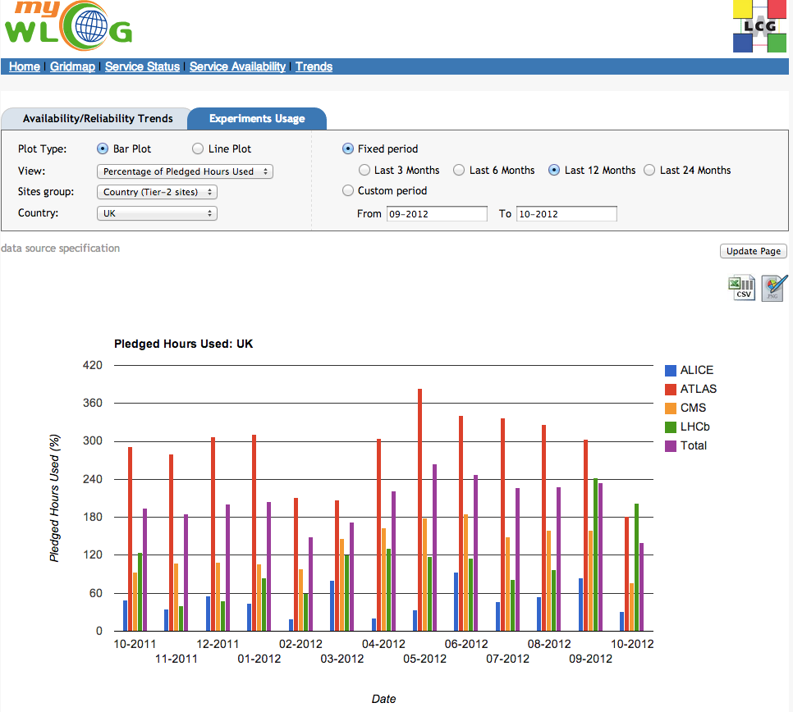
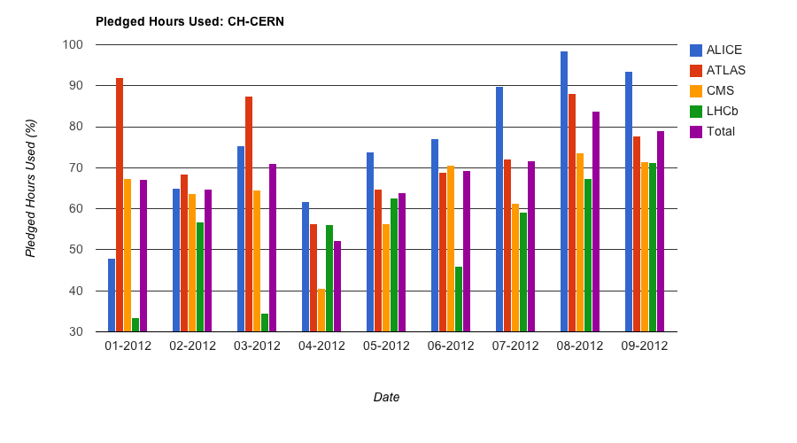
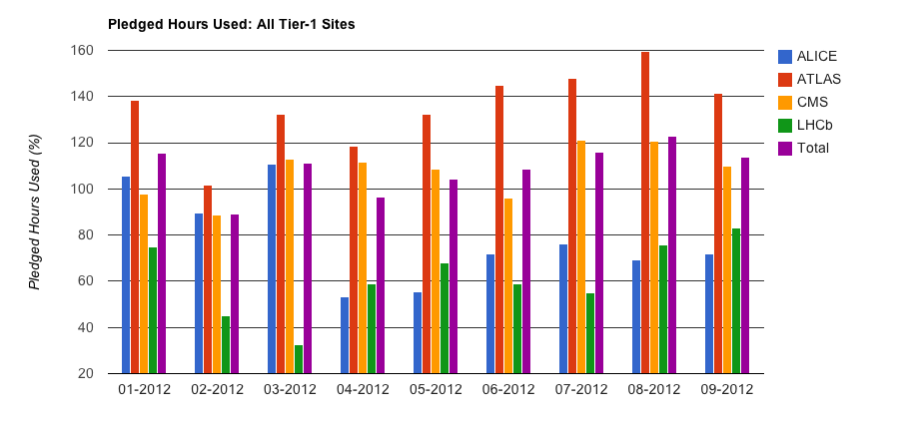
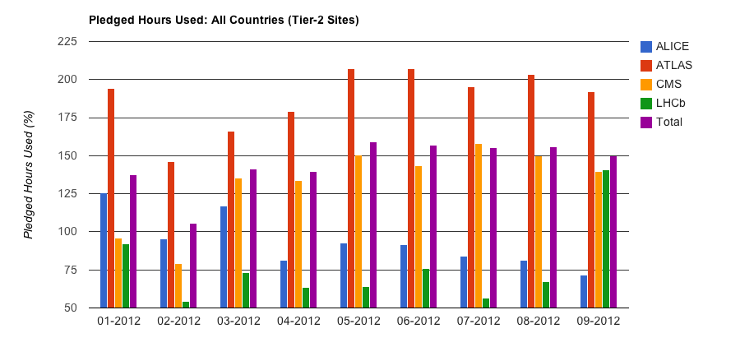
Comparison: use/pledge
Tier 0
Tier 1
Comparison between use per experiment and pledges
Tier 2
These comparisons now available in the MyWLCG web portal, linked to the WLCG web.
For Tier 2, can generate comparisons by country

Slide 14
WLCG Operations
Operations over the summer quite smooth
Long-lasting issue with LSF at CERN:
  Heavy use patterns, scale and complexity of CERN setup
    Some mitigations being put in place
    Long term is to review batch strategy – started

Slide 15
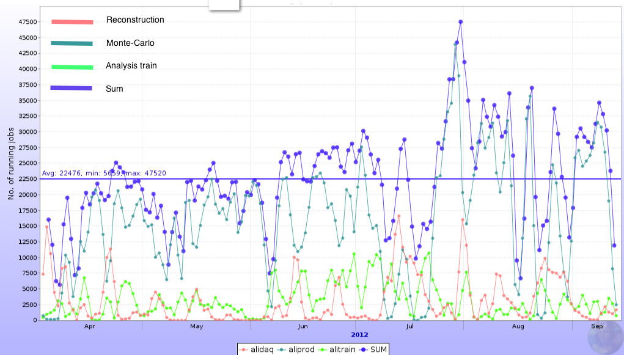
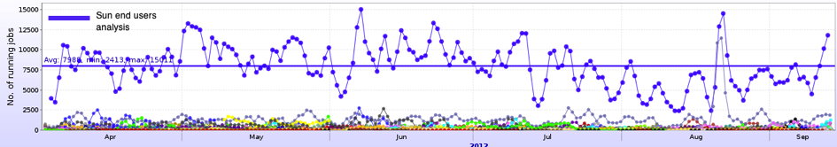
Some points to note
ALICE:
  Low efficiencies of CPU use has improved →
ATLAS:
  More CPU available than pledges: essential for the amount of MC required
  Extended run means disk will be a limitation until 2013 deployments
  Will reduce amount of data to tape (no ESD)
CMS:
  Frequent use of Tier 0 CPU above allocation – re-pack of parked data
  Use data popularity tools (as ATLAS) → better use of Tier 2 disk
  CMS reconstruction code x8 speed-up (40% less memory) since 2010 (other experiments have similar significant efforts)
LHCb:
  New “swimming” activity – very CPU intensive, but important for physics
  Have reduced no. disk copies to fit in disk pledges
  New DST format (includes RAW) – far more efficient stripping but means tape shortfall at Tier 1s (they have asked for help)
  Extended run (and p-Pb run) exacerbates this issue
Organized
activities
~80% of CPU
Chaotic user
analysis
~20% of CPU
Increase of CPU for analysis trains, proportional decrease of chaotic

Slide 16
Resource pledges

Slide 17
Extended run 2012
Has implications for resources in 2012
  ~20% more data than original plan
Additional resources unlikely?
  Tier 0 – no additional resources
  Unlikely at most Tier 1 and Tier 2 sites
    Except limited number of sites where early installations of 2013 pledges may be available

Slide 18
2013 + 2014 (LS1)
Extended 2012 run also has implications for 2013
Requests for 2013 have been revised to take this into account
2014 requests close to the 2013 revised requests
  some slight increases needed for analysis work and simulation
Full scale computing activities in LS1:
  Analysis…
  Full re-processings of complete 2010-12 data
  Simulations needed for 2015 at higher energy

Slide 19
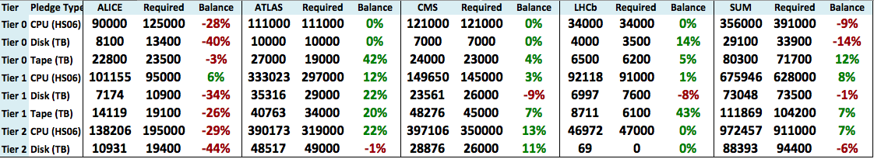
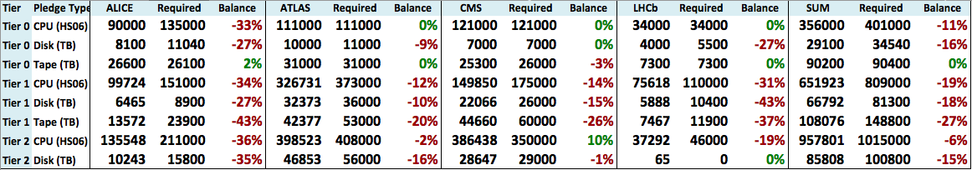
Balance of pledge/requirements 2013-14
2013: requirements as Approved by the RRB in April
  This does not reflect the recently updated requirements – REBUS will be updated following this meeting
This reflects the current state of the pledges: not complete for 2014
http://wlcg-rebus.cern.ch/apps/pledges/summary/

Slide 20
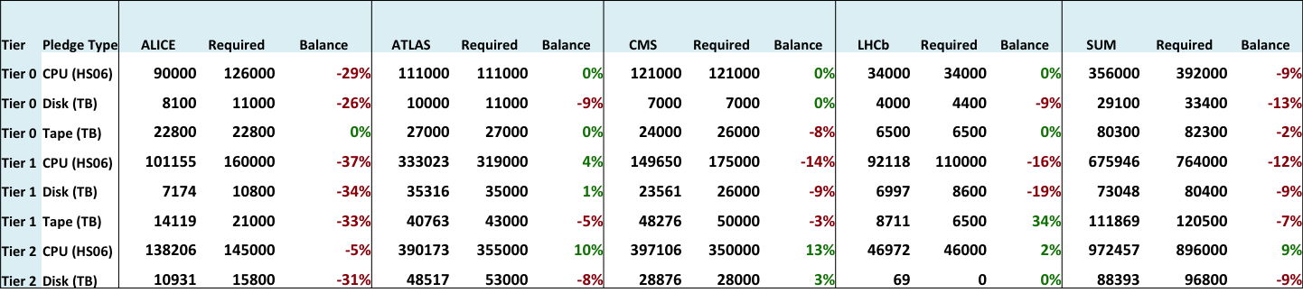
Pledge balance wrt updated request
This is the current situation for 2013
  Scrutinised values change the overall picture only slightly

Slide 21
First look at resource needs for 2015
We have made some first estimates of the likely requirements in 2015
Significant uncertainties in the assumptions at the moment:
  In particular, LHC running conditions and availability, implications for pile-up, etc
  Physics drivers to increase trigger rates in order to fully exploit the capabilities of LHC and detectors
    See LHCC report
Working assumption: resource levels in 2015 should match a continual growth model consistent with recent years
  In 2009-12 we have seen growth in resources of ~30% /year
Absolutely essential that we maintain funding for the Tier 1 and 2 centres at a good level

Slide 22
Funding & expenditure

Slide 23
Funding & expenditure for WLCG at CERN
Materials planning based on current LCG resource plan
  Currently understood accelerator schedule
  Provisional requirements evolve frequently – in particular “optimistic” assumption of needs in 2015 ff
  Large uncertainties on some anticipated costs
Personnel – plan kept up to date with APT planning tool used for cost estimates of current contracts, planned replacements, and on-going recruitment
Impact for 2013 & beyond:
  Personnel: balanced situation foreseen
  Materials: reasonably balanced given inherent uncertainties; rely on ability to carry-forward to manage delays (e.g. in CC consolidation, remote T0 costs)

Slide 24
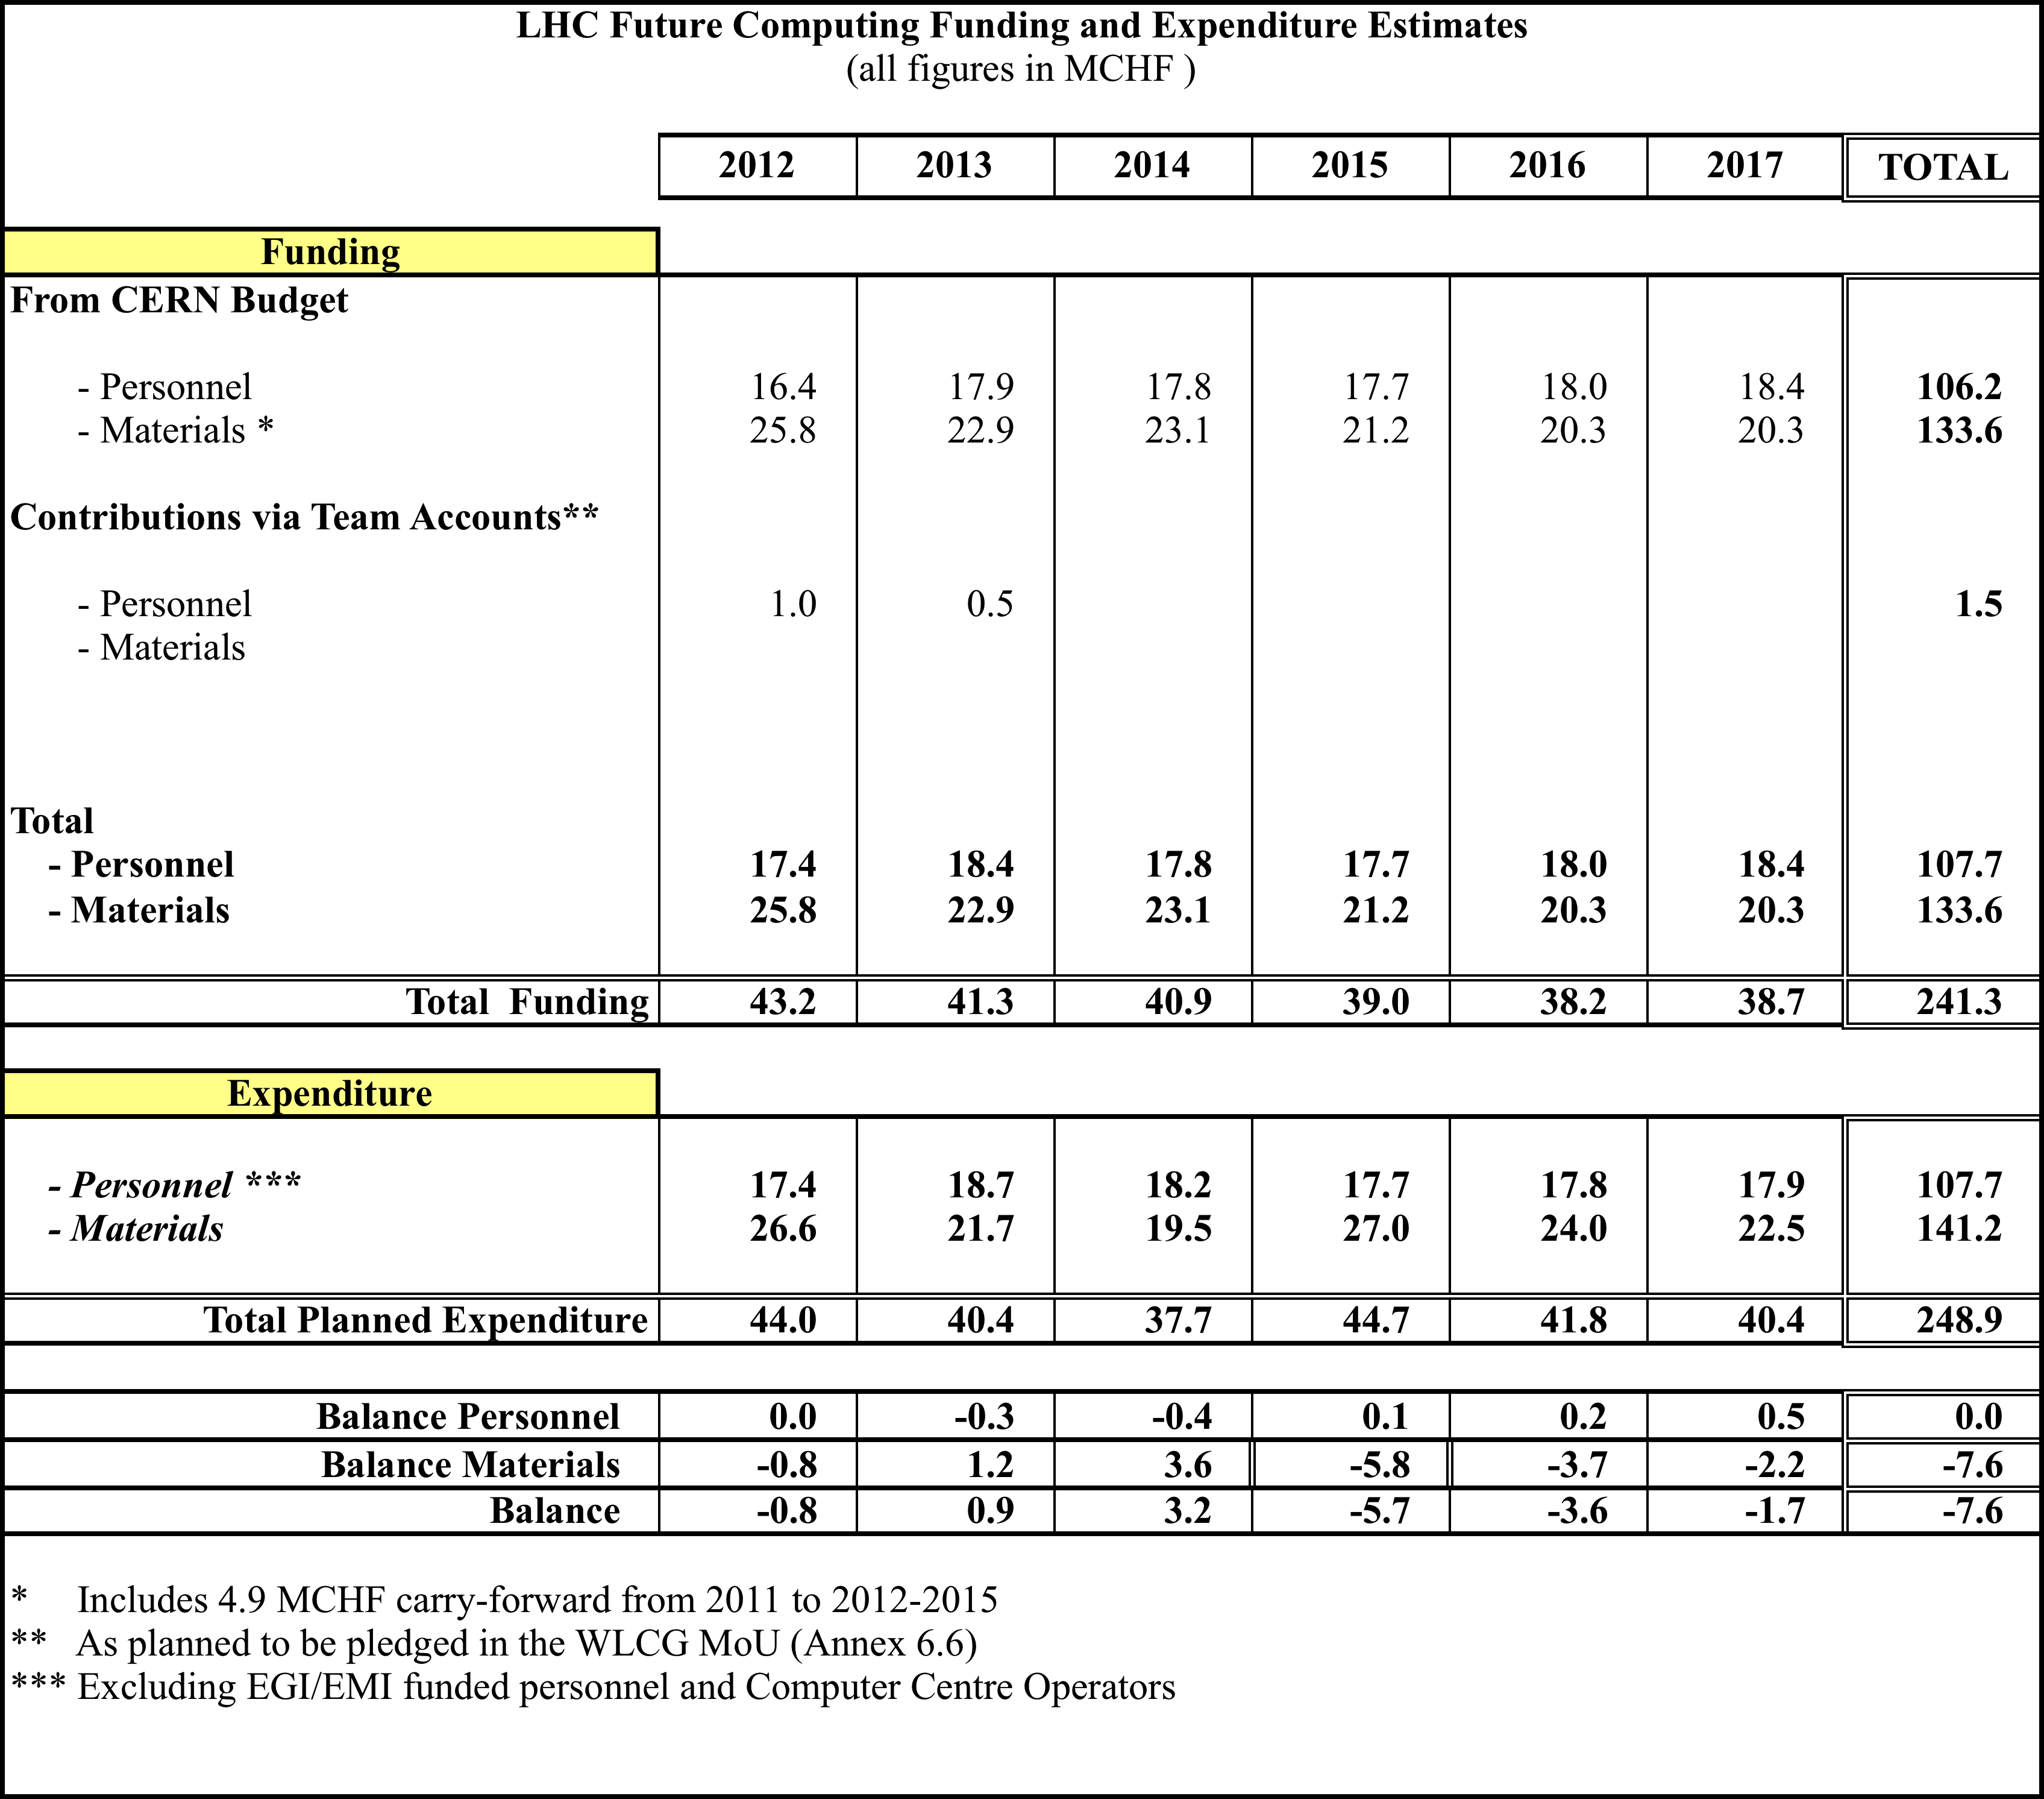
WLCG funding and expenditure

Slide 25
Funding & expenditure for WLCG at CERN
Impact for 2013 & beyond:
  Personnel: balanced situation foreseen
  Materials: reasonable given inherent uncertainties; rely on ability to carry-forward to manage delays (e.g. in CC consolidation, remote T0 costs)
    As actual costs are clarified, balancing of the budget may mean that actual Tier 0 resources can not match the requests

Slide 26
Planning & Evolution

Slide 27
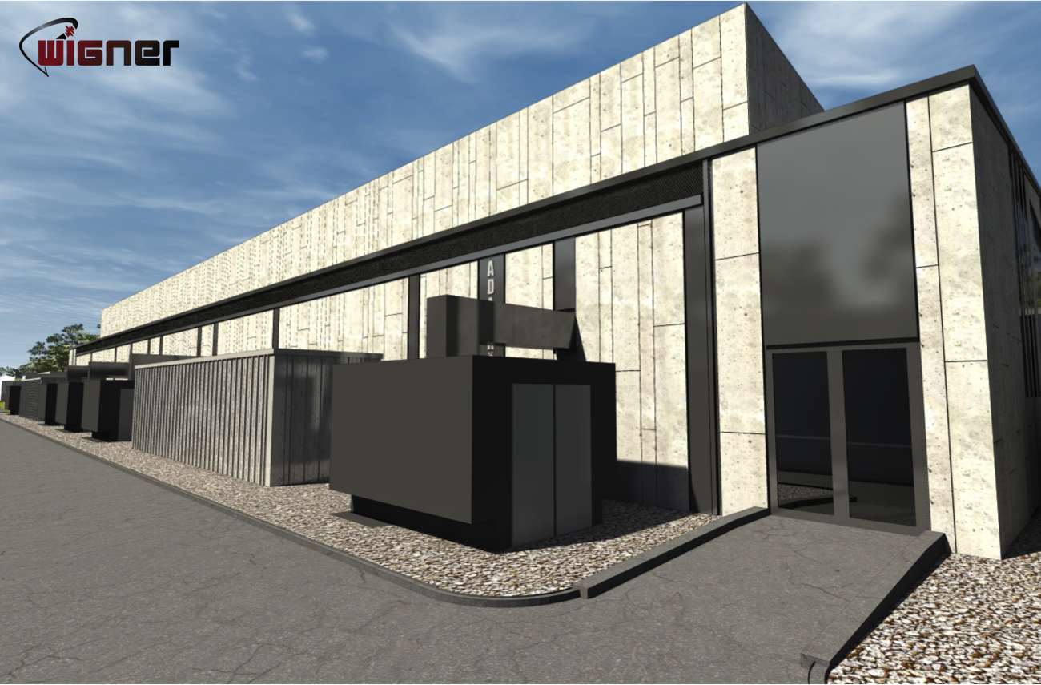
Tier 0 upgrades
CERN CC – extension
  Scheduled for completion Nov 2012 – still on track
  Required for 2013 equipment installation
Wigner centre

Slide 28
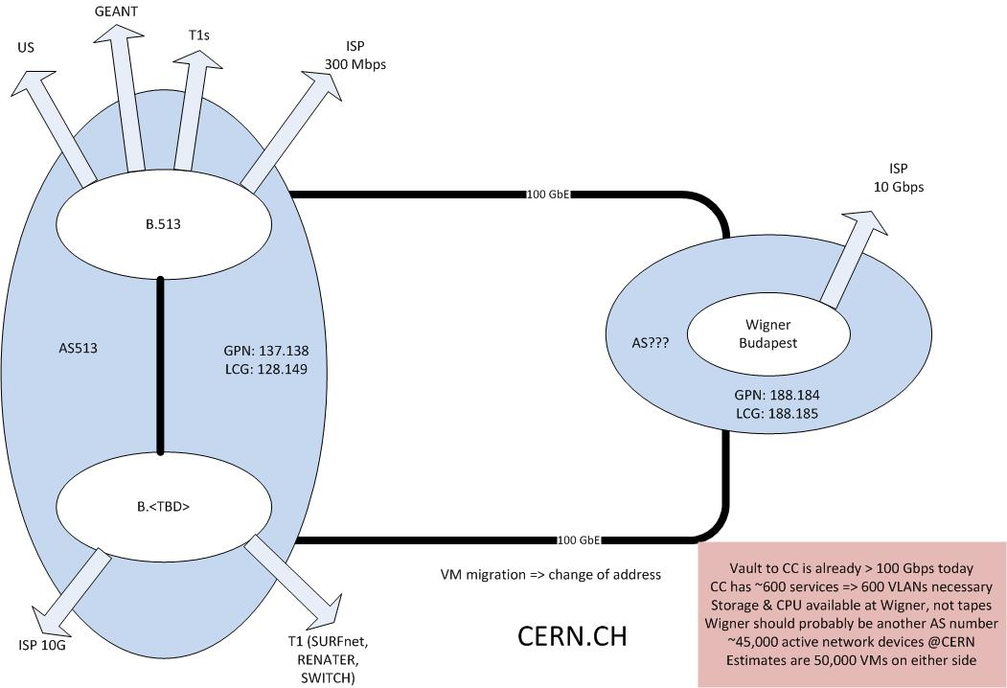
Evolution of Tier 0 - Wigner

Slide 29
Tier 0 upgrades
CERN CC – extension
  Scheduled for completion Nov 2012 – still on track
  Required for 2013 equipment installation
Wigner centre
  Site visit recently – progress on schedule
  Expect to be able to test first installations in 2013
  Networking CERN-Wigner (2x100 Gb): procurement ongoing
  Latency testing has been ongoing for several months
    Fraction of lxbatch with 35 ms delay – no observed effects

Slide 30
Technical evolution
Following the reports of the working groups
Long term group:
  WLCG Service Operations, Coordination and Commissioning
    Core operations – work with EGI + OSG – follow up all operational, deployment, integration activities.
    Consolidation and strengthening of existing organised and ad-hoc activities
Also, clear desire for coordinated effort around existing and potential common projects
  Ensure this is an ongoing activity for the future
Several fixed term groups to follow up on specific aspects of the working groups
  Storage interfaces, I/O benchmarking, data federations, monitoring, risk assessment (follow up)

Slide 31
Grid projects
EMI – ends April 2013
  Software maintenance & lifecycle
    Ongoing work to define how WLCG software support (for ex-EMI sw) will be managed in future
    This is very convergent with what OSG is intending to do
    Need to re-ensure commitments from sw maintainer institutes (has been done by EMI)
  DPM collaboration
    There is a proposal for a DPM Collaboration to continue support/evolution beyond the EMI project, and several countries have expressed their intentions to join this collaboration. This will help the long-term support for this storage product.
    This is a model for future community support/development of key software

Slide 32
The promise of cloud technology…
Use of technology
  Virtualisation
  New “standard” interfaces (well, maybe one day)
Services
  Academic clouds
    Grid → cloud? (or grids & clouds co-exist)
  Commercial clouds
    Outsourcing of services
    Use for data processing, storage, analysis
New types of services, new ways of providing services

Slide 34
Summary
WLCG operations are in good shape
Scale of use continues at a high level globally,
  at data volumes much higher than anticipated
Planning for the future in several areas
Essential to maintain adequate Tier 1, Tier 2 funding in the coming years
  Concern that the physics potential will be limited by the availability of computing
  Concern that computing funding is competing with detector upgrades

