Slide 1
Introductory presentation
Benedikt Bergmann
Institute of Experimental and Applied Physics, Czech Technical University in Prague, Czech Republic
Vienna - 11/20/12

Slide 2
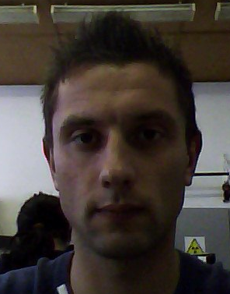
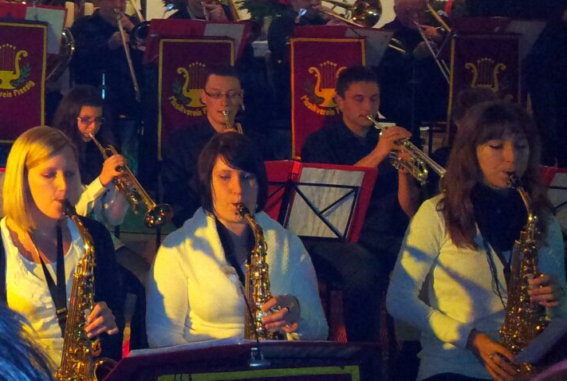
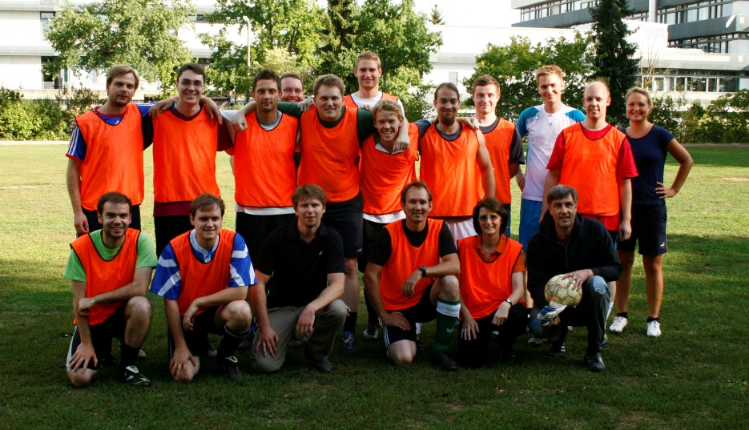
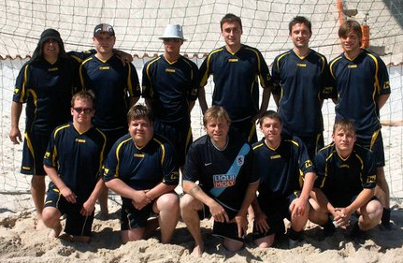
General information
X-mas Concert (2011)
Benedikt Bergmann
Germany, Pressig
12th February 1987
Interest and Hobbies
  Soccer, Beach Soccer, Running, Hiking, ….
  Music: Trumpet, Keyboard
Bavarian Beach Soccer Champion (2010)
ECAP vs. Theory 4:1 (2012)

Slide 3
Scientific Career
2006 German ABITUR
2007 – 2010: Studying Bachelor‘s courses at Friedrich-Alexander University Erlangen
  “Studies on ambient deep-sea background noise at the ANTARES-site“, Erlangen Centre for Astroparticle Physics (ECAP)
2010 – 2012: Master‘s courses at FAU
  “Application of a time-resolving X-ray pixel detector in the detection of coincident fluorescence emissions after double K-shell vacancy production in the electron capture decay of Fe-55” , ECAP
Since 2012: PhD student within the ARDENT-framework
  PhD thesis at ECAP FAU
  Institute for Experimental and Applied Physics, Czech Technical University in Prague (IEAP CTU)

Slide 4
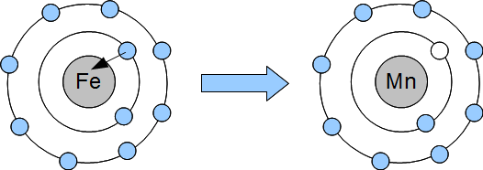
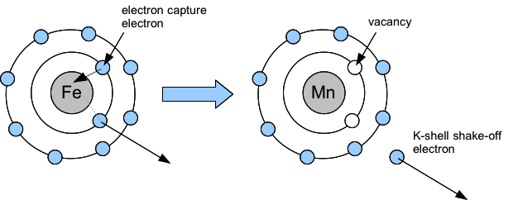

Double vacancy production in EC of Fe-55
Usually
but, each ~ 10^{-4 th} disintegration
Questions:
  What is the value of P_{KK} (= ratio single to double vacancy production)?
  Is there an angular dependence between the two X-rays?
Emission of 1 K-X-ray
Emission of 2 coincident K-X-rays

Slide 5
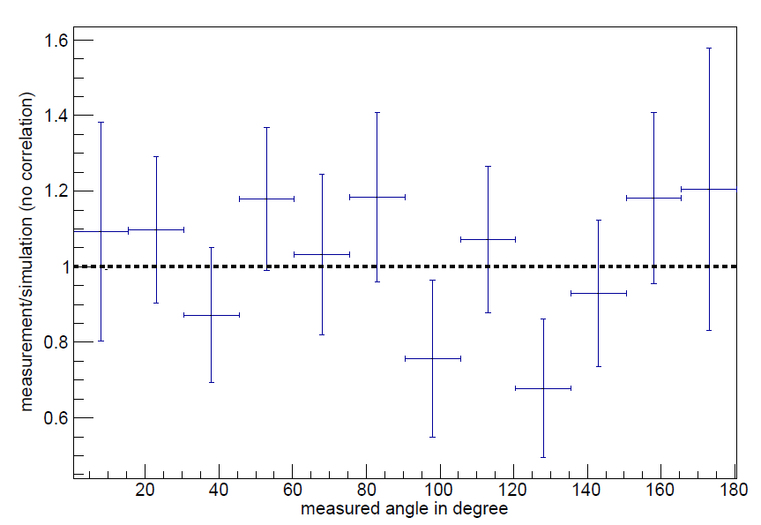
Results
P_{KK} = (1.40 ± 0.17_{stat.} ± 0.05_{syst.}) . 10⁻⁴
Angular distribution

Slide 6
ARDENT: Optimization of mixed field data evaluation
“As an ESR, you will work in the field of complex radiation detection. The aim of the work is development and optimization of data evaluation techniques for one or more Medipix/Timepix pixel detectors (individually and in coincidence mode) in order to distinguish reliably different species of the mixed radiation fields. You will work on Monte Carlo simulations of the detector setup to improve the precision of the data evaluation.”
Evaluate data taken by the MPX-devices already installed in ATLAS detector concerning dosimetric issues, especially neutron dosimetry
Contribute to the ATLAS upgrate from MPX to TPX during next shut down

Slide 7
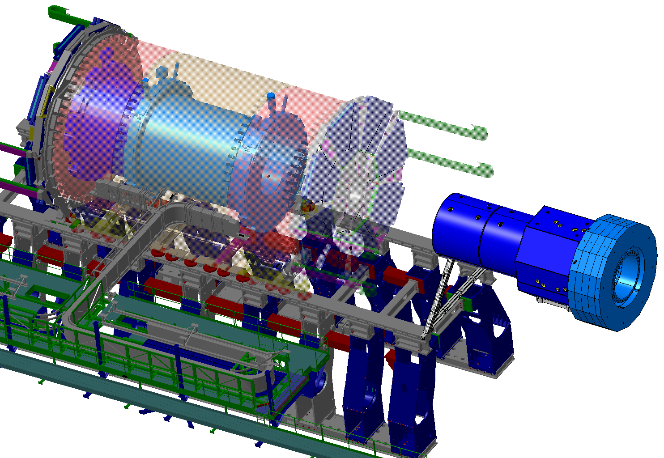
ATLAS – MPX positions
M14
M1
M7
M3
M13
M9
M4
M2
M5
M8
M6
M12
M15
M10
M11
Side A

Slide 8
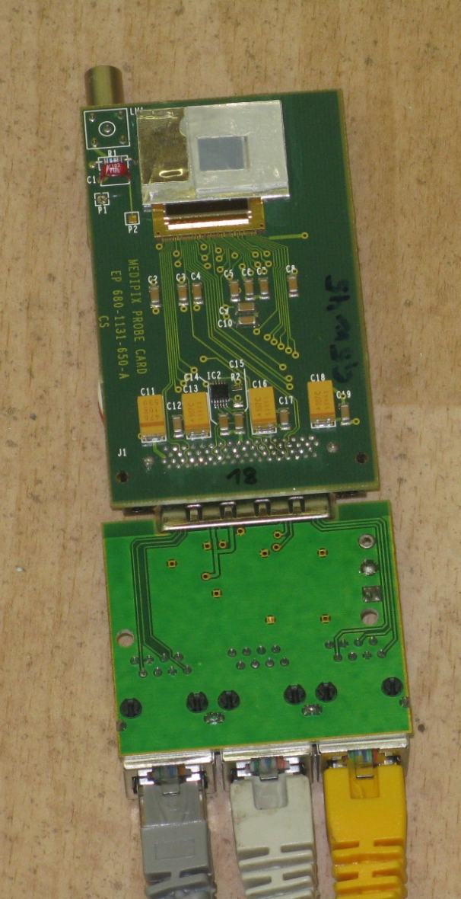
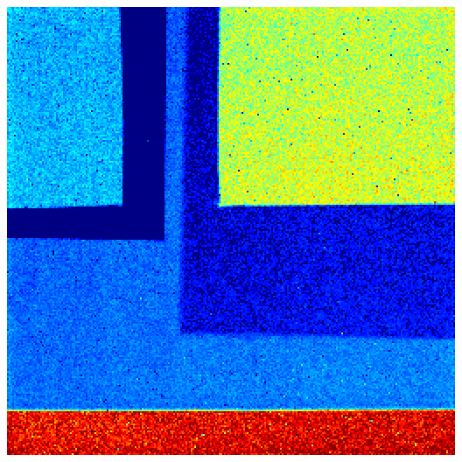
Neutron detection
Medipix 2 ASIC with 300µm Silicon layer
  256 x 256 pixel
Converter foils:
  ⁶Li(n,α)³H -> thermal neutrons
  PE: recoiled protons -> fast neutrons
LiF
PE
PE + Al
Al
Uncovered

Slide 9
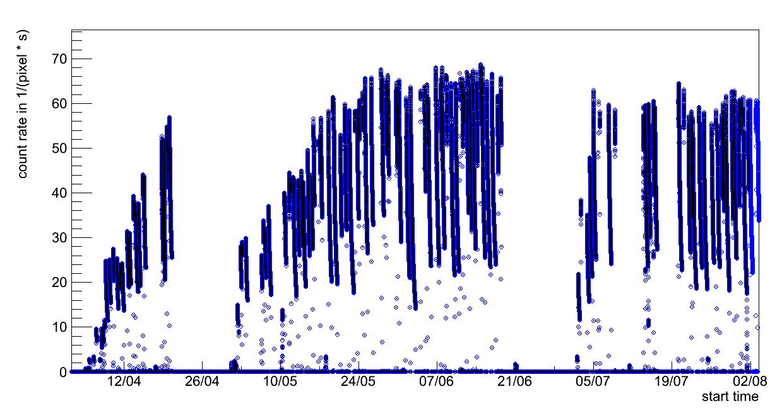
Studies on activation in the ATLAS cavern
Activation of surrounding material during collisions in the ATLAS detector
  Luminosity monitoring with MPX devices: Background contribution
  Dosimetric aspect: What is the time dependency of the equivalent dose rate after the collisions?
collision region
?

Slide 10
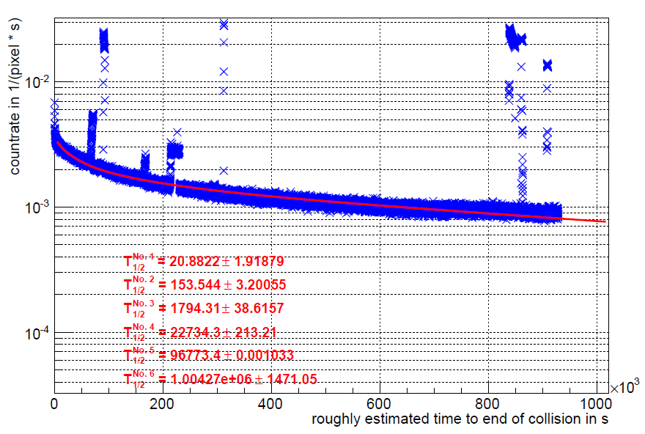

Modelling the decay of activation products (mpx01)
$$f\left(x\right)=\sum_{i=1}^{6}{k_{i}∙e^{−\frac{ln⁡(2)}{T_{1/2}^{i}}∙t}}$$
components with longer half life present

Slide 11
Next steps
Are these half lifes reproduceable for mpx01?
  Take other no beam regions and see if the results will be identical
What does the activation look like at the sites of the mpx02-mpx15?
  Spatial distribution of activation in the ATLAS cavern
Translate the measured count rates to dose rates
  Evaluate the regions below each converter seperately (determine the composition of the radiation)
(Luminosity monitoring
  Estimate the background contribution due to this activation during collision periods)

Slide 12
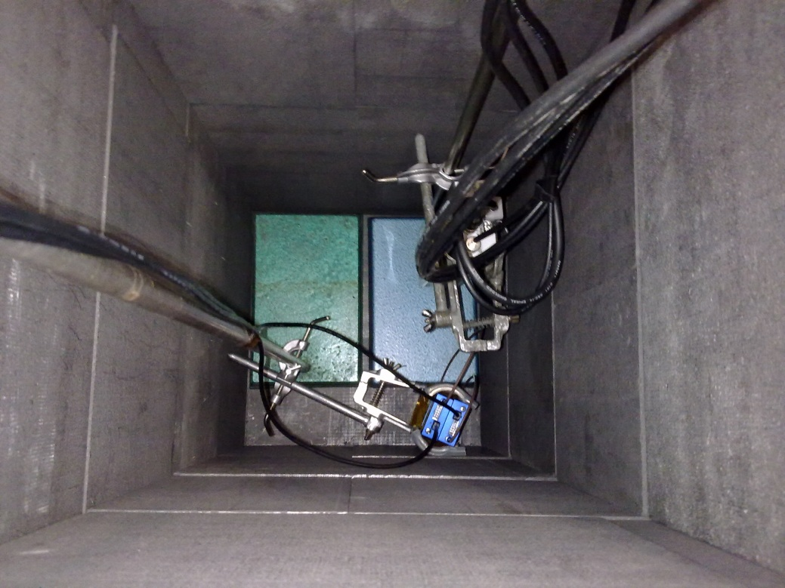
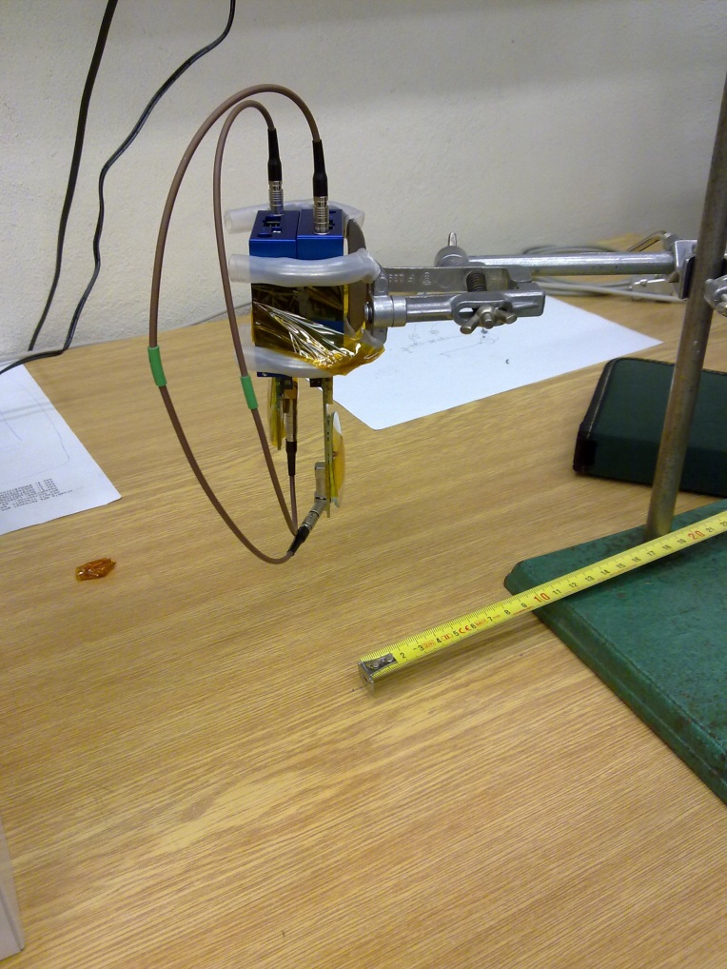
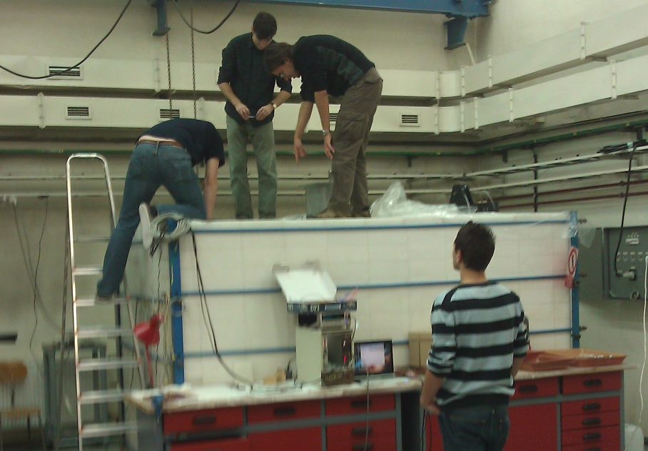
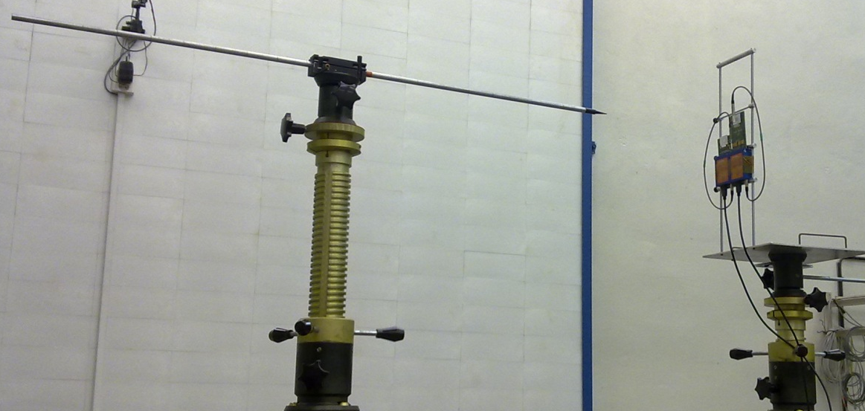
ATLAS upgrate: Measurement at Czech Metrological Institute
thermal neutron measurement
fast neutron measurement
Upgrate from MPX to TPX
Measurement to compare the response of MPX and TPX to thermal neutron and fast neutron impact (Cf, AmBe)

Slide 13
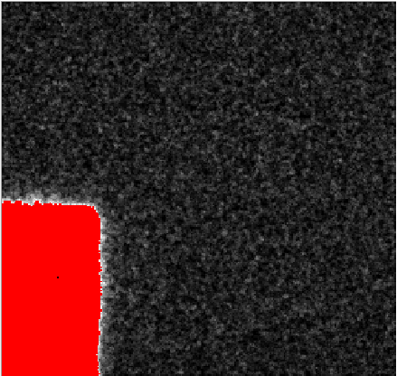
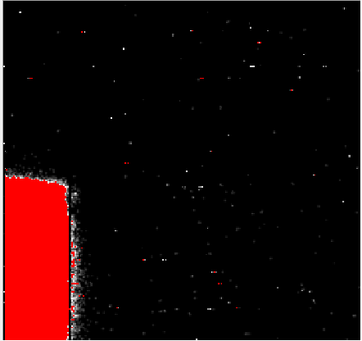
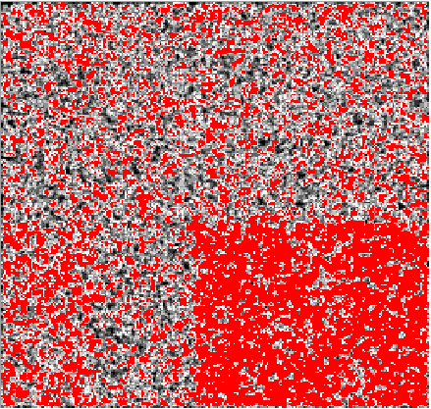
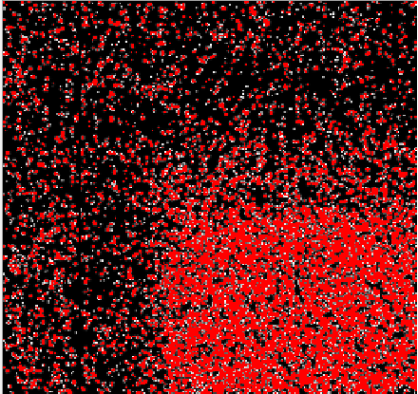
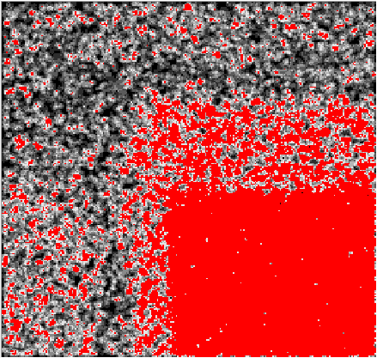
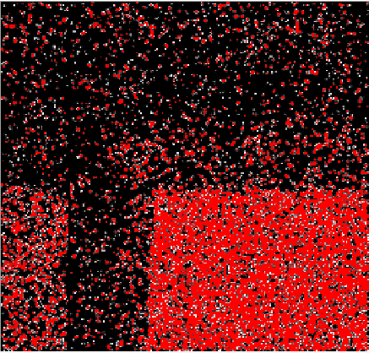
Comparison: MPX vs. TPX
MPX
TPX
thermal neutrons (E < 0.5eV)
MPX
TPX
²⁵²Cf (E_{mean} = 2 MeV)
MPX
TPX
AmBe (E_{mean} = 4 MeV)

Slide 14
Thank you for your attention!

