Slide 1
1st Annual ARDENT Workshop: ESR Presentation by Kevin Loo
Joseph Bucci³, Michael Lerch¹, Jan Jakubek³, Steven Meikle⁴, Marco Petasecca¹, Mitra Safavi-Naeni¹, Marco Zaider⁵, Anatoly Rozenfeld¹
[1] CMRP, University of Wollongong, [2] St George Cancer Care Centre, Kogarah, [3] Institute of Experimental and Applied Physics, Prague, [4] BMRI, University of Sydney, [5] Memorial Sloan-Kettering Cancer Centre, New York

Slide 2
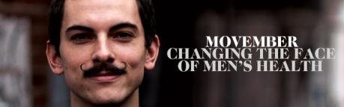
Kevin Loo
Centre for Medical Radiation Physics- University of Wollongong, Australia, 2006-present
Bachelor of Medical Radiation Physics (Adv Hon): graduated first class honours in 2009
  Topic: High spatial resolution surface dosimetry for episcleral eye plaque radiation therapy using MOSkin
Commenced PhD studies 2010:
  Topic: BrachyView: A novel intra-operative system for prostate brachytherapy
  Supported by National Health and Medical Research Council and Australian Rotary Health

Slide 3
BrachyView Concept
Brachytherapy implant localisation uncertainty causes dosimetric complications
  Prostate mobility
  Seed twisting
  Brachy needle placement errors
Intraoperative dynamic dose planning
  Fuse with existing ultrasound technology
New in-body ultra-functional probe:
  Ultrasound, radiation source and CT imaging captured real-time
  Possibility to introduce fast, online seed position imaging using seeds themselves as radiation source
Applications:
  Seed positioning in tumour
  Real-time CT imaging of implants

Slide 4
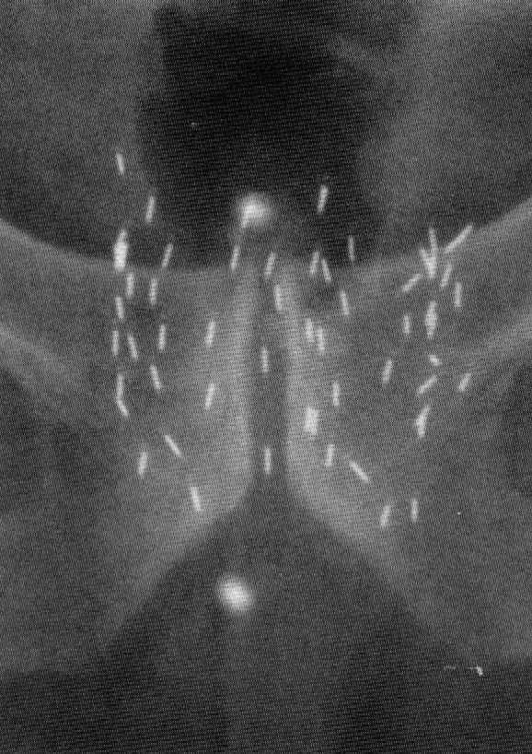
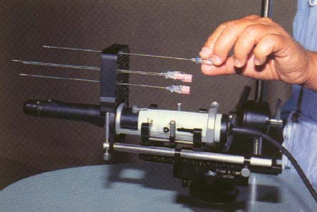
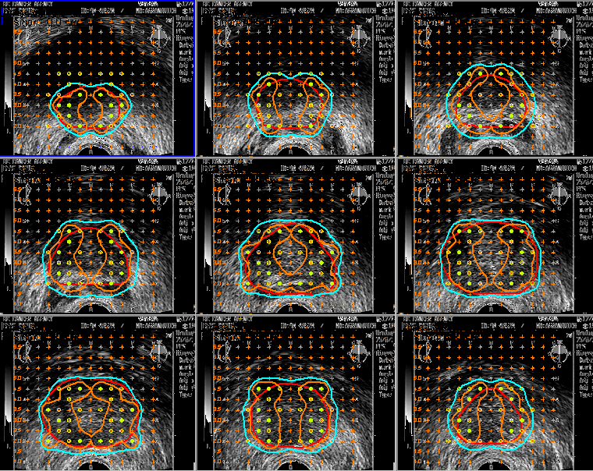
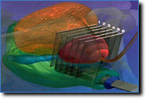
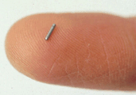
Current Technology - TRUS
Result
Seed misplacement
errors
Urethral and rectal
toxicity: 40% cases
No real-time planning option available
Disadvantage: not true ‘real-time’, planar image only (no anatomy), cumbersome and expensive equipment
Ultrasound Guided insertion of small radioactive seeds
Images to computer planning system
Transrectal Ultrasonography (TRUS) do not provide seed location

Slide 5
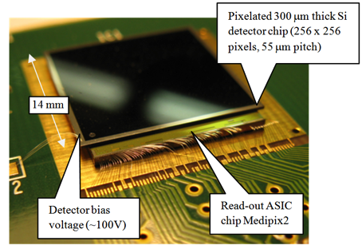
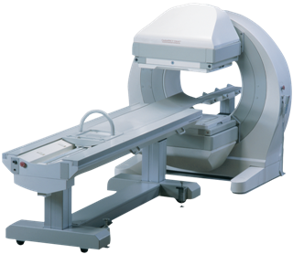

Application 1: Seed Positioning
Medipix
+
=
TRUS
Gamma Camera
>US$ 700,000
Gamma camera lacks anatomical information, which is provided by proposed medipix dataset fusion with ultrasound images
Multiple medipix detectors in TRUS probe for multiple views and therefore, seed triangulation

Slide 6
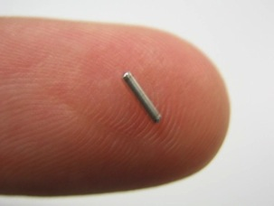
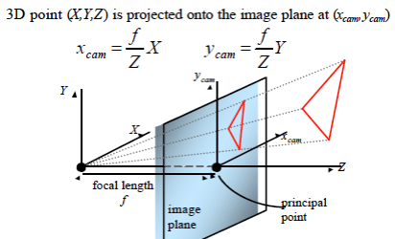
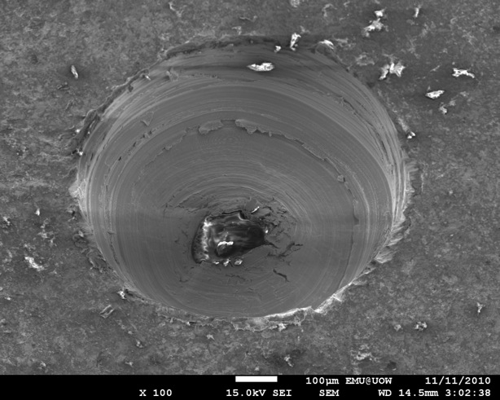
Pinhole Gamma Camera Concept
ONCURA I-125 Seed:
- Shell dimensions: 4.5x0.8mm
Radioactive core: 2.8x0.5mm

Slide 7
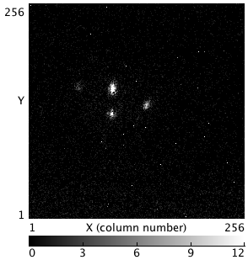
Based on multiple views from medipix, seed position can be triangulated from projected rays through pinhole
Note: for seeds ‘behind’ other seeds, multiple views are essential (see figure; seeds B3 and D3)
Determine possibility of seed coordinates

Slide 8
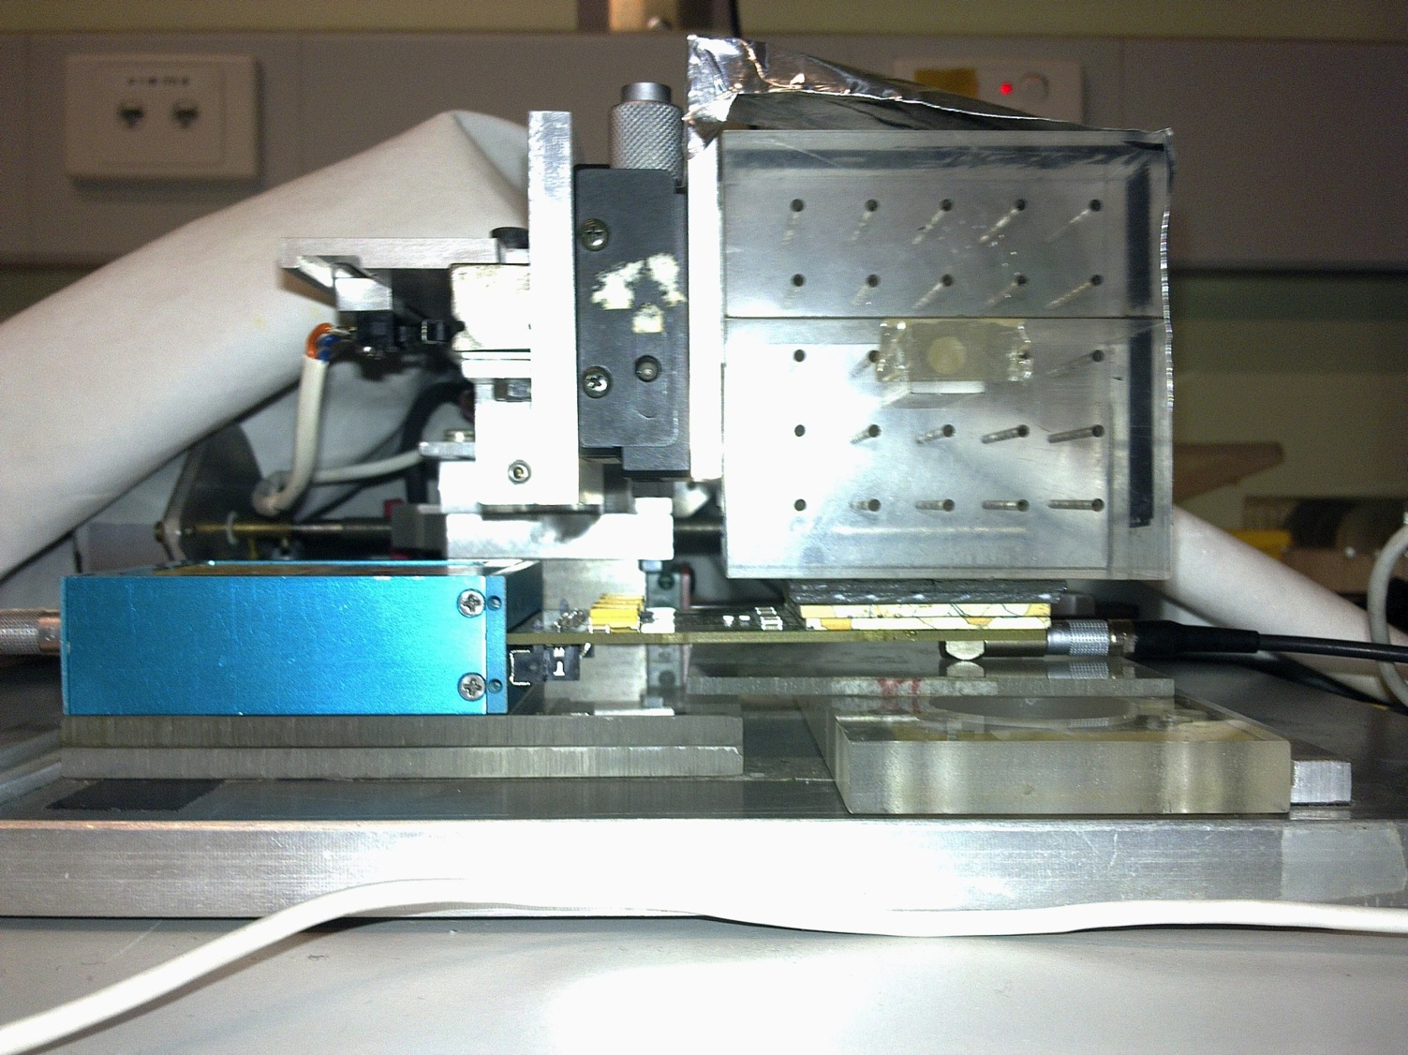
Experimental Setup
1
2
3
4
5
E
D
C
z
B
A
x
Lead collimator
(pinhole at origin)
y
Medipix
PMMA phantom 60x60x60mm
Grid (rows A-E, columns 1-5) to simulate template in TRUS brachy implant procedure
Single chip used in experiment
Phantom is moved relative to detector and collimator to obtain multiple views
  Model of multipinhole collimator using single pinhole and detector

Slide 9
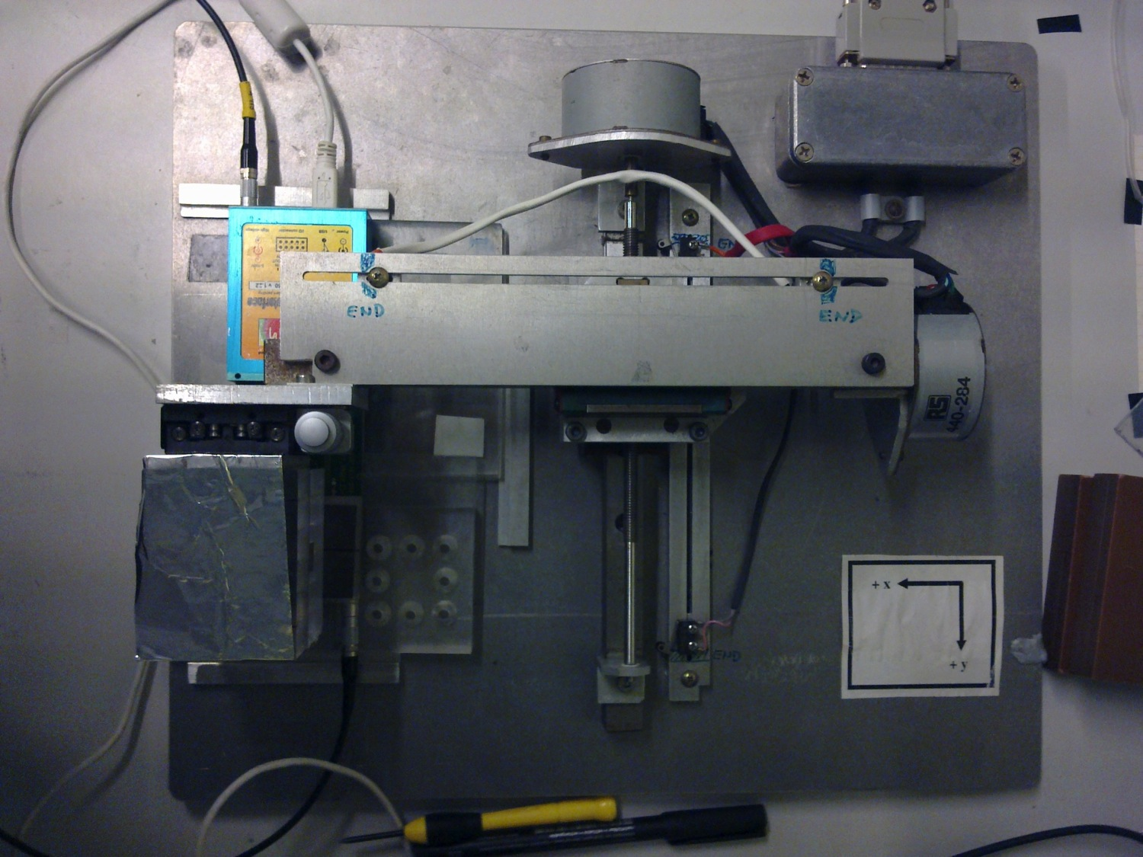
Medipix USB interface
Phantom attached to motorised XY table
Capable of stepping in 5.2µm increments in x-direction, and 10.4 µm in y-direction
Relative motion of phantom to detector is equivalent to multiple pinholes to view seed from different directions

Slide 10
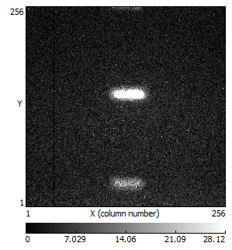
Seed Images
1
2
3
4
5
E
D
Phantom
C
B
A
Lead collimator
Medipix
Row A- 5 seeds, single acquisition,
Note that only 3 seeds are in field of view

Slide 11
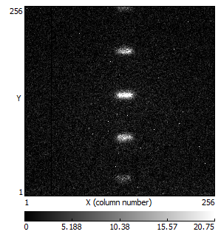
Seed Images
1
2
3
4
5
E
D
Phantom
C
B
A
Lead collimator
Medipix
Row B- 5 seeds, single acquisition,

Slide 12
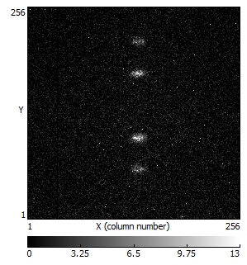
Seed Images
1
2
3
4
5
E
D
Phantom
C
B
A
Lead collimator
Medipix
Row C- 5 seeds, single acquisition,

Slide 13
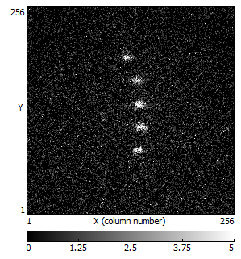
Seed Images
1
2
3
4
5
E
D
Phantom
C
B
A
Lead collimator
Medipix
Row D- 5 seeds, single acquisition,

Slide 14
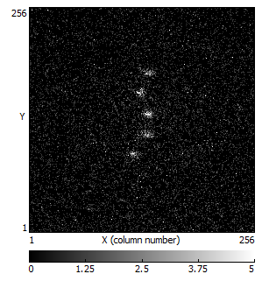
Seed Images
1
2
3
4
5
E
D
Phantom
C
B
A
Lead collimator
Medipix
Row E- 5 seeds, single acquisition,

Slide 15
Reconstruction process

Slide 16
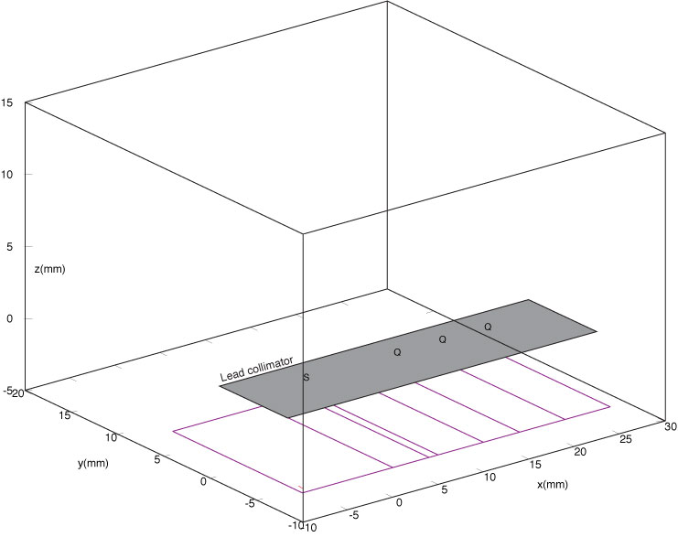
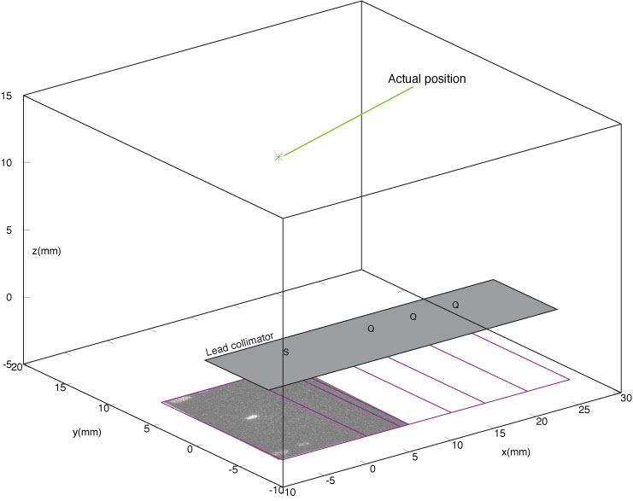
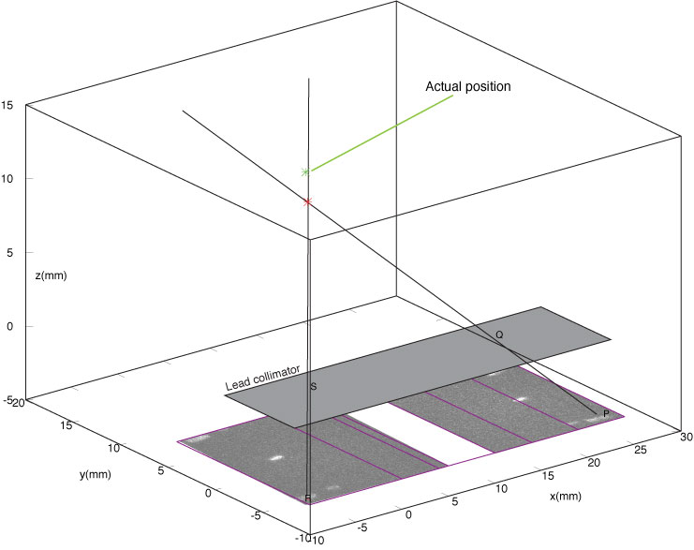
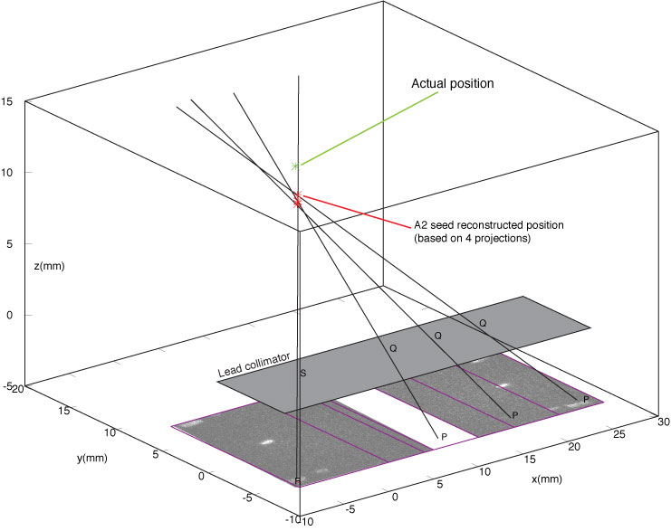


Experimental results
Using linear algebra, the point of intersection of rays through pinhole is used to reconstruct seed coordinate (centre-of-mass)
NOTE: lines do not necessarily intersect in 3D, and so use the midpoint of shortest chords between skew lines
Accuracy within 0.5-1mm of expected positions

Slide 17
Experimental Results

Slide 18
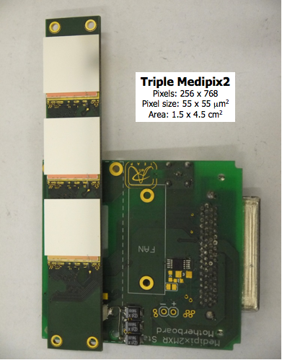
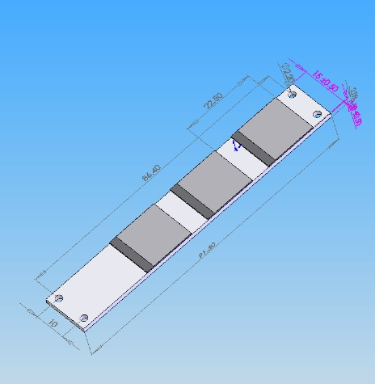
Detector Design
Multiple views from novel 3 chip/multi-pinhole design
Integrate with existing TRUS probe design

Slide 19
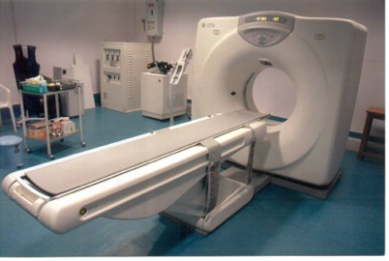
BrachyView and CT
External x-ray source
(typically C-arm or O-arm apparatus)
CT scanner >US $800,000
Prostate
In-body CT with rotating x-ray tube
80 times less dose
Diagnostic and screening capability
Rectal cavity
TRUS Probe w/ Medipix
Not to scale
Notes:
19

Slide 20
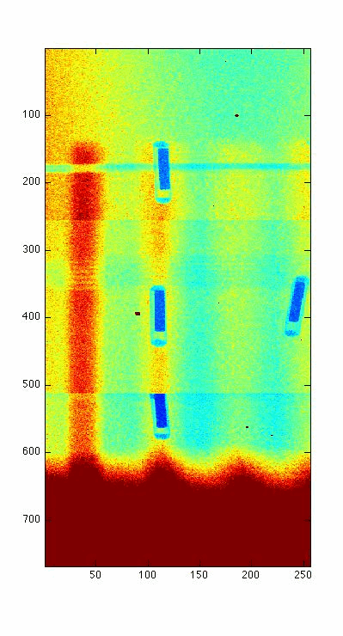

Obtain 180 projection images to simulate realistic clinical scenario
Using iterative reconstruction method (OSEM), limited angles are no problem
Note: presence of ‘dead zones’ due to spacing on detector plane
First steps taken in developing reconstruction algorithms
Notes:
20

Slide 21
Conclusions
Brachytherapy procedures benefit from knowledge of exact seed coordinates during implant
Experimental proof-of-concept studies completed with promising results
Image reconstruction algorithm for CT slices has been developed and is currently being tested for use in limited angle reconstruction (limited FOV)
Perform dosimetry on reconstructed seed positions to determine best treatment outcomes
Enhance/introduce ability for intraoperative dynamic dose planning developed at MSKCC
  Real-time adjustment of seed and needle placement based on actual implants, not preplanned arrangements
  Streamline entire procedure to include post-implant dosimetry and CT imaging into single procedure: so-called ‘one-stop-shop’

Slide 22
My research and ARDENT
Familiarity with Medipix technology, and have received training in fundamentals surrounding Medipix operation
Unique clinical application of Medipix has great potential
Further my expertise in this powerful device for medical imaging but also in developing dosimetry techniques for mixed radiation fields

Slide 23


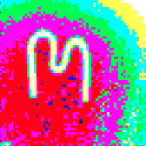



Notes:
23

