Slide 1
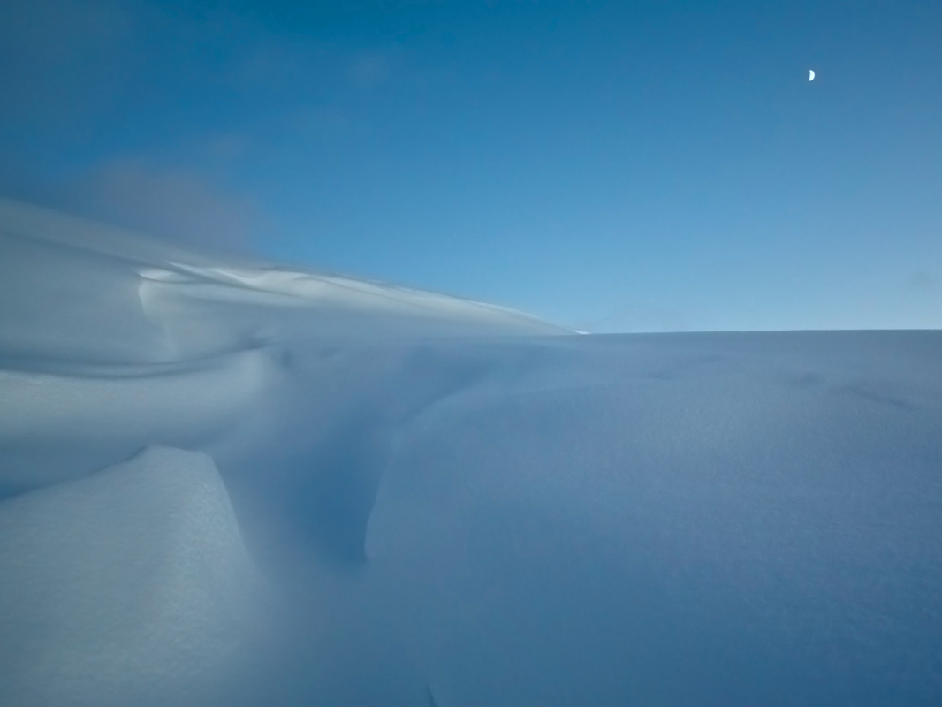
Erik Fröjdh
ESR 2 – Application of Medipix
in radiation dosimetry

Slide 2
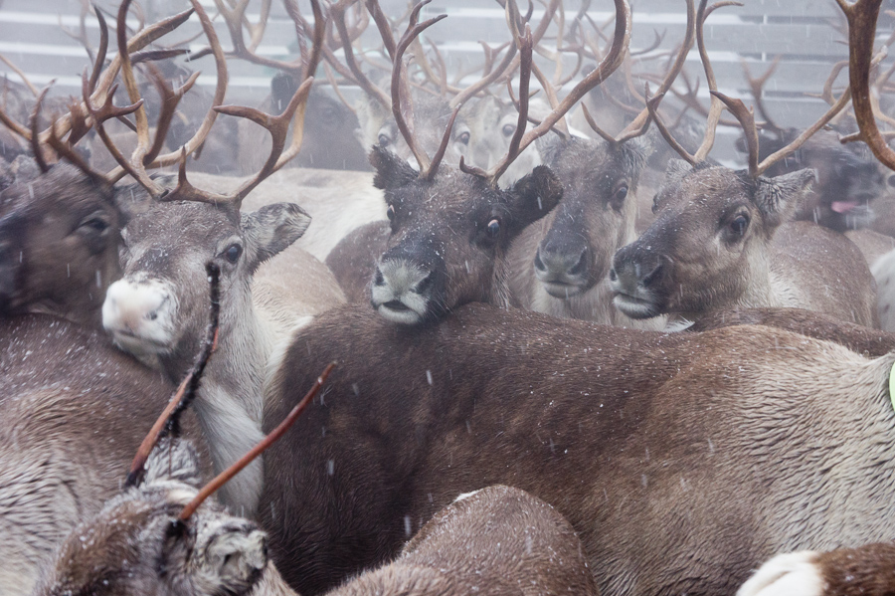
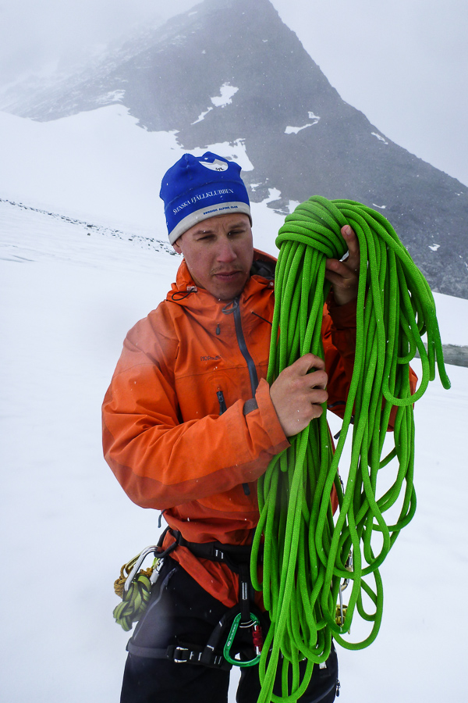


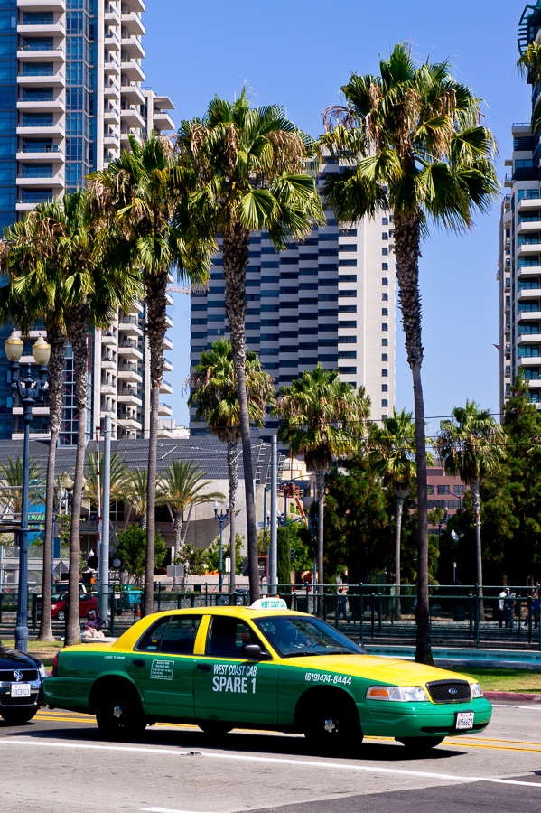
Outline
Presentation
Medipix/Timepix
Assorted results

Slide 3
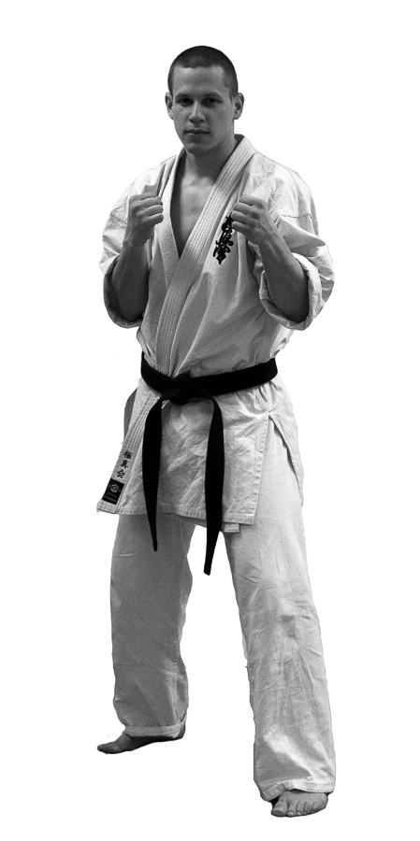
Specifications
Name: FRÖJDH, Lars Erik
Age: 28 years
Height: 175cm
Weight: 70kg
Born: Sundsvall, SWEDEN
Nationality: Swedish, Sami
Education: Masters Degree in Physics,
Mid Sweden University

Slide 4
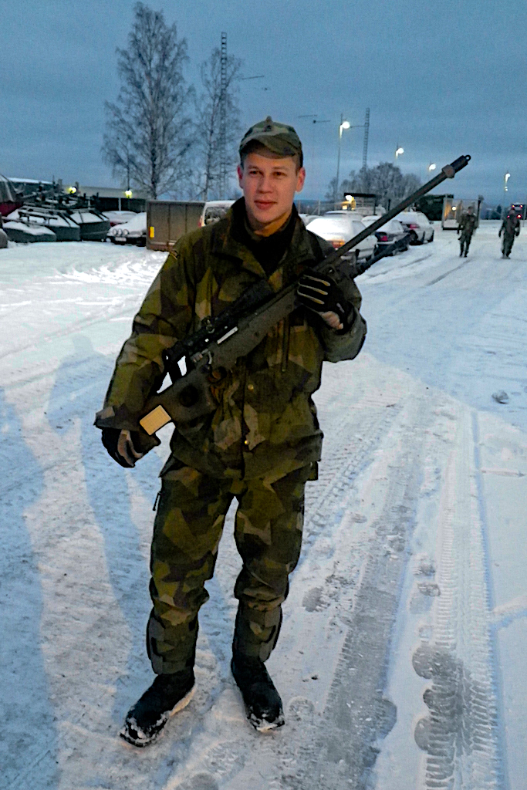
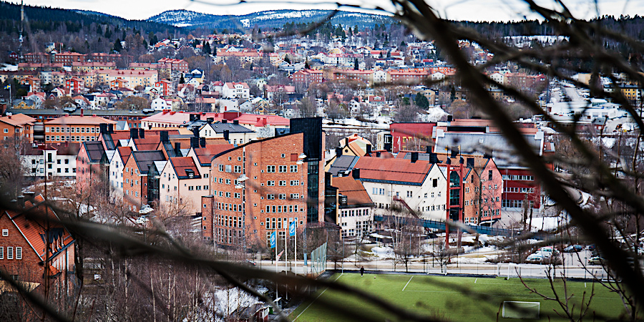


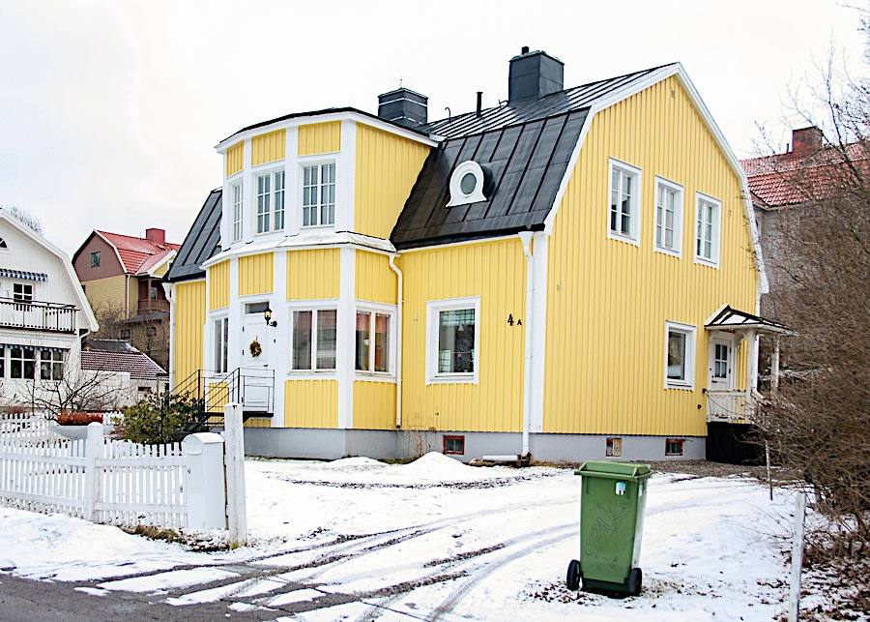
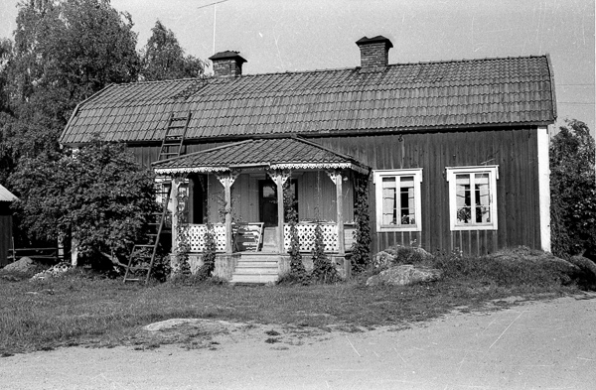
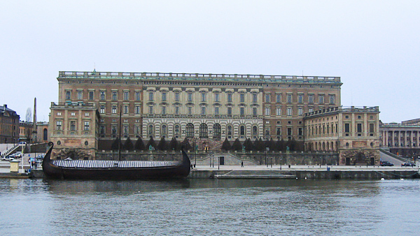
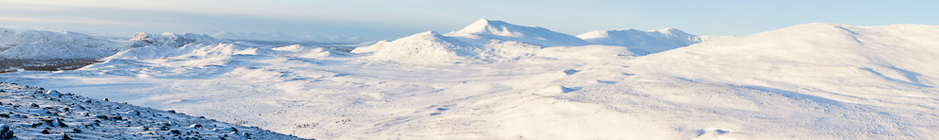
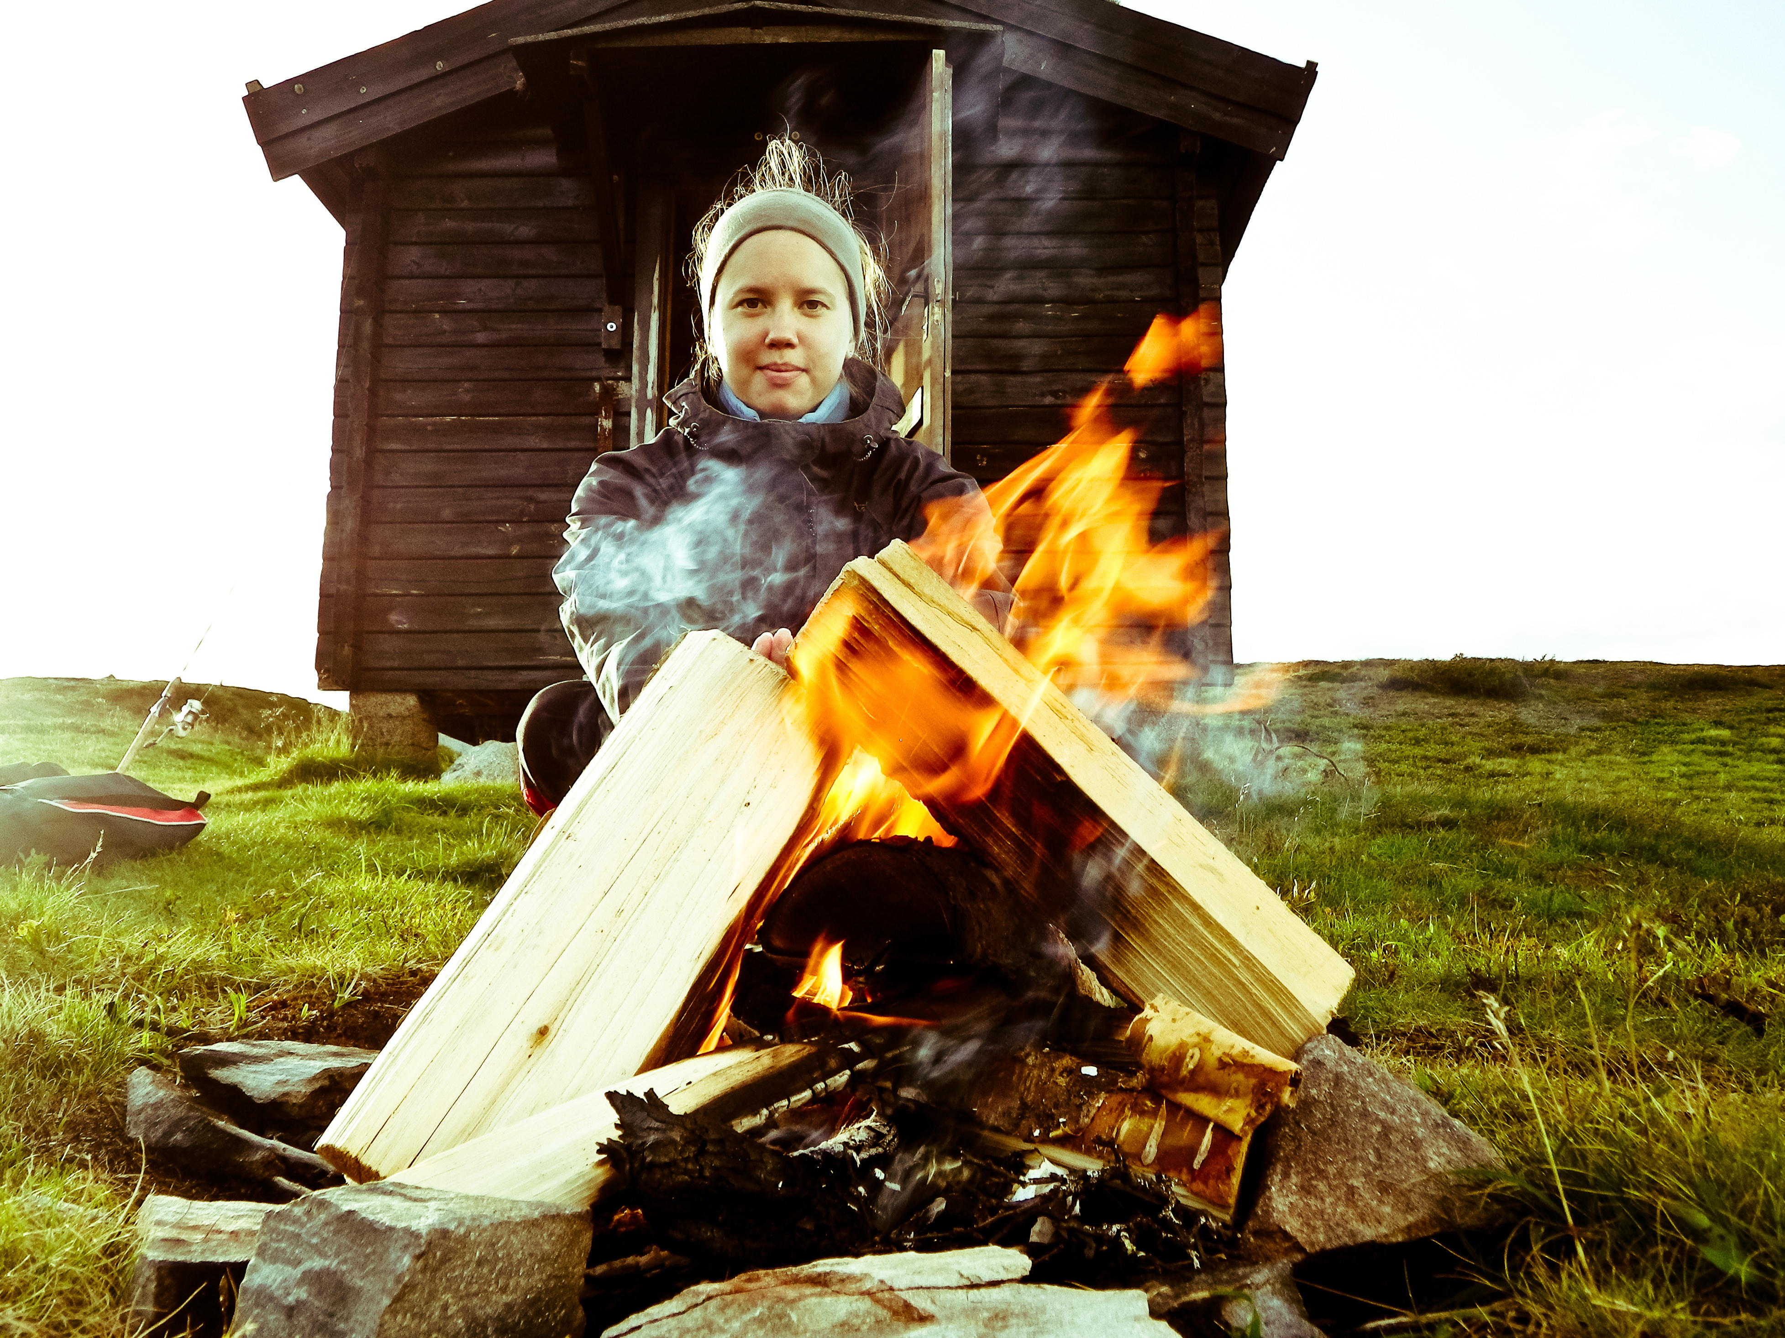

Slide 5


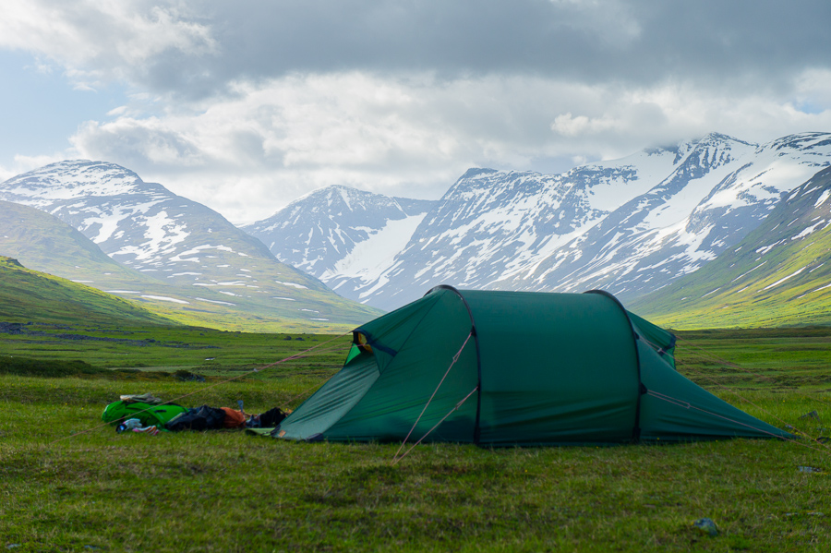

Slide 6


Slide 7
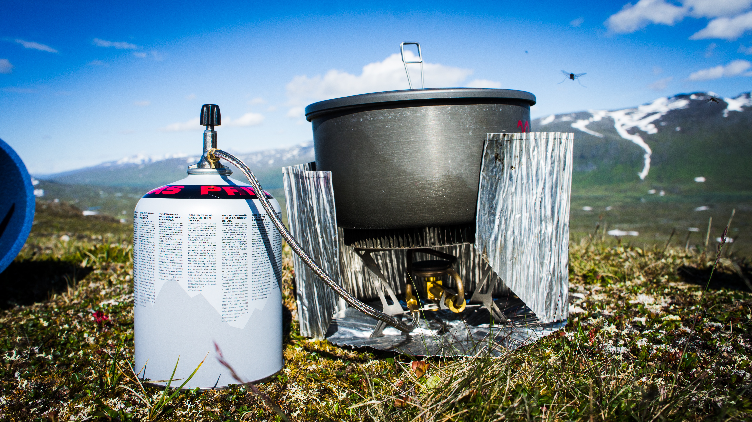

Slide 8


Slide 9
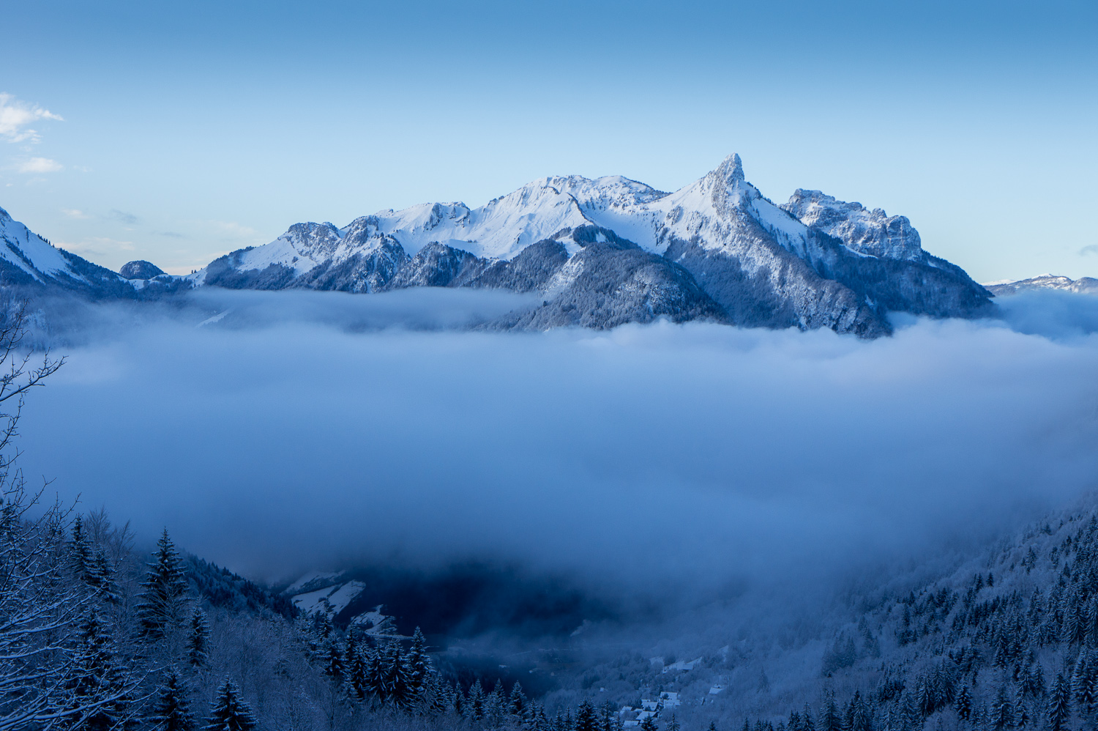

Slide 10


Slide 11

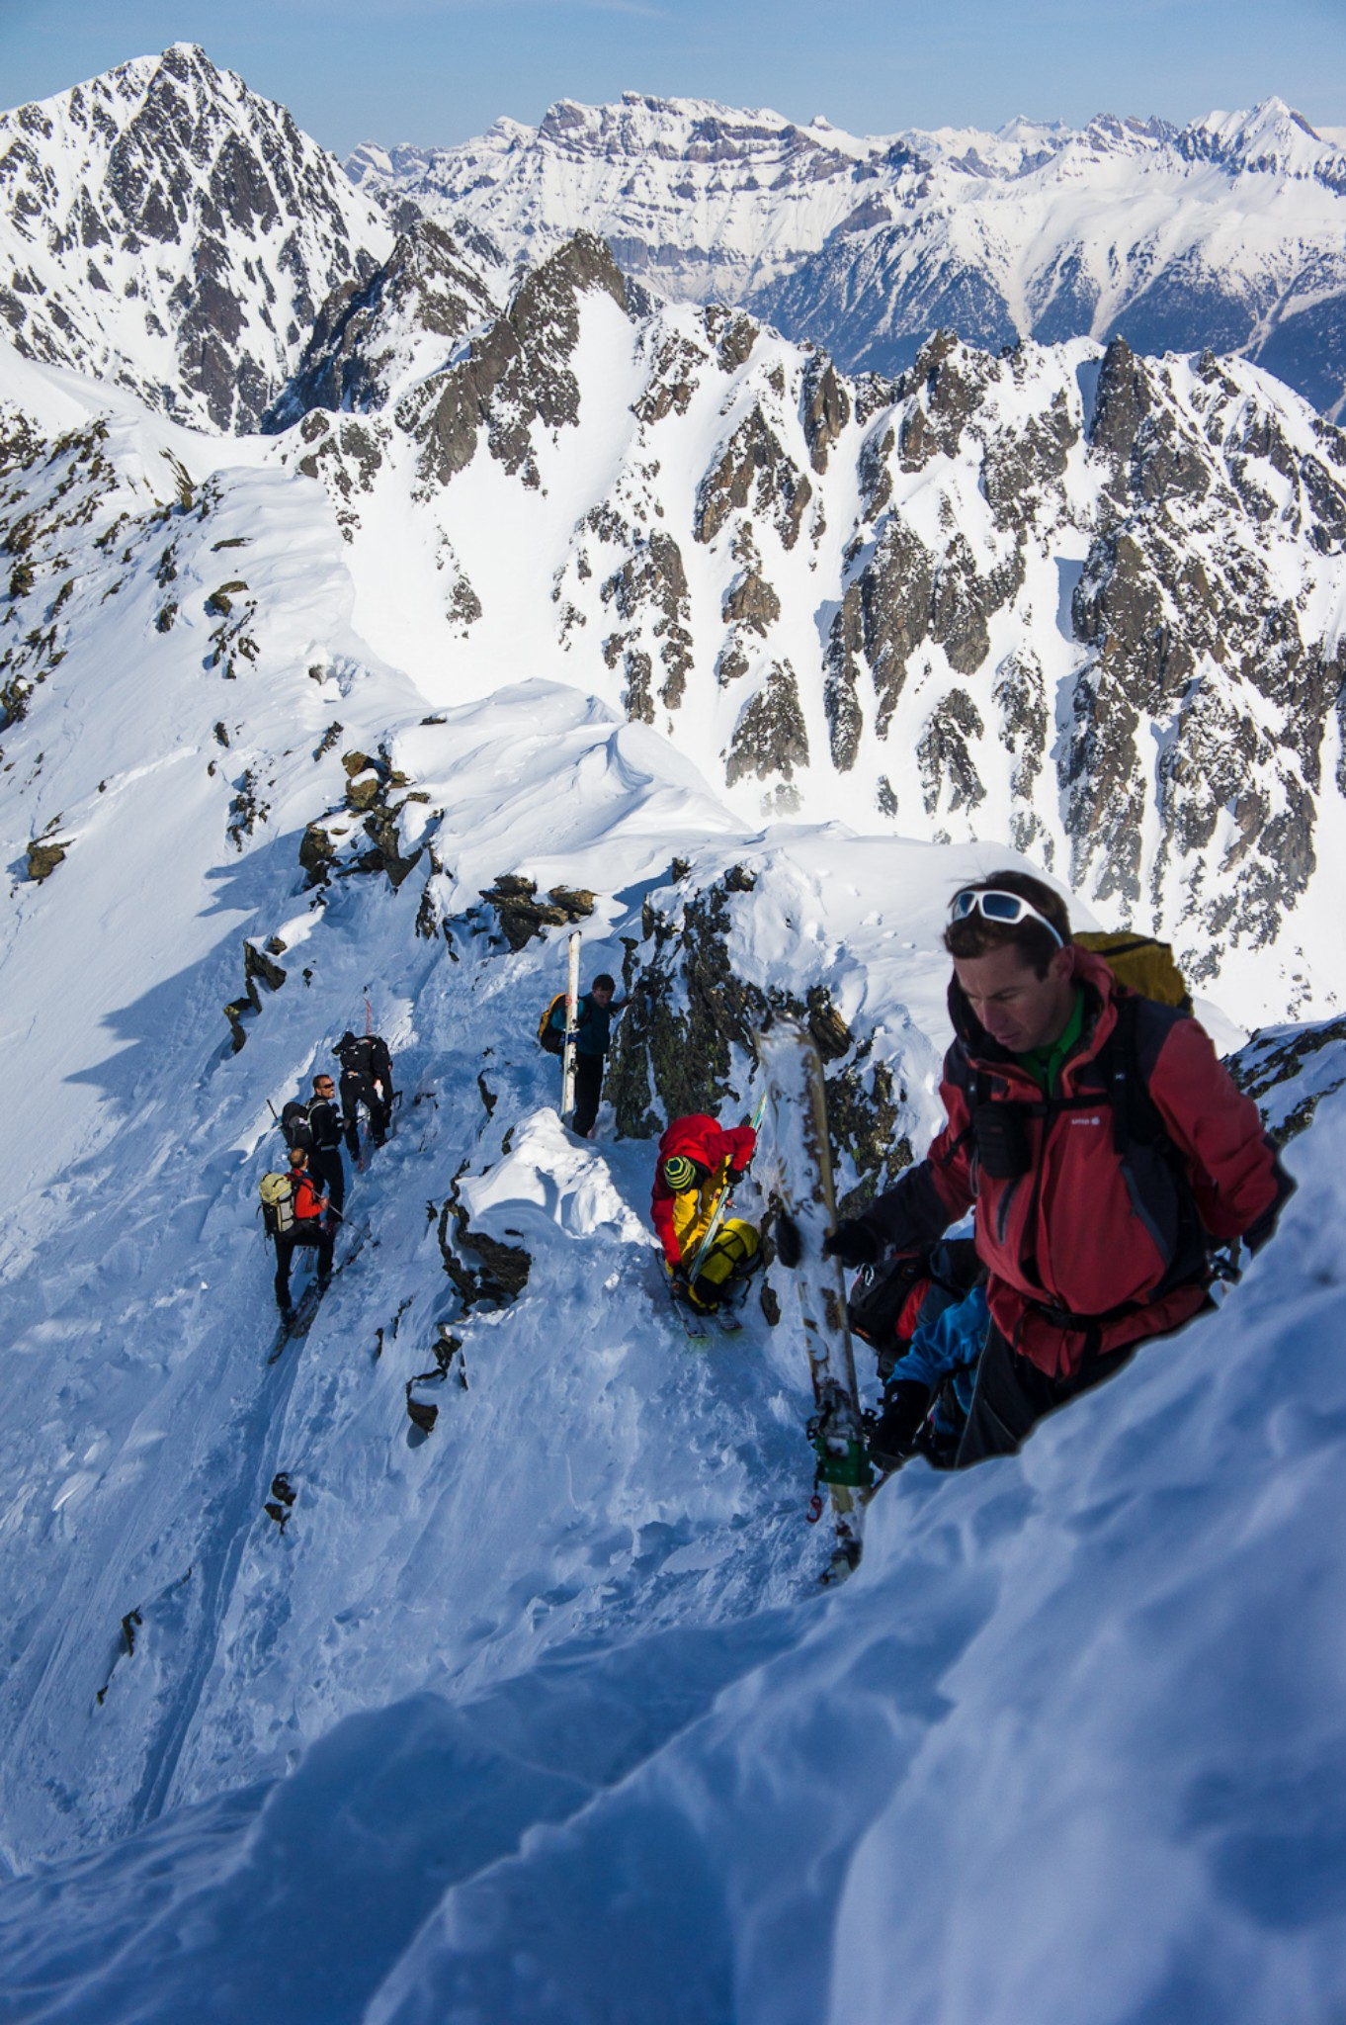
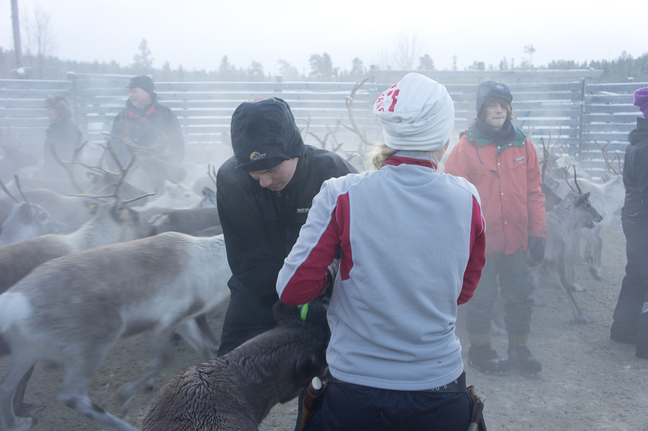
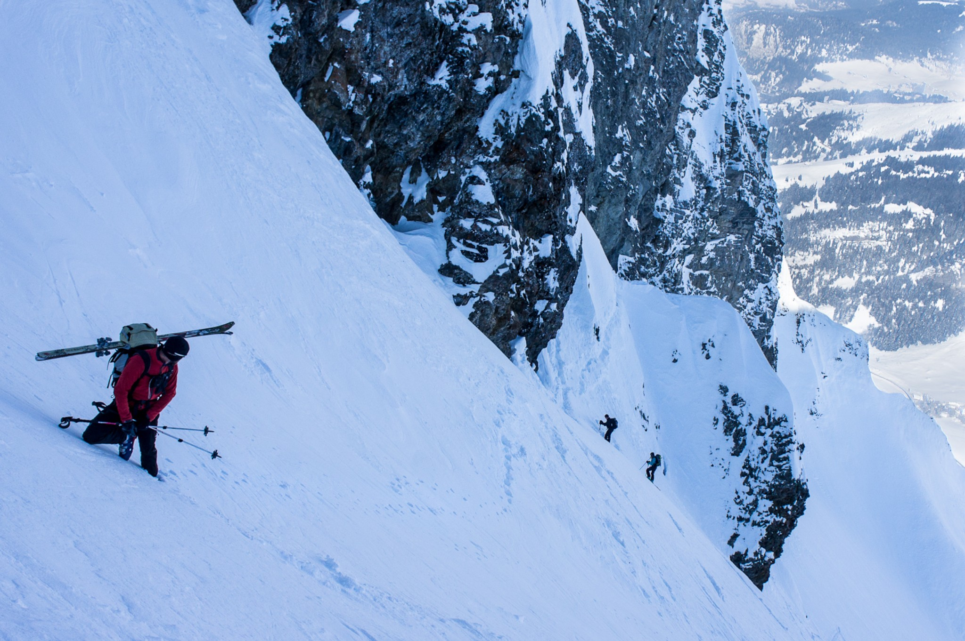

Slide 12
Timepix
Hybrid Pixel Detector
256x256 pixels
55um pixel pitch
Single Photon Processing
  Time-over-Threshold
  Time of arrival
  Photon Counting
Capable of operating in
both electron and hole
collection mode

Slide 13
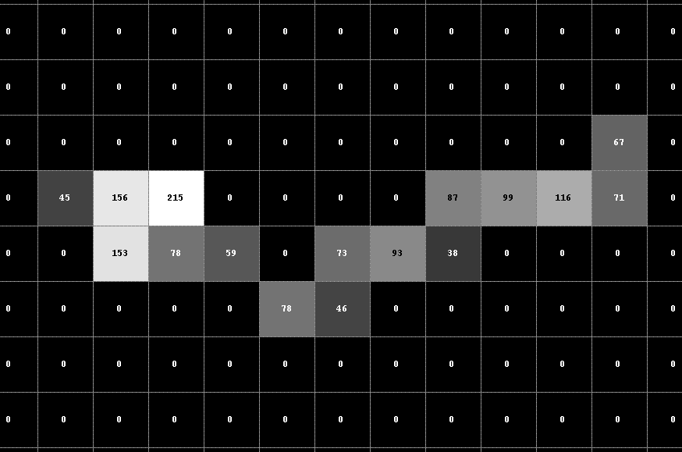
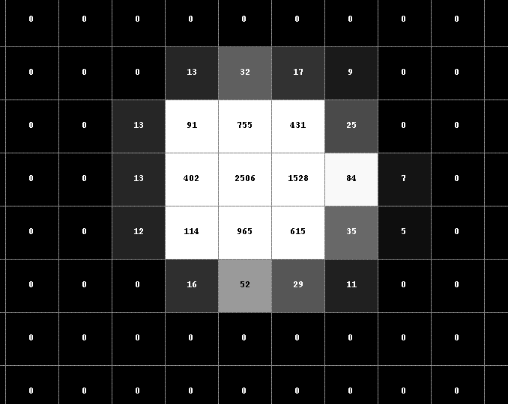
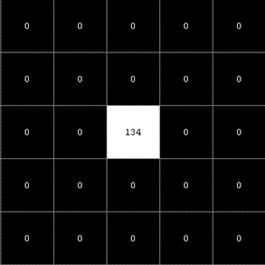
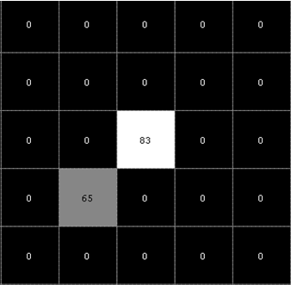
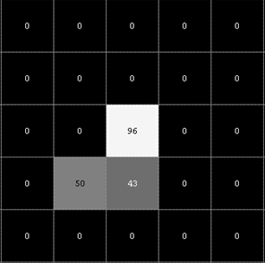
Timepix as a Dosimeter
amplitude
Electron
Alpha
TH
time
Photons

Slide 14
Signal generation
Signal is generated by moving charge
Most of the signal is generated close to the read out chip
Clearer spectrum almost no depth of interaction dependence except diffusion
Graphics: D. Krapohl, Mid Sweden University

Slide 15
Characterization of Sensor Material
In order to use Timepix as a dosimeter we need to understand the detector
Signal is a combination between radiation interaction, charge transport and the read out electronics
High-Z materials is needed for gamma ray detection but poses more problems than silicon

Slide 16
Defects in CdTe Sensors
110um, -300V
55um, -300V

Slide 17
Measurement Setup
Mono energetic
pencil beam, 79keV
Scanning
  Normal
  Inclined
Fitpix 2.3 Read out system, Pixelman software (IEAP, Czech Technical University, Prague)
Python, PyROOT and a home cooked framework

Slide 18
Defects in CdTe Sensors
110um, -300V
55um, -300V

Slide 19
Defect Mapping
Raster scan
110um steps
Counting mode
Compare beam position with the counts in the sensor

Slide 20
Defect Mapping
Charge difts towards the center of the defect
Indication of high leakage current. (field/ikrum)

Slide 21
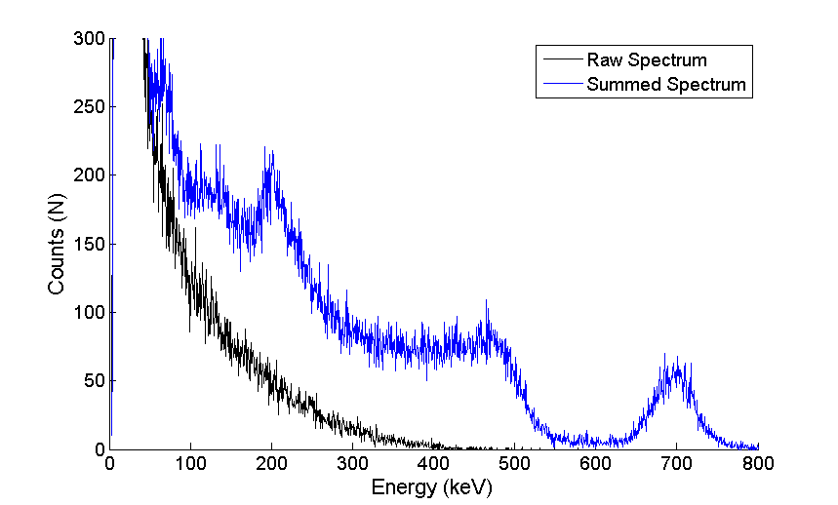
Possible measurements
Spectra at different depths
Slice out layers
Sum clusters
Measure cluster size

Slide 22
Troubleshooting
Beam profile 25keV
Should be linear when plotted in log scale
Evidence of an harmonic (3rd) in the beam
Graph: D. Krapohl, Mid Sweden University

Slide 23
Thank you…
Questions?

