Slide 1




ESR_3
S.Puddu
Supervisors: M. Silari, F. Murtas

Slide 2
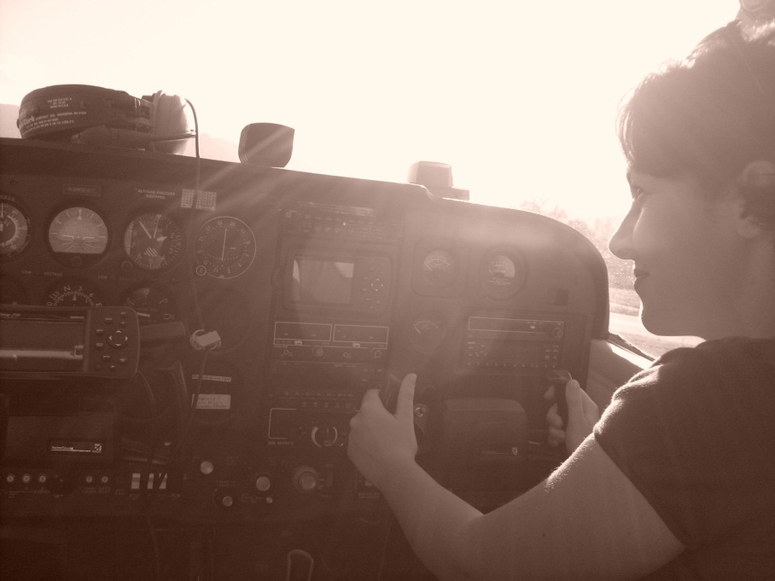
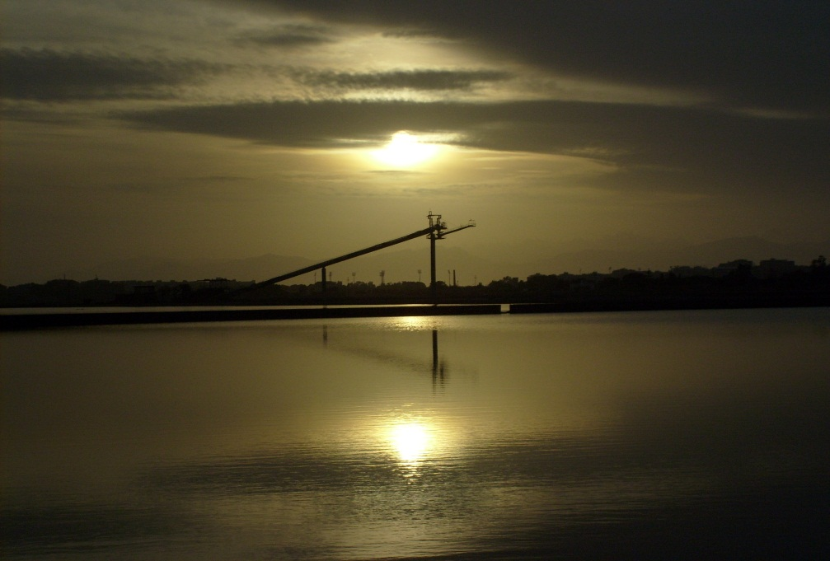
Nice to meet you
Name: Silvia Puddu
Born in Cagliari-Sardinia (Italy)
Study: Università degli Sutdi di Cagliari
  Bachelor thesis: Development of a portable system For the test on MWPC at ALICE esperiment
  Master Thesis: Development of a diagnostic system for burning plasma (INFN-LNF/ENEA)
    Poster APS 2009 X-ray detector for burning plasmas – S. Puddu , F. Bombarda, G. Pizzicaroli, F. Murtas
    Nuclear Instruments and Methods, doi :10.16/j.nima.2009.06.101(2009)
    Design of a GEM-based detector for the measurement of fast neutrons. B. Esposito, F. Murtas, R.Villari, M. Angelone, D. Marocco, P. Pillon and S. Puddu

Slide 3
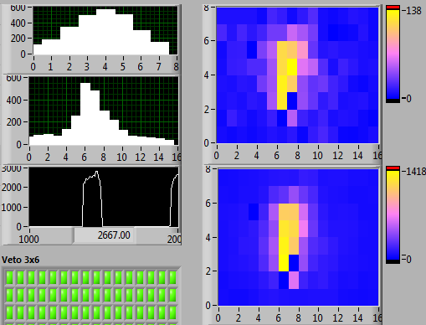
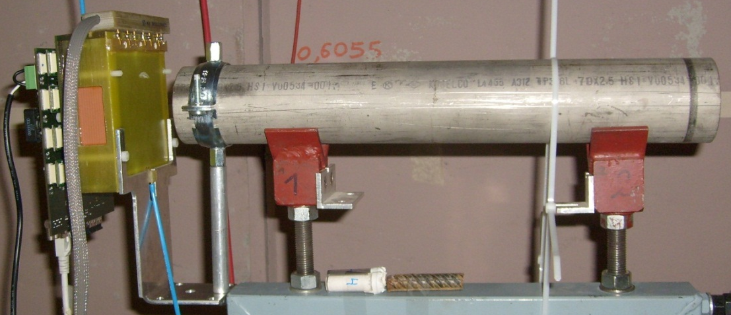
ESR 3
90°
Study of applications of triple GEM detector
  Beam monitoring for CERF and CNAO
  Beam monitoring for spallation source
  Neutron dosimetry
  Radioactive waste

Slide 4
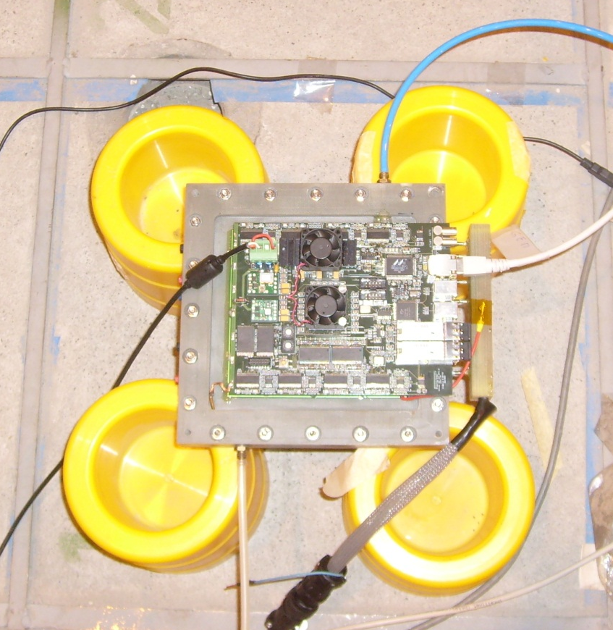
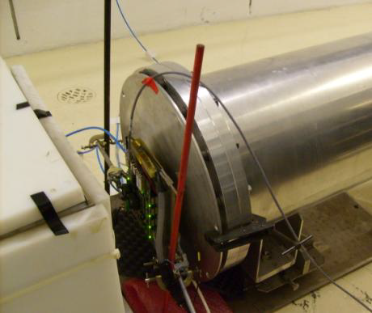
ESR 3
Study of applications of triple GEM detector
  Beam monitoring for mip CERF and CNAO
  Beam monitoring for spallation sources
  Neutron dosimetry
  Radioactive waste

Slide 5
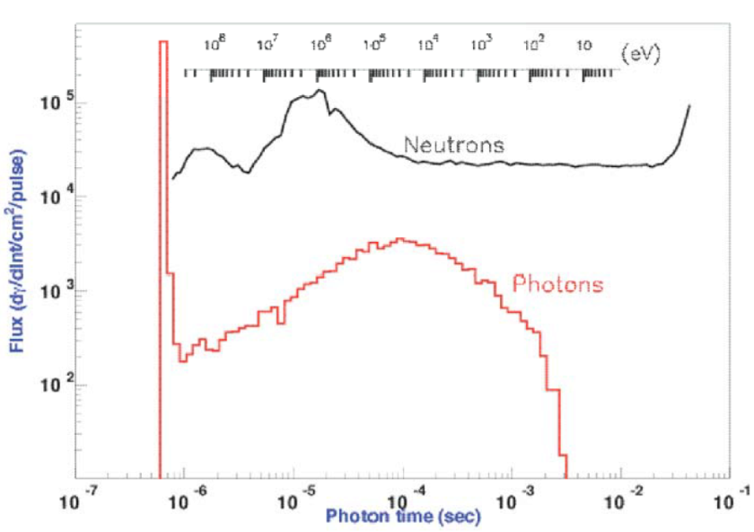
Results @ n_TOF: ieee 2012
Prompt γ flash at ~ 600 ns
10⁸ 10⁷ 10⁶ 10⁵ 10⁴ 10³ 10² 10 (eV)
10⁵
10⁴
Neutron flux vs energy
Φ(dγ/dlnt/cm²/pulse)
~4.7 μs
~63.7 μs
10³
γ from neutrons radiative capture in the beam dump
+
10²
“Slow” photons from several processes
10⁻⁷ 10⁻⁶ 10⁻⁵ 10⁻⁴ 10⁻³ 10⁻² 10⁻¹
^{Photon Time(s)}
Measurements range
E. Chiaveri et al, CERN n_TOF facility performance report, CERN-SL-2002-053 ECT (2002)
C. Guerrero Sanchez, The neutron beam and the associated physics program of the CERN n_Tof facility, ATS seminar

Slide 6
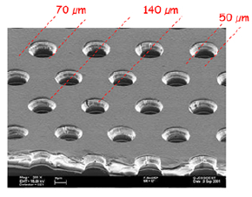
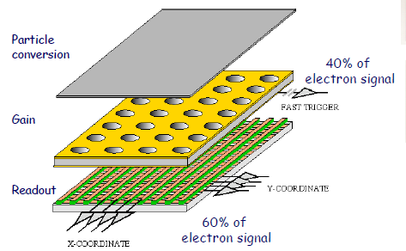
Results @ n_TOF: ieee 2012
70 μm
140 μm
50 μm
Particle conversion, charge amplification and signal induction zones are physically separated
Time resolution depends on geometry and gas: 9.7 ns for Ar-CO2 (70-30)
Spatial resolution depends on geometry (up to 200 μm), however is limited by readout
Dynamic range: from 1 to 10⁸ particles/cm² s
Effective gain is given by the formula:
F. Sauli NIM A386 531
M. Alfonsi et al., The triple-Gem detector for the M1R1 muon station at LHCb, N14-182, 2005 IEEE-NSS

Slide 7
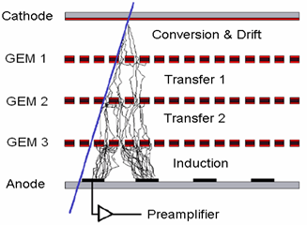
Results @ n_TOF: ieee 2012
3mm
1mm
2mm
1mm
Particle conversion, charge amplification and signal induction zones are physically separated
Time resolution depends on geometry and gas: 9.7 ns for Ar-CO2 (70-30)
Spatial resolution depends on geometry (up to 200 μm), however is limited by readout
Dynamic range: from 1 to 10⁸ particles/cm² s
Effective gain is given by the formula:
F. Sauli NIM A386 531
M. Alfonsi et al., The triple-Gem detector for the M1R1 muon station at LHCb, N14-182, 2005 IEEE-NSS

Slide 8
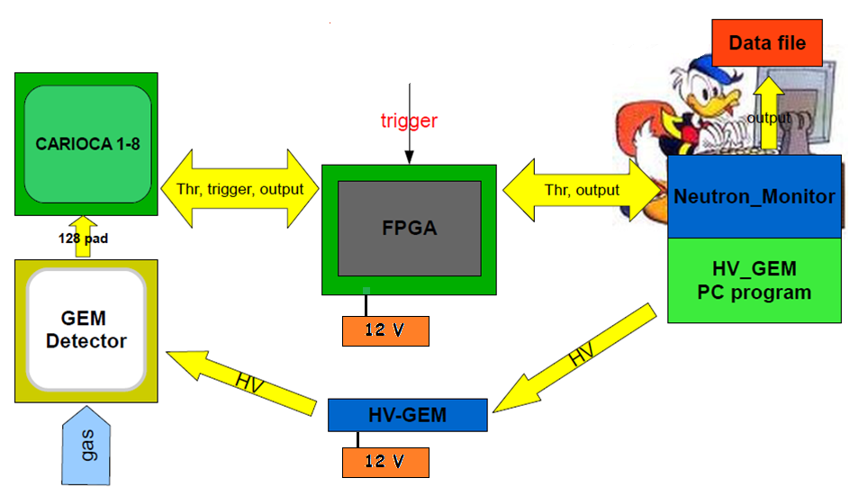
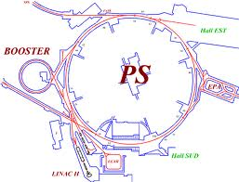
Results @ n_TOF: ieee 2012

Slide 9
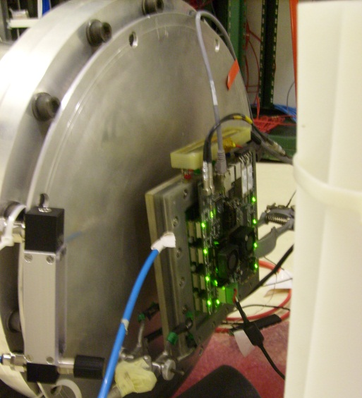
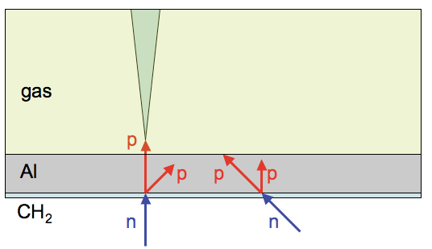
How detect fast neutrons
Neutron converter 60 μm PE + 40 μm Al
Gas mixture Ar-CO₂ 70%-30%
Measurements near to the beam dump
Low γ sensitivity: HV at 870V → gain ~ 300
200 m
Neutrons interact with CH₂, and, due to elastic scattering processes, protons are emitted and enter in the gas volume generating a detectable signal.
Aluminium thickness ensures the directional capability, stopping protons that are emitted at a too wide angle.

Slide 10
Low Sensitivity to Photons
HV scan with n_TOF and Cs137 with a gate of 1 second
Counts (Hz)
Counts (Hz)
Neutrons
Photons
Working point (870V)
HV(V)
HV(V)

Slide 11
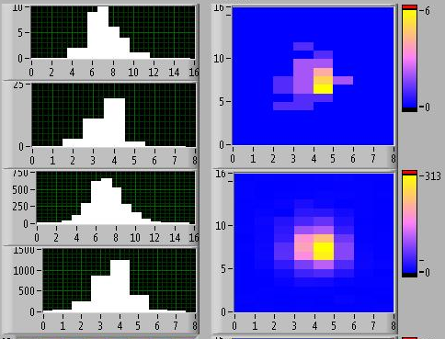
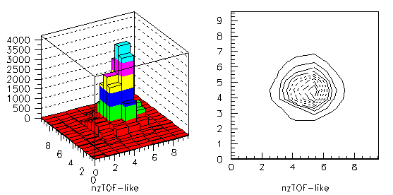
Results @ n_TOF: ieee 2012
Instantaneous counts (10 msec)
y
x
y
x
Cumulative counts
Constant: 3640 ± 40
Mean1: 5.9 ± 1.8 cm
Mean2: 5.5 ± 1.8 cm
Delay 2000 ns, HV 870 V, gate 10 ms
Two different intensity beams arrive to the facility

Slide 12
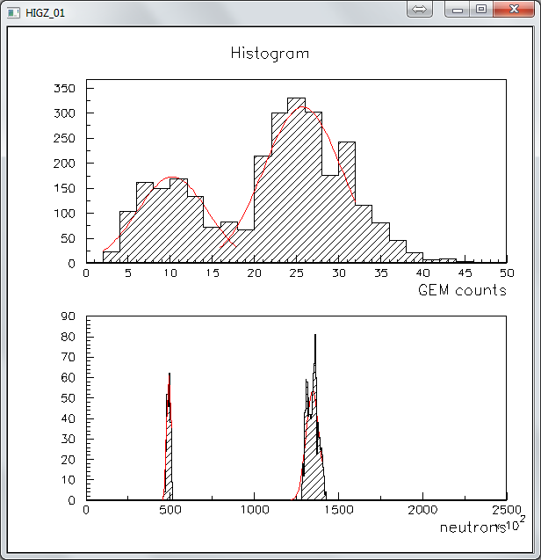
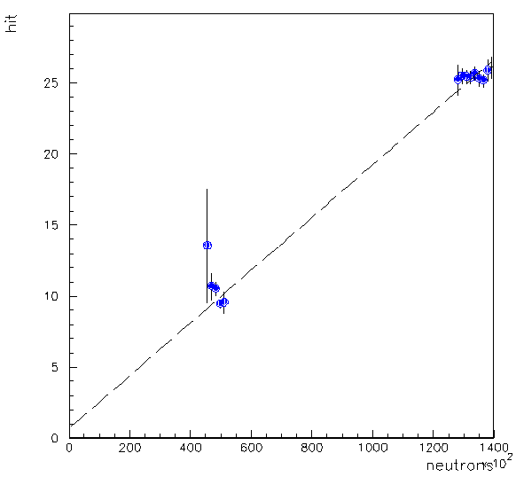
Results @ n_TOF: ieee 2012
From proton beam monitor
49000 ± 1000
136000± 4000
Beam2
Mean efficiency 2.0 ± 0.1 e-4
Beam 1
Beam2
From gem neutron monitor
10 ± 3 hits
26 ± 5 hits
Beam1

Slide 13
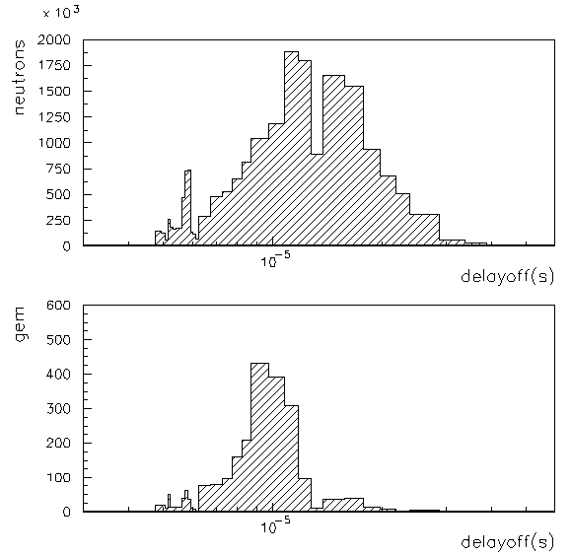
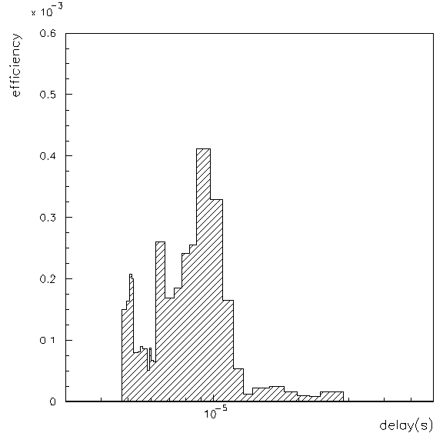
Results @ n_TOF: ieee 2012
The FPGA can detect neutrons vs a delay in time allowing to make a time (i.e. Neutron energy) scan that allows the efficiency vs energy to be measured (uncertainty ~0.1 ÷1%, ~20% at 10 MeV ) .
Number of neutrons acquired
3 MeV
10 MeV
Number of neutrons detected
2 x10⁻⁴
100 keV
13

Slide 14
TANKS
14

